Slide 1
Research Applications
Corrupting luxury:
Did the Greeks think that creature comforts were morally harmful?
Truphe (τρυφή)

Slide 2
Corrupting Luxury
Hellenistic Historians
Theopompus
Timaeus
Ephorus

Slide 3
Idea of Luxury after Alexander
Evidence is fragmentary
Athenaeus of Naucratis (c. 200 CE)

Slide 4
Evidence of Athenaeus
Athen. 12.522d-e
Clearchus says in the fourth book of his Lives that the Tarentines, having gained possession of strength and power (ἀλκὴν καὶ δύναμιν) advanced to such a an extent of truphe that they would shave (παραλεαίνεσθαι)their whole skins and they initiated depilation (ψιλώσεως)for other men.

Slide 5
Close quotation?
strength and power (ἀλκὴν καὶ δύναμιν)
would shave (παραλεαίνεσθαι)
depilation (ψιλώσεως)

Slide 6
Research Question
Can the computer help to evaluate accuracy of later quotation when there is no original?

Slide 7
Complication
We cannot concentrate on vocabulary, since many relevant passages in Athenaeus are about the same subjects.

Slide 8
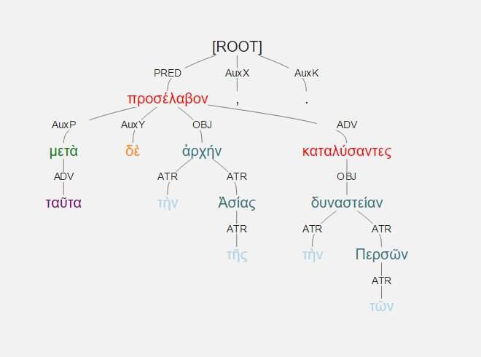
What else is there?
Syntax:

Slide 9
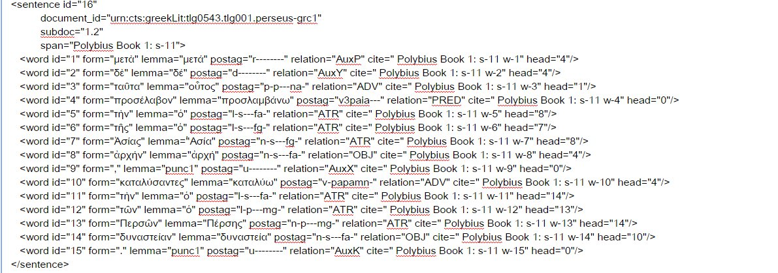

Slide 10
<word id="1" form="μετὰ" lemma="μετά" postag="r--------" relation="AuxP" cite=" Polybius Book 1: s-11 w-1" head="4"/>
<word id="4" form="προσέλαβον" lemma="προσλαμβάνω" postag="v3paia---" relation="PRED" cite=" Polybius Book 1: s-11 w-4" head="0"/>

Slide 11
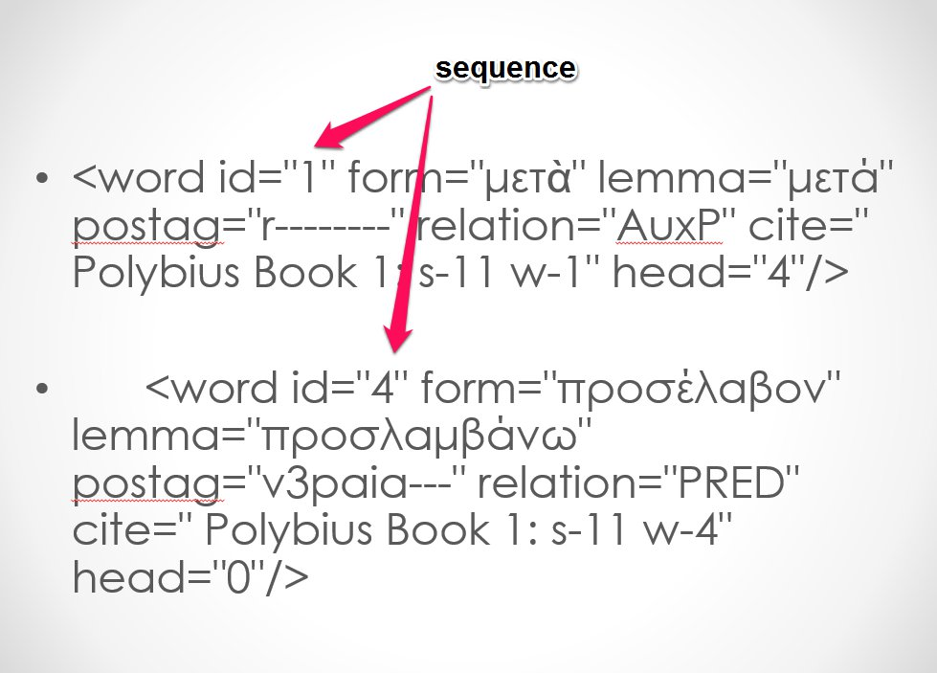
Data points

Slide 12
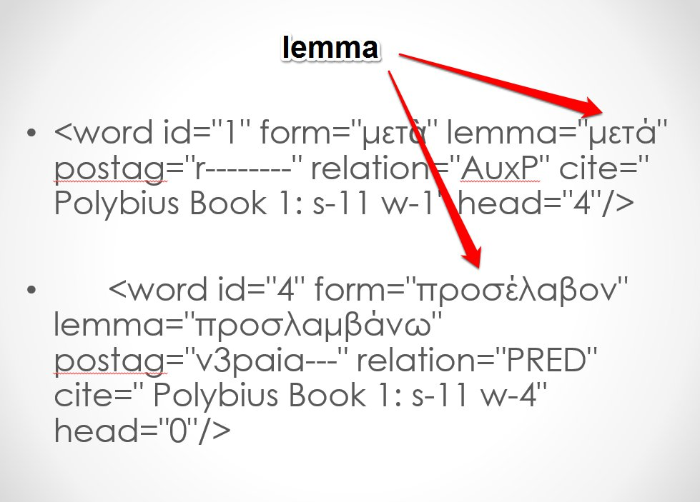
Data points

Slide 13
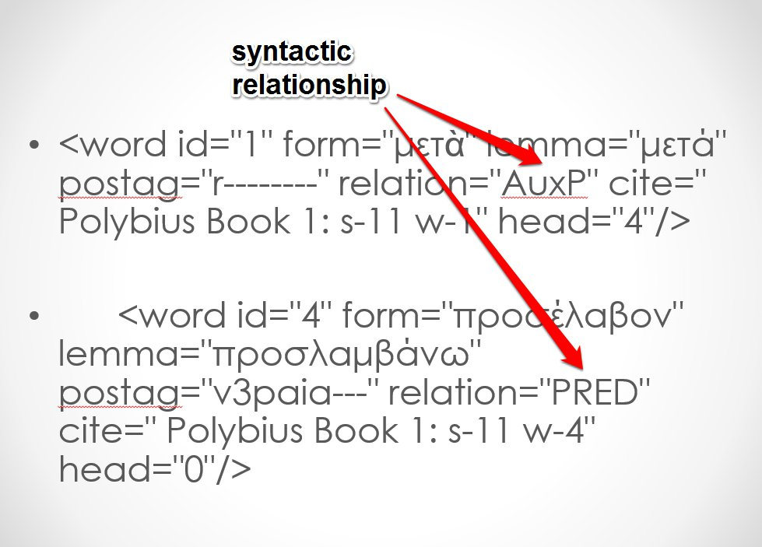
Data points

Slide 14
How to use the data?
“Syntax Words” (sWords)
After
Charles Hollingsworth introduces “DepWords” (“Using Dependency-Based Annotations for Authorship Identification,” TSD 2012, 314-19.)
Grigori Sidorov, et al., introduce “Sn-grams” (“syntactic n-grams) (“Syntactic Dependency-Based N-grams as Classification Features,” in Advances in Computational Intelligence, ed. By I. Batyrshin and M. G. Mendoza, Berlin 2012, pp. 1-11.)

Slide 15
Why sWords?
Input for many standard tools (just like lexical words)
Directly incorporate dependency relationships
Immediate significance to user

Slide 16
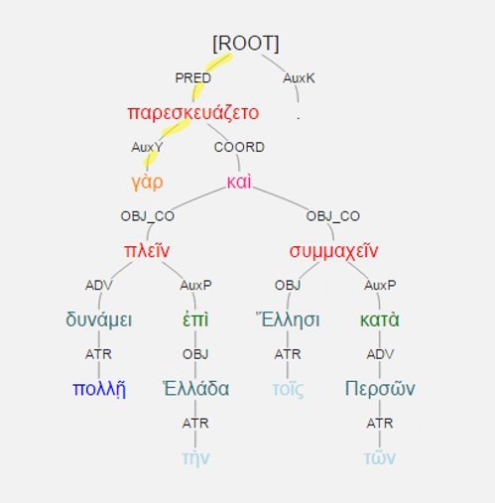
What is it?
sWord for γὰρ: #-pred-auxy

Slide 17
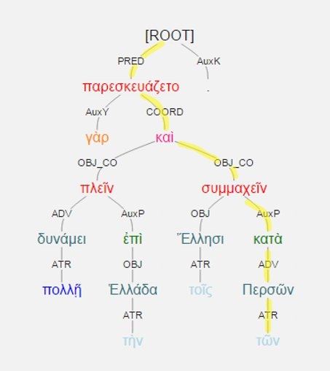
sWord of τῶν: #-pred-coord-obj_co-auxp-adv-atr

Slide 18
Several flavors of sWord available
e.g., add part of speech
sWord of τῶν: #-pred-v-coord-c-obj_co-v-auxp-r-adv-n-atr-l

Slide 19
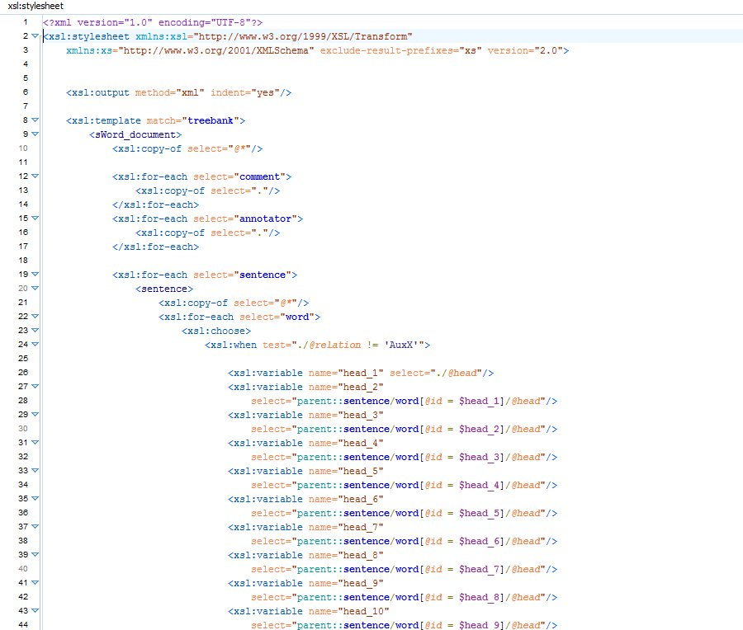
XSLT (Extansible Stylesheet Language Transformations)

Slide 20
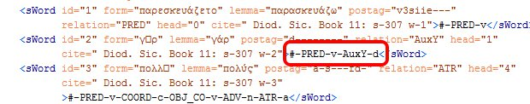
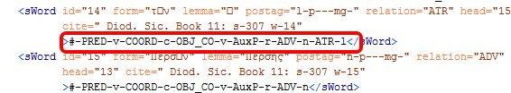
The XML output

Slide 21
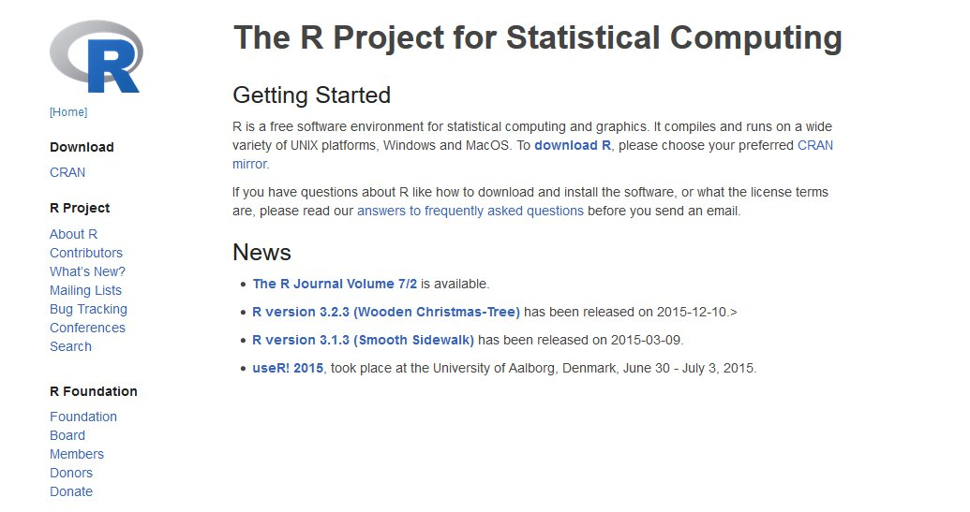
sWord xml data need to be processed

Slide 22
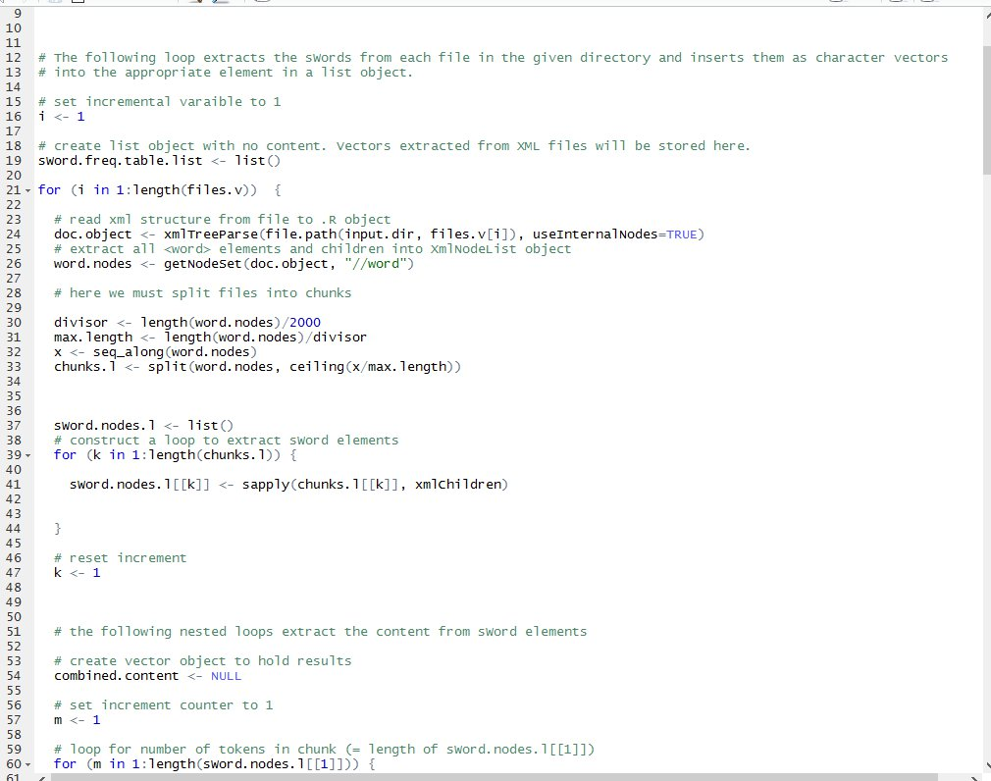
R for data extraction and analysis

Slide 23
Basic analytical datum: relative frequency
 | atr-l | auxp-r | auxy-d | coord-c | obj-n | adv-v
Athenaeus_Book12 | 2.429398 | 1.467585 | 1.350136 | 0.942767 | 1.044345 | 0.822144
Athenaeus_Book13 | 2.394172 | 1.413214 | 1.353592 | 0.769489 | 1.195223 | 0.924132
DiodorusSic_Book11 | 3.483732 | 1.643999 | 1.3777 | 1.054276 | 1.444905 | 0.844261
Herodotus_Book1 | 2.249401 | 1.17319 | 1.602193 | 0.947577 | 1.18868 | 1.076884
Plutarch_Alcibiades | 2.34799 | 1.042357 | 1.239366 | 1.420256 | 1.167726 | 0.908033
Plutarch_Lycurgus | 2.426592 | 1.083438 | 1.221049 | 1.337339 | 0.934199 | 0.940014
Polybius_Book1 | 3.281203 | 1.684164 | 1.229101 | 1.082934 | 1.01525 | 0.864043
Polybius_Book10 | 3.023371 | 1.627366 | 1.143731 | 0.981648 | 0.866621 | 0.755516
Polybius_Book2 | 3.131607 | 1.76064 | 1.121614 | 1.027751 | 0.950954 | 0.79736
Polybius_Book9 | 2.827143 | 1.554589 | 1.146828 | 0.93785 | 0.864793 | 0.749261
Thucydides_Book1 | 2.131581 | 1.27717 | 1.461471 | 1.150261 | 0.873002 | 0.880277
Xenephon_Hellenica1 | 2.376407 | 1.572548 | 1.479602 | 1.034968 | 1.032456 | 1.019895

Slide 24
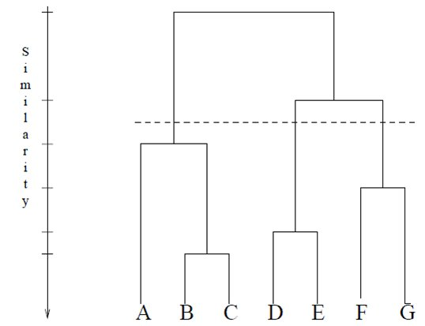
For example:
Try clustering.

Slide 25
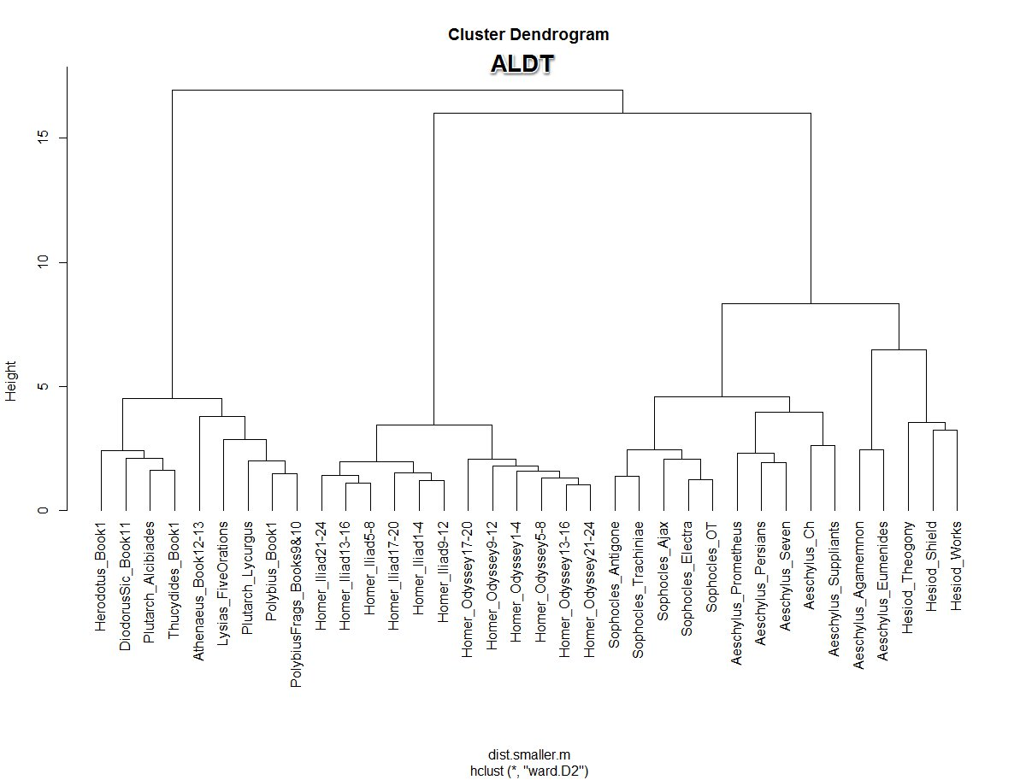

Slide 26
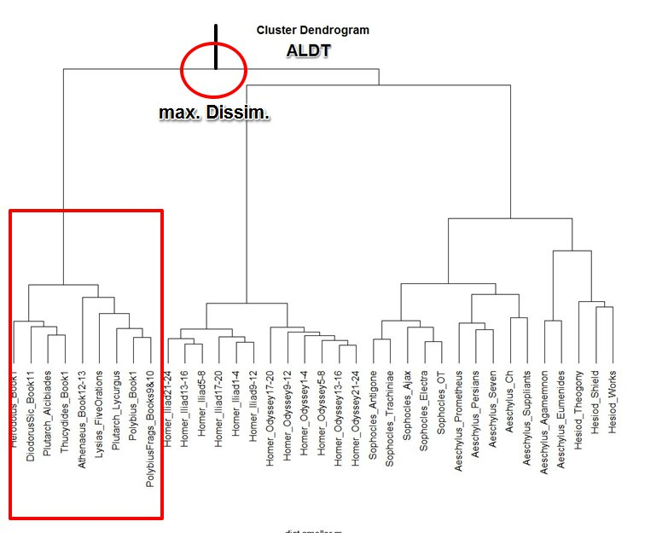
Chief subdivision

Slide 27
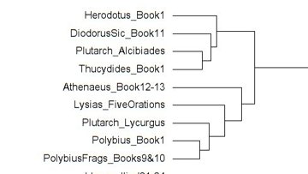
Greatest dissimilarity: prose v. verse

Slide 28
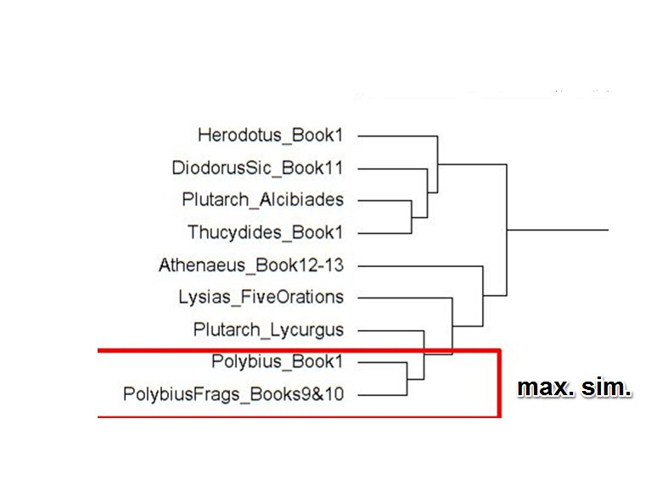
Closest Match

Slide 29
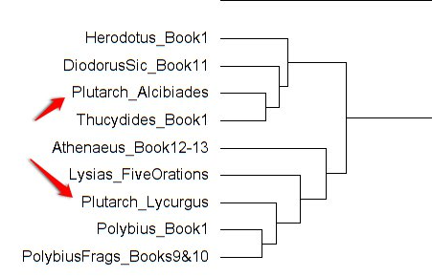
Anomalous Plutarch?

Slide 30
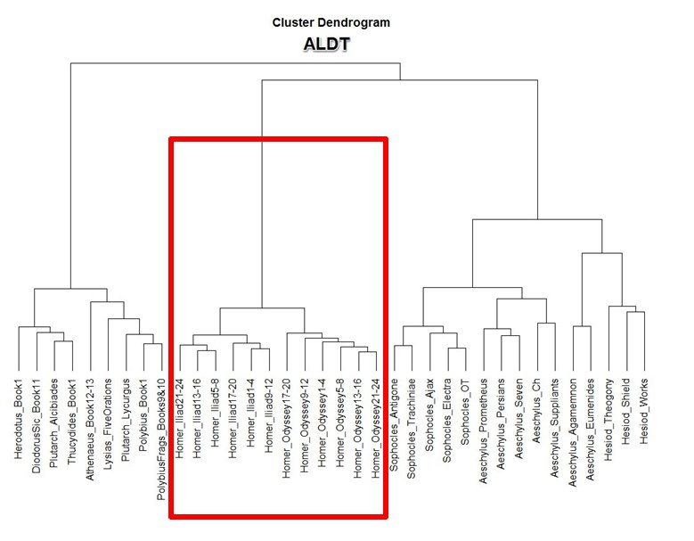
Second major division:
Homeric v. non-Homeric verse

Slide 31
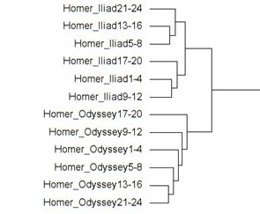
Homer

Slide 32
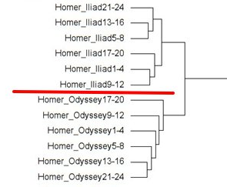
Iliad v. Odyssey

Slide 33
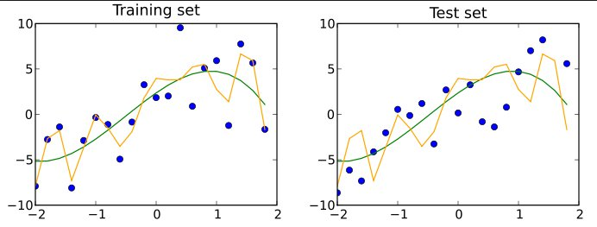
Nest step: classification testing

Slide 34
Classification testing with sWords
Naïve-Bayes & Support Vector Machine:
Both give success rate = c. 85%
Naïve-Bayes sensitive to number of features
Analysis of non-sWord data with same parameters: c. 78%

Slide 35
sWords as heuristic tool

Slide 36
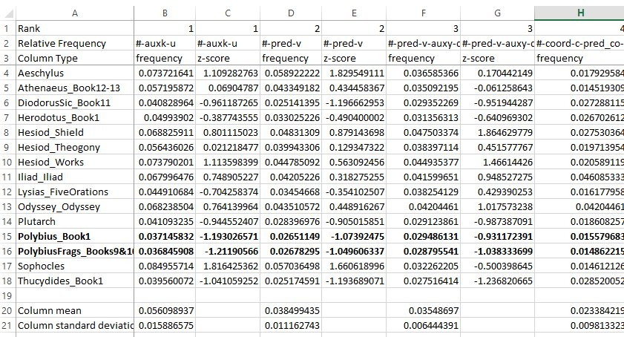
What sWords characterize these two Polybius texts?

Slide 37
Polybius 1 and Fragmentary Polybius
Mostly concordant
When they diverge, they diverge sharply
#-pred-v-adv-v (7th most frequent sWord in corpus)
Polybius 1: Freq. = 0.01758 (z-score = 1.9194) (437 occurrences in 26,894 tokens)
Frag Poly: Freq. = 0.01124 (z-score = -0.6266) (218 in 19,378 tokens)

Slide 38
Remember:
sWords agglutinative constructs
They are not independent variables
Divide #-pred-v-adv-v by #-pred-v
Polybius 1: freq = 0.6633 (z-score = 3.444)
Frag Poly: freq. = 0.42 (z-score = 1.1072)

Slide 39
What is #-pred-v-adv-v anyway?

Slide 40
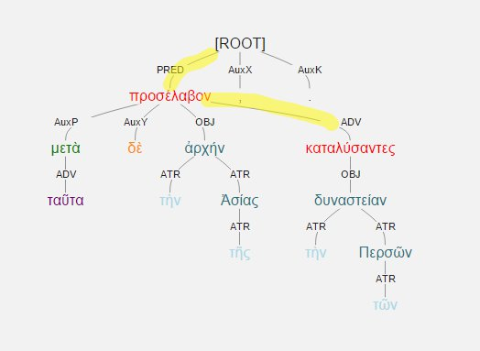
μετὰ δὲ ταῦτα προσέλαβον τὴν τῆς Ἀσίας ἀρχήν, καταλύσαντες τὴν τῶν Περσῶν δυναστείαν
Polybius 1.2.5

