Slide 1
Treebanking and Author Attribution in Greek Prose
Treebanking Ancient Languages
Leipzig University
December 14, 2015
Robert J. Gorman, Dept. of Classics
Vanessa B. Gorman, Dept. of History
University of Nebraska-Lincoln

Slide 2
Can we determine the accuracy of quotes, paraphrases, epitomes, and excerpts of Greek prose authors?

Slide 3
Athenaeus (c. 200 CE) preserves some 2500+ quotes or paraphrases to 800+ writers (verse and prose)

Slide 4
Epitomizers and Excerptors
Polybius (2nd c. BCE) has 5 of 40 books preserved through direct transmission
Others mainly preserved in the excerptors working for Emperor Constantine VII Porphyrogenitus (10th c. CE)
Diodorus Siculus (1st c. BCE) has 15 of 40 books preserved through direct transmission
Others mainly in Photius (9th century CE) and the same Constantine excerptors

Slide 5
Derive Syntactic “Thumbprints”
Create a database of syntactically analyzed Greek prose
Teach the computer to distinguish known authors (proof of concept)
Compare directly-transmitted to epitomized prose by the same author

Slide 6
Fragments of Lost Authors
Compare to fragments of the same author that are preserved elsewhere
Compare to context in Athenaeus and Photius
Does it resemble:
The other fragments of the same author?
The context in Athenaeus?

Slide 7
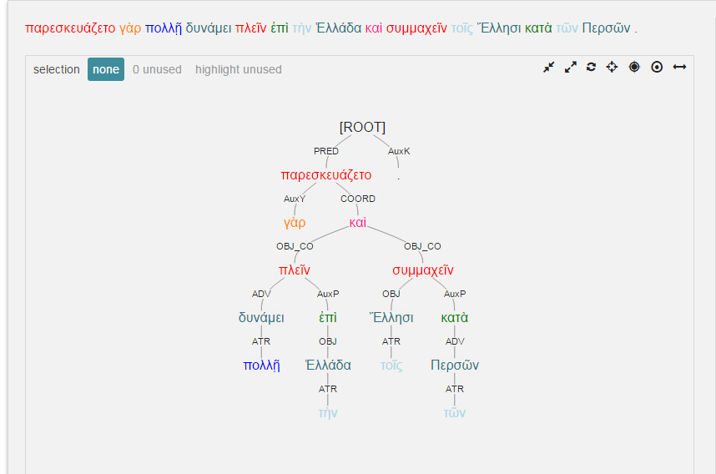
Diodorus 11.26.4

Slide 8
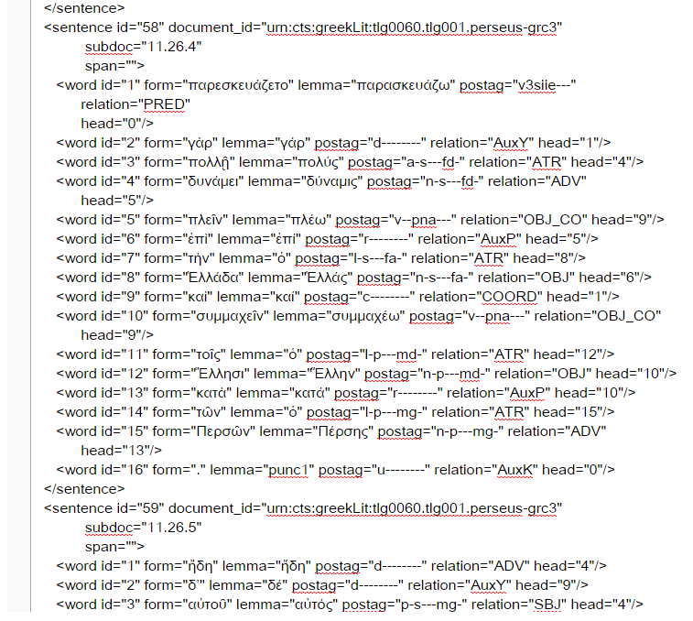

Slide 9
For each word in AGDT we have:
dependency (word’s parent, children)
syntactic relation (grammatical label for dependency)
Lemma
Morphology
Position in sentence

Slide 10
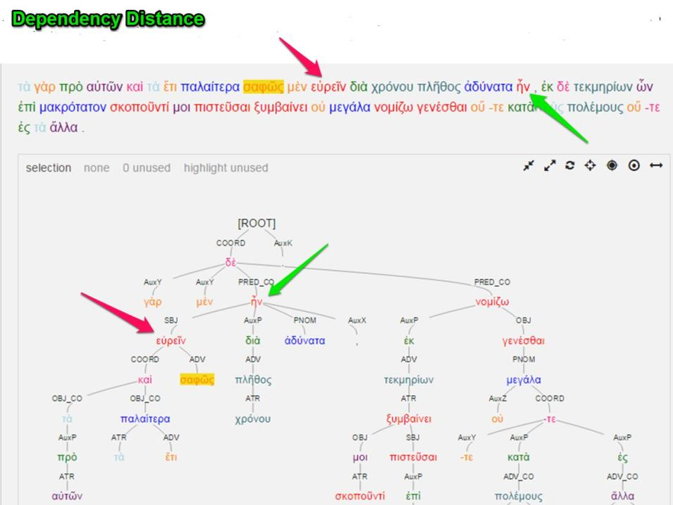

Slide 11
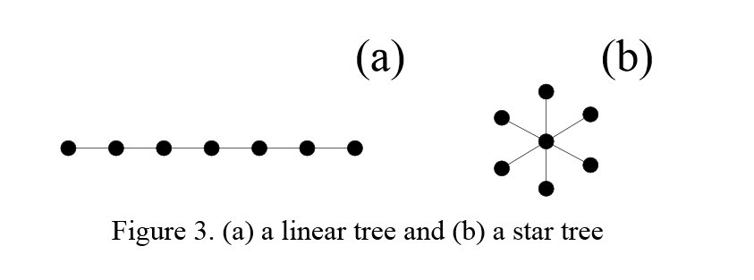
Dependency Degree
Linear vs. hubby structure

Slide 12
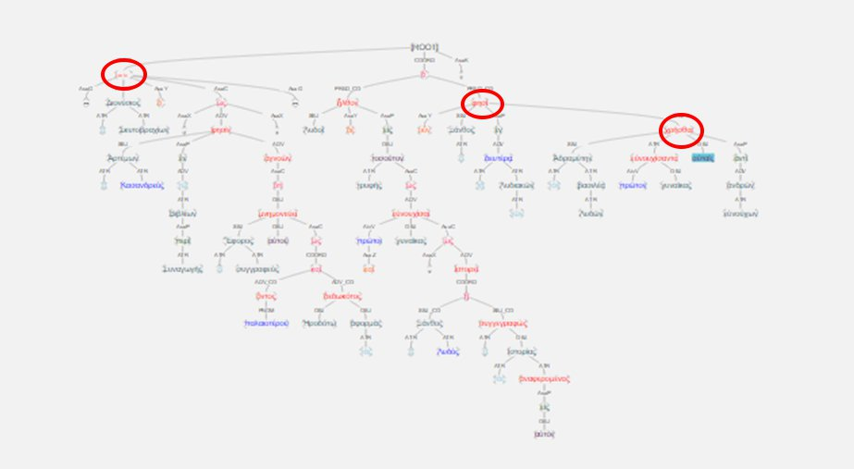

Slide 13
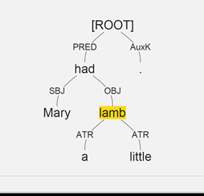

Slide 14
Mary: SBJ-PRED-ROOT
had: PRED-ROOT a: ATR-OBJ-PRED-ROOT little: ATR-OBJ-PRED-ROOT lamb: OBJ-PRED-ROOT

Slide 15
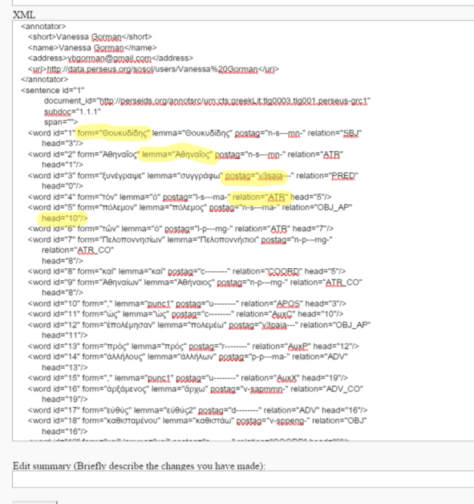

Slide 16

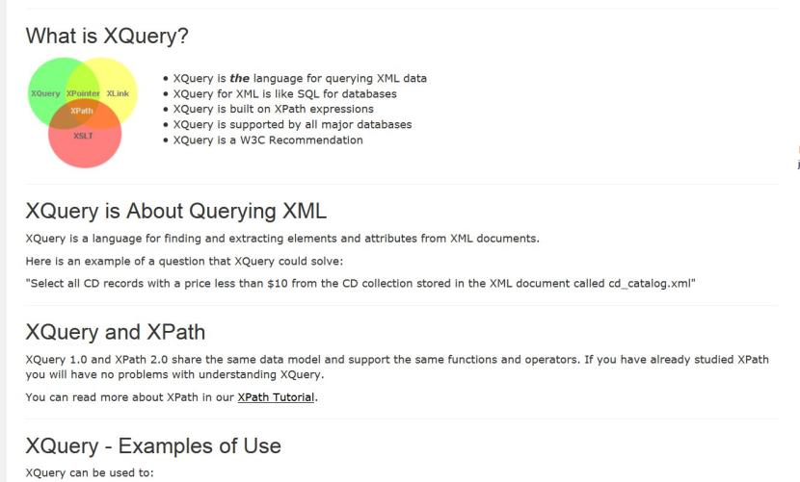

Slide 17
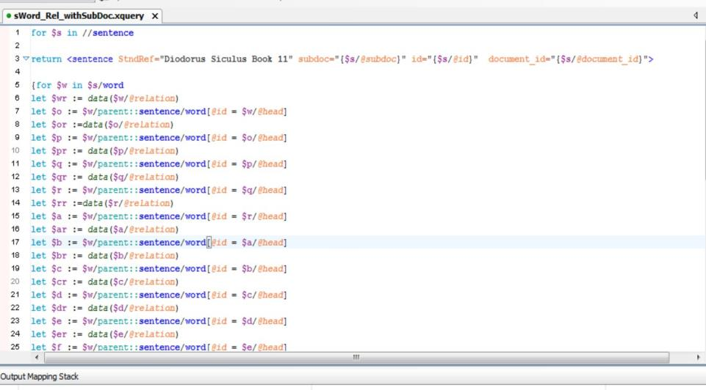

Slide 18
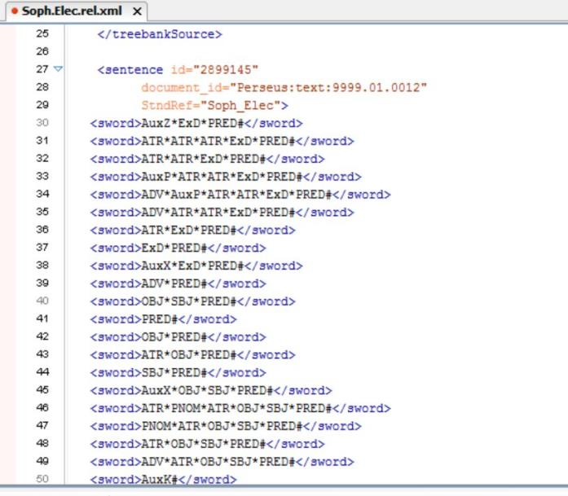
Ὦ τοῦ στρατηγήσαντος ἐν Τροίᾳ ποτὲ / Ἀγαμέμνονος παῖ
"O child of Agamemnon, once leading an army at Troy"

Slide 19
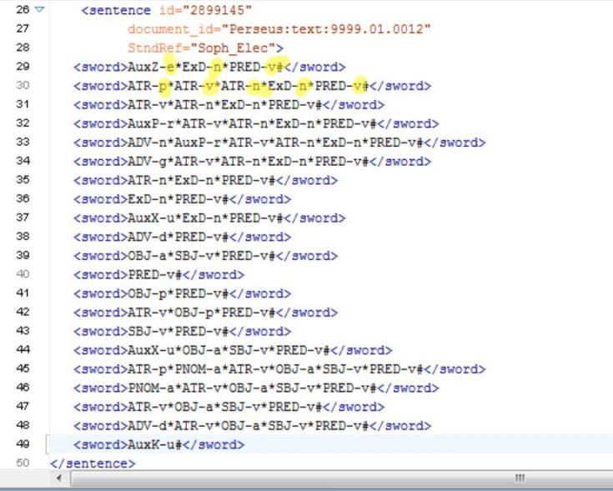
Ὦ τοῦ στρατηγήσαντος ἐν Τροίᾳ ποτὲ / Ἀγαμέμνονος παῖ
"O child of Agamemnon, once leading an army at Troy"

Slide 20
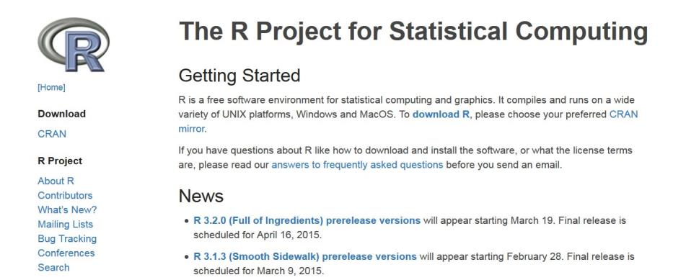

Slide 21
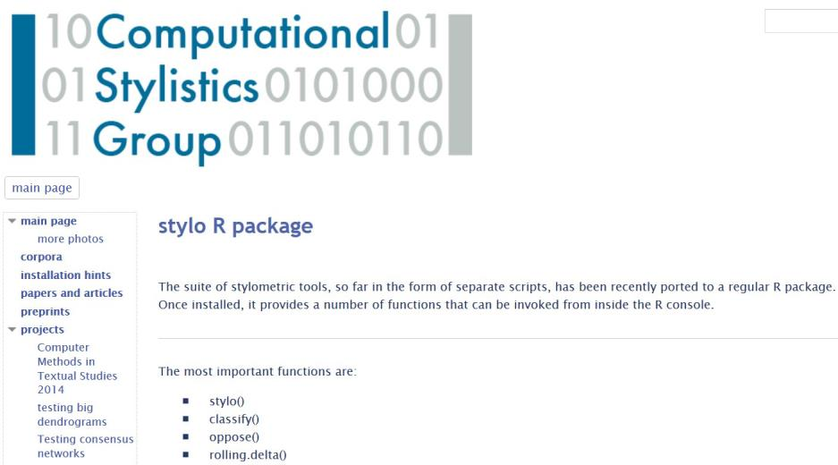

Slide 22
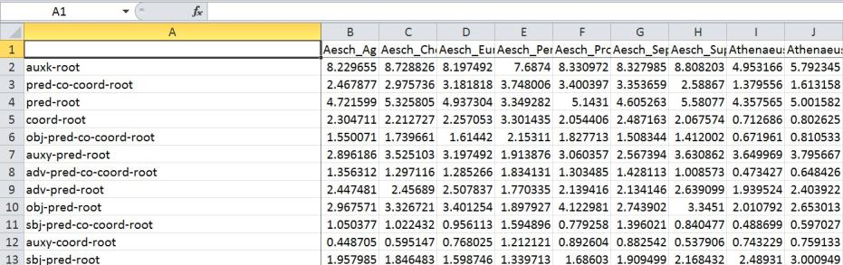

Slide 23
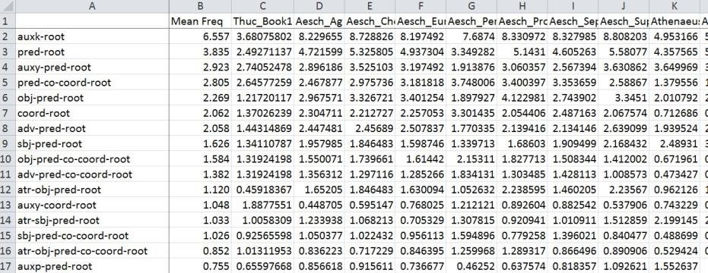

Slide 24
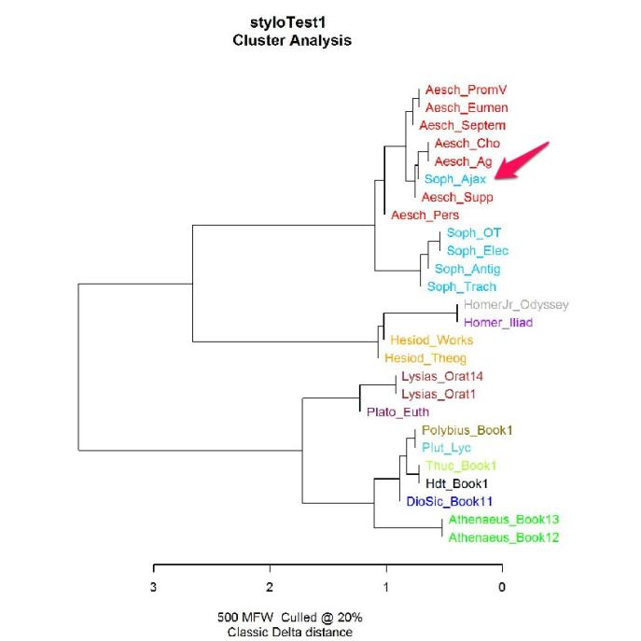

Slide 26
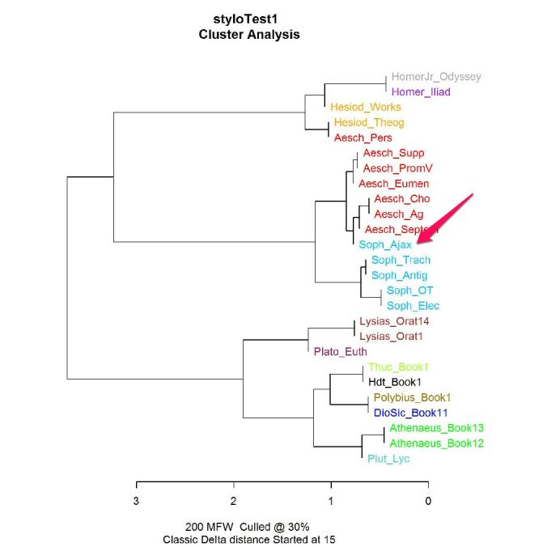

Slide 28
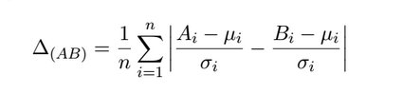
Burrows Delta

Slide 29

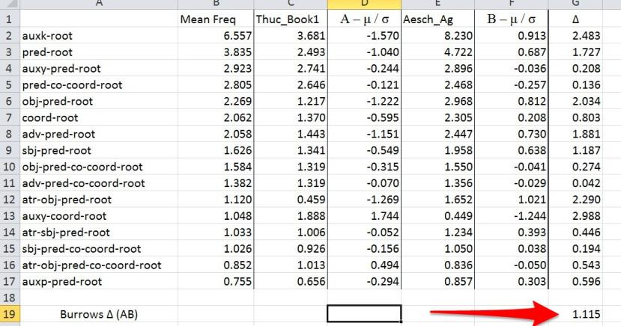

Slide 30
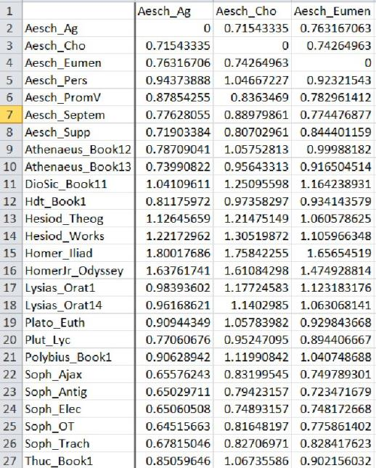

Slide 31
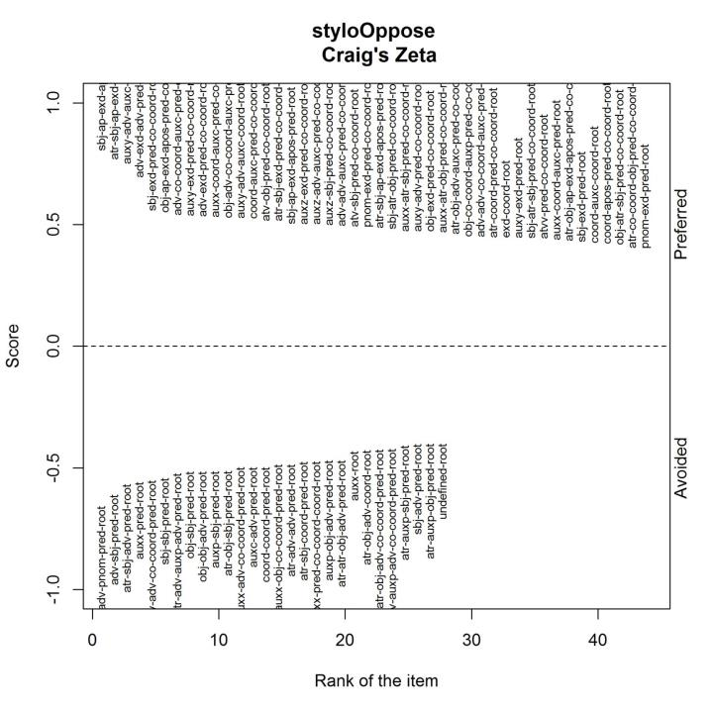

Slide 32
Craig’s Zeta
Divide corpus 1 into segments of equal size (size = n)
Segments with at least 1 example of given feature are hits.
Each hit is worth 1 point.
Hit
Hit
Hit
Hit
Hit
Hit
Hit
Hits/segments = preferred feature score
Divide corpus 2 into segments of size n.
Segments with no examples of feature are misses.
Each miss is worth -1 point.
Miss
Miss
Miss
Miss
Miss
Miss
Miss
Miss
Misses/segments = avoided feature score

Slide 34
Thucydides

Slide 35
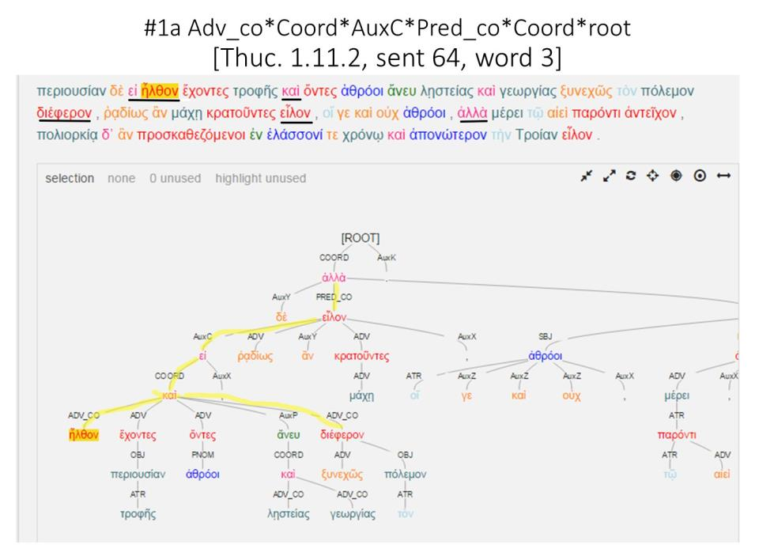

Slide 36
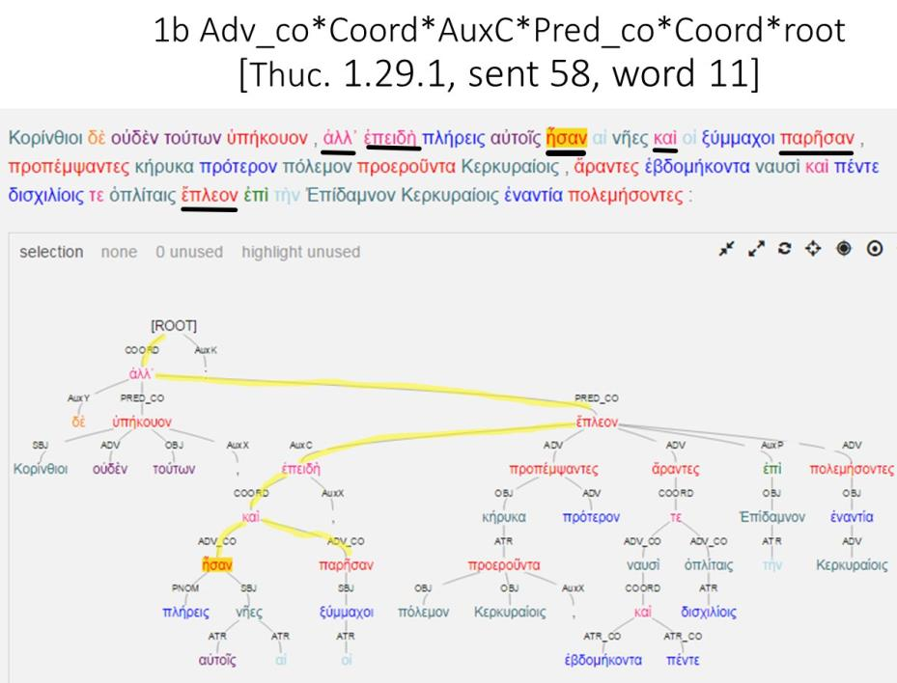

Slide 37
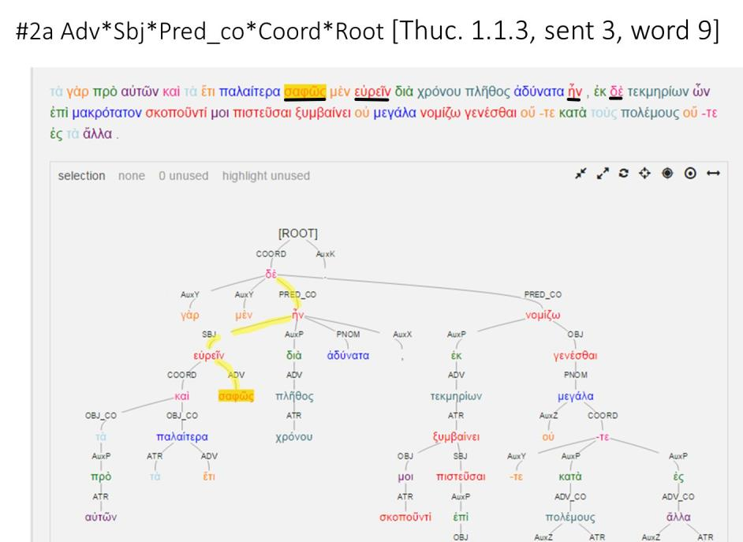

Slide 38
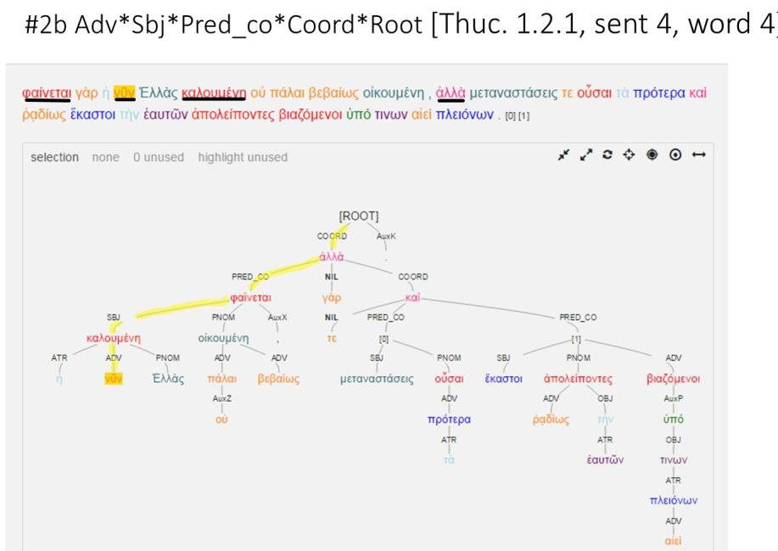

Slide 39
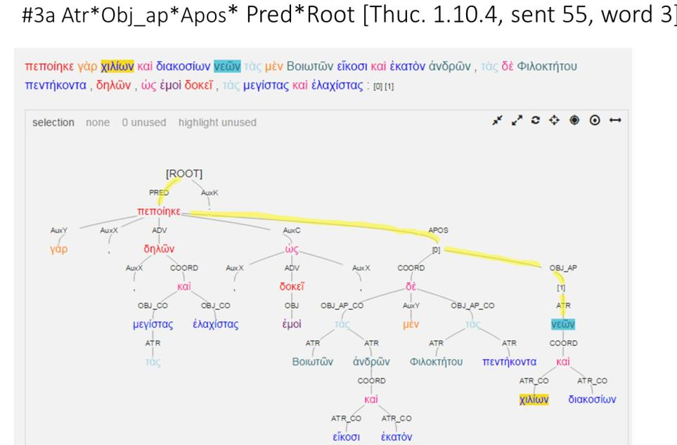

Slide 40
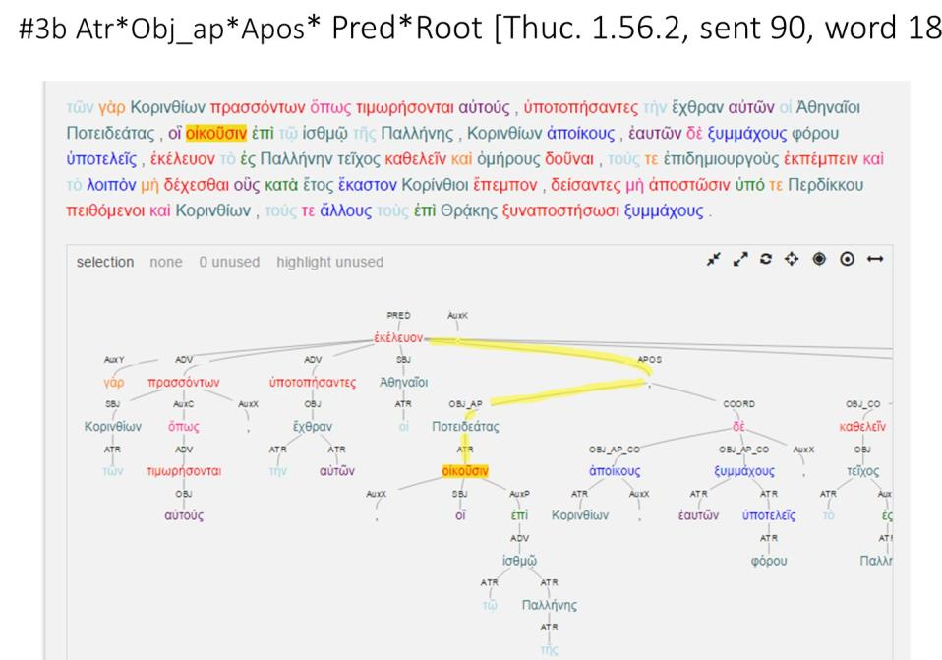

Slide 41
Herodotus

Slide 42
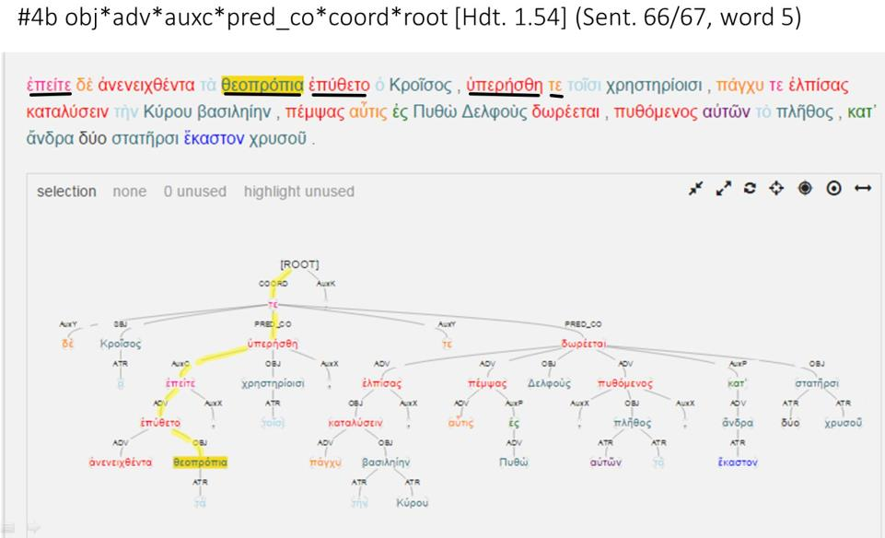

Slide 43
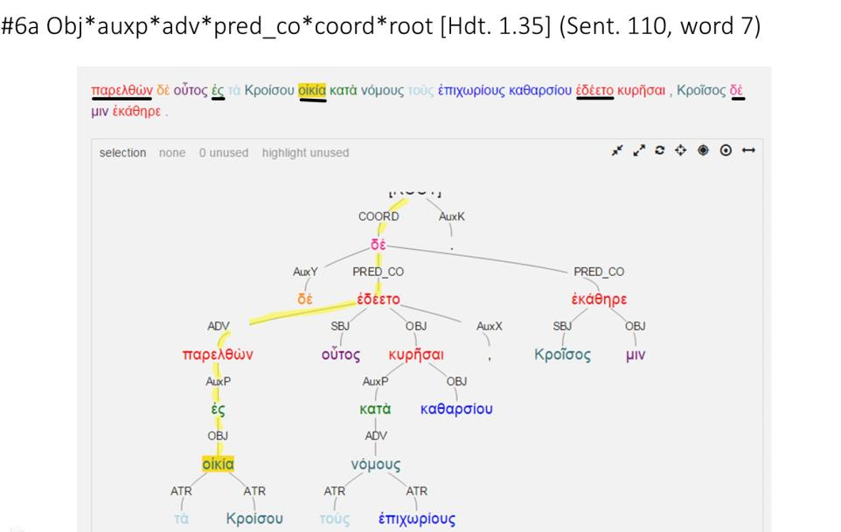

Slide 44
Polybius

Slide 45
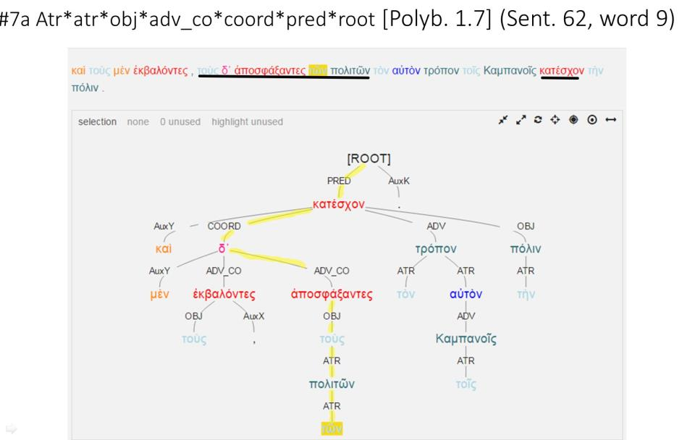

Slide 46
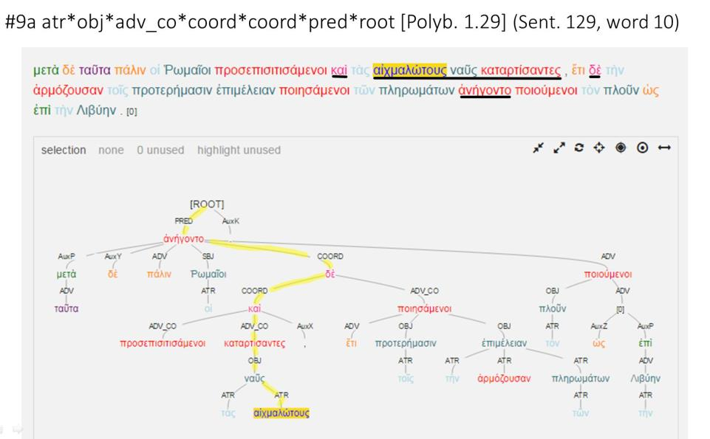

Slide 47
Homer

Slide 48
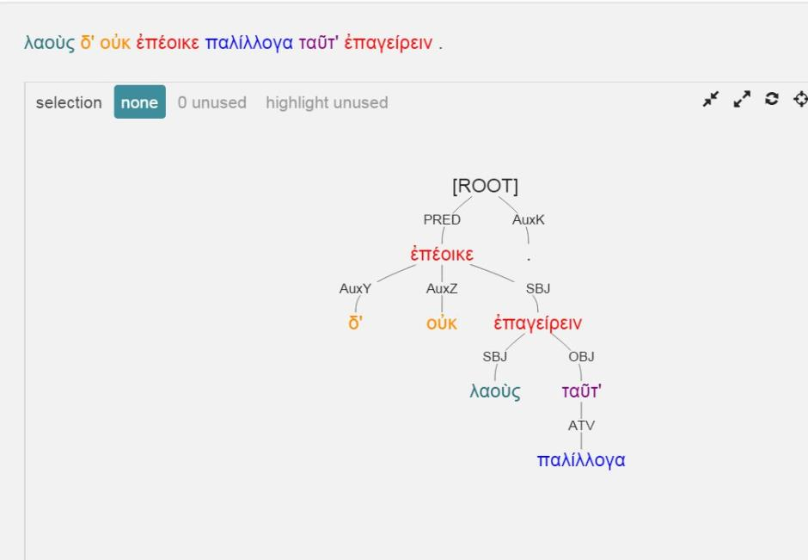

Slide 49
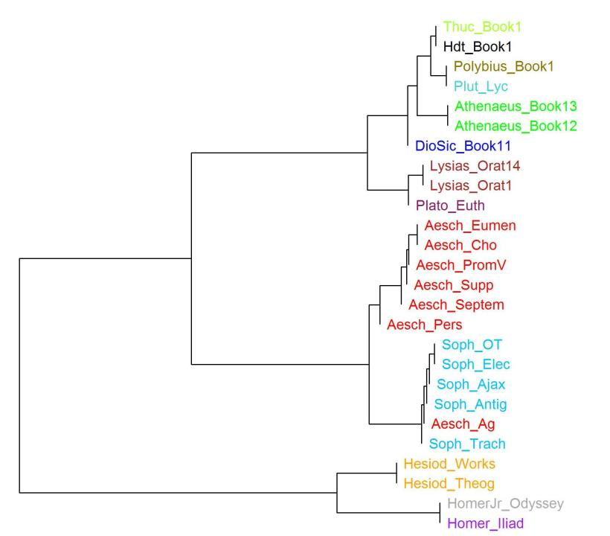

Slide 50


Slide 51
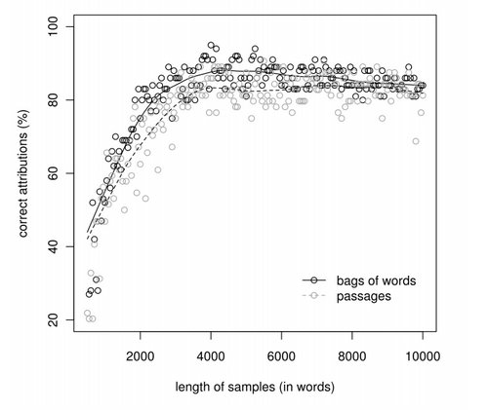
Maciej Eder

Slide 52
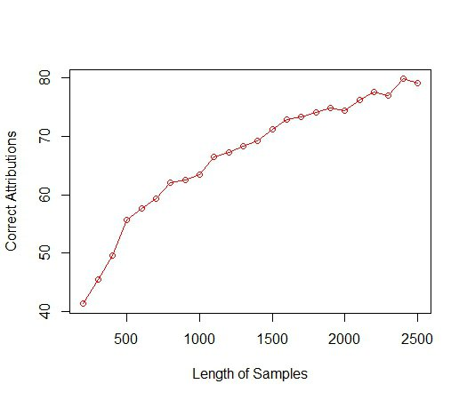

Slide 53
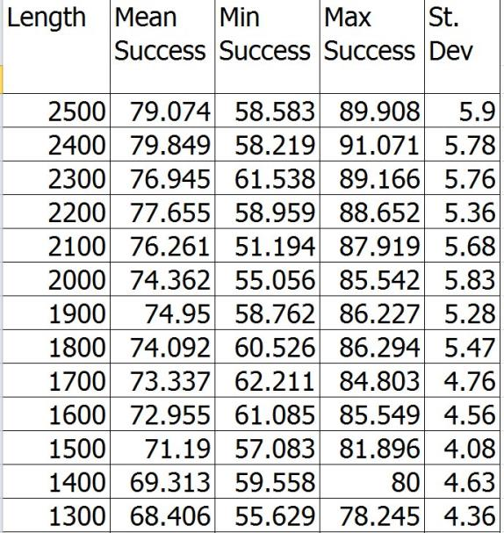

Slide 54
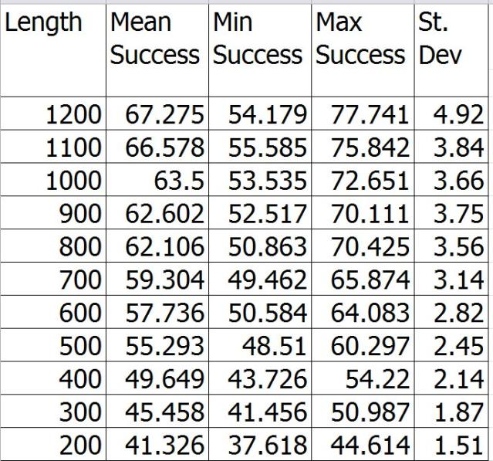

Slide 55
Leipzig Open Philology Project
Digital Athenaeus Project
Perseus and Perseids Projects, Tufts University
Perseus Open Publication Series
University of Nebraska−Lincoln
Dept. of History
Dept. of Classics and Religious Studies

