Slide 1
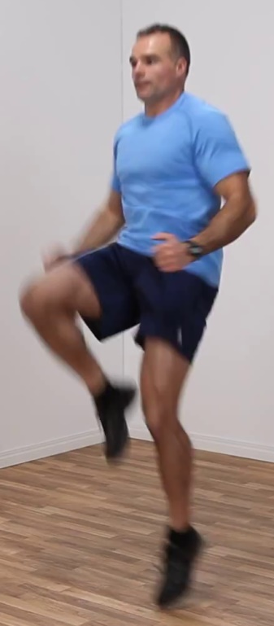
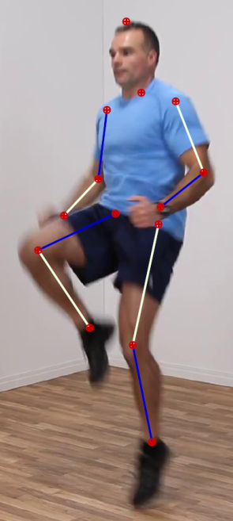
14 “noisy”
heat-maps
14 “clean”
heat-maps
ConvNet
Part
Detector
GM to fix
mistakes

