Slide 1
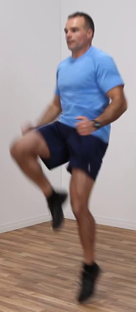
Part-
Model
N_{jnts}
(N_{jnts}+1)
Spatial-
Model
1
torso heat-map:

