Slide 1
INTRODUCTION
METHODOLOGY
EXPERIMENTAL RESULTS
CONCLUSION
Prediction of COVID-19 Infection Using
Epidemiology Dataset
Ravi Satvik (202018008), Omkar Chavan (202018037)
Dev Patel (202018055), Smit Gandhi (202018057)
Dhirubhai Ambani Institute of Information and Communication Technology

Slide 2
METHODOLOGY
EXPERIMENTAL RESULTS
CONCLUSION
INTRODUCTION
INTRODUCTION
What is Coronavirus and Where did it originate
Origin of Coronavirus in India
COVID - 19 vaccine development
Importance of predicting the trends of the pandemic

Slide 3
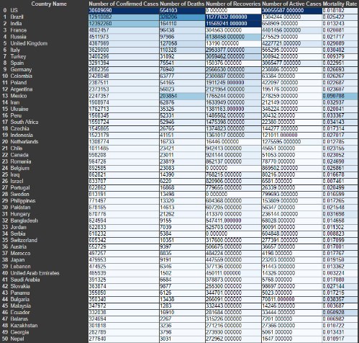
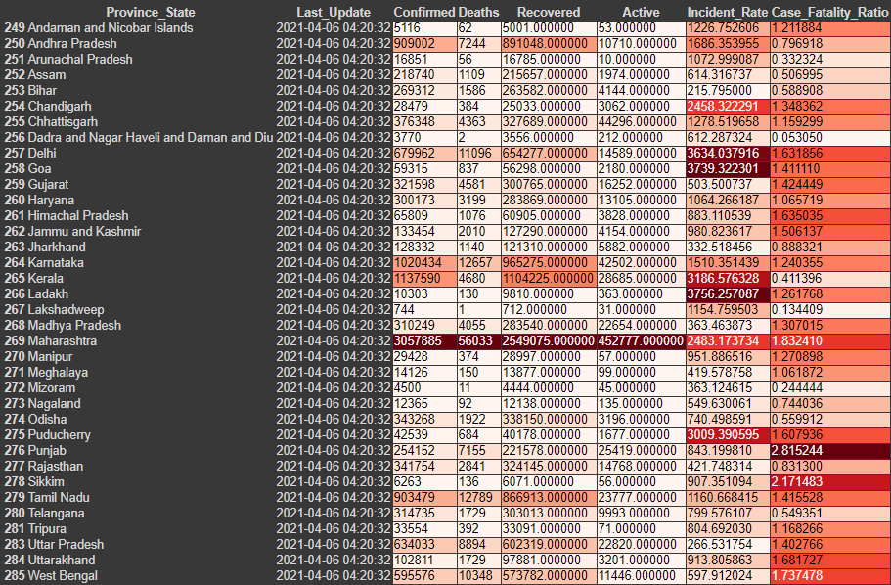
METHODOLOGY
EXPERIMENTAL RESULTS
CONCLUSION
INTRODUCTION

Slide 4
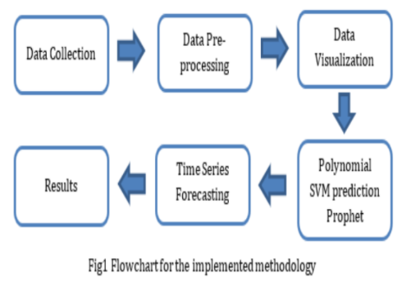
INTRODUCTION
EXPERIMENTAL RESULTS
CONCLUSION
METHODOLOGY
Methodology

Slide 5
INTRODUCTION
METHODOLOGY
CONCLUSION
EXPERIMENTAL RESULYS
EXPERIMENTAL RESULTS
Polynomial Reg. < SVM
Death Cases
MSE:
64284563965.06807
Confirmed Cases
MSE:
383840912143933.8
Recovery Cases
MSE:
74519946226288.28
Recovery Cases
MSE:
4031589341630122.5
Death Cases
MSE:
1.4552996900209048e+16
Confirmed Cases
MSE:
36212697702295.13
World Dataset
Polynomial Regression
Confirmed Cases
Death Cases
Confirmed Cases
Recovery Cases
SVM Prediction
Recovery Cases
Death Cases

Slide 6
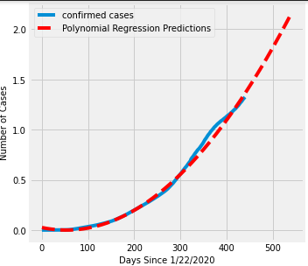
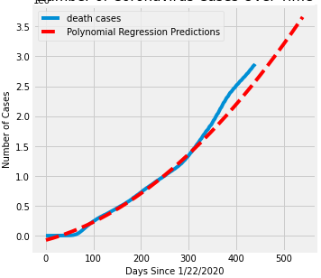
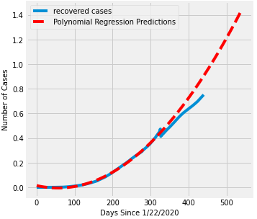
INTRODUCTION
METHODOLOGY
CONCLUSION
EXPERIMENTAL RESULYS
EXPERIMETAL RESULTS
Polynomial Regression
Confirmed cases Prediction By Polynomial Reg.
Death cases Prediction By Polynomial Reg.
Recovery cases Prediction By Polynomial Reg.

Slide 7
INTRODUCTION
METHODOLOGY
CONCLUSION
EXPERIMENTAL RESULYS
EXPERIMETAL RESULTS
India Dataset
Polynomial Regression
SVM
Prediction
Prophet
Model
Recovered Cases MSE: 2432174018901.882
Recovered Cases MSE: 2579123406135.711
Confirmed Cases MSE: 3654559843473.5767
Deaths Case MSE: 86710415944391.67
Confirmed Cases MSE: 3555250000000
Deaths Case MSE: 569023000
Poly reg.
<
Prophet
<
SVM
Deaths Case MSE: 127912217.263184
Confirmed Cases MSE: 905268287138.0388
Recovered Cases MSE: 5157170000000

Slide 8
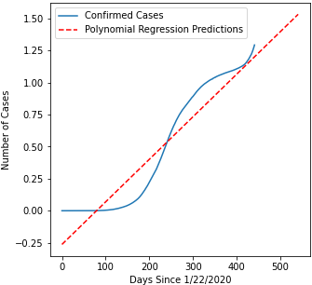
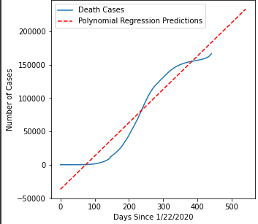
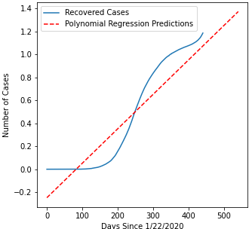
INTRODUCTION
METHODOLOGY
CONCLUSION
EXPERIMENTAL RESULYS
EXPERIMETAL RESULTS
Polynomial Regression
Confirmed cases Prediction By Polynomial Reg.
Death cases Prediction By Polynomial Reg.
Recovery cases Prediction By Polynomial Reg.

Slide 9
INTRODUCTION
METHODOLOGY
EXPERIMENTAL RESULTS
CONCLUSION
EXPERIMETAL RESULTS
CONCLUSION
Model Conclusion
From all the models and values which we get, we can say that Polynomial Regression is batter then SVM for India and rest of world Covid-19 cases prediction.
Also we compare these two models with Facebook Prophet pre defined model we conclude that Prophet model is batter then both models.
Overall Conclusion
So, from our model prediction we can say that Covid-19 cases will increase for 100 days for India and rest of the world.

Slide 10
Thank
You

