Slide 1


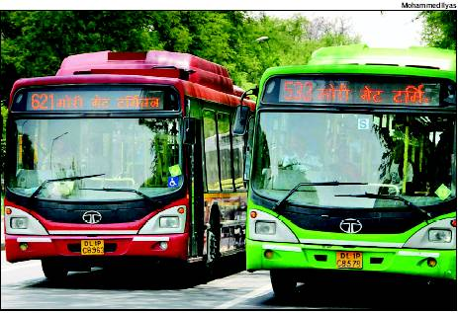

TravelEasy
A potential solution to
traveling in public!

Slide 2
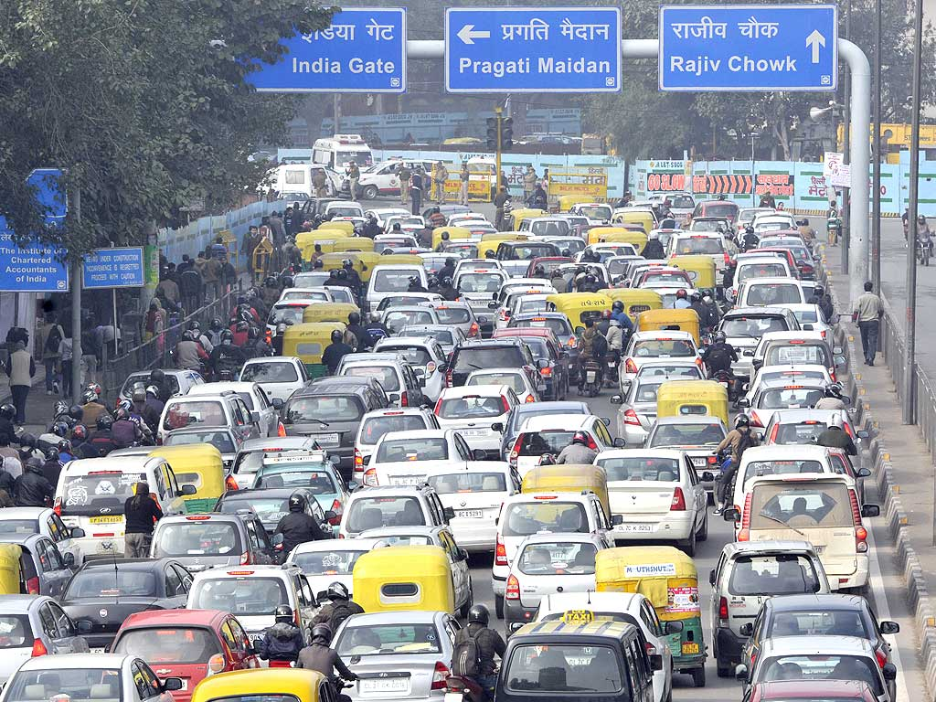
Introduction
The brainstorming session for a breakthrough Idea allotted being 1 hour, put us into some weird thinking.
So, we thought, what’s the latest issue being faced by all and still we haven’t reached a potential solution yet?

Slide 3
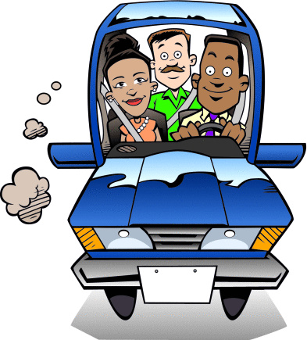
What we Intend to Do
Since, people are really not willing to switch to public transport for obvious reasons, we decided to change this thinking.
When our own Honorable Chief Minister is seeking help for this traffic problem, we have given it a shot to go about changing the mindsets.

Slide 4
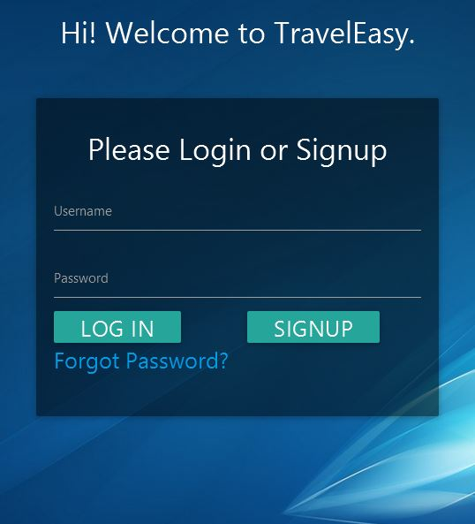
TravelEasy
Travel Easy makes use of existing plying public transportation and tries to bring them together at one place.
After some lookup on the internet we observed-
There wasn’t any platform to compare these services.
People don’t have a definite and summarized review of the services.
Putting all these together, could enhance the productivity of public transport.

Slide 5
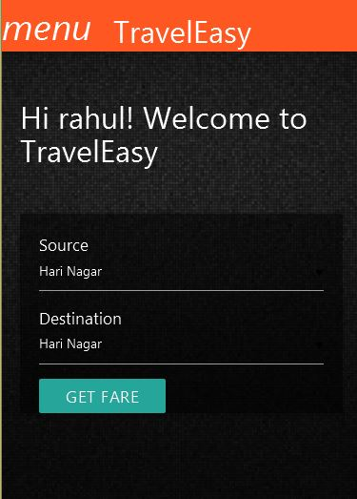
Inside TravelEasy
So, what exactly it does.
It simply takes in the source and destination desired by the user and it magically prints out the cost of using each service, bringing them all at one place, hence letting user to choose the better service according to the needs.

Slide 6
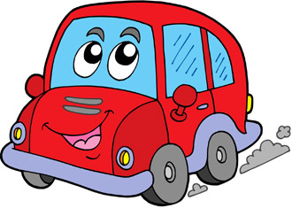
How is it Useful?
It let’s the users know of different means they have to travel.
Also, there’s a big potential to control out the rates and even bring them at competitive prices considering the people have choices.
The revenue model can be built around the fact that companies would try to have a solid following here and a good service nature.

Slide 7

Future Prospects
Due to some time constraints, we had to leave some of the functionalities for some other time which we surely intent to work on.
These would be-
1. Expanding to the android as well as iOS platforms.
2. Adding the reviews and ratings to the services.
3. Personalized reviews and options to car pool.
4. Data Analytics.

Slide 8
Thank You
Live Project
Team CentralPerk

