Slide 1
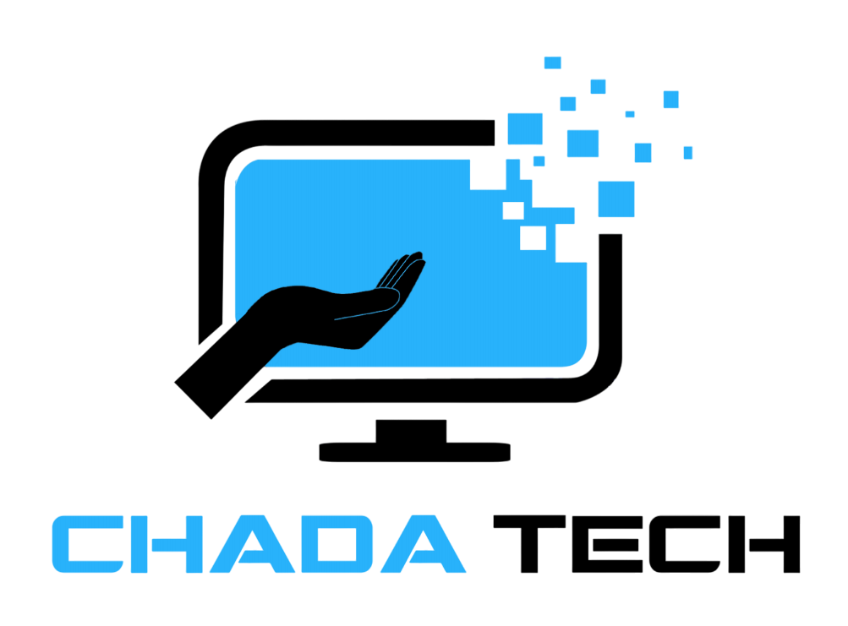
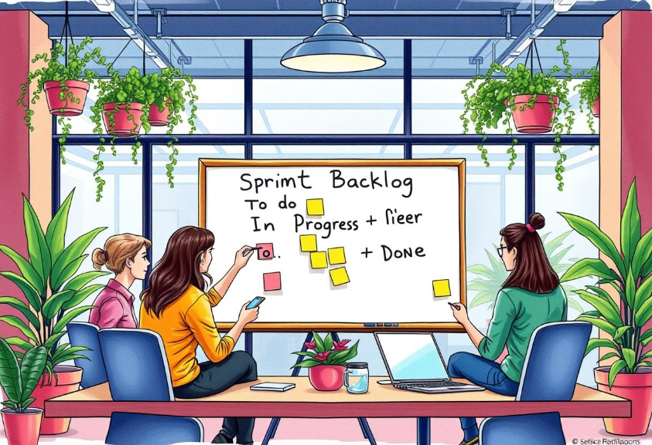
Scrum-Agile vs. Waterfall
Key Considerations for Software Development
Rick Goshen
April 15, 2025
CS-250
Scrum: Iterative, flexible
Waterfall: Sequential, rigid
Consider project needs

Slide 2

Agile Roles and Their Importance
Product Owner: Prioritizes backlog, aligns development with business goals and acts as a liaison between stakeholders, and development team.
Scrum Master: Facilitates events, removes impediments, ensures effective communication, and maintains Agile practices.
Developer: Designs, builds, delivers product increments ensuring quality and functionality.
Tester: Develops test cases and verifies that product increments meet quality and stakeholder expectations.
(Reference: Verwijs & Russo, 2021)

Slide 3

Agile Phases
Planning: Clearly defining sprint goals and product backlog items.
Design: Collaborative development of solutions, leveraging iterative feedback.
Implementation: Incremental delivery of functioning product features.
Testing: Continuous verification against user stories and acceptance criteria.
Deployment: Regular, incremental releases to stakeholders and users.
Review & Retrospective: Gather feedback from stakeholders and continuously improve processes for future sprints.
(Reference: Hron & Obwegeser, 2022)

Slide 4
Waterfall Model Explained and Contrasted with Agile
Linear, sequential phases: Requirements gathering, design, implementation, testing, deployment, and maintenance.
Differences:
Waterfall requires comprehensive upfront planning and minimal flexibility once phases begin.
Agile accommodates continuous changes and emphasizes iterative development.
Example: In a waterfall approach, the mid-project shift to wellness and detox content would have required significant re-planning and potential delays. Agile allowed immediate adaptation and continuity.
(Reference: Cucolaş & Russo, 2023)

Slide 5
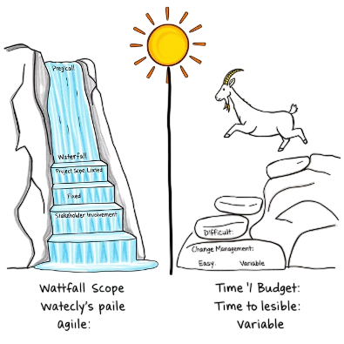
Factors for Choosing Waterfall or Agile
Project Scope and Stability: Agile excels with evolving scopes; Waterfall suits well-defined, stable requirements.
Stakeholder Involvement: Agile benefits from frequent stakeholder engagement; Waterfall has limited points of stakeholder interaction.
Change Management: Agile efficiently handles changes during development; Waterfall may lead to costly delays.
Time and Budget Constraints: Agile offers flexibility for iterative adjustments; Waterfall demands firm resource allocation from the start.
(Reference: Kokol et al., 2021)

Slide 6
References
Cucolaş, A., & Russo, D. (2023). The impact of working from home on the success of Scrum projects: A multi-method study. Journal of Systems and Software, 197, 111562. https://doi.org/10.1016/j.jss.2022.111562
Hron, M., & Obwegeser, N. (2022). Why and how is Scrum being adapted in practice: A systematic review. Journal of Systems and Software, 183, 111110. https://doi.org/10.1016/j.jss.2021.111110
Kokol, P., Zagoranski, S., & Kokol, M. (2021). Software development with Scrum: A bibliometric analysis and profile. ArXiv. https://doi.org/10.48550/arXiv.2103.01095
Verwijs, C., & Russo, D. (2021). A theory of Scrum team effectiveness. ACM Transactions on Software Engineering and Methodology, 32(3), 1–51. https://dl.acm.org/doi/pdf/10.1145/3571849

