Slide 1



IMAGECHAIN FOR MEDICAL
RECORDS USING BLOCKCHAIN
Team Members : Gowtham R (20BIR018)
Shivaas G (20BIR046)
Vishnu Priyan M (20BIR058)
Team No : 12
Nature of Project: Research
Supervisor : Ms.S.S.Saranya
Assistant professor
Department of Computer Technology

Slide 2
Table of contents
Introduction
Domain Description and Languages used
Objective of the Research
Existing System & Drawbacks
Problem
Proposed System
Process Flow
System Flow Diagram
Output Details
References

Slide 3
Introduction
Information is stored in a blocks that are connected together in a blockchain
Imagechain is a cryptographic structure that chains digital images with blockchain hash links.
EMRs, EHRs & PHRs - it collects medical images and patient information and stores in a text files.
Medical applications of blockchain technology are emerging, with potentially many applications in medical imaging.

Slide 4
Why blockchain?
Non-destructive (immutable)
P2P network
Decentralized Apps
Tamper proof
Transparent
Authenticity
Trusts

Slide 5
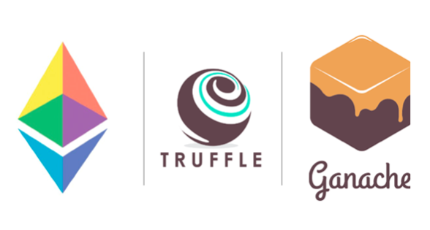
Dependencies

Slide 6
Objective of the Project
A chain is not public as it contains the patient’s sensitive data.
Instead, it may be accessed by the patient and medical personnel.
The images are ordered chronologically, so the structure of the database depicts treatment progress with added timestamps.
First Image is followed through cryptpgraphy process and then it goes through smart contracts for blockchain process.
This all implementation provide the extra security to important images.

Slide 7
Existing System & Drawbacks
Ransomware attack (Eg: AIIMS)
Cloud-based healthcare data systems
Pervasive social network (PSN) nodes.
Blockchain-based electronic medical records (EMR)
Post-marketing surveillance (PMS)
Content-based image retrieval
MedBlock – stores address of blocks containing the patient related records.

Slide 8
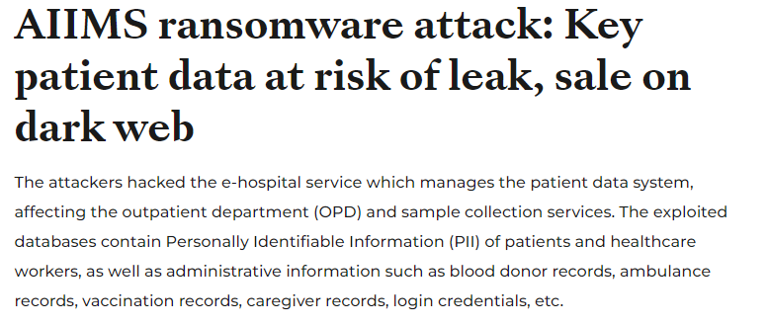
Problem
https://health.economictimes.indiatimes.com/news/hospitals/aiims-ransomware-attack-key-patient-data-at-risk-of-leak-sale-on-dark-web/95820909

Slide 9
Proposed System
To propose a new method of chaining digital images.
The main assumption is that the solution should not require an external database.
To create a system in which images are linked directly to each other, and no other ﬁles are needed.
Each image contains an embedded piece of information that may be considered as a data block.
Two methods – embedding(data into image) and ex-tracting function(data out of image)(hash parameters)
Notes:
27 February 2023
1-10
9

Slide 10
Process Flow
Use of Cryptography Process as Steganography
Image is Given as Input in the System
Then Data is given
Image and Data is Combined
Encryption/Decryption process follows
Decrypted Data is taken as value.
Smart contract is deployed using blockchain application
Web3 injected that connects with metmask
Web3 provider is Ganache
Metamask, Ganache and Remix IDE all are connected for deploying of smart contracts
Smart Contract Deployed successfully
Then Transaction follows in Ganache.
For each process we get a Transaction hash.
System Successfully Completed and run.

Slide 11
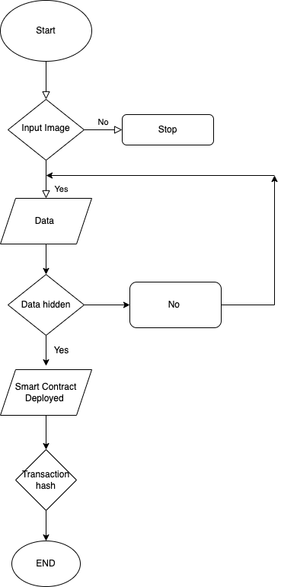
System Flow Diagram
Notes:
27 February 2023
1-10
11

Slide 12
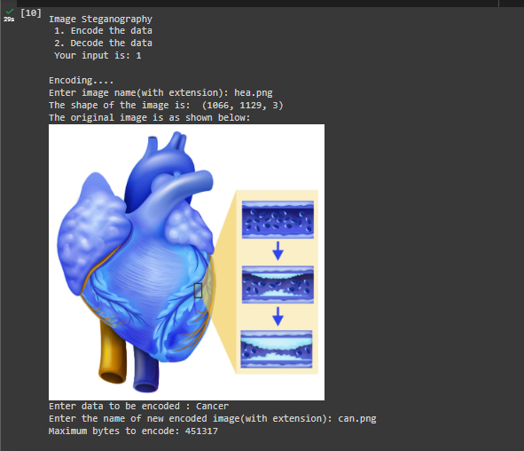
Output

Slide 13
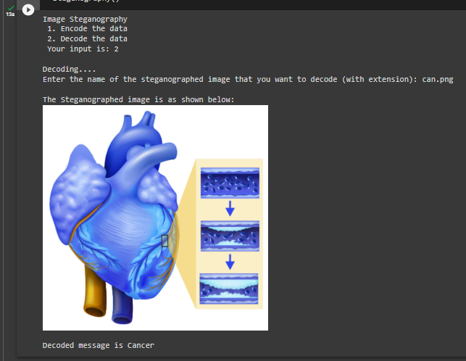
Output

Slide 14
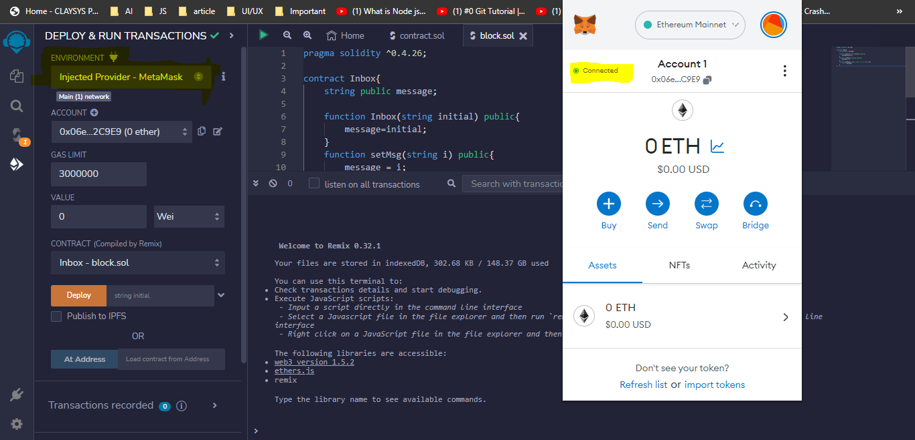
Injected Provider - MetaMask

Slide 15
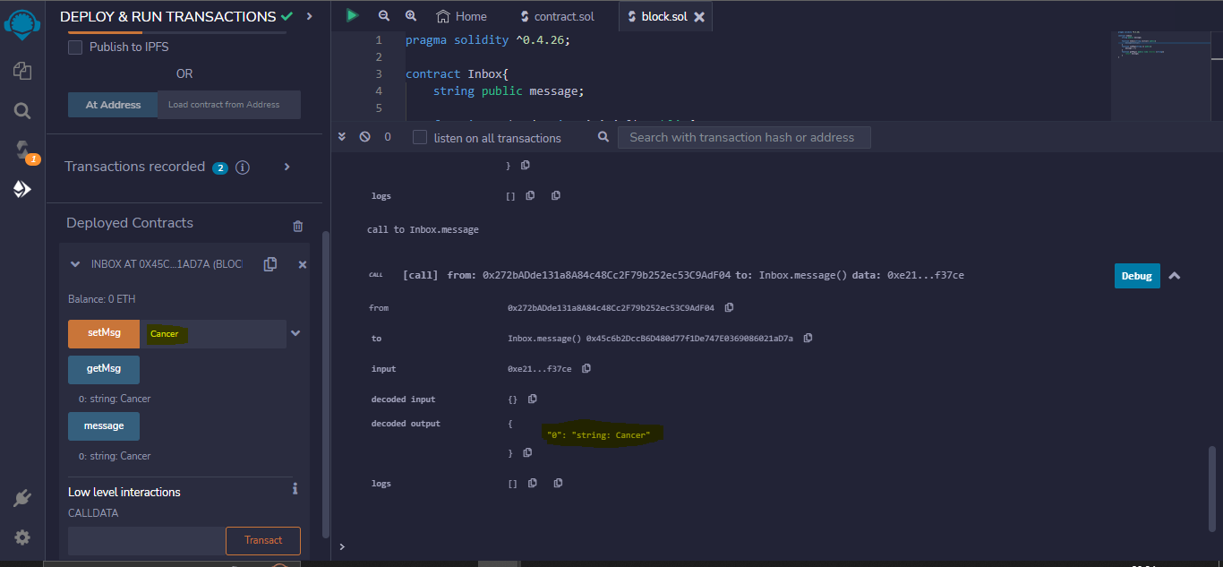
Deploy Contracts with message

Slide 16
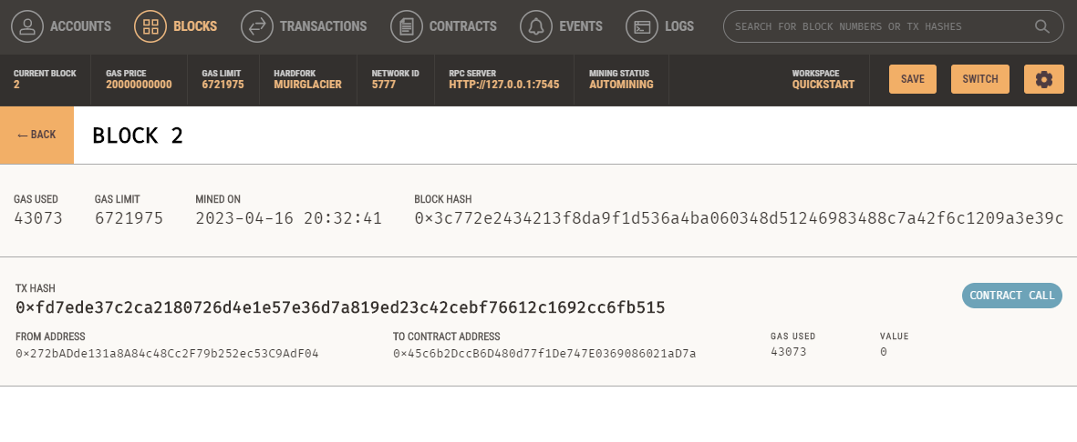
Block Details

Slide 17
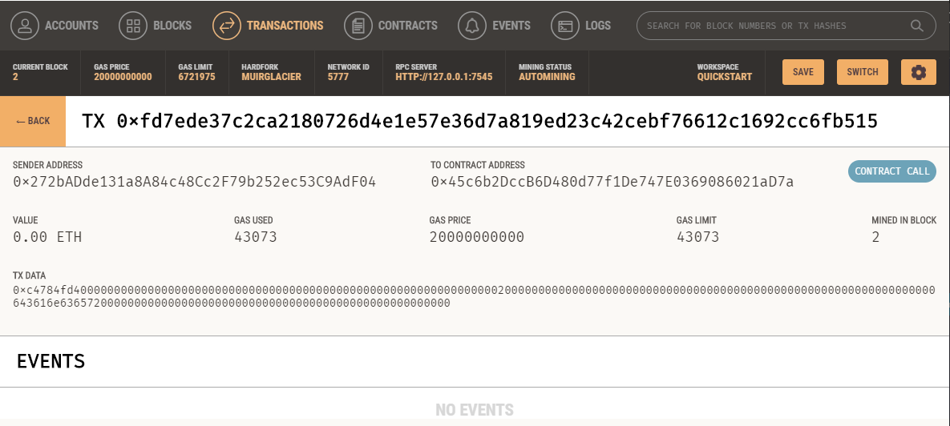
Transaction Details

Slide 18
References
[1]. Koptyra, K. and Ogiela, M.R., 2020. Imagechain—Application of blockchain technology for images. Sensors, 21(1), p.82.
[2]. Yue, X., Wang, H., Jin, D., Li, M. and Jiang, W., 2016. Healthcare data gateways: found healthcare intelligence on blockchain with novel privacy risk control. Journal of medical systems, 40, pp.1-8.
[3]. Zhang, A. and Lin, X., 2018. Towards secure and privacy-preserving data sharing in e-health systems via consortium blockchain. Journal of medical systems, 42(8), p.140.
[4]. Sylim, P., Liu, F., Marcelo, A. and Fontelo, P., 2018. Blockchain technology for detecting falsified and substandard drugs in distribution: pharmaceutical supply chain intervention. JMIR research protocols, 7(9), p.e10163.

Slide 19
THANK YOU

