Slide 1
Design and Analysis of Cryptographic Technique for Communication System
KONGU ENGINEERING COLLEGE
DEPARTMENT OF COMPUTER TECHNOLOGY
By
Gowtham R (20BIR018) 2^{nd yr.} Information Systems

Slide 2
Overview
What Cryptography refers to
Pros/cons crypto
Proposed Work
Vigenère Cipher
Polybius Square Cipher
Hybrid Cipher
Conclusion

Slide 3
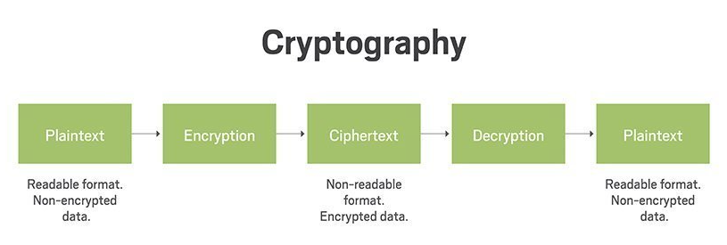
What Cryptography refers to
Study of techniques for securing communication and data in the presence of adversaries
Types of Cryptography:
Symmetric Cryptography – same key
Asymmetric Cryptography – public key, private key
Applications: Digital signatures, Military operations, Electronic Money etc.,

Slide 4
Pros
Highly Secure
Confidentiality – no one other than authorized party can read the encrypted message
Authentication – verification of identity
Data Integrity – was the data tampered?
Non-repudiation – Non Denial
Cons
Less use of hybrid algorithms
Selective access control also cannot be realized through the use of cryptography.
Cost and time
Difficult to access even for a legitimate user at a crucial time of decision-making.
Threats that emerge from the poor design of systems.

Slide 5
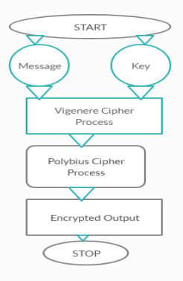
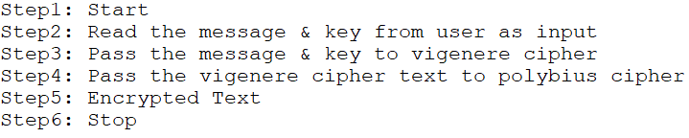
Proposed Work - Flow Chart & Algorithm

Slide 6
Proposed Work cont.,
The method employs use of both vigenère cipher and polybius square cipher in its encryption process.
The ciphertext will first be operated on using Vigenère.
A chosen key out of random will initiate the process.
At the end of the process, the resulting ciphertext then becomes a message as input for the polybius square cipher process.
This process will end up making the final ciphertext more difficult to be broken using existing cryptanalysis processes.

Slide 7
Vigenère Cipher
Method of encrypting alphabetic text.
It is a simple form of polyalphabetic substitution.
Encryption is done by Vigenère square or Vigenère table.
Table consists of the alphabets written out 26 times in different rows, each alphabet shifted cyclically to the left compared to the previous alphabet, corresponding to the 26 possible caesar ciphers.
Cipher uses a different alphabet from one of the rows in the encryption process.
The alphabet used at each point depends on a repeating keyword.

Slide 8
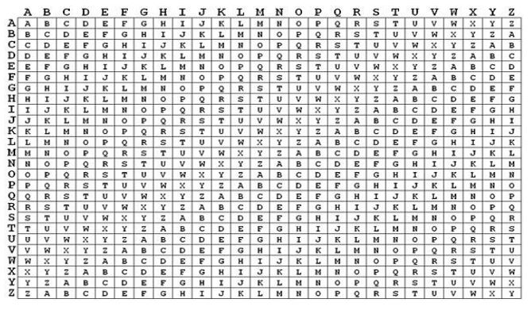

Slide 9
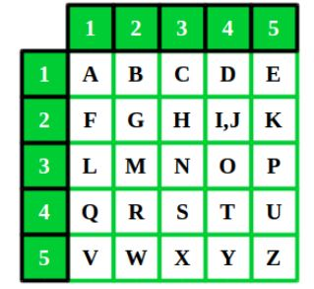
Polybius Square Cipher
A table allows to convert letters into numbers.
Table can be randomized and shared with the recipient.
To fit the 26 letters of the alphabet into the 25 cells created by the table, the letters ‘i’ and ‘j’ are usually combined into a single cell.

Slide 10


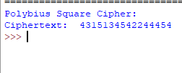
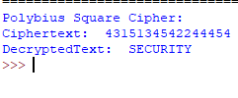
Vigenère Cipher Output Polybius Square Cipher Output

Slide 11
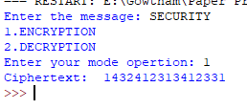
Hybrid Cipher
Combination of Vigenere and Polybius Square Cipher it takes encoding mode where it governs on [A-Z] alphabetic letters and numerical both in the system.
It makes the system tough and unbreakable for any assaults and attacks from outside

Slide 12
EXAMPLE
plain_txt = “PROGRAMMING” key = “CODE” Step1: Pass the plain_txt and key to the vigenere_cipher algorithm we will get our result as a letters (vigenere_cipher_text) Step2: Pass the vigenere_cipher_txt to polybius_cipher algorithm we will get our result as a number (polybius_cipher_text) Here, polybius_cipher_text is our ENCRYPTED TEXT (CIPHER TEXT)

Slide 13
Conclusion
An algorithm, which includes the special characters, numerical, binary numbers and hexadecimal will increase the complexity as well as decrease the time.
Vigenere cipher is one of the cryptographic method that is considered simplest and weakest due to many limitations.
To overcome the limitations of Vigenere cipher we proposed summation of polybius cipher that makes much secure against Kasiski and Friedman attacks.

Slide 14
THANK YOU

