Slide 1
Scientific Machine Learning and Tensorflow tutorial
Physics informed neural networks and Inverse Problems
Ravi G Patel
Scientific Machine Learning Department
February 1 – 2, 2024
Numerical PDEs: Analysis, Algorithms, and Data Challenges
ICERM
Brown University
SAND2024-00806O

Slide 2
Physics informed neural networks
We previously fit neural networks to functions by regressing against data,
We used a loss function that penalized against RSS
Neural networks can also be trained using more general loss functions like a PDE residual
Solves a PDE
Residual:

Slide 3
Physics informed neural networks¹ (PINNs) as a PDE collocation scheme
For the PDE,
interior
boundary
Let the solution be defined by a neural network,
Choose collocation points in space-time
Define a residual,
Minimize
¹ Raissi et al., arXiv:1711.10561

Slide 4
Control volume PINNs¹ (CVPINNs)
For PDEs of the form,
Let the solution be defined by a neural network,
Choose mesh in space-time
Apply divergence theorem to each cell in the mesh
Approximate integrals with quadrature
Fluxes at boundaries replaced by prescribed values
Minimize residuals
² R.G. Patel et al., JCP (2022)

Slide 5
Inverse problems with PINNs
If we have a data, , and a parameterized PDE, e.g.,
We can find the parameter, , using PINNs by adding an extra term to the PINNs loss,
This will simultaneously solve the PDE while adjusting the parameters such that the solution matches the data

Slide 6
Constraints for PINNs
Often the parameters we’re fitting need to be constrained
Well-posedness of the PDE
E.g., the conductivity in the heat equation must be positive
We can penalize against negative conductivity by adding another term to the loss,
With a high enough regularization weight, the minima will not have negative conductivity

Slide 7
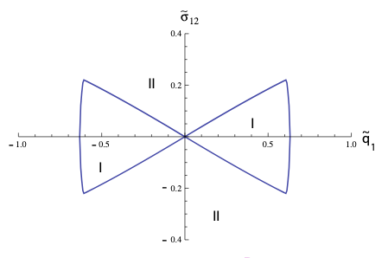
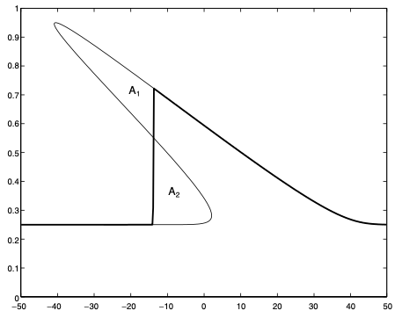
CVPINNs for hyperbolic conservation laws A case study of Physics informed constrained learning
Ingredients needed:
A numerical method for the PDE,
A parameterization for
Challenges,
PDE forms discontinuities
must produce a well-posed IBVP
Shock solution to the traffic flow equation¹
Hyperbolic region for Grad’s 13 moment equations²
¹ LeVeque, Finite Volume Methods for Hyperbolic Problems, 2004
² Brini and Ruggeri, Continuum Mech. Thermodyn., 2020

Slide 8
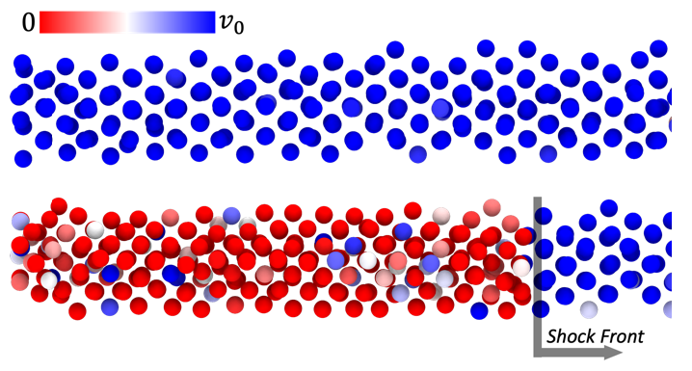
EOS discovery FOR copper UNDER SHOCK
Perform LAMMPS¹ simulations of the reverse-ballistic impact experiment
Various impact velocities and initial temperatures
Fit an EOS to the LAMMPS data using CVPINNs
Regularized neural network parameterization to preserve hyperbolicity in the Euler equations (convex Entropy)
Use fitted EOS to perform FD simulations of a new impact case and compare to LAMMPS
¹LAMMPS, https://lammps.sandia.gov

Slide 9
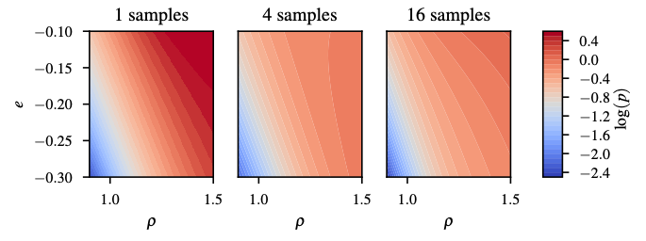
EOS fits for shocked copper
EOS fits using penalty to prevent loss of hyperbolicity

Slide 10
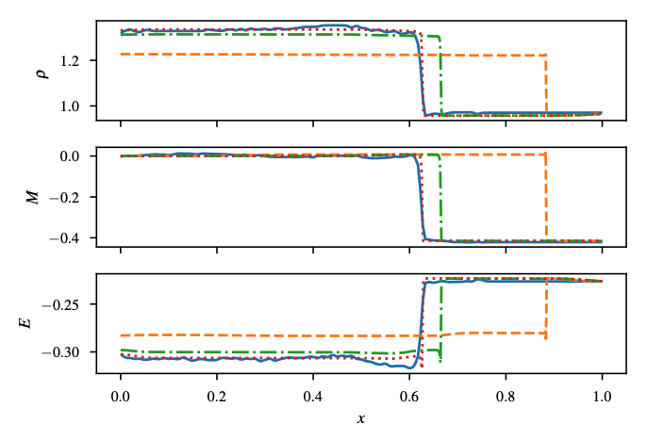
EOS fits test for shocked copper
Use fitted EOS’s to solve new impact case
Viscous regularized finite difference (FD) code on a fine mesh
LAMMPS
1 Sample fit
4 Sample fit
16 Sample fit

Slide 11
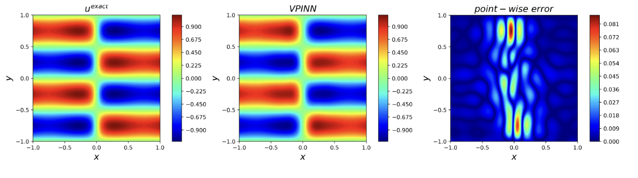
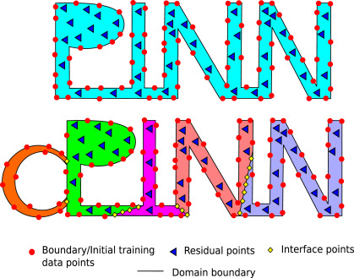
Other Pinns variants
Variational PINNs (E. Kharazmi et al., arXiv:1912.00873 (2019))
Conservative PINNs (A. Jagtap et al., CMAME (2020))

Slide 12
Exercise
Exercise 1
Develop a PINN for the viscous Burgers equation
Solve the forward problem for the viscous Burgers equation
Using the provided data, find the viscosity coefficient
Exercise 2
Find the frequency of the forcing term in the Poisson equation

