Slide 1
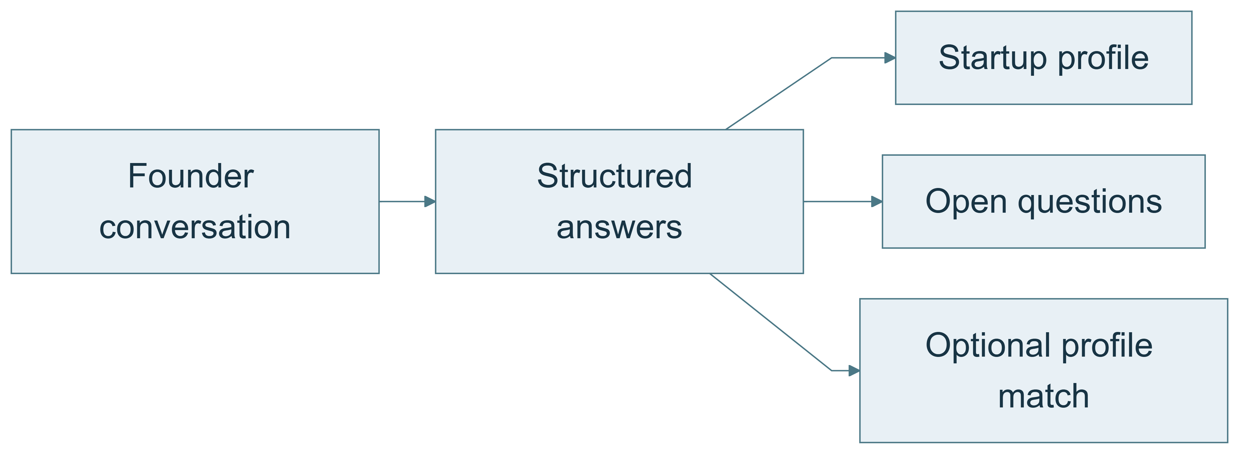
The interview result
A structured, reviewable startup profile is the outcome. Voice is the interaction channel.
What should be useful after the conversation?
01 / 11
Notes:
1. Start with the result
**Design question:** What should be useful after the conversation?
**On-slide message:** A structured, reviewable startup profile is the outcome. Voice is the interaction channel.
[Standalone diagram](diagrams/01-start-with-the-result.mmd)
**Speaker notes**
When I read the challenge, I started with the information we should have at the end: team, product, stage, traction, market, financing and next steps. A pleasant conversation matters, but the lasting value is a useful result that someone can review. That gave me a way to work backwards into the design.
**Demo action**
Open a completed interview report. Point to one answer, one open item and the separate completeness and match indicators.
**Source pointers**
- [app/analysis.py](../../app/analysis.py) — `analyze` : Builds the report from saved interview state.
- [frontend/src/InterviewReport.tsx](../../frontend/src/InterviewReport.tsx) — `InterviewReport` : Displays answers, scores and transcript evidence.
**Be precise about the limitation**
A match score exists only if an administrator configured criteria. It is not a general investment-quality rating.
**Transition:** To produce this result consistently, I first needed a data model.
Diagram source (editable Mermaid):
flowchart LR
A[Founder conversation] --> B[Structured answers]
B --> C[Startup profile]
B --> D[Open questions]
B --> E[Optional profile match]
Source document: docs/learning/DEMO_STORYLINE_SLIDES.md

Slide 2
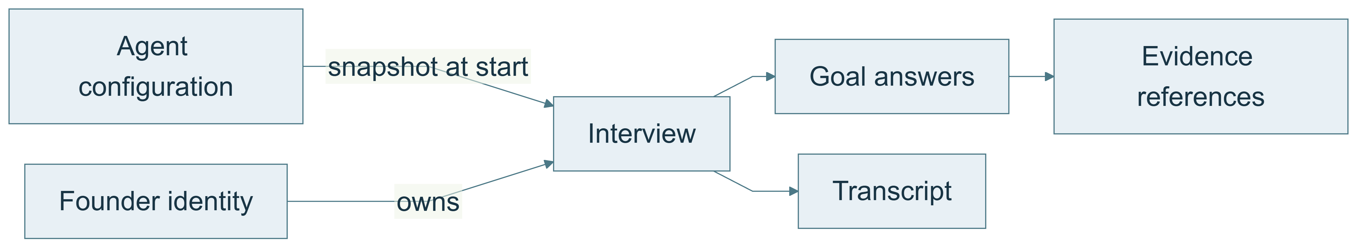
Questions, answers and interviews
Configuration describes what to learn; each interview stores its own answers and configuration snapshot.
How do I keep records comparable and isolated?
02 / 11
Notes:
2. Separate questions, answers and interviews
**Design question:** How do I keep records comparable and isolated?
**On-slide message:** Configuration describes what to learn; each interview stores its own answers and configuration snapshot.
[Standalone diagram](diagrams/02-separate-questions-answers-and-interviews.mmd)
**Speaker notes**
I separated the questions from the answers. A question belongs to the configuration; an answer belongs to a specific interview. I also separated free text, categories and numbers. Team experience can remain descriptive, stage should use consistent categories, and funding needs require a number and currency. The configuration is saved with the interview so a later edit does not change how an old conversation is interpreted.
**Demo action**
Show a number goal and a choice goal in the admin interface, then the configuration version in a saved result.
**Source pointers**
- [app/goals.py](../../app/goals.py) — `AnswerGoal` : Question, sufficiency criteria, type and condition.
- [app/goals.py](../../app/goals.py) — `GoalAnswer` : Model-proposed answer with a quote.
- [app/goals.py](../../app/goals.py) — `GoalState` : Persisted answer progress.
- [app/models.py](../../app/models.py) — `Interview` : Owns configuration, answers, transcript and state.
- [app/main.py](../../app/main.py) — `start` : Creates an owned interview with a configuration snapshot.
**Be precise about the limitation**
The current system isolates records by founder and interview. It does not yet have a separate company master-data model or one company shared across multiple founder accounts.
**Transition:** Once the data structure was clear, I could decide which decisions actually need AI.
Diagram source (editable Mermaid):
flowchart LR
C[Agent configuration] -->|snapshot at start| I[Interview]
F[Founder identity] -->|owns| I
I --> A[Goal answers]
I --> T[Transcript]
A --> E[Evidence references]
Source document: docs/learning/DEMO_STORYLINE_SLIDES.md

Slide 3
The backend selects the question
Use AI to interpret the founder. Keep question selection, follow-up limits and persistence in code.
AI: interpretation and evidence
Backend: progression and storage
One model call per turn
03 / 11
Notes:
3. The backend chooses the question; AI understands the answer
**Design question:** How much freedom should the language model have?
**On-slide message:** Use AI to interpret the founder. Keep question selection, follow-up limits and persistence in code.
[Standalone diagram](diagrams/03-give-ai-a-bounded-responsibility.mmd)
**Three points to put on the slide**
- OpenAI extracts answers, evidence and a short acknowledgment.
- The backend selects a predefined question or clarification from the configured goals.
- One structured model call per turn avoids a second model round trip for wording.
**Speaker notes — 60–90 seconds**
I started with the required outcome: comparable answers supported by the conversation. Founders should still be able to speak naturally, answer several questions at once, or correct themselves. That is where I use the language model: it maps their statements to our answer goals and judges whether the configured criteria are met.
The backend then validates those proposed answers and decides what information is still missing. It selects the next configured question or clarification, enforces the follow-up budget, and saves the resulting state. OpenAI can contribute a short acknowledgment, but it does not rewrite the question. The worker speaks the reply only after the backend has returned the saved result.
For this demo, that boundary gives me predictable progression, testable rules and one model call per turn. The compromise is that clarifications sound less tailored to the exact wording of the founder. My next step toward more natural dialogue would be to let AI phrase a question for a goal selected by the backend, while retaining the configured question as a fallback.
**Concrete example to explain aloud**
Founder: “We probably need about half a million.”
The extractor needs an explicit currency before treating that as a complete EUR answer. The backend can therefore select the configured clarification: “Welchen konkreten Betrag in Euro plant ihr aufzunehmen?” A future contextual phrasing step could instead ask: “About half a million—do you mean euros?” Both pursue the same goal, but only the latter generates the question wording from this conversation.
**Alternatives — keep in speaker notes or a backup slide**
| Alternative | What it improves | Why it was not selected for this demo |
| --- | --- | --- |
| Backend selects the goal, AI phrases the question afterward | Contextual wording while preserving progression rules | Adds another sequential model call in a straightforward implementation, with latency, cost and wording checks |
| One call extracts answers and proposes the next question | Contextual wording without a second sequential call | The question is proposed before backend validation and next-goal selection, so it needs a consistency check and fallback |
| LLM controls the interview and chooses when to finish | Flexible conversation, including unexpected counterquestions | Harder to enforce coverage, follow-up limits and completion rules, and harder to reproduce failures |
The current approach improves predictability but does not guarantee semantic accuracy or that every founder supplies every answer. Unknown and partial information remains visible. A schema and an exact quote establish structure and traceability, not truth. The model's sufficiency classification still influences which path the deterministic controller takes.
**Demo action**
Show a goal's configured question and clarification in the admin interface. Then show `Extraction` and `ask()` in code: the model returns answers and an acknowledgment, while `ask()` selects the stored question text. A text simulation demonstrates the controller only; it does not demonstrate AI interpretation.
**Source pointers**
- [app/models.py](../../app/models.py) — `Extraction`: Answers, acknowledgment and explicit summary confirmation.
- [voice/extraction.py](../../voice/extraction.py) — `extract`: One structured model call and sufficiency instructions.
- [app/planner.py](../../app/planner.py) — `advance`, `select_next`, `ask`: Validation, progression, fixed questions and optional acknowledgment.
- [app/goals.py](../../app/goals.py) — `AnswerGoal`: Editable question, clarification and criteria.
- [voice/worker.py](../../voice/worker.py) — `llm_node`: Speaks the canonical backend reply through the TTS pipeline.
- [app/store.py](../../app/store.py) — `update`: Atomic persistence before the successful response.
**Be precise about the limitation**
The tone setting primarily influences the AI acknowledgment; it does not rewrite the configured questions. A hard-coded full-company-name clarification is an additional backend exception. Changing the TTS voice changes delivery, not contextual phrasing. One model call is a latency-saving design choice, not proof that the complete voice round trip always meets the two-second target.
**Transition:** With that responsibility split established, I needed explicit criteria for when each answer is sufficient.
Diagram source (editable Mermaid):
flowchart LR
U[Founder statement] --> L[OpenAI extracts answers and evidence]
L --> V[Backend validates and updates state]
V --> P[Backend selects goal and configured question]
P --> S[Save interview before returning reply]
S --> R[Optional AI acknowledgment plus fixed question]
R --> T[ElevenLabs speaks the reply]
Source document: docs/learning/DEMO_STORYLINE_SLIDES.md

Slide 4
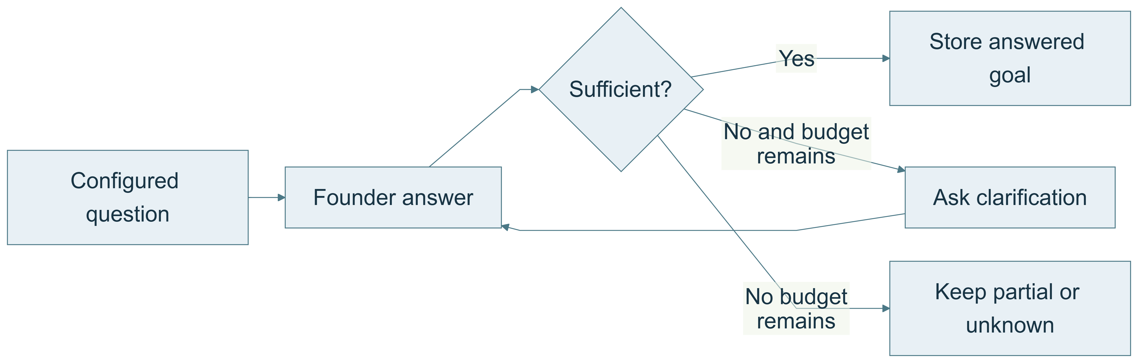
Answer goals and follow-up limits
Each goal has sufficiency criteria and a bounded follow-up budget.
How do we know whether an answer is useful?
04 / 11
Notes:
4. Define answer goals and clarification rules
**Design question:** How do we know whether an answer is useful?
**On-slide message:** Each goal has sufficiency criteria and a bounded follow-up budget.
[Standalone diagram](diagrams/04-define-answer-goals-and-clarification-rules.mmd)
**Speaker notes**
A question list alone does not say whether we learned enough. For traction, “things are going well” should trigger a specific follow-up. “Two paying customers and 900 euros monthly revenue in September” is much more useful. The model evaluates the statement against configured criteria; the controller limits follow-ups. If the founder still cannot answer, the gap remains visible and we move on.
**Demo action**
Expand the traction goal. Show its criteria and clarification limit. Optionally answer vaguely in the text simulator, clearly identifying it as a controller demonstration rather than an AI test.
**Source pointers**
- [app/goals.py](../../app/goals.py) — `default_goals` : Initial questions and sufficiency criteria.
- [app/planner.py](../../app/planner.py) — `ask` : Tracks first questions and follow-ups.
- [app/planner.py](../../app/planner.py) — `select_next` : Enforces exhaustion and chooses a next goal.
- [frontend/src/GoalEditor.tsx](../../frontend/src/GoalEditor.tsx) — `GoalEditor` : Edits criteria and clarification budgets.
- [tests/test_goals.py](../../tests/test_goals.py): Regression examples for clarification and applicability.
**Be precise about the limitation**
The example decision diamond is conceptual: the LLM supplies the sufficiency classification and deterministic code enforces the budget. There is no separate deterministic semantic judge.
**Transition:** The order should be predictable without forcing the founder to speak in that order.
Diagram source (editable Mermaid):
flowchart LR
Q[Configured question] --> A[Founder answer]
A --> C{Sufficient?}
C -->|Yes| S[Store answered goal]
C -->|No and budget remains| F[Ask clarification]
F --> A
C -->|No budget remains| O[Keep partial or unknown]
Source document: docs/learning/DEMO_STORYLINE_SLIDES.md

Slide 5
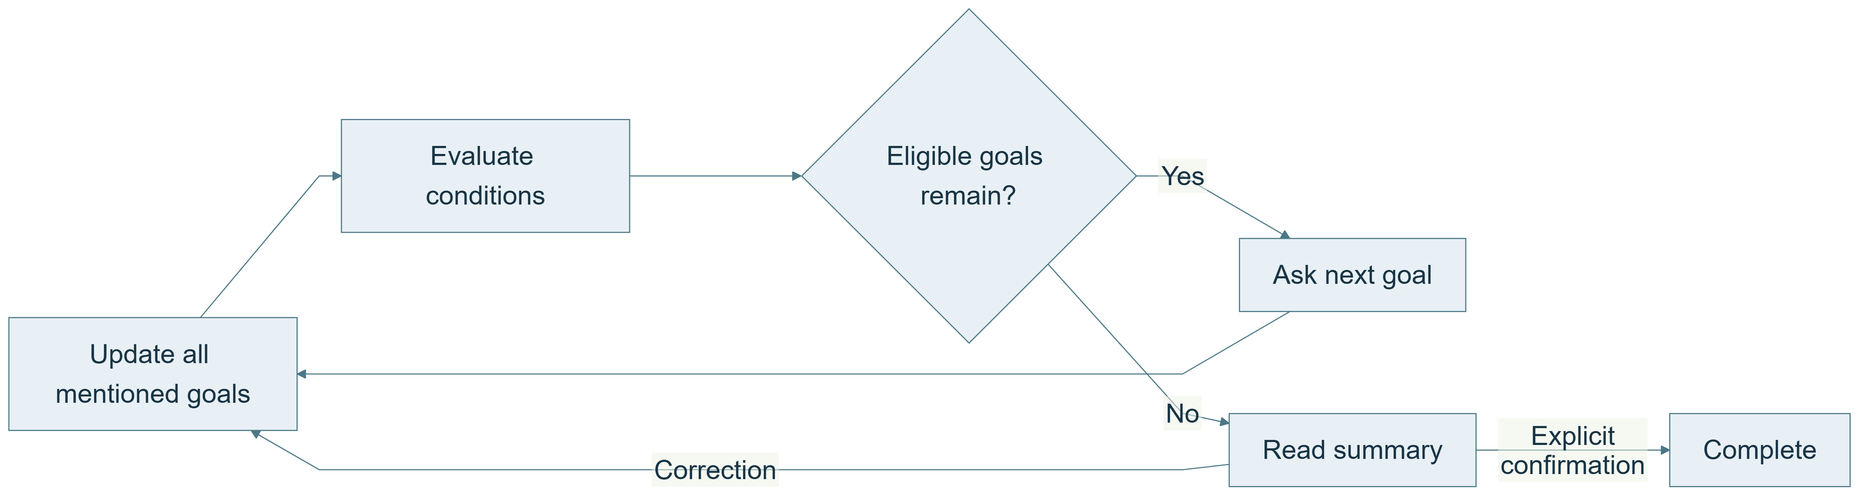
Flexible conversation, explicit state
Ask the next relevant unanswered goal; retain information offered out of order.
How do we avoid repetition and irrelevant questions?
05 / 11
Notes:
5. Guide a flexible conversation
**Design question:** How do we avoid repetition and irrelevant questions?
**On-slide message:** Ask the next relevant unanswered goal; retain information offered out of order.
[Standalone diagram](diagrams/05-guide-a-flexible-conversation.mmd)
**Speaker notes**
The configured order is a guide. If the founder already explained the team while discussing the product, that information is retained. Conditional goals also matter: someone who is not raising money should not have to invent a funding round. When no eligible questions remain, the agent reviews the result. A correction creates a fresh review; simply stopping the microphone is not approval.
**Demo action**
Show a financing condition. In a prepared transcript, point out an early answer that prevented a repeated question and the final confirmation.
**Source pointers**
- [app/planner.py](../../app/planner.py) — `applicability` : Distinguishes relevant, excluded and unresolved conditions.
- [app/planner.py](../../app/planner.py) — `select_next` : Prioritizes relevant unanswered required goals.
- [app/planner.py](../../app/planner.py) — `advance` : Handles review, correction and confirmation.
- [app/interview.py](../../app/interview.py) — `stop_interview` : Marks unfinished sessions incomplete.
**Be precise about the limitation**
The normal questions and clarifications are configured text. The model does not freely invent every next question. Repeat and clarification requests preserve the pending goal. Clarifications use configured criteria; contextual generation of follow-up questions remains future work.
**Transition:** Because interpretation can be wrong, the result needs an audit trail.
Diagram source (editable Mermaid):
flowchart LR
A[Update all mentioned goals] --> B[Evaluate conditions]
B --> C{Eligible goals remain?}
C -->|Yes| D[Ask next goal]
D --> A
C -->|No| E[Read summary]
E -->|Correction| A
E -->|Explicit confirmation| F[Complete]
Source document: docs/learning/DEMO_STORYLINE_SLIDES.md

Slide 6
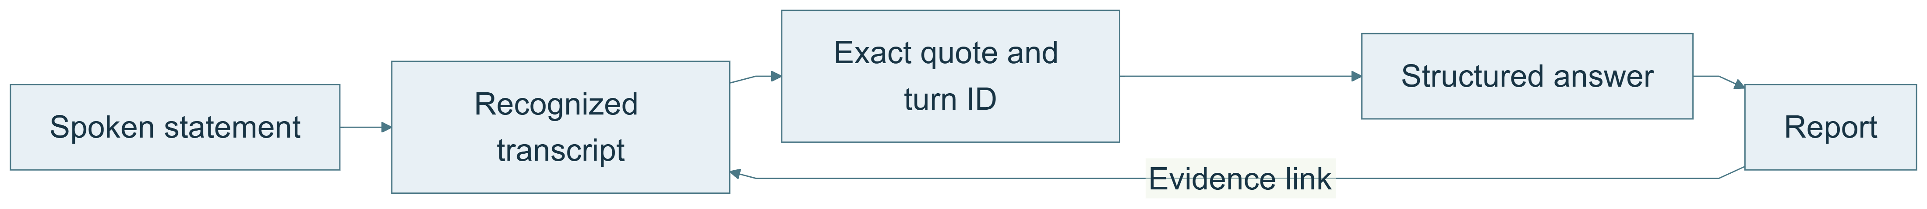
Evidence behind each answer
Connect interpreted answers to recognized statements and preserve uncertainty.
How can someone check what the AI concluded?
06 / 11
Notes:
6. Make answers traceable
**Design question:** How can someone check what the AI concluded?
**On-slide message:** Connect interpreted answers to recognized statements and preserve uncertainty.
[Standalone diagram](diagrams/06-make-answers-traceable.mmd)
**Speaker notes**
I wanted a report that can be checked rather than a summary we simply trust. Every extracted answer needs evidence from the current recognized statement. The report links back to that contribution. We also distinguish an unknown answer from a negative match, and completeness from fit. A founder gets a spoken review so corrections can happen before completion.
**Demo action**
Click “Beleg ansehen” in the report and demonstrate transcript search. Show a missing criterion next to the coverage indicator.
**Source pointers**
- [app/planner.py](../../app/planner.py) — `advance` : Checks quote occurrence before applying answers.
- [app/main.py](../../app/main.py) — `worker_speech` : Persists transcript events (text may exist even when TTS fails) and interruption flags.
- [app/analysis.py](../../app/analysis.py) — `analyze` : Derives match, coverage, completeness and chronology.
- [frontend/src/InterviewReport.tsx](../../frontend/src/InterviewReport.tsx) — `InterviewReport` : Links report claims back to transcript entries.
**Be precise about the limitation**
The transcript is recognized text, not raw audio. It may already contain STT mistakes. Merged multi-turn answers currently have limited evidence provenance.
**Transition:** Only after establishing the text-based logic did I need to choose the voice pipeline.
Diagram source (editable Mermaid):
flowchart LR
S[Spoken statement] --> T[Recognized transcript]
T --> Q[Exact quote and turn ID]
Q --> A[Structured answer]
A --> R[Report]
R -->|Evidence link| T
Source document: docs/learning/DEMO_STORYLINE_SLIDES.md

Slide 7
The voice pipeline
A media pipeline surrounds the domain controller; providers remain replaceable.
How does the same interview logic work with speech?
07 / 11
Notes:
7. Connect text and voice through replaceable services
**Design question:** How does the same interview logic work with speech?
**On-slide message:** A media pipeline surrounds the domain controller; providers remain replaceable.
[Standalone diagram](diagrams/07-connect-text-and-voice-through-replaceable-services.mmd)
**Speaker notes**
Voice is a sequence of responsibilities: capture audio, recognize text, interpret the answer, decide the next step and generate speech. LiveKit handles the real-time session. A factory selects the speech recognizer; both provider plugins already expose the same internal interface. The worker talks to the backend instead of writing storage directly. That keeps conversation rules separate from provider choices.
**Demo action**
Show create_stt, then the AgentSession construction in the worker. Avoid opening .env or exposing keys.
**Source pointers**
- [voice/stt.py](../../voice/stt.py) — `create_stt` : Returns the selected implementation of the common STT interface.
- [voice/worker.py](../../voice/worker.py) — `entrypoint` : Assembles the LiveKit session.
- [voice/extraction.py](../../voice/extraction.py) — `Extractor` : Interprets recognized statements.
- [app/providers.py](../../app/providers.py) — `room_access` : Issues a room-scoped browser token.
- [app/config.py](../../app/config.py) — `Settings` : Server-side provider selection and credentials.
**Be precise about the limitation**
STT selection is currently server-wide, not an admin form field or a per-interview provider snapshot. Provider changes still need real speech tests.
**Transition:** The architecture then had to support conversational speed, not just correct output.
Diagram source (editable Mermaid):
flowchart LR
B[Browser microphone] --> K[LiveKit transport]
K --> S[Deepgram or ElevenLabs STT]
S --> L[OpenAI extraction]
L --> A[API planner and storage]
A --> T[ElevenLabs TTS]
T --> K2[LiveKit transport]
K2 --> O[Browser speakers]
Source document: docs/learning/DEMO_STORYLINE_SLIDES.md

Slide 8
Response time and streaming
One structured model call per turn; save before speaking; stream the audio.
Where can we remove waiting without losing correctness?
08 / 11
Notes:
8. Optimize the response path
**Design question:** Where can we remove waiting without losing correctness?
**On-slide message:** One structured model call per turn; save before speaking; stream the audio.
[Standalone diagram](diagrams/08-optimize-the-response-path.mmd)
**Speaker notes**
A voice interface feels slow even when an answer is technically correct if the pause is too long. I avoided a second model call just to produce a question: after saving the answer, the controller already knows the next reply. TTS then streams it. Turn-taking is another tradeoff. A shorter pause feels fast but may cut off a multi-part company name, so the name question gets extra patience.
**Demo action**
Show llm_node and endpointing_delay. Mention the real multi-part-name issue and its targeted regression test.
**Source pointers**
- [voice/worker.py](../../voice/worker.py) — `llm_node` : Extracts, persists and yields the canonical reply.
- [voice/worker.py](../../voice/worker.py) — `endpointing_delay` : Adds patience for the startup name.
- [voice/worker.py](../../voice/worker.py) — `agent_state` : Records a worker-side latency proxy.
- [voice/extraction.py](../../voice/extraction.py) — `Extractor` : Uses a bounded request without automatic model retries.
- [tests/test_voice.py](../../tests/test_voice.py): Tests sequencing, failures and endpointing policy.
**Be precise about the limitation**
This diagram is an ordered path, not a measured timing chart. The structured LLM response is not token-streamed. The worker metric is not browser speaker latency or a proven p95.
**Transition:** The user still needs clear control over when the microphone is active.
Diagram source (editable Mermaid):
flowchart LR
E[Detected speech end] --> X[One extraction call]
X --> V[Validate and save]
V --> Q[Canonical reply]
Q --> T[Streaming TTS]
T --> F[First audible response]
Source document: docs/learning/DEMO_STORYLINE_SLIDES.md

Slide 9
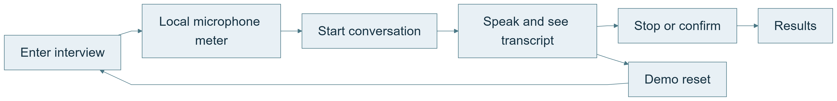
The startup experience
Make entry, microphone feedback, start and stop explicit.
How does a first-time founder know what to do?
09 / 11
Notes:
9. Design the startup interaction
**Design question:** How does a first-time founder know what to do?
**On-slide message:** Make entry, microphone feedback, start and stop explicit.
[Standalone diagram](diagrams/09-design-the-startup-interaction.mmd)
**Speaker notes**
The browser needs permission and visible feedback. A microphone test should show a level, not just confirm permission. During the interview, room connection and agent readiness are separate states. Stop releases microphone capture before waiting for persistence. The demo reset clears the active interface and gives the next interview a new context without deleting previous results.
**Demo action**
Let the audience see the meter respond, start a short conversation, and point out Stop. Use Reset only when you want to end that demonstration.
**Source pointers**
- [frontend/src/App.tsx](../../frontend/src/App.tsx) — `start` : Creates an interview and connects browser audio.
- [frontend/src/App.tsx](../../frontend/src/App.tsx) — `stop` : Releases microphone capture before saving the stop.
- [frontend/src/App.tsx](../../frontend/src/App.tsx) — `resetDemo` : Stops and reloads the local demo.
- [frontend/src/MicrophoneTest.tsx](../../frontend/src/MicrophoneTest.tsx) — `MicrophoneTest` : Local signal meter and resource cleanup.
- [frontend/e2e/microphone.spec.ts](../../frontend/e2e/microphone.spec.ts): Permission and cleanup tests.
- [frontend/e2e/reset.spec.ts](../../frontend/e2e/reset.spec.ts): Fresh-state reset and error-path tests.
**Be precise about the limitation**
The local meter measures signal energy, not speech intelligibility. Browser tests with simulated audio do not replace real-device testing.
**Transition:** Finally, I separated things an administrator should change from things that require code.
Diagram source (editable Mermaid):
flowchart LR
A[Enter interview] --> M[Local microphone meter]
M --> S[Start conversation]
S --> C[Speak and see transcript]
C --> E[Stop or confirm]
E --> R[Results]
C --> D[Demo reset]
D --> A
Source document: docs/learning/DEMO_STORYLINE_SLIDES.md

Slide 10
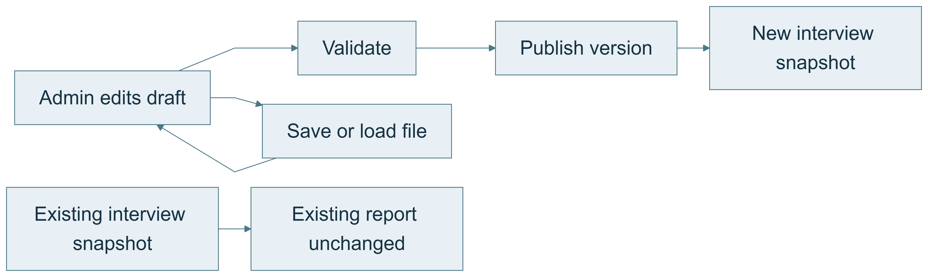
Configuration and two user roles
Version questions, criteria and voice settings; keep the UI focused on two roles.
What should be editable without a deployment?
10 / 11
Notes:
10. Configure behavior and then refine presentation
**Design question:** What should be editable without a deployment?
**On-slide message:** Version questions, criteria and voice settings; keep the UI focused on two roles.
[Standalone diagram](diagrams/10-configure-behavior-and-then-refine-presentation.mmd)
**Speaker notes**
Administrators can change questions, sufficiency criteria, follow-up limits, voice settings and an optional target profile. Files let us keep different configurations, and publication makes activation explicit. React and TypeScript support interactive browser state; FastAPI and Pydantic provide validated backend contracts. SQLite makes local development easy, with a Firestore implementation for deployment. Visual design then makes those flows clear instead of driving the architecture.
**Demo action**
Select a preset voice, show save/load configuration, and point to “Version veröffentlichen”. Explain that a running interview retains its old version.
**Source pointers**
- [frontend/src/GoalEditor.tsx](../../frontend/src/GoalEditor.tsx) — `GoalEditor` : Question and answer-goal editing.
- [frontend/src/GoalEditor.tsx](../../frontend/src/GoalEditor.tsx) — `MatchEditor` : Optional target profile editing.
- [frontend/src/App.tsx](../../frontend/src/App.tsx) — `saveConfig` : Export current validated settings.
- [frontend/src/App.tsx](../../frontend/src/App.tsx) — `loadConfig` : Load a validated draft.
- [app/main.py](../../app/main.py) — `publish` : Version conflict checks and publication.
- [frontend/src/style.css](../../frontend/src/style.css): Visual hierarchy and responsive layout.
- [frontend/vite.config.ts](../../frontend/vite.config.ts): Frontend tooling and API proxy.
- [pyproject.toml](../../pyproject.toml): Python stack and dependency groups.
**Be precise about the limitation**
UI polish is not a substitute for the tested lifecycle. App.tsx remains concentrated; splitting pages and session hooks is sensible future work.
**Transition:** I can now explain the system through both its strengths and its remaining compromises.
Diagram source (editable Mermaid):
flowchart LR
A[Admin edits draft] --> V[Validate]
V --> P[Publish version]
A --> F[Save or load file]
F --> A
P --> N[New interview snapshot]
O[Existing interview snapshot] --> R[Existing report unchanged]
Source document: docs/learning/DEMO_STORYLINE_SLIDES.md

Slide 11
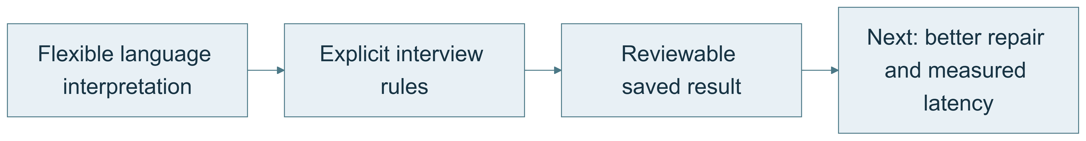
Design tradeoffs and next steps
Flexible language input with explicit state, evidence and transaction rules.
What did this design prioritize?
11 / 11
Notes:
11. Close with the tradeoff
**Design question:** What did this design prioritize?
**On-slide message:** Flexible language input with explicit state, evidence and transaction rules.
[Standalone diagram](diagrams/11-close-with-the-tradeoff.mmd)
**Speaker notes**
The central choice is to keep language interpretation flexible while keeping progression, storage and scoring explicit. That gives us a system we can inspect and test. The compromise is that structured collection is currently stronger than unrestricted conversation. My next priorities would be better counterquestion handling, richer evidence provenance and measured end-to-end latency across realistic voices and microphones.
**Demo action**
Return to the completed result from the opening slide. End on the useful output, not a terminal window.
**Source pointers**
- [docs/learning/APP_DEEP_DIVE.md](../../docs/learning/APP_DEEP_DIVE.md): Backend rationale and limitations.
- [docs/learning/FRONTEND_DEEP_DIVE.md](../../docs/learning/FRONTEND_DEEP_DIVE.md): Frontend rationale and limitations.
- [docs/LIVE_TEST_REPORT.md](../../docs/LIVE_TEST_REPORT.md): Recorded live-test evidence.
**Be precise about the limitation**
Present this as the reasoning behind the design, not a fabricated claim that every implementation step occurred in this order.
Diagram source (editable Mermaid):
flowchart LR
A[Flexible language interpretation] --> B[Explicit interview rules]
B --> C[Reviewable saved result]
C --> D[Next: better repair and measured latency]
Source document: docs/learning/DEMO_STORYLINE_SLIDES.md

