Slide 1

CoursePulse AI
Adaptive Learning Context Understanding
Angelah Laba · Russel Gramer · Matthew Lukacs · David Petrusev
MS in Management and Analytics · Emerging Technologies – Summer 2026

Slide 2







THE PROBLEM
Higher Education Has a Feedback Latency Problem
Professors discover student confusion after quizzes, assignments, and exams — when it's too late to adjust instruction.
Learning
Confusion Occurs
Assignment Submitted
Poor Performance
Faculty Notices
Key Insight: Students already signal confusion through reflections — but those signals are unstructured and hard to analyze at scale.

Slide 3
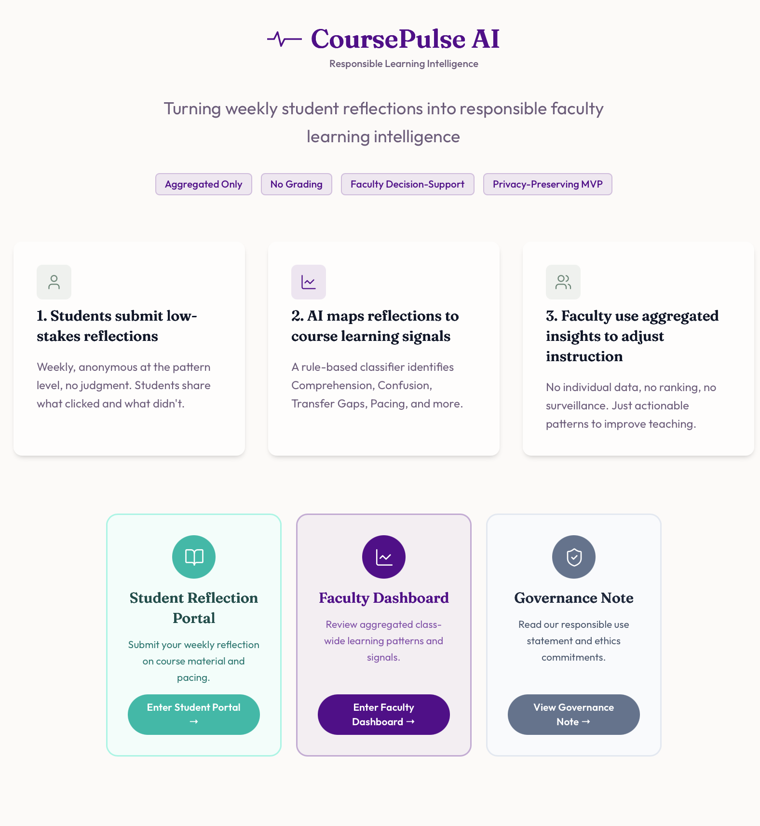
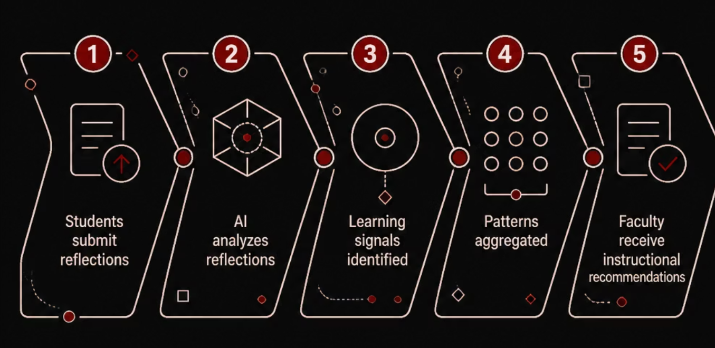
OUR SOLUTION
Introducing CoursePulse AI
An AI-powered faculty learning intelligence platform that transforms student reflections into actionable instructional insights — in real time.
What CoursePulse Does
Supports faculty decision-making
Improves visibility into student learning
But it doesn't
Does not grade or rank students
Does not predict failure
Does not surveil students

Slide 4
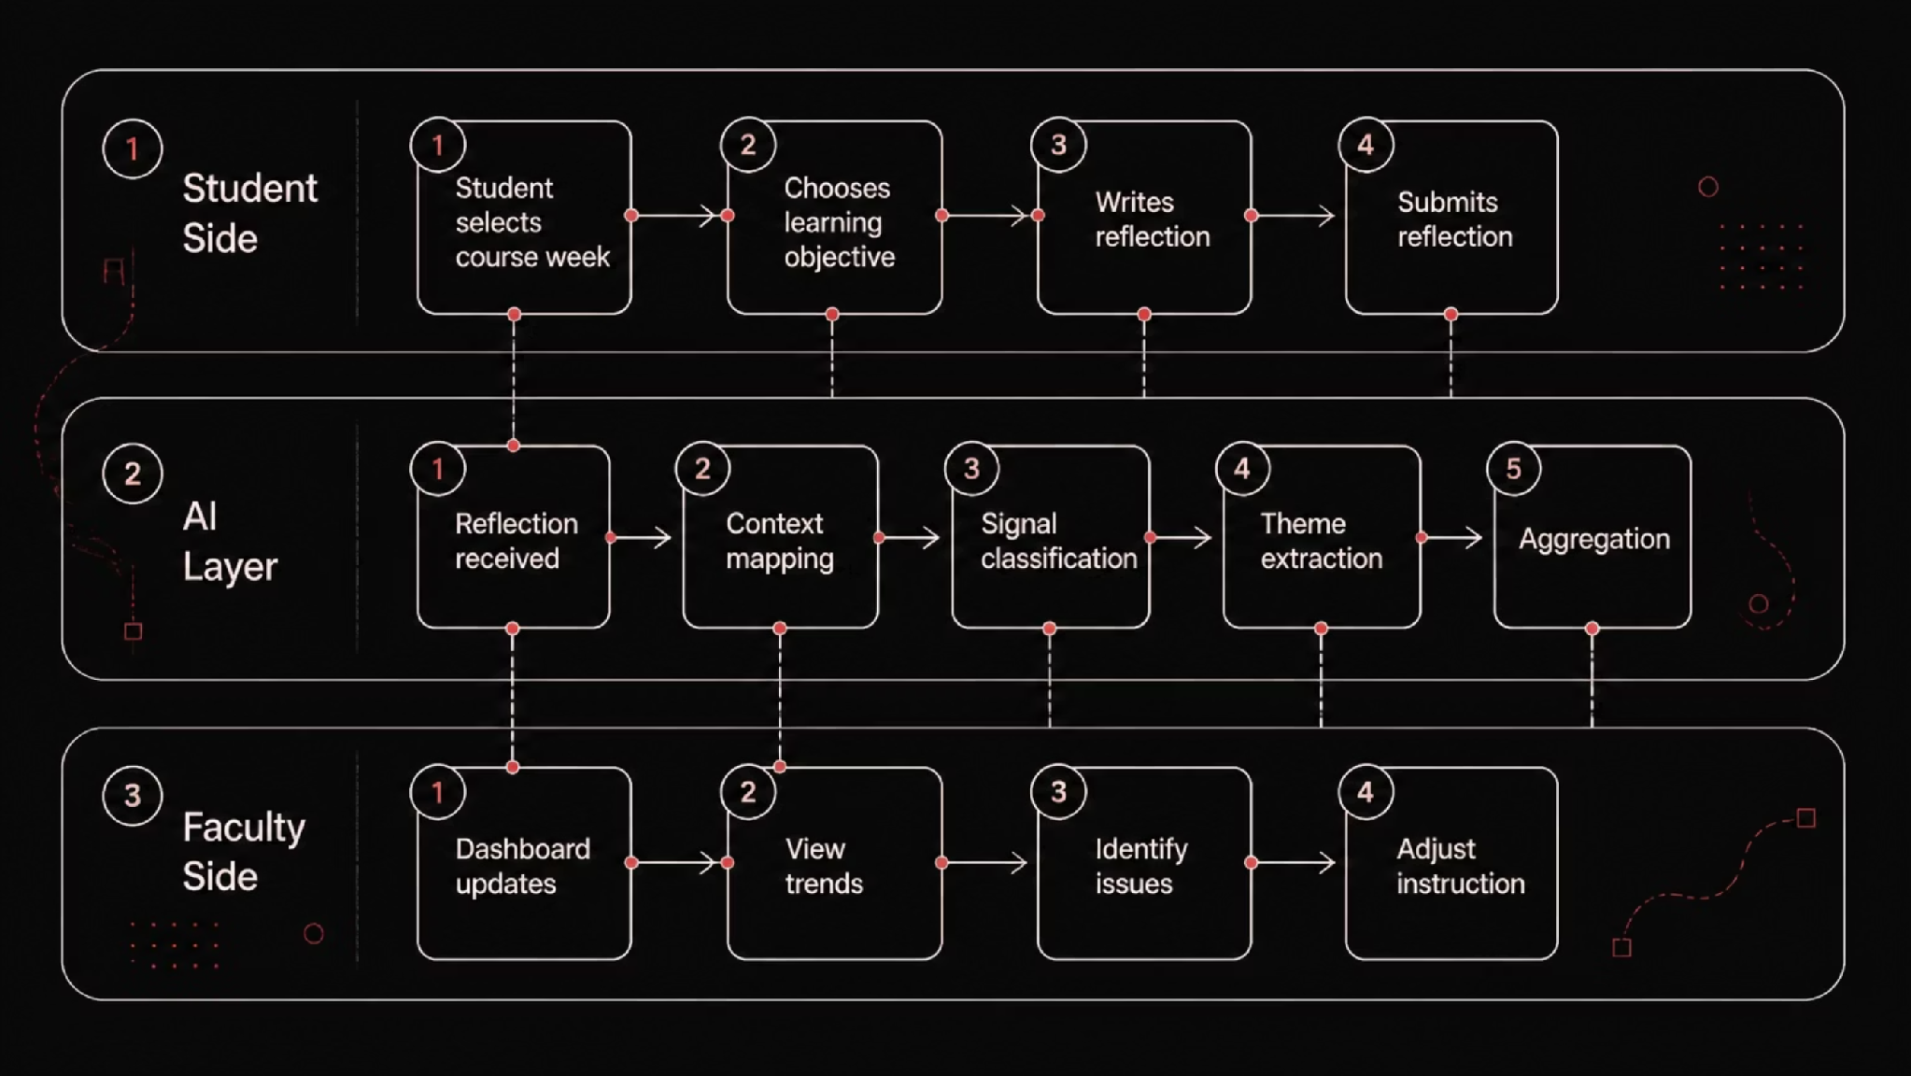
USER JOURNEY
From Reflection to Action: The Full Workflow
The student experience is lightweight — a structured reflection in minutes. The AI layer operates invisibly, mapping context and classifying signals. Faculty receive a clean, aggregated dashboard ready for instructional decisions.

Slide 5
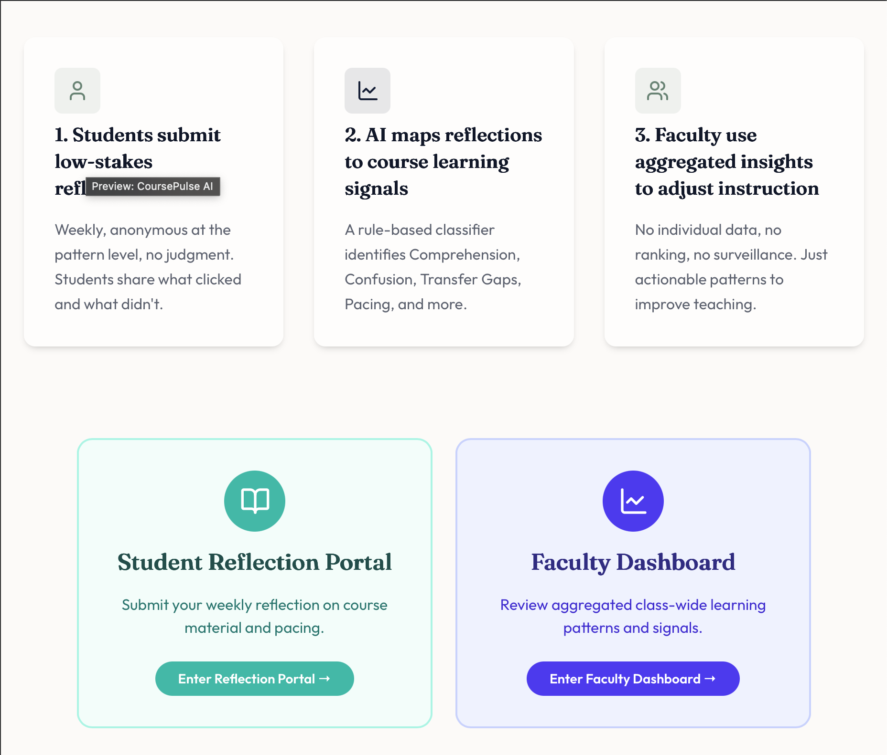
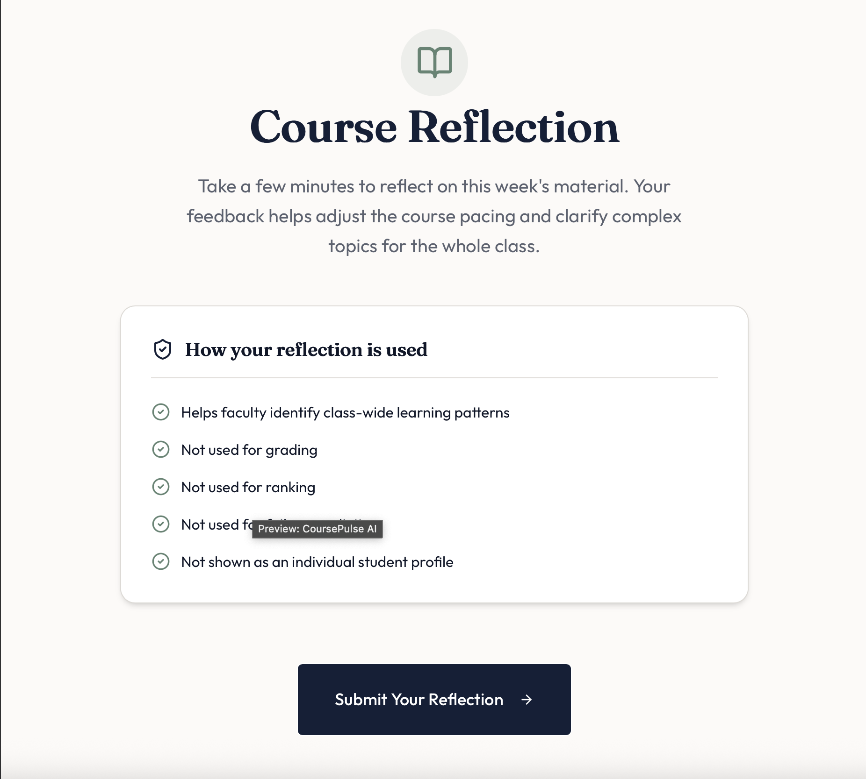
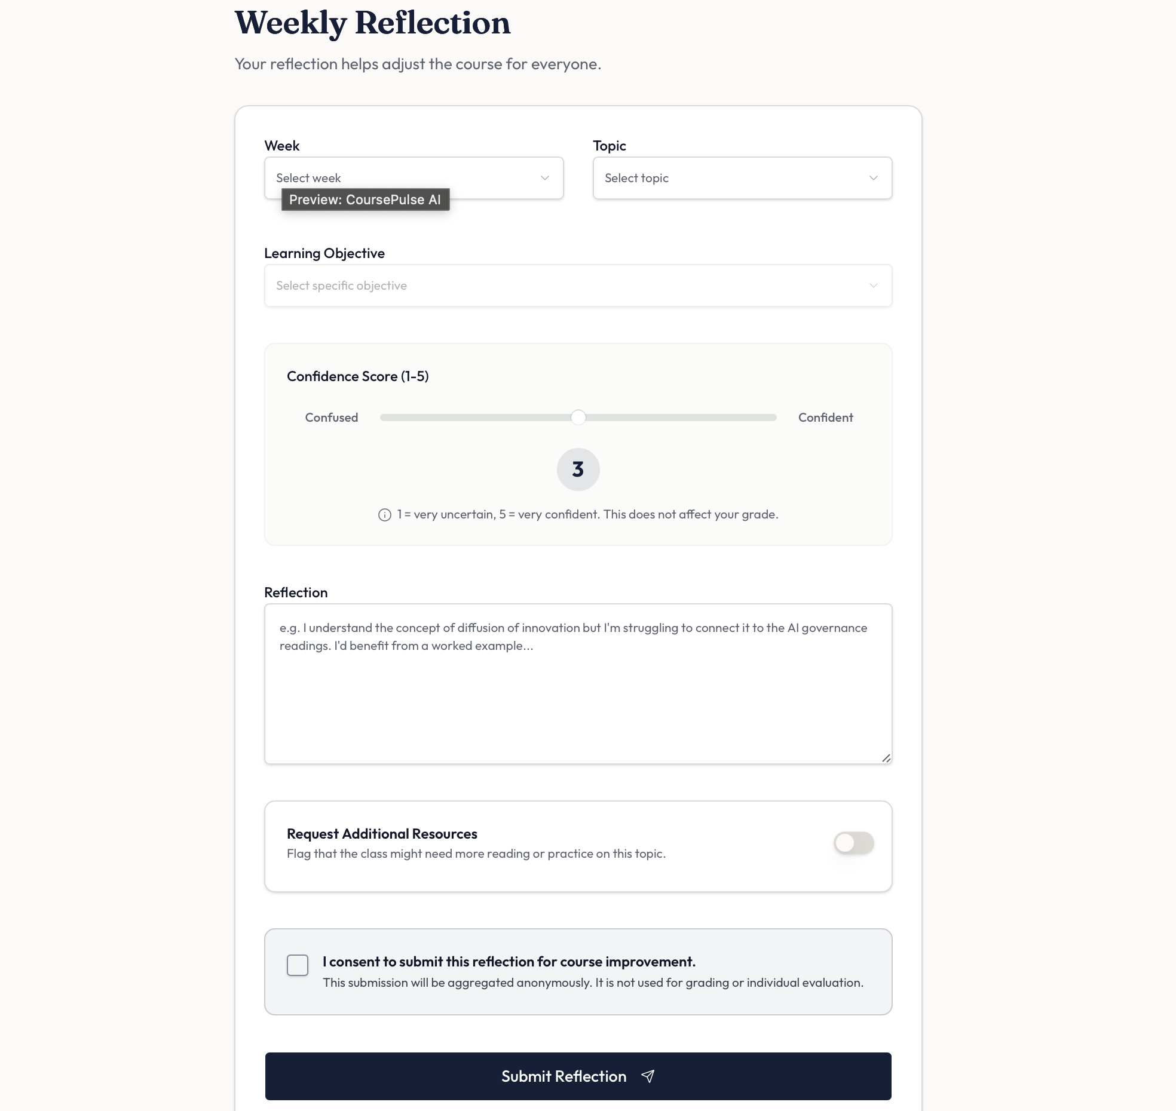
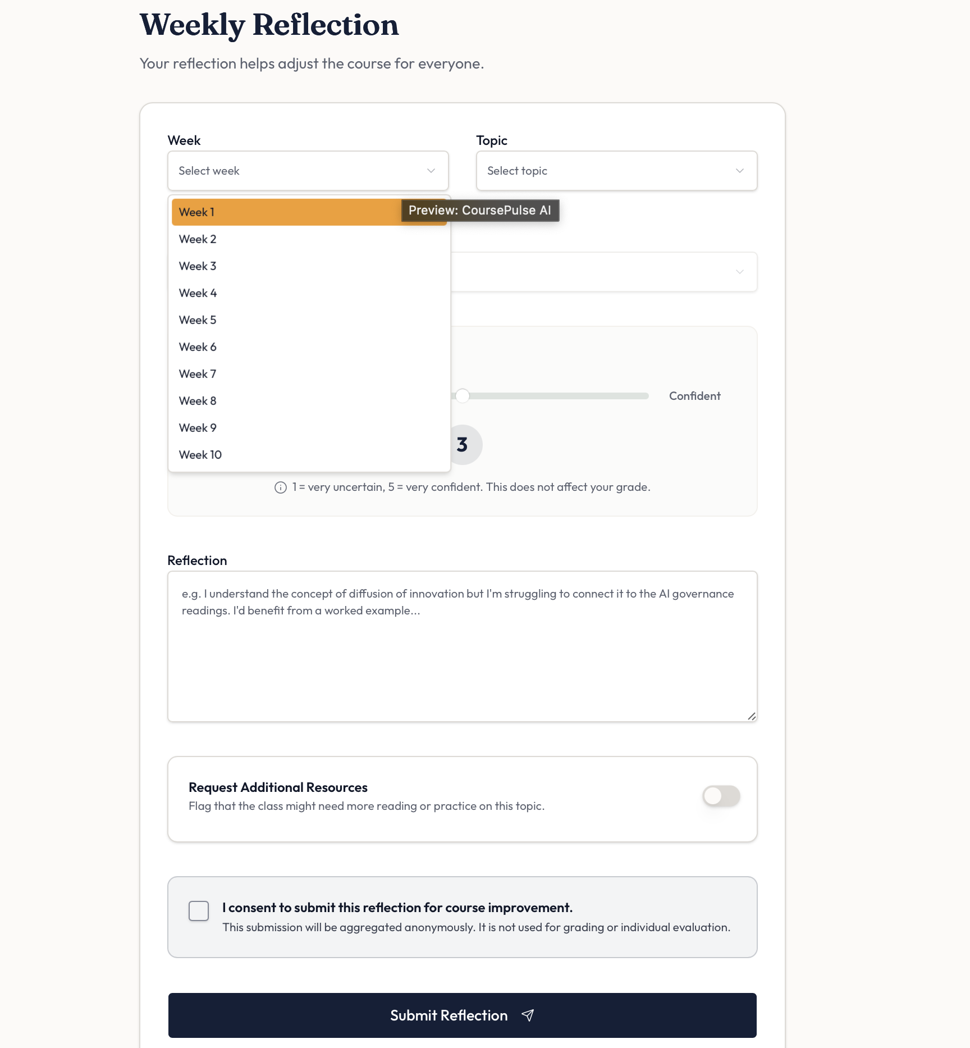
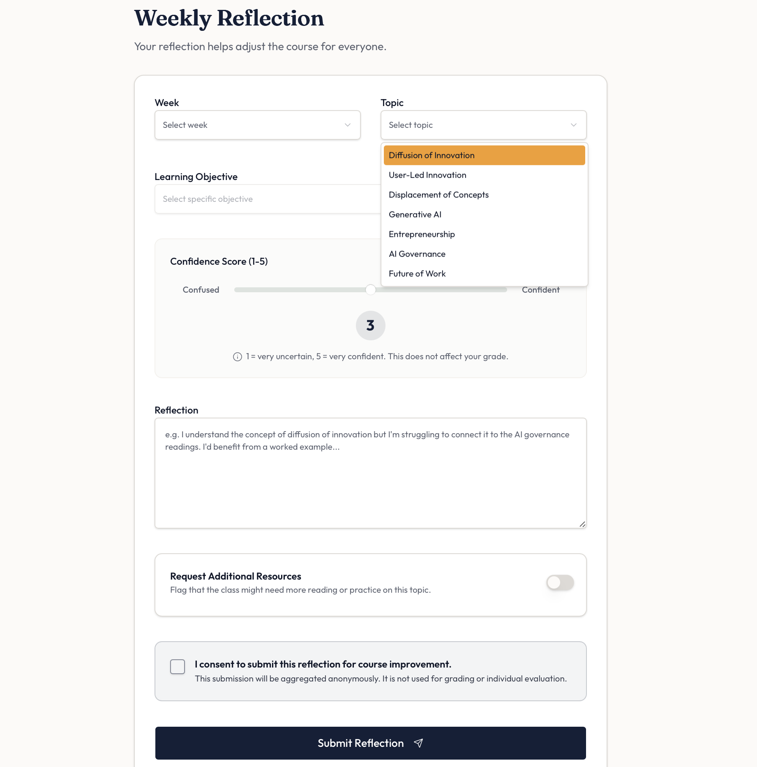
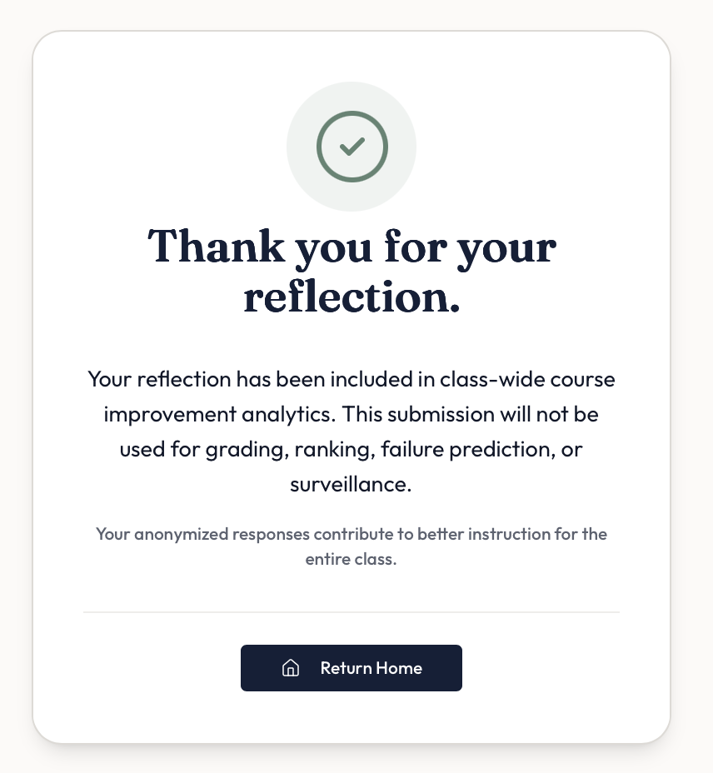
Student Perspective

Slide 6
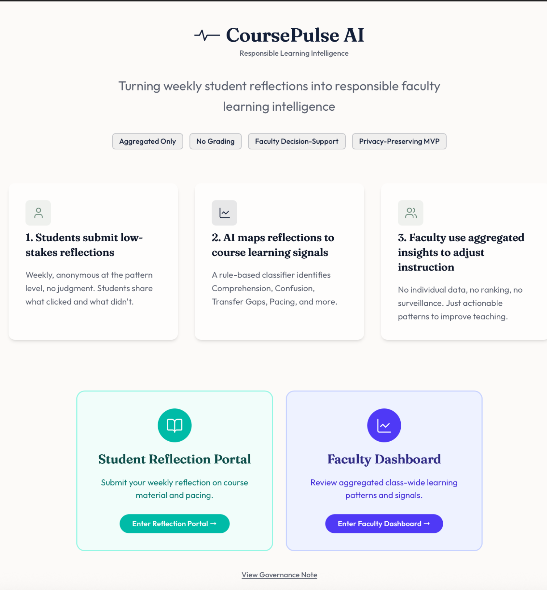
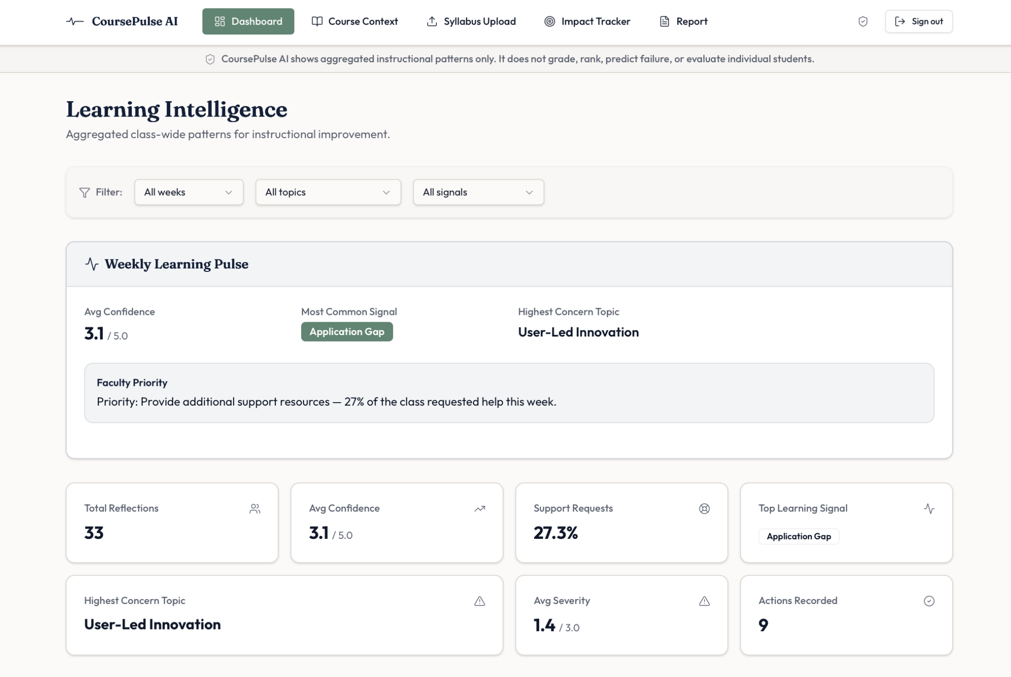
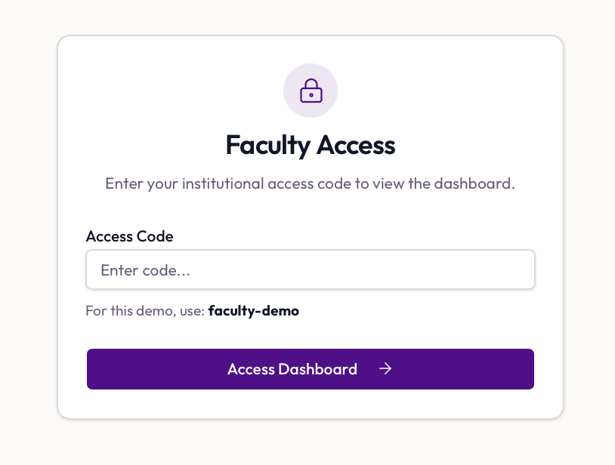
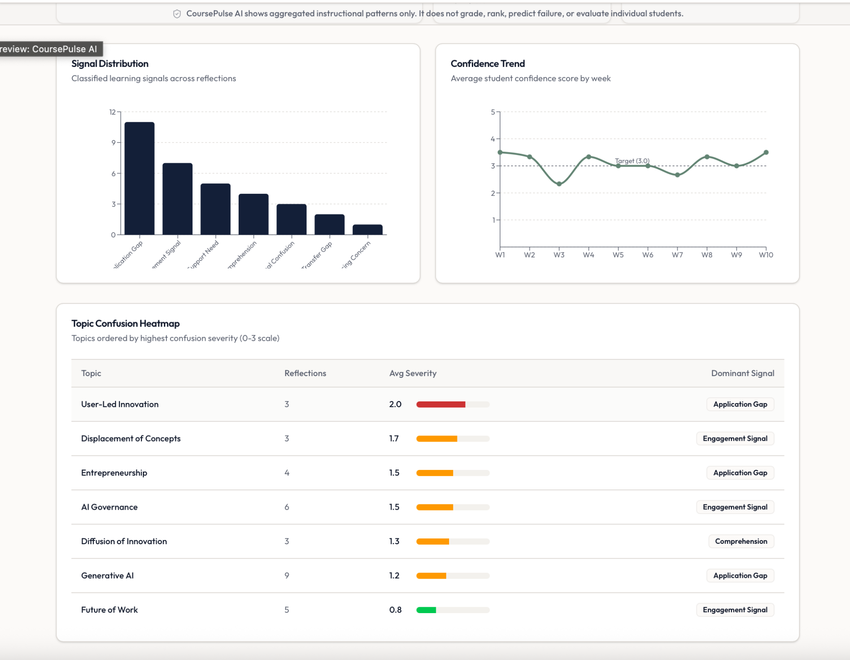
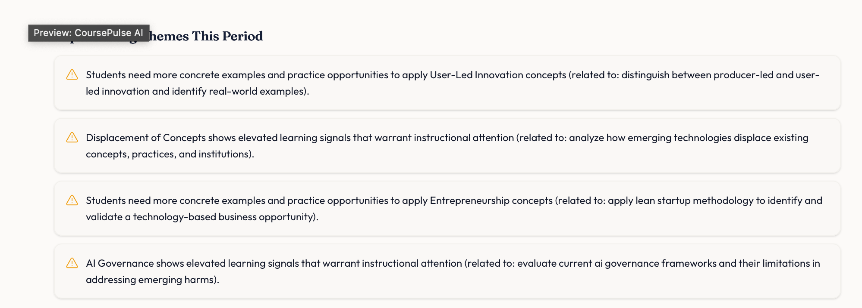
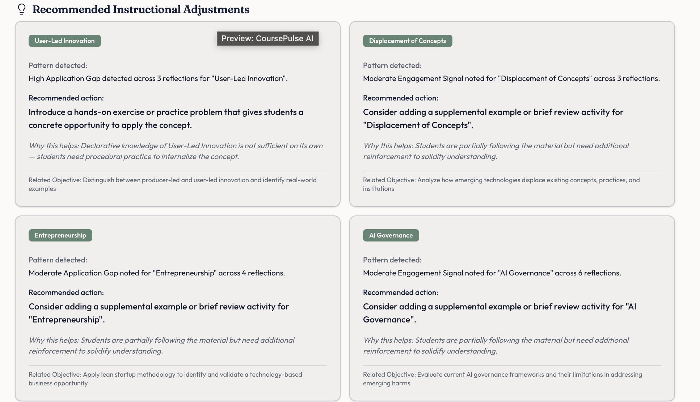
Faculty Perspective

Slide 7
USE CASE
Seeing the Signal in Action
Example Student Reflection
Why This Matters
Topic: Diffusion of Innovation Theory
The student knows the concept. The problem is not comprehension — it's application.
That distinction helps professors respond correctly, with targeted support rather than re-teaching.
"I understand the theory, but I struggle to apply it to real companies."
AI Output
Primary Signal: Application Gap
Secondary Signal: Confidence Concern
Topic: Diffusion of Innovation
Suggested Action: Provide real-world case studies and application exercises

Slide 8

AI ENGINE
The Learning Signal Classification Framework
Signal Type
What It Means
Definitional Confusion
Student doesn't understand the core concept
Application Gap
Cannot apply concept to a scenario
Transfer Gap
Cannot connect concept to new situations
Pacing Concern
Course is moving too fast
Support Need
Student needs additional resources
Engagement Signal
Positive interest or participation
Example: "The lecture made sense, but I could not complete the case study." → Application Gap → Mapped to Learning Objective → Added to Dashboard

Slide 9
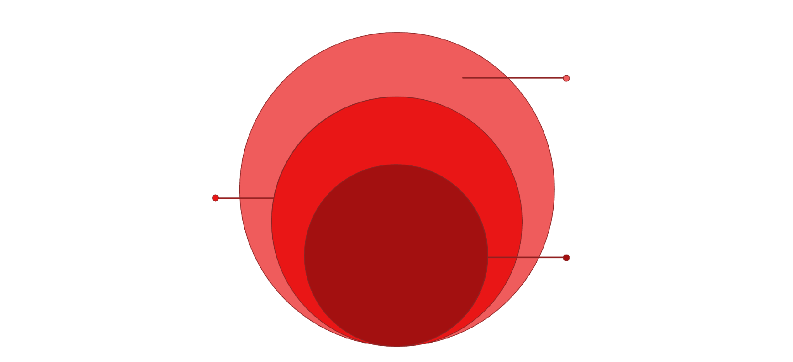
ARCHITECTURE
Solution Architecture
Interface & Controls
Student Interface, Faculty Dashboard, Governance
Processing Layer
Aggregation Layer and Course Context
Core Engine
Learning Signal Engine for AI classification
CoursePulse operates as a clean, layered pipeline — from student input through AI classification to faculty-facing insights, all governed by responsible AI controls.
Frontend
Backend
Streamlit
Python
Database
AI Layer
SQLite
OpenAI API / Prompt Classification
Deployment
Version Control
Replit
GitHub

Slide 10
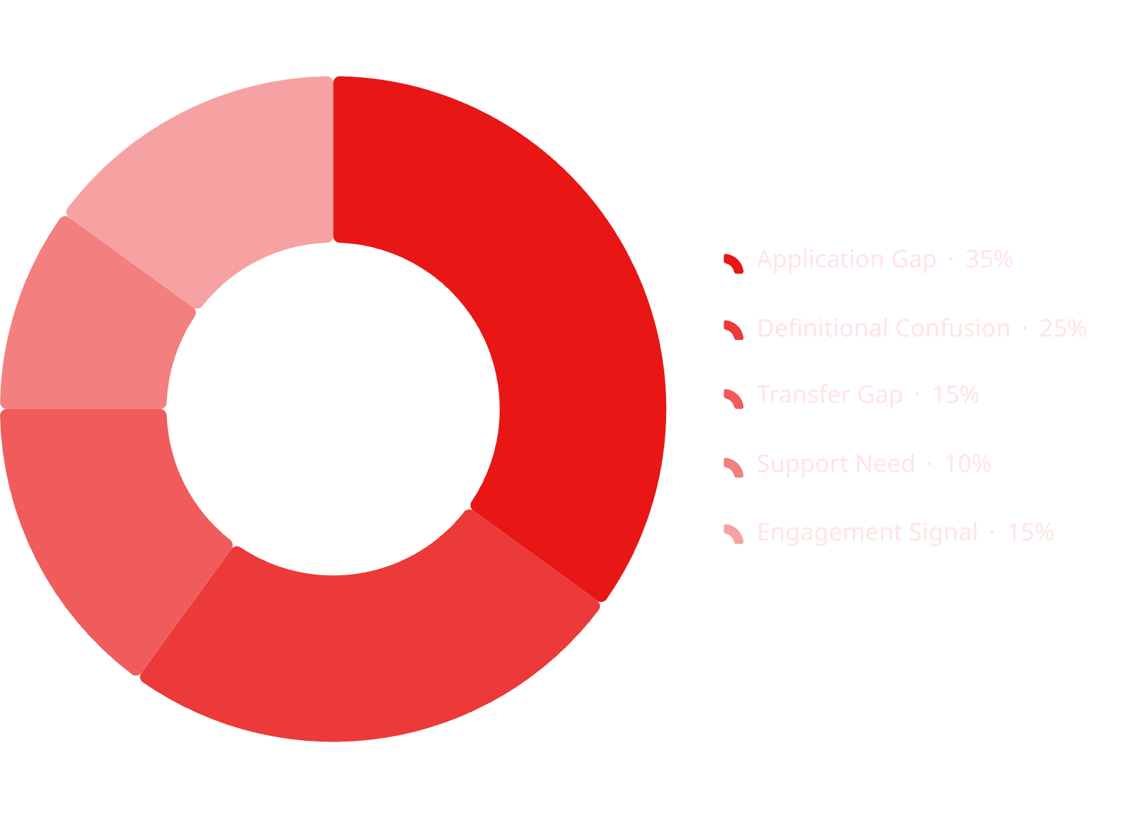

FACULTY DASHBOARD
Faculty Dashboard Design
Dashboard Components
Signal Distribution Chart — visual breakdown of learning signals across the class
Top Confusion Topics — ranked list of concepts students struggle with most
Confidence Trend — week-over-week trajectory (W1: 4.2 → W2: 3.8 → W3: 3.4)
Recommended Action — AI-generated instructional guidance for faculty
"Students understand theory but struggle applying concepts to case studies."

Slide 11

RESPONSIBLE AI
Human-Centered Governance
CoursePulse is designed with clear ethical boundaries. Faculty remain the decision-makers — AI provides visibility, not judgment.
What CoursePulse Will Never Do
Grade or rank students
Predict failure or flag at-risk students
Generate academic penalties
Monitor behavior or diagnose mental health
Privacy & Compliance Controls
Aggregate reporting only — no individual surveillance
Faculty review required before any action
Data minimization by design
Transparency disclosures built in
FERPA-aware assumptions throughout

Slide 12
ROADMAP
MVP Scope & Future Vision
MVP Phases
Current Status
01
✅ Problem Definition · User Research · Signal Taxonomy · Governance Framework
🔄 Replit Development · Reflection Dataset · Dashboard Design
⏳ Integration Testing · End-to-End Demo · Final Presentation
Student Reflection Form
02
Course Context Database
Future Expansion
Student Success Analytics — track class-wide trends over time
LMS Integration — Canvas, Blackboard, Brightspace
Research Opportunities — NYU SPS AI Lab, DSI Publication
03
AI Signal Classification
04
Faculty Dashboard
05
Governance Layer

