Slide 1
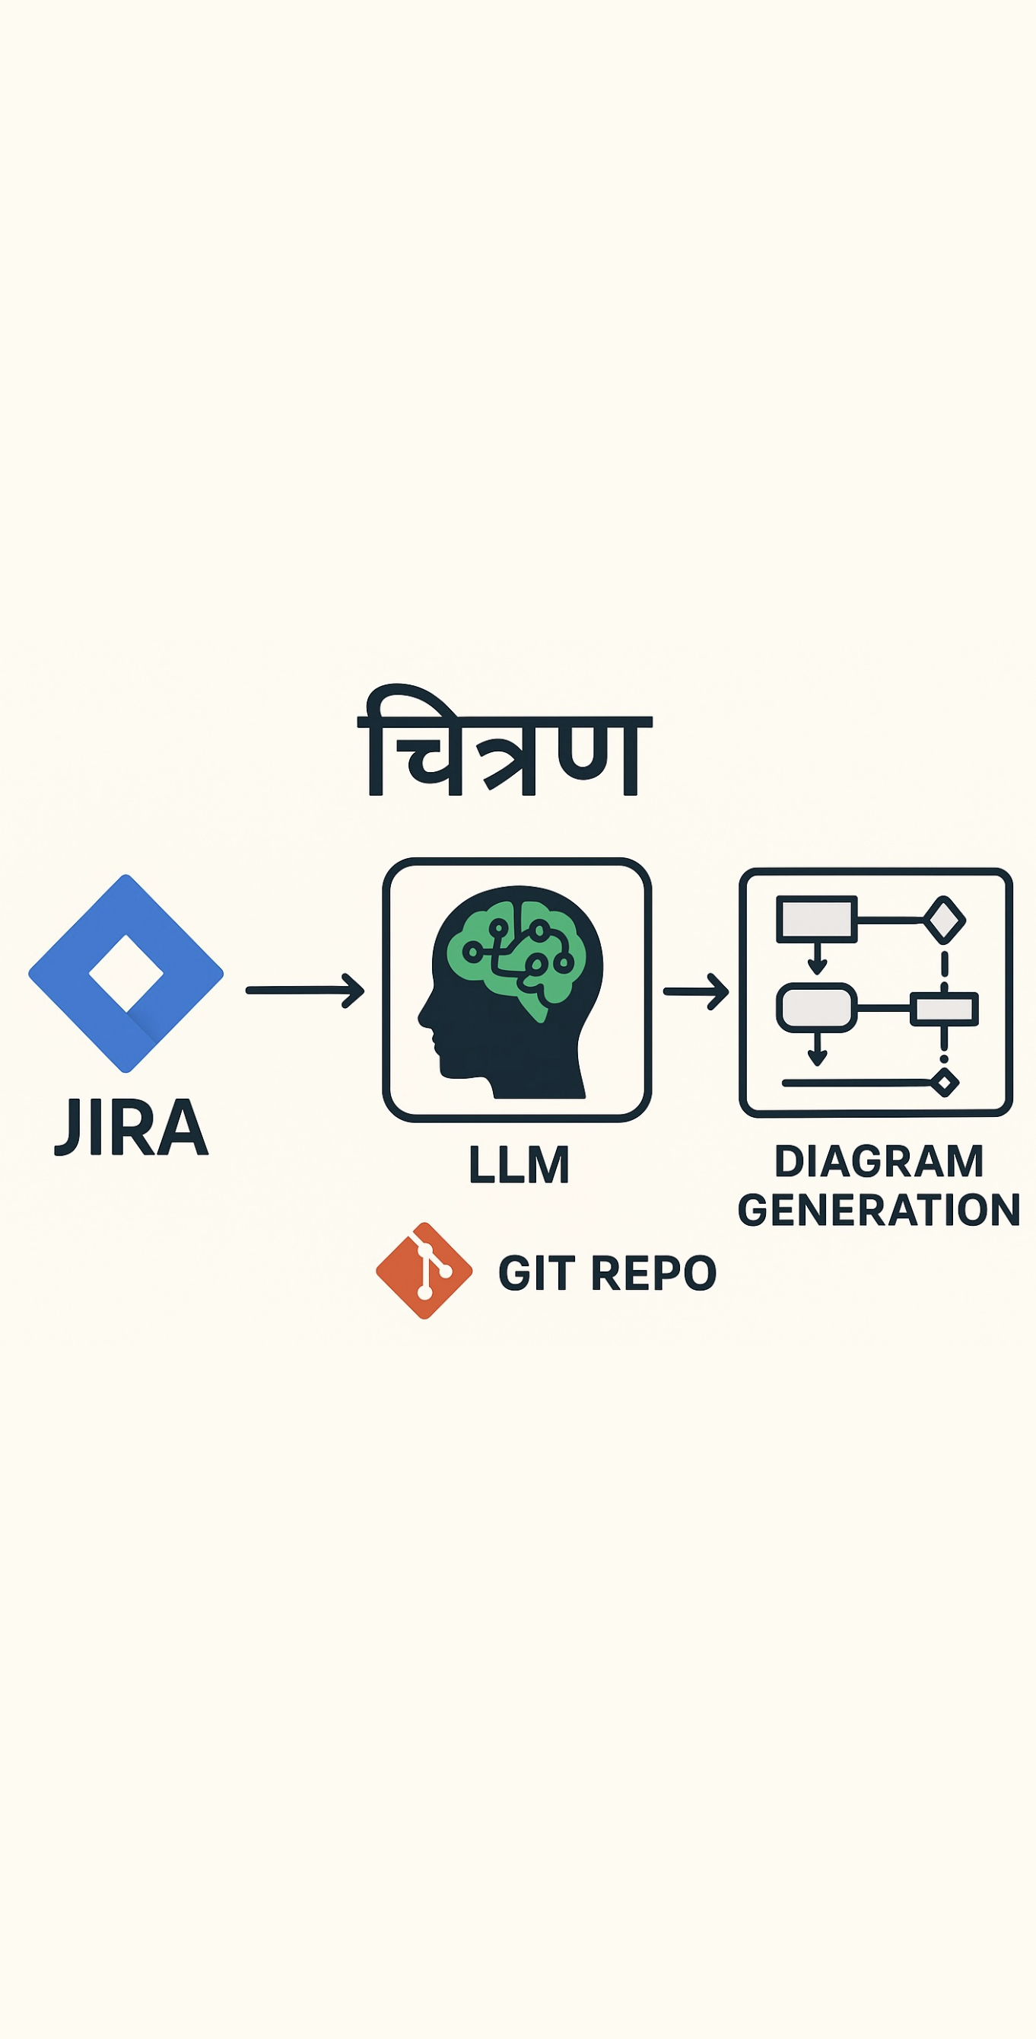
Chitrana
From Issue to Insight:
Auto-Generating TAM Diagrams from JIRA
for Smarter Development
From:
Prabal Mahanta
Ravi Kumar Gupta
Swadesh Mohapatra

Slide 2

Problem
Statement
  Manual diagram creation is time-consuming.
  Diagrams often become outdated with changing requirements or code.
  Difficult to visualize architecture from legacy code or JIRA-based stories.
  Understanding Legacy code for Transforming it to new Cloud Based.
  Often the architecture Diagrams and the actual code is not in sync.
  Keep architecture artifacts current.
  Reduce manual effort and improve comprehension of system logic.
Challenges
Need

Slide 3

Proposed
Solution
Automatically generate TAM diagrams by parsing:
JIRA Epics/Stories (using JIRA API)
Legacy Code (using code analysis/parsing)
Real-time diagram generation
Integration with JIRA & code repositories
Target Users: Architects, Developers, Product Teams
Tool Concept
Key Features

Slide 4
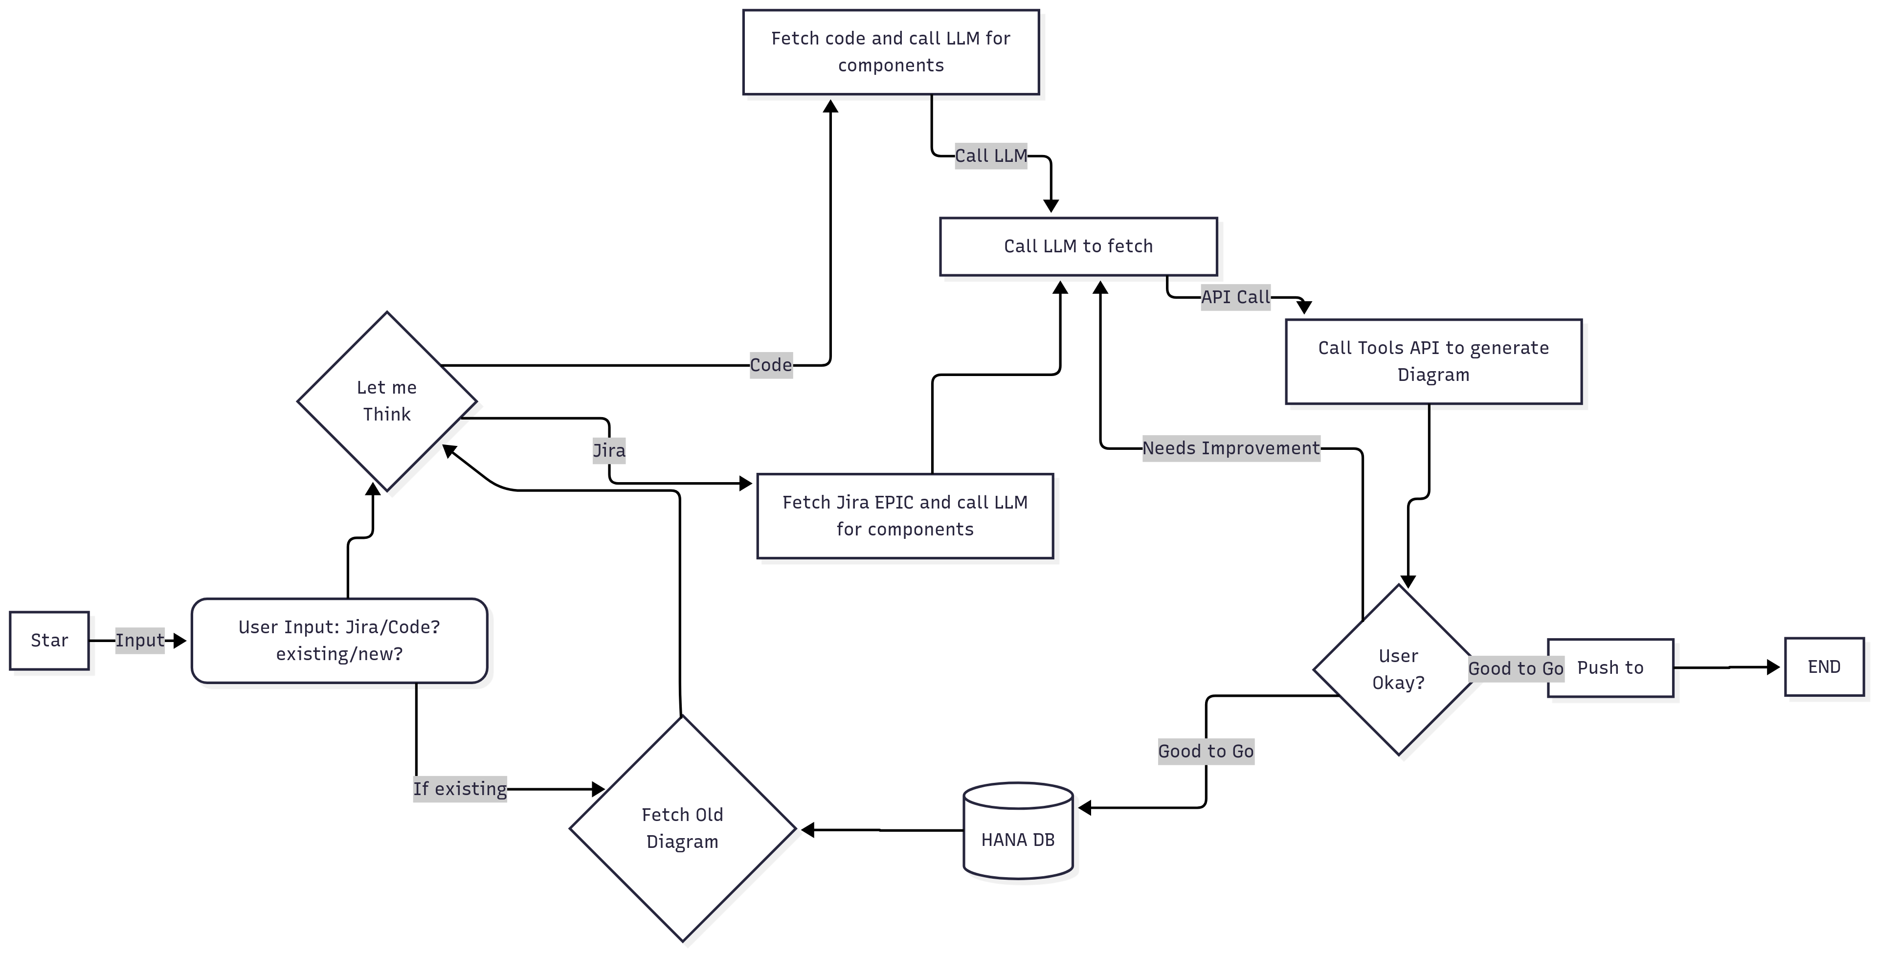

Slide 5
Benefits & Next Steps
Saves time and ensures up-to-date architecture views
Provides a clear understanding of the legacy code for improvement/changes.
Even the last-minute changes can be accommodated in the architecture diagrams easily.
Will help any new developer/architect/Project Manager to understand the functionality and approach.
Enhances traceability from requirements to implementation
PoC development using sample JIRA and code
Tools to be evaluated
Gather feedback and iterate
Benefits
Next Steps

Slide 6


Questions

