Slide 1

The Importance of Data Quality in Healthcare
Robert Gregory
Colorado State University Global
Course Code: MIS581 Capstone: Business Intelligence and Data Analytics
Instructor: Dr. Steve Chung
Due Date: 5/10/2023
Notes:
The research paper will address questions related to managing data quality issues in healthcare research and why measuring data quality is crucial in healthcare.

Slide 2

Heath-care and Data Quality: Problem Statement
Data Quality relates to the overall quality of data given certain variables
Data Quality is essential in Healthcare
Can impact patient outcomes
Hampers research in healthcare
Leads to waste: Time, money and resources
Can include missing data, inaccurate data, or other anomalies
Data is unreliable or even unavailable
Data used for analytics. ML or Data Science impacts the relative success of such tools and processes
Notes:
Data quality is essential in all domains, but it is especially with healthcare, where poor data can affect the accuracy and reliability of predictive analytics, data science modeling, and other techniques. In healthcare, this mean impacting patients and their health outcomes. An example of bad data is that it can lead to incorrect diagnoses and improper treatment plans, but on a broader level, data quality issues can lead to inadequate disease surveillance. Moreover, poor data quality generates waste: Data is misused, resources are also wasted (time and monetary investment), which in turn can leads to increased healthcare costs, longer hospital stays, and even mortality risks. Therefore, efforts to improve data quality in healthcare should be a priority for researchers, healthcare providers, and policymakers.

Slide 3
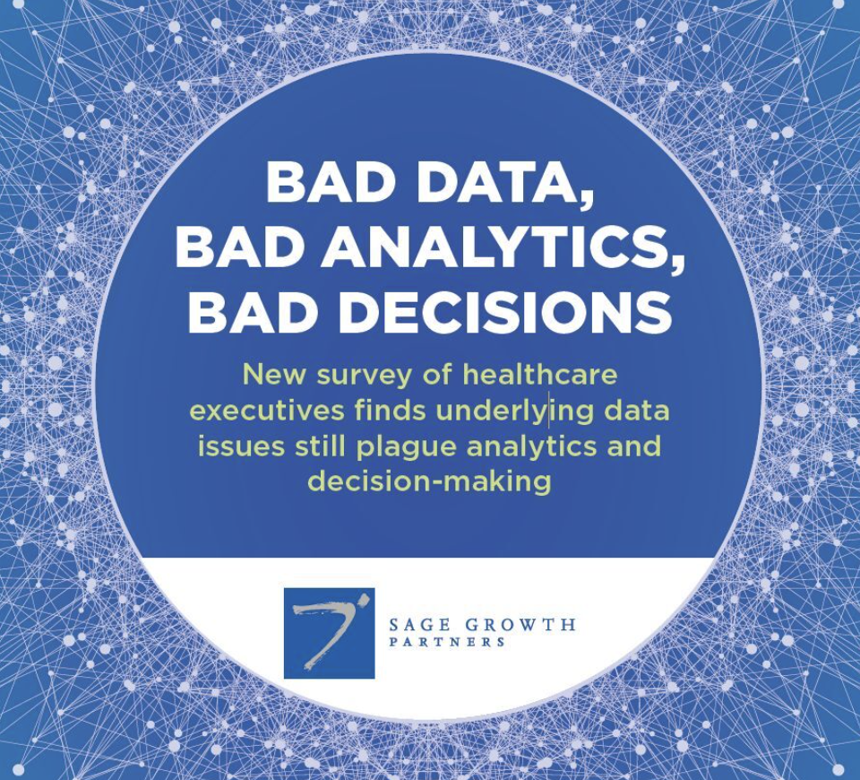
Heath-care and Data Quality: Problem Statement
According to a survey of over 100 healthcare executives, conducted by Sage Growth Partners and commissioned by InterSystsems, many leaders in the industry note that the data is now available for advanced analytics but data cannot be trusted for clinical and business decisions
Electronic data has seen widespread adoption in healthcare yet data quality issues hamper the ability to make decisions, identify issues in care and help to optimize the revenue cycle
Source: https://www.intersystems.com/resources/bad-data-costs-healthcare-organizations-millions/ (Bad Data Costs Healthcare Organizations Millions 2023)
Notes:
According to a survey of over 100 healthcare leaders, conducted by the Sage Growth Partners and Intersystems, many leaders believe they now have the tools to harness the power of big data but are not hampered by the quality of the data. Many of these leaders do not trust the data, and without the trust, it is very difficult to then trust the models, outcomes, predictions or insights that come out of the data.
Source: https://www.intersystems.com/resources/bad-data-costs-healthcare-organizations-millions/ (Bad Data Costs Healthcare Organizations Millions, 2023)

Slide 4

Data Quality & Healthcare: Objective
Research the problem of data quality in healthcare
What is the current state of data quality in healthcare research, specifically?
How is a data quality assessment conducted and how is data quality measured?
What standards exist for data quality validation and what tools can be utilized?
Notes:
Objectives: The research paper aims to address questions related to managing data quality issues in healthcare and why data quality and management processes are crucial in healthcare. The study will focus on answering four questions: (1) What is the current state of data quality and health research? (2) What health research data quality processes exist today? (3) What are the recommended data quality dimensions for health research? and (4) What happens when we factor in use and context? The study will use datasets from healthdata.gov to validate data quality dimensions and assess data quality using standardized methods. The study also highlights the importance of data quality and management in healthcare, as poor data quality can lead to costly fixes and a loss of trust in the healthcare system.

Slide 5

Null Hypothesis, Alternative Hypothesis and Test Data
Research Question (Restated):
Given a sample dataset on Covid-19 treatment locations that is described as being of “good quality”, what impact would running additional data quality tests have on it?
The data is maintained by Healthdata.gov
The Null hypothesis states that the findings will show that the data quality score is 80% or higher, so a “good quality” score, consistent with the datasets description
The alternative hypothesis states that the findings will show significant data quality errors, a score lower than 80%, meaning that the Null hypothesis can be rejected
Notes:
Using a sample dataset on treatment locations for COVID-19 (located here https://healthdata.gov/Health/COVID-19-Test-to-Treat/6m8a-tsjg) that is classified as ‘good quality’, what impact would running additional data quality checks using advanced testing techniques, have on the final quality score?” The null hypothesis (HO) and alternative hypothesis (HA) can be written as:
The Null hypothesis is that this data on treatment locations with medicine for COVID-19 is accurate and of high quality. This serves as the baseline expectation that there be little to no observable impact with additional data quality checks.
The alternative hypothesis will state the exact opposite, in that the mean score after running advanced testing techniques will result in a position that the the data is inaccurate and of poor quality.

Slide 6

Example: Data Quality Errors and Covid19
In 2020, during the height of the Covid-19 pandemic, it was found that the UK government had lost track of over 16,000 positive test results
This is an example of bad data quality, since missing records are one of the biggest issues with datasets in healthcare
This problem could have had a huge health outcome since people who tested positive would not have been tracked
The loss of data can create panic and widespread problems
Notes:
The COVID-19 experience that the world is sill reeling from serves as a great example of why data quality is so essential. In 2020, the UK government lost track of 16,000 positive COVID test results that occurred, which at the time led to understandable panic and concern, given that the people who tested positive in these cases would not have been asked to self-isolate as a result of the data issue (BBC, 2020).
Source: BBC. (2020, October 5). Covid: 16,000 coronavirus cases missed in daily figures after it error. Covid: 16,000 coronavirus cases missed in daily figures after IT error. Retrieved March 22, 2023, from https://www.bbc.com/news/uk-54412581

Slide 7

Data Quality Dimensions
Completeness: Are records in a dataset complete or are certain attributes missing (NULL)
Uniqueness: Are records unique or are there duplicates, which can impact analytics
Accuracy: Can the data be trusted or are there inaccuracies which will impact the results of any analytics process
Consistency: Is data consistent across datasets or are there differences with the same data in different sources
Notes:
When validating for data quality, the topic of data quality dimensions often come up, since these are the variables that help us measure the relative quality level of any dataset. Usually there are at least six different data quality dimensions that are cited: Completeness, uniqueness, accuracy, consistency are four big ones, but validity, availability, integrity, and timeliness are additional ones that can be used to validate data. Furthermore, the data quality dimensions work in a hierarchy and are interrelated, in other words, a single record within a dataset can have can only be said to be accurate if it is valid, and validity depends on accuracy of the data, completeness of the data, uniqueness of the data, and so on.

Slide 8

Data Quality Tools and Analytic Processes
Many tools and technologies exist in the industry today to help with data quality validation
Data Analytics professionals often use Python and Pandas for processing, cleaning, and combining data, so these tools can also be used to validate data when converted to a dataframe
Data Profiling tools like Great Expectations and DBT also help to provide quick statistical measurements of the data including number of missing values, total counts, etc.
Notes:
Python and Pandas allow for easy data manipulation, is very powerful, and can even be utilized for data quality testing. Finally, DBT and GE are great for automating data validation work and building out a fully continuous data pipeline process that can analyze, clean and score the data in a manner that is great for organizations that are wanting to simplify, but modernize, their tech stack.

Slide 9

Data Quality Assessment: Human In The Loop
Once the data quality dimensions are settled on, the next step is to perform a data quality assessment.
This helps set a baseline for where the quality of the data stands, and by keeping with this methodology, further testing can be compared against the starting point.
A human is still needed to use domain knowledge, as well as other statistical testing techniques to help evaluate the quality level.
Tools that are driven by automation and AI can help drive much of the data quality process, but humans are still important, also known as “human in the loop”
Parameterizing a Beta distribution and testing for a 90% confidence interval is an example
Notes:
A data quality assessment can be conducted by evaluating each of the data quality dimensions used for the validation. But a human is still needed to help: As one author on a blog titled “Show Me The Data” described the process, the human can first help by annotating the target value through a more consistent and structured process, and secondly, go above and beyond the simple sampling process, since this only gives us the “mean of the distribution of potential values that could have produced that result”; Rather, it would also be important to quantify the uncertainty that is a by-product of this selective sampling, so calculating a “90% confidence interval for the observed values” through the parametrization of a Beta distribution calculation would be ideal (https://showmethedata.blog, 2021). All of which helps determine if data quality levels are truly changing, as opposed to a randomized process, which instills less confidence.

Slide 10

A Six-Sigma Approach to Data Quality
A Six-Sigma Methodology for Data Quality:
1 - Define: Baseline objectives and scope of work
2 - Assess: What is the current state of the data quality? What problems do we have?
3 - Improve: What are the steps needed to improve data quality and what is the roadmap?
4 - Control: What are the service-level agreements (SLA) and what processes are needed to formalize how we maintain data quality moving forward?
Notes:
A modified Six Sigma approach for data quality evaluation is a great starting point for conducting an assessment and constantly improving on the process. This includes the following four phases: Define, assess, improve, and control (Jugulum, 2014). With the first phase, define, baseline objectives and scope can be identified, while for the second phase, the assess phase, questions like, “Is 90% of all records for the address field having a valid value considered acceptable?” and “How will the data assessment be conducted and what variables should be included?”, will be addressed (Jugulum, 2014).
Meanwhile, the improve phase is all about resolving data quality issues, performing root-cause analysis, and identifying long-term improvement plans, while the last phase, control, helps establish service-level agreements, helps formalize a change management process, and identifies all of the reporting and dashboard requirements needed for ongoing maintenance of the data quality project (Jugulum, 2014).

Slide 11
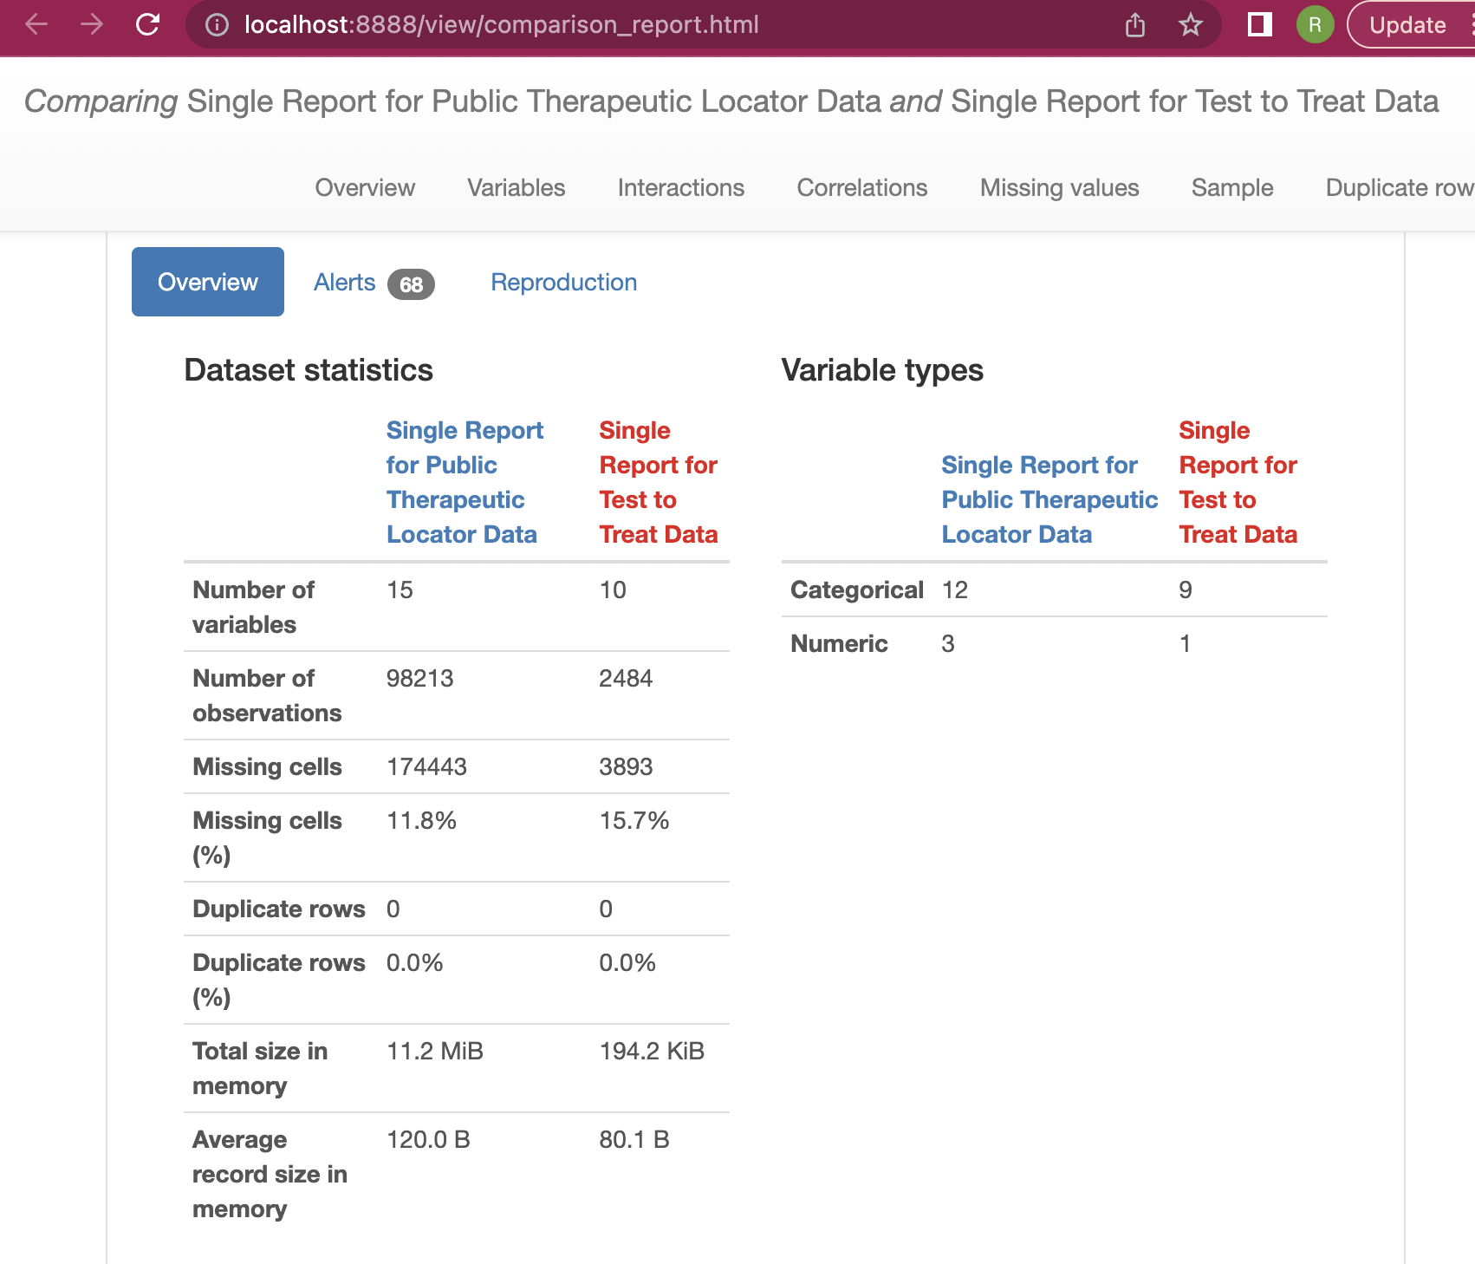
Data Quality Results
After performing a data quality assessment, a quality score of 83 for the first dataset was given.
The second dataset utilized has a slightly lower score of 80
The image to the right shows a sample data profiling test and resulting report
Notes:
After running data quality checks using a combination of tools—Pandas, Pandas-Profiling, and Great Expectations—a data quality assessment focusing on completeness, conformity, and uniqueness results in a data quality score of 83 for the first dataset, and 80 for the second dataset, meaning that both datasets represent a high-level of data quality but only suffer from incompleteness for the attributes considered “critical”. But when introducing a new data quality check to look for accuracy and validity, not only for a single dataset in isolation, but for both datasets in totality, a Python library called “geopy” was utilized, which allows for cross-checking address data against multiple geocoding web services (Google Maps, MapQuest, Bing

Slide 12
References
BBC. (2020, October 5). Covid: 16,000 coronavirus cases missed in daily figures after it error. Covid: 16,000 coronavirus cases missed in daily figures after IT error. Retrieved March 22, 2023, from https://www.bbc.com/news/uk-54412581
Bernardi, F. A., Alves, D., Crepaldi, N. Y., Yamada, D. B., Lima, V. C., & Rijo, R. P. C. L. (2022, January 1). Data quality in health research: A Systematic Literature Review. medRxiv. Retrieved March 20, 2023, from https://www.medrxiv.org/content/10.1101/2022.05.31.22275804v1
Ehsani-Moghaddam, B., Martin, K., & Queenan, J. A. (2021). Data quality in healthcare: A report of practical experience with the Canadian Primary Care Sentinel Surveillance Network data. Health information management : journal of the Health Information Management Association of Australia, 50(1-2), 88–92. https://doi.org/ 10.1177/1833358319887743
How to measure data quality - 13 metrics you should be tracking (but don't). Show Me The Data. (2021, May 12). Retrieved April 8, 2023, from https://showmethedata.blog/how-to-measure-data-quality-13-metrics
Oleg Bess, M. D. (2021, December 23). Data quality issues plague the US Health Care System. OncLive. Retrieved March 20, 2023, from https://www.onclive.com/view/data-quality-issues-plague-the-us-health-care-system
Stanley, J., & Schwartz, P. (2023). Automating data quality monitoring at scale. O’Reilly.

