Slide 1


Predicting gaming price and potential continuation of Franchise using machine learning
Data Science with Python Course
Roger Zhang

Slide 2
Business problem
Gaming franchise attract more fans and players. Creates a pool of stable supporters.
Example: Pokémon, Civilization, etc.
Problem: Games with high popularity and rating should be considered favorable investment.
Goal: Find the relationship between game ratings, popularities, game pricing and potential for continuation of franchise.

Slide 3
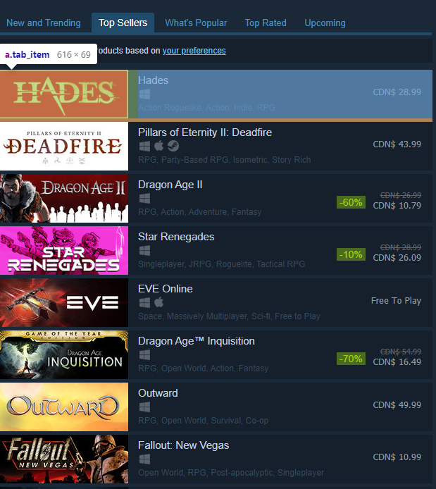
Analysis
Source – Steam store
Steam store recommend related games under each game.
Rating, popularities and prices on each page.
Tools: Sklearn, Beautiful soup.

Slide 4
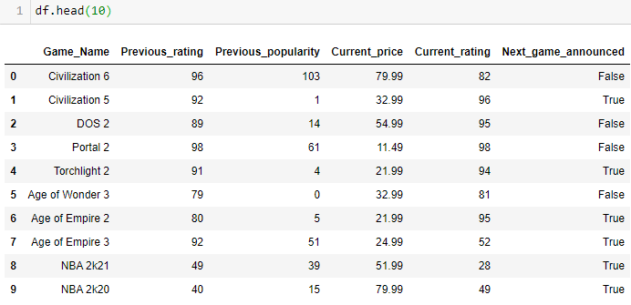
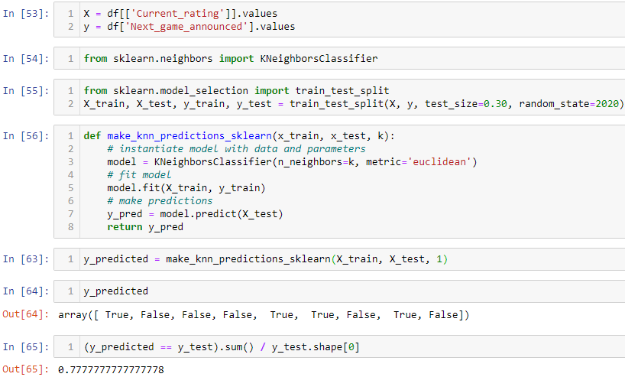
Classification on Potential continuation

Slide 5
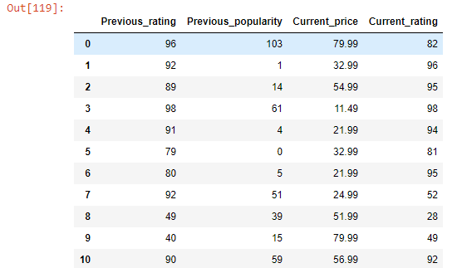
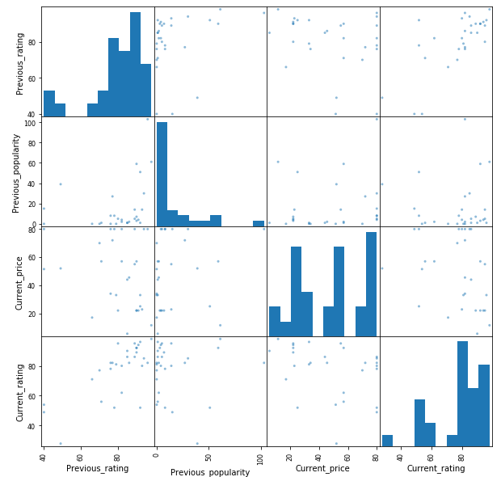
Regression analysis on Pricing

Slide 6
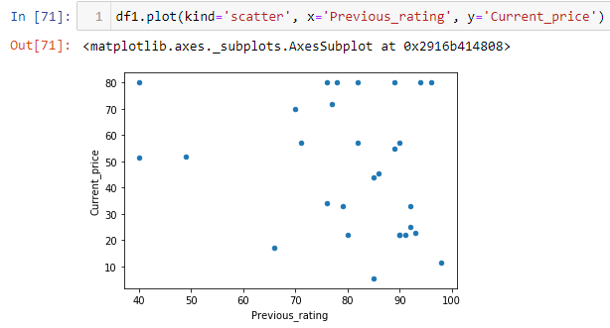
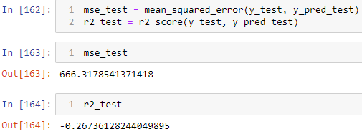
Regression analysis on Pricing

Slide 7
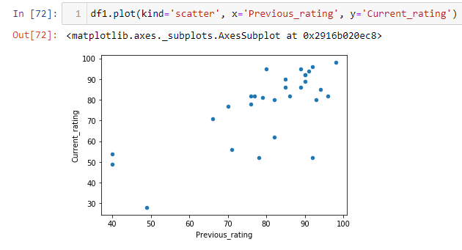
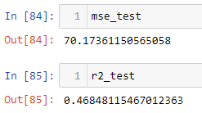
Previous rating and Current rating

Slide 8
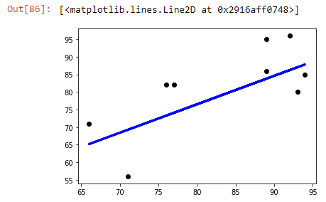
Previous rating and Current rating

Slide 9
Future Improvements
Run Q test to reject outliers.
More data required.

