Slide 1
National Institute of Technology Tiruchirappalli
RESEARCH PROGRESS PRESENTATION
Lunar South Pole Digital Twin | Constraint-Aware Rover Vision Workplan
Rover-view perception, battery-aware navigation, and local decision support
Problem 1
Vision-based terrain hazard and confidence detection
Problem 2
Battery- and constraint-aware local navigation
Lunar South Pole Digital Twin - Computer Vision Extension

Slide 2
Extension Objective
RESEARCH PROGRESS PRESENTATION
Problem
Why This Extension Is Needed
A global path may still fail locally if the rover has low battery, shadow exposure, compute limits, or uncertain visual perception.
Intern 1-4 modules create global fusion, confidence, target, and policy outputs.
The next step is to test a rover inside that digital twin with local perception and realistic operating constraints.
The study uses simulated rover-view observations derived from orbital/digital-twin layers.
Approach
Use simulated rover-view observations with battery, energy, shadow, confidence, and compute constraints.
Outcome
A constraint-aware rover decision layer that checks each local move before execution.
Lunar South Pole Digital Twin - Computer Vision Extension

Slide 3
Research Questions
RESEARCH PROGRESS PRESENTATION
Problem 1
Problem 2
Can a rover classify local terrain as safe, risky, shadowed, or uncertain from a simulated rover-view scene?
Can a rover choose local actions while respecting battery, energy, shadow, confidence, and compute constraints?
Common Question
Can local rover-view perception reduce hazard exposure and energy risk without losing the selected science objective?
local perception
confidence
battery-aware action
Lunar South Pole Digital Twin - Computer Vision Extension

Slide 4
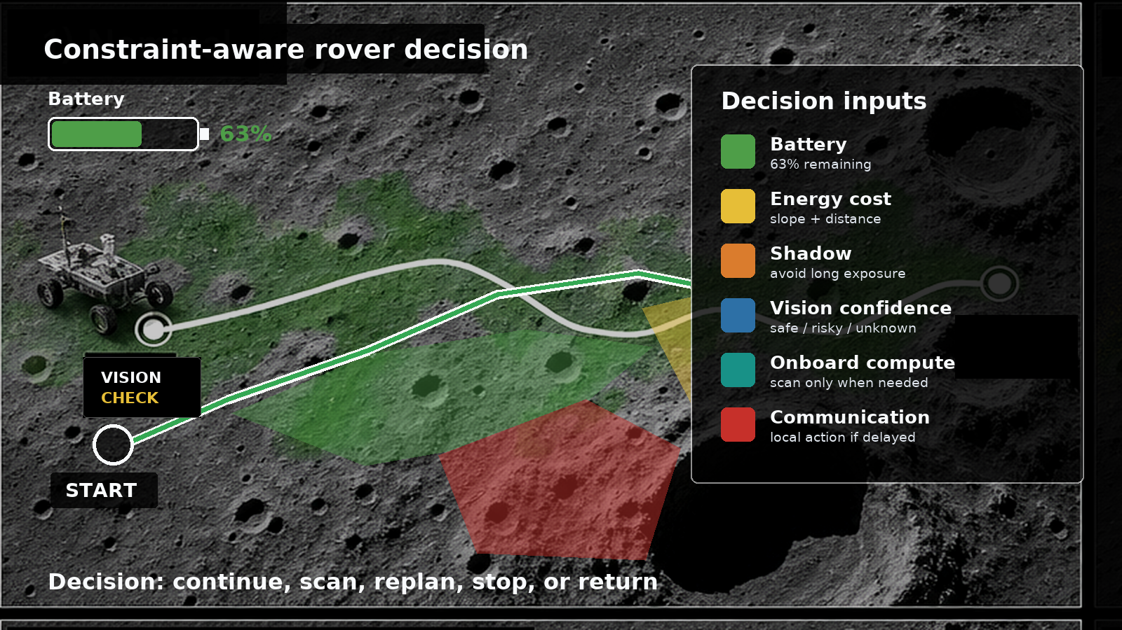
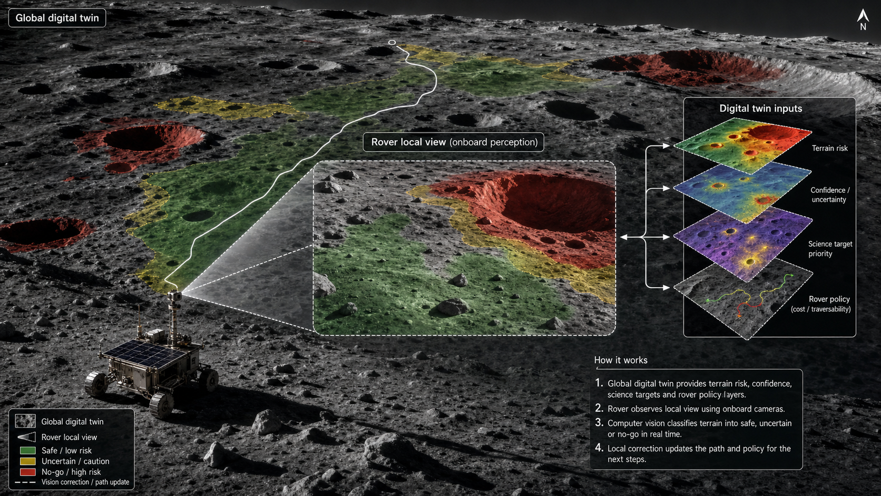
Starting Inputs And Rover Constraints
RESEARCH PROGRESS PRESENTATION
Intern 1
fused terrain and semantic context
Intern 2
confidence classes and invalid areas
Intern 3
science target and reward regions
Intern 4
grid-world, policies, and RL environment
Lunar South Pole Digital Twin - Computer Vision Extension

Slide 5
Two Constraint-Aware Vision Modules
RESEARCH PROGRESS PRESENTATION
Local Terrain Perception
Constraint-Aware Navigation
safe / risky / shadowed / uncertain terrain with confidence | Problem 1
move / scan / replan / stop / return under battery and risk limits | Problem 2
Shared Platform
Integration Check
Python grid-world with raster crops, energy model, and policy loop | Common
compare global, vision-only, and battery-aware rover policies | Common
Lunar South Pole Digital Twin - Computer Vision Extension

Slide 6
Problem 1: Local Terrain Perception
RESEARCH PROGRESS PRESENTATION
Research question
Main Work
Can a rover identify local hazard class and perception confidence from a simulated rover-view scene?
Generate local rover-view crops.
Extract texture, edge, contrast, shadow fraction, and uncertainty cues.
Classify each view as safe, risky, shadowed, or uncertain.
Datasets
LROC image, LROC shadow mask, LOLA slope/roughness, Intern 1 terrain context, Intern 2 confidence classes
Outputs
Deliverable
rover-view crop examples
hazard + confidence map
confusion matrix / false-safe rate
comparison with LOLA terrain risk
local hazard-class map, confidence table, and false-safe summary
Lunar South Pole Digital Twin - Computer Vision Extension

Slide 7
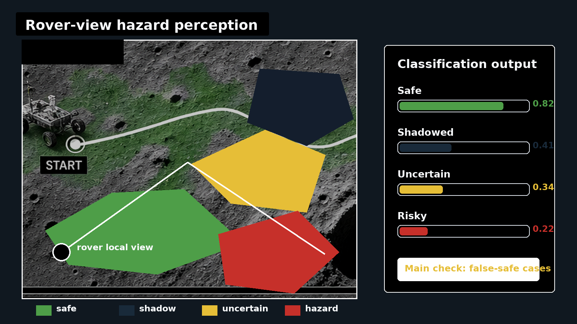
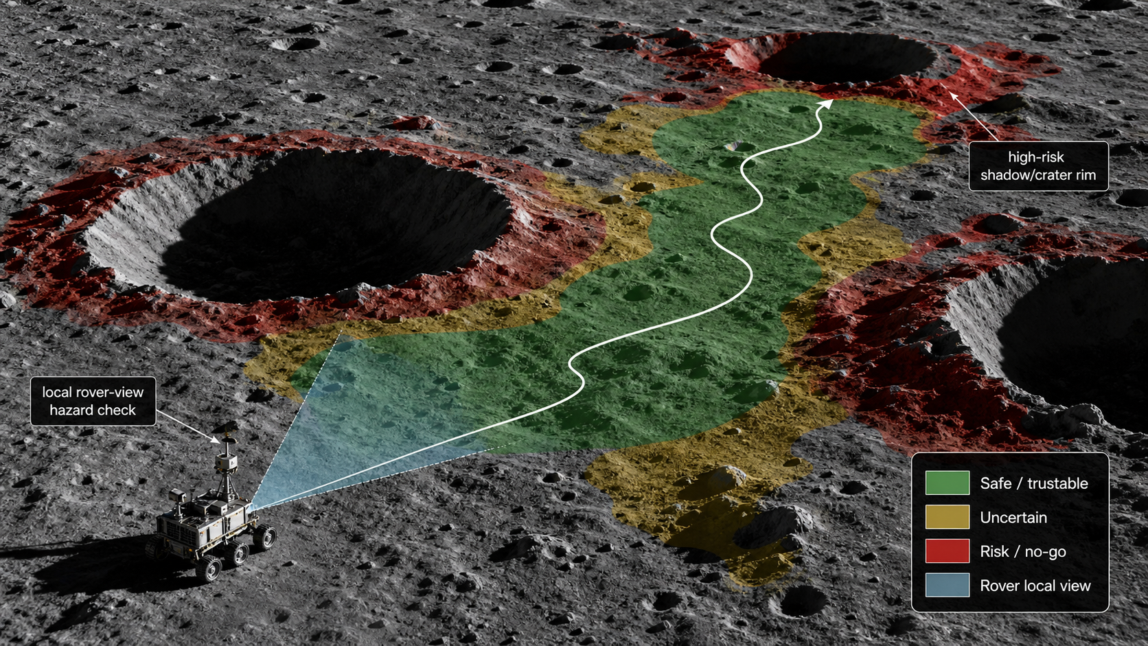
Problem 1: Rover-View Terrain Perception Workflow
RESEARCH PROGRESS PRESENTATION
Simulated local perception from digital-twin layers
Lunar South Pole Digital Twin - Computer Vision Extension

Slide 8
Problem 1: Method And Validation
RESEARCH PROGRESS PRESENTATION
OpenCV Baseline
Classifier Option
Ground Truth
texture, edges, contrast, shadow fraction, and uncertainty cues
use ML only if rule/feature methods are insufficient
LOLA slope/roughness, shadow mask, and confidence labels
Main Risk To Track
Metrics
false-safe output: rover view says safe but terrain/shadow labels say risky
accuracy, F1, false-safe rate, confidence agreement, and calibration
Lunar South Pole Digital Twin - Computer Vision Extension

Slide 9
Problem 2: Battery-Aware Local Navigation
RESEARCH PROGRESS PRESENTATION
Research question
Main Work
Can a rover make safer local navigation decisions while respecting battery and operating constraints?
Start from A*, Q-learning, or rule-based policy output.
Check the next few cells using local perception, battery reserve, shadow risk, and confidence.
Choose local action: move, scan, replan, stop, or return.
Datasets
Intern 4 grid-world, Intern 2 confidence map, Intern 3 targets, local hazard labels, battery/energy model
Outputs
Deliverable
corrected path examples
battery profile
constraint violation table
hazard exposure and science-return comparison
original path vs vision-only vs battery-aware path comparison
Lunar South Pole Digital Twin - Computer Vision Extension

Slide 10
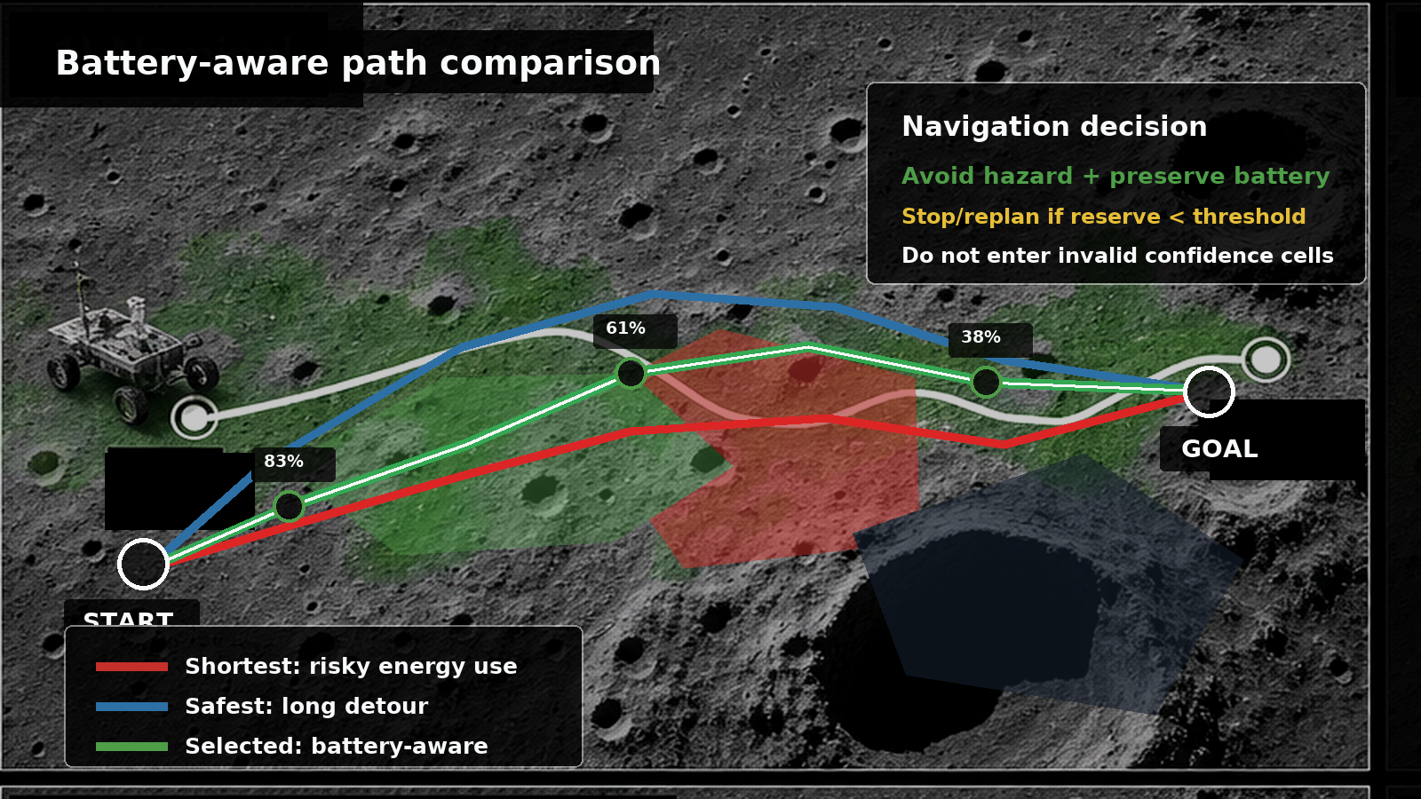
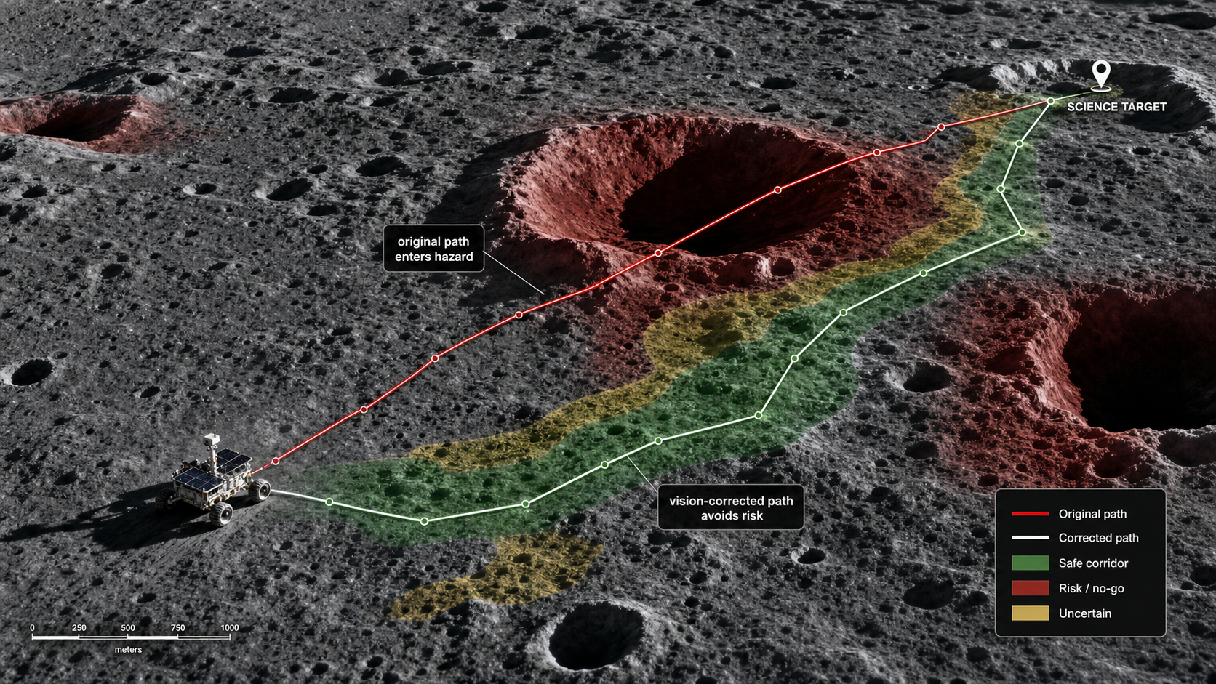
Problem 2: Battery-Aware Path Comparison
RESEARCH PROGRESS PRESENTATION
Compare shortest, safest, and battery-aware local navigation
Lunar South Pole Digital Twin - Computer Vision Extension

Slide 11
Problem 2: Policy And Constraint Comparison
RESEARCH PROGRESS PRESENTATION
Original Policy
Vision-Only Correction
Battery-Aware Policy
A*, shortest path, safest path, science-priority policy, or Q-learning output
same global goal, but local moves corrected using perception only
uses perception plus energy, shadow, confidence, and reserve constraints
Rule
Constraint
Compare hazard exposure, energy use, path cost, travel distance, success rate, and science return.
Do not let local correction violate confidence, slope, shadow, battery-reserve, or compute limits.
Lunar South Pole Digital Twin - Computer Vision Extension

Slide 12
Integration With Intern 1-4 Outputs
RESEARCH PROGRESS PRESENTATION
Intern 1
Intern 2
Intern 3
Intern 4
fused layers supply semantic terrain context
confidence classes define trust and invalid areas
science targets define goal/reward regions
grid-world policy supplies the original path
Integration Output
A rover-local decision module that checks global policy outputs using perception, confidence, battery, energy, and operating constraints before each movement.
Lunar South Pole Digital Twin - Computer Vision Extension

Slide 13
Simulation Platform
RESEARCH PROGRESS PRESENTATION
rasterio
Main Platform
read and crop orbital layers
Python custom grid-world or Gymnasium-style environment
numpy
array operations, scoring, and battery profile
opencv-python
vision features and local hazard masks
Computer Vision
OpenCV and scikit-image for local crops, edges, texture, masks, and confidence checks
gymnasium
state, action, reward, and constraint loop
networkx / A*
classical path baseline and energy comparison
Lunar South Pole Digital Twin - Computer Vision Extension

Slide 14
Final Expected Outcome
RESEARCH PROGRESS PRESENTATION
Perception
Navigation
Evaluation
local safe/risky/shadowed/uncertain classes with confidence
battery-aware move, scan, replan, stop, or return decision
hazard exposure, energy use, path cost, success, and science return
Together
The extension moves the digital twin from global planning toward local rover perception, constraint-aware navigation, and decision support.
Lunar South Pole Digital Twin - Computer Vision Extension

Slide 15
Guide Review Decision
RESEARCH PROGRESS PRESENTATION
Problem 1
Problem 2
Vision-Based Terrain Hazard And Confidence Detection
Focus: what the rover sees locally
Output: safe/risky/shadowed/uncertain classes with confidence
Battery- And Constraint-Aware Rover Navigation
Focus: local decision under battery, shadow, confidence, and compute limits
Output: energy-feasible local navigation comparison
Common Scientific Position
This is a simulated rover-view study from digital-twin/orbital layers for testing perception and local decision logic.
Lunar South Pole Digital Twin - Computer Vision Extension

