Slide 1
Uber Case Study
R.GANESH SRIDAR

Slide 2
UBER – Digital Technology and Cab aggregator
Uber Technologies Inc. is a technology company headquartered in San
Francisco, California, United States.
It operates in 570 cities worldwide.
It develops, markets and operates the Uber car transportation and food delivery mobile
apps.
Uber drivers use their own cars, although drivers can rent a car to drive with Uber too.

Slide 3
Business Problem and analysis
Uber found that there were lot of cancellations as well as non-availability of cabs in a city. Uber wants to find a solution for the supply demand and gap.
The aim of this analysis is to identify the root cause of the problem (i.e. cancellation and non availability of cars) and recommend ways to improve the situation.
Limitations of this analysis
Only to and fro traffic from Airport and City is considered

Slide 4
Understanding of Data : Data exploration
There are six attributes associated with each request made by a customer:
Request id: A unique identifier of the request
Pick-up point: The point from which the request was made (i.e. either City or Airport)
Driver id: The unique identification number of the driver
Status: Whether the trip was completed, cancelled or there were no cars available
Time of request: The date and time at which the customer made the trip request
Drop-off time: The drop-off date and time, in case the trip was completed

Slide 5
Our methodology for this analysis
Gather data for the analysis (download and import in R)
Clean and Format the data for readability (Data formats fixing “/”and “-”)
Understand the data by visual Inspection (Data Structure)
Correcting Data formats and Separating relevant Information (like hour of the day, Trip Duration)
Extrapolate the Derived Metrics
Filter Data Set on Trip Status, Pickup Point, Hour of trip and driver id.
Perform Univariate and Segmented Univariate analysis on the Data.
Plot the results of Analysis and Understand the root cause of the issue.
Final Recommendations
Key Assumptions
Cabs at the airport only take new trips originating from the airport, i.e. do not leave the airport until they get a trip.
City Cabs may have different trips but we will take them now to Airport only.

Slide 6
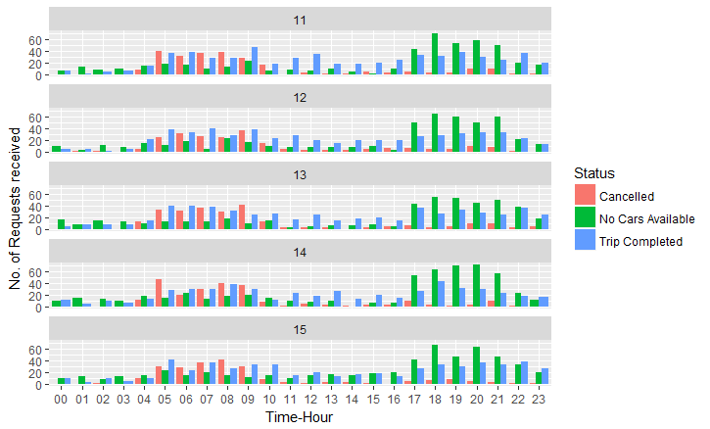
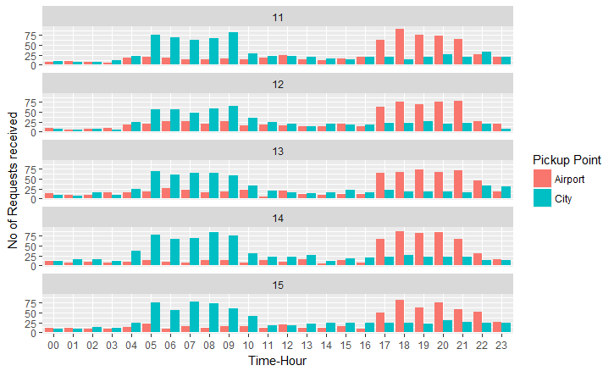
Requests(Demand) and Drops(Supply) with status
This graph shows the almost same trend for all the days.

Slide 7
Combining the data for all the days
There is high demand (Peak
Time) at Airport between 5:00 PM to 22:00 PM.
There is high demand (Peak
Time) at City between 4:00 AM to
10:00 AM.

Slide 8
Dividing the request time in to Category
12AM to 5AM - Early_morning_Status
5AM to 10AM - Mid_Morning_Status
10AMto 5PM - Day_time_Status
5PMto 10Pm – Evening_Status
10PM-12AM – Late_night_rush

Slide 9
Request Analysis : Requests(Demand) and Drops(Supply)
There is a huge demand deficiency between peak hours at Airport and City.
This may be because of cars not available or cancellations

Slide 10
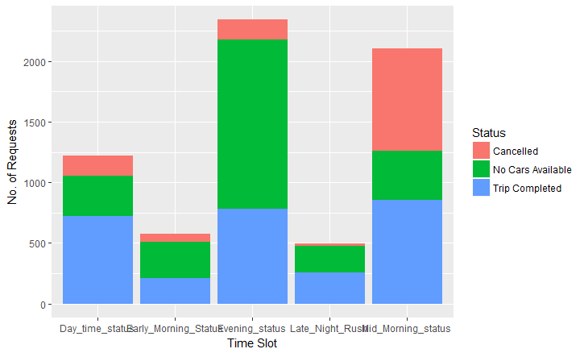
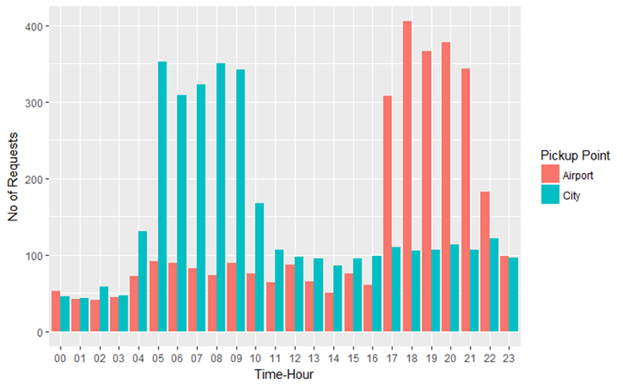
Uber Business problem: Identification
High Cancelled trips during
morning (5AM-10AM)
Cabs are not available
During Evening (5PM-10M)

Slide 11
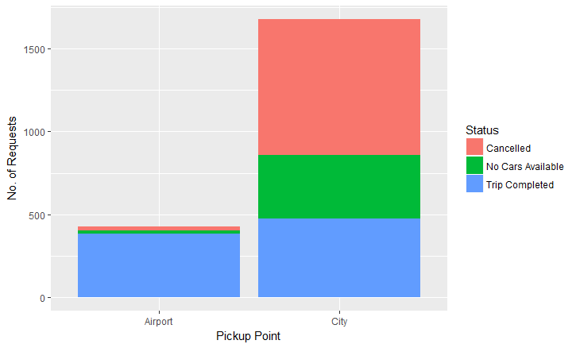
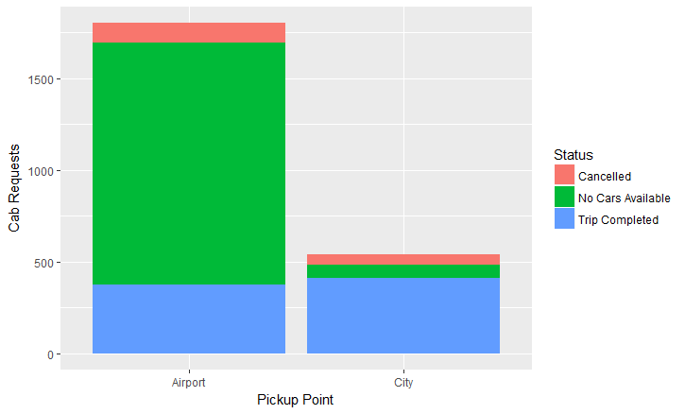
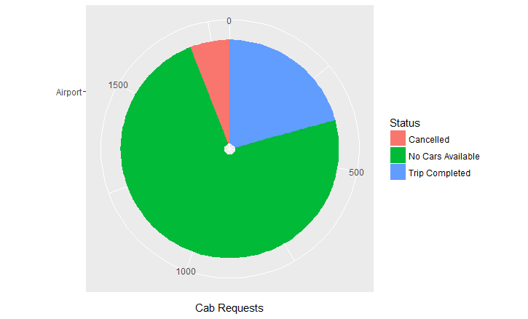
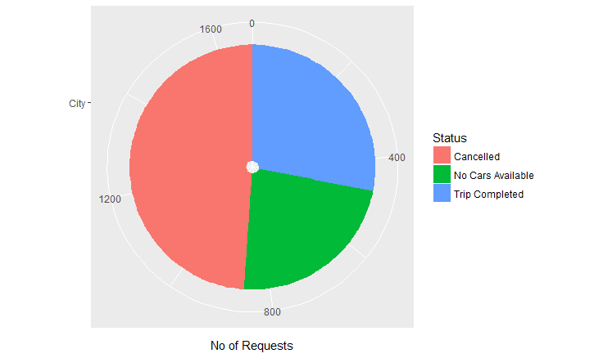
Problem statistics
Based on Analysis in R
Supply from Airport :373
Demand is for 1800
Supply from city is 472
Demand City is 1677

Slide 12
Trip Cancellations at City :
As visualized, there is a sharp increase in cancelled trips from 4:00am to 10:00
am.
As visualized , there is less demand of cabs from the Airport during 4:00am to
10:00am.
Therefore if drivers are asked to accept the trip to airport there are ample chances, that they
might have to wait at the airport for a long period of time before they get a new trip.
The Supply and Demand gap in this duration in the above time frame is very high and is
forcing cab drivers to cancel the trips in favor of better business opportunities in city.
No Cars Available at Airport
As visualized, there is rapid increase “no cars available” cases from 5:00 pm
to 22:00 pm and there is sharp increase demand of cabs From the Airport during 5:00
pm to 22:00 pm.
As visualized in plot there is a gap in Demand and Supply of Cabs at the
Airport.
This Sharp increase in demand in this timeframe cause Lesser numbers of cars availability
at airport.

Slide 13
Recommendations to Uber :
For Morning trips :
• Providing an incentive for trips from city to airport between 4am and 10am . This will help to increase the cabs in Airport during morning hours.
Uber can provide fuel mileage refund or offers to compensate fuel in case they return from airport without any raid.
For Evening trips :
• Drivers can be incentivized to carry out trips between 4:00am to 10:00 am in city.
• Drivers can also be compensated for their waiting time for above period.
• For arresting ”No cars available”: Strict monitoring of cabs is required and within certain kilometer drivers can be informed to take these trips
• Also cabs which are away can also be informed beforehand and incentivized suitably for reaching
airport for taking trips.

