Slide 1
Git & Github Introduction
Greg Stephens, greg@udon.org
11/Mar/2016

Slide 2
Agenda
Git Intro & Github Account Setup
Create & Cloning Repositories
Updating Repository
Multi-user Updates to Repository

Slide 3
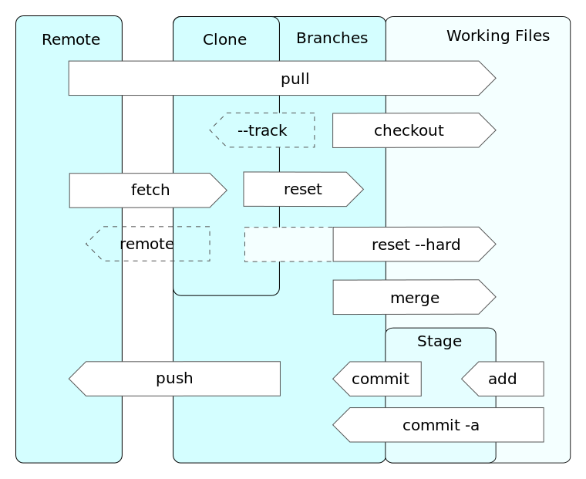
Git Intro
Git is source code mgmt and version control created by Linus Torvalds – Open Source
Data structures:
Cache/Staging – tracks working dir
Object Database – append only
Remote Git Server (optional)
GitHub is a server implementation also Bitbucket, Springloops
Backup & Collaboration

Slide 4
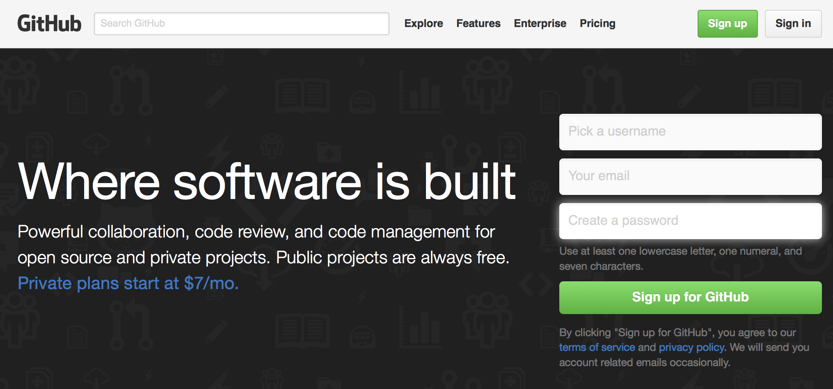
Create Github Account
Altermatives - Bitbucket, Springloops, etc

Slide 5
Git command line – initial setup
Install git command on local system
http://git-scm.com
Set global Git configuration
git config --global user.name “Greg Stephens”
git config --global user.email greg@udon.org

Slide 6
Git command line – setup new repository
Init – initialize local repository (current directory)
Creates local .git repository
git init
Add – stages files/directories to repository
git add .
Commit – Submit files to local repository with comment
git commit –m “Initial commit”

Slide 7
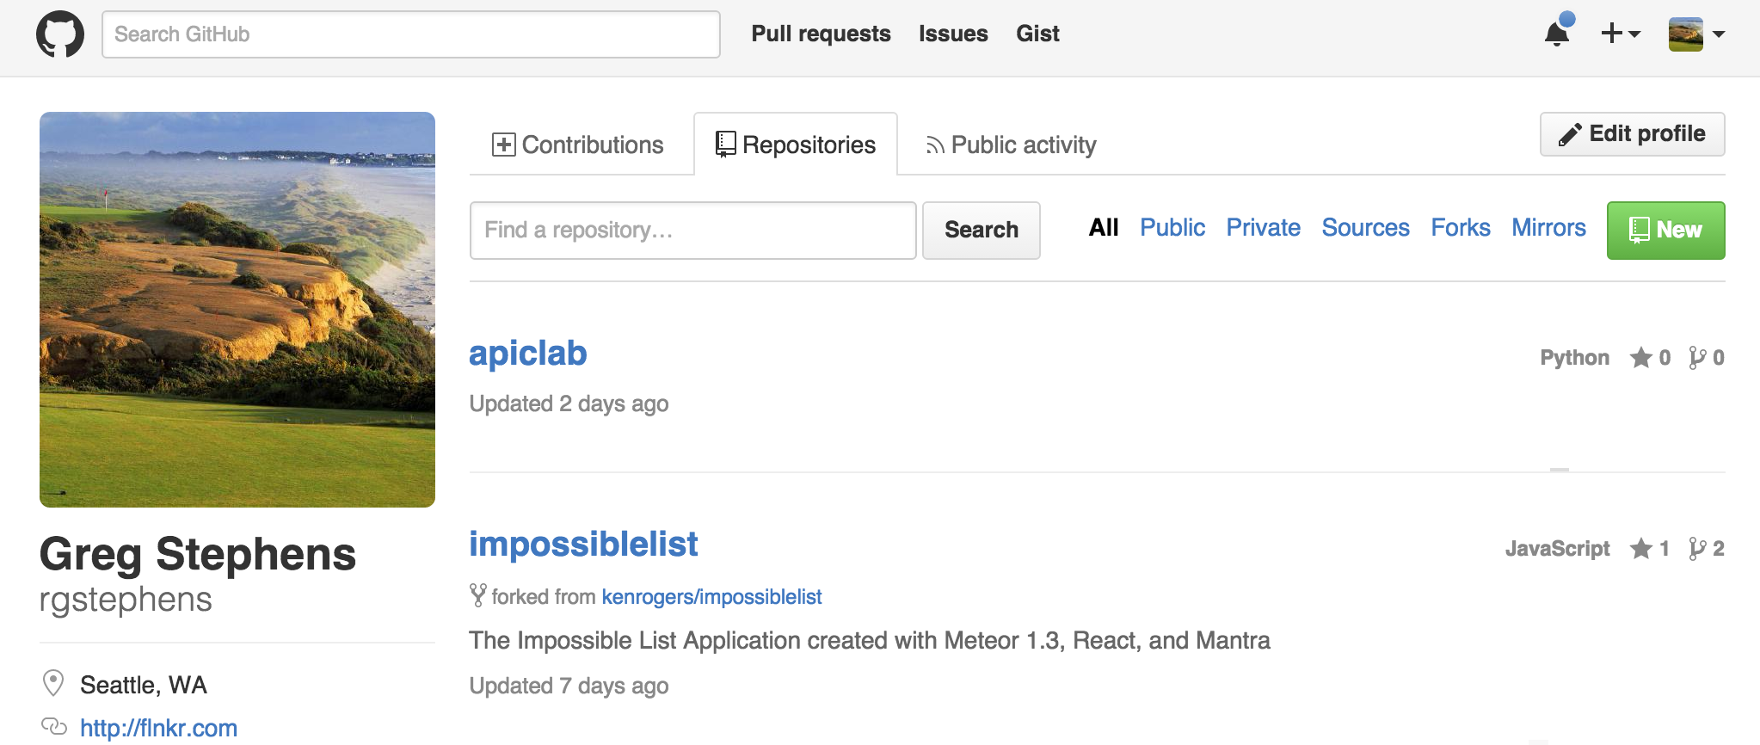
Create New Github Repository

Slide 8
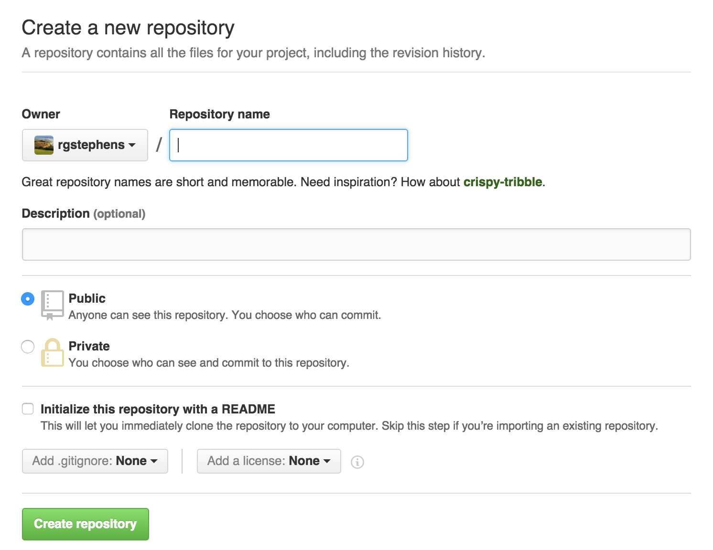
Create New Github Repository

Slide 9
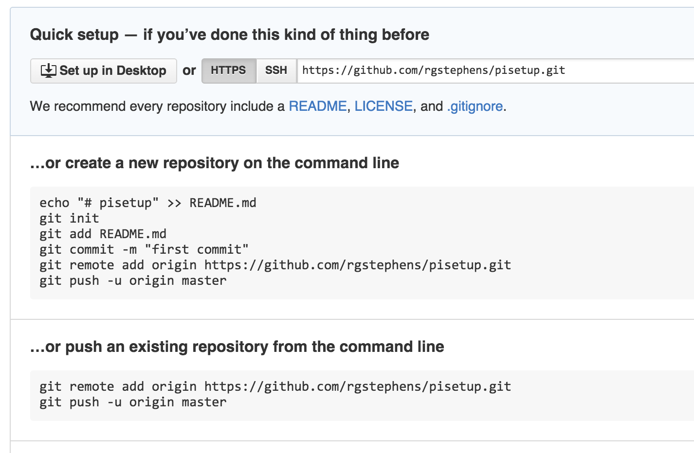
Create New Github Repository

Slide 10
Git command line – setup new repository
Remote – Setup access to remote repository (create first in GUI)
git remote add origin https://github.com/rgstephens/pisetup.git
git remote remove origin
Push – First time submit of files to remote repository
git push –u origin master
Take a look at repository on Github
http://github.com/rgstephens/pisetup

Slide 11
Work with existing repository
Clone – Copy repository from Remote master
Creates local .git repository
git clone https://github.com/rgstephens/pisetup.git
git clone https://github.com/rgstephens/apiclab.git

Slide 12
Changes
Start changing & adding files
.gitignore # files to ignore
Status – after changing some files, check status git status # show which files changed
Diff – after changing some files, check status git diff # detailed differences
Add, Commit & Push
git add . git commit –m “Issue #4 resolved”
git push origin master

Slide 13
Branches
Branch – Associate a name with changes you are about to make to local repository
Create a new branch off of master called newFeature
git checkout –b newFeature master
Checkout – Change to another branch
git checkout newFeature
Show – show all branches and active branch
git branch

Slide 14
Pushing Changes to Remote Respository
Commit – Submit changes to local repository
git add . git commit –m “Comment on changes” git push origin newFeature
Merge with Master
git checkout master git merge newFeature
Push – Submit changes to remote repository
git push origin master git branch –d newFeature

Slide 15
Git command line – existing repository
Clone – Copy repository from Remote master
Creates local .git repository
Commit – Submit changes to local repository
Push – Submit changes to remote repository
Branch – Associate a name with changes you are about to make to local repository
Merge – Merge branch into master
Master is the name of the main branch of a repository

Slide 16
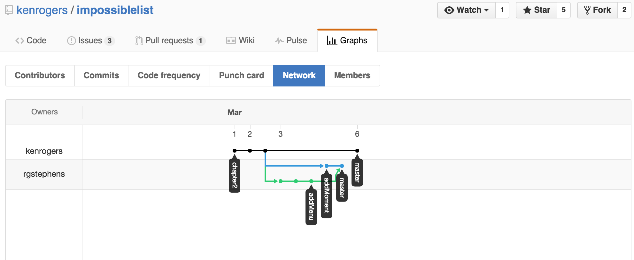
Github Network View

Slide 17
Git Functions with Multiple Users
Fork – Make my own copy of owners repository
Typically done on remote Git server (Github)
After Fork, do normal operations:
Clone – download my fork to local system
Make Branch, modify files, Commit changes, Push changes to server, Merge
Pull Request – Ask owner of original repository to pull your changes into the main repository

Slide 18
Github Network View – Multiple Users

Slide 19
Git GUI
SmartGit

Slide 20
Further Learning
GitHub Hello World
https://guides.github.com/activities/hello-world/
Atlassian First Time Repository Setup
https://www.atlassian.com/git/tutorials/setting-up-a-repository
Atlassian Forking Workflow – Good Multi-user Workflow:
https://www.atlassian.com/git/tutorials/comparing-workflows/centralized-workflow
Git for Beginners
http://juristr.com/blog/2013/04/git-explained/
Greg’s Git Blogpost - http://flnkr.com/2016/03/bitbucket/

