Slide 1

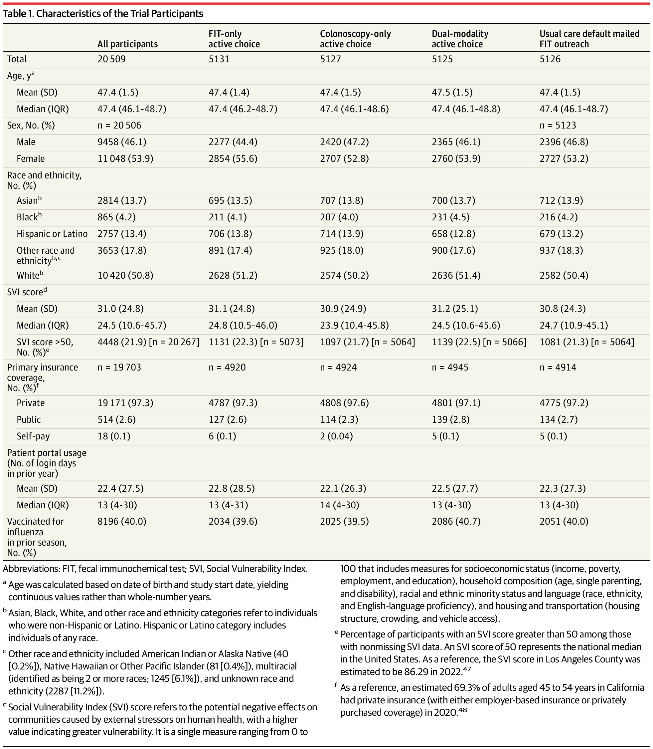
From: Population Health Colorectal Cancer Screening Strategies in Adults Aged 45 to 49 Years: A Randomized Clinical Trial
JAMA. 2025;334(9):778-787. doi:10.1001/jama.2025.12049
^{Table Title:}
Characteristics of the Trial ParticipantsAbbreviations: FIT, fecal immunochemical test; SVI, Social Vulnerability Index.
a Age was calculated based on date of birth and study start date, yielding continuous values rather than whole-number years.
b Asian, Black, White, and other race and ethnicity categories refer to individuals who were non-Hispanic or Latino. Hispanic or Latino category includes individuals of any race.
c Other race and ethnicity included American Indian or Alaska Native (40 [0.2%]), Native Hawaiian or Other Pacific Islander (81 [0.4%]), multiracial (identified as being 2 or more races; 1245 [6.1%]), and unknown race and ethnicity (2287 [11.2%]).
d Social Vulnerability Index (SVI) score refers to the potential negative effects on communities caused by external stressors on human health, with a higher value indicating greater vulnerability. It is a single measure ranging from 0 to 100 that includes measures for socioeconomic status (income, poverty, employment, and education), household composition (age, single parenting, and disability), racial and ethnic minority status and language (race, ethnicity, and English-language proficiency), and housing and transportation (housing structure, crowding, and vehicle access).
e Percentage of participants with an SVI score greater than 50 among those with nonmissing SVI data. An SVI score of 50 represents the national median in the United States. As a reference, the SVI score in Los Angeles County was estimated to be 86.29 in 2022.
f As a reference, an estimated 69.3% of adults aged 45 to 54 years in California had private insurance (with either employer-based insurance or privately purchased coverage) in 2020.
^{Date of download: 9/8/2025}
Copyright 2025 American Medical Association. All rights reserved, including those for text and data mining, AI training, and similar technologies.

