Slide 1
Project Report
on
Gaussian Particle Filtering
Submitted to
Dr. Sheetal Kalyani
Submitted by
RAJ GAURAV TIWARI SARTHAK GUPTA
(EE19S010) (EE20M021)
SAI DINESH KANCHARANA KOTTI VENKATA SAI KIRAN
(EE20D401) (EE20M014)
TA: SHASHANK SHEKHAR (EE17D022)

Slide 2
Table of Contents
Abstract
Filters
Introduction
Gaussian Particle Filtering
Time Update Algorithm
Measurement update Algorithm
Models
Univariate Nonstationary Growth Model (UNGM)
Bearings Only Tracking (BOT)
Inferences.

Slide 3
Introduction
This paper introduces a new filter called the Gaussian particle filter.
It is based on the particle filtering concept, and it approximates the posterior distributions by single Gaussians.
It is shown that under the Gaussianity assumption, the Gaussian particle filter is asymptotically optimal in the number of particles.
Simulation results are presented to demonstrate the versatility and improved performance of the Gaussian particle filter over conventional Gaussian filters.

Slide 4
Filters
Filters are used for estimating unknown state variables using series of measurements observed over time , containing statistical noise . For ex:-Robot location is the unknown variable or states and observations are measured through sensors.
In this paper, we have implemented the Gaussian particle filter, SIR and a variant of Kalman filter, known as the extended Kalman filter.

Slide 5
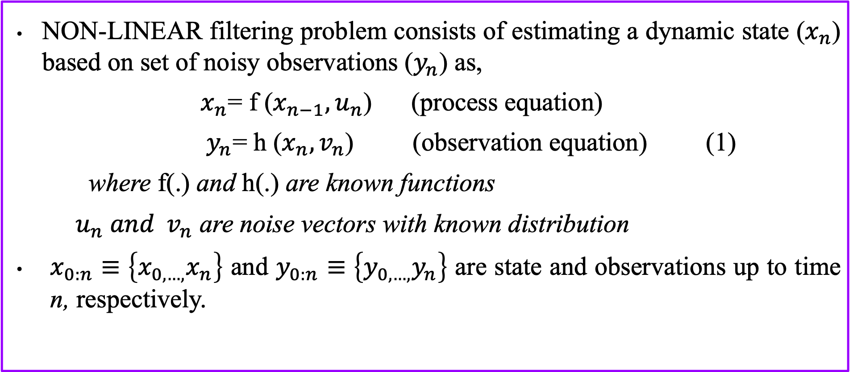
Dynamic State Space
NON-LINEAR filtering problem consists of estimating a dynamic state ($x_{n}$) based on set of noisy observations ($y_{n}$) as,
$x_{n}$= f ($x_{n−1},u_{n}$) (process equation)
$y_{n}$= h ($x_{n},v_{n}$) (observation equation) (1)
where f(.) and h(.) are known functions
$u_{n} and v_{n}$ are noise vectors with known distribution
$x_{0:n}$ $≡\left\{x_{0,…,}x_{n}\right\}$ and $y_{0:n}$ $≡\left\{y_{0,…,}y_{n}\right\}$ are state and observations up to time n, respectively.

Slide 6
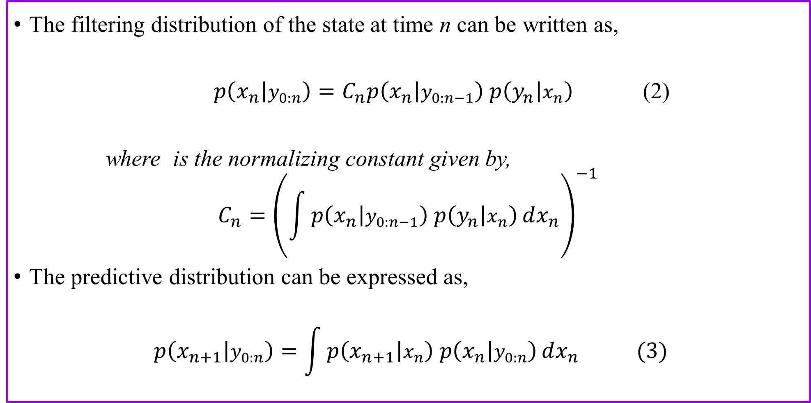
Filtering and Predictive distributions
The filtering distribution of the state at time n can be written as,
$p\left(x_{n} | y_{0:n}\right)=C_{n}p\left(x_{n} | y_{0:n−1}\right)$ $p\left(y_{n} | x_{n}\right)$ (2)
where is the normalizing constant given by,
$$C_{n}={\left(\int{p\left(x_{n} | y_{0:n−1}\right) p\left(y_{n} | x_{n}\right)}dx_{n}\right)}^{−1}$$
The predictive distribution can be expressed as,
$$p\left(x_{n+1} | y_{0:n}\right)=\int{p\left(x_{n+1} | x_{n}\right) p\left(x_{n} | y_{0:n}\right)}dx_{n} (3)$$

Slide 7
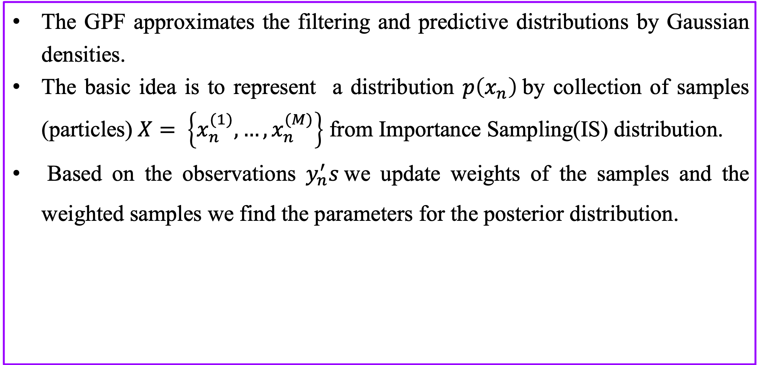
Gaussian Particle filter (GPF)
The GPF approximates the filtering and predictive distributions by Gaussian densities.
The basic idea is to represent a distribution $p\left(x_{n}\right)$by collection of samples (particles) $X= \left\{x_{n}^{(1)},…,x_{n}^{(M)}\right\}$ from Importance Sampling(IS) distribution.
Based on the observations $y_{n}^{′}s$we update weights of the samples and the weighted samples we find the parameters for the posterior distribution.

Slide 8
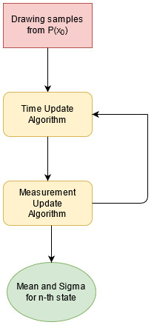
Flow Chart for implementation

Slide 9
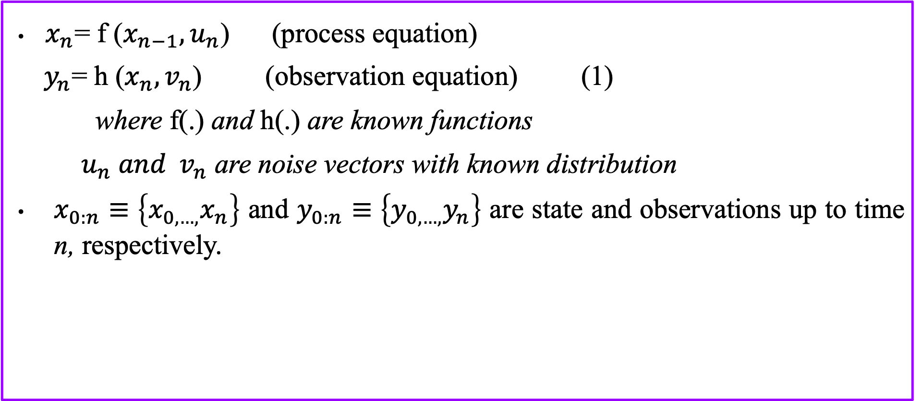
Dynamic State Space
$x_{n}$= f ($x_{n−1},u_{n}$) (process equation)
$y_{n}$= h ($x_{n},v_{n}$) (observation equation) (1)
where f(.) and h(.) are known functions
$u_{n} and v_{n}$ are noise vectors with known distribution
$x_{0:n}$ $≡\left\{x_{0,…,}x_{n}\right\}$ and $y_{0:n}$ $≡\left\{y_{0,…,}y_{n}\right\}$ are state and observations up to time n, respectively.

Slide 10
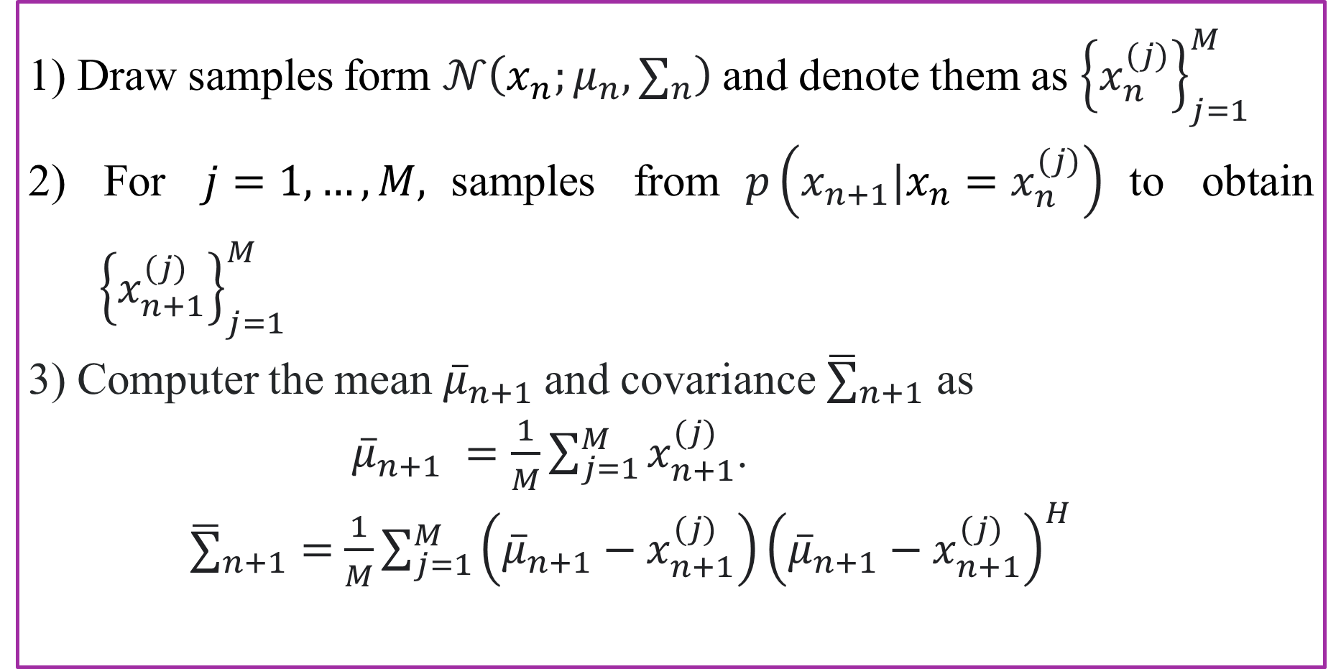
Time update Algorithm
1) Draw samples form $𝒩\left(x_{n};μ_{n},∑_{n}\right)$and denote them as ${\left\{x_{n}^{(j)}\right\}}_{j=1}^{M}$
2) For $j=1,…,M,$samples from$p\left(x_{n+1}|{x_{n}=x}_{n}^{(j)}\right)$to obtain ${ \left\{x_{n+1}^{(j)}\right\}}_{j=1}^{M}$
3) Computer the mean ${\overline{μ}}_{n+1}$and covariance ${\overline{∑}}_{n+1}$ as
${\overline{μ}}_{n+1} =\frac{1}{M}\sum_{j=1}^{M}{x_{n+1}^{(j)}}$.
${\overline{∑}}_{n+1}=$ $\frac{1}{M}\sum_{j=1}^{M}{\left({\overline{μ}}_{n+1}−x_{n+1}^{(j)}\right){\left({\overline{μ}}_{n+1}−x_{n+1}^{(j)}\right)}^{H}}$

Slide 11
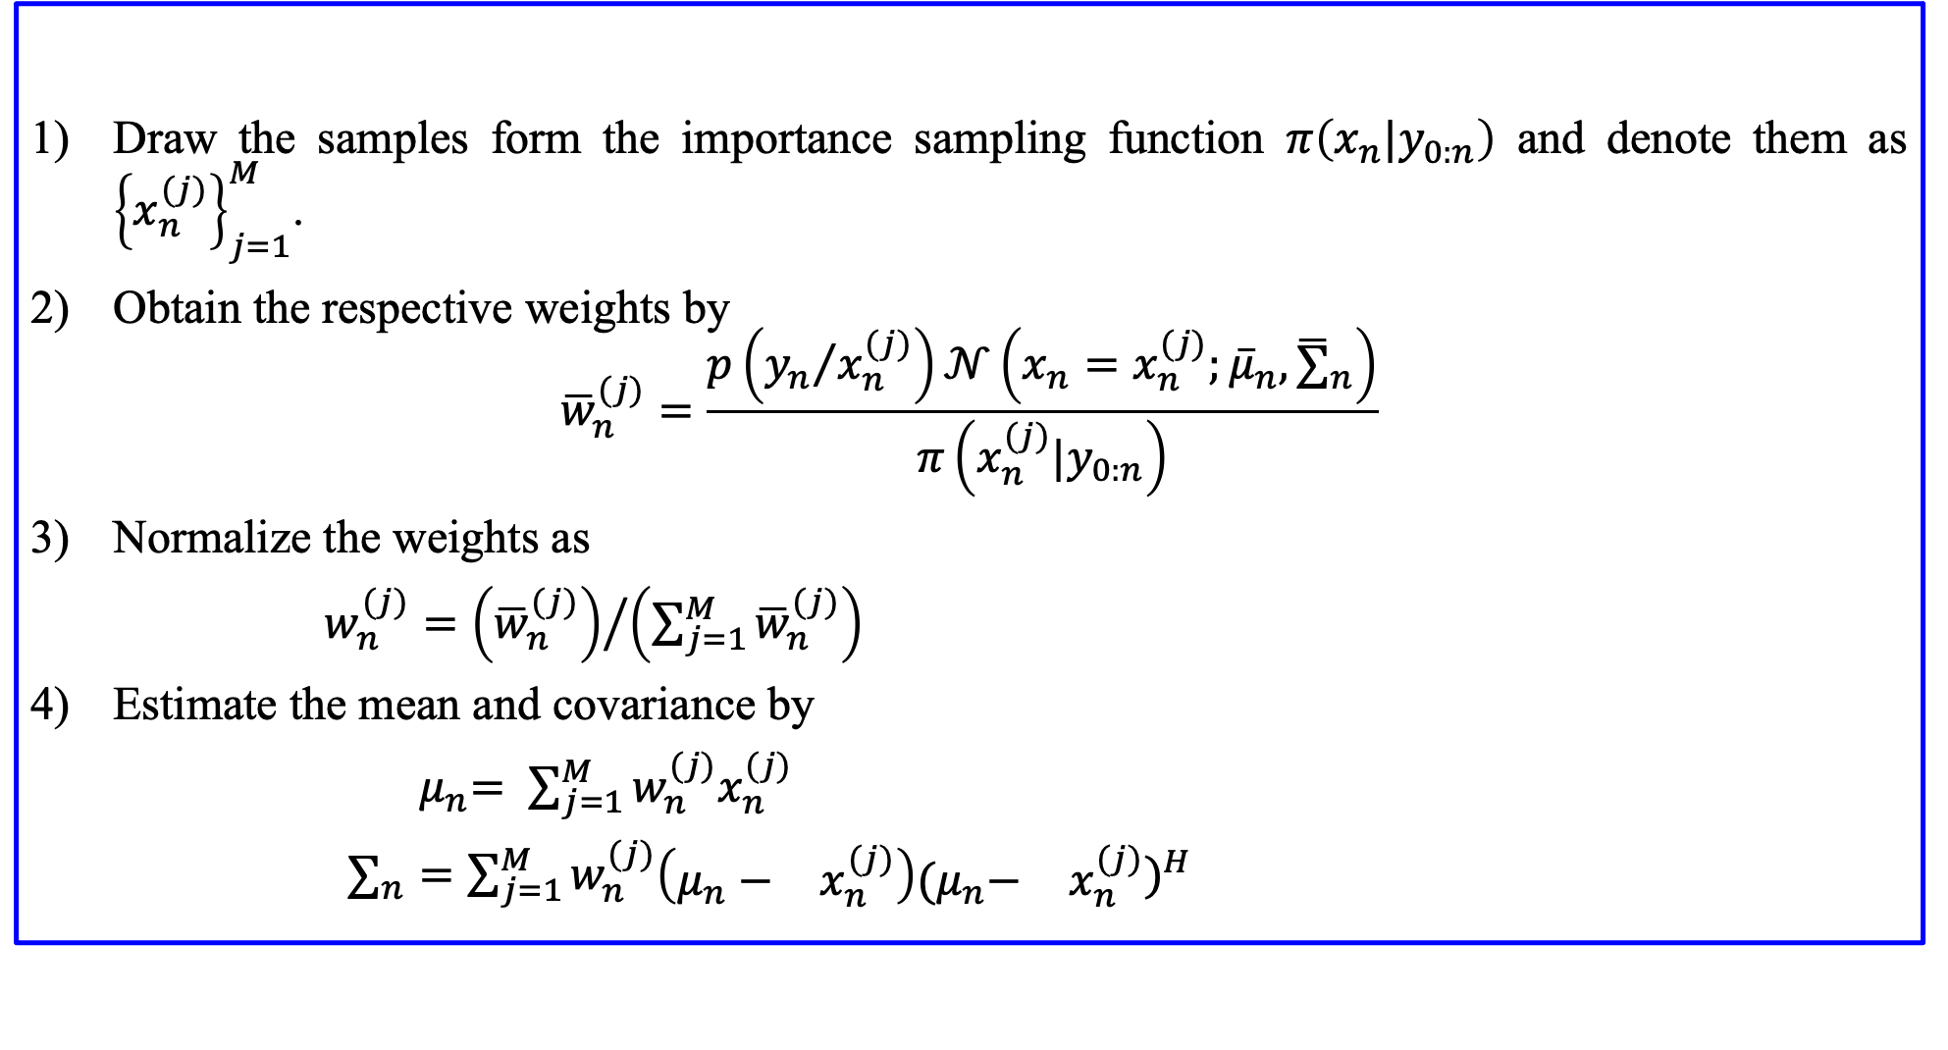
Measurement Update Algorithm
Draw the samples form the importance sampling function $π\left(x_{n}|y_{0:n}\right)$and denote them as ${\left\{x_{n}^{(j)}\right\}}_{j=1}^{M}$.
Obtain the respective weights by
$${\overline{w}}_{n}^{(j)}=\frac{p\left({y_{n}}/{x_{n}^{(j)}}\right)𝒩\left(x_{n}=x_{n}^{(j)};{\overline{μ}}_{n},{\overline{∑}}_{n}\right)}{π\left(x_{n}^{(j)}|y_{0:n}\right)}$$
Normalize the weights as
$w_{n}^{(j)}={\left({\overline{w}}_{n}^{(j)}\right)}/{\left(\sum_{j=1}^{M}{{\overline{w}}_{n}^{(j)}}\right)}$
Estimate the mean and covariance by
${ μ}_{n}= \sum_{j=1}^{M}{w_{n}^{(j)}x_{n}^{(j)}}$
$∑_{n}=\sum_{j=1}^{M}{w_{n}^{(j)}\left(\begin{matrix}μ_{n}− & x_{n}^{(j)}\end{matrix}\right){\begin{matrix}{(μ}_{n}− & x_{n}^{(j)}\end{matrix})}^{H}}$

Slide 12
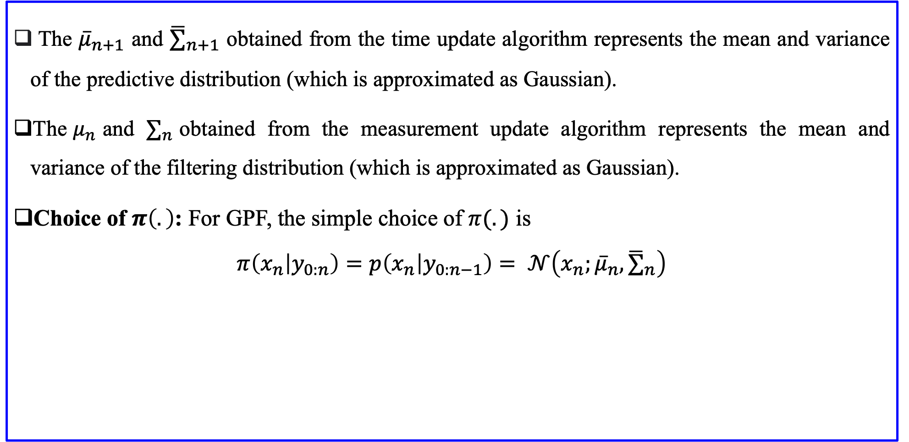
Continue...
The ${\overline{μ}}_{n+1}$ and ${\overline{∑}}_{n+1}$ obtained from the time update algorithm represents the mean and variance of the predictive distribution (which is approximated as Gaussian).
The${ μ}_{n}$and $∑_{n}$obtained from the measurement update algorithm represents the mean and variance of the filtering distribution (which is approximated as Gaussian).
Choice of $π\left(.\right)$: For GPF, the simple choice of $π(.)$ is
$$π\left(x_{n} | y_{0:n}\right)=p\left(x_{n} | y_{0:n−1}\right)= 𝒩\left(x_{n};{\overline{μ}}_{n},{\overline{∑}}_{n}\right)$$

Slide 13
Simulation Models
The Models we are going to work on:-
Univariate Non stationary Growth Model(UNGM)
Bearing Only Tracking(BOT)

Slide 14
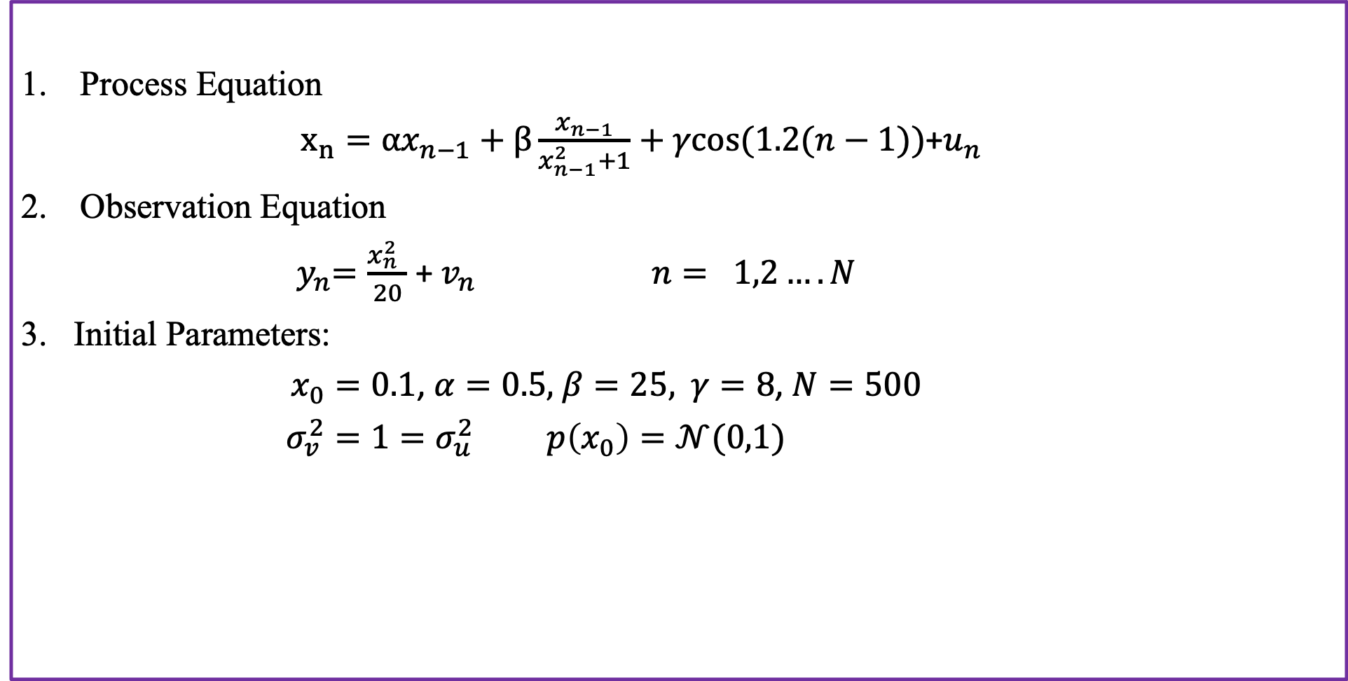
Univariate Non-stationary Growth Model
Process Equation
$x_{n}=αx_{n−1}+β\frac{x_{n−1}}{x_{n−1}^{2}+1}+γcos⁡(1.2(n−1))$+$u_{n}$
Observation Equation
${ y}_{n}=\frac{x_{n }^{2}}{20}$ + $v_{n}$ $n= 1,2….N$
Initial Parameters:
$x_{0}=0.1$, $α=0.5,$ $β=25,$ $γ=8$, $N=500$
$σ_{v}^{2}=1=σ_{u}^{2}$ $p\left(x_{0}\right)=𝒩(0,1)$

Slide 15
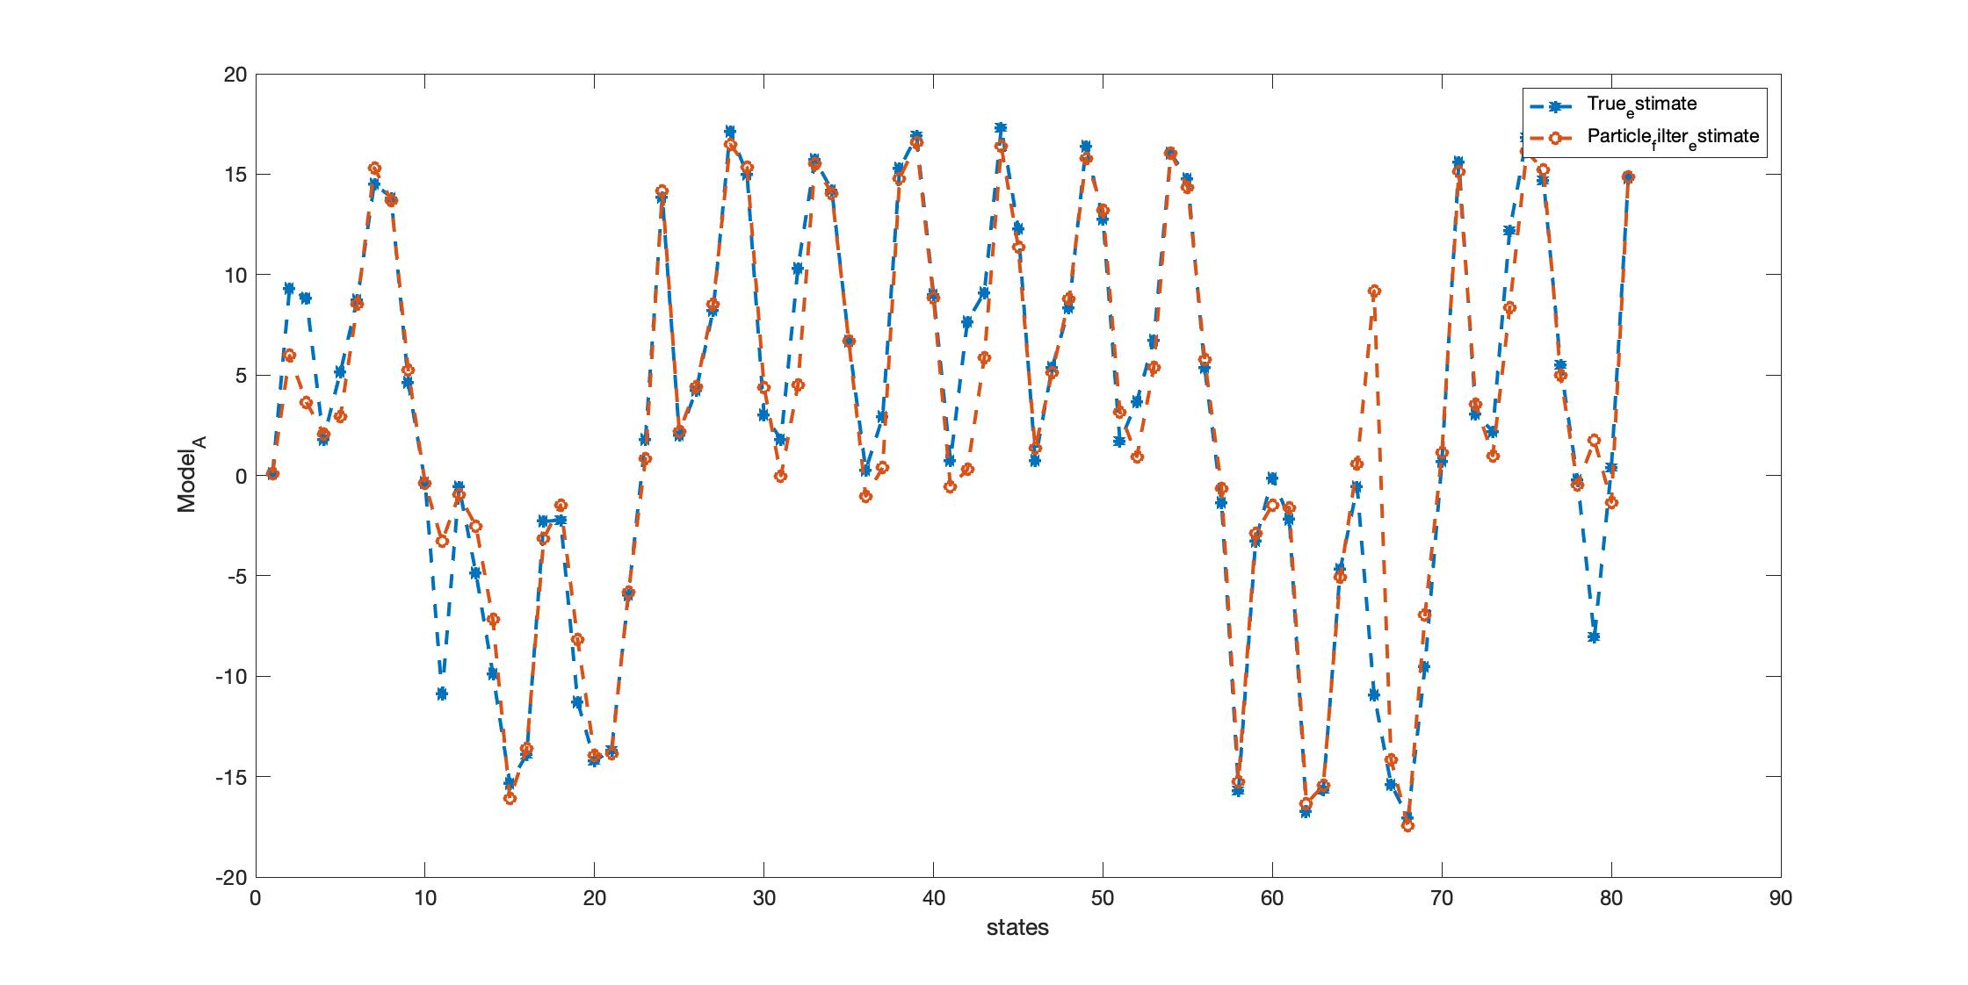
UNGM Tracking
Figure 1: Plot of true state and estimate of GPF for UNGM model.

Slide 16
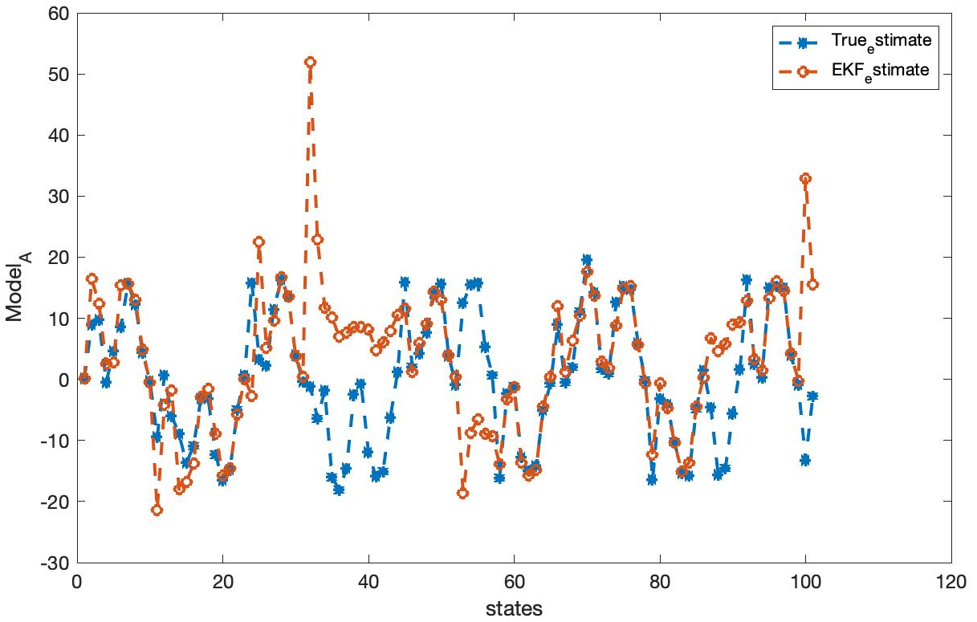
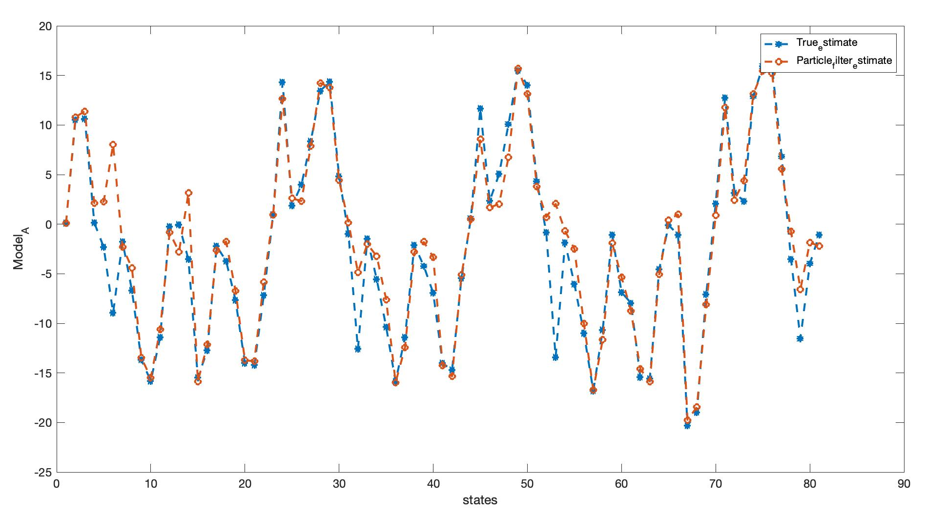
UNGM Tracking with other filters
Figure 2: Plot of true state and estimate of EKF for UNGM
Figure 3: Plot of true state and estimate of SIR for UNGM

Slide 17
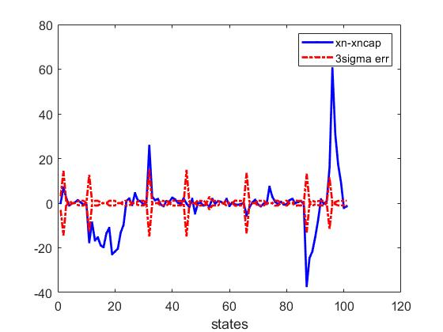
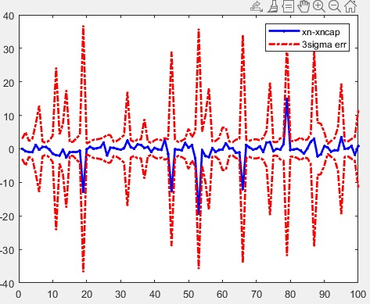
Performance evaluation
Figure 4: Plot of prediction error of GPF
Figure 5: Plot of prediction error of EKF

Slide 18
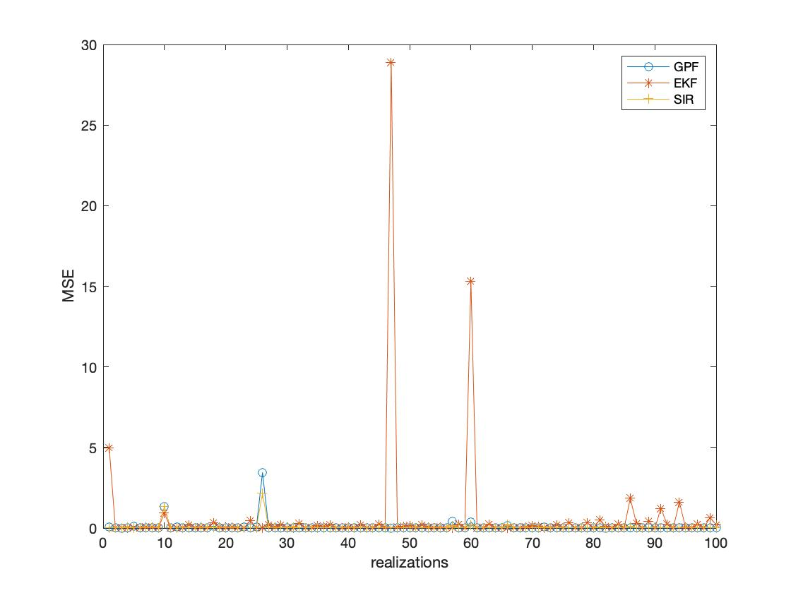
MSE plot of all the filters
Figure 6: Performance comparison of GPF, SIR and EKF, for M=1000 particles

Slide 19
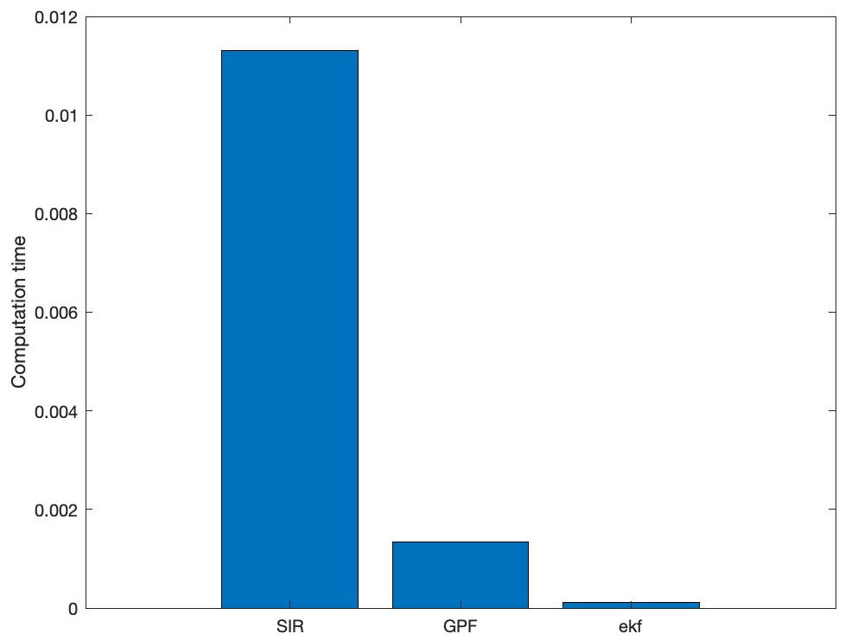
Computation time for UNGM
Figure 7: Computation Time for SIR, GPF and EKF for UNGM model using M=1000 particles

Slide 20
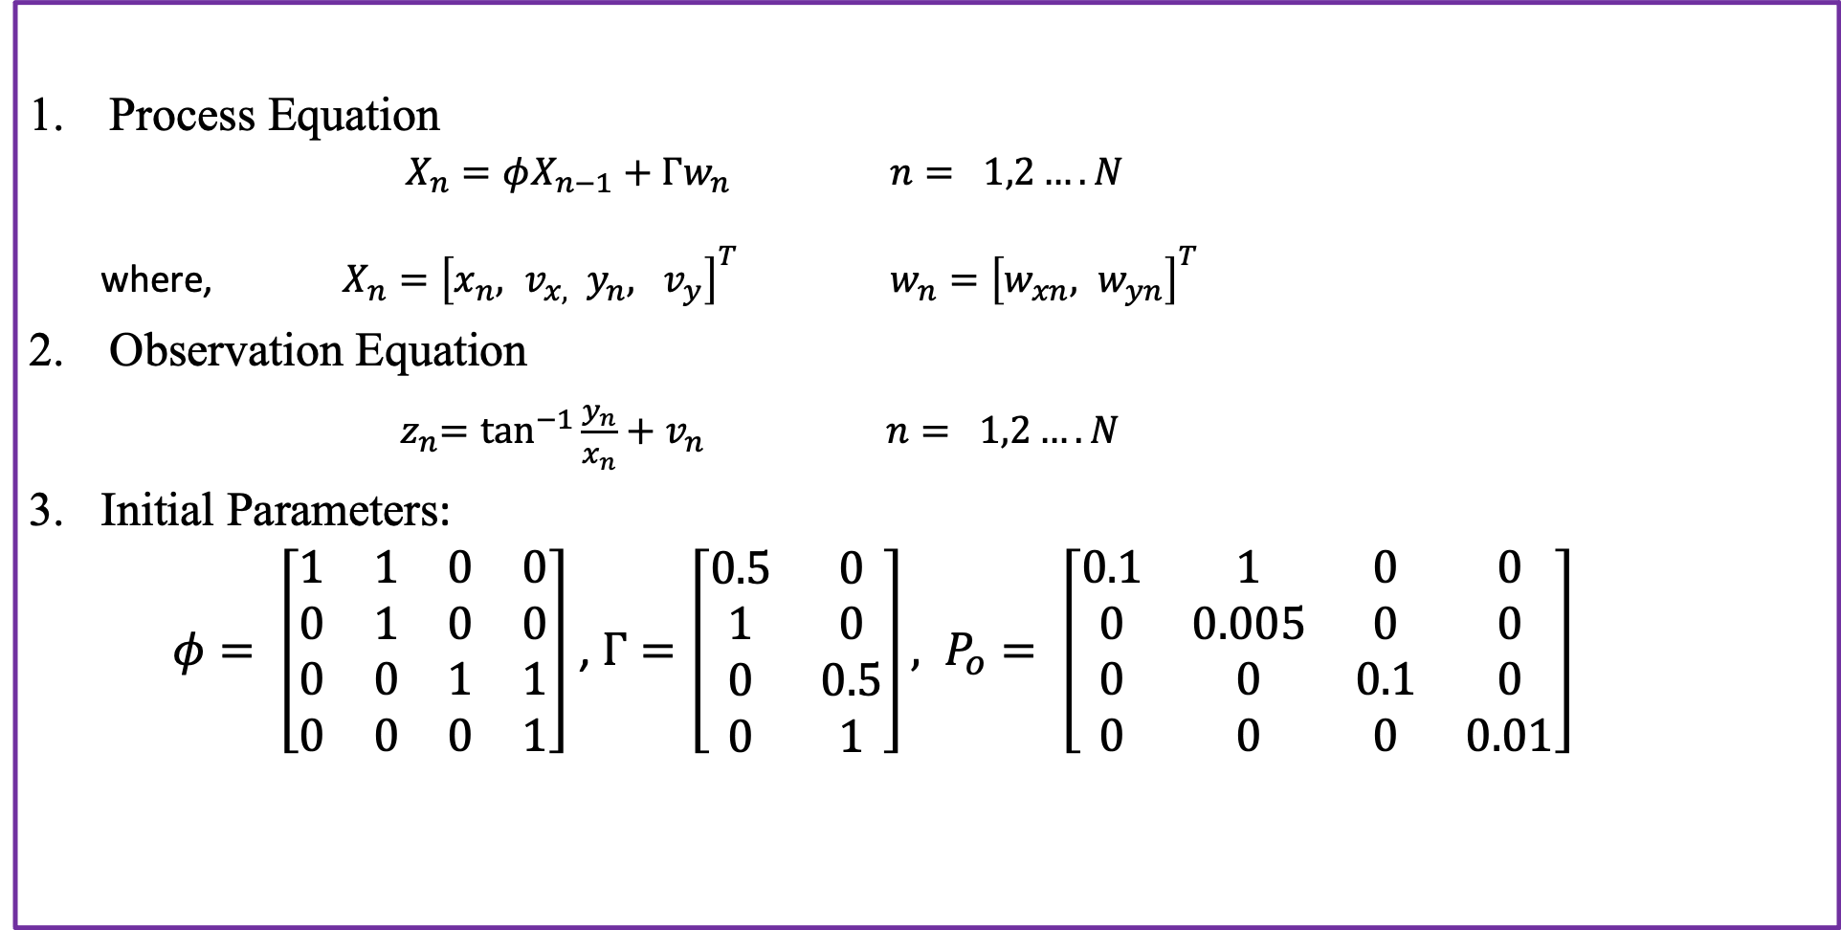
Bearing Only Tracking (BOT)
Process Equation
$X_{n}=φX_{n−1}+Γw_{n}$ $n= 1,2….N$
where, $X_{n}={\left[x_{n}, v_{x, } y_{n}, v_{y}\right]}^{T}$ $w_{n}={\left[w_{xn}, w_{yn}\right]}^{T}$
Observation Equation
${ z}_{n}=\tan^{−1}{\frac{y_{n}}{x_{n}}}+v_{n}$ $n= 1,2….N$
Initial Parameters:
$φ= \left[\begin{matrix}1 & 1 & 0 & 0 \\ 0 & 1 & 0 & 0 \\ 0 & 0 & 1 & 1 \\ 0 & 0 & 0 & 1\end{matrix}\right]$ , $Γ=\left[\begin{matrix}0.5 & 0 \\ 1 & 0 \\ 0 & 0.5 \\ 0 & 1\end{matrix}\right], P_{o}= \left[\begin{matrix}0.1 & 1 & 0 & 0 \\ 0 & 0.005 & 0 & 0 \\ 0 & 0 & 0.1 & 0 \\ 0 & 0 & 0 & 0.01\end{matrix}\right]$

Slide 21
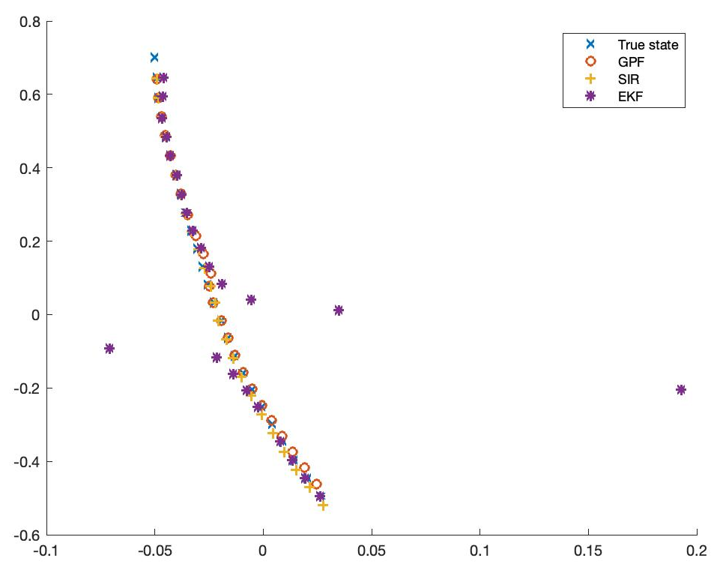
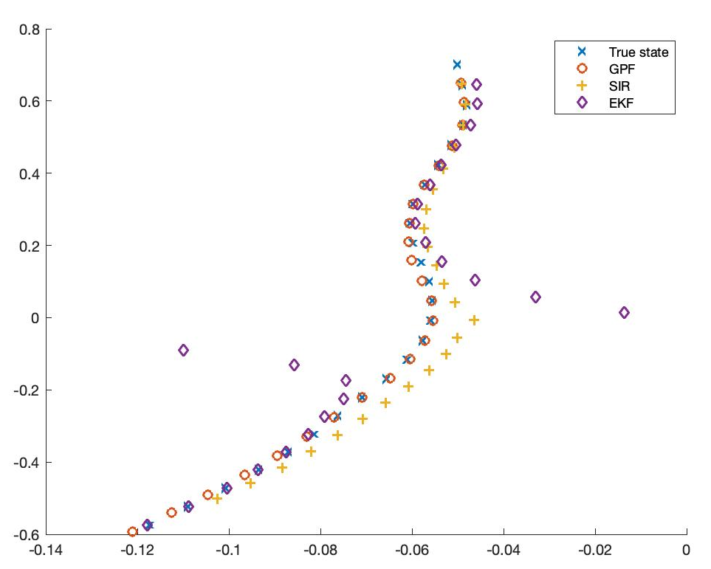
BOT tracking by filters
As we can see from the above plots, GPF and SIR are tracking the true state almost exactly, but EKF is diverging at some points.
Figure 8: BOT tracking of GPF, SIR and EKF.

Slide 22
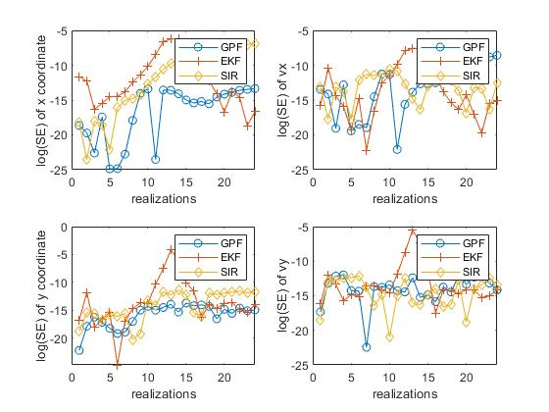
Performance evaluation
Figure 9: Performance comparison of GPF, SIR, EKF

Slide 23
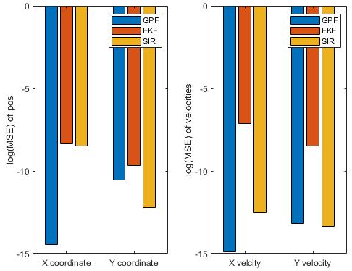
Performance Evaluation
Figure 10: Performance comparison of GPF, SIR, EKF. Average MSEs for position and velocities in x and y directions.

Slide 24
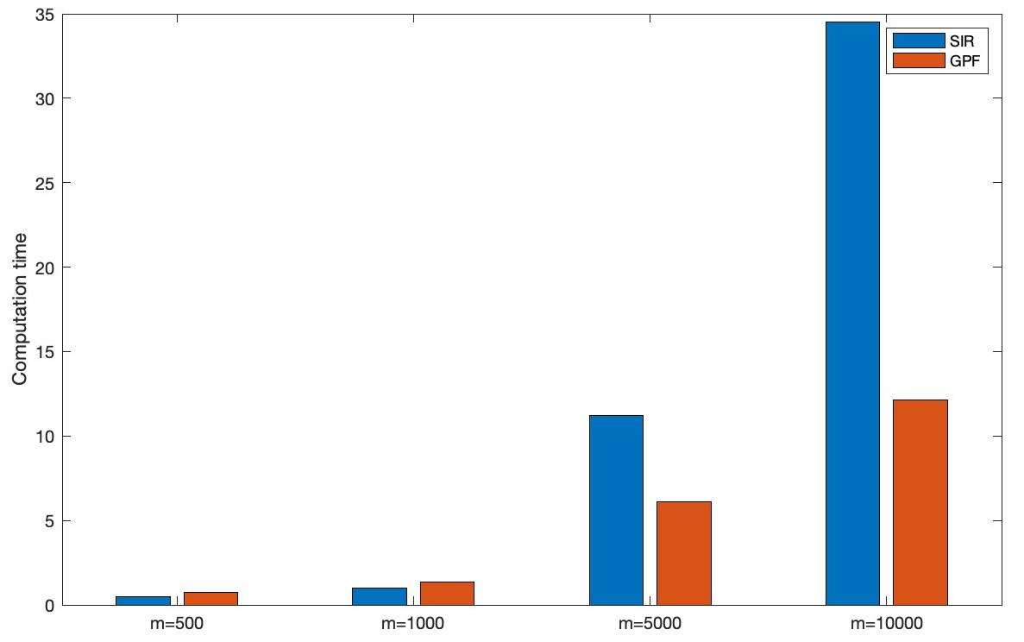
GPF vs SIR computation time
Figure 11: Computation time comparison between SIR and GPF for different number of particles.

Slide 25
Inferences and conclusions
As from results we observe that Gaussian particle filter works almost as good as SIR filter in terms of accuracy, but with a very higher computational efficiency.
GPF is better than EKF, in terms of the accuracy and stability.
In case, of GPF only the mean and variance are propagated iteratively, which is not the case with other particle filters like SIR which is using resampling.
GPF also works better with Gaussian mixtures and non-linear models are used in place of unimodal Gaussian distribution which is generally not the case with other filters.

Slide 26

Thanks a lot for being patience and listening to us.
Any Suggestion will be highly admired!!!

