Slide 1
Formal Modeling and Analysis of
Real-Time Systems
…in the age of AI
Rong Gu
ronggufly@gmail.com
Dec 16, 2025
Notes:
Welcome. This is Formal Modeling and Analysis of Real-Time Systems. We teach it this year with an explicit question running through it: now that AI can build models for us, what is actually worth learning? Short answer — the concepts, and the judgement to check what the AI produces.

Slide 2
Who am I?
▸ Rong Gu — Formal Methods Developer at P (2025 – now)
– 2010 / 2013: BSc & MSc in Software Engineering, Xi'an Jiaotong University, China
– 2013–2017: Embedded software engineer, China
– 2022: PhD in Computer Science, Mälardalen University (Seceleanu, Enoiu, Lundqvist)
– 2022–2025: Postdoc, Mälardalen University (IDT) — formal modelling & analysis of embedded systems
▸ Contact: ronggufly@gmail.com
2
Notes:
A quick word on where I'm coming from: embedded software, a PhD and postdoc on formal modelling and analysis of embedded systems, and now formal methods at P.

Slide 3
FOUNDATIONS
What is a model?
▸ Model — an abstract representation of reality
– leaves out detail to make the workings understandable
▸ A system model helps you…
– understand the functionality of the system
– communicate with customers and colleagues
– …and, if given precise semantics, reason about it rigorously
AI is a model too — but a different kind
A large language model is itself a model of reality — but a statistical, non-semantic one you cannot feed to a prover for a guarantee.
This course is about models you can reason about, and about checking the ones an AI builds for you.
3
Notes:
Start with the basic idea of a model: an abstraction of reality that helps us understand it. The hook on the right is the theme of the course — an LLM is itself a model of the world, but a statistical, non-semantic one. You can't hand it to a prover and get a guarantee. We build models we CAN reason about.

Slide 4
FOUNDATIONS
Models: perspectives & examples
▸ Three perspectives on a system
– External — its context / environment
– Behavioural — what the system does over time
– Structural — its architecture
▸ Examples
– Data-flow models — how data is processed as it moves
– State-machine models — response to events
Is it a model? Is an AI a model?
Both describe a system's behaviour.
The difference is verifiability: a state machine has
semantics you can check; an AI's internal 'model'
does not. Keep that distinction in mind all lecture.
4
Notes:
Three perspectives — external, behavioural, structural — and two classic example families. Good discussion prompt: 'is an AI a model?' Yes, but not a verifiable one. That difference is the whole point.

Slide 5
FOUNDATIONS
Formal models
▸ A formal model has mathematical semantics
– every symbol and transition has a precise, unambiguous meaning
▸ That precision is what makes rigorous analysis possible
– you can prove properties, not just inspect diagrams
The trust anchor
Formal semantics is exactly what lets you check
someone else's model — including one produced by AI.
No semantics → no proof → no basis for trust.
This is why we still model formally when AI can
generate artifacts in seconds.
5
Notes:
Formal = mathematical semantics: every symbol has a precise meaning. Emphasise the trust anchor framing — semantics is exactly what lets you check someone else's model, including one an AI generated. No semantics, no proof, no basis for trust.

Slide 6
THE SPINE OF THIS COURSE
Model analysis: Verification vs Validation
▸ Analysis needs two inputs
– a system model, and a system requirement
▸ Verification — “did we build the thing right?”
– formal verification, simulation, testing
▸ Validation — “did we build the right thing?”
– user validation, test scenarios, judgement
Where AI fits
VERIFICATION is symbolic and automatable —
AI helps most here: draft models, TCTL properties,
run tools.
VALIDATION connects the model to real-world intent.
It lives OUTSIDE the formal system, so AI cannot own
it — the AI only has what you typed, not the intent.
AI manipulates the symbols; it cannot supply the
intent or the guarantee.
6
Notes:
This is the spine of the course. Verification asks 'did we build the thing right?' — symbolic, exhaustive, automatable, and where AI helps most. Validation asks 'did we build the right thing?' — it connects the model to real-world intent and lives OUTSIDE the formal system, so AI can't own it. Repeat the line: AI manipulates the symbols; it cannot supply the intent or the guarantee.

Slide 7
VERIFICATION
Formal verification
▸ Check ALL system behaviours — exhaustive, not sampled
▸ The property to check is stated in a logic
▸ Algorithmic verification (model checking)
– explore the state space, check it against logic properties
– scalability is still a genuine challenge
Exhaustive ≠ probabilistic
An LLM gives a plausible answer, fast, with no guarantee. Model checking gives certainty over every reachable behaviour.
Powerful ≠ certain.
7
Notes:
Formal verification checks ALL behaviours, exhaustively, against a property in logic. Contrast with an LLM, which gives a plausible answer fast but with no guarantee. Powerful is not the same as certain.

Slide 8
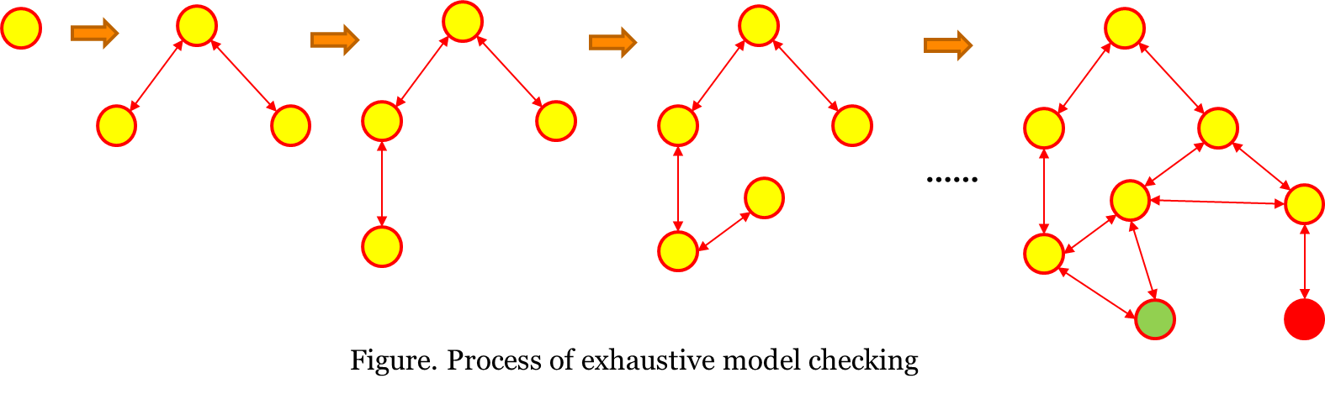
VERIFICATION
Model checking: the state-space explosion
▸ The number of states grows explosively with components, clocks and variables
▸ This is an open research challenge…
– …orthogonal to how capable LLMs become
AI does not dissolve state explosion — the reason model checking is still hard is not a reason AI can replace it.
8
Notes:
The catch is state-space explosion — the number of states blows up with components, clocks and variables. Make the point clearly: this is an open problem that has nothing to do with how good LLMs get. It's the concrete rebuttal to 'why model-check at all now?'

Slide 9
WHY THIS STILL MATTERS
Formal methods in the age of AI
AI lowers the cost
Building models and drafting
properties — historically the
barrier to formal methods —
is now fast and assisted.
…and raises the stakes
If AI authors the artifact, you
must verify it. The verifier is
the trust anchor, and AI is a
fallible author.
Your job shifts
From drawing automata to:
specify precisely, validate
against intent, and judge the
counterexample. That is durable.
9
Notes:
The thesis slide. Walk the three cards: AI lowers the historic cost of formal methods; that raises the stakes, because now you must verify AI's output and AI is a fallible author; so your job shifts from drawing automata to specifying, validating, and judging counterexamples. That last skill is the durable one.

Slide 10
VERIFICATION
Deductive verification (theorem proving)
▸ Prove correctness from axioms and inference rules
– not fully automated — needs human guidance
▸ Classic syllogism
– All men are mortal; Socrates is a man
– ∴ Socrates is mortal
Plausible reasoning vs sound proof
An LLM can imitate this reasoning — and often gets it
right — but offers no guarantee of soundness.
A proof does.
Genuinely shifted by AI: LLMs + proof assistants are
pushing autoformalization, making deductive
verification more automatable than before.
10
Notes:
Deductive verification proves correctness from axioms and rules — not fully automated. The Socrates syllogism is the toy example. Honest note: this is genuinely shifted by AI — LLMs plus proof assistants are pushing autoformalization. But imitating reasoning is not the same as a sound proof.

Slide 11
MODEL CHECKING
Model checking = model (A) + requirement (F)
▸ A — the model: a network of timed automata
▸ F — the requirement: a temporal-logic formula, e.g.
– Invariant — something bad never happens
– Reachability — something can eventually happen
– Liveness — something always eventually happens
Tool: UPPAAL (Uppsala University & Aalborg University)
The oracle
The model checker is the oracle of truth: given A and F it answers with certainty, and hands you a counterexample when F fails.
It is where an AI-built model gets checked.
11
Notes:
Model checking takes two inputs: the model A (a network of timed automata) and the requirement F (a temporal-logic formula). The checker is the oracle — it answers with certainty and hands you a counterexample when F fails. It is where an AI-built model gets checked.

Slide 12
REAL-TIME SYSTEMS
Real-time systems
▸ Correctness depends on the logical order of events AND their timing
– not the fastest time — the right time
▸ A controller (discrete) drives a plant (continuous)
▸ Everyday examples
– airbags, cruise control, production lines, robots, protocols
Why proof, not vibes
These are safety-critical: “probably correct” is not acceptable when an airbag must fire within milliseconds.
Timing correctness must be proven, and that is exactly what real-time model checking does.
12
Notes:
Real-time systems: correctness depends on order AND timing — the right time, not the fastest. A discrete controller drives a continuous plant. These are safety-critical, so 'probably correct' is not acceptable; timing must be proven.

Slide 13
REAL-TIME SYSTEMS
Real-time model checking: the working loop
Model
Simulate
Verify
Interpret
Refine
▸ Model the tasks and the environment as automata, then verify the resulting network
▸ A counterexample sends you back into the simulator to see why
Reframed for the AI era
The MODEL step is exactly what AI can now assist.
The durable human skill is the rest of the loop:
read the trace, interpret it, validate against intent,
and decide what to refine. Don't outsource the
judgement — only the drawing.
13
Notes:
The working loop: model, simulate, verify, interpret, refine. Here's the reframing — the MODEL step is exactly what AI now assists. The durable human skill is the rest: read the trace, interpret it, validate against intent, decide what to fix. Outsource the drawing, not the judgement.

Slide 14
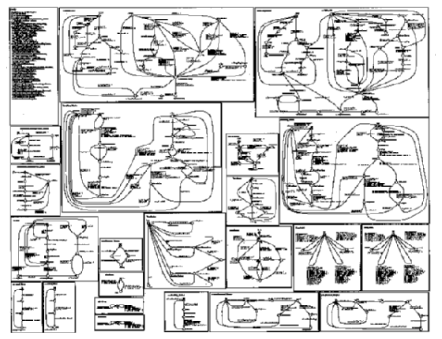
REAL-TIME SYSTEMS
…at industrial scale
▸ A real protocol model (ABB): every box is an automaton
▸ Engineers ask questions no one can eyeball
– is this error state reachable?
– max response time between two states?
– is this variable always < 64?
– is the system guaranteed to reach this state?
▸ At this scale an AI-generated model MUST be checked — you cannot verify it by reading it
14
Notes:
A real industrial protocol model from ABB — every box is an automaton. Engineers ask questions no one can answer by eye: is this error state reachable, what's the max response time, is this variable always under 64. At this scale an AI-generated model MUST be checked; you cannot verify it by reading it.

Slide 15
TIMED AUTOMATA
Example: light control
▸ Wanted behaviour
– pressed once → light on
– pressed twice quickly → light gets brighter
– pressed again → light off
▸ The word “quickly” is about timing — hold that thought
15
Notes:
Our running example. The wanted behaviour is simple to state — but note the word 'quickly'. That's a timing requirement, and it's what forces us toward clocks.

Slide 16
TIMED AUTOMATA
Finite-state automata
▸ A finite state graph with
– a set of nodes (states / locations)
– a set of edges (transitions)
– a set of labels (actions)
a
Off
On
b
A two-state light: a turns it on, b turns it off
16
Notes:
Finite-state automata: nodes (states), edges (transitions), labels (actions). The minimal foundation.

Slide 17
TIMED AUTOMATA
Finite-state automata with variables
▸ Extend FSA with variables
– guards — conditions on variables to enable a transition
– assignments — updates / resets on a transition
▸ Semantics: transition systems
Flag==1
a
Flag:=2
Off
On
Flag==2
b
Flag:=1
Guards gate edges; assignments update state
labels: guard action update
17
Notes:
Extend FSA with variables: guards decide when an edge is enabled, assignments update state on the edge. Semantics are transition systems.

Slide 18
TIMED AUTOMATA
Light control without time — it doesn't work
The gap
Nothing here distinguishes a quick second press from a slow one.
We need to measure elapsed time → add a clock.
Off
Light
Bright
Every transition is a single button press
18
Notes:
Try to model light control with a plain FSA and it fails — nothing distinguishes a quick second press from a slow one. Every edge is just 'press'. We need to measure elapsed time, so we add a clock.

Slide 19
TIMED AUTOMATA
Timed automata (Alur & Dill, 1990)
▸ Guard — a timing constraint, e.g. x > 10
▸ Action — a synchronisation label, e.g. a
▸ Clock reset — set a clock to 0, e.g. x := 0
x>10
a
x:=0
1
2
labels: guard action update
AI doesn't change this
The definition of a timed automaton is mathematics — it is
exactly the same in 2025 as in 1990. What AI changes is who
draws the automaton, not what it means.
19
Notes:
Timed automata, Alur and Dill 1990: guards are timing constraints, actions synchronise, clocks reset to zero. Say it plainly — this definition is mathematics; it's the same in 2025 as in 1990. AI changes who draws the automaton, not what it means.

Slide 20
TIMED AUTOMATA
Light control, with a clock
Analysis
Can the light
eventually become
bright? Ask the
model checker.
Off
x:=0
Light
x<=3
Bright
x>3
Presses are the events; clock x separates a quick press (x≤3 → Bright) from a slow one (x>3 → Off)
labels: guard action update
20
Notes:
Now light control works: clock x measures the delay between presses. A quick press (x<=3) goes to Bright; a slow one (x>3) returns to Off. The natural analysis question — can the light eventually become bright — is one we hand to the model checker.

Slide 21
TIMED AUTOMATA
Timed automata: semantics
▸ State = ( location, clock values )
– clocks x, y take real values
▸ Two kinds of transition
– discrete — follow an edge (instantaneous)
– delay — stay put; all clocks advance by the same real amount
x<=5 & y>3
a
x:=0
n
m
labels: guard action update
( n, x=2.4, y=3.14 ) —a→ ( m, x=0, y=3.14 ) discrete
( n, x=2.4, y=3.14 ) —1.1→ ( n, x=3.5, y=4.24 ) delay
21
Notes:
Semantics: a state is a location plus real-valued clock readings. Two transition kinds — discrete (follow an edge, instantaneous) and delay (stay put, all clocks advance by the same real amount). The two example lines show each.

Slide 22
TIMED AUTOMATA
Invariants force progress
▸ An invariant bounds how long you may stay in a location
– upper bounds only, e.g. x<=5
▸ It cannot delay past x=5, so it must act
– risk: it can also get stuck (deadlock) — a design smell to check
x<=5
y<=10
n
m
x<=5 & y>3
a
x:=0
Without the invariant the automaton could delay forever in n
labels: guard action update
22
Notes:
Invariants are upper bounds that force progress: the automaton can't delay past the bound, so it must act. Flag the risk — invariants can also cause deadlock, which is itself something to verify.

Slide 23
TIMED AUTOMATA
Clock constraints
▸ For clocks x, y and an integer constant c, a constraint is built from:
– comparisons: x < c, x <= c, x >= c, x > c
– clock differences: x - y <= c
– conjunction: g1 & g2 (and, via negation, disjunction)
▸ Guards use these freely; invariants use upper bounds only
23
Notes:
The grammar of clock constraints: comparisons, clock differences, conjunction. Guards use them freely; invariants use upper bounds only.

Slide 24
TIMED AUTOMATA
Timed automata: guards & invariants
Lower bound
Bounded
With invariant
x>=2
x:=0
2<=x<=3
x:=0
x>=2
x:=0
l
l
l
x<=3
fires once x≥2, may wait longer
fires only while 2≤x≤3
invariant x≤3 forces the action
labels: guard action update
24
Notes:
Three variants on one location: a lower-bound guard, a bounded window, and a guard plus an invariant that forces the action. This is where students build intuition for hand-tracing.

Slide 25
TIMED AUTOMATA
Modelling tasks: periodic, sporadic, aperiodic
Periodic (20)
Sporadic (≥20)
Aperiodic (5–100)
x==20
x:=0
x>=20
x:=0
5<=x<=99
x:=0
T
T
T
x<=20
x<=100
exactly every 20 time units
at least 20 apart, may wait
between 5 and 100 apart
labels: guard action update
25
Notes:
Modelling task arrivals: periodic fires exactly every 20 (guard x==20, invariant x<=20); sporadic is at-least-20-apart (guard x>=20, no invariant); aperiodic is between 5 and 100 (guard 5<=x<=99, invariant x<=100).

Slide 26
TIMED AUTOMATA
Timed automata: a light switch
▸ On only after >2 units since off
▸ Auto-off after 9 units, unless pressed again
push
x:=0
x>2
push
x:=0
off
on
x<=9
x==9
x:=0
labels: guard action update
26
Notes:
A fuller example, the light switch: on only after more than 2 units since off, auto-off after 9, and a re-press resets the clock (the self-loop). Good one to pause on.

Slide 27
TIMED AUTOMATA
Semantics: action & delay transitions
▸ Action transition (l, v) —a→ (l', v')
– guard g holds in v; apply reset r; invariant of l' holds in v'
▸ Delay transition (l, v) —d→ (l, v+d)
– invariant of l must hold throughout the delay
Example trace (light switch, clocks x, y):
(off, 0, 0) —3.5→ (off, 3.5, 3.5)
—push→ (on, 0, 0) [both reset]
—π→ (on, π, π) —push→ (on, 0, π) …
27
Notes:
The formal rules behind it: an action transition needs its guard satisfied and the target invariant to hold after the reset; a delay transition keeps the invariant true throughout. The trace at the bottom is exactly the kind of hand-tracing the assignment will ask for.

Slide 28
TIMED AUTOMATA
Networks of timed automata
▸ Several automata run in parallel
▸ They synchronise on channels
– a! — send / a? — receive
– both edges are taken together, atomically
▸ Shared (bounded) integer variables too
x>=2 & i==3
a!
y:=0
l1
l2
m1
m2
a?
i:=i+1
a! and a? fire together — a two-way rendezvous
labels: guard action update
28
Notes:
Compose several automata into a network; they synchronise on channels — a! sends, a? receives, and both edges fire together atomically. Shared bounded integers too. This is how we model interacting components.

Slide 29
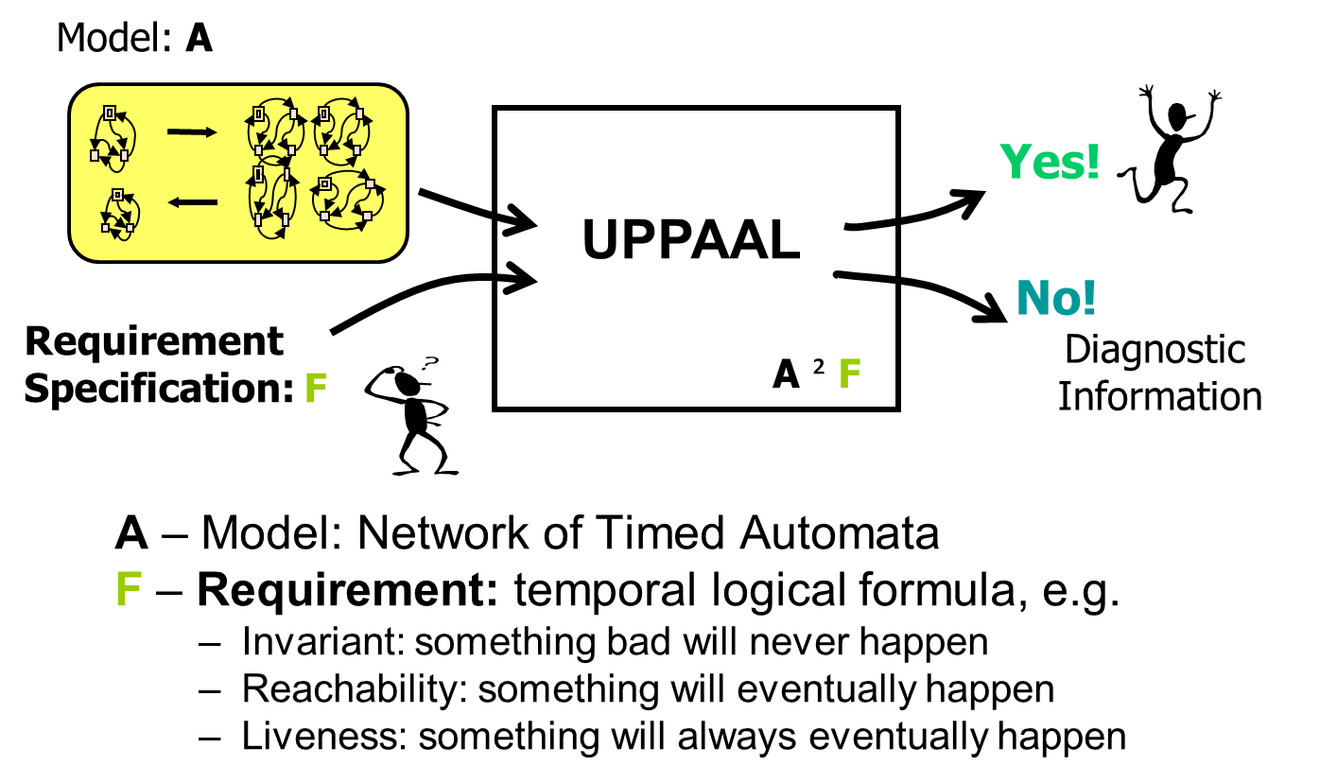
SPECIFICATION
Specifying requirements
▸ Requirements become temporal-logic formulae
– Invariant — something bad never happens
– Reachability — something may happen
– Liveness — something eventually happens
▸ Choosing the RIGHT property is validation
– AI can draft a formula; only you know which requirement it must capture
29
Notes:
Now: how do we say what to check? Requirements become temporal-logic formulae — invariant, reachability, liveness. Stress that choosing the RIGHT property is validation: AI can draft a formula, but only you know which requirement it has to capture.

Slide 30
SPECIFICATION
TCTL — Timed Computation Tree Logic
▸ A branching-time logic over the model's computation tree
– state formulae describe a single state
– path formulae quantify over paths (traces)
▸ A path carrying timing is a timed path
▸ Path formulae: reachability, safety, liveness
UPPAAL
UPPAAL verifies a decidable subset of TCTL — expressive enough for the real-time properties engineers actually need to check.
30
Notes:
TCTL is a branching-time logic over the model's computation tree: state formulae describe one state, path formulae quantify over traces, and a trace with timing is a timed path. UPPAAL checks a decidable subset.

Slide 31
SPECIFICATION
Quantifiers in TCTL
▸ Path quantifiers
– E — there exists a path
– A — for all paths
▸ State quantifiers along a path
– [] — all states (G)
– <> — some state (F)
▸ Combinations we use: A[], A<>, E<>, E[]
In words
A[] p — invariantly p (always)
E<> p — p is reachable (possibly)
A<> p — p is inevitable (unavoidable)
E[] p — potentially always p
31
Notes:
The quantifiers: E/A over paths, [] and <> over states along a path, and the four combinations we actually use. The right box gives the plain-English reading.

Slide 32
SPECIFICATION
The property patterns you'll use
E<> p
Reachable
p holds in at least one reachable state — sanity checks
A[] p
Invariant / safety
p holds in all reachable states — “bad never happens”
E[] p
Potentially always
some path keeps p true forever
A<> p
Inevitable / liveness
every path eventually reaches a p-state
p --> q
Leads-to
A[](p imply A<> q) — whenever p, eventually q
32
Notes:
The five patterns students will use in the lab. E<> for sanity/reachability, A[] for safety, A<> for liveness, E[] for potentially-always, and leads-to for response properties. Point out leads-to is just A[](p imply A<> q).

Slide 33
AI FOR FORMAL MODELLING
Using AI to build formal models
AI is good at
• drafting a model from a description
• boilerplate and UPPAAL syntax
• candidate TCTL properties
• quick iterations on your feedback
AI is bad at
• guarantees — it gives plausible, not proven
• hallucinated counterexample traces
• missing subtle timing edge cases
• the intent you didn't state (validation)
Maps straight onto verification (AI helps) vs validation (yours). AI manipulates the symbols; you supply the intent and demand the guarantee.
33
Notes:
Now we turn to using AI for the modelling itself. Left column: what it's good at — drafting models, syntax, candidate properties, fast iteration. Right: what it's bad at — guarantees, hallucinated traces, missed edge cases, and the intent you didn't state. It maps straight onto verification versus validation.

Slide 34
AI FOR FORMAL MODELLING
How to prompt for a UPPAAL model
▸ State the requirement precisely — units, bounds, edge cases
▸ Name the formalism: a network of timed automata
▸ Enumerate the components and their shared events (channels)
▸ Ask for a single runnable .xml with the queries embedded
▸ Iterate on the counterexamples the tool returns
Point your AI at a UPPAAL skill
A UPPAAL skill (one you build — next slide) encodes the modelling language and the exact .xml file format, so the AI emits models that actually load and verify rather than plausible-looking guesswork.
Good prompt + skill → a correct model. You still own the question: is it the RIGHT model?
34
Notes:
The practical recipe for prompting: precise requirement with units and edge cases, name the formalism, list components and channels, ask for a single runnable .xml with queries embedded, and iterate on counterexamples. Point them at a UPPAAL skill — which they build in the next slide — so the AI emits models that actually load and verify.

Slide 35
AI FOR FORMAL MODELLING
Build your own skill
▸ A bare LLM drifts on UPPAAL's exact syntax and file format
– capture the know-how in a skill → models that load and verify
▸ An Agent Skill = a small folder your AI loads on demand
– a SKILL.md: when to use it, and the procedure
– reference docs it opens only when needed
– portable across AI tools (Claude Code, Codex, …)
BUILD A UPPAAL SKILL
1. Ground it in the official docs (docs.uppaal.org): the modelling language and the .xml format.
2. Write a thin SKILL.md: the modelling workflow + correctness rules (escaping, upper-bound invariants, embedded queries).
3. Add a reference doc: the concrete .xml structure and a small worked example.
4. Validate: generate a model, load it in UPPAAL, confirm it verifies.
We don't hand you the skill — building it is the point
To make an AI produce correct UPPAAL models you must understand UPPAAL yourself — and be able to check its output.
That understanding is exactly what the assignment rewards.
35
Notes:
Key twist: we do NOT give you a ready-made UPPAAL skill — if you want one, you build it, and that's the point. Explain what an Agent Skill is: a small folder your AI loads on demand, with a SKILL.md that says when to use it and how, plus reference docs it opens only when needed. Walk the four build steps on the right: ground it in the official UPPAAL docs, write a thin SKILL.md with the workflow and correctness rules, add a reference with the concrete .xml format and an example, then validate by generating a model and checking it verifies in UPPAAL. Land the message: to make an AI produce correct models you must understand UPPAAL yourself — which is exactly what the assignment rewards.

Slide 36
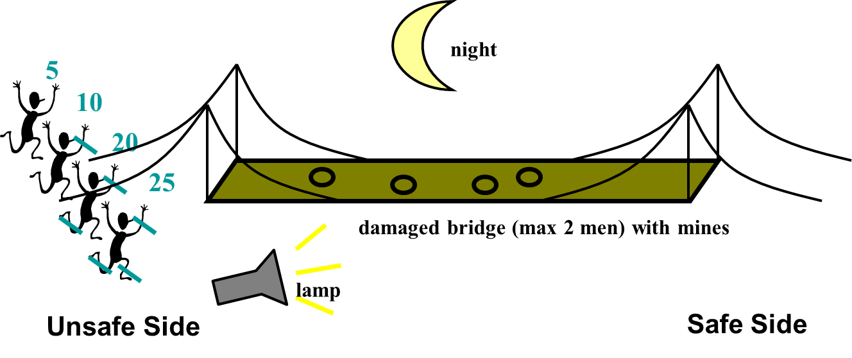
AI FOR FORMAL MODELLING
Worked example: the bridge problem
▸ The prompt gives the problem and the question — not the automaton
▸ Your UPPAAL skill supplies the modelling
– locations, a clock, the guards, and the TCTL query
▸ UPPAAL then confirms a schedule exists
– E<> (all safe && total <= 60)
▸ AI built it fast; the model checker made it trustworthy
A GOOD PROMPT — PLAIN ENGLISH + THE QUESTION
“Using your UPPAAL skill, build a model for the
bridge-crossing puzzle. Four people cross a narrow
bridge at night with one torch; it holds two at a time,
so someone must carry the torch back; a pair moves at
the slower one's pace. Crossing times: 5, 10, 20, 25 min.
Can all four cross within 60 minutes? Add a query that
answers this, verify it, and check it cannot deadlock.”
36
Notes:
Worked example — the bridge problem. Read the prompt on the slide out loud, and make the point: it's plain English — it states the puzzle and the question, but says nothing about locations, clocks, or guards. That's what a good prompt looks like. The UPPAAL skill supplies the modelling, and UPPAAL confirms a 60-minute schedule exists. The AI built it fast; the model checker made it trustworthy.

Slide 37
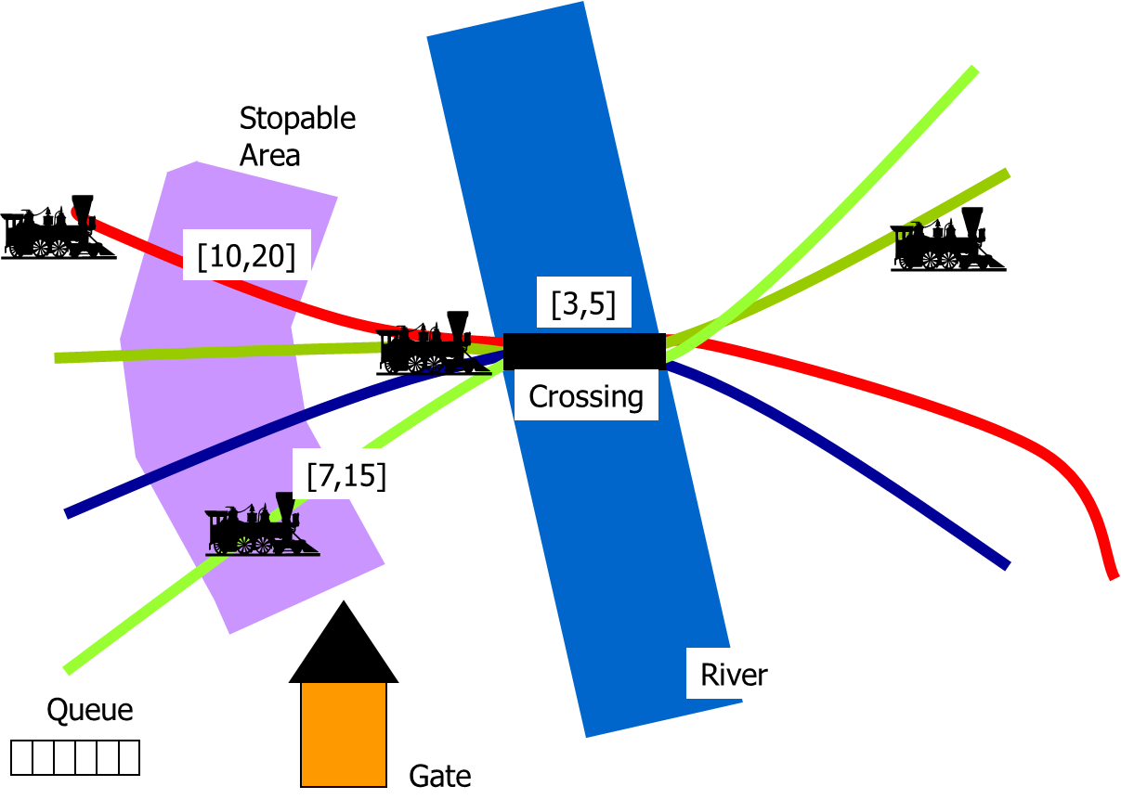
WORKED EXAMPLES
Another classic: the train crossing
▸ Several trains, one shared bridge — mutual exclusion under timing
– approach signal, a 10-unit window to stop, then the crossing
– a controller issues stop / go as trains leave
▸ Exactly the kind of concurrent, timed coordination where a hand argument is hopeless and model checking shines
37
Notes:
The train crossing: several trains, one shared bridge, mutual exclusion under timing constraints and a controller. Exactly the concurrent, timed coordination where a hand argument is hopeless and model checking earns its keep.

Slide 38
WORKED EXAMPLES
When behaviour is stochastic: UPPAAL SMC
▸ Statistical model checking for stochastic timed automata
– probabilistic choice between enabled transitions
– distributions over delays; ODEs for continuous variables
▸ Queries answer probabilistic questions
– estimate Pr[<=T](<> p); test Pr >= p0; compare two probabilities
Use when the requirement is probabilistic
Classic TCTL proves deterministic timing;
SMC estimates likelihoods when the system itself
is random. Different question, same discipline.
38
Notes:
When behaviour is genuinely random, UPPAAL SMC handles stochastic timed automata and answers probabilistic questions — estimate a probability, test it against a threshold, compare two. Different question, same discipline. Keep this brief.

Slide 39
BEFORE THE ASSIGNMENT
What's yours vs. what's the AI's
The AI can
• draft the automata
• write UPPAAL syntax
• suggest properties
• run the tool
Only you can
• decide what to model (intent)
• choose the right property
• validate the model against reality
• judge whether the counterexample means the model or the requirement is wrong
39
Notes:
Reflection before the assignment. Left: what the AI can do for you. Right: what only you can do — decide what to model, choose the right property, validate against reality, and judge whether a counterexample means the model or the requirement is wrong. That right-hand column is what we grade.

Slide 40
ASSIGNMENT
Assignment: a pedestrian crossing controller
▸ Model a signalised pedestrian crossing: vehicle lights, WALK / DON'T-WALK, a push button
▸ The requirement is deliberately under-specified — you must pin down and justify the numbers
– pedestrians “shouldn't wait too long”; WALK must last “long enough” to cross
– cars and pedestrians must NEVER get a green at the same time
– respond promptly to a press, but don't switch too rapidly
▸ You receive an assigned parameter set / twist (crossing width, a bus-priority input, a night mode)
Why this is AI-resistant
The thresholds are yours to choose and defend against real-world intent — the AI never received that intent, so it
cannot justify them for you. Paste the brief into any tool and the judgement, traces and defence remain your work.
40
Notes:
The assignment: a pedestrian crossing controller. It's deliberately under-specified — 'not too long', 'long enough' — so you must fix the numbers and justify them. Everyone gets an assigned parameter set or twist. Explain why that makes it AI-resistant: the AI never received the intent, so it can't defend your thresholds for you.

Slide 41
ASSIGNMENT
Assignment: what you submit (graded)
▸ Requirement interpretation — resolve each ambiguity; state your thresholds and justify them against intent
▸ Formalisation — the requirements as TCTL properties, with a reason for each interpretation
▸ Model + emergent-failure hunt — build it (AI-assisted is fine); use verification to find where it breaks
– document each failure with the counterexample trace UPPAAL produces
▸ Hand-traced counterexample — reproduce one failing trace by hand: locations and clock valuations, step by step
▸ Fix & re-prove — correct the model and show the property now holds
▸ Reflection — where AI helped, where it was wrong, and how verification/validation caught it
41
Notes:
Walk through the seven graded deliverables. The load-bearing ones are the threshold justification, the emergent-failure hunt with real counterexample traces, and especially the hand-traced counterexample — locations and clock valuations, step by step — which an AI hallucinates.

Slide 42
ASSIGNMENT
Assignment: submission & using AI
▸ Submit
– one runnable UPPAAL model .xml with queries embedded
– the counterexample traces and your hand trace
– a short report covering all seven deliverables
▸ Using AI is allowed and expected
– the grade is what you add on top of its output
The test we designed against
“If you paste the whole brief into any AI tool, what is left for you to do?”
Answer: choose and defend the thresholds, hand-trace a counterexample, and validate the model against the real crossing.
That is the part that shows you learned — and the AI cannot do it for you.
42
Notes:
Submission is a single runnable .xml with queries embedded. Using AI is allowed and expected — the grade is what you add on top of its output. End on the design test: if you paste the whole brief into any tool, what's left for you to do? The parts that show you learned.

