Slide 1
Formal Modeling and Analysis of Real-time Systems
Rong Gu
ronggufly@gmail.com
Dec 16, 2025

Slide 2
Who am I?
Rong Gu– short description:
2010: Bachelor Degree in Software Engineering, Xi’an Jiaotong University, China;
2013: Master Degree in Software Engineering, Xi’an Jiaotong University, China;
2013-2017: Embedded software engineer, China;
2022 June: Doctoral Degree of Computer Science at Mälardalen University. Supervisors: Cristina Seceleanu, Eduard Enoiu, Kristina Lundqvist;
2022 June – 2025 Oct: Posdoc at Mälardalen University. IDT. Formal Modelling and Analysis of Embedded Systems
2025 Dec – Now: Formal Methods Developer at P.
Contact info: ronggufly@gmail.com

Slide 3


Slide 4
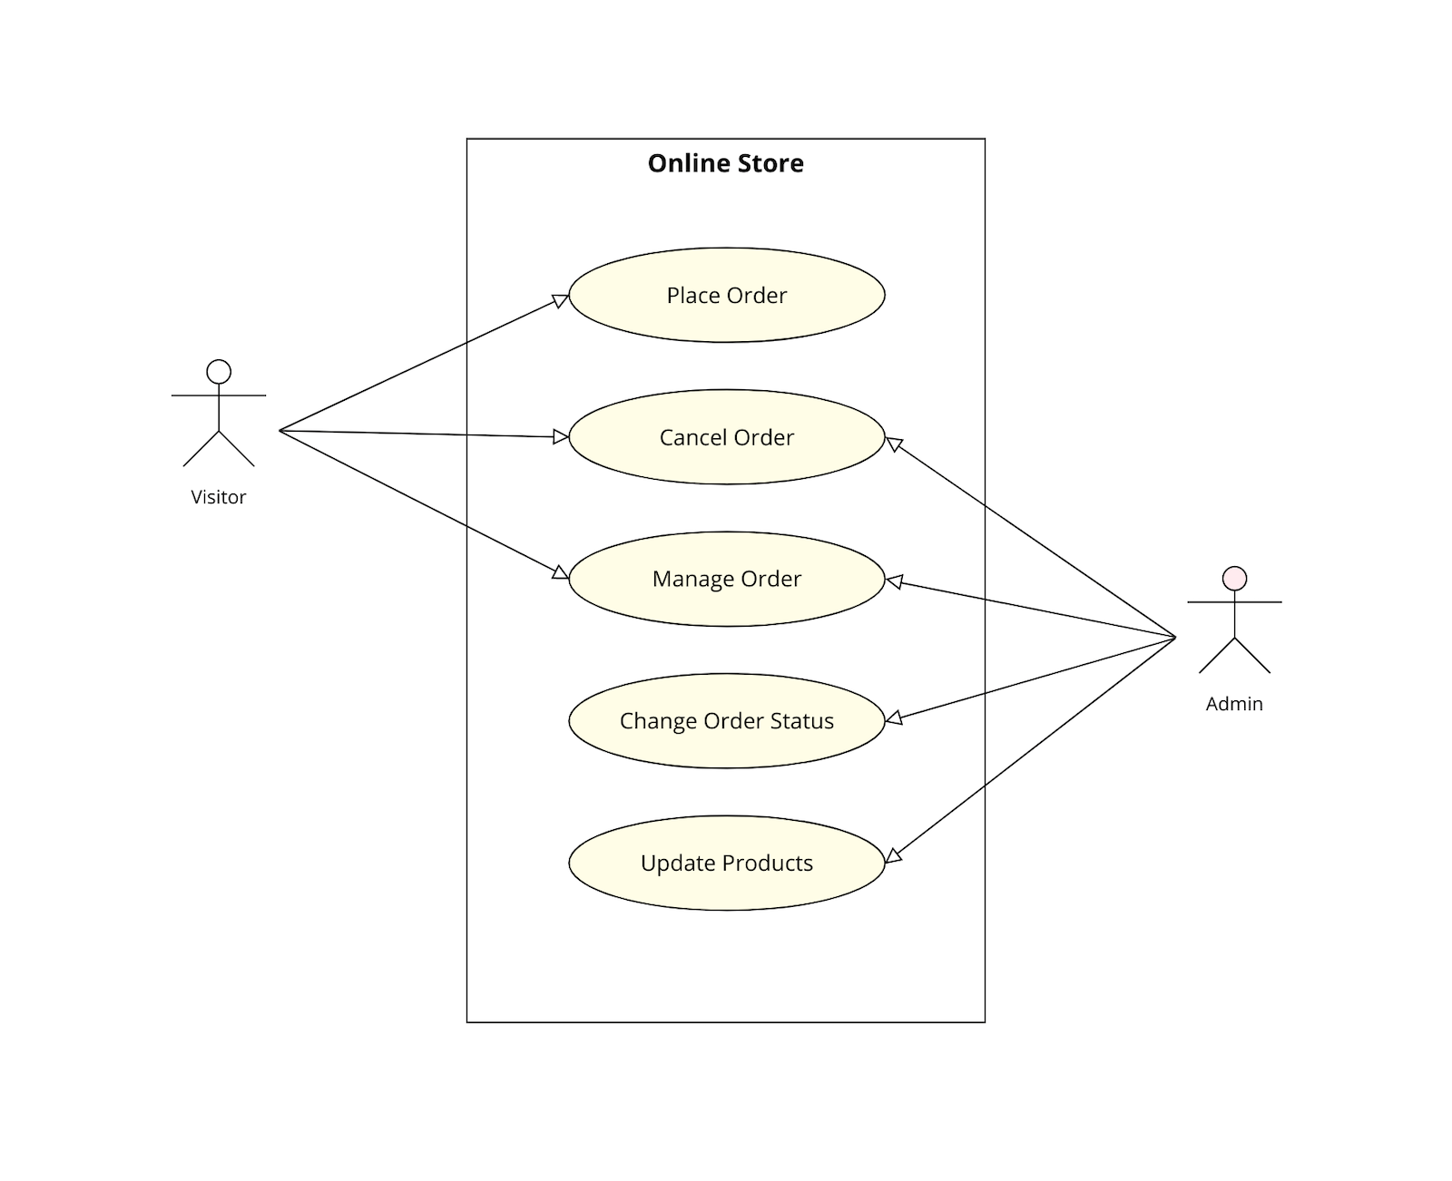
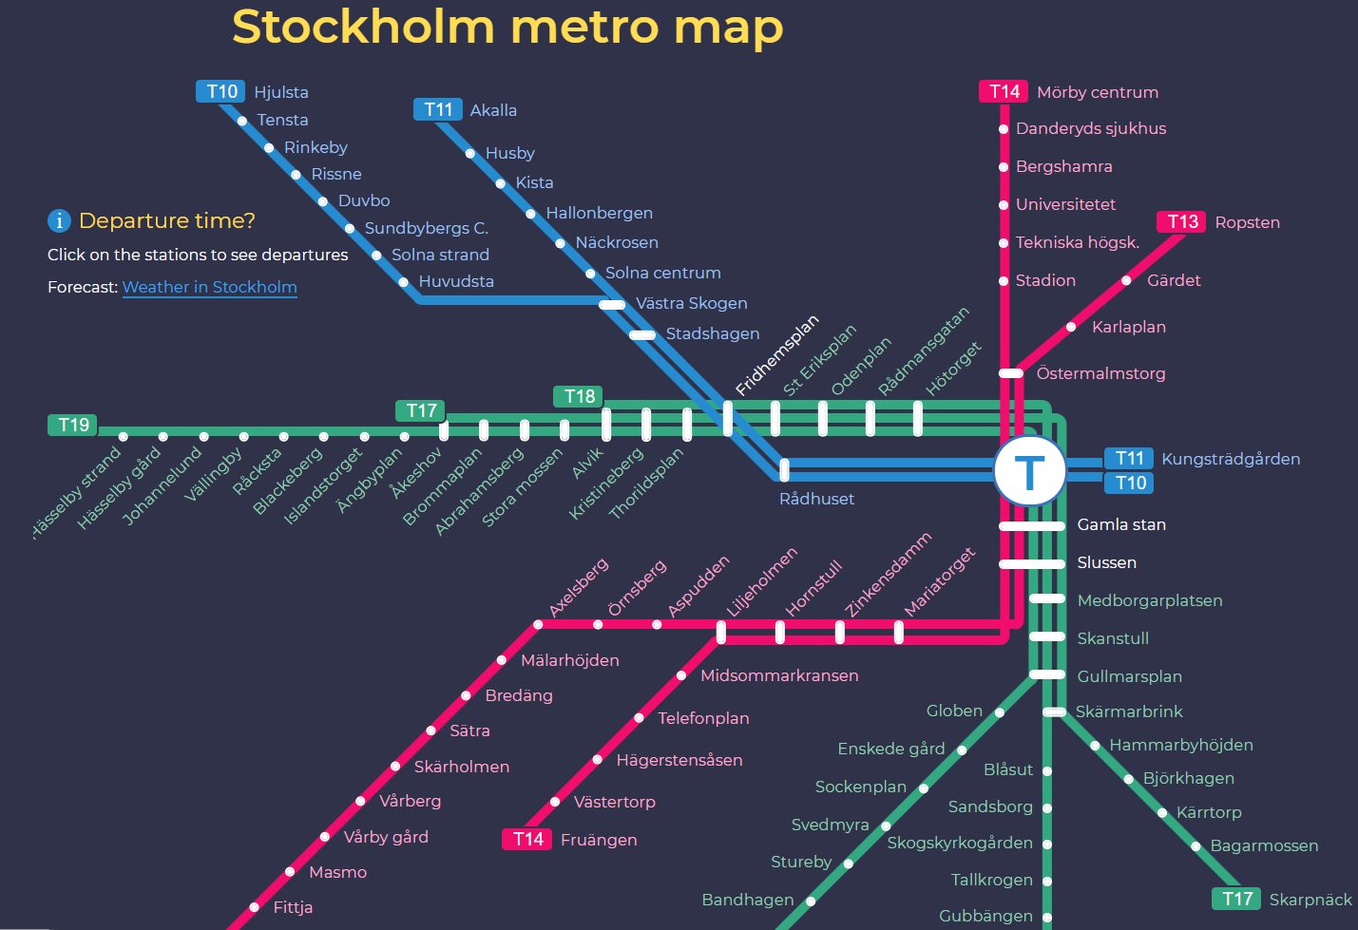
Models
Model:
Abstract representation of reality,
Facilitates the understanding of its workings.
System model:
Helps one understand the functionality of the system,
Used to communicate with customers,
If given semantics: are amenable to rigorous analysis.

Slide 5
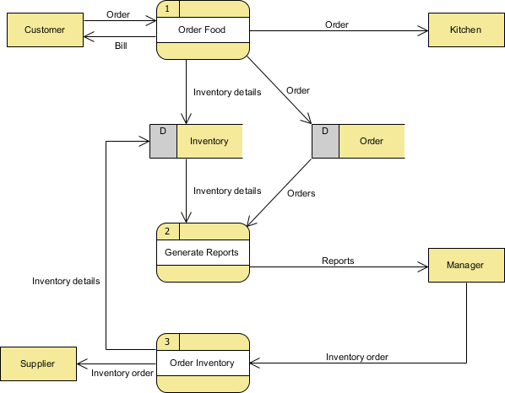
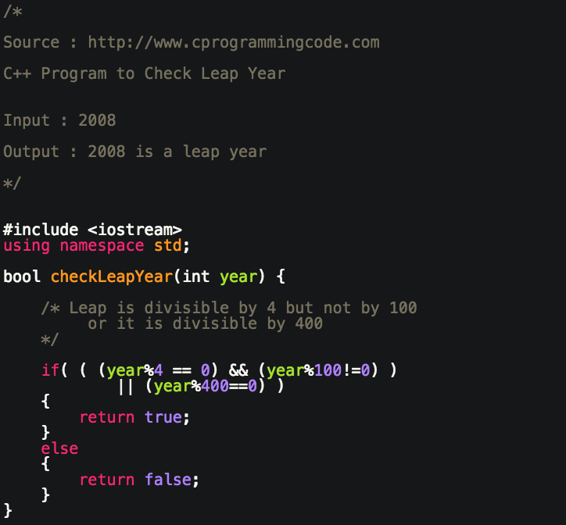
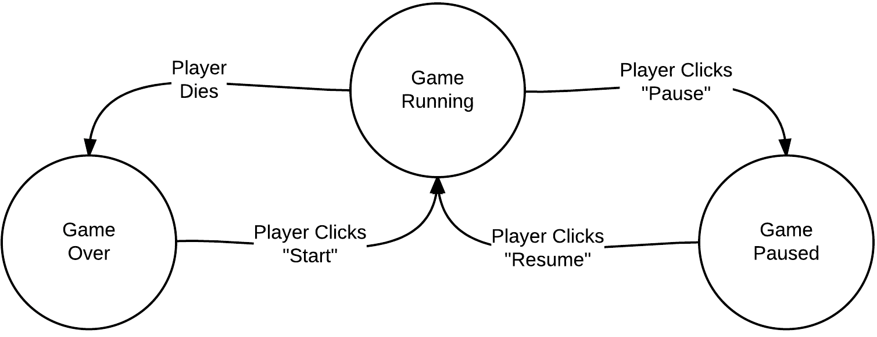
Models
Different perspectives:
External perspective: the system’s context / environment,
Behavioral perspective: the overall system behavior,
Structural perspective: the system’s architecture.
Examples:
Data flow models: show how data is processed as it moves through the system,
State machine models: show the systems response to events.
Is it a model?

Slide 6
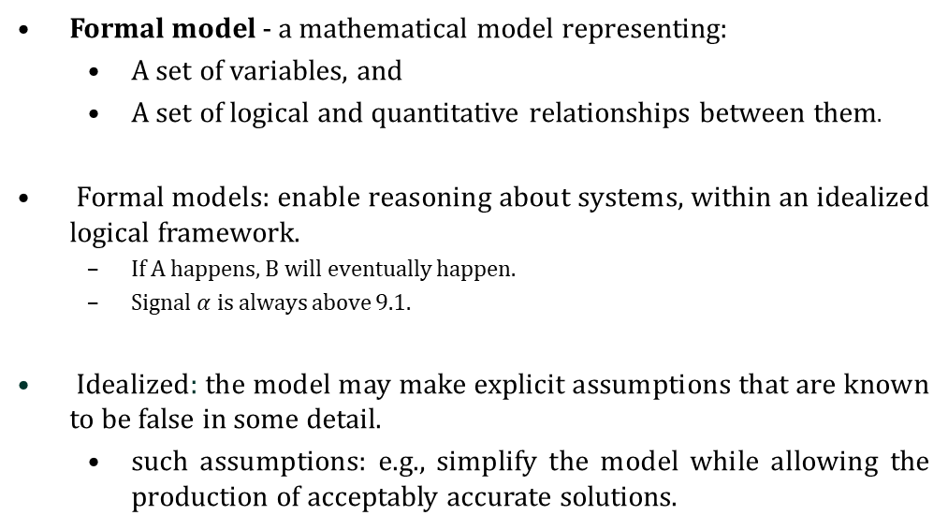
Formal Models
Formal model - a mathematical model representing:
A set of variables, and
A set of logical and quantitative relationships between them.
Formal models: enable reasoning about systems, within an idealized logical framework.
If A happens, B will eventually happen.
Signal $α$ is always above 9.1.
Idealized: the model may make explicit assumptions that are known to be false in some detail.
such assumptions: e.g., simplify the model while allowing the production of acceptably accurate solutions.

Slide 7
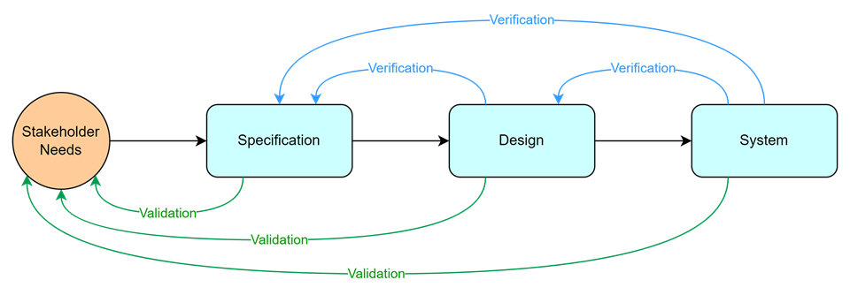
Model Analysis
Investigation conducted to provide information about the quality of the product or service.
Intended to discover software bugs.
Prerequisites:
System model,
System requirement.
Techniques
Verification:
Formal verification
Simulation-based testing
Physical testing
Validation:
Physical testing
User validation
Test scenarios

Slide 8
Formal Verification
Checking ALL system behaviours (i.e., exhaustive verification),
Property to check is given in some logic.
Algorithmic Verification (model checking)
Exploration of the state space, and check it against logic expressions (a.k.a., properties)
Scalability is still a challenge!

Slide 9
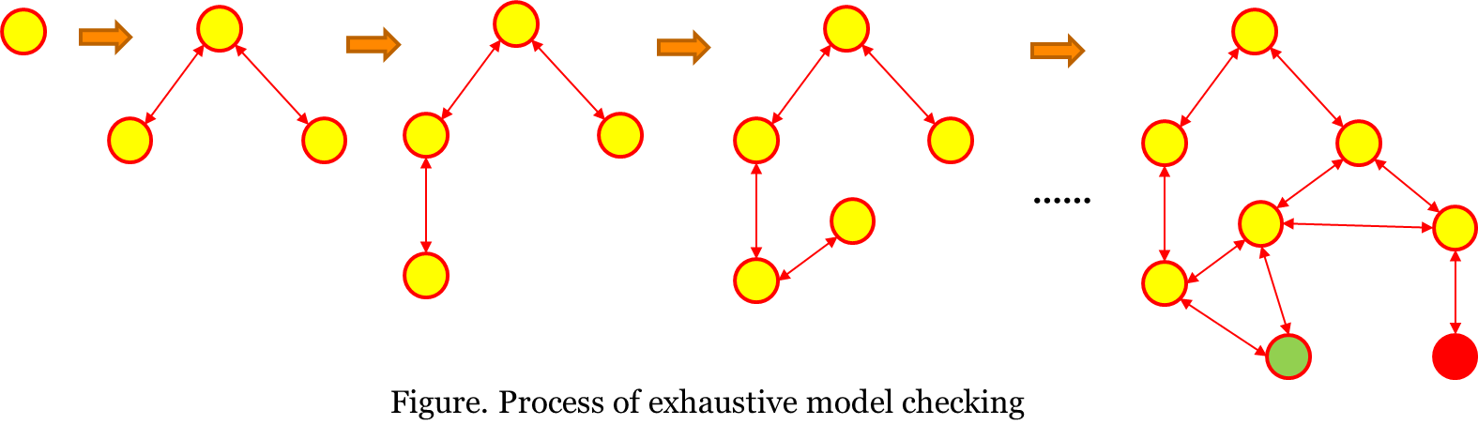
Model Checking
State space explosion problem

Slide 10
Formal Verification
Checking ALL system behaviours (i.e., exhaustive verification),
Property to check is given in some logic.
Algorithmic Verification (model checking)
Exploration of the state space,
Scalability is still a challenge!
Deductive Verification (theorem proving)
Uses axioms, rules to prove the correctness of a given model,
Not fully automated (hindered application).

Slide 11
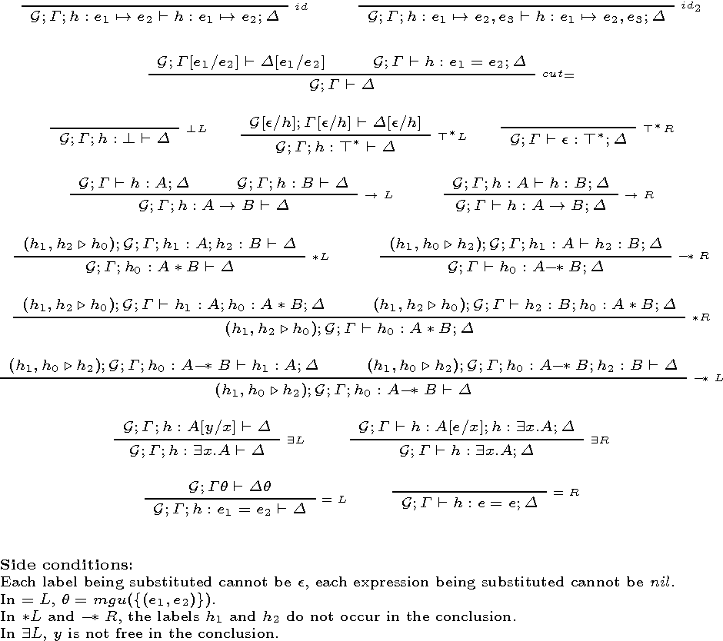
Theorem Proving
Example A:
Precondition 1: All men are mortal;
Precondition 2: Socrates is a man;
Conclusion: Socrates is mortal.
Example B:

Slide 12
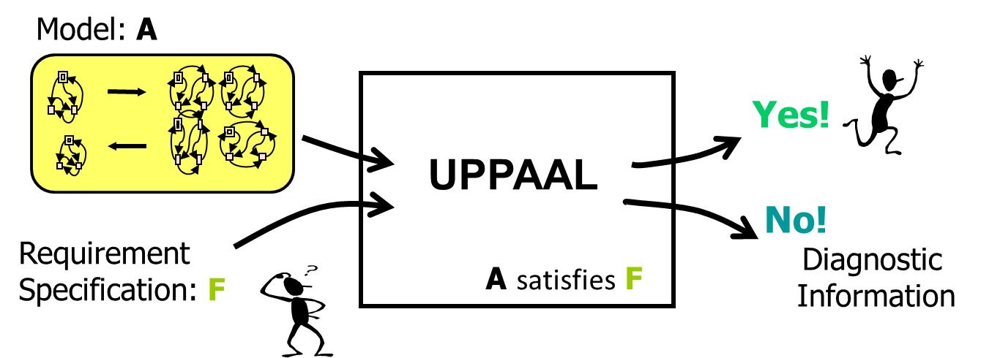
Model Checking
1
A – Model: Network of Timed Automata
F – Requirement: temporal logical formula, e.g.
Invariant: something bad will never happen
Reachability: something will eventually happen
Liveness: something will always eventually happen
1: A model checker developed by Uppsala University and Aalborg University
Notes:
If we have a model and some property, a requirement, we can ask a model checker, like Uppaal to check if the model satisfies the requirement speciffication in an automatic manner. If it does we are happy, if not we will like to understand what is happening, it is the same as when you run a computer program in Java for example that you wrote and then if it is missbehaving you look at what happened at a certain point and then maybe you try to debugg it. The same principels govern also this process of model-checking.
In our case the model will be a network of timed automata, a model that consists of more than one timed automata (more than one time machines) and a requirement will be temporal logic formulae, like a property saying if something bad will never happen, or something good may happen, or that something will eventually happen, if you want to see some progress in your system. We will work with a software tool for this..

Slide 13
Real-Time Systems
sensors
Task
Task
Task
Task
actuators
Plant
Continuous
Controller Program
Discrete
Real-Time System
A system where correctness not only depends on the logical order of events but also on their timing!!
E.g.:
Air Bags, Cruise Control, Production Lines, Robots
Real-time Protocols
Notes:
When we think about real-time systems we refer to a systems with time. A real-time systems is a system that has a functional behavior that depends on timing of different events happening for its correctness.
It doesn’t need just to deliver only outputs at any time but it needs to deliver them at the right time, not the fastest time but the right time. A real-time system contains programs, tasks, sensors and actuators for influencing the environment.
Another thing to note here is that the controller program is a computer program and it is discrete in its nature while the plant (the envirnomnent) is continuos with countinuos behavior. We can find such computer programs controling a lot of products we use every day: air bags, cruise control, trains, robots, braking systems. In manufacturing plants and other industrial automation systems you can find real-time systems.

Slide 14
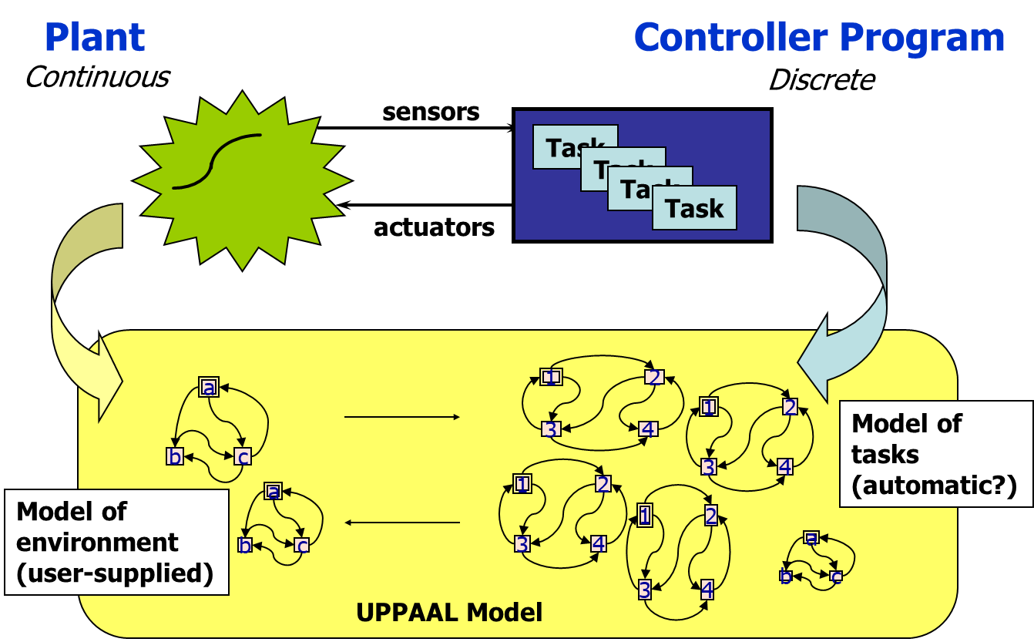
Real-Time Model-Checking
Notes:
So, in order to analyze a system like this we need to have a model. A model will be for example an automata that represents the tasks and a model that represents how the system interacts with the environment. We can make a model of this like a finite state machine and then we can try to verify this model. There are specific techniques to verify this like model-checking. Model-checking uses the model and some property from models….

Slide 15
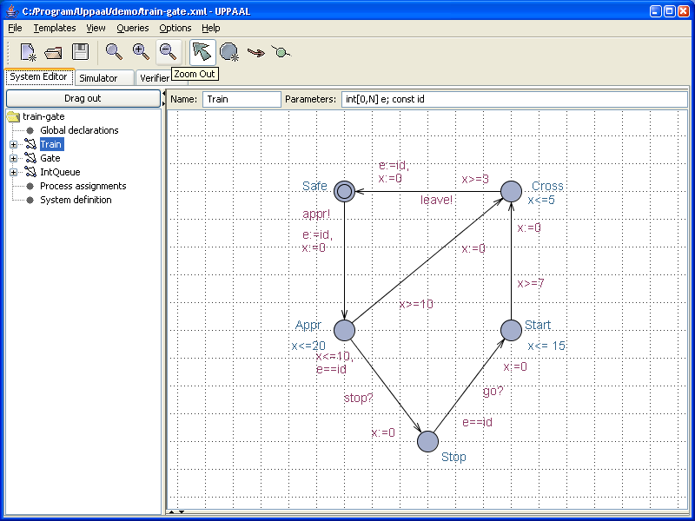
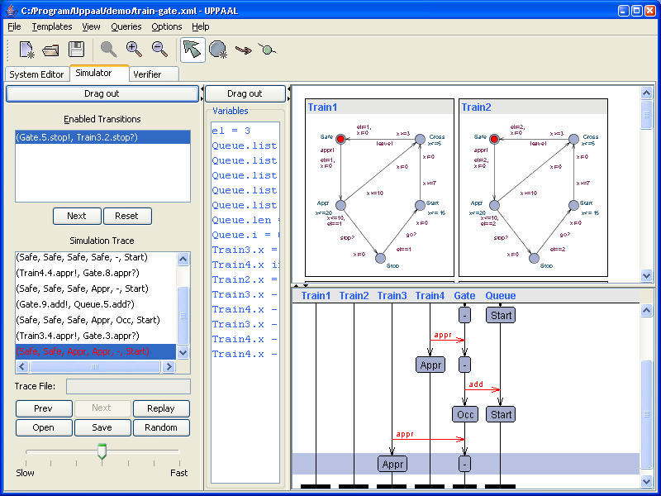
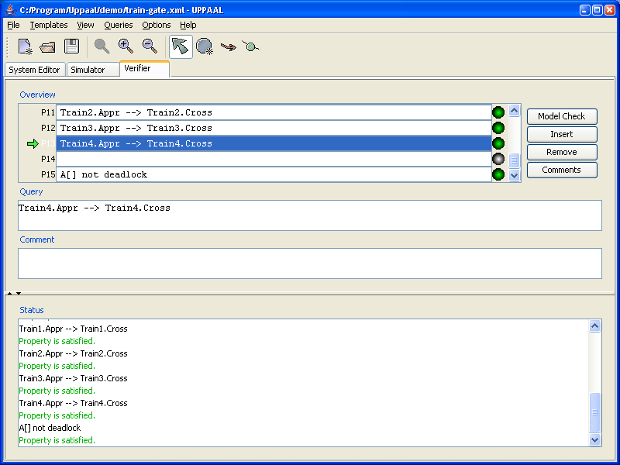
Formal modeling and verification
Simulation
Modeling
Verification
Notes:
When working with a tool like uppaal we would like to have a gui for creating our models, where you create your automata, you add the guards and so on, names of locations. And then you want to simulate the system, play with the model, see how it behaves, you can see the different automata and variables, you have also a trace on how the model behaves in time and then you can verify things. You can have a user interface where you have your temporal logic formulae and you can check if certain properties are satisfied. Basically you can just type your own properties and see if they hold or not… These properties should correspond to the requirements one designs for a system. You can have different properties that you can verify. An example would be a reachabiliuty property such that the model reaches a certain point in the execution. If the verification fails for a property then you want to play with that trace in the simulator and see why this happened. So you can have a flow going from the verification towards the simulation and then if you found a mistake you can go back into the model and modify it.

Slide 16
Example model-based verification
Is this error state reachable?
Max response time between reaching these two states?
Is the system guaranteed to reach this state?
Is this variable value always less than 64?
Is this component always operating in this state?
Notes:
Here is a model some researchers created for ABB some many many years ago. This is just to show you how big and complex these models can be in industrial practice. All of these boxes are automatas. These models represent a protocol used for data communication. As an engineer developing this protocol you might wonder if this error state is reachable any time in the execution of the system. This is not a trivial question to ask. If you would try to analyze this manually it could take days or months until you would come up with a definite answer. Or is this component always operating in this state or it can go somewhere else... What is the maximum time for the system to go from a point to another. In industry there are so many requirements like this that need to be checked before you can realease a system to the users. For example you would like to verify if the a component can be active in a certain amount of time after you press a certain button. You can verify also a variable in the system is always less than 64 during execution, if not something would be wromng or is the system guaranteed to reach this state of the system. These are just examples of properties one can verify on this kind of models. This, just to give you an overall idea of what kind of model-based verification we are focusing on.

Slide 17
Example: Light Control
?
Wanted Behaviour:
pressed once = light
pressed twice quickly = light will get brighter
pressed again = light off.

Slide 18
Finite state automata
Finite state graph, with:
Set of nodes (states),
Set of edges (transitions),
Set of labels (actions).
I
A
On
Off
B
Notes:
The most Indistrial model ☺
State / transition graphs. Mode machine. Something in UML.
Many other models can be viewed / translated to / analysed as FSA

Slide 19
Finite state automata with variables
Extend Finite State Automata with variables e.g.
Relational automata and/or guarded commands
Guards and assignments on transitions
Semantics: Transition Systems
guard
action
Flag==1
a
reset, or update
Flag:=1
Flag:=2
On
Off
Flag:=1
b
Flag==2
Notes:
There are many finite state automata extensions. Most common is the one extended with variables, like relational automata that has states and transitions with actions, guards and assignment on transitions. It is a condition on variables when to take a transition and then we can also update the variables or reset them.
In timed automata you have variables but those variables are clocks, and you can reset those clocks. We will define later the semantics of timed automata in terms of transitions systems.

Slide 20
Light Control
Wanted Behaviour:
pressed once = light
pressed twice quickly = light will get brighter
pressed again = light off.
Notes:
So now we have our light controller again.
This doesnt work as we want to, so we
introduce a clock variable x

Slide 21
Light Control
press
Off
press
Light
press
Bright
press
Wanted Behaviour:
pressed once = light
pressed twice quickly = light will get brighter
pressed again = light off.
Notes:
So now we have our light controller again.
This doesnt work as we want to, so we
introduce a clock variable x

Slide 22
Timed Automata Alur & Dill 1990
Guard
Timing constraints e.g. X>10
Action
Synchronization e.g. a
Clock reset
Reset clock to 0 e.g. X:=0
1
X>10
a
X:=0
2
Notes:
So for timed automata, here is a simple example with two nodes and one edge. On the edge we have a guard that states that x is greater than 10, we can think about it as a timing constraint. The label or the action here is a and then we can reset the clock for example to 0. Let us say for example x=11 in node 1, we can take this transition but then when we get to the second node x is 0. It is very simple right?

Slide 23
Timed Automata: Light Control
with Timing
SOLUTION: Add real-valued clock x to measure the delay between press events
Notes:
This clock x is used in the following way: when we go from
off location to Light location we reset the clock to make sure this is 0.
so now the clock is increasing in location light, when the next press we need
to check the value of x such that we go to Bright or off. from light location
if x smaller or equal to 3 the press is quick so the light can go to bright location.
Otherwise if x is larger than 3 the press is long so we go back to off location.
From Bright location we can go to off location of course.
SO we added a clock and this clock basically measures the time spend
in location Light. As you can easily observe in location light you can spend as
much time as you want right but when you get to Light location the time
is always measured.
So timed automata is a finite state automata extended with clocks.

Slide 24
Timed Automata: Light Control
with Timing
press
Off
press
X:=0
Light
press
Bright
X<=3
press
X>3
SOLUTION: Add real-valued clock x to measure the delay between press events
Analysis: can the light become bright eventually?
Notes:
This clock x is used in the following way: when we go from
off location to Light location we reset the clock to make sure this is 0.
so now the clock is increasing in location light, when the next press we need
to check the value of x such that we go to Bright or off. from light location
if x smaller or equal to 3 the press is quick so the light can go to bright location.
Otherwise if x is larger than 3 the press is long so we go back to off location.
From Bright location we can go to off location of course.
SO we added a clock and this clock basically measures the time spend
in location Light. As you can easily observe in location light you can spend as
much time as you want right but when you get to Light location the time
is always measured.
So timed automata is a finite state automata extended with clocks.

Slide 25
Timed Automata: Semantics
Alur & Dill 1990
Action
used
for synchronization
Clocks: x, y
n
Guard
Boolean combination of integer bounds
on clocks
Location
Reset
Action performed on clocks
x<=5 & y>3
2.4
State
( location , x=v , y=u ) where v,u are in R
a
3.5
Edge
5.4
Transitions
x := 0
a
Discrete Trans
( n , x=2.4 , y=3.1415 )
( m , x=0 , y=3.1415 )
m
Location
e(1.1)
Delay Trans
( n , x=2.4 , y=3.1415 )
( n , x=3.5 , y=4.2415 )
e(3.0)
Delay Trans
( n , x=2.4 , y=3.1415 )
( n , x=5.4 , y=6.1415 )
Notes:
we should try to define the semantics of timed automata. So here we have these two locations n and m. There are two clocks x and y. and guards, guards here can be a bit more complicated than in the example I gave before, they can be a Boolean combination. the guard says that x needs to be smaller or equal to 5 and y needs to be larger than 3. Then we take the action a and then we reset x. this was done in 1990 by Alur and Dill, two researchers that were at Stanford at the time.
a state in timed automata has two different parts, the current location and the current values of all clocks, which are real valued. You can think about a state in timed automata as similar to a state in a software program which contains all the variables used during execution. Getting back to timed automata, there are two different types of transitions between states. The automaton may either delay for some time (a delay transition), or follow a discrete transition (an action transition). For example we can be in location n with x=2.4 and y=pi, we can take the action transition a and go to location m where x is reset to 0 and y is still pi. This is a discrete transition or a action transition in a timed automaton and this is the transition between location n and location m. This transition is taking instantaneously, no time is spend taking this transition. Time is always spend in the location. This is one thing you can do. Another thing you can spend some more time in n location. An example of a delay transition can be the following: assume we are in location n and x is again 2.4 and y is pai. We can stay in location n for 1.1 time units and after taking this delay we are still in location n but x becomes 3.5 and y becomes 4.2415. right, x and y have increased by 1.1, this transition can be taken if we want to stay longer in n.
If we stay for 1.1 clocks are increasing also with1.1, these are what we call perfect clocks. Interesting is that we can choose to stay in n such that we can’t take the action transition to m location. X can become larger than 5 and then we can’t leave location n. So, this is part of the behavior of a timed automaton. This is all depended on how you model the timed automaton.

Slide 26
Timed Automata with Invariants
n
x<=5
Clocks: x, y
Transitions
x > 5
x<=5 & y>3
e(3.2)
Location
Invariants
( n , x=2.4 , y=3.1415 )
a
e(1.1)
( n , x=2.4 , y=3.1415 )
( n , x=3.5 , y=4.2415 )
x := 0
m
y<=10
Invariants ensure progress!!
g4
g1
g3
g2
Notes:
One way to make sure you always take this action transition is to introduce location invariants. So, as long as you operate in the n location, this invariant needs to be true. So when you get to the point of delaying until x is 5 you can’t delay further because the invariant will become false. This introduces other problems, you can get stuck in the n location. Let say that we get up to one point where x is 5 but the guard says that x needs to smaller than 4.
Let us take an example, we are in location n, x is 2.4 and y is pi, then you can’t delay for 3.2 because this will make x 6.6 and that is not possible in location n because of the invariant. We can still do this delay of 1.1 and we are still in location n. So we have some type of non-determinism here, we can delay for a while or take a transition, but at least the invariant is a way to ensure there is some progress in the model. You can still do mistakes in the model but still now you have this possibility…which we will see later is quite important for modelling real-time systems.
We should note here that in this transition system you can take any real value for the delay not only 1.1 or other similar values.

Slide 27
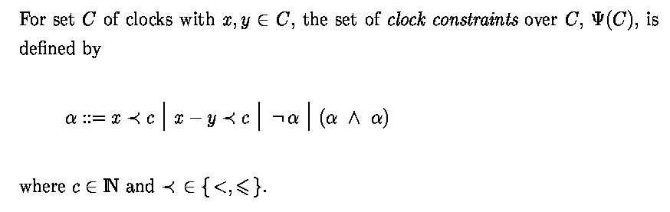
Clock Constraints
Notes:
Just to show how these constraints on clocks look like. Let us assume we have a set C of clocks with x and y being part of this set we can say that x needs to be compared to c, c needs to integer, so x can be less than c, or less than or equal, we can have the difference between two clocks, we can negate this so we can do greater than or greater than or equal and then we can have conjuction so we can have a combination of clock constraints. Because of the negation we can have also the disjunction also as a clock constrain. We will come back to this later when we actually use this clock constraints.

Slide 28
Timed Automata: Example
X>=2
X:=0
l
X:=0
Notes:
So here is an example. What does it do? L is the initial location, actually the only location and we have one transition or edge which goes back to l. So the first state is location l and x is 0. right? And then we can delay for a while.

Slide 29
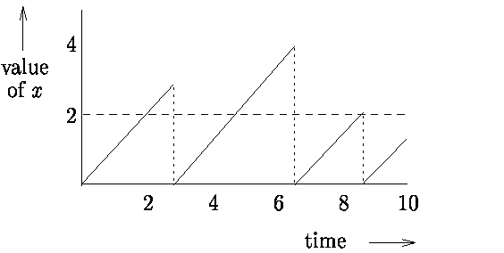
Timed Automata: Example
X>=2
X:=0
l
X:=0
Notes:
So if we delay for two time units x will be 2. You can see this if we plot time on the horizontal axis and the value of x on the vertical axis. If we delay this further we can take the action transition, If we do so we come back to l location and x becomes 0. This is one possible trace of the system.

Slide 30
Timed Automata: Example
2<=x<=3
X:=0
l
X:=0
Notes:
What about this system? This is similar, the only thing that I added is a upper-bound on x. So it is starting in the same initial state and the point is that we can take the action transition only when x is between 2 and 3 but you can choose to further delay while staying in location l. So, as long as this transition is taken the system is alive and working, otherwise is a bit useless.

Slide 31
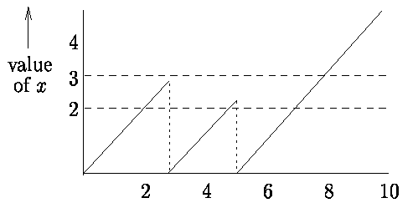
Timed Automata: Example
2<=x<=3
X:=0
l
X:=0
Notes:
Interesting for this timed automata is that x becomes larger than 3 this transition can’t be ever taken. So, a better solution would be to add this part of the guard x smaller or equal to 3 to the location l as an invariant….

Slide 32
Timed Automata: Example
X>=2
X:=0
l
X<=3
X:=0
Notes:
So, if we have this timed automata now, it is the same type of system but the behavior is much more interesting.

Slide 33
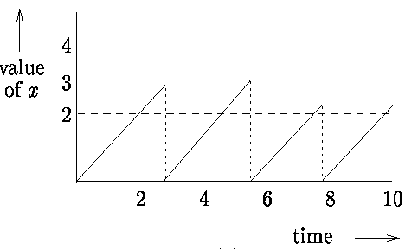
Timed Automata: Example
X>=2
X:=0
l
X<=3
X:=0
Notes:
if we start in l with x equals 0, as long as we are in l the invariant needs to be true so x is always smaller or equal to 3. We can’t have x greater than 3 in this location. When x is greater than 2 we can take the action transition. When x is 3 we must take the transition, the model says so… We should say here that this again is showing some non-determinism in when to take the transition but also this could be more complicated by having other transitions that can be taken simultaniously. These are two sources of non-determinism....

Slide 34
Timed Automata: Example (periodic task, period 20)
x==20
T
x≤20
x:=0
Notes:
So, if we want to model a real-time systems containing one periodic task with period 20 which operates in location T for 20 time units and then it starts again. This transition is showing when the task is released. This system takes this edge every 20 time units if we assume x is initially 0 or smaller than or equal to 20.

Slide 35
Timed Automata: Example (sporadic task w min period 20)
x≥20
T
x:=0
Notes:
Ok, here is another timed automata that will model what we call, a sporadic task which has a minimum interarrival time of 20. So we can take the action transition every 20 time units but you can wait longer in location T.

Slide 36
Timed Automata: Example (aperiodic task, every 5 to 100)
5≤x≤99
T
X≤100
x:=0
Notes:
If you want to model an aperiodic task which has a minimum interarrival time of 5 and a maximum of 100. So you can try to model different time models using these rather simple concepts….

Slide 37
Timed Automata: Light Switch
Switch may be turned on whenever more than 2 time units since last “turn off”
Light automatically switches off after 9 time units if it is not pressed.
x>2 push x:=0
x>2
off
on
x≤9
push
x:=0 x==9
X:=0
Notes:
This is a light switch modelled in timed automata. We have a location where the light is off and another one where the light is on. So, we can’t go to on before two time units, but after two time units we can turn on the light switch. Then what happens? When do we go to off again? So we can go to off after 9 time units, except if there are other presses that will reset the clock. So you can spend a lot of time in on location if we would like to. I modeled this press action with a question mark because I think about it as an arrival of a signal that comes from the environment. The uses presses and then in this light switch the press question mark gets activated whereas from the transition from on to off there is no press action so this can’t happen without any external interaction. Ok…. I will give you the semantics definition of a timed automata for you to study at after the lecture.

Slide 38
Demo
The Light Control example

Slide 39
Semantics Definition
Clock valuations:
State:
Action transition
Delay transition
g a r
l
l’
Notes:
I will briefly go through it here… We have the idea of clock valuations, that is the assignments of the clocks. We have a set of clocks and each clock has a value, a real value... It takes a set of clocks and gives the values.. The state, as I said, is a pair of locations and clock values, v is a part of the clock valuations function. As I said, we have two types of transitions, actions transitions, so if we are in some location l with the clock valuations v and if we follow an edge labeled a to a new location l prime with clock valuation v prime if and only if there is an action transition from l to l prime having a guard a lable a and a reset and the current clock valuation must satisfy the guard and the new clock valuation is the current clock valuation but we have applied the reset on the transition and the invariant of l prime must be satisfied by these new clock valuations.
We have the delay transition when we stay in the same location and if we delay for d time units, the new clock valuation will be the same as the previous one + d and the new clock valuation must satisfy the invariant and it needs to do that throught the delay. So this is the semantics definition. Please have a look on it after the lecture.

Slide 40
Timed Automata: Example
x>2 push x,y :=0
X,y:=0
x>2
off
on
y<=9
push
x:=0
y==9
x:=0
……
Notes:
Here is an example of a trace from the light switch. If we are in off, x and y are 0 we can delay for 3.5 and we are still in off but we add 3.5 to the clocks. Now if we take the transition from off to on, this will be an action transition, push. What happens there, both x and y are reset so now we are in location on with x and y equal 0. now if we delay for pi time units then we are still in location on but the clocks are both pi. Now we do a push transition because x is greater than 2. In this example only x is reset, so then we are still in on, x is 0 and y is pi and so on.

Slide 41

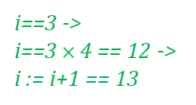
Networks of Timed Automata
with (finite) integer variables
l1
m1
x>=2 &&
i==3
y<=4
………….
a!
a?
Two-way synchronization
x := 0
i:=i$×$4
y := 0
i:=i+1
l2
m2
Example transitions
(l1, m1,………, x=2, y=3.5, i=3,…..) (l2,m2,……..,x=0, y=0, i=?,…..)
a
i==3 ->
i==3 $×$4 == 12 ->
i := i+1 == 13
Notes:
So we can extend the model to consist of a network of timed automata, meaning that we have couple of timed automata in this system and they can synchronize on action transition. So I introduce here the a exclamation mark and a question mark. In order to take a transition a question mark you need another transition a exclamation mark. These two are the complementary actions. So you cannot take action a exclamation mark without taking the a question mark transition. For this I show an example transitions. Suppose we start in location l1 and m1, x=2, y=3.5 and i=3 (I introduced I here, I is an integer variable) if we look at the conjunction of the two guards, the valuations satisfy the guard conjunctions on the edges they can take both transitions in the same time synchronized and then we can do the resets and then we end up in l2 m2 locations, x will be 0 because we reset x, y is 3.5 and i is incremented with 4 so it becomes 7. So now we can have several automata that can communicate with each other. In theory and practice you can synchronize more than two automata…. You will see that in the lab assignments how you can use broadcasting syncronizations and so on...

Slide 42
Demo
The Light Control example in UPPAAL

Slide 43
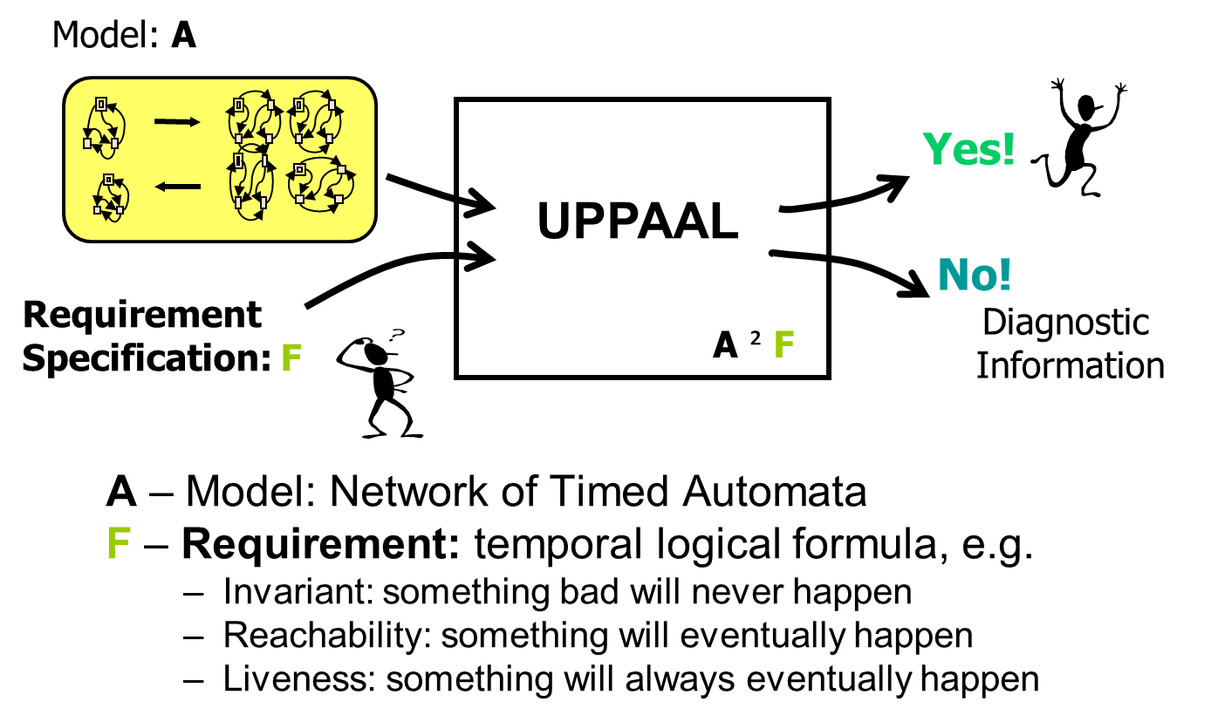
How to specify what to check?
Notes:
For using timed automata and UPPAAL for model checking we need to express Requirements as temporal logical formula, for example
Invariant: something bad will never happen, something may happen
Liveness: something will eventually happen

Slide 44
Specification of Requirements
TCTL - Timed Computation Tree Logic
A → C→ C → C → … a path
(A,v) → (C,v’) → …+ time = a timed path
A
A
semantics
v:=0
v:=0
B
C
B
C
A
C
C
Notes:
Uppaal uses the decidable subset of TCTL. Like in TCTL, the query language consists of path formulae and state formulae. State formulae describe individual states, whereas path formulae quantify over paths or traces of the model, a path that includes time information is called a timed path. Path formulae can be classified into reachability, safety and liveness

Slide 45
Quantifiers in TCTL
E - exists a path
A - for all paths
[ ] - all states in a path (or G).
<> - some state in a path (or F).
We shall look at the following combinations:
A[], A<>, E<>, and E[].
Path operators
State operators
Notes:
UPPAAL supports couple of quantifiers: exists a path, for all paths, all states in a path, some state in a path. In short, the four temporal quantifier combinations are always, potentially always, possibly, and unavoidable.

Slide 46
E<>p – “p Reachable”
It is possible to reach a state in which p is satisfied.
p is true in (at least) one reachable state.
p
Notes:
Reachability properties are the simplest form of properties. They ask whether a given state formula, p, possibly can be satisfied. by any reachable state. Another way of stating this is: Does there exist a path starting at the initial state, such that p is eventually satisfied along that path. Reachability properties are often used while designing a model to perform sanity checks. For instance, when creating a model of a communication protocol involving a sender and a receiver, it makes sense to ask whether it is possible for the sender to send a message at all or whether a message can possibly be received. These properties do not by themselves guarantee the correctness of the protocol for example that any message is eventually delivered, but they validate the basic behavior of the model. We express that some state satisfying p should be reachable in at least one reachable state.

Slide 47
A[]p – “Invariantly p”
p holds invariantly.
p is true in all reachable states.
p
p
p
p
p
p
Notes:
Safety properties are on the form: “something bad will never happen”. For instance, in a model of a nuclear power plant, a safety property might be, that the operating temperature is always (invariantly) under a certain threshold, or that a meltdown never occurs. A variation of this property is that “something will possibly never happen”. For instance when playing a game, a safe state is one in which we can still win the game, hence we will possibly not loose. In Uppaal these properties are formulated positively, e.g., something good is invariantly true. Let p be a state formulae. We express that p should be true in all reachable states

Slide 48
E[ ] p – “Potentially Always p”
p is potentially always true.
There exists a path in which p is true in all states.
p
p
p
Notes:
Another property is E[ ] p – “Potentially Always p, this shows if There exists a path in which p is true in all states.

Slide 49
A<>p – “Inevitable p”
p will inevitable become true
the automaton is guaranteed to eventually reach a state in which p is true.
p is true in some state of all paths.
p
p
p
Notes:
Liveness properties are of the form: something will eventually happen, for example. when pressing the on button of the remote control of the television, then eventually the television should turn on. Or in a model of a communication protocol, any message that has been sent should eventually be received. In its simple form, liveness is expressed with the path formula eventually p.

Slide 50
A[]( g imply A<> p )
g leads to p: whenever g is true, p will inevitable become true.
In UPPAAL: g --> p
g
p
p
p
Notes:
This is a useful form in practice called leads to or response property, which can be understand as whenever g is satisfied, then eventually p will be satisfied, for example whenever a message is sent, then eventually it will be received.

Slide 51
Demo
The Light Control example in UPPAAL

Slide 52
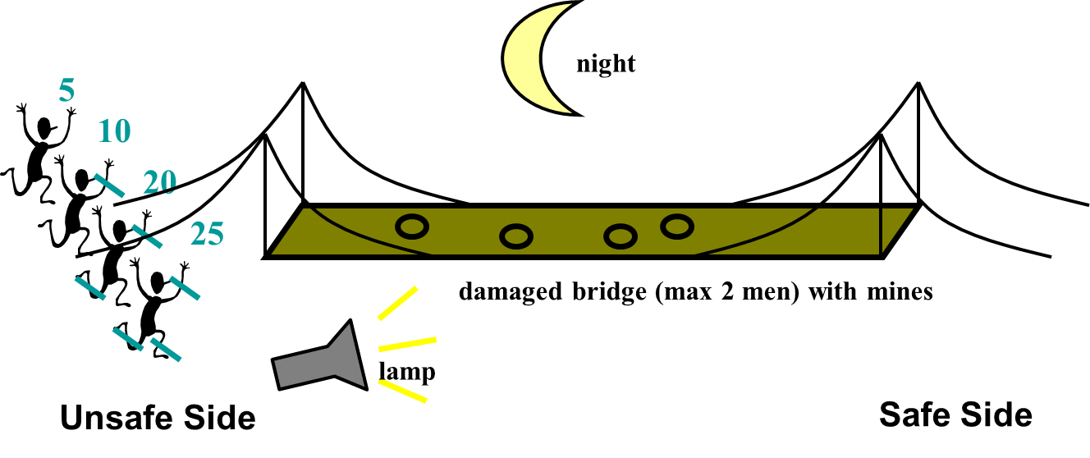
Bridge Problem
Is it possible find schedule for all four men
to reach safe side in 60 min?
Notes:
Now. Let us try to solve a famous problem, The Viking problem or bridge problem which is a famous logic puzzle that deals with four people, a bridge and a torch. It is one of the river crossing puzzles, where a number of objects must move across a river, with some constraints.
Four people or soldiers/vikings come to a river in the night. There is a narrow and damaged bridge, but it can only hold two people at a time. They have one torch and, because it's night, the torch has to be used when crossing the bridge. Viking A can cross the bridge in 5 minutes, B in 10 minutes, C in 20 minutes, and D in 25 minutes. When two people cross the bridge together, they must move at the slower person's pace. The question is, can they all get across the bridge in 60 minutes or less?
Can you show me that it exists a way for getting all four Vikings over the bridge within 60 minutes or less?

Slide 53
Demo
The Bridge Problem in UPPAAL

Slide 54
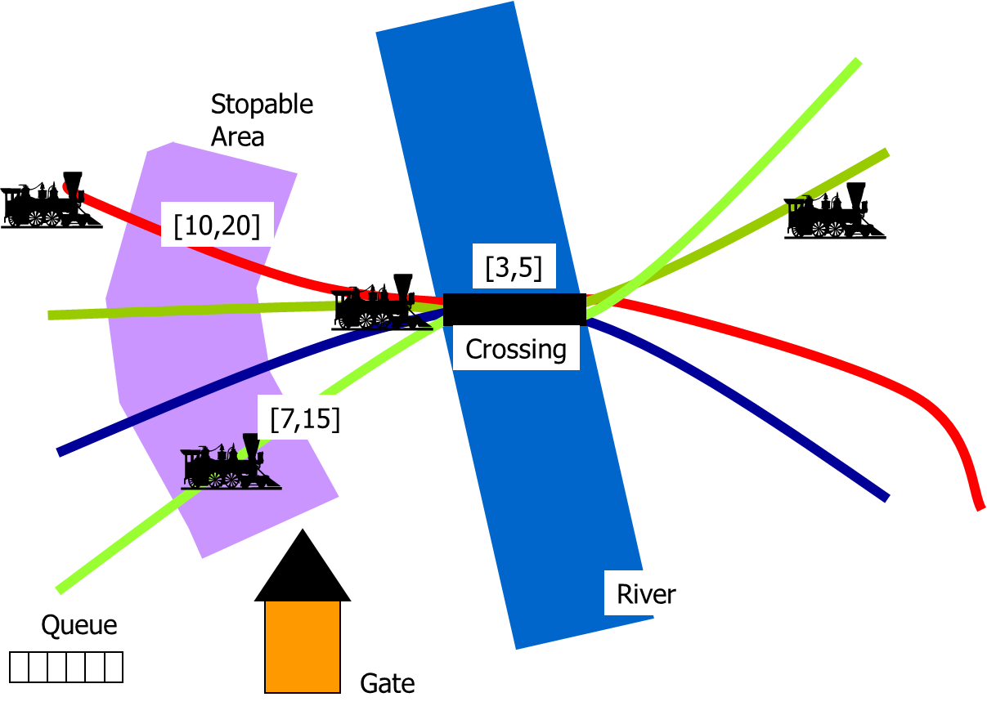
Train Crossing
Notes:
. It is a railway control system which controls access to a bridge for several trains. The bridge is a critical shared resource that may be accessed only by one train at a time. The system is defined as a number of trains (assume 6 for this example) and a controller. A train can not be stopped instantly and restarting also takes time. Therefor, there are timing constraints on the trains before entering the bridge. When approaching, a train sends a appr! signal. Thereafter, it has 10 time units to receive a stop signal. This allows it to stop safely before the bridge. After these 10 time units, it takes further 10 time units to reach the bridge if the train is not stopped. If a train is stopped, it resumes its course when the controller sends a go! signal to it after a previous train has left the bridge and sent a leave! signal.

Slide 55
Demo
The Train Crossing Problem in UPPAAL

Slide 56
UPPAAL SMC
Statistical model checking (SMC) for stochastic timed automata.
Stochastic timed automata extends timed automata with:
Probabilistic choices between multiple enable transition (probabilities may be defined by the user),
Probability distributions for non-deterministic time-delays
Uniform distributions for time-bounded delays, or
Exponential distributions with user-defined rates for cases of unbounded delays.
Continuous variables can evolve according to ordinary differential equations.

Slide 57
UPPAAL SMC
Querys:
Random simulations,
Probability evaluation:
What is the probability P_{M}(<>_{x≤C} ϕ) for a given NSTA M?
Hypothesis Testing:
Is the probability P_{M}(<>_{x≤C} ϕ) for a given NSTA M greater or equal to a certain threshold p ∈ [0, 1] ?
Probability comparison:
Is the probability P_{M}(<>_{x≤C} ϕ₁) greater than the probability P_{M}(<>_{y≤D}ϕ₂)?

Slide 58
Demo
Train Crossing in UPPAAL SMC

Slide 59
Assignment
Design a communication protocol, where the communication between the Sender and the Receiver is done through a lossy and noisy Channel.
The Sender sends the message and awaits the acknowledgment from the Receiver. Since the communication is done through the Channel, the message might be passed to the Receiver after 1 time unit or lost. If the Receiver receives the message, it will send the acknowledgement after 1 time unit. Again, this is done through the Channel, so the acknowledgement can be sent to the Sender after 1 time unit or lost. In case the acknowledgement does not reach the Sender in 5 time units (either the message or the acknowledgement is lost), the Sender will send the message again without dely. Similarly, after the acknowledgement is received, the Sender will send another message without delay.

Slide 60
Assignment
Modeling guidelines:
Model the system as a network of 3 timed automata: Sender, Channel, and Receiver;
The messages between the Sender, Channel and Receiver should be modeled as modeled as regular UPPAAL channels;
• The Sender should identify that a message has been lost based on
the value of its internal clock.
s_msg
r_msg
Sender
Channel
Receiver
r_ack
s_ack

Slide 61
Assignment
Model the system in UPPAAL.
Verify the following properties:
The system cannot deadlock;
The receiver might send an acknowledgment;
The messages sent by the sender are eventually received by the receiver.
Submit the UPPAAL model and the requirement files (.xml and .q), together with a short report.

Slide 62
Assignment
More information on UPPAAL:
https://uppaal.org/
The Annex
“A Tutorial on Uppaal 4.0”, Gerd Behrmann, Alexandre David, and Kim G. Larsen

Slide 63
Annex
UPPAAL Syntax
Notes:
First half I will spend some time on how to model things in UPPAAL, so we will look at a model of timed automata that we look on previously but we will focus on the specific uppaal syntax, then I will show an example and show how uppaal works and then how to model check timed automata, how to analyze the models., how to represent states, ectera…

Slide 64
Timed Automata in UPPAAL
Timed Automata with Invariants
urgent action channels,
urgent and committed locations,
data-variables (with bounded domains),
arrays of data-variables,
constants,
guards and assignments over data-variables and arrays…,
templates with local clocks, data-variables, and constants.
C subset
Notes:
If you remember, last time we talked about timed automata with invariants, so finite state machines with locations. With edges, they have variables that represent clocks, that represent time, they can be tested in uppaal on the guards, they can be reset to 0, and you can have actions on the edges. I am sure you remember all of this…. Today we will talk about many extensions that exist in the tool. On this slide you can see a list of these extensions that we will talk today. So we have regular action channels but then we can urgent action channels that i want you to understand by the end of this lecture. As we have regular locations, we have also urgent and commited locations. I mentioned already last time that we don’t have only clocks as variables we can also have integer variables, so I will show what you can do with integer variables. You can have arrays of these variables and of course constants. And you can have guards and assignments on these variables. In addition, and this is quite useful, you can have different modelling features, like templates for istantianting the same timed automata multiple times. Then there is also a subset of C that can be used on the assignments in timed automata. So as you can see we have a different modelling language as last time. Actually this is purely for convenience, with a few exceptions that are few features that are extending the expressivness of timed automata. We are still modelling in timed automata. You can think about this as extra syntax such that it is easier to model real systems.

Slide 65
Declarations in UPPAAL
The syntax used for declarations in UPPAAL is similar to the syntax used in the C programming language.
Clocks:
Syntax:
clock x1, …, xn ;
Example:
clock x, y; Declares two clocks: x and y.
Notes:
First, let us look on how we can declare things in uppaal. UPPAAL has a similar syntax to the C programming langugae. Is everyone familiar with C or C++? So when you declare clocks you can use the key word clock followed by the name of the clock. You can declare two or more clocks by using a comma separated list that finishes with a semicolon. Here is an example. If you want to declare two clocks x and y you just right clock x comma y semicolon. Simple…

Slide 66
Declarations in UPPAAL (cont.)
Data variables
Syntax:
int n1, … ; Integer with “default” domain.
int[l,u] n1, … ; Integer with domain “l” to “u”.
int n1[m], … ; Integer array w. elements n1[0] to n1[m-1].
Example;
int a, b;
int[0,1] a, b[5][6];
Notes:
Data variables are of type int. There is a default domain of the integer which is based on how things are represented on a particular machine. So when you declare an integer you can use the domain of the integer with a lower and upper value between square brackets giving the domain of the integer. So, if you wanted a boolean variable you can say int with a domain between 0 and 1. Of course you can have a comma separated list of these integers that ends with a semicolon. You can do arrays, pretty much like in C, so you can give the size of the array. So, for example if you want a two dimensional array b you can write b followed by 5 in square brackets and 6 in square brackets.

Slide 67
Declarations in UPPAAL (cont.)
Actions (or channels):
Syntax:
chan a, … ; Ordinary channels.
urgent chan b, … ; Urgent actions (see later)
Example:
chan a, b;
urgent chan c;
Notes:
Channels are used to synchronise processes. This is done by annotating edges in the model with synchronisation labels.
Channels can be declared as regular channels chan a, or urgent channels with urgent chan key words followed by a comma separated set. Urgent channels are similar to regular channels, except that it is not possible to delay in the source state if it is possible to trigger a synchronisation over an urgent channel. We will see how urgent actions work later…

Slide 68
Declarations UPPAAL (const.)
Constants
Syntax:
const int c1 = n1;
Example:
const int[0,1] YES = 1;
const bool NO = false;
Notes:
Integers, booleans, and arrays and records over integers and booleans can be marked constant by prefixing the type with the keyword const. const int[0,1] YES = 1; const bool NO = false
This works preety much as you would expect.

Slide 69
Timed Automata in UPPAAL
Clock Assignments
Location Invariants
x = n
n
Variable Assignments
x<=5
clock natural number “and”
x>=5 && y>3
a!
Clock guards
x = 0
Data guards
m
y<=10
g4
g1
g3
g2
Notes:
And then we have clock assignments. We went through them last time. Let us start with the guards. A guard can be a guard over a clock or a data guard over a data variable and then you can write more complicated guards using a comma sign. For a clock guard you can have a comparison with an integer value wthich can be less, less or equal and so on. For the data guards, it is some integer expression together with a logical operation on another expresion. Integer expression are on the yellow box on the left side of the slide to show what kind of assignments are allowed. You can assign also clocks with an integer value, or you can assign a data variable to some expression which can be an integer value, or some array, or a constant, or a negation of some expression and so on…ahh and you can have also conditional expression like in C: if the guard is true the result can be an expression otheriwse the result is another experssion,
And then you can have this location invariants. They are preety much like guards but you can only have upper bounds, less or less than.

Slide 70
Timed Automata in UPPAAL
Clock Assignments
Location Invariants
n
Variable Assignments
x<=5
Actions:
“a” name of action
a! or a?
one or zero per edge
clock natural number “and”
x>=5 , y>3
a!
Clock guards
x := 0
Data guards
m
y<=10
g4
g1
g3
g2
Notes:
And then you have this actions and this is just a name that you declared. Then you the actions are of the form a question mark or a exclamation mark. I always think about exclamation mark as the action starting the synchronization. Just to note here, a is a side effect free expression evaluating to a channel. The intuition is that two processes can synchronise on enabled edges annotated with actions, i.e. two edges in different processes can synchronise if the guards of both edges are satisfied, and they have synchronisation labels a question mark and a exclamation mark, where a question mark and a exclamation mark evaluate to the same channel a. You can have one or zero action per edge. Nothing means it doesn’t need to syncronize.

Slide 71
Broadcast Synchronization
Declared like broadcast chan a, b, c[2];
If a is a broadcast channel:
a! = Emmision of broadcast
a? = Reception of broadcast
A set of edges in different processes can synchronize if one is emitting and the others are receiving on the same b.c. channel.
A process can always emit.
Receivers must synchronize if they can.
No blocking.
Notes:
Up to now we have the type of timed automata we discussed last time, except that we have more data variables. We can declare channels that are a bit different: The syntax is the same as for regular channels but you add the keyword broadcast. The semantics is that Broadcast channels allow 1-to-many synchronisations. The intuition is that an edge with synchronisation label a exclamation mark emits a broadcast on the channel a and that any enabled edge with synchronisation label a question mark will synchronise with the emitting process (receiption of broadcast) For example an edge with an emit-synchronisation on a broadcast channel can always fire (provided that the guard is satisfied), no matter if any receiving edges are enabled. But those receiving edges, which are enabled will synchronise. I don’t think you will use broadcasting syncronizations but it is good to know about them…

Slide 72
Urgent Channels: Example 1
Suppose the two edges in automata P and Q should be taken as soon as possible.
I.e. as soon as both automata are ready (simultaneously in locations l1 and s1).
How to model with invariants if either one may reach l1 or s1 first?
P:
Q:
l1
s1
a!
a?
l2
s2
Notes:
Now we come back to the idea of urgent channels. Here is an untimed model. Assume that automata P is in l1 and automata Q is S1. We want them to take when both are in l1 s1 a transition as quick as possible. You remember in timed automata they can always choose to delay if they want to. Can we model this with invariants? You can always reset the clock when getting to l1 and then say that you can spend just 0 time units in the location l1 and then you take the transition and send but if the receiver in Q automata is not available to receive then this will really not work. This is not possible also if in Q we do the same trick. What you can do is declare the channel as urgent and urgent means as soon as possible they should syncronize. If a sruncronation on a urgent channel is possible they cannot delay any longer.

Slide 73
Urgent Channels: Example 1
Suppose the two edges in automata P and Q should be taken as soon as possible
I.e. as soon as both automata are ready (simultaneously in locations l1 and s1).
How to model with invariants if either one may reach l1 or s1 first?
Solution: declare action “a” as urgent.
P:
Q:
l1
s1
a!
a?
l2
s2
Notes:
Just simply declare this action as urgent. Now it doesn’t matter which automaton comes first to l1 or s1, when they are ready they will both syncronize. This is a place where you can model this in timed automata. You can maybe do that in a very complicated model but Uppaal makes this work outside the framework of timed automata.

Slide 74
Urgent Channels
urgent chan hurry;
Informal Semantics:
There will be no delay if transition with urgent action can be taken. Restrictions:
No clock guard allowed on transitions with urgent actions.
Invariants and data-variable guards are allowed.
Notes:
As I said you can declare it as follows: urgent chan and then the name of the channel followed by a semicolon. Informal Semantics: There will be no delay if transition with urgent action can be taken. That doesn’t mean that other transitions cannot be taken when there is no delay. The only restriction refers to the delay….
There are some Restrictions No clock guard allowed on transitions with urgent actions and Invariants and data-variable guards are allowed.

Slide 75
Urgent Channel: Example 2
Assume i is a data variable.
We want P to take the transition from l1 to l2 as soon as i==5.
P:
l1
i==5
l2
Notes:
Here is an example on how to make use of urgent channels, Here i is a data variable and we want this automaton to take this transition as soon as I becomes 5. This is how you think about programs usually in regular programming languages, they do things as quickly as possible. They don’t spend time in l1 if they can…in timed automata you need to think about the notion of time and you can always choose to delay. Here you can choose to delay forever in l1. Assume that we want this automaton to take the transition from l1 to l2 as soon as i==5.

Slide 76
Urgent Channel: Example 2
Assume i is a data variable.
We want P to take the transition from l1 to l2 as soon as i==5.
Solution: P can be forced to take transition if we add another automaton: where “go” is an urgent channel, and we add “go?” to transition l1→l2 in automaton P.
P:
l1
i==5
go?
s1
go!
l2
Notes:
So you can introduce an urgent syncronization here….if you add a little automaton with a state s1 and one transition going back to location s1 that is always willing to syncronzie using the go urgent channel. If you add this go here and if we are in l1 and i become 5 that means that it needs to take the go transiition. It cannot delay forever in l1. it will take the transition without delay except if there is another option... Remember that transitions are instantanious. There is no time in taking a transition, in 0 time units. So you can do infinetiely many transitions in 0 time actually, that is a bad model but you could do that. That is what is called zeno model....

Slide 77
Urgent Location: Example
Assume that we model a simple media M: that receives packages on channel a and immediately sends them on channel b.
P models the media using clock x.
P:
l1
a
M
b
a?
x:=0
l2
X<=0
x==0
b!
l3
Notes:
When working with UPPAAL you will realize the need for an urgent location that I want to illustrate with this small example. Assume there is a communication medium, like an internet cable; whenever it receives something on a it sends something on b. It could be modeled as this little automata on the right of the slide. It starts in location l1. When it receives an a it sets a clock to 0 and then it makes sure that no time is pend in location l2 and then it sends the b. So, wihout any delay a is received and b is send. You can model it precisely using a clock x as the automaton in the slide.

Slide 78
Urgent Location: Example
Assume that we model a simple media M: that receives packages on channel a and immediately sends them on channel b.
P models the media using clock x.
Q models the media using urgent location.
P and Q have the same behavior.
P:
Q:
l1
l1
a
M
b
a?
x:=0
a?
l2
l2
X<=0
urgent
x==0
b!
b!
l3
l3
Notes:
But in UPPAAL you can just declare the channel l2 as being urgent and then the automaton on the right with the yellow urgent box on l2 will behave as the automaton on the right that contains the clock x. this is purely syntactic suggar but is quite useful in practice.

Slide 79
Urgent Location
Click “Urgent” in State Editor.
Informal Semantics:
No delay in urgent location. Note: the use of urgent locations reduces the number of clocks in a model, and thus the complexity of the analysis.
Notes:
In uppaal Click “Urgent” in State Editor. and then you make sure there is No delay in urgent location,
If you use urgent locations you save a clock to be used for something else. So the use of urgent locations reduces the number of clocks in a model, and thus the complexity of the analysis. Think about this when modelling….

Slide 80
Committed Location: Ex. 1
Assume: we want to model a process (P) simultaneously sending message (a) to two receiving processes (when i==0).
P’ sends “a” two times at the same time instant, but in location “n” other automata, e.g. Q may interleave (which is wrong):
P’:
P:
l1
l1
i==0
i==0
a!
a!a!
n
i:=1
urgent
l2
a!
i:=1
Q:
i==0
l2
k1
k2
Notes:
An interesting concept is the commited location. Assume: we want to model a process (P) simultaneously sending message (a) to two receiving processes (when i==0). When I becomes 0 P will send two a syncronizations. Would you say these have the same semantics? Timing wise NO. but practically it can be another timed automata that does something while this operates in n. In practice you can take the transition in P prime from l1 to n and then the Q automata can do something and then in P prime you can take the transition from n to l2. making it urgent makes the location n atomic timing wise but it can still be interrupted by some other automaton doing something.

Slide 81
Committed Location: Ex. 1
Assume: we want to model a process (P) simultaneously sending message (a) to two receiving processes (when i==0).
P’ sends “a” two times at the same time instant, but in location “n” other automata, e.g. Q may interleave (which is wrong):
Solution: mark location n “committed” in automata P’ (instead of “urgent”).
P’:
P:
l1
l1
i==0
i==0
a!
a!a!
n
i:=1
committed
l2
a!
i:=1
Q:
i==0
l2
k1
k2
Notes:
If you want to make this location atomic mark the location n as commited. When you get to n location the next transition in the entire network of timed automata needs to involve the next edge from n. urgent locations, committed locations freeze time. Committed locations are useful for creating atomic sequences and for encoding synchronization between more than two components. Notice that if several processes are in a committed location at the same time, then they will interleave but I will not go into too many details with this…

Slide 82
Committed Location
Click “Committed” i State Editor.
Informal Semantics:
No delay in committed location.
Next transition must involve automata in committed location. Note: the use of committed locations reduces the number of
clocks in a model, and allows for more space and time efficient
analysis.
Notes:
In uppaal Click “Committed” i State Editor. There will be No delay in committed location and the Next transition must involve automata in committed location.
the use of committed locations reduces the number of clocks in a model, and allows for more space and time efficient analysis.

Slide 83
Committed Location: Ex. 2
Assume: we want to pass the value of integer ”k” from automaton P to variable ”j” in Q.
The value of k can is passed using a global integer variable ”t”.
Location “n” is committed to ensure that no other automat can assign “t” before the assignment “j:=t”.
P:
l1
Q:
l1
t:=k
n
a?
committed
j:=t
a!
l2
l2
Notes:
Assume we want to pass the value of integer ”k” from automaton P to variable ”j” in Q. Integer is k. I could use a temporary variable t with the value of k and then make sure that q reads this. Interesting to notice here but in a timed automata the value of t can be changed before passing it to Q. In order to make sure that nothing happens in the assignments in P and Q then we can have an intermediate location called n that is commited and then you send the a so nothing will interfere and then the right value will be passed.

Slide 84
More Expressions
Operators (not clocks):
Logical:
&& (logical and), || (logical or), ! (logical negation),
Bitwise:
^ (xor), & (bitwise and), | (bitwise or),
Bit shift:
<< (left), >> (right)
Numerical:
% (modulo), ? (max)
Assignments:
+=, -=, *=, /=, ^=, <<=, >>=, :=
Prefix and postfix:
++ (increment), -- (decrement)
Notes:
Ok… now to go to easier things. There are more expressions that you can use, not on cloks but on the data variables which you should be familiar from other programming languages, Most of the expression syntax of UPPAAL coincides with that of C, C++ and Java. Logical: && (logical and), || (logical or), ! (logical negation), Bitwise:^ (xor), & (bitwise and), | (bitwise or), Bit shift: << (left), >> (right) Numerical: % (modulo), ? (max) Assignments: +=, -=, *=, /=, ^=, <<=, >>=, := Prefix and postfix: ++ (increment), -- (decrement) .

Slide 85
More on Types
Multi dimensional arrays
e.g. int b[4][2];
Array initialiser:
e.g. int b[4] := { 1, 2, 3, 4 };
Arrays of channels, clocks, constants.
e.g.
chan a[3];
clock c[3];
const k[3] { 1, 2, 3 };
Broadcast channels.
e.g. broadcast chan a;
Notes:
Again, some more data types you can use, Multi dimensional arrays Array initialiser: e.g. int b[4] := { 1, 2, 3, 4 };
Arrays of channels, clocks, constants. chan a[3]; clock c[3]; const k[3] { 1, 2, 3 };, Broadcast channels., e.g. broadcast chan a; as we talked before.

Slide 86
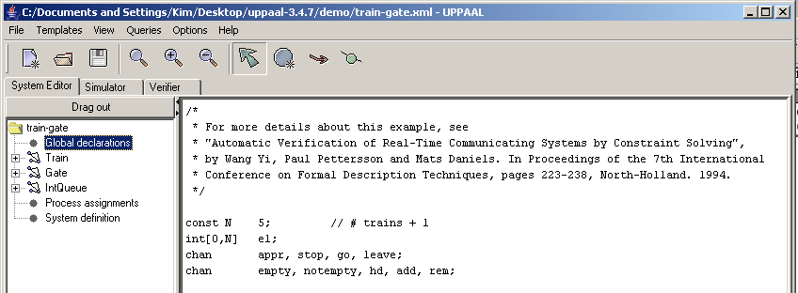
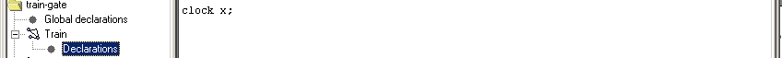
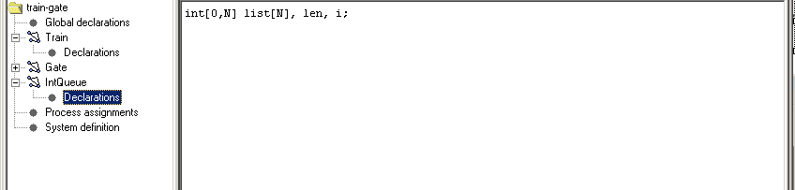
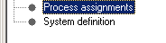
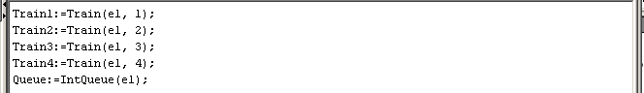
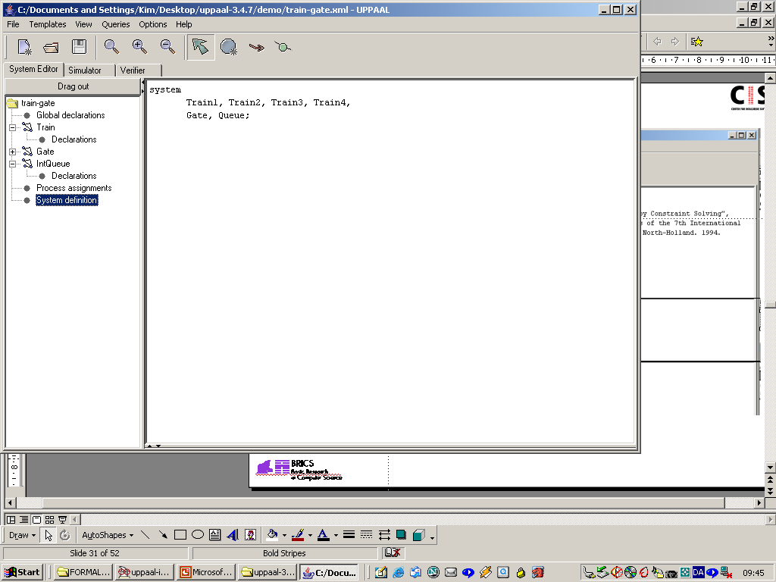
Declarations
Constants
Bounded integers
Channels
Clocks
Arrays
Templates
Processes
Systems
Notes:
In uppal you can declare all these global variables, constants, channels, clocks and arrays. Together with templates, processes and systems. The automaton of a template consist of Locations and edges. A template may also have local declarations and parameters. A template is instantiated by a process assignment (in the system definition). In the system definition, a system model is defined. Such a model consists of one or more concurrent processes, local and global variables, and channels. On the slide a system is made out of couple of processes named Train1, Train 2, Train3 Train 4 which are instantiated based on a template named Train containing the timed automaton. You will work with this more in the lab.

Slide 87
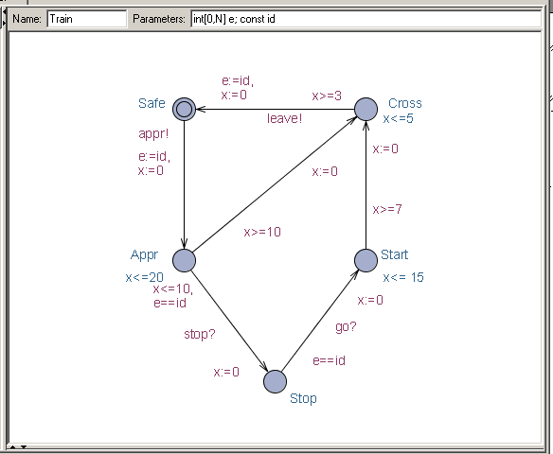
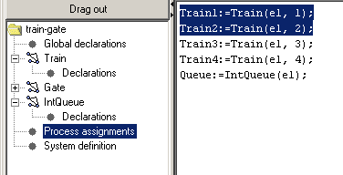
Templates
Templates may be parameterised:
int v; const min; const max
int[0,N] e; const id
Templates are instantiated to form processes:
P:= A(i,1,5);
Q:= A(j,0,4);
Train1:=Train(el, 1);
Train2:=Train(el, 2);
Notes:
Templates without parameters are instantiated into exactly one process with the same name as the template. Parameterised templates give rise to one process per combination of arguments, i.e., UPPAAL automatically binds any free template parameters. Any such parameter must be either a call-by-value bounded integer and or a call-by-value scalar. In this example the train template is parametrized using two parameters int[0,N] e; const id. Then this template is instantiated in form of a process. For example Train 1= Train (e1, 1);

Slide 88
Extensions
Select statement
models a non-deterministic choice
x : int[0,42]
Types
Record types
Type declarations
Meta variables:
not stored with state
meta int x;
Forall / Exists Expressions
forall (x:int[0,42]) expr true if expr is true for all values in [0,42] of x
exists (x:int[0,4]) expr true if expr is true for some values in [0,42] of x
Example: forall (x:int[0,4])array[x];
Notes:
Uppaal has couple of extensions for programming systems that can be useful: one is the select statement that models a non-deterministic choice. For example if you say x followed by : dots and then the integer range beteen 0 and 42 then x will be assigned a sudo random value when the transition is taken that contains this select statement. ecord types are specified by using the struct keyword, following the C notation. For example, a record can consist of the two fields a and b which are integer. I
Another extensions is that integers, booleans, and arrays can be marked as meta variables by prefixing the type with the keyword meta. Meta variables are stored in the state vector, but are sematically not considered part of the state. I.e. two states that only differ in meta variables are considered to be equal.
You can have also forall and exist expressions: An expression forall (x:int[0,42]) expr is true if expr is true for all values in [0,42] of x.
An expression exists (x:int[0,4]) expr is true if expr is true for some values in [0,42] of x.

Slide 89
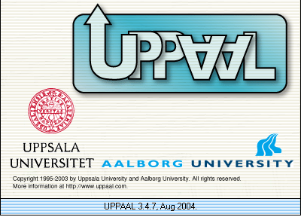
Modeling Formalisms
Query Language
CLASSIC
Notes:
For using timed automata and UPPAAL for model checking we need to express Requirements as temporal logical formula in Uppaal’s TCTL. We discussed about this sometime in the previous lecture.

Slide 90
Query Language
A subset of the logic Timed Computation Tree Logic (TCTL).
Can be efficiently implemented
P’s compu-tation tree:
P:
A
A
B
C
B
C
A
C
C
Notes:
Uppaal uses a simplified version of TCTL. Like in TCTL, the query language consists of path formulae and state formulae. State formulae describe individual states, whereas path formulae quantify over paths or traces of the model, a path that includes time information is called a timed path. Path formulae can be classified into reachability, safety and liveness

Slide 91
Quantifiers in TCTL
E - exists a path ( “E” in UPPAAL).
A - for all paths ( “A” in UPPAAL).
G - all states in a path ( “[]” in UPPAAL).
F - some state in a path ( “<>” in UPPAAL).
The following combination are supported:
A[], A<>, E<>, E[].
Notes:
UPPAAL supports couple of quantifiers: exists a path, for all paths, all states in a path, some state in a path. In short, the four temporal quantifier combinations are always, potentially always, possibly, and unavoidable.

Slide 92
E<> p – “p Reachable”
E<> p – it is possible to reach a state in which p is satisfied.
p is true in (at least) one reachable state.
p
Notes:
Reachability properties are the simplest form of properties. They ask whether a given state formula, p, possibly can be satisfied. by any reachable state. Another way of stating this is: Does there exist a path starting at the initial state, such that p is eventually satisfied along that path. Reachability properties are often used while designing a model to perform sanity checks. For instance, when creating a model of a communication protocol involving a sender and a receiver, it makes sense to ask whether it is possible for the sender to send a message at all or whether a message can possibly be received. These properties do not by themselves guarantee the correctness of the protocol for example that any message is eventually delivered, but they validate the basic behavior of the model. We express that some state satisfying p should be reachable in at least one reachable state.

Slide 93
A[] p – “Invariantly p”
p
A[] p – p holds invariantly.
P is true in all reachable states.
p
p
p
p
p
Notes:
Safety properties are on the form: “something bad will never happen”. For instance, in a model of a nuclear power plant, a safety property might be, that the operating temperature is always (invariantly) under a certain threshold, or that a meltdown never occurs. A variation of this property is that “something will possibly never happen”. For instance when playing a game, a safe state is one in which we can still win the game, hence we will possibly not loose. In Uppaal these properties are formulated positively, e.g., something good is invariantly true. Let p be a state formulae. We express that p should be true in all reachable states

Slide 94
A<> p – “Inevitable p”
A<> p – p will inevitable become true
the automaton is guaranteed to eventually reach a state in which p is true.
P is true in some state of all paths.
p
p
p
Notes:
Liveness properties are of the form: something will eventually happen, for example. when pressing the on button of the remote control of the television, then eventually the television should turn on. Or in a model of a communication protocol, any message that has been sent should eventually be received. In its simple form, liveness is expressed with the path formula eventually p.

Slide 95
E[] p – “Potentially Always p”
p
E[] p – p is potentially always true.
There exists a path in which p is true in all states.
p
p
Notes:
Another property is E[ ] p – “Potentially Always p, this shows if There exists a path in which p is true in all states.

Slide 96
Local Properties
A[]p, A<>p, E<>p, E[]p, p₁ --> p₂
p is a local property
Syntax:
p::= a.l | gd | gc | deadlock |
p and p | p or p | not p |
p imply p | ( p )
data guard
clock guard
automata location
process name
Notes:
Just to summarize, you can have couple of types of properties: you will use them in UPPAAL quite a lot in the lab. p in these properties is a local property that can be any side-effect free expression. In addition it is possible to test whether a process is in a particular location and whether a state is a deadlock and so on.

