Slide 1
Context
Big Data- Overview of Big Data
Hadoop- Overview
UseCases

Slide 2
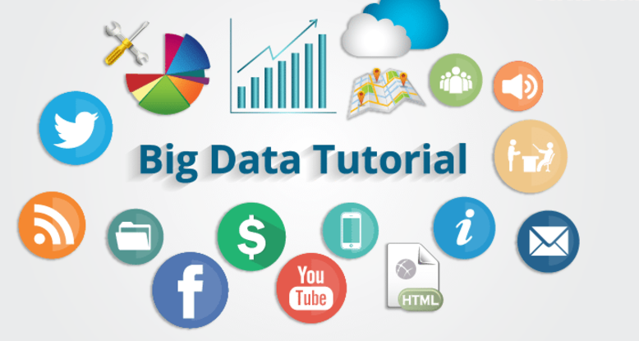
Data & Big Data
1.Enhancement of Technology
2.IOT
3.Social Media
4.Others
Notes:
enhancement of technology like previously we are using landline , keypad phones , but now smart phones.
Self-Driving Cars ( smart A.C & Refrigerators )
2020 we can have many IOT devices
Most evolution of big data, generates more data, data not present in structured, huge data
( Reatil, Hea;thCare )

Slide 3
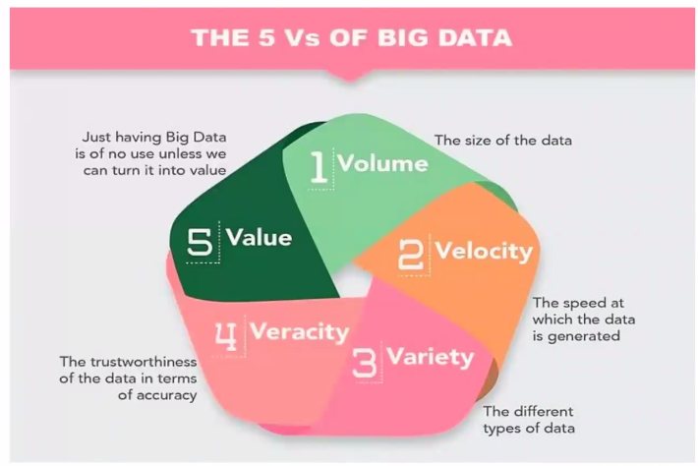
Three Characteristics of Big Data
Notes:
Big Data has three characteristics, namely, variety, velocity, and volume.
Variety
Variety encompasses managing the complexity of data in many different structures, ranging from relational data to logs and raw text.
Velocity
Velocity accounts for the streaming of data and movement of large volume of data at a high speed.
Volume
Volume denotes the huge scaling of data ranging from terabytes to zettabytes and more.

Slide 4
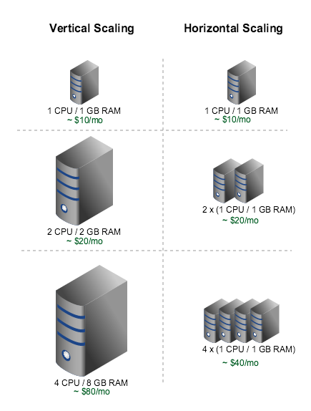
Horizontal AND Vertical Scaling of Hardware

