Slide 1


“The Internal Predictors of Business Performance in Small Firms: A Logistic Regression Analysis”
By: Mohammed-Khalil Ghali, and Rahul Gupta
Dr. Shuxia (Susan) Lu

Slide 2
Agenda
Introduction
Research Data and Analytical Methods
Analysis of the data
Cluster analysis and variable reduction
Construction of the dependent variable
Results of binary logistic regression
Results of ordinal logistic regression
Interpretation of results
Conclusion

Slide 3
Problem and Objective
Problem
To provide understanding of small business performance and emphasizes the importance of addressing internal and external factors to improve the performance of small businesses
Objective
To identify the internal factors that influence the performance of small businesses

Slide 4
Dataset
Dataset used was collected from The National Survey of Small Tourism and Hospitality Firms i.e., “Small Firms in the Events Sector undertaken in 2003”
Data provides a variety of internal influencing variables
Organization characteristics and event activity
Performance measures
Marketing activity
Employment and training
Quality management
Outsourcing and finance

Slide 5
Methodology
To meet the objectives of the research number of stages are performed
Cluster analysis
Variables
Independent
Categorical
Non-normally distributed
Dependent (business performance)
Discrete
Removed initial variables that does not significantly affect business performance and combining the others
Methods
Logistic regression
Binary
Ordinal

Slide 6
Cluster Analysis and Variable Reduction
Independent variable
Important clusters found are quality control measures, performance measures, some marketing variables, and variables related to human resources and training
Dependent variable (performance)
Levels of similarity between the turnover, profit, employment and demand suggest to combining into one variable
Notes:
Turnover and profit are most similar, fitting within an 86 per cent similarity umbrella. The measures for last year and next year also show sufficient similarity (71.3 per cent) to justify the inclusion of both the past measures and future forecasts

Slide 7
Binary Logistic Regression
Logistic regression is applicable in this paper as we have a mixture of categorical and continuous variables
In the case of binary logistic regression the dependent variable “overall performance” needs to be dichotomous
The cut-off point was decided to be 19 (the median), the original scale is 8 to 24 (the sum of individual variables score)

Slide 8
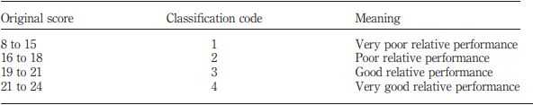
Ordinal Logistic Regression
To reduce the data loss in the dependent variable the modelling process was retried with the performance measure recoded into four categories
For this purpose, in the case of ordinal logistic regression the dependent variable overall performance score was recoded using the percentiles as class boundaries (Q1:16, Q2:19, Q3:22 )
Performance measure classification for ordinal logistic regression

Slide 9
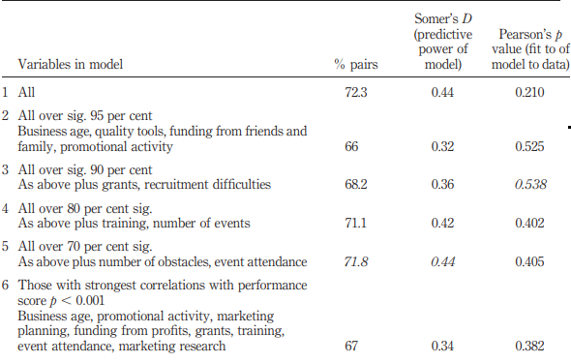
Binary Model Results

Slide 10
Binary Model Results
The best fitting model using the binary response variables includes the predictors “business age”, “quality tools”, “funding from family”, “promotional activity”, “funding from grants” and “recruitment difficulties”
The model 3 correctly places 68.2 per cent of the observations as higher or lower performance and only includes those variables whose effect on performance is significant at the 90 per cent level

Slide 11
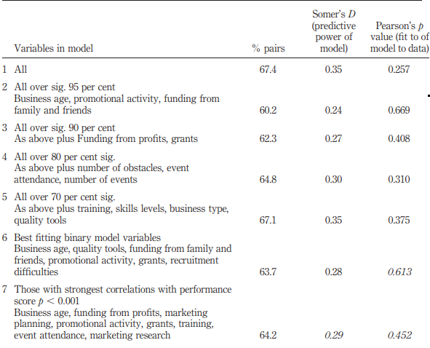
Ordinal Model Results

Slide 12
Ordinal Model Results
The ordinal logistic model which correctly places the most observations (63.7 per cent) appears to be the one that uses the same variables as the best fitting binary model
The best and more parsimonious model, which only includes highly significant variables (95 per cent level), is provided by model 2. This model still correctly places over 60 per cent of the observations into a performance category and has the highest Pearson’s p value (fit of data to the model)

Slide 13
General Interpretation of Results
The ordinal model is more parsimonious than the binary model and has a better fit of data to the model although this model is less successful at classifying cases
Although the two models achieve different results they contain three predictors in common. These are “business age”, “promotional activity” and “funding from family”
The importance of business age in determining success is largely related to establishing longer term sources of finance for the business

Slide 14
Thank you!

