Slide 1

Technology Review
Keep Calm and HODL!
Tejas, Puru, Rohit & Vishnu, Spring 2018

Slide 2
Our Requirements
Simple UI
Efficient pre-processing of natural language
Interactive visualization
Easy integration between ML results and UI
Inexpensive hosting

Slide 3
Assessment List
Programming Language
Visualization Package
Data Preprocessing
Machine Learning Package
Hosting

Slide 4
Programming Language – Python
Appeal
  Easy syntax for general programming
  Popularity
  Speed
  ML Libraries
  Documentation and online community support
Drawbacks
  Semantic errors only at runtime
  Poor support for Threading

Slide 5
Programming Language – R
Appeal
  Great for Statistical Analysis
  Libraries
  Online Support
  Minimal programming background required
Drawbacks
  Not so great for general programming, scalability and integrations
  Speed

Slide 6
Visualization Package - Bokeh
Appeal
  Jupyter Notebook Support
  Interactive Plots
Drawbacks
  Need to know both Python and JavaScript
  Slower for big datasets
  Inconsistency issues
  Lack of sufficient documentation

Slide 7
Visualization Package – Plotly Dash
Appeal
  Handles big datasets better
  No inconsistency issues
  Easier to learn
  Popular
Drawbacks
  Insufficient documentation

Slide 8
Visualization Package – Tableau Public
Appeal
  Popular
  Drag and Drop
  Interactive
  Storyboarding
Drawbacks
  Learning Curve
  Hard to integrate with custom UI

Slide 9
Visualization Package – R Shiny
Appeal
  Great for fast prototyping
  Abundant charting libraries
Drawbacks
  Not great for multi page Apps

Slide 10
Data Preprocessing – Pandas/dplyr/data.table
Appeal
  Good Readability
  Sufficient Documentation
  Online Support
Drawbacks
  Nothing standing out

Slide 11
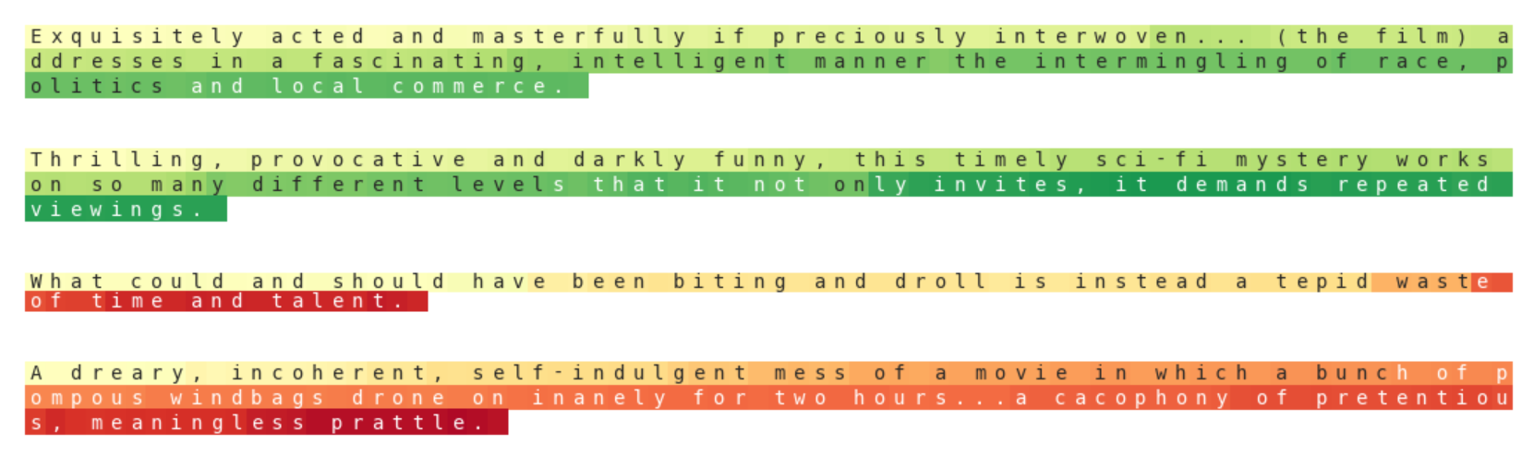
Text Preprocessing – NLTK
Good documentation and support
Fast in production
Sentiment Analysis: NVIDIA-sentiment-discovery

Slide 12
Machine Learning – Scikit Learn
Appeal
  Faster with Numpy
  Abundant Documentation
  Great online community and support
  Easy syntax and less lines of code
Drawbacks
  Later versions tend to break older ones

Slide 13
Machine Learning – Statsmodels
Appeal
  Great for complex statistical analysis
  Great for parameter estimation and (statistical) testing.
Drawbacks
  Lesser variety of options
  Less popular for ML prototyping

Slide 14
Hosting – AWS/Azure/GCP
Appeal
  Variety of options
  Support for multiple languages
Drawbacks
  Expensive

Slide 15
Hosting - UW
Appeal
  Free
  Easier to deploy
  Need to check support for Dash
Drawbacks
  Expires after graduation

Slide 16
Hosting - GitHub
Appeal
  Easy to deploy

Slide 17


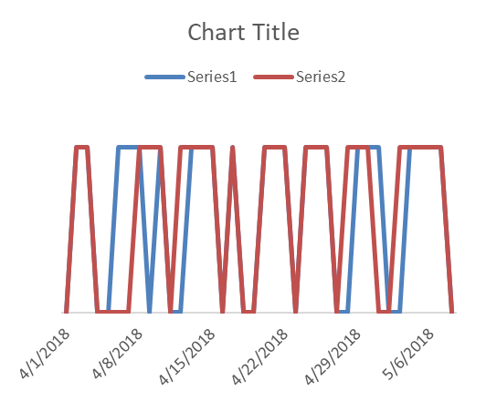


Today’s Prediction
73% Confidence
Past Performance
70% Accuracy
81% Recall
72% Precision
Actual
Predicted

Slide 18
Final Selection
Reddit (BigQuery) + Twitter (Tweepy)
Python
Pandas + NLTK
Scikit Learn
Plotly Dash
Hosting - TBD

Slide 19
Thank You!

