Slide 1

Classifying U.S. Speed Limit Signs
SHAKTI PATEL, REVANTH CHALLURU, HARICESH RATNAHARAN, GRISHMA KALIDINDI, DAVID TRACCARELLA

Slide 2
Agenda
Research
Timeline
Previously Considered
Digit Recognizer
Tesseract
Our Model
Challenges & Shortcomings
Our Approach

Slide 3
The Problem
According to NHTSA, speeding accounted for 27% of all traffic fatalities in 2016
An increase from 5.6% in 2015
Increased interest & development in computer vision capabilities for autonomous vehicles
Dynamically detect and read speed limit signs to improve alert system & encourage safer driving practices

Slide 4
Research
Mostly European traffic sign models
Shape/Edge detection
FSR
Hough Transform
Histogram of Oriented Gradients
Recognition Algorithm
Neural Network
SVM

Slide 5
Our Approach
Goal
Work on a U.S. dataset of speed limit signs
Source
Open Source Resources
Learning
Transfer Learning
Model
Build Our Own Model

Slide 6
Timeline
Open Source Tools & Methods
Tesseract
Tesseract OR CNN?
Ability to recognize digits
Prototype
Demo
Digital Recognizer
TensorFlow
Read from speed limit signs
Reading License Plates
Poor performance
Needs more data
Classifies speed limit signs

Slide 7
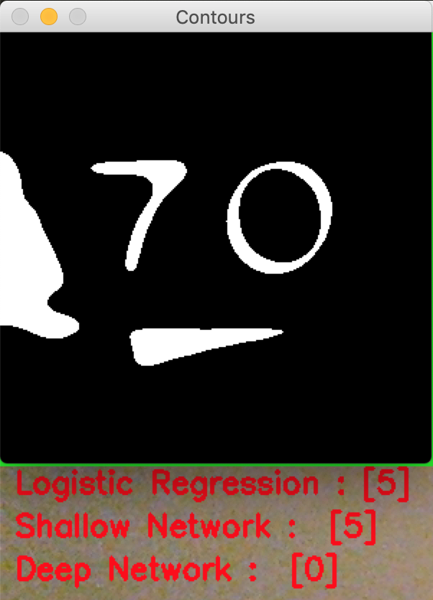
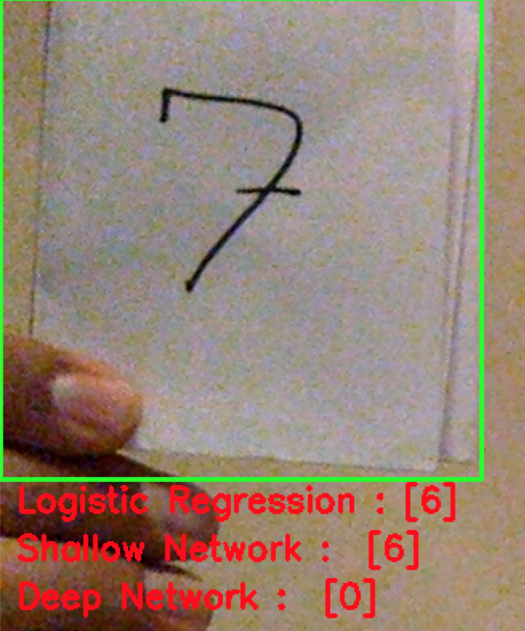
Digit Recognizer

Slide 8
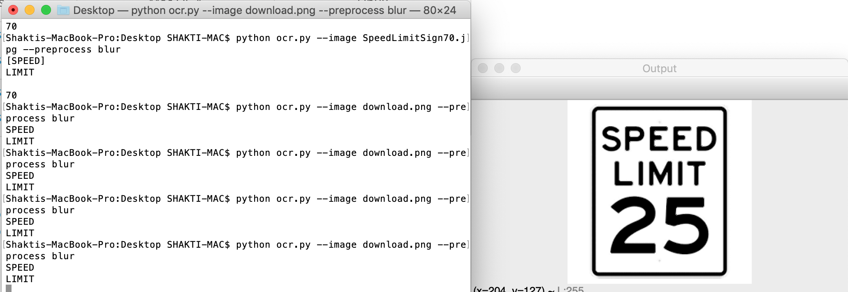

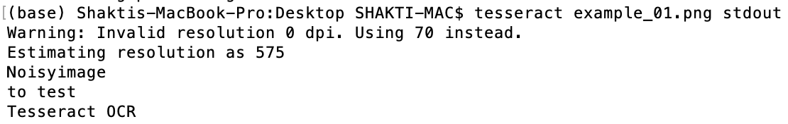
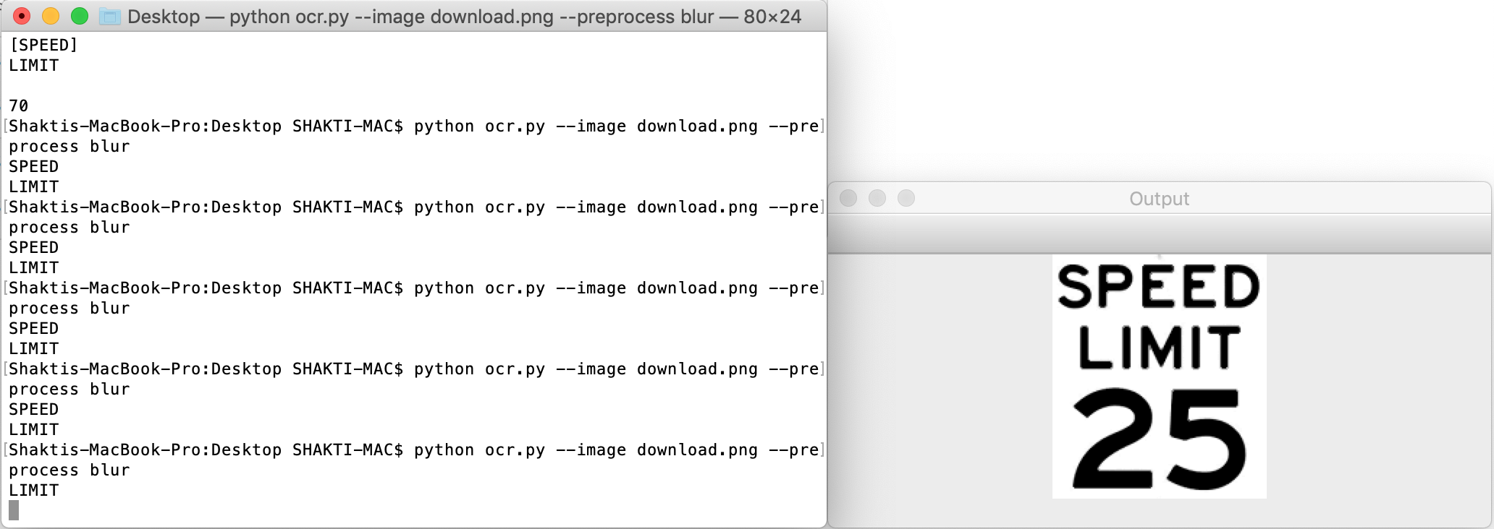
Tesseract
What we expected it to do …
What it actually did …

Slide 9
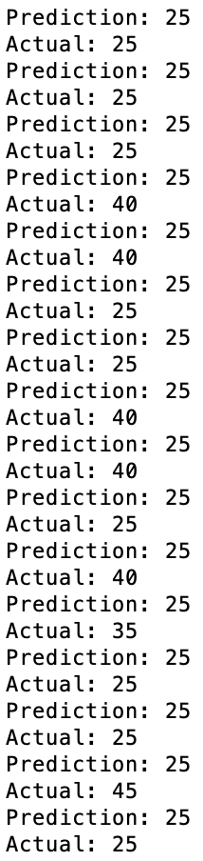
Our own TensorFlow model
Outcome:
A decent dataset
https://www.kaggle.com/shaktip258/cropped-speed-limit-signs
A classification model
Classifies images of speed limit signs
High accuracy, low precision/recall
Roadblocks & Challenges
Quantity of data
Finetuning the model

Slide 10
Other Challenges
More information on European traffic signs than U.S.
Noisy images
Environment setup
Computing power

Slide 11
QUESTIONS?

