Slide 1
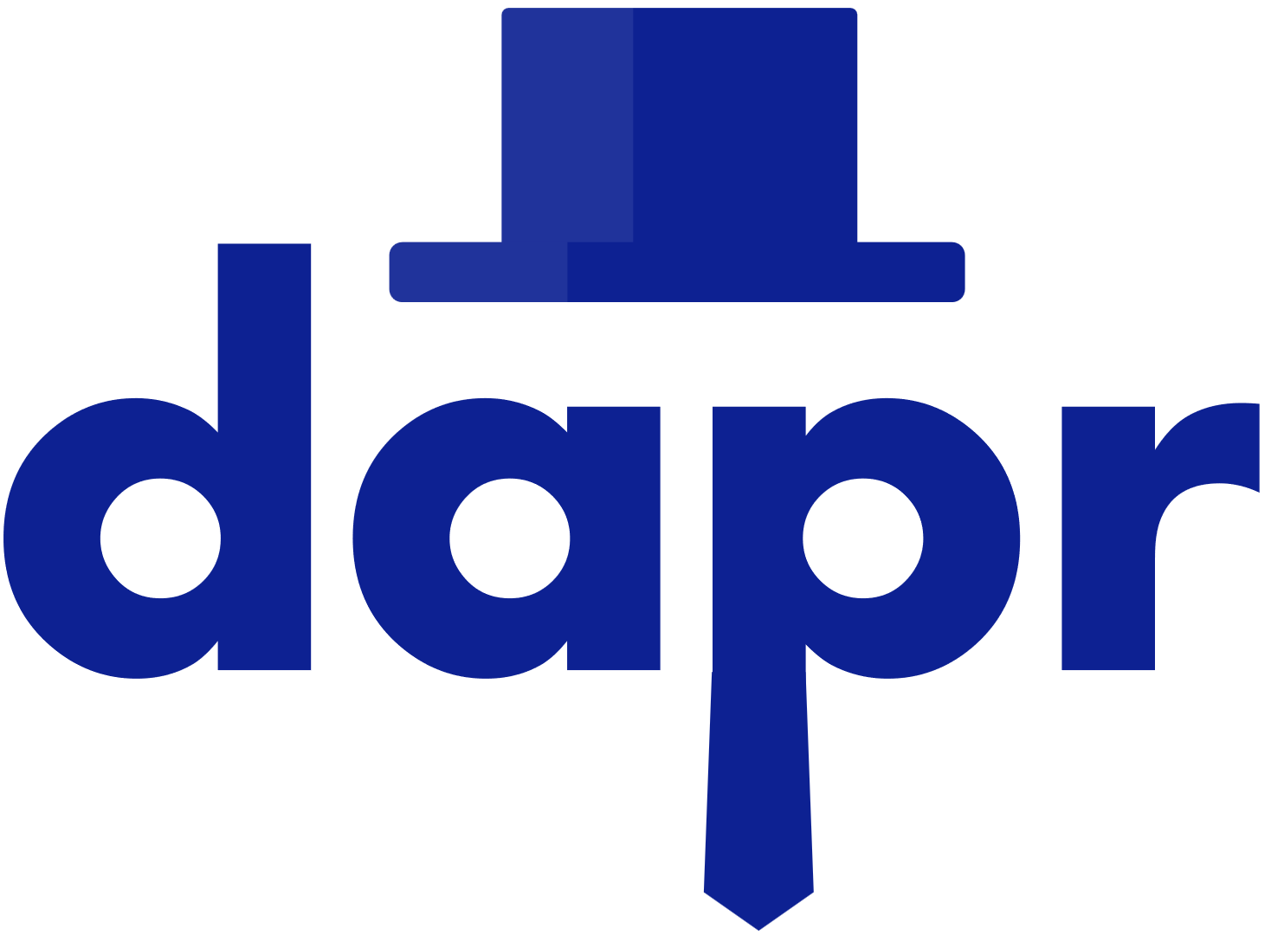
Distributed Application Runtime
Ragavan
Lead Software Engineer
Phoenix

Slide 2
Agenda
Demo

Slide 3
What is Dapr?
Build resilient, stateless and stateful applications
cloud and edge
Any languages and frameworks
Portable, event-driven runtime

Slide 4
Distributed Application Challenges
Communication
Resiliency
Distributed Data
Secrets
Observability
Notes:
For each of these complex challenges, multiple products are often available. But, shielding your application from product differences and keeping code maintainable and portable become a challenge.

Slide 5
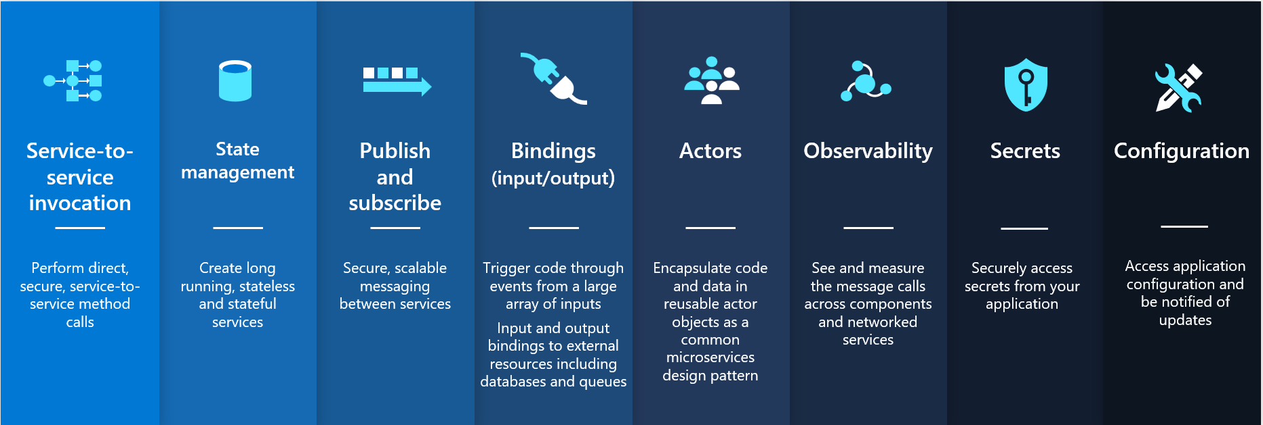
Building Blocks

Slide 6
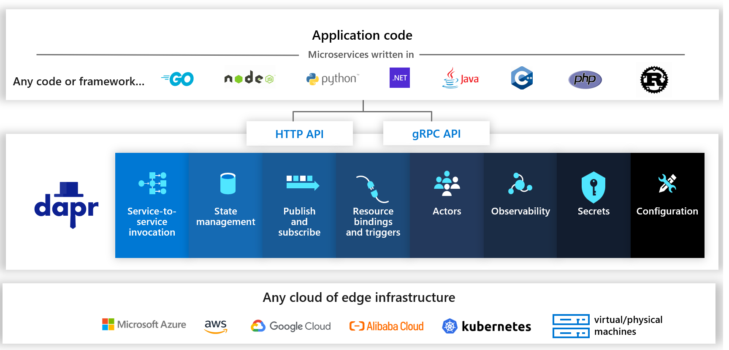
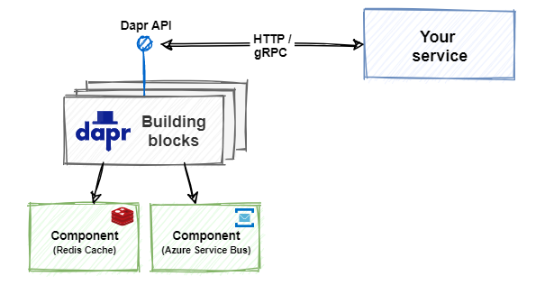
Building Blocks Integration

Slide 7
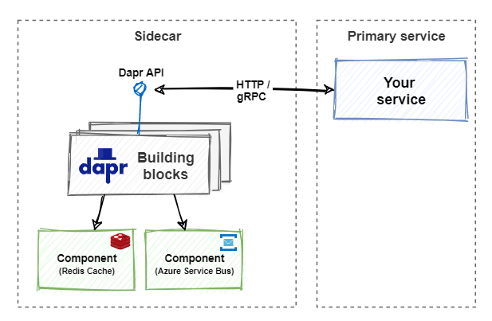
Sidecar Architecture

