Slide 1

Distributed Application Runtime
Ragavan
Lead Software Engineer
Notes:
Greet & Intro
High performance, scalable and reliable distributed application easier
Focus on Developer perspective

Slide 2
Agenda
Distributed App & it’s Challenges
About Dapr & It’s capabilities
Demo App with Dapr
Notes:
Refresh our minds on Distr. Apps.

Slide 3
Distributed Application
Notes:
Greet & Intro
High performance, scalable and reliable distributed application easier
Focus on Developer perspective

Slide 4
Distributed Application
An Application that runs on multiple computers within a network at the same time and can be stored on servers or with cloud computing

Slide 5
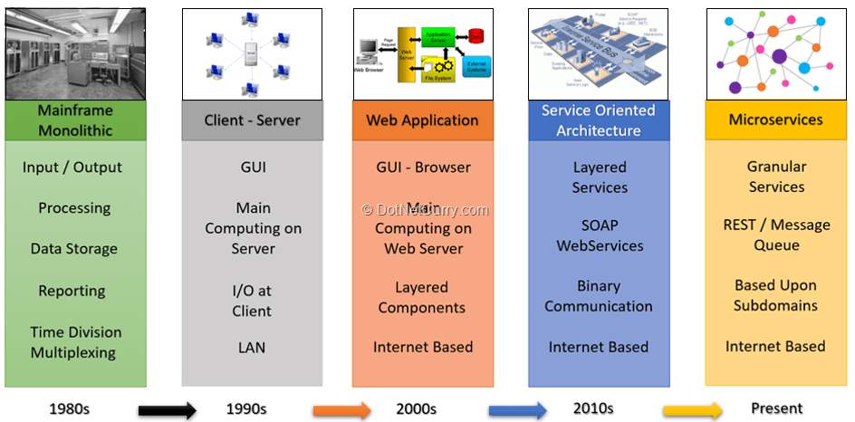
Distributed Application
An Application that runs on multiple computers within a network at the same time and can be stored on servers or with cloud computing
Notes:
Advantages: Fault tolerance, Scalability & Maintenance
Pre/Post Web
N-Tier/SOA to group related responsibilities together sharing same DB, also called as Distributed Monolith

Slide 6
Distributed Application Challenges
Communication
Resiliency
Distributed Data
External System Integration
Observability
Notes:
Communication
Sync (HTTP/GRPC)
Service discovery, access control, encryption, certificate management
Async (Messages)
Message broker integration, deduplication with at least once delivery
Resiliency - retries/back-off periods, circuit breakers
Distributed Data - Concurrency, Consistency & Expirations
External system – SDKs & libraries availability, own implementation
Observability - Traces, Logs & Metrics

Slide 7
What?
Notes:
Greet & Intro
High performance, scalable and reliable distributed application easier
Focus on Developer perspective

Slide 8
Dapr
Open source, lightweight & portable, event-driven runtime
Takes over the complex challenges that developers encounter
Codifies proven industry practices & standards
Exposes APIs to build resilient, secure, stateless or stateful apps faster and easier
Let have your code simple & vendor neutral, also portable
Notes:
Lightweight process (58mb binary, 4mb physical memory) runs anywhere to perform operations based on some events happens expernally
Any language/Framework
Lets you focus on business logic
Encrypted communication, access controls, W3C Tracing Context, Cloud Events, Open telemetry, resilient etc

Slide 9
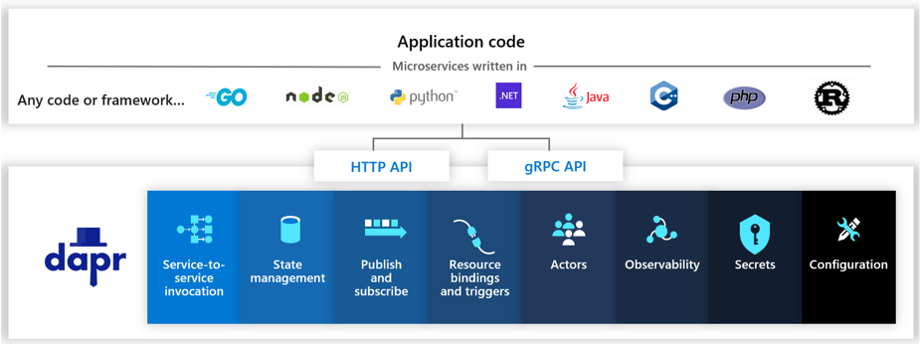
Building Blocks
Notes:
Independent building blocks
Just one, some or all can be used
Each building block explanation
Q: How the dapr building block know what

Slide 10
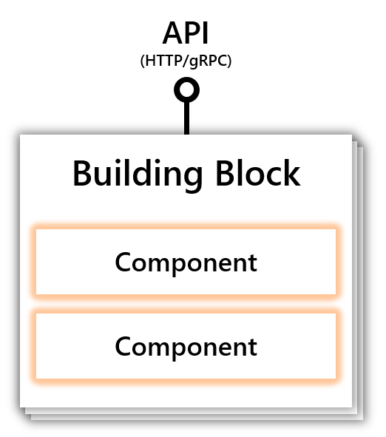
Components
Notes:
Can load one or more components at runtime
Each component are implementation of interface exposed by Dapr
Hence easy to plug and play with different components

Slide 11




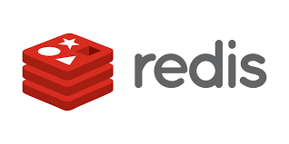




Components
80+ Components

Slide 12
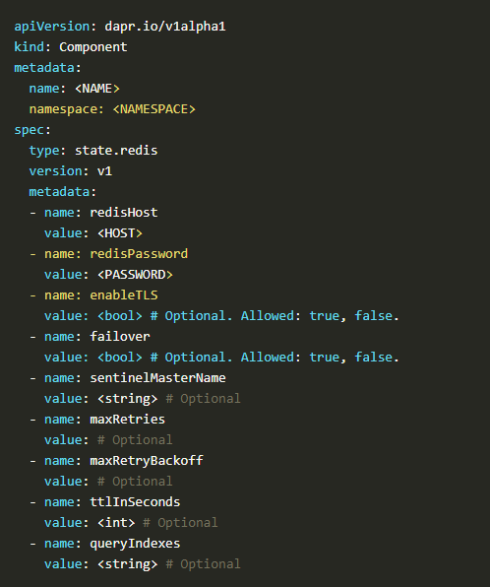
Components

Slide 13
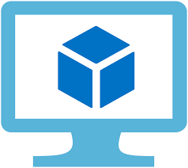
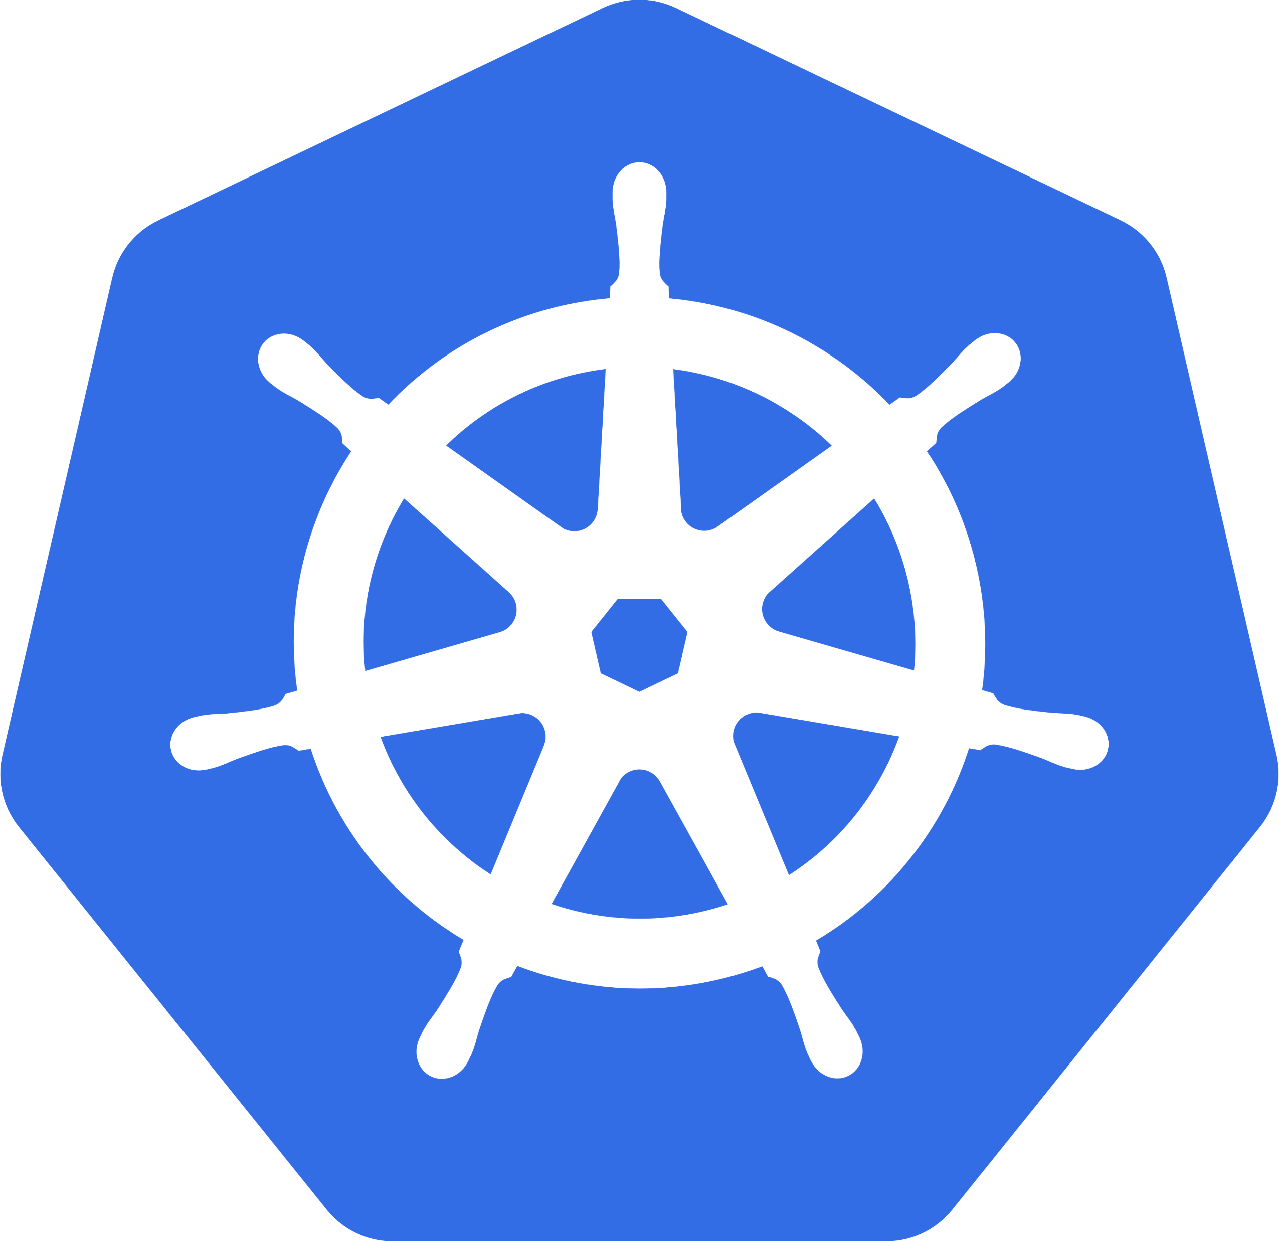
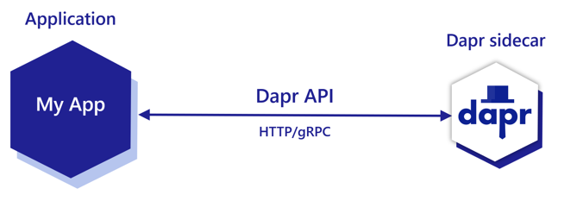
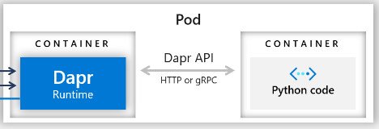
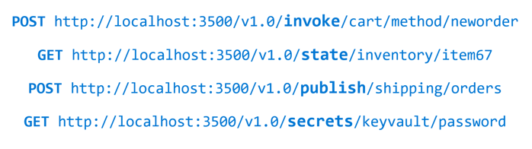
Sidecar Architecture

Slide 14
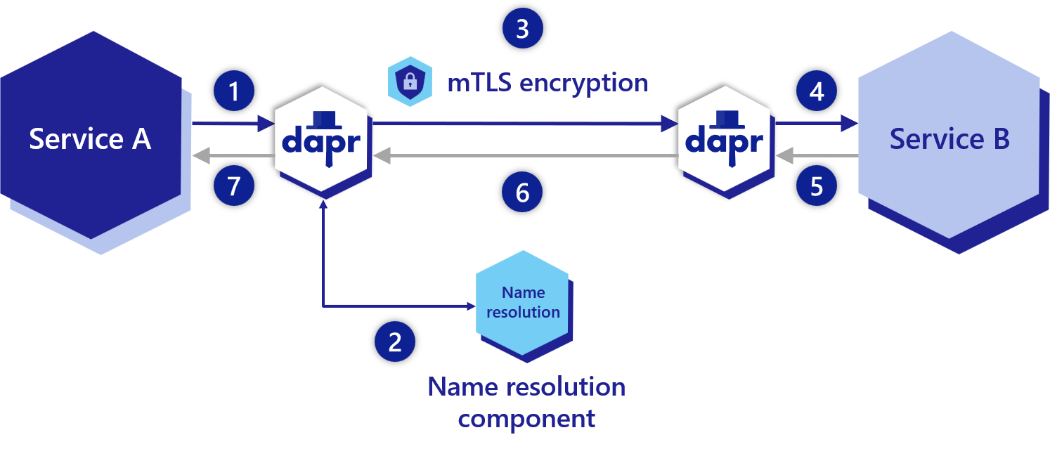
Service-to-Service Invocation Building Block
PATCH/POST/GET/PUT/DELETE
http://localhost:<daprPort>/v1.0/invoke/<appId>/method/<method-name>

Slide 15
Service-to-Service Invocation Building Block
Reliable & Secure communication using standard gRPC & HTTP protocols
Dapr acts as a reverse proxy.
Built in features
Service Discovery
Security
Access control
Resiliency
Load balancing
Tracing and metrics
PATCH/POST/GET/PUT/DELETE
http://localhost:<daprPort>/v1.0/invoke/<appId>/method/<method-name>

Slide 16
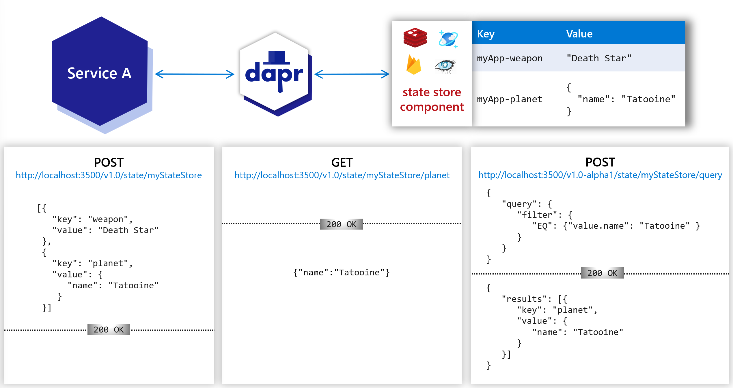
State Management Building Block
Notes:
Setting the choices on concurrency control and data consistency.
Performing bulk update operations CRUD including multiple transactional operations.
Querying and filtering the key/value data.

Slide 17
State Management Building Block
To store and query data as key/value pairs in the supported state stores.
Build in features
Pluggable state stores
Configurable behaviours
Concurrency (Last/First write wins)
Consistency (Eventual/Strong Reads)
Per state TTL
Sharing the state with other services
Notes:
Setting the choices on concurrency control and data consistency.
Performing bulk update operations CRUD including multiple transactional operations.
Querying and filtering the key/value data.

Slide 18
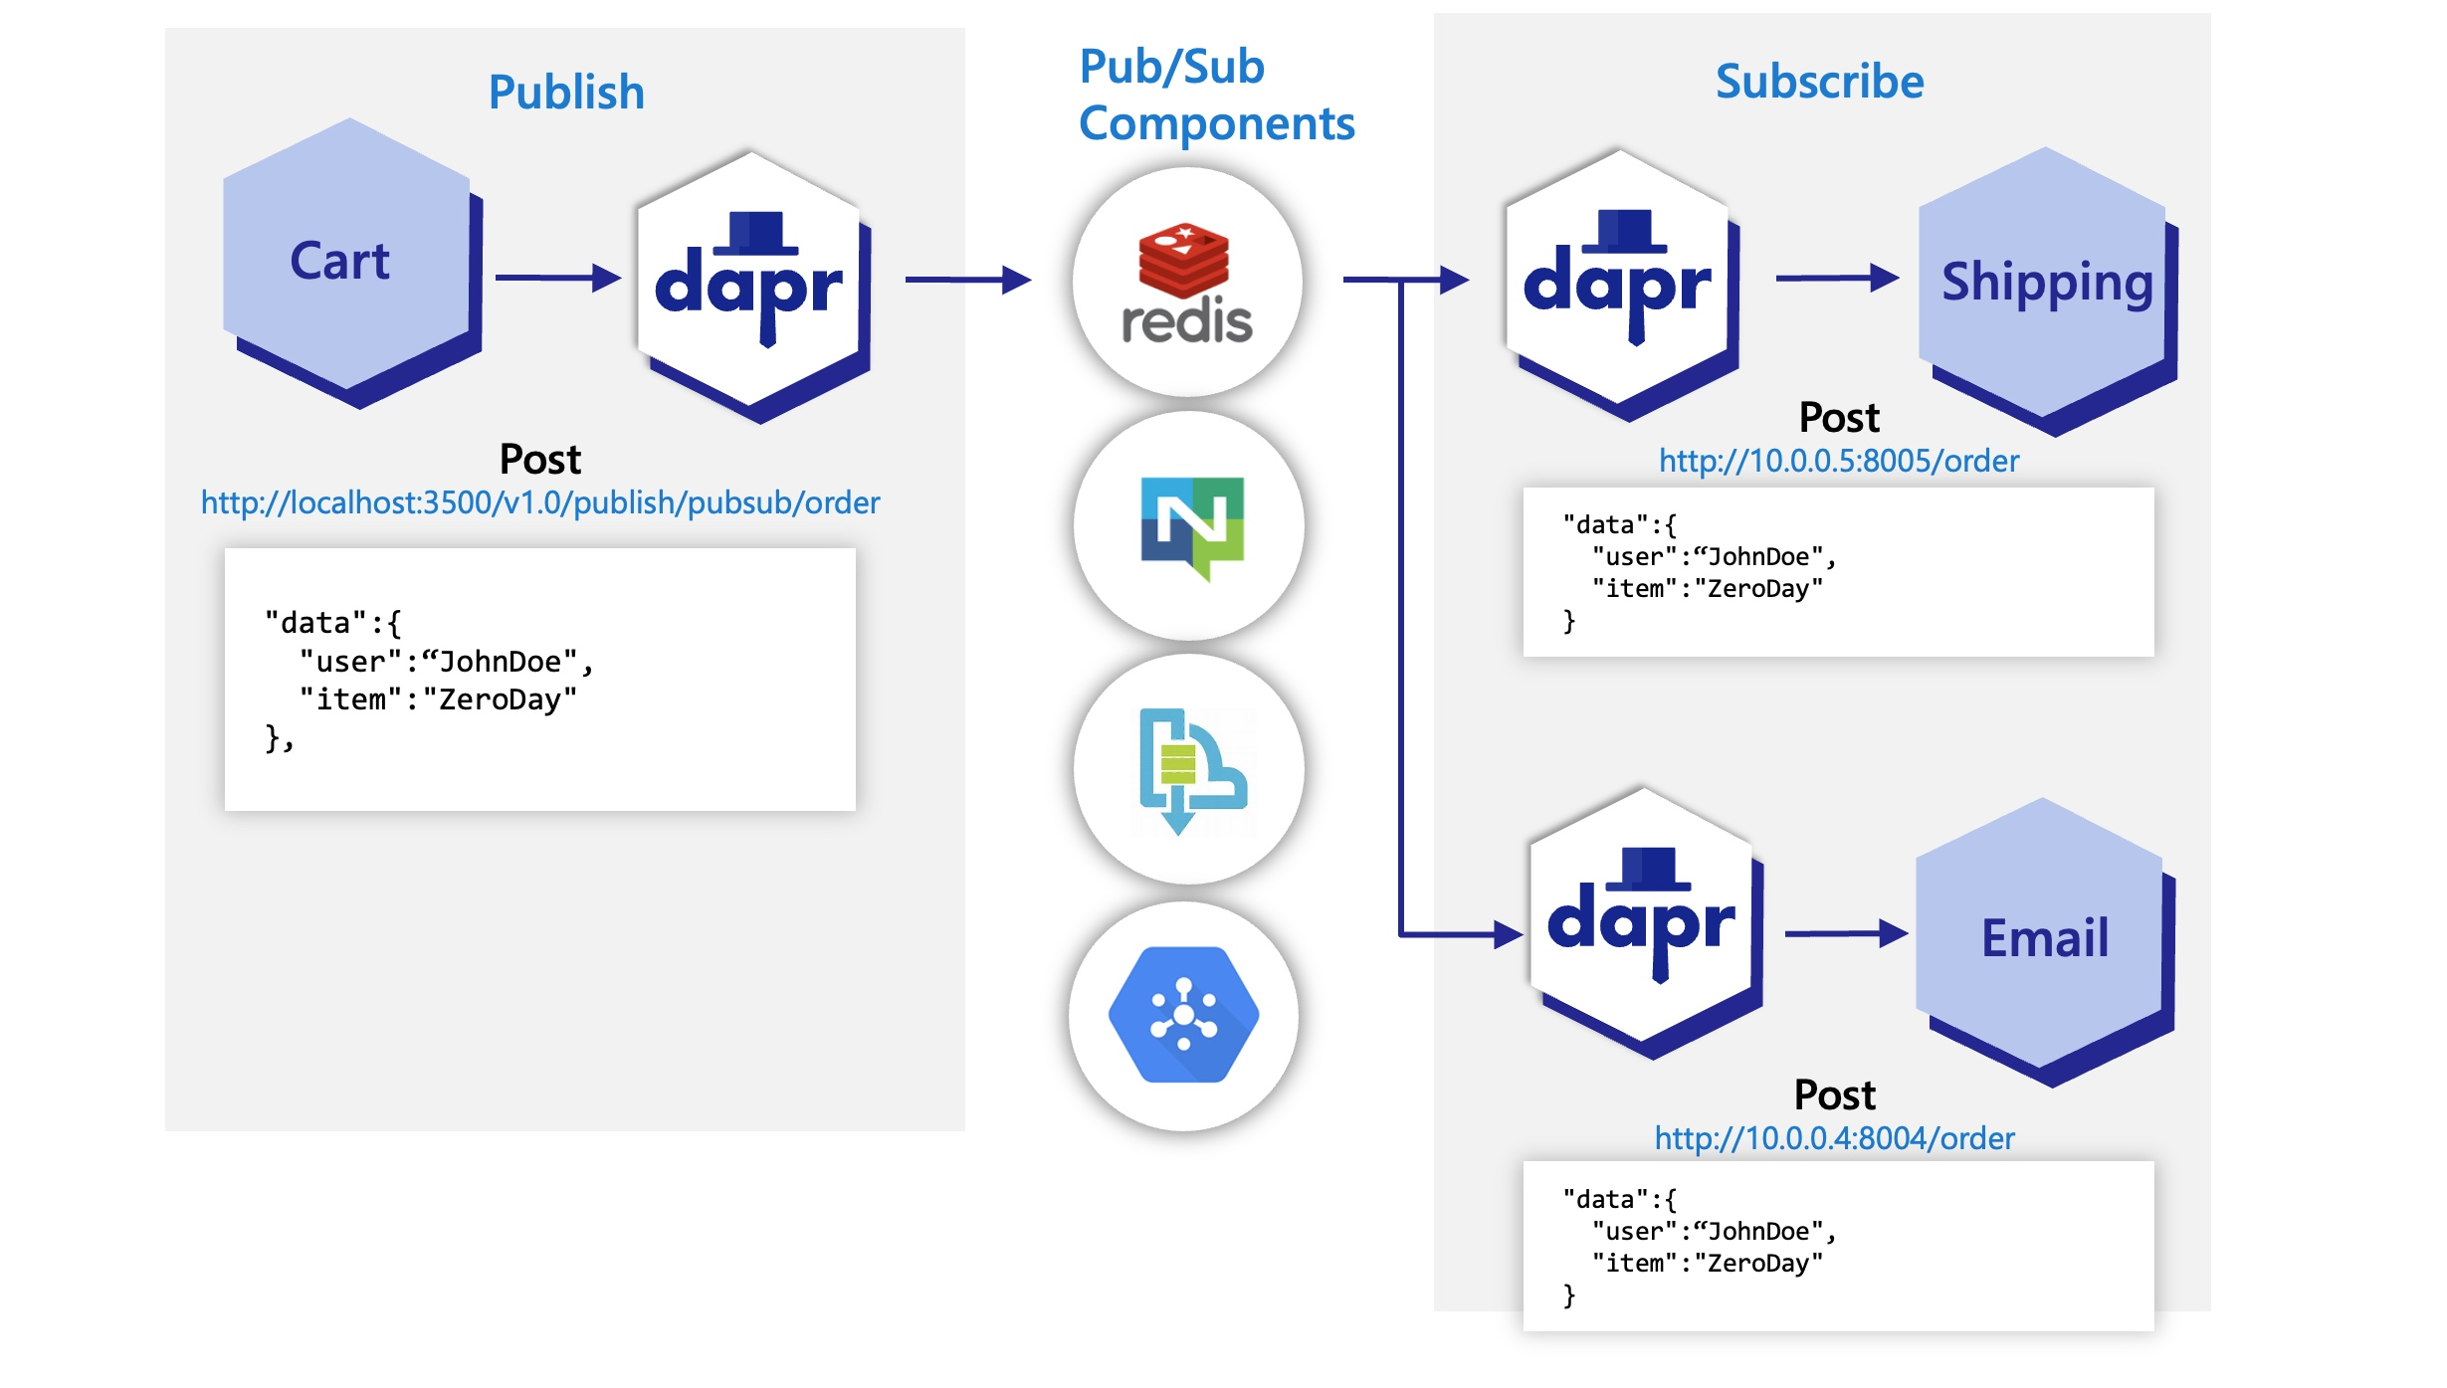
Publish and Subscribe Building Block

Slide 19
Publish and Subscribe Building Block
At-least-once guarantee on message delivery
Integrates with various message brokers and queueing systems
Extremely portable and flexible to changes.
Built in features
Cloud events message specification
Programmatic & Declarative subscription
Competing consumers pattern
Topic scoping
Per Message TTL

Slide 20
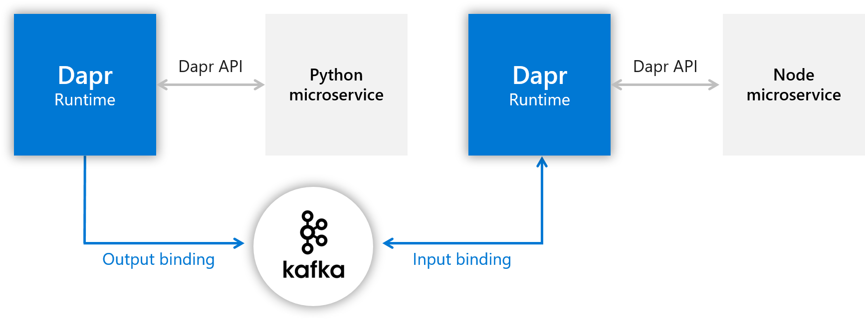
Bindings Building Block

Slide 21
Bindings Building Block
Input Bindings: Triggering your Apps with events coming from external systems
Output Bindings: Triggering external systems with event occurred in your App
No worries on implementation details of interacting with systems
Resiliency is In-Built
Seamless switch between bindings at run time

Slide 22
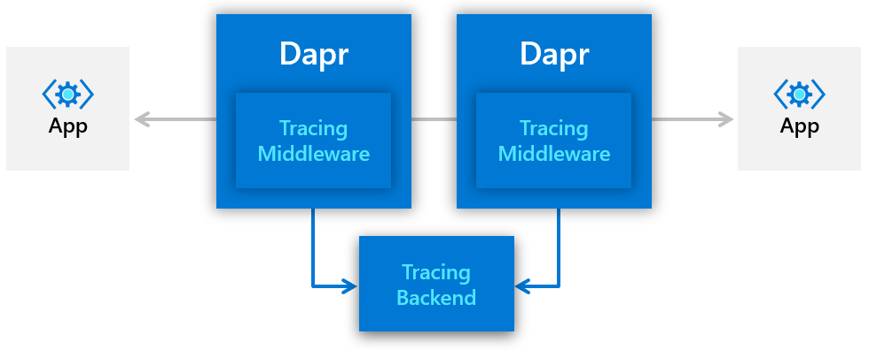
Observability Building Blocks

Slide 23
Observability Building Blocks
Distributed traces and metrics collection using middleware
Uses W3C trace context & Zipkin protocol, hence supports various backends
Combining with OpenTelemetry collector, exports traces to even more backends
Extensible to multiple exports at the same time
Consistent tracing behaviour guaranteed

Slide 24
Secrets Building Block
Setting up a component for a specific secret store solution.
Retrieving secrets using the Dapr secrets API in the application code.
Optionally, referencing secrets in Dapr component files.
Limiting access to secrets

Slide 25
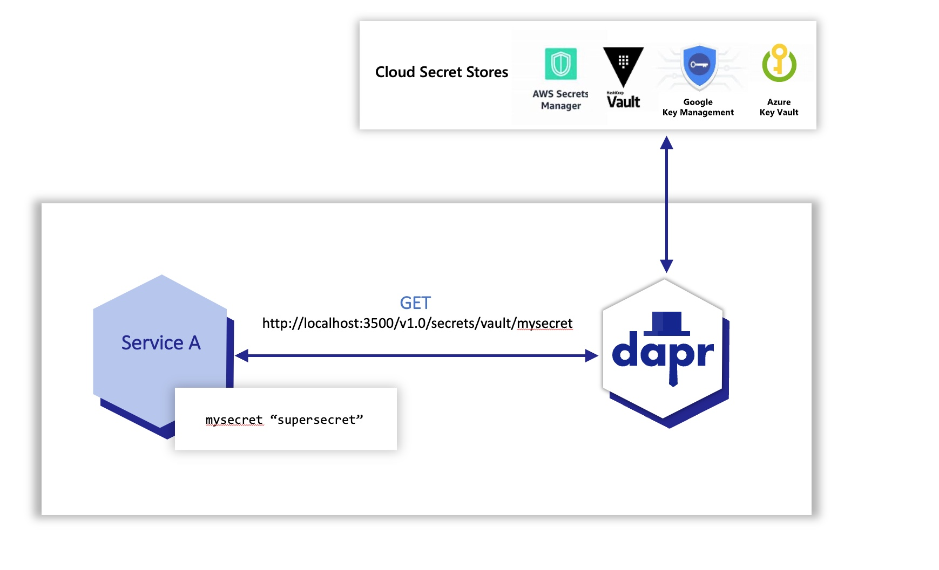
Secrets Building Block
Setting up a component for a specific secret store solution.
Retrieving secrets using the Dapr secrets API in the application code.
Optionally, referencing secrets in Dapr component files.
Limiting access to secrets

Slide 26
Demo

Slide 27
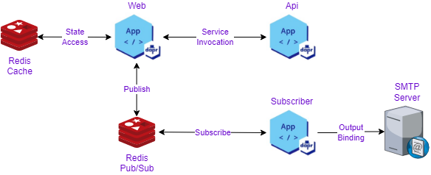
Demo

Slide 28
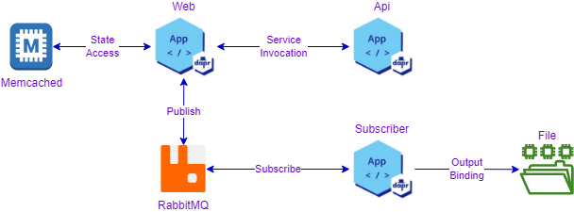
Demo

