Slide 1

Distributed Application Runtime
Ragavan
Lead Software Engineer

Slide 2
Agenda
About Dapr
Distributed App Challenges
How Dapr rescues
Major Dapr building blocks
Demo App with Dapr

Slide 3
About Dapr
Open sourced by Microsoft Engineers, now community driven
Now CNCF incubation project.
V1.0 released in early 2021.
Major cloud vendors integrates
Event driven & portable runtime written in Go lang

Slide 4
Distributed Application Challenges
Notes:
Comfortable with Client/Server & N-Tier, but not distributed application of bigger scale

Slide 5

Distributed Application Challenges
Communication
Notes:
Comfortable with Client/Server & N-Tier, but not distributed application of bigger scale
Sync/Async communication
Sync - Discover and invoking right endpoint, considering versions
Async - Defining message format
Encryption and Security

Slide 6

Distributed Application Challenges
Communication
Resiliency
Notes:
Resiliency
Load balancer setup
Retries
Circuit breaker

Slide 7

Distributed Application Challenges
Communication
Resiliency
Distributed Data
Notes:
Distributed Data
Transaction
Consistency (Strong vs Eventual)
Concurrency (Last/First writes to consider)

Slide 8

Distributed Application Challenges
Communication
Resiliency
Distributed Data
External systems integration
Notes:
External System Integration

Slide 9

Distributed Application Challenges
Communication
Resiliency
Distributed Data
External systems integration
Secrets
Notes:
External System Integration

Slide 10

Distributed Application Challenges
Communication
Resiliency
Distributed Data
External systems integration
Secrets
Observability
Notes:
External System Integration

Slide 11






Goal of Dapr
Build resilient, stateless and stateful applications
Any languages and frameworks
Focus on business logic
Vendor neutral & simple code
cloud and edge
Incremental adoption

Slide 12
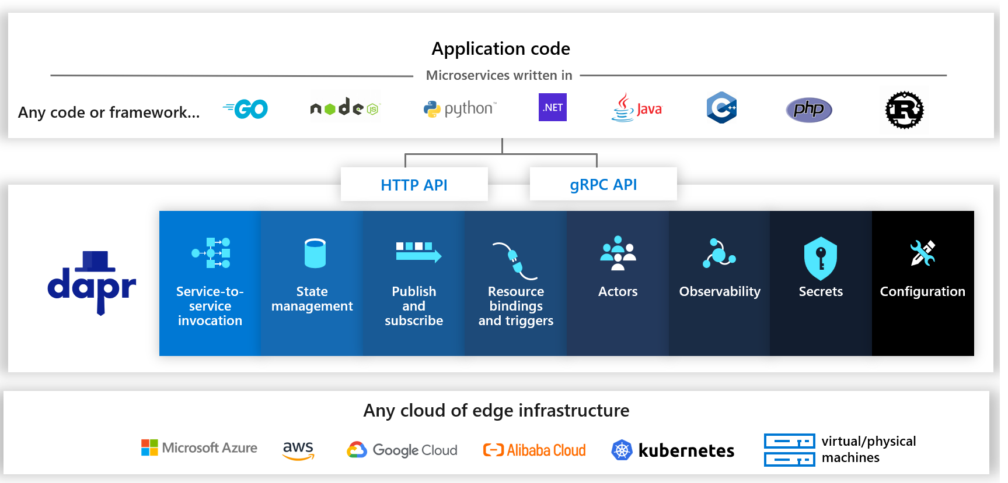
Building Blocks

Slide 13
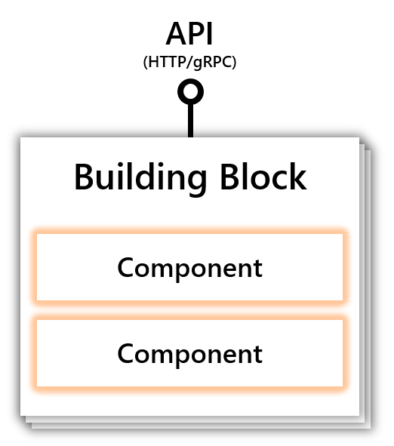
Components

Slide 14



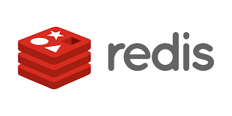





Components
80+ Components

Slide 15
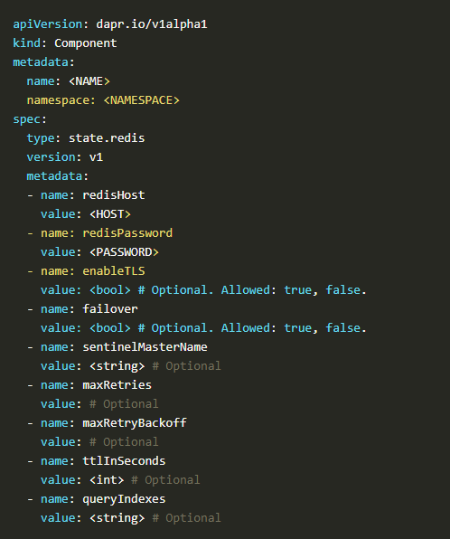
Components
80+ Components

Slide 16
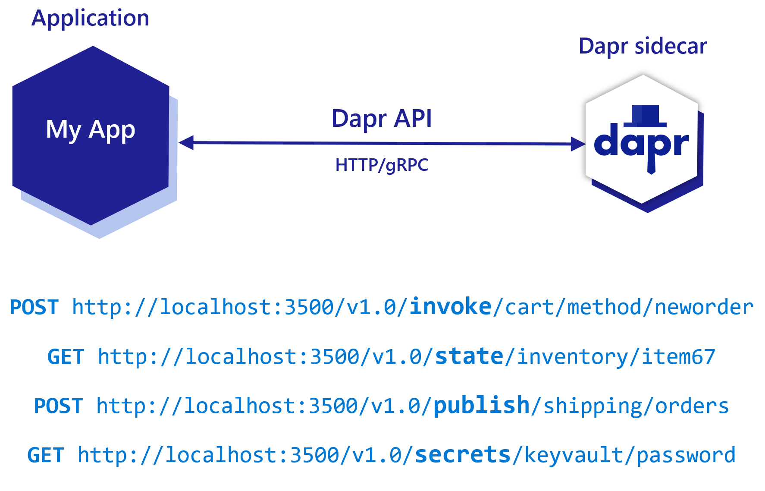
Sidecar Architecture

Slide 17
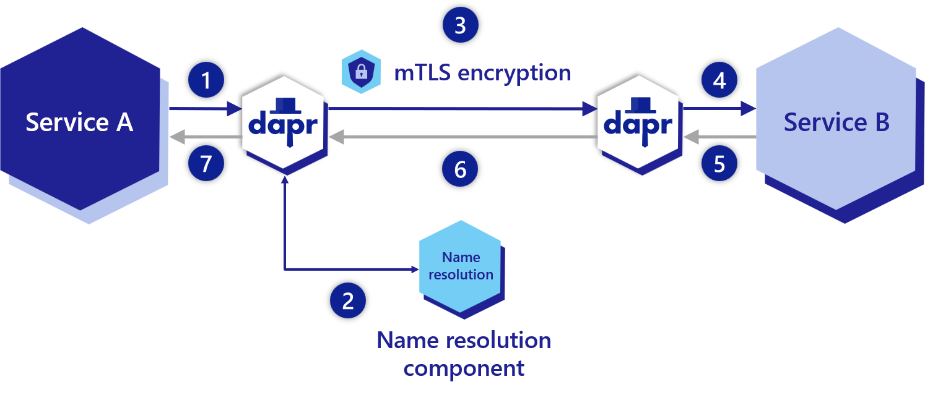
Service-to-Service Invocation Building Block
Reliable & Secure communication using standard gRPC & HTTP protocols
Dapr API acts as a reverse proxy.
Built in features
Security
Access control
Retries
Service discovery
Load balancing
Tracing and metrics
PATCH/POST/GET/PUT/DELETE
http://localhost:<daprPort>/v1.0/invoke/<appId>/method/<method-name>
Notes:
How do I discover and invoke methods on different services?
How do I call other services securely with encryption and apply access control on the methods?
How do I handle retries and transient errors?
How do I use tracing to see a call graph with metrics to diagnose issues in production?

Slide 18
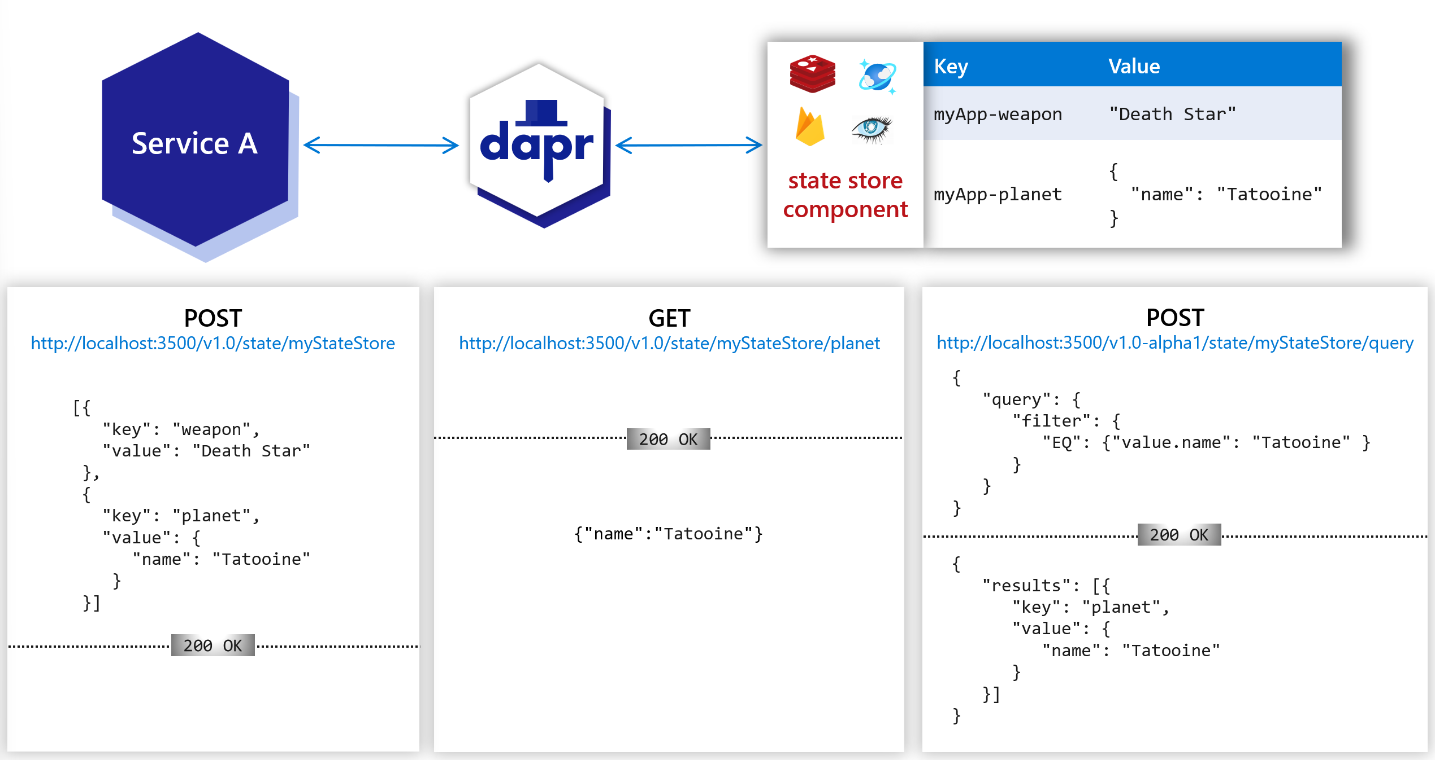
State Management Building Block
To store and query data as key/value pairs in the supported state stores.
Build in features
Pluggable state stores
Configurable behaviours
Concurrency (Last/First write wins)
Consistency (Eventual & Strong)
TTL Support
Sharing the state with other apps
Notes:
Setting the choices on concurrency control and data consistency.
Performing bulk update operations CRUD including multiple transactional operations.
Querying and filtering the key/value data.

Slide 19
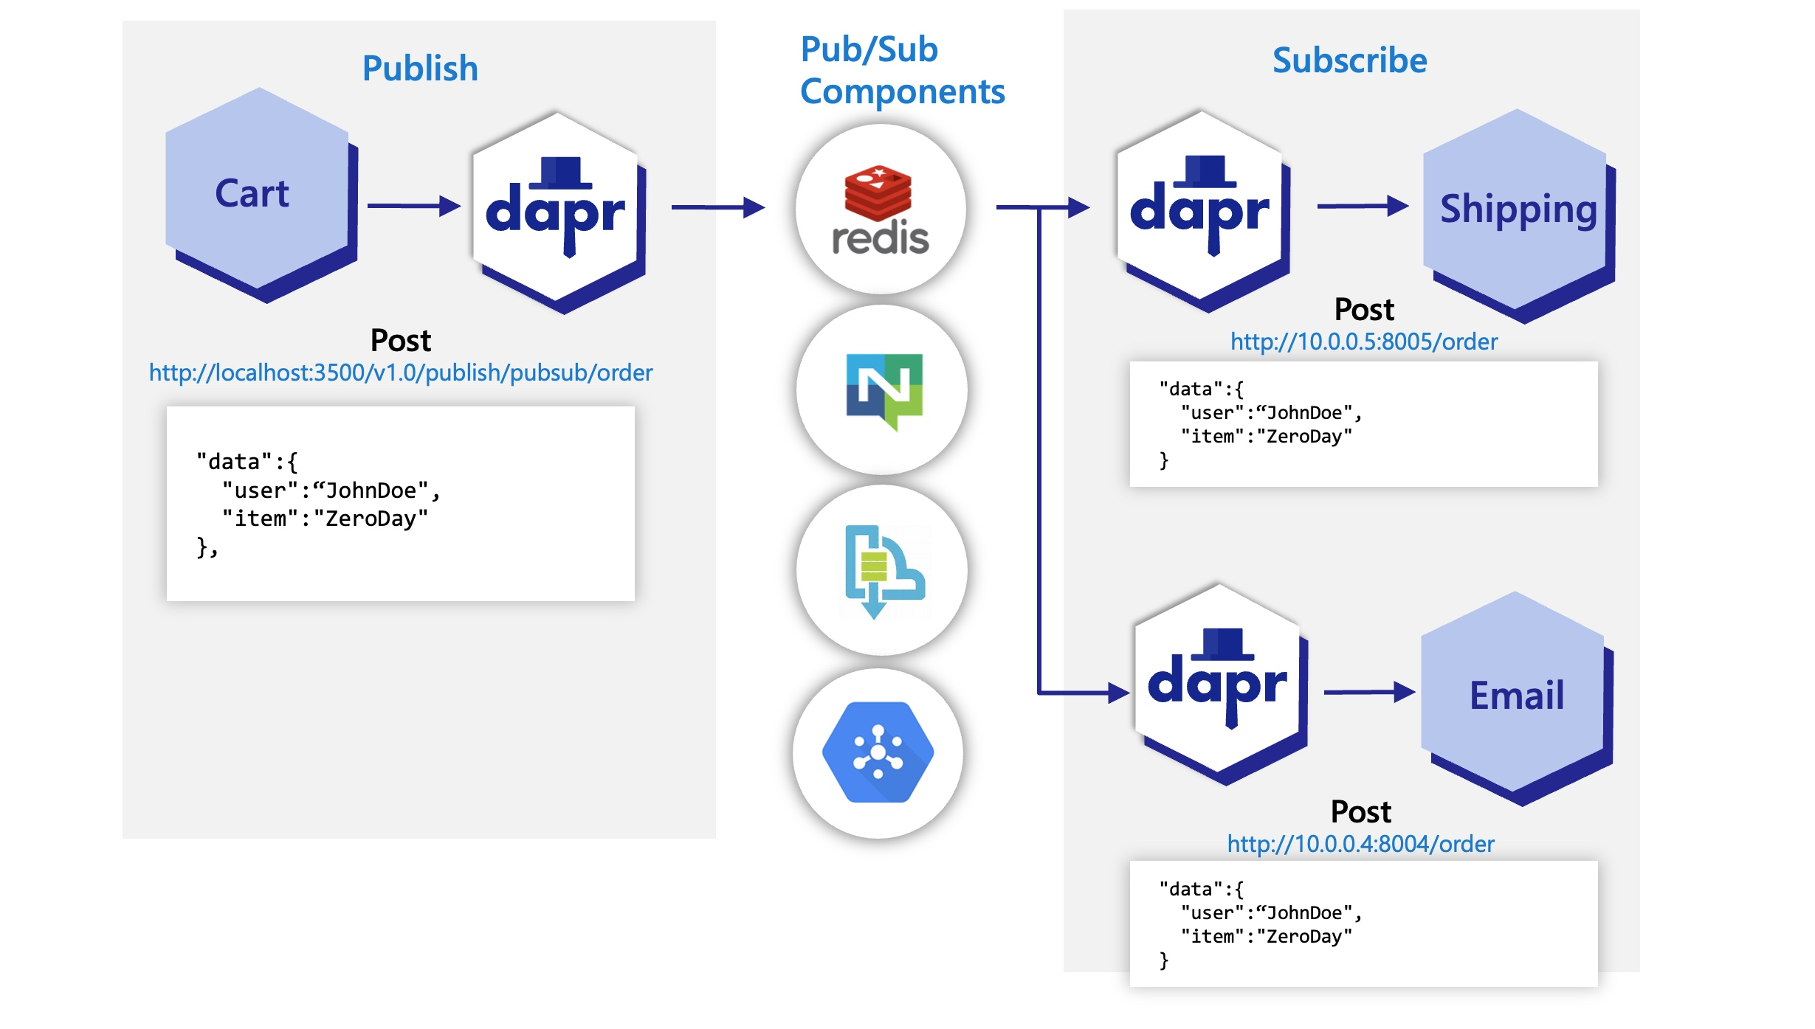
Publish and Subscribe Building Block
At-least-once guarantee on message delivery
Integrates with various message brokers and queueing systems
Extremely portable and flexible to changes.
Built in features
Cloud events message specification
Declarative & Programmatic subscription
Competing consumers pattern
Topic scoping
Message TTL

Slide 20
Bindings Building Block
Input Bindings - Triggering your Apps with events coming from external systems
Output Bindings – Triggering external systems with event occurred in your App
No worries on implementation details of interacting with systems
Resiliency is In-Built
Seamless switch between bindings at run time
Highly portable

Slide 21
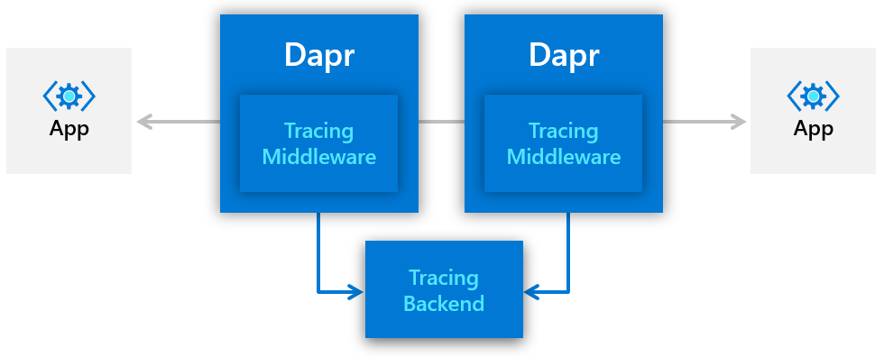
Observability Building Blocks
For distributed traces and metrics collection
Uses W3C trace context & Zipkin protocol, hence supports various backends
Combining with OpenTelemetry collector, exports traces to even more backends
Consistent tracing behaviour guaranteed
Extensible to multiple exported at the same time

Slide 22
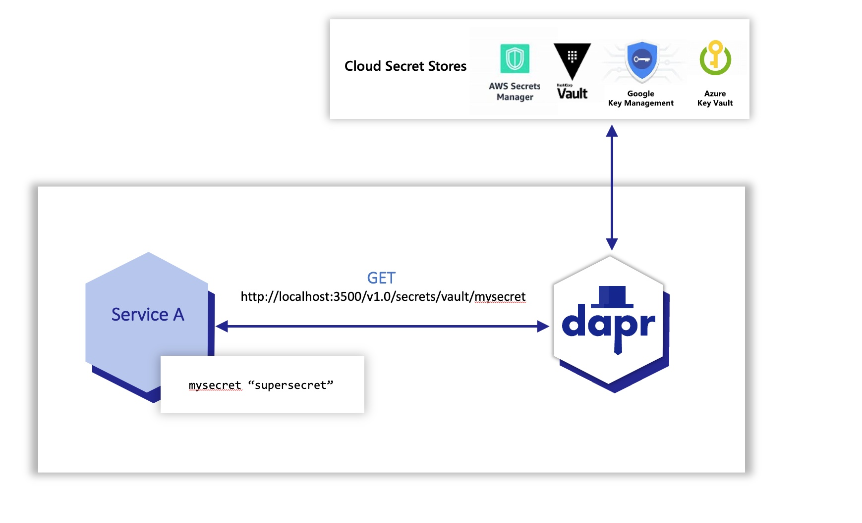
Secrets Building Block
Setting up a component for a specific secret store solution.
Retrieving secrets using the Dapr secrets API in the application code.
Optionally, referencing secrets in Dapr component files.
Limiting access to secrets

Slide 23
Demo

