Slide 1



Introduction C2Rust
Michael Ling & Xuefeng Han

Slide 2
Introduction C2Rust
C2Rust: Migrating Legacy Code to Rust
The C2Rust project is being developed by Galois and Immunant. This tool can translate most C modules into semantically equivalent Rust code.
The translator focuses on supporting the C99 standard.
Resource:
Git link: https://github.com/immunant/c2rust
YouTube: https://www.youtube.com/watch?v=WEsR0Vv7jhg
Notes:
Following slides mainly came from C2Rust founder’s presentation

Slide 3
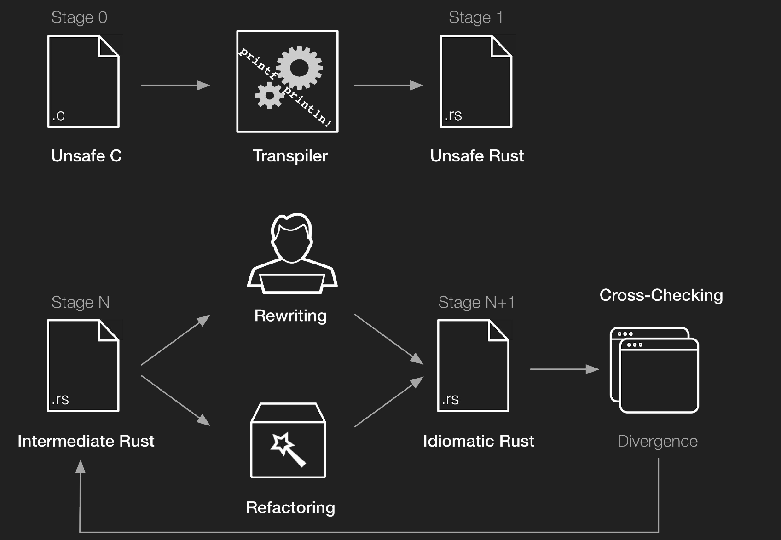
Introduction C2Rust
Notes:
C2Rust is not 100% automation but helps from unsafe C translate to Rust.
C2Rust helps you migrate C99-compliant code to Rust. The translator (or transpiler) produces unsafe Rust code that closely mirrors the input C code. The primary goal of the translator is to preserve functionality; test suites should continue to pass after translation. Generating safe and idiomatic Rust code from C ultimately requires manual effort. However, we are building a scriptable refactoring tool that reduces the tedium of doing so. You can also cross-check the translated code against the original (tutorial).

Slide 4
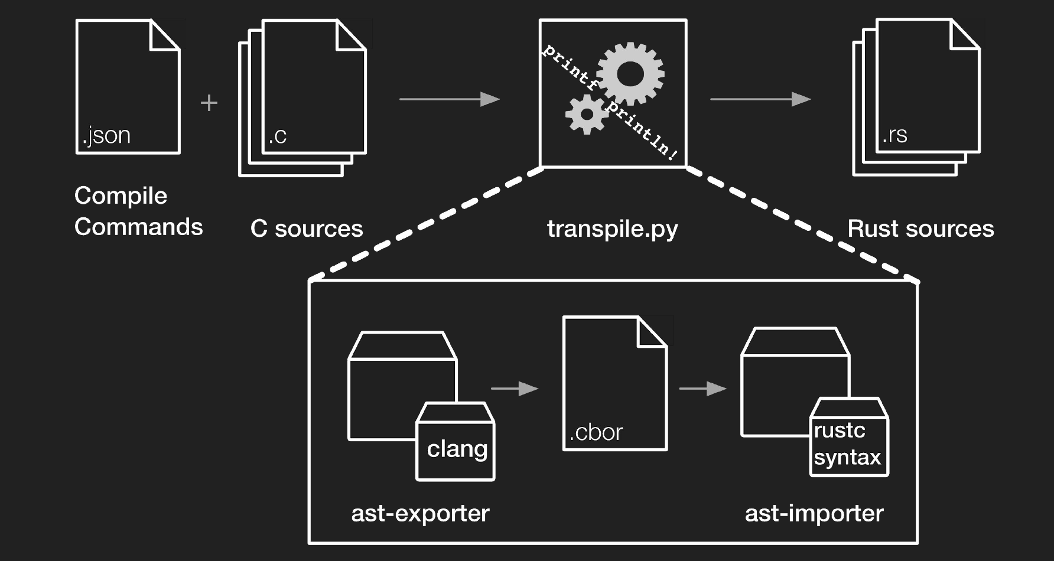
Transpiler
Notes:
C2Rust is not 100% automation but helps from unsafe C translate to Rust.
C2Rust helps you migrate C99-compliant code to Rust. The translator (or transpiler) produces unsafe Rust code that closely mirrors the input C code. The primary goal of the translator is to preserve functionality; test suites should continue to pass after translation. Generating safe and idiomatic Rust code from C ultimately requires manual effort. However, we are building a scriptable refactoring tool that reduces the tedium of doing so. You can also cross-check the translated code against the original (tutorial).

Slide 5
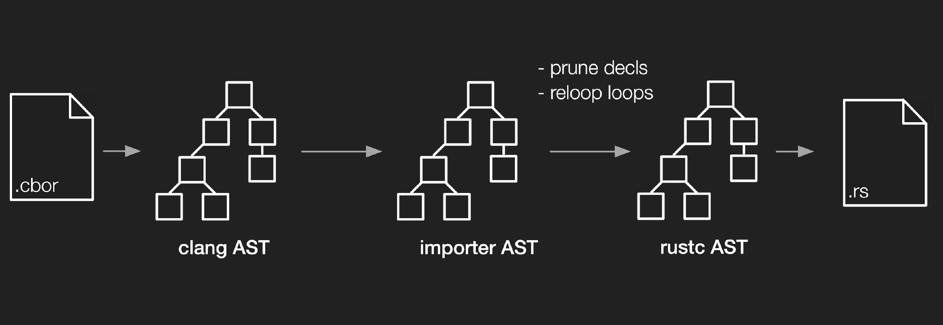
Transpiler
Notes:
C2Rust is not 100% automation but helps from unsafe C translate to Rust.
C2Rust helps you migrate C99-compliant code to Rust. The translator (or transpiler) produces unsafe Rust code that closely mirrors the input C code. The primary goal of the translator is to preserve functionality; test suites should continue to pass after translation. Generating safe and idiomatic Rust code from C ultimately requires manual effort. However, we are building a scriptable refactoring tool that reduces the tedium of doing so. You can also cross-check the translated code against the original (tutorial).

Slide 6
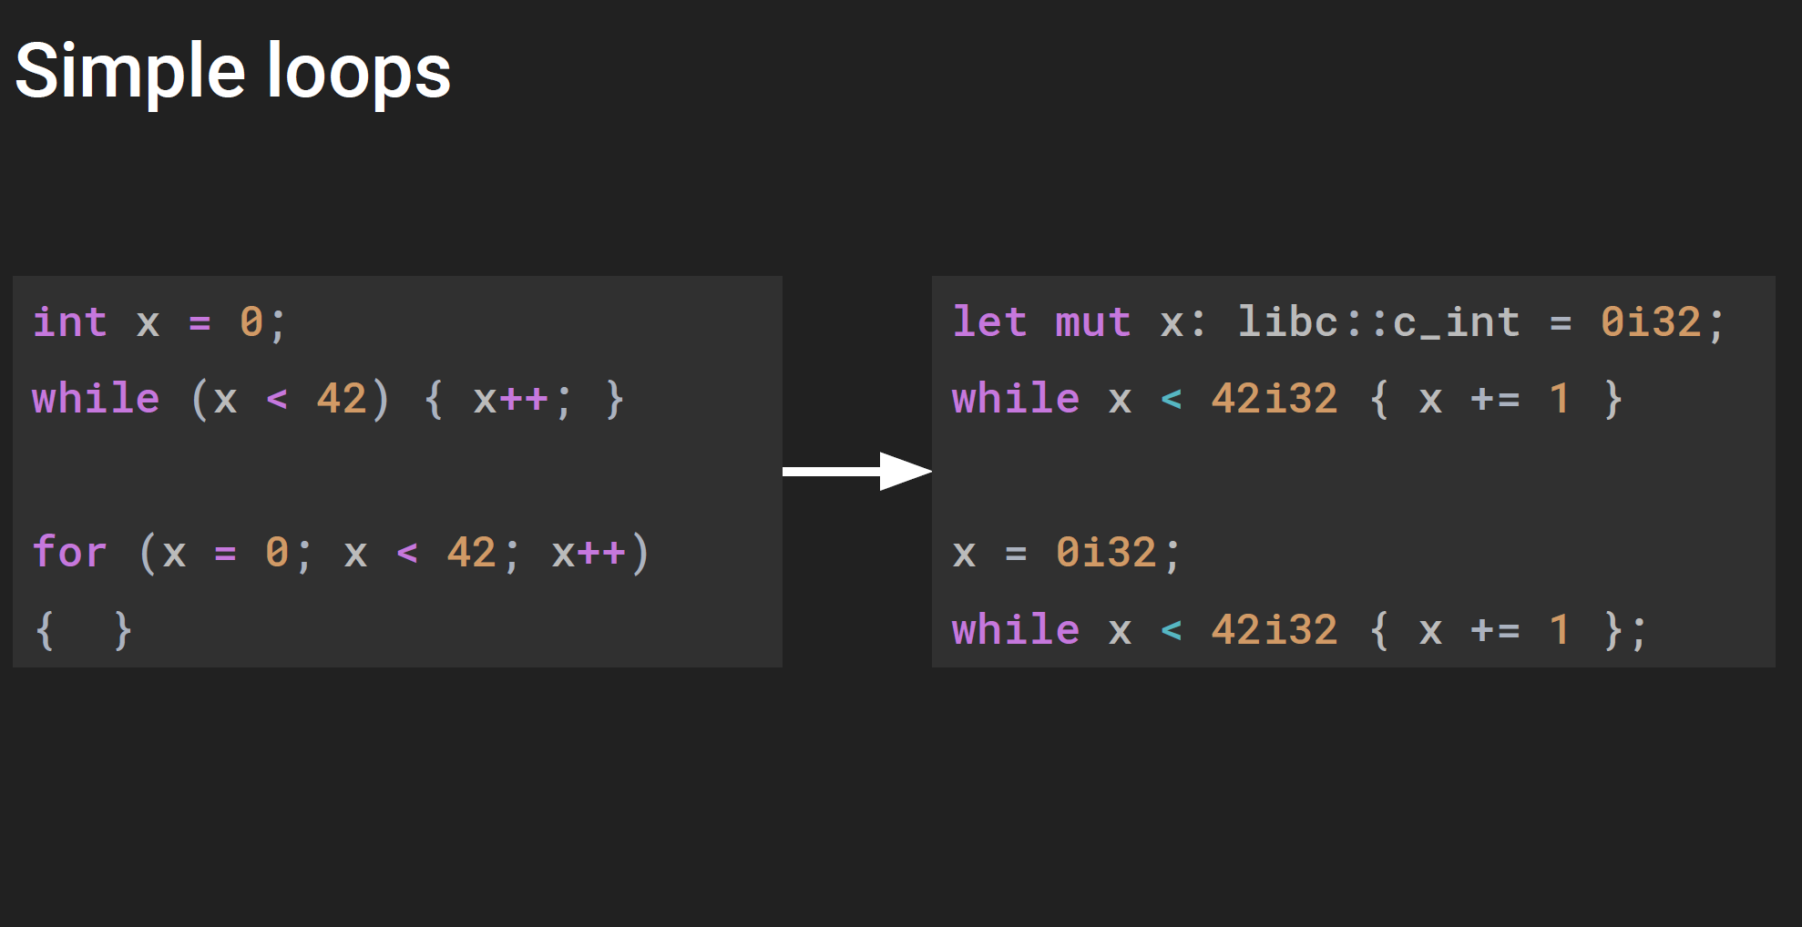
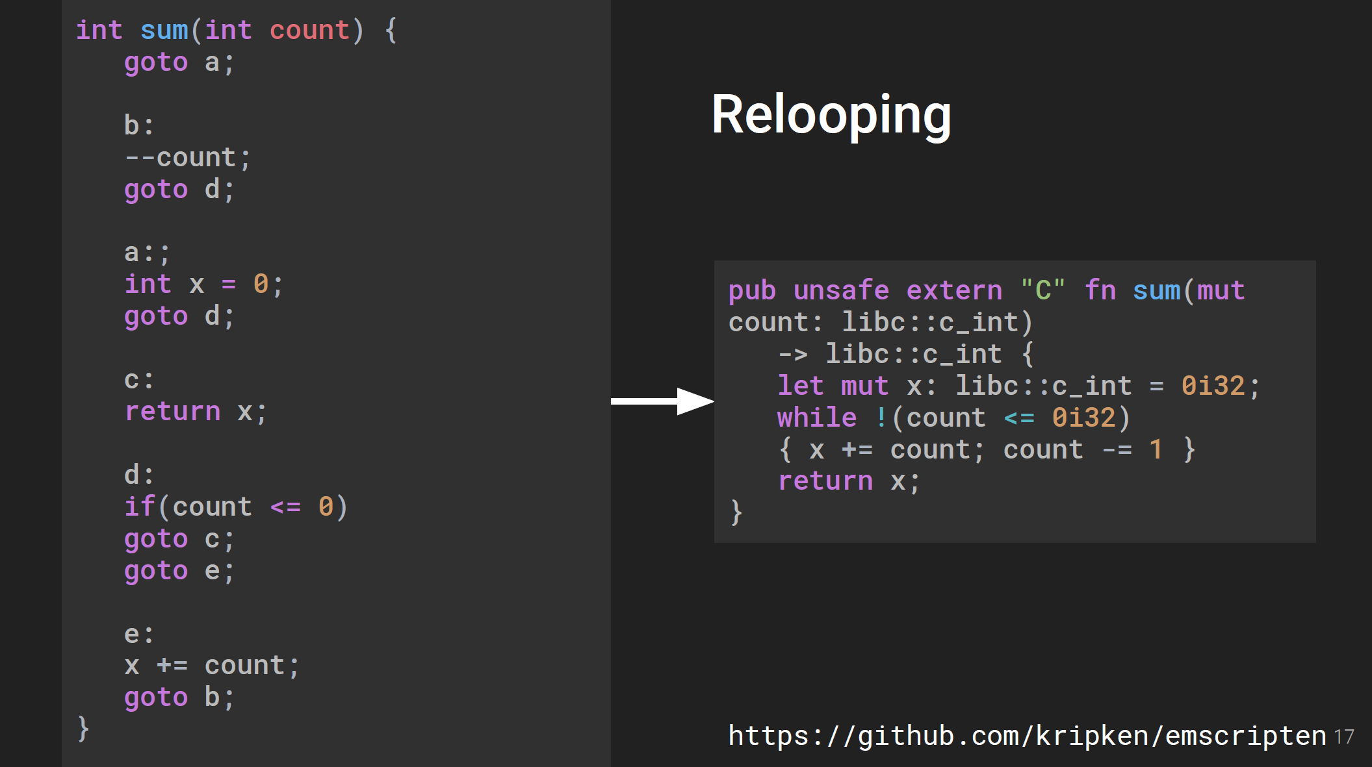
Examples

Slide 7
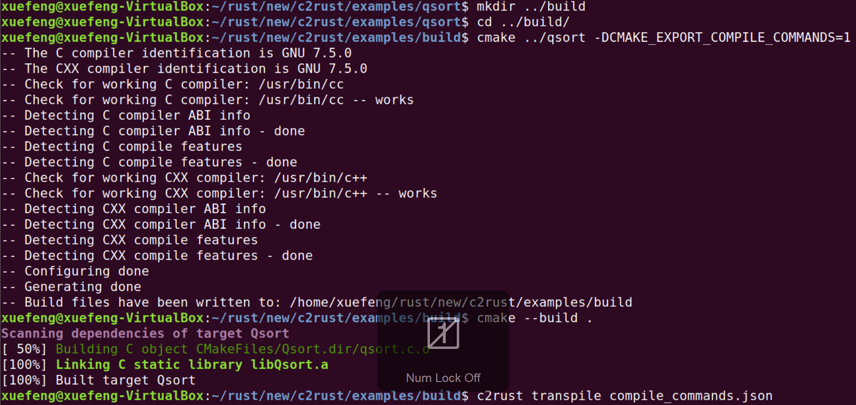
Practice : from qsort.c to qsort.rs
Notes:
Add a flow for git clone, installation etc

Slide 8
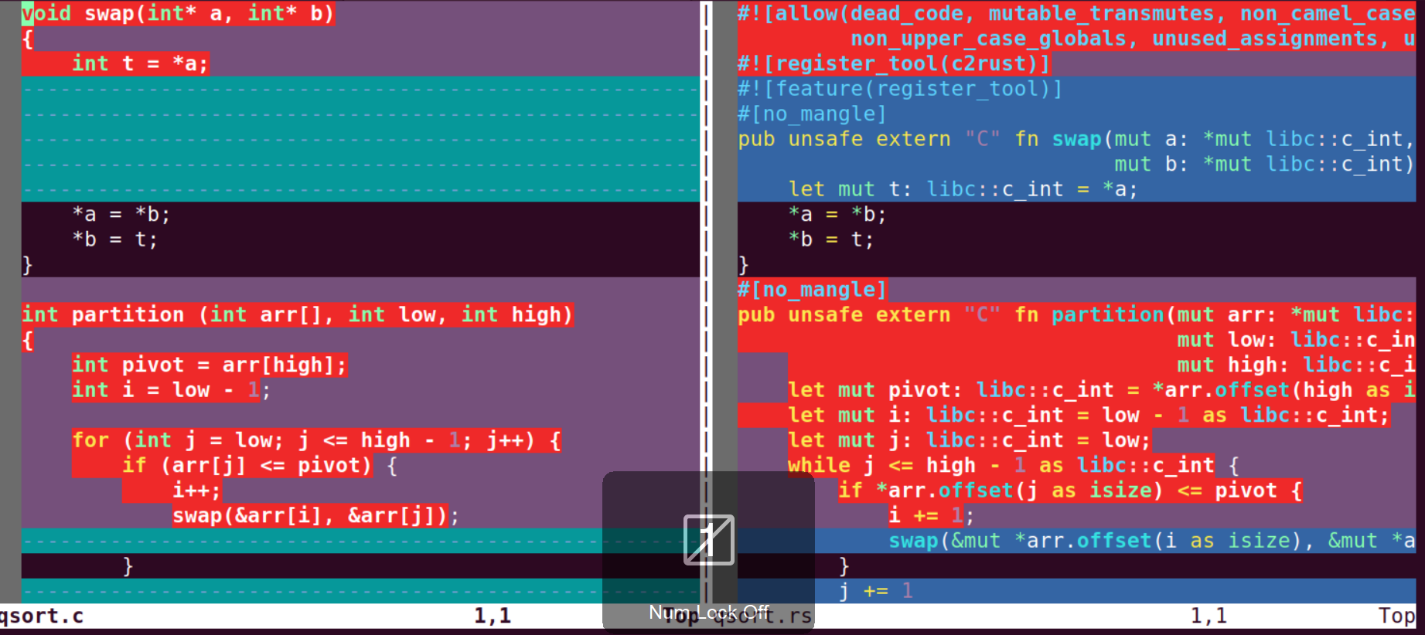
Comparsion qsort.c vs qsort.rs
Notes:
Add a flow for git clone, installation etc

Slide 9
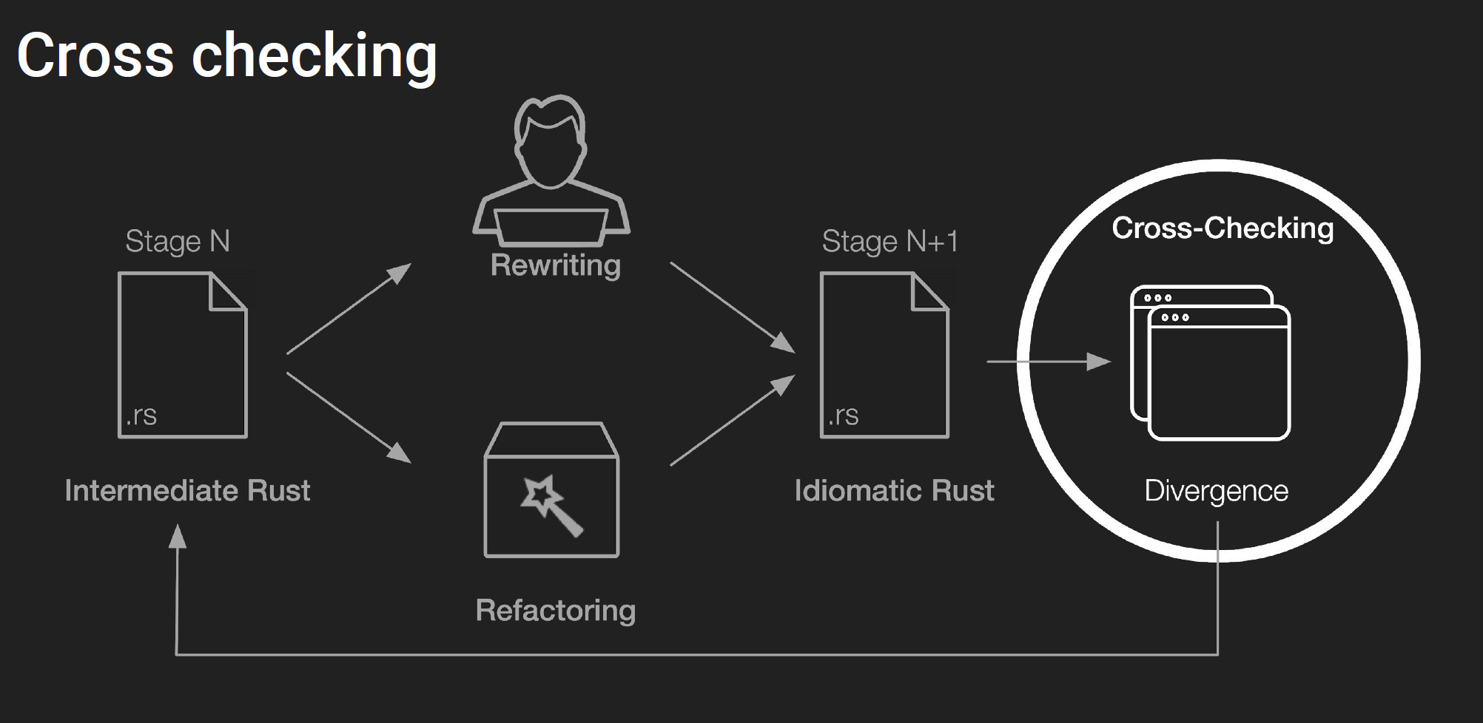
Cross Checking
Notes:
Add a flow for git clone, installation etc

Slide 10
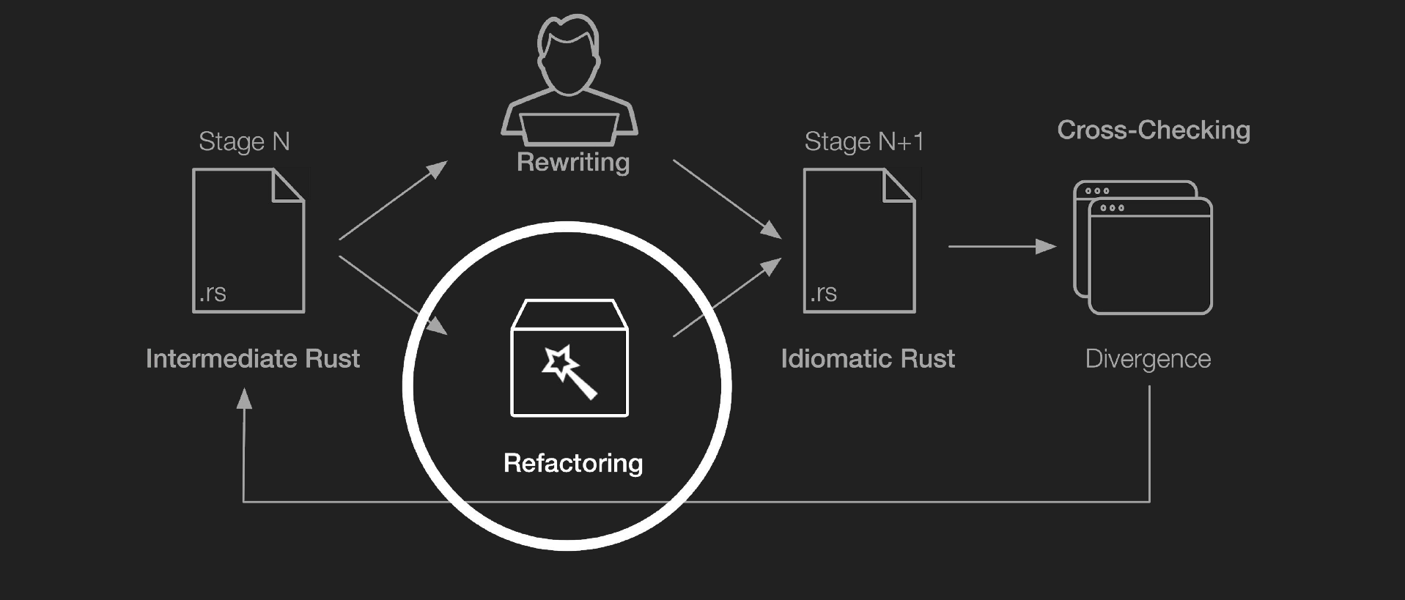
Refactoring
Notes:
Add a flow for git clone, installation etc

Slide 11
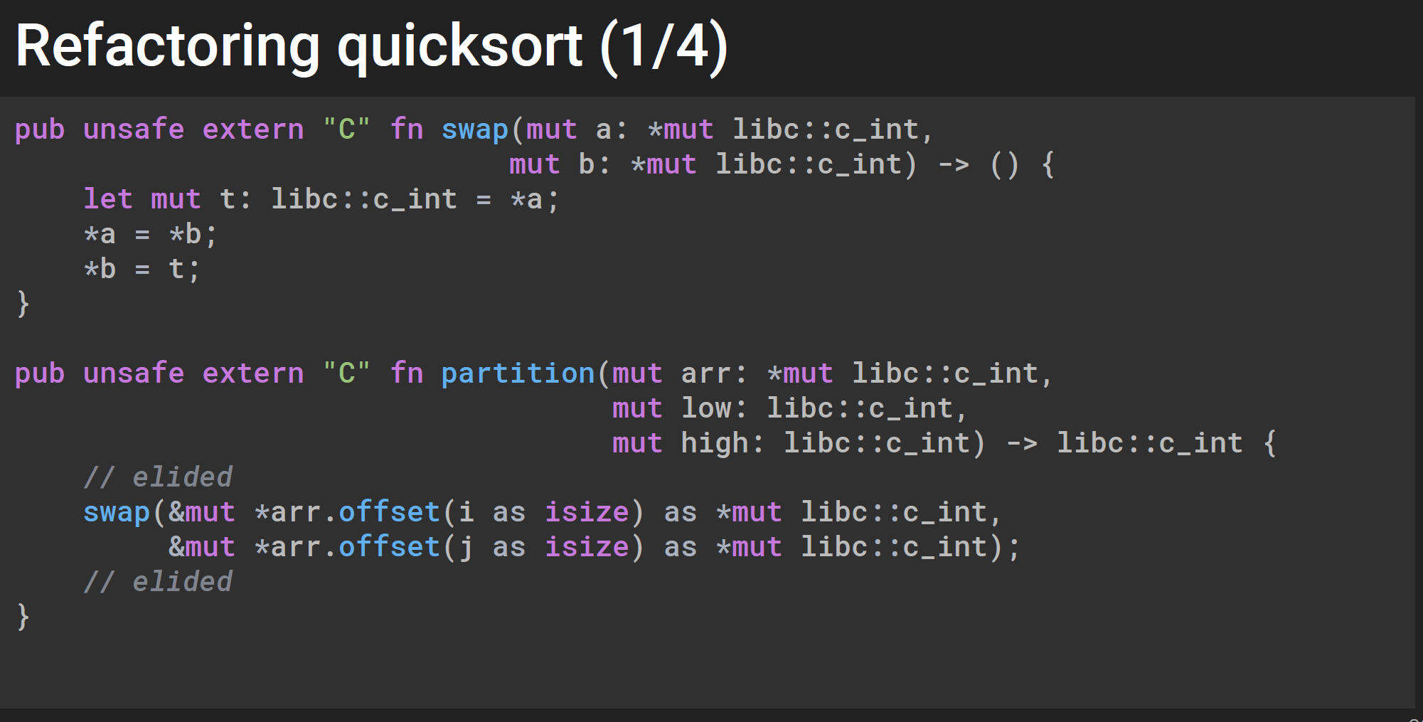
Refactoring
Notes:
Add a flow for git clone, installation etc

Slide 12
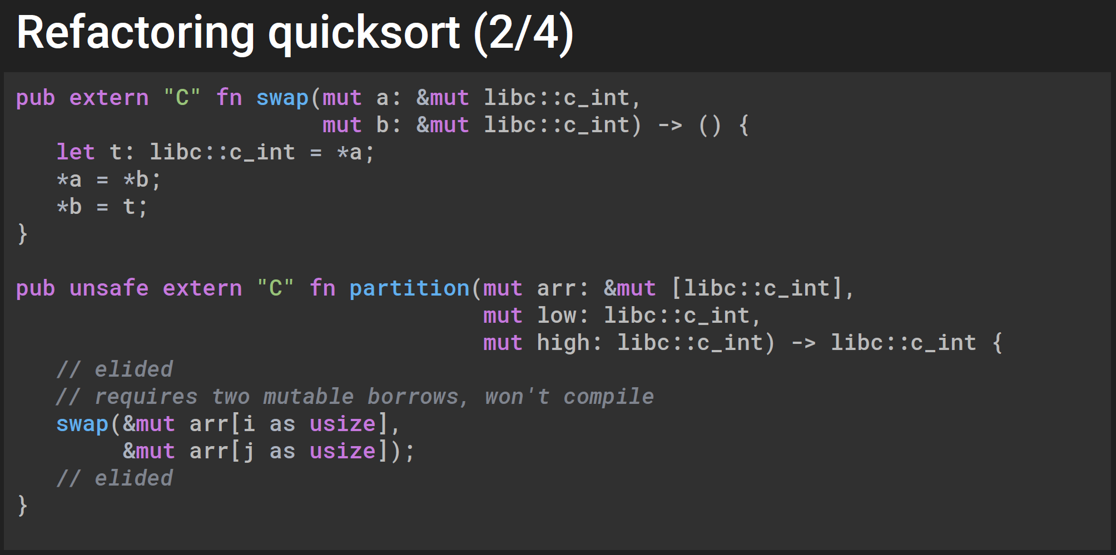
Refactoring
Notes:
Add a flow for git clone, installation etc

Slide 13
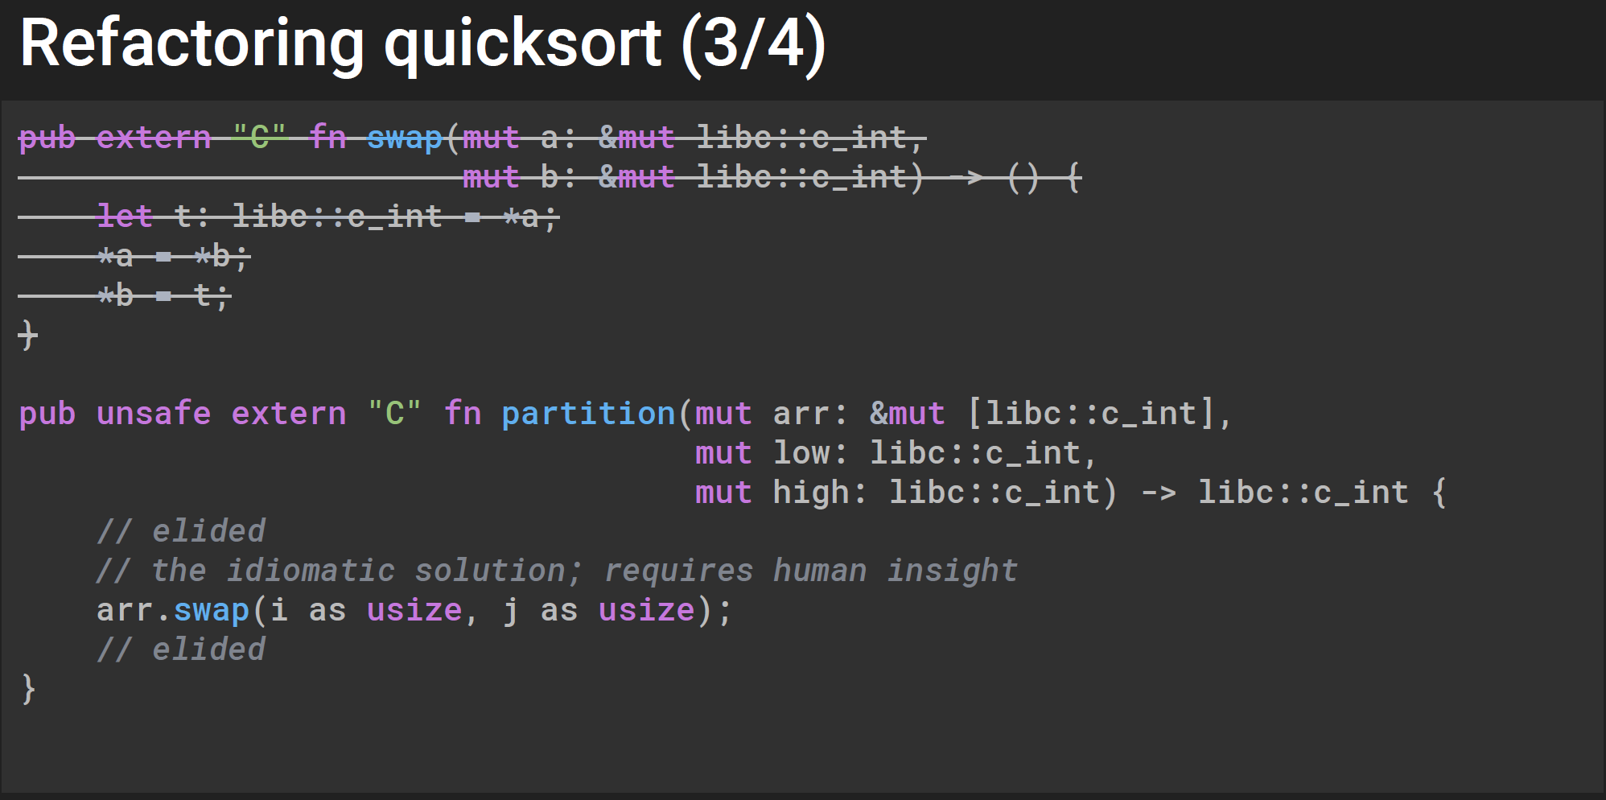
Refactoring
Notes:
Add a flow for git clone, installation etc

Slide 14
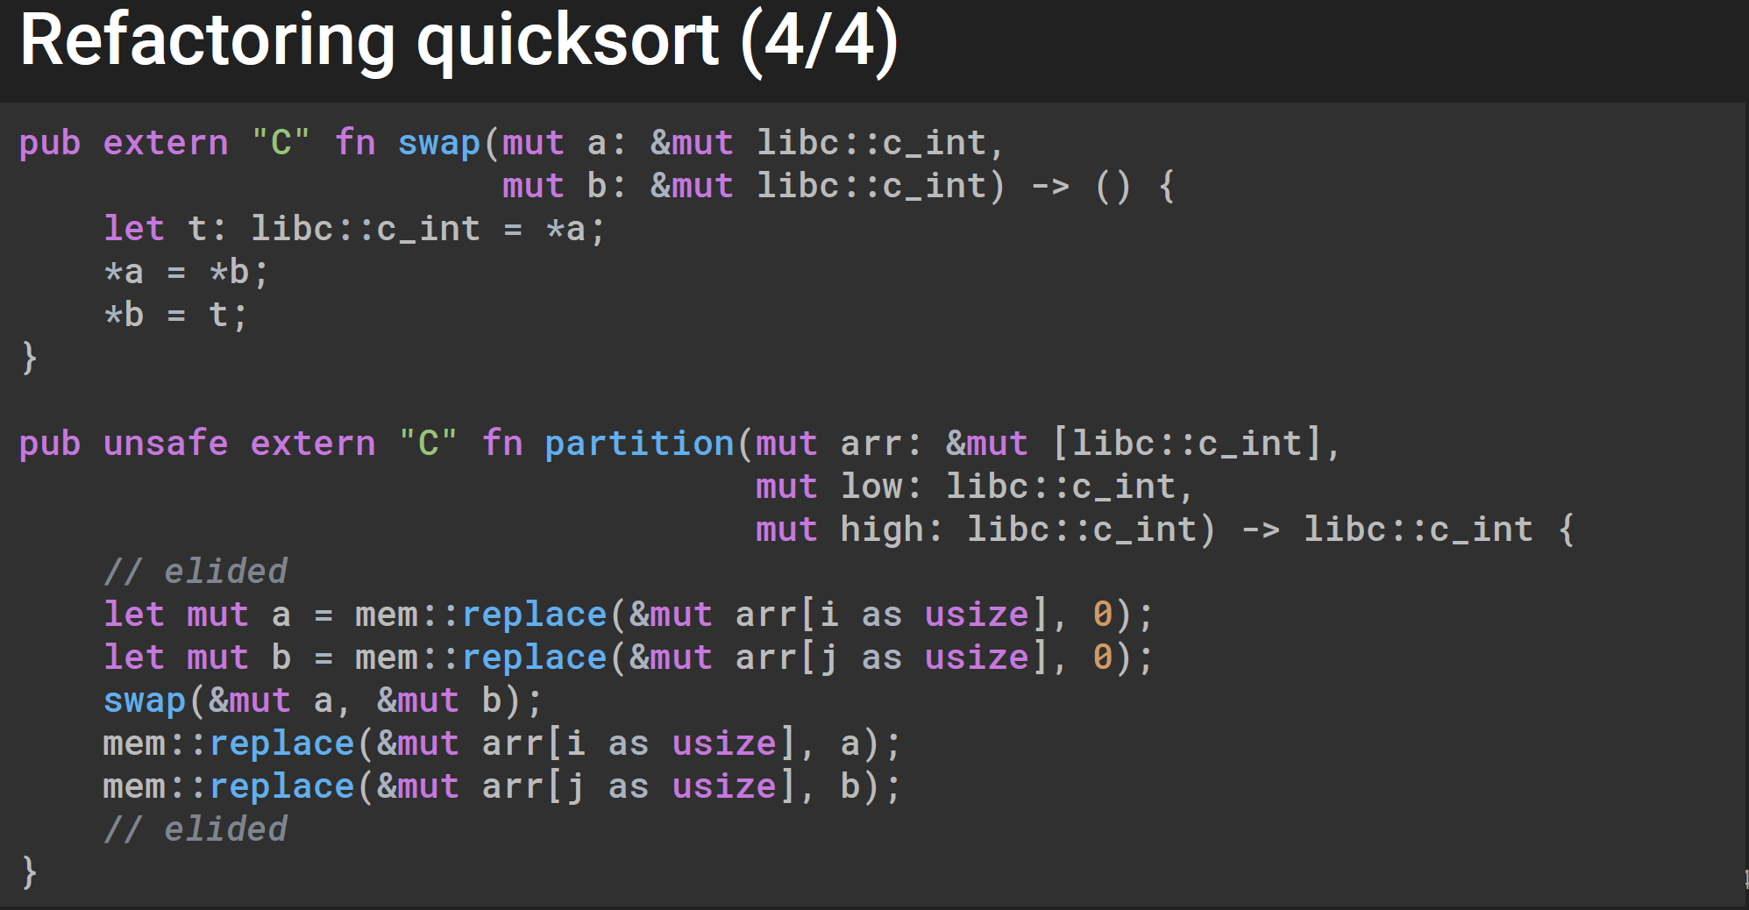
Refactoring
Notes:
Add a flow for git clone, installation etc

Slide 15
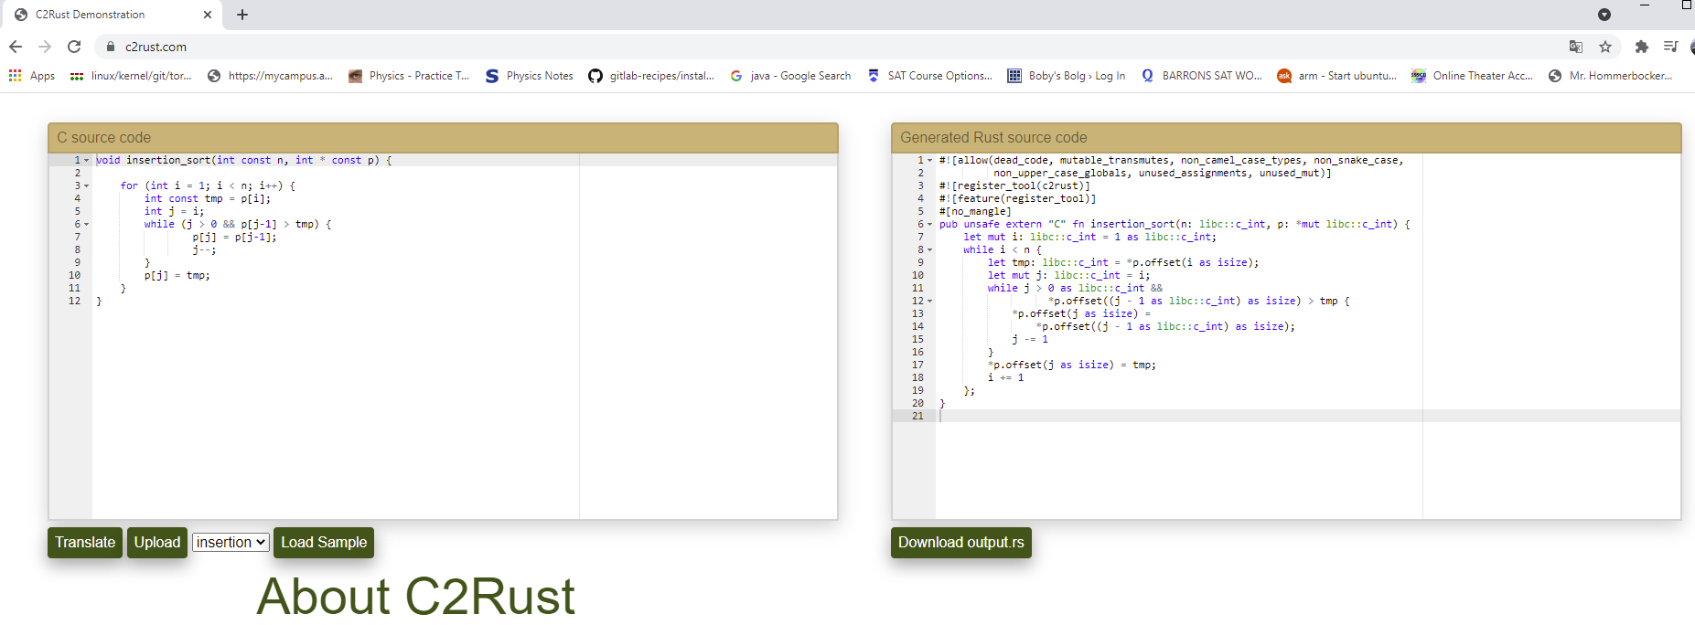
Online Tools
Notes:
www.c2rust.com

Slide 16
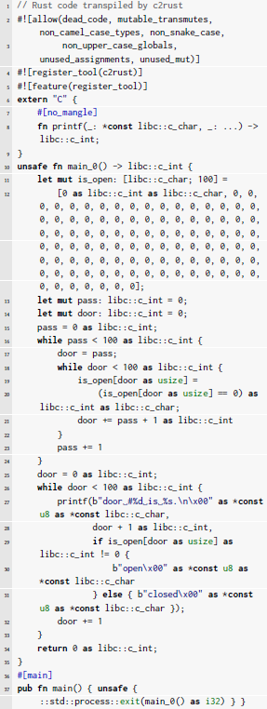
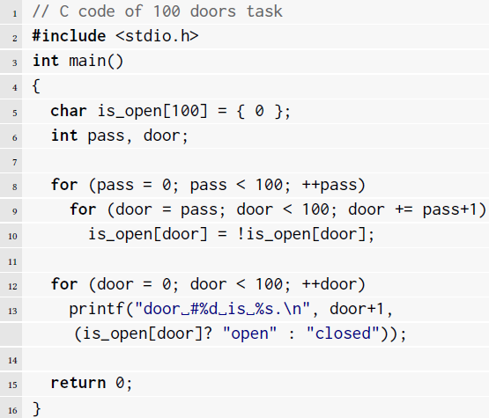
C2Rust Enhancement: an Example (1/4)
C2Rust Result

Slide 17
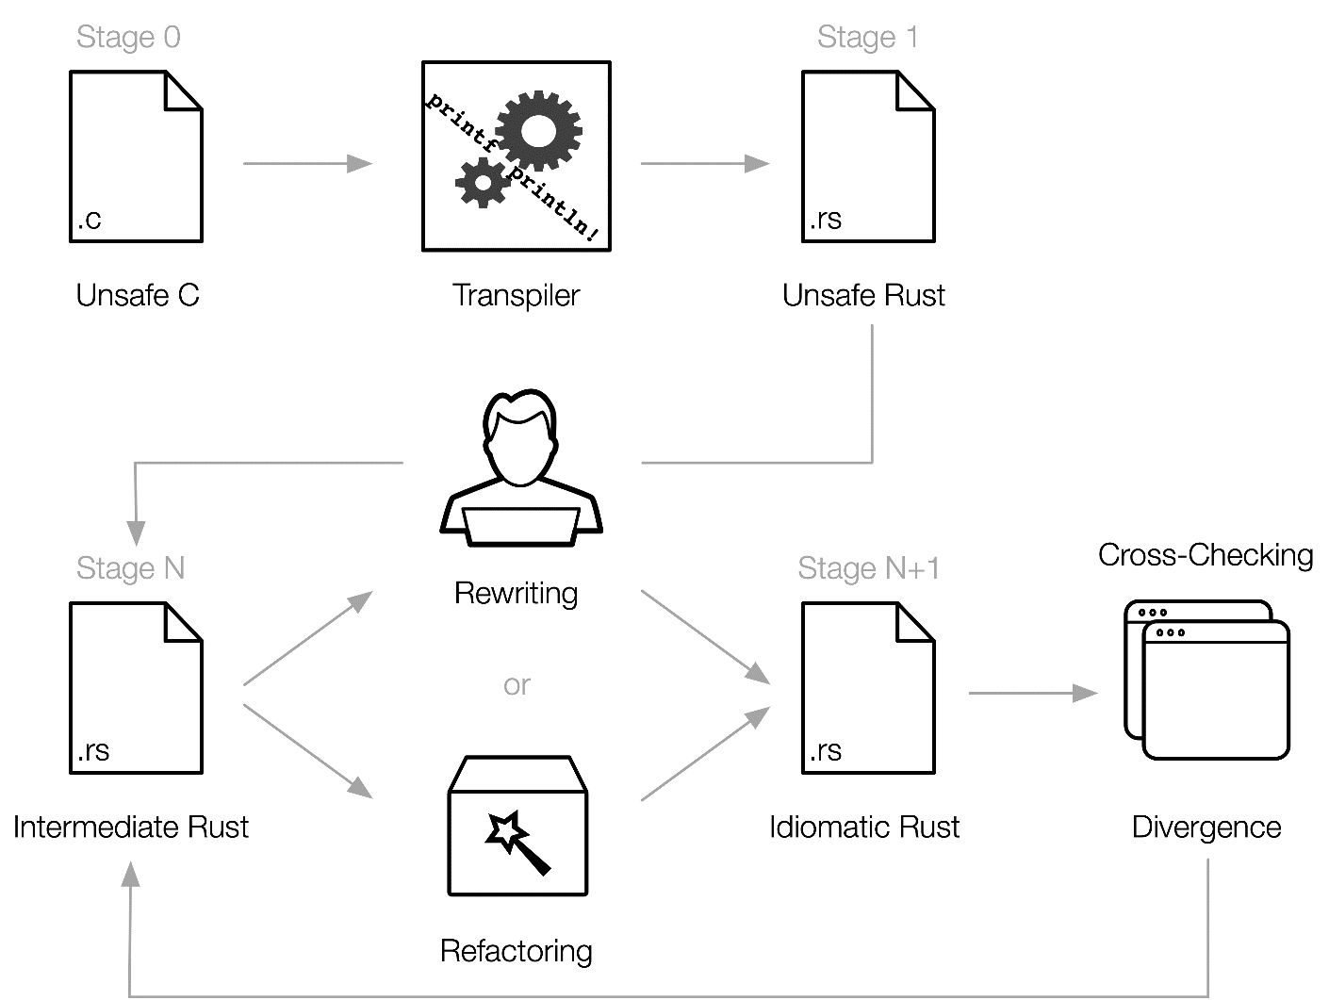
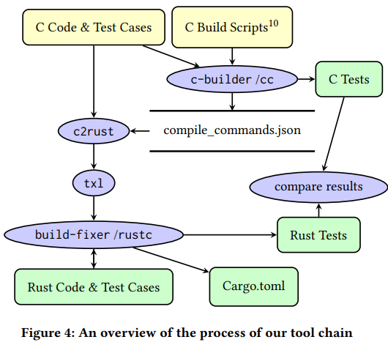
C2Rust Enhancement: an Example (2/4)

Slide 18
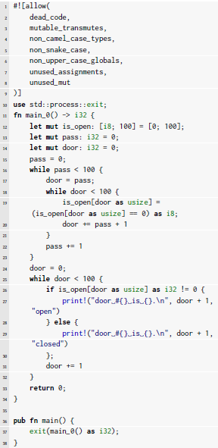

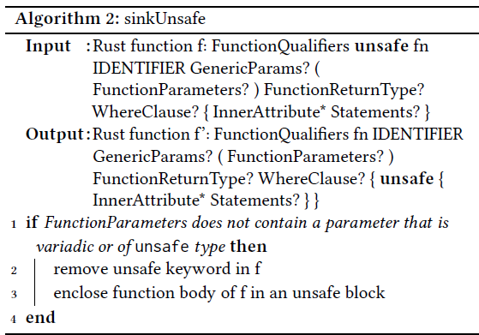
C2Rust Enhancement: an Example (3/4)
C2Rust Result
CRustS Result
Rust Code
Refactor
TXL Algorithms

Slide 19
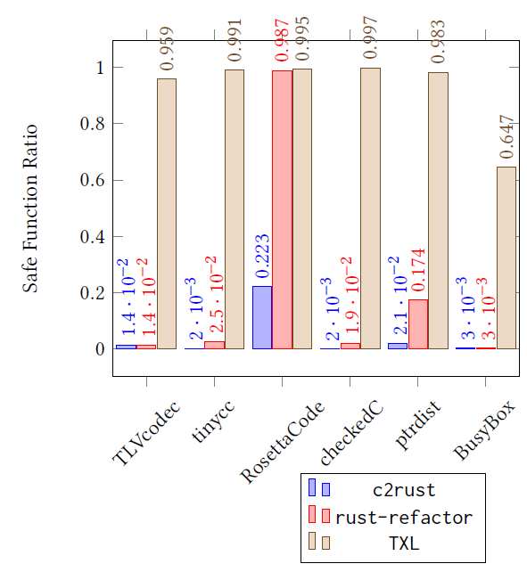
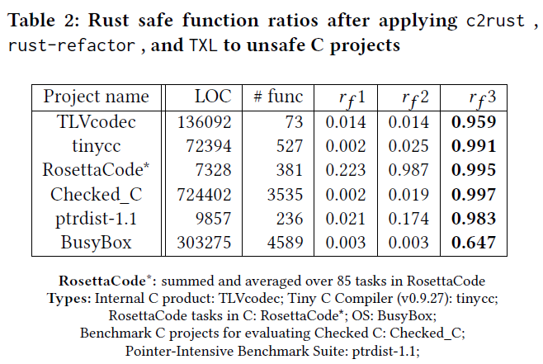
C2Rust Enhancement: an Example (4/4)

Slide 20
Reference :
Git link: https://github.com/immunant/c2rust
YouTube: https://www.youtube.com/watch?v=WEsR0Vv7jhg
Slides: https://www.ics.uci.edu/~perl/rustconf18_c2rust.pdf

