Slide 1



Slide 2

Timeline
Intro to the atPlatform
Flutter Overview
atPlatform Overview

Slide 3

End-to-end encryption is really hard!

Slide 4
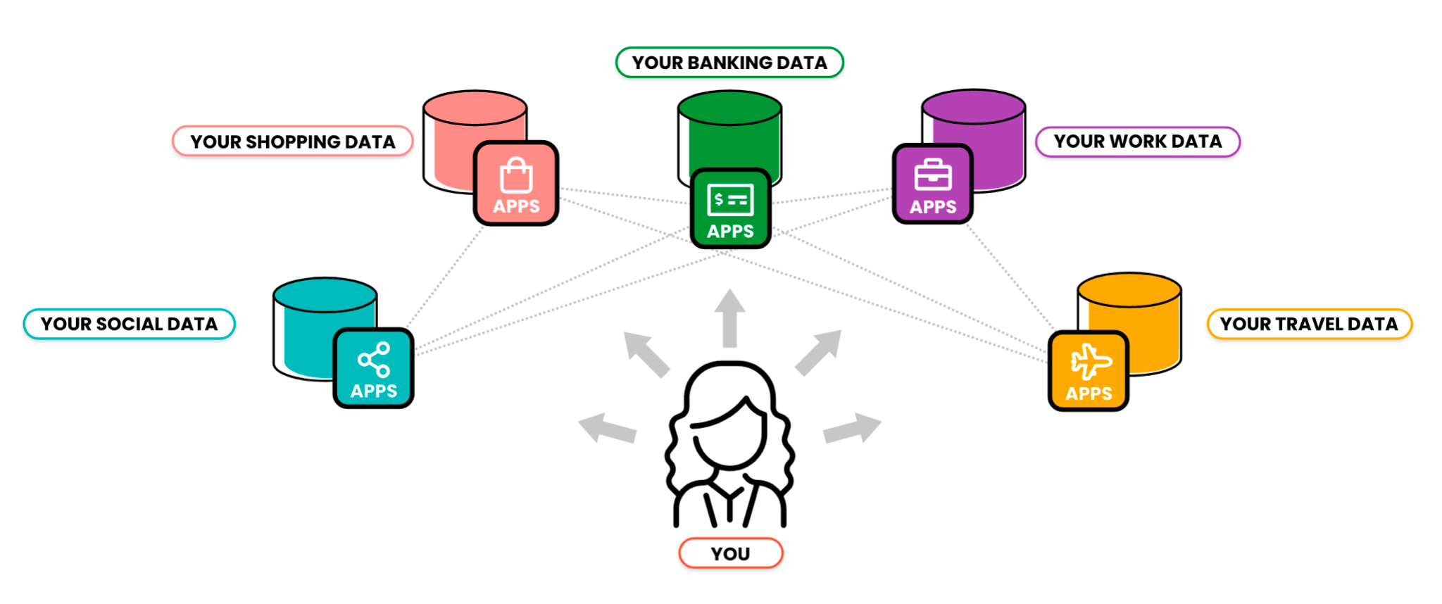
Today’s internet architecture

Slide 5
But, what if it was really easy...

Slide 6
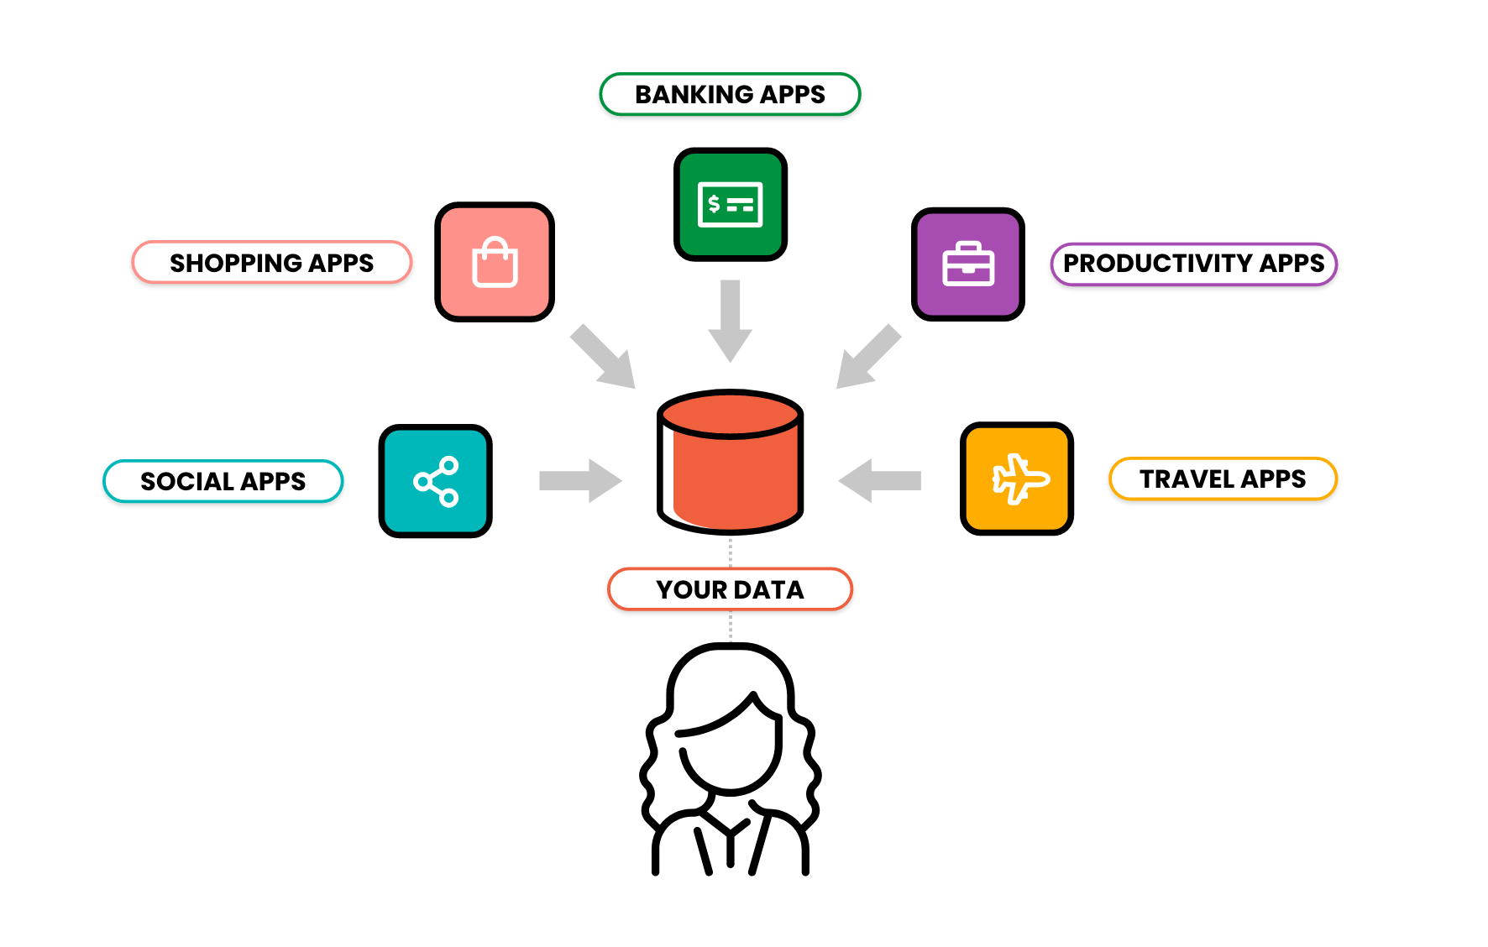
Flipping the Internet

Slide 7
How do we do that?

Slide 8


How it works
@
Primary Server
@bob wants to message you...
Where’s @alice?
Where is @bob?
Hi @alice...
@alice address
@bob address
Okay
Once
Deny
Message?
@bob
Prove URU
@alice
Proof
Notes:
DNS - primary server - secondary server
Protocol POL
Permissions
Where is the data stored
Who has access

Slide 9
Built with Flutter

Slide 10
What is Flutter?
Flutter is Google’s UI toolkit for building beautiful, natively compiled applications for mobile, web, and desktop from a single codebase.
It’s free and open source.

Slide 11
Everything is a Widget.

Slide 12
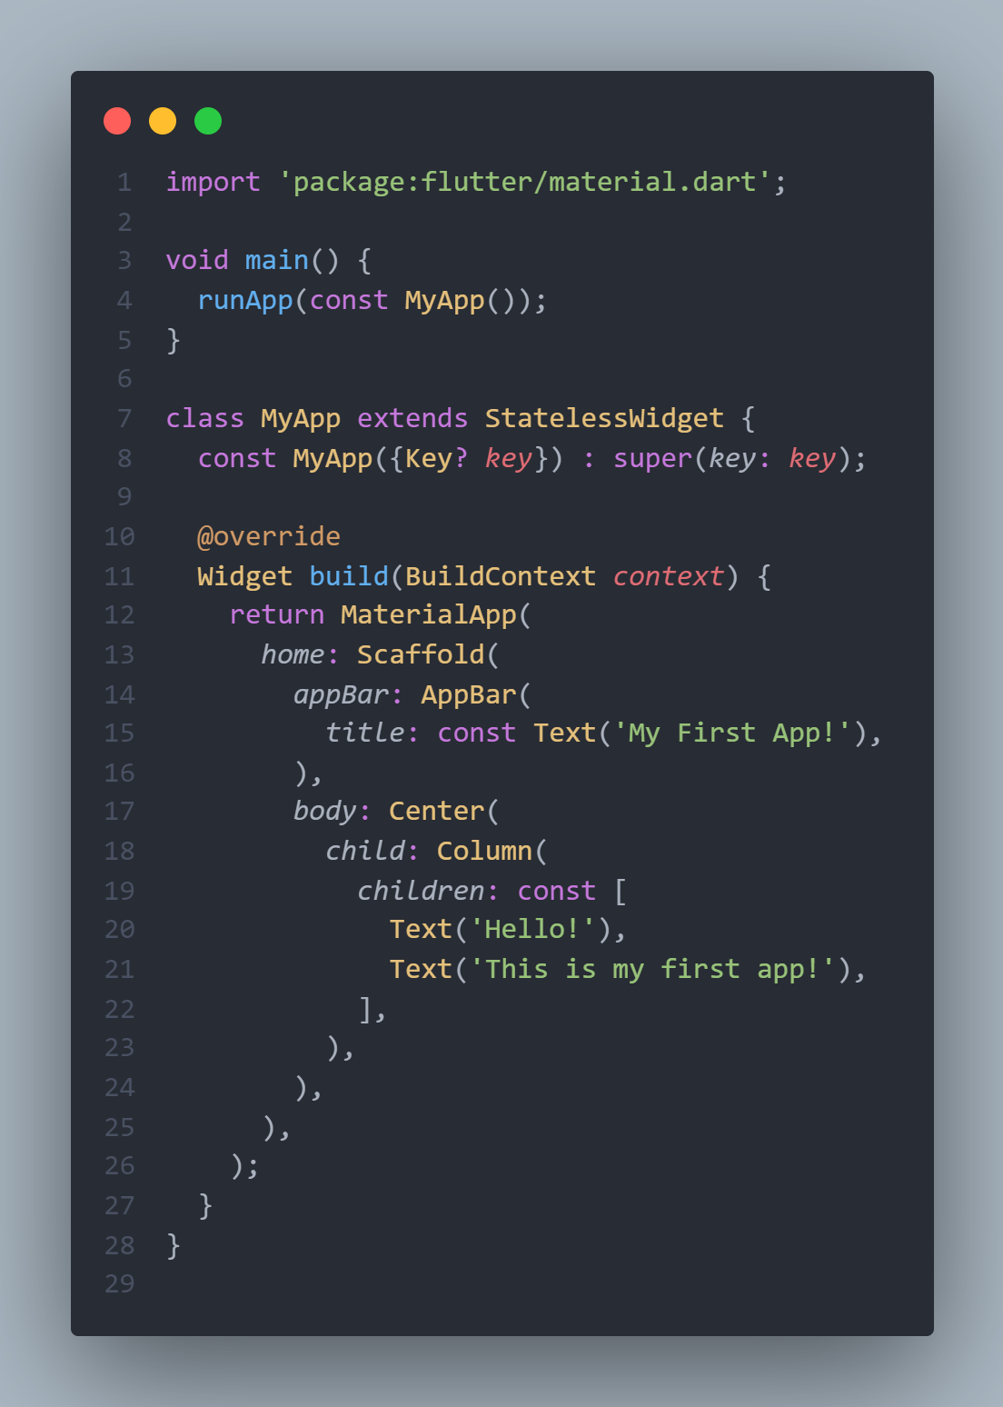
Widgets
Two main types of widgets
Stateless
Stateful
Common Widgets
Text
Row, Column
Stack
Container
Center
Padding
Material Design
MaterialApp
Scaffold
AppBar

Slide 13
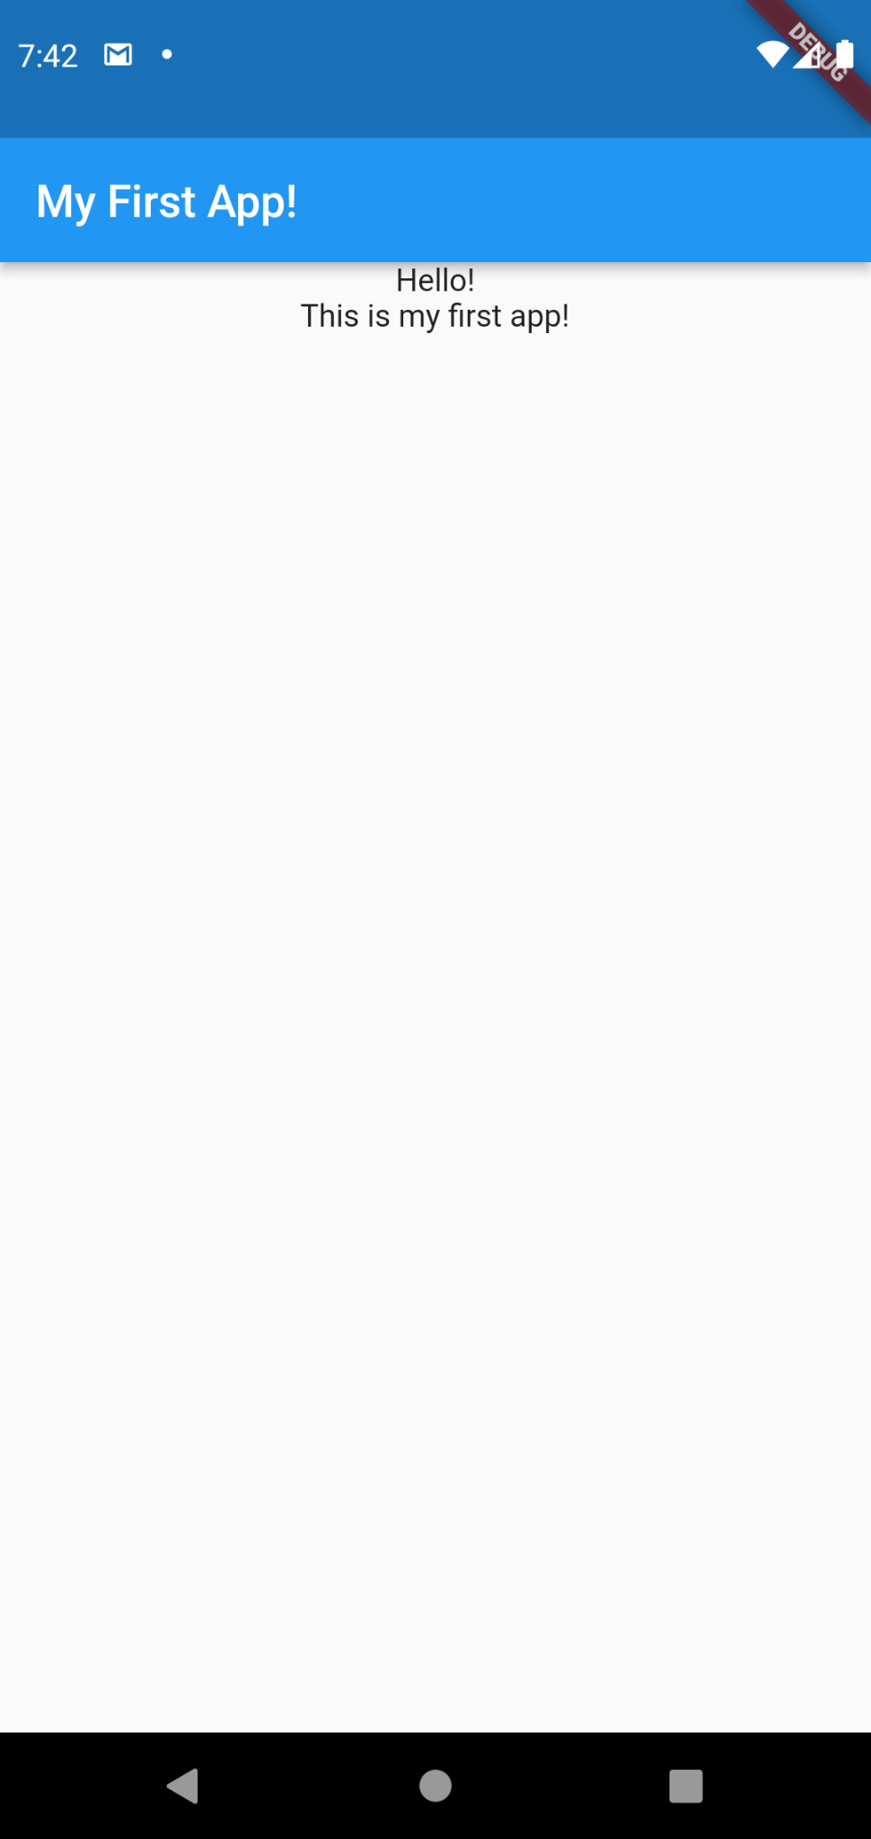
Widgets

Slide 14
Widgets
Import the Material Design Flutter library.
Just like other programming languages, dart uses the main function to enter the application. We call runApp to start our app.
In a stateless widget, data is never changed. If you need to manipulate data in a widget, use a stateful widget instead.
The build function is how you create your UI. It returns a single widget, which may contain multiple widgets within it.

Slide 15
Widgets
Learn More Here: https://flutter.dev/docs

Slide 16
The atPlatform

Slide 17
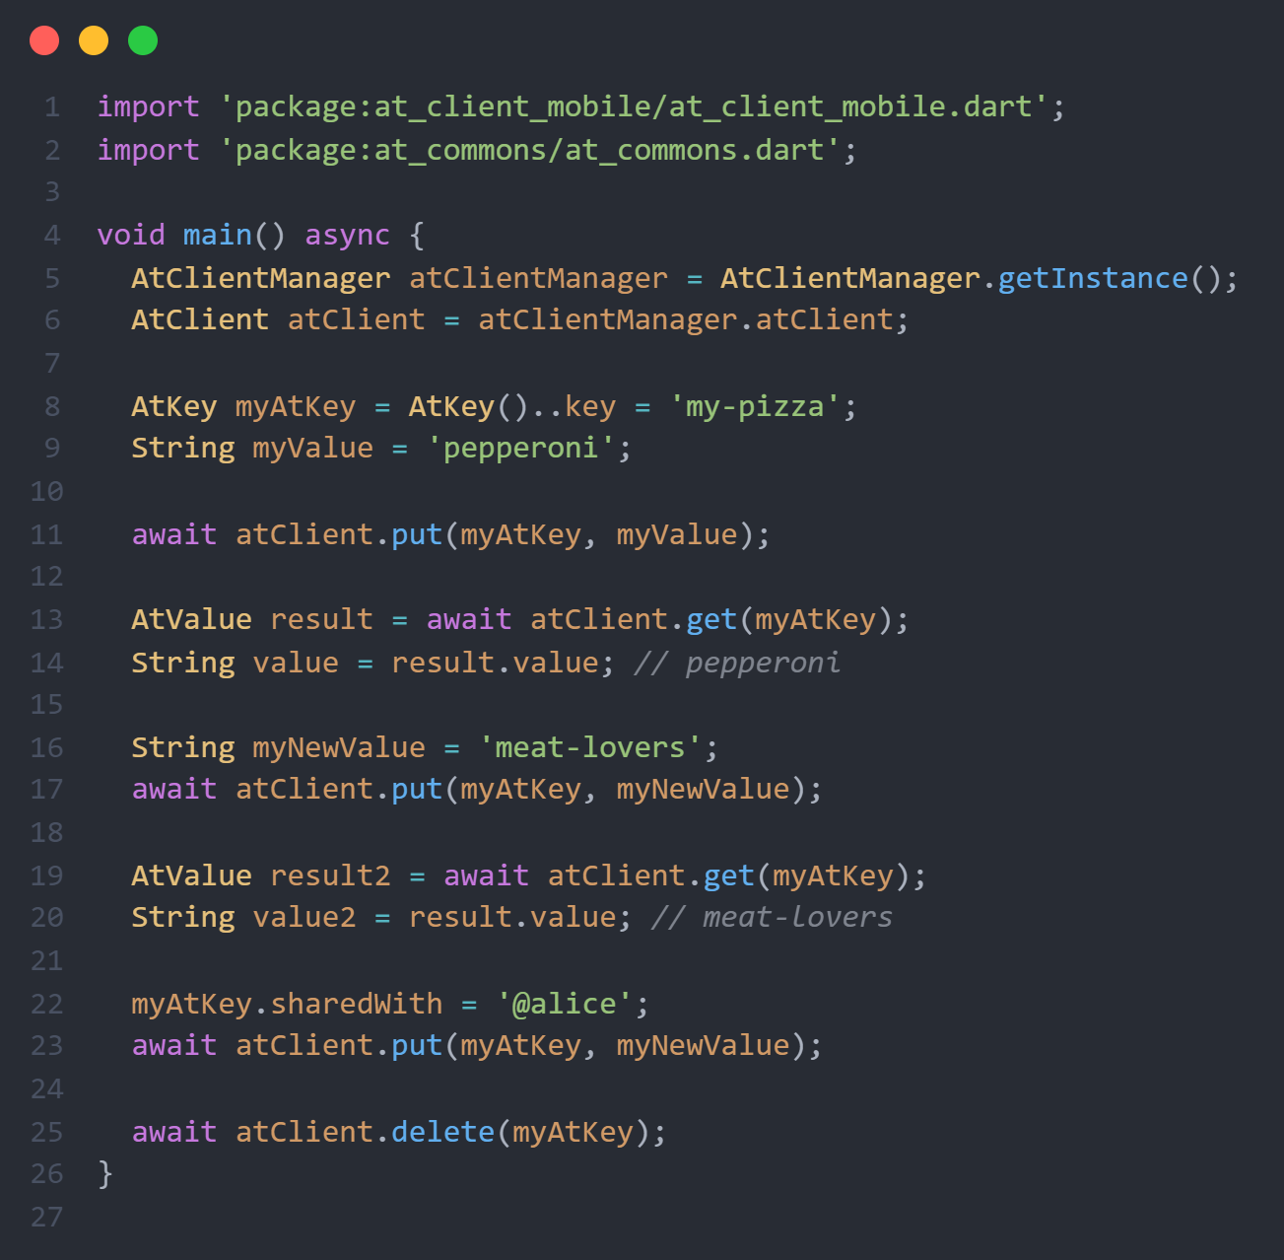
atPlatform
AtClientManager
AtClient
AtKey
key
sharedBy
sharedWith
namespace
metadata
AtValue
value
Verbs (functions)
put
get
delete

Slide 18
atPlatform
Get the AtClient from AtClientManager
Declare an AtKey and its value
Store a value using the AtClient
Get a value from an AtKey
Change a value and update it
Get the new value
Share the value with @alice
Delete the AtKey for @alice

Slide 19
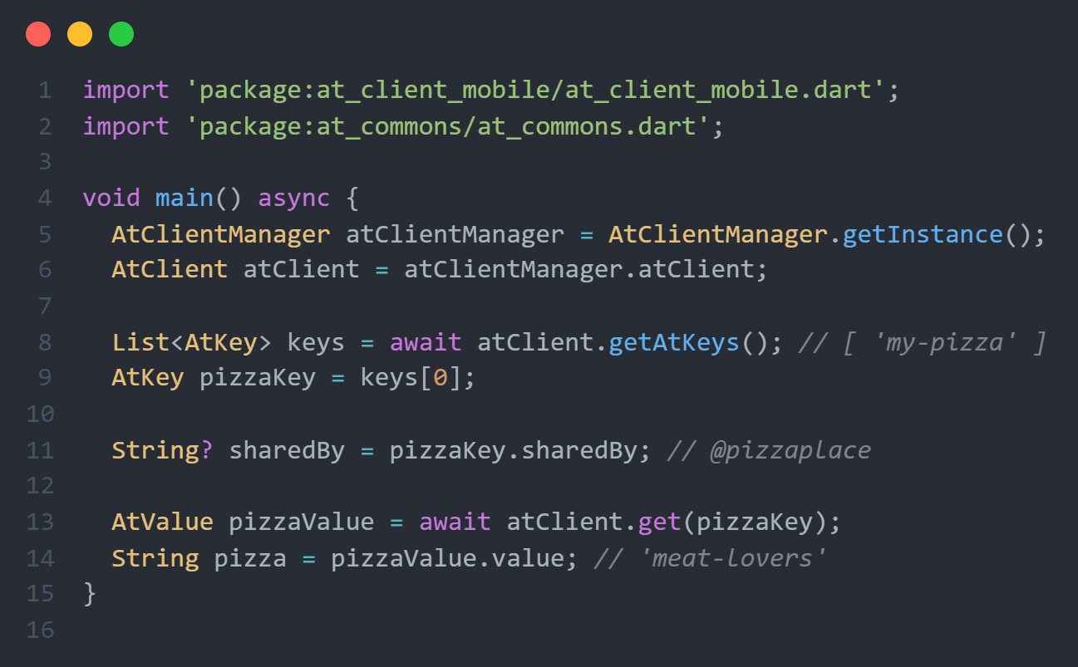
atPlatform
Import SDK (AtClientManager & AtClient)
Import for AtKey & AtValue
Get AtKeys and store them in a list
Get the first AtKey from the list
Who the key was shared by (@pizzaplace)
Get the value from @pizzaplace

Slide 20
atPlatform
Get Started Here:
docs.atsign.com

Slide 21
But wait…

Slide 22
https://github.com/atsign-foundation/at_pico_w

Slide 23
Join Us and Reinvent the Internet!
Main Site: https://atsign.com/
Dev Site: https://docs.atsign.com
Open source GitHub: https://github.com/atsign-foundation/

Slide 24

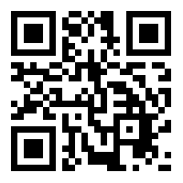
Join us after hours on our Discord for setup help.

