Slide 1
Exploring TIC: Unleashing the Power of Google, Microsoft, Git, and GitHub

Slide 2
Table of contents
3 Introduction
4 Google
6 Microsoft
7 Git
8 GitHub
10 Conclusion

Slide 3
Introduction
In the fast-evolving realm of Information and Communication Technologies (TIC), the intersection of innovation and connectivity reshapes how we interact, collaborate, and build solutions. This comprehensive report explores the multifaceted landscape of TIC and delves into the key technologies that drive its dynamic evolution. From industry titans like Google and Microsoft to the indispensable version control system Git and its collaborative extension GitHub, this investigation aims to unravel the pivotal roles these technologies play in shaping our digital present and future.

Slide 4

Google: A TIC Powerhouse
Discover how Google tools like G Suite, Google Drive, and Google Workspace can enhance collaboration, productivity, and innovation in TIC. Leverage the full potential of Google's cloud-based solutions for your projects.

Slide 5
N° of visits to google per month
Country | Google monthly traffic (billions) | Share of global traffic
USA | 18.15 | 18.28%
INDIA | 11.74 | 11.82%
JAPAN | 5.51 | 5.55%
INDONESIA | 4.42 | 4.45%
BRAZIL | 3.29 | 3.31%

Slide 6

Microsoft Corporation, a technology giant, provides a comprehensive suite of tools revolutionizing modern productivity. From the ubiquitous Microsoft Office suite (Word, Excel, PowerPoint) to collaborative platforms like Microsoft Teams and cloud services via Azure, Microsoft's tools empower businesses and individuals alike. With a focus on seamless integration, innovation, and user-friendly interfaces, Microsoft continues to shape the digital landscape.

Slide 7
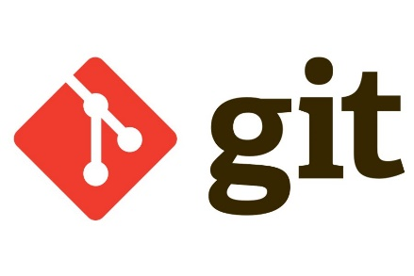
Git: Revolutionizing Version Control
Git, a powerful distributed version control system, revolutionizes code collaboration. Offering decentralized workflows, branching strategies, and robust version tracking, Git ensures streamlined development processes. From small projects to large-scale endeavors, Git's flexibility and efficiency make it a cornerstone of modern software development.

Slide 8

GitHub: Collaboration Redeﬁned
GitHub is a web-based platform for version control and collaborative software development.
It enables developers to host, review, and manage code repositories. With features like pull requests and issue tracking, GitHub facilitates efficient collaboration within development teams.

Slide 9

The transformative power of TIC technologies lies in their ability to reshape collaboration. Beyond mere efficiency gains, these tools redefine how teams collaborate, breaking down geographical barriers and fostering a culture of innovation and shared success..

Slide 10

Conclusion
TIC technologies are not just tools; they are enablers of digital endeavors. From streamlining workflows to fostering creativity, these technologies empower individuals and organizations to embark on a journey of continuous improvement and innovation.
In the ever-evolving tapestry of technology, this report serves as a snapshot—a momentary pause to understand and appreciate the current landscape. As we step into the future, armed with the insights gained from this exploration, we stand poised on the cusp of a digital frontier where the possibilities are boundless, and the only constant is change. The journey continues, and with each stride, we pave the way for a tomorrow shaped by the transformative force of Information and Communication Technologies.
.

