Slide 1

The Brain Dump
Project 2
( Felix Moon | Jacob Chaffee | Jenna King | Ryan Hayden | Neil Dhand )

Slide 2
Our Project
What’s the Brain Dump?
Our Goal

Slide 3
Demo
https://the-brain-dump.herokuapp.com

Slide 4
Model
User
username: STRING (Mandatory)
password: STRING (Mandatory)
1
N
Post
body: TEXT (Mandatory)
category: STRING (Mandatory)
file_location: STRING (Optional)
timeout: INTEGER (Optional, 24)
shared: BOOLEAN (Optional, false)
like_count: INTEGER (Optional, 0)
dislike_count: INTEGER (Optional, 0)
extended: BOOLEAN (Optional, false)
UserId: foreign key (Mandatory)
Comment
text: TEXT (Mandatory)
author: STRING (Optional, “Anonymous”)
PostId: foreign key (Mandatory)
1
N

Slide 5
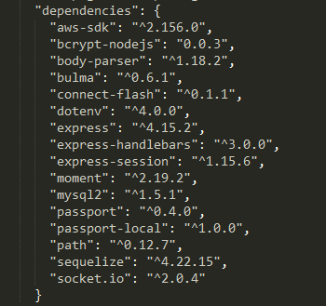
Dependencies
To upload a file to AWS S3
To get a error message from passport.js
To use process.env.*** variables
in a local machine
To do live-chat and
to broadcast to all clients

Slide 6
MVC
BACKEND
FRONTEND
HTML ROUTES
SIGNUP/LOGIN
HANDLEBARS
MAIN
API ROUTES
NEW POST
SELF-TIMER
COMMENT
CHAT ROUTES
LIVE CHAT
MODEL
DATABASE

Slide 7
Self-timer.js
Timer invoke
For each post,
Timeout?
yes
Delete the post
and notify to client
no
For each post,
enough like?
yes
no
Extend timeout
and notify to client
For each post,
enough dislikes?
yes
no
Delete the post
and notify to client

Slide 8
Future Development

