Slide 1
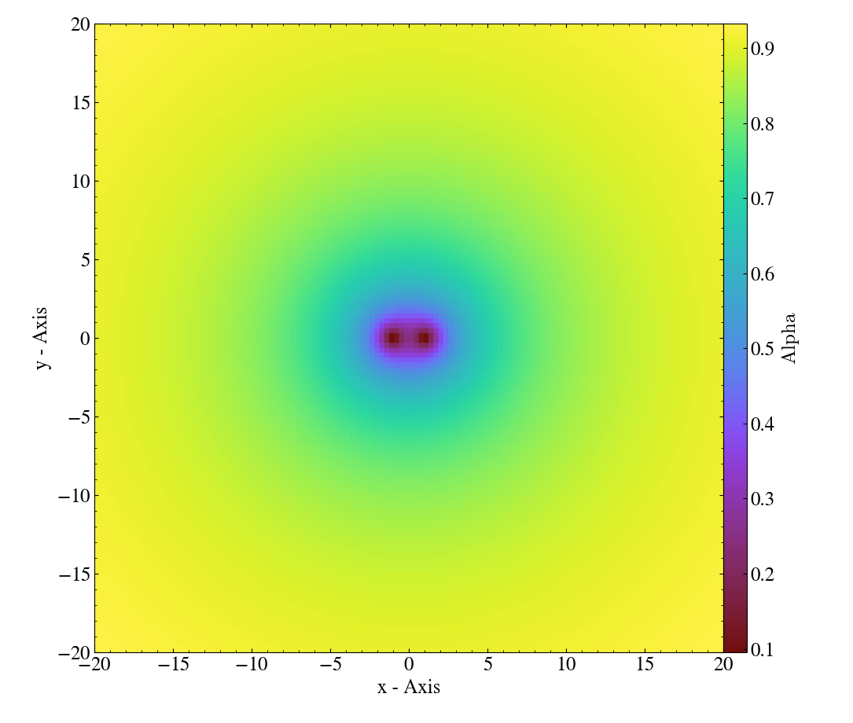

Interfacing Symbolic General Relativity with AMReX
Scientific Achievement
The equations of General Relativity are notoriously difficult to implement in numerical schemes, due to their complexity when expanded from symbolic form. To discretize these equations on distributed-memory meshes we developed automatic symbolic manipulators in Python that generate highly efficient code based on AMReX data structures. Our project focuses on developing these tools to be used for numerical simulation of gravitational problems.
Significance and Impact
Simulating gravitational physics with AMReX will allow researchers to consider more complex problems using exascale architectures.
Numerical simulation of two black holes initially at rest and merging into a single black hole is shown above. The initial data and evolution equations are implemented using code generators, and numerical simulations are performed using AMReX. Shown is the time lapse, whereby observers closer to the black holes experience slower time evolution. Darker values indicate higher lapse.
Research Details
The equations are automatically expanded in C++ AMReX-based code using the newly developed code generators.
The code generators are effective for use in generating and simulating black hole collisions (shown above). We are currently running tests to validate our discretization scheme across different numerical regimes.
Currently simulations use MPI + OpenMP parallelism and upcoming work will incorporate CUDA via AMReX’s parallelism abstractions for GPU-based supercomputers.
ECP ExaStar project (PI: Kasen): A. Peterson

