Slide 1
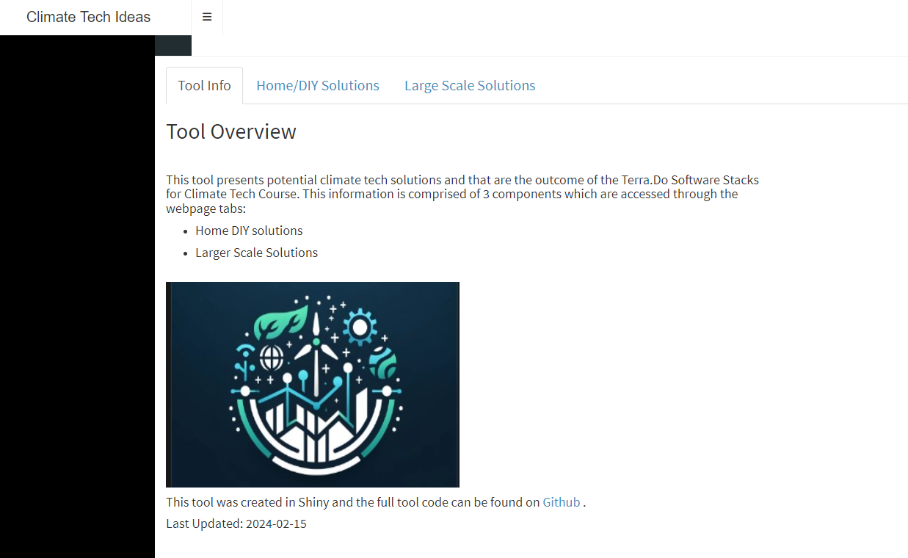
Project Purpose
Create something useful or interesting based upon skills I learned in this class that could be applied to my current job or that could spawn an unrelated side project.

Slide 2




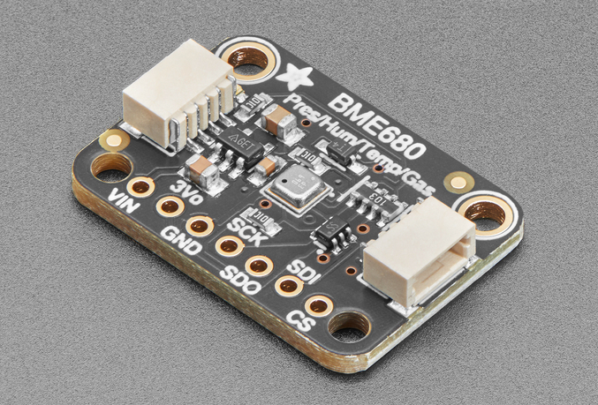
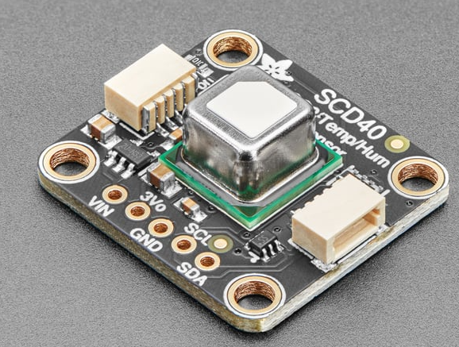
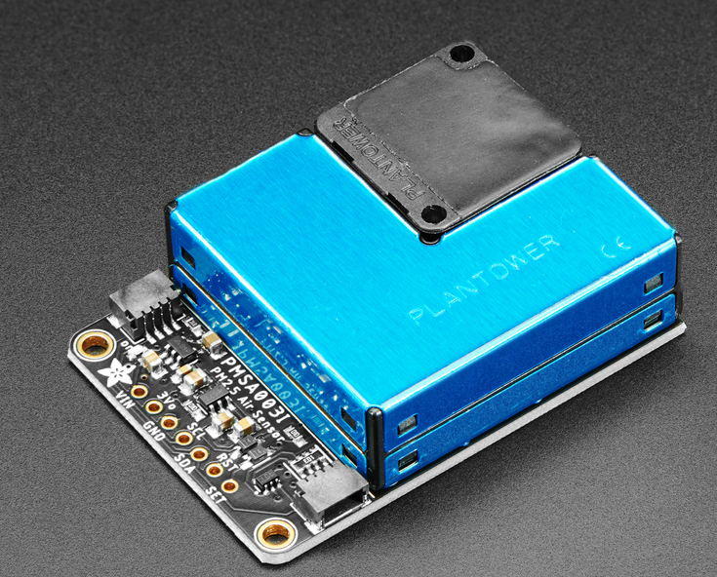
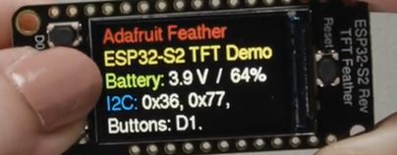
Tech Stack

Slide 3
Tool Features

Slide 4
Takeways

Slide 5
Future Work
Connect app directly to live IOT database
Additional user defined inputs connecting to backend data
Locations (lat/lng), home energy model parameters

Slide 6
Interested in collaborating on R/Python Shiny apps for:
Transportation electrification market (charging availability,
Sauna market (custom sensors and sauna accessories)
Home energy market
Others???
Contact me
reidhaefer14@gmail.com
reidhaefer.rbind.io
https://www.linkedin.com/in/reidhaefer/

Slide 7
bring in transportation datasets
bring in local data from Tahoe Open data or other easily accessible datasests in spatial form - people love maps.
Areas for improvement
Add user defined dynamic location input. Currently the lat lon definitions are hard coded in the python pre-processing script and the app was developed in R so the lat long values aren't available to activated dynamically.
Connect the IOT data to the home energy model - make the all of the inputs to the home energy model dynamic.
Bring in the energy generation data to recommend cheapest times to charge an EV.
Phils project
charger availability, utilization, and functional data (Phil) - data source? from an analytics company (anonymous)? This data could be very useful to integrate into travel demand modeling
weather data (Phil) - data source? - visual crossing

