Slide 2
Marketplace.sol ERC721
NFT.sol ERC721
Metasalt token ERC20
Controller contracts - ? Openzeppelin? Chainlink
Queries Oraxcl
Input
NFT address
Fee – paid only in MS tokens
Output
T/F

Slide 3
Metadata
Scan “identifier” such as QR code or barcode from mobile app camera
Get string or number
If string, convert to number
Obtain image file of the thing you want to mint as an NFT
Obtain random number, e.g, BrandGUID, anyGUID, any unique number w/sufficient entropy not be hacked
Hash(random number + Identifier)
Keccak256(BrandGUID + (QR code))
SHA256 (AnyGUID + (barcode))
Mint ERC721 contract
Add prefix - 01_Keccak256(QR_code)
Store metadata on chain in ERC721
Indexer

Slide 4
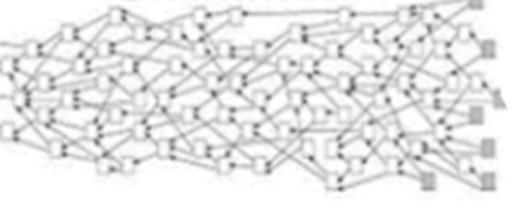
SC – ERC20 ERC721 -?
Takes MS tokens
Oracle
Return True/false
If this NFT was minted at that address

Slide 5
NFT.sol
Blockchain
Authentication.sol
Requestor
Mobile app
GUID
GUID
Mobile app
GUID

Slide 6
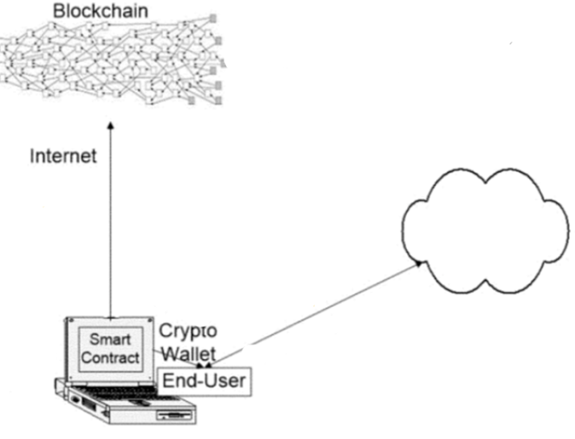

Slide 7
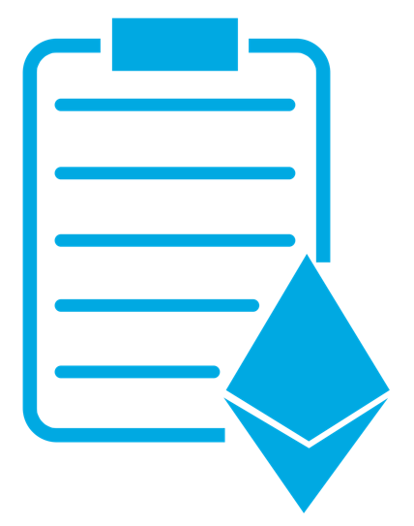

Slide 8
Moralis DB
Name
GUID
Name
F
3
4
E
GUID
Fee (Native token)
B
1
Name queried
C
Name
NFT.sol
NFT contract Address
0x2712ffe8423…
Mobile
Requestor
D
Authenticator. Sol
QR Code
2
Hash(GUID + QR Code)
H
NFT contract Address
0x2712ffe8423…
QR Code
5
QR Code
G
Hash(GUID + QR Code)
A
Blockchain

