Slide 2
Marketplace.sol ERC721
NFT.sol ERC721
Metasalt token ERC20
Controller contracts - ? Openzeppelin? Chainlink
Queries Oraxcl
Input
NFT address
Fee – paid only in MS tokens
Output
T/F

Slide 3
Metadata
Scan QR code or barcode from mobile app camera or image file and get string or number
If string, convert to number
Generate random number (Nothing fancy. Elliptical math not required)
Keccak256(Random number + (QR code or barcode))
Add prefix - 01_Keccak256(QR_code)
Store metadata on chain in ERC721

Slide 4
SC – ERC20 ERC721 -?
Takes MS tokens
Oracle
Return True/false
If this NFT was minted at that address

Slide 5
NFT.sol
Blockchain

Slide 6
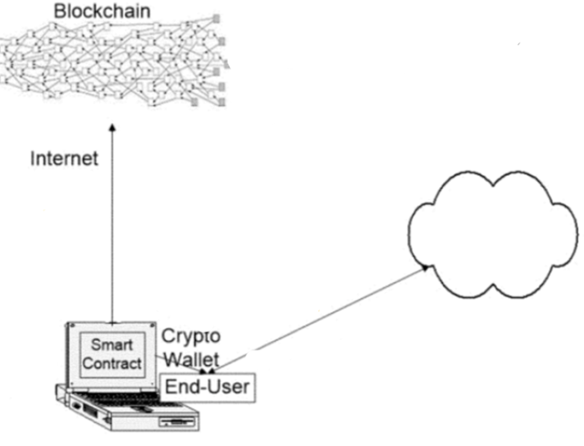

Slide 7
