Slide 1


BORDER MONITORING WITH WIRELESS SENSOR NETWORKS
ELE 402 - Special Topics in Automation Systems
Student: Rafael Rihart Halmann
Advisor: Cel. Jorge Stoccedo
Prof.: Edison Pignaton

Slide 2
SUMMARY
Problem definition
Simulatin environment
Metrics
Simulation setup
Simulation results

Slide 3
Problem definition

Slide 4
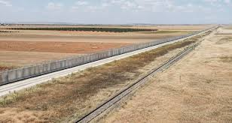
Problem Definition
Evaluate four different routing protocols (DSR, AODV, DSDV and TORA) in the application of border surveillance system in order to meet performance metrics regarding energy consumption, packet delivery ratio, end-to-end delay and throughput.
Border Monitoring Characteristics:
Long distances and relative narrow range of area to be monitored;
Usually it demands high cost or even infeasible for installation of infrastructure;
Demands discretion in order to avoid being located and destroyed by the invader;
WSNs Suitability
Easy field implementation;
Centralized/Decentralized control;
Static/Mobile sink;
Auto-configurable;

Slide 5
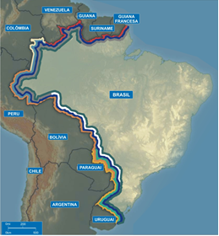
motivation and Relevance
Border surveillance characteristics:
Border extensions to be monitored is about 17,000 km;
Only about 4% of our border is monitored;
Hostile and uninhabited topography;
Sparse intrusion events occurrence;
Long time interval between events;
Cost constraint;

Slide 6
Simulatin environment

Slide 7
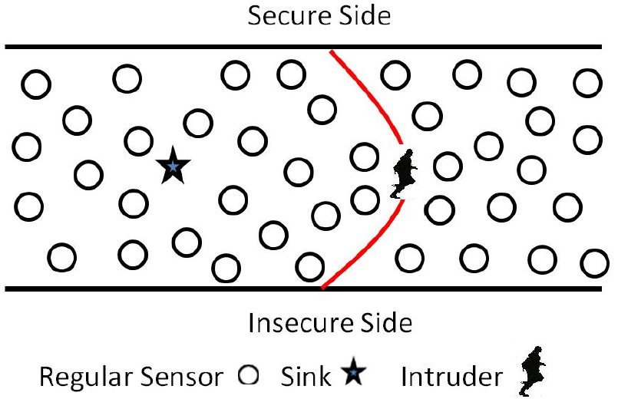
SIMULATION ENVIRONMENT
NETWORK SIMULATOR (NS-2)
Environment Definition and Configuration
Narrow and long distance area representing a border surveillance scenario [1][2];
Simulate the intruder detection via U.S. Naval Research Laboratory extension to NS-2 (nrlsensorsim) [3]:
PHENOM broadcast packets through a specific channel;
Adjust the sensing sensitivity of the physical phenomenon by the transmission range of the broadcasted packets;
Do not contributes with network overhead once PHENOM protocol works independently from the WSN protocol.

Slide 8
SIMULATION ENVIRONMENT
NETWORK SIMULATOR (NS-2)
In order to quantitatively compare the options, four metrics have been considered based on [1], [2] and [4]:
Wireless Sensor Network Performance Metrics
Energy Consumption (Maximum energy per node and average energy of the network)
Packet Delivery Ration
End-to-End Delay
Troughput

Slide 9
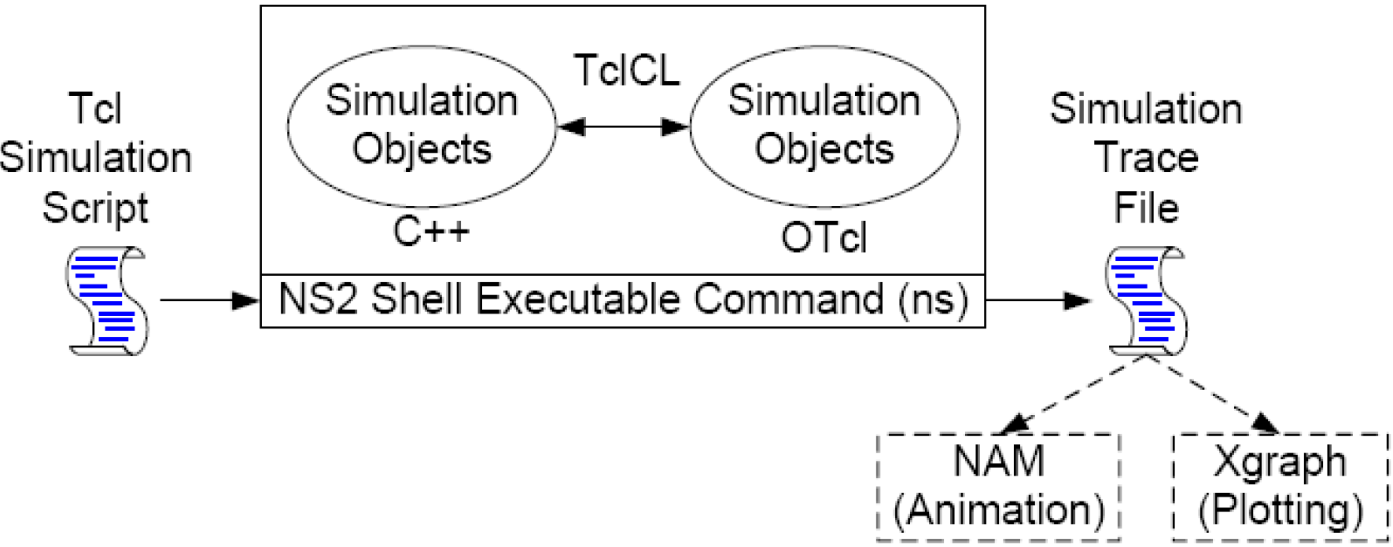
SIMULATION ENVIRONMENT
NS-2 ARCHITECTURE
Two frameworks
C++: Low level componente definition and data processing;
Otcl: User interface and simulation environment configuration;
Event-driven simulator;
Support for mono-thread event processing;
Support for trace file;
Graphical animation of the network;

Slide 10
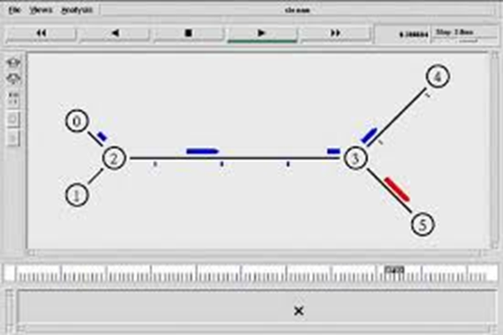
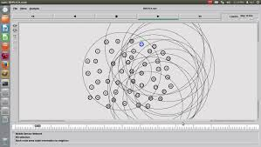
DETAILED DEFINITION OF THE PROPOSAL SOLUTION
NETWORK SIMULATOR (NS-2)
First version in 1989 based on Real Network Simulator;
Developed by Berkley University;
Open source and free for research and educational;
Discrete-event network simulator
Two languages:
C++ for protocol implementation;
Otcl to describe and configure the simulation environment;
IP and non-IP based networks simulation;
Support for Wi-Fi, WiMAX, or LTE for layers 1 and 2 with a variety of static or dynamic routing protocols;

Slide 11
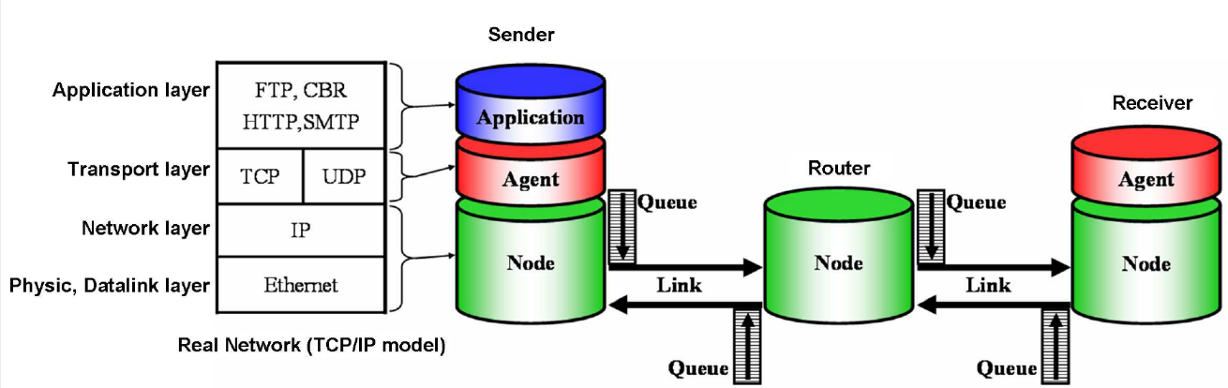
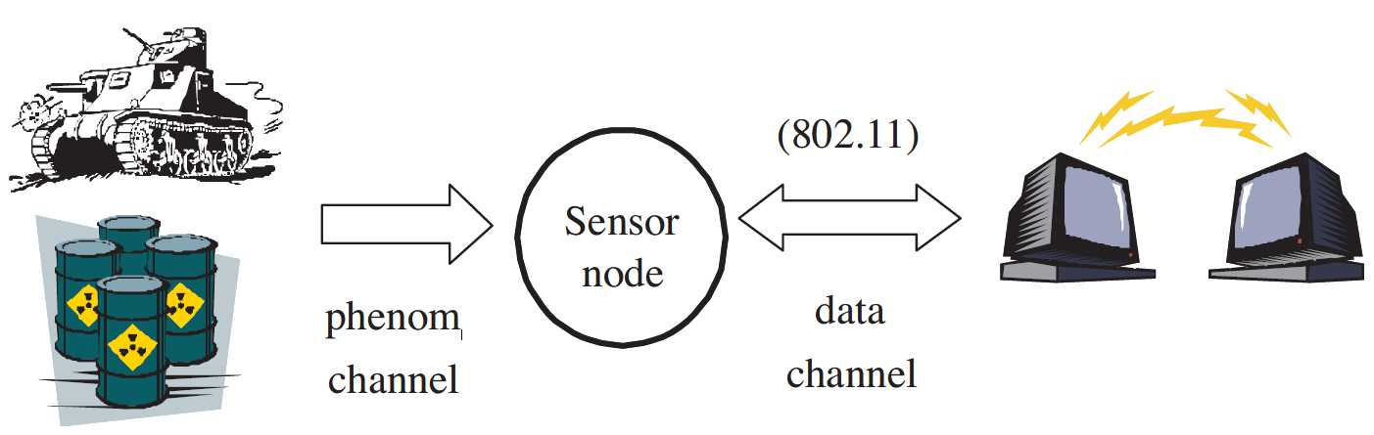
DETAILED DEFINITION OF THE PROPOSAL SOLUTION
NS-2 ARCHITECTURE
Phenomenon
Use a specific channel;
Implements its own routing protocol;
Four diferente types of phenomenon
CO – carbono monoxid;
HEAVY GEO – heavy seismic activity;
LIGHT GEO – light seismic activity;
SOUND – audible sound;
TEST_PHENOMENON – generic;
Steps for implementing a simulation
Step 1: Declare simulator and output file;
Step 2: Setting node and Link;
Step 3: Setting agent;
Step 4: Setting application;
Step 5: Setting simulation time and schedulers
Step 6: Declare finish;

Slide 12
Metrics

Slide 13
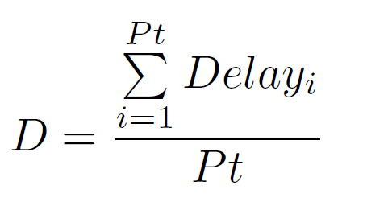
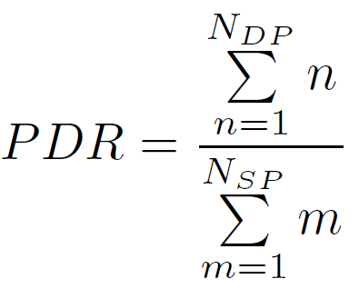
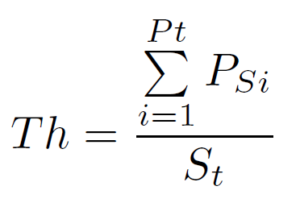
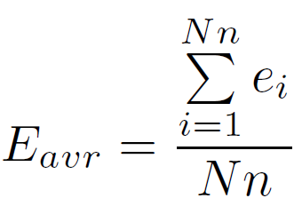
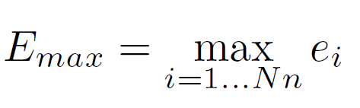
METRICS TO EVALUATE THE PROTOCOLS
NETWORK METRICS
In order to quantitatively compare the options, four metrics have been considered based on [1], [2] and [4]:
End-to-End delay | Packet delivery ration (PDR)
Throughput | Energy consumption

Slide 14
Simulation setup

Slide 15
Simulation setup
SIMULATION
Rectangle sensor area (10 km x 500 m);
Deterministic and random sensor deployment;
Protocols:
Static and mobile sink;
On-demand and proactive;
DSR – Dinamic Source Routing;
DSDV – Destination Sequence Distance Vector;
AODV – Ad-hoc On Demand Routing Protocol;
TORA – Temporarlly Ordered Routing Algorithm (did not work in NS-2.26 until now);
Population criterion – node density;

Slide 16
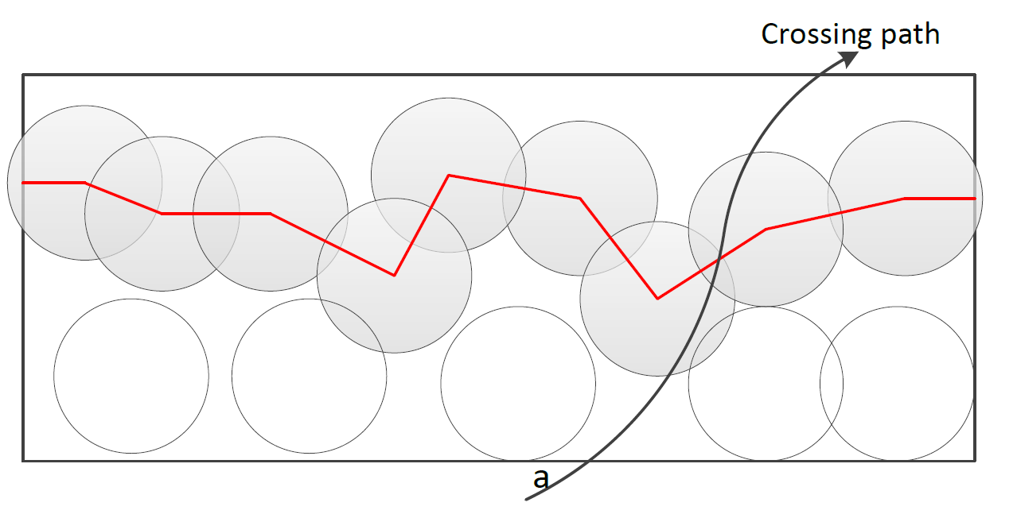
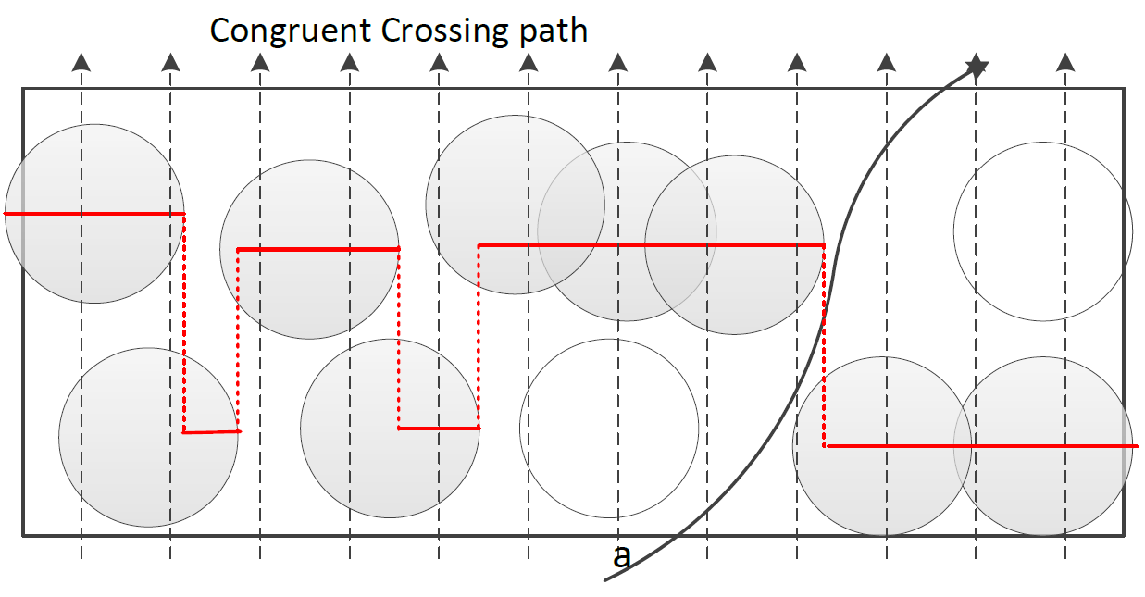
SIMULATION SETUP
CALCULATION OF THE NODE DENSITY [1][7]
Strong Barrier Coverage
Weak Barrier Coverage / Orthogonal Detection

Slide 17
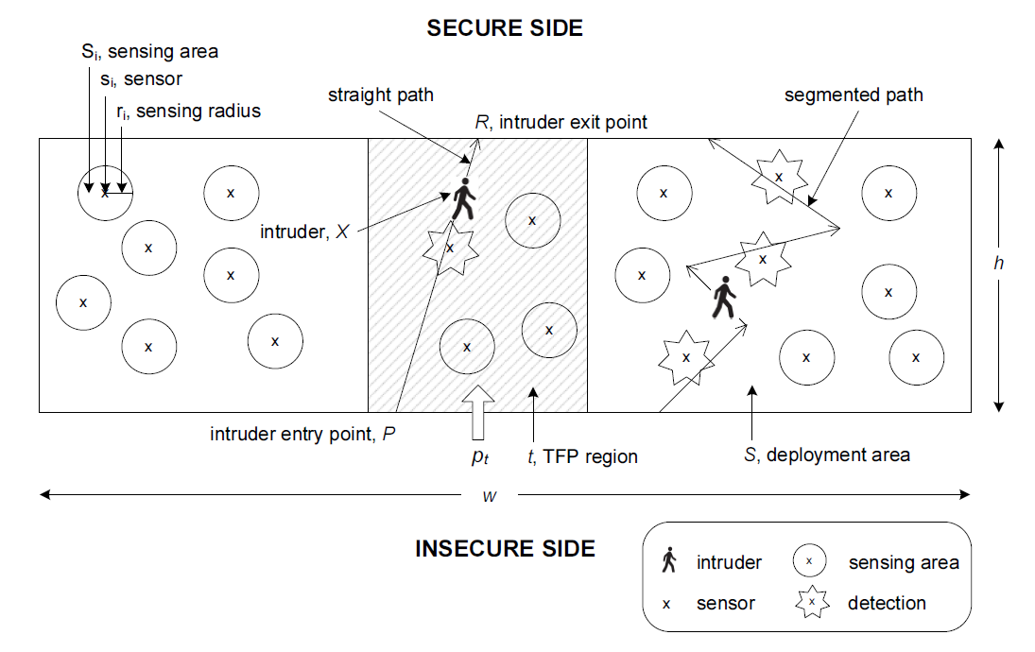
SIMULATION SETUP
CALCULATION OF THE NODE DENSITY
DetQM [7]

Slide 18
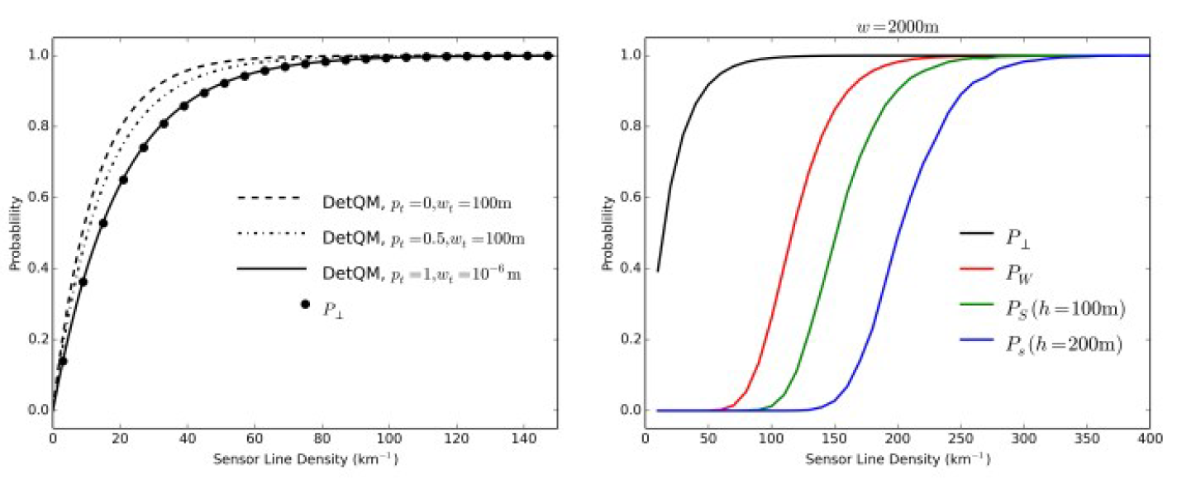
SIMULATION SETUP
CALCULATION OF THE NODE DENSITY
[1] M. Hammoudeh et al., “A Wireless Sensor Network Border Monitoring System: Deployment Issues and Routing Protocols”, in IEEE Sensors Journal, vol. 17, no. 8, pp. 2572-2582, 15 April15, 2017. doi: 10.1109/JSEN.2017.2672501

Slide 19
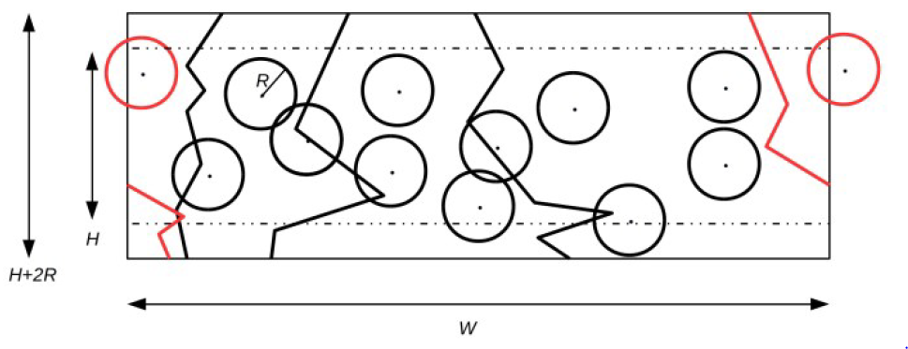
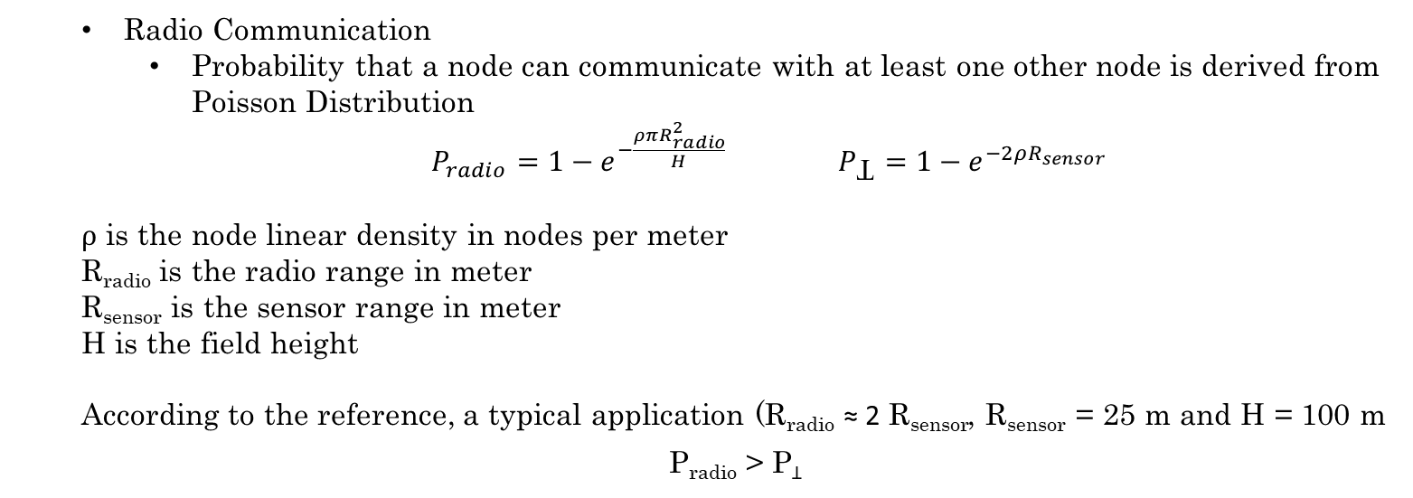
Simulation setup
CALCULATION OF THE NODE DENSITY [1] [8]
Radio Communication
Probability that a node can communicate with at least one other node is derived from Poisson Distribution
$P_{radio}=1−e^{−\frac{ρπR_{radio}^{2}}{H}}$ $P_{Ʇ}=1−e^{−2ρR_{sensor}}$
ρ is the node linear density in nodes per meter
R_{radio} is the radio range in meter
R_{sensor} is the sensor range in meter
H is the field height
According to the reference, a typical application (R_{radio} ≈ 2 R_{sensor}, R_{sensor} = 25 m and H = 100 m
P_{radio} > P_{Ʇ}

Slide 20
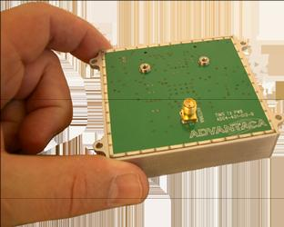
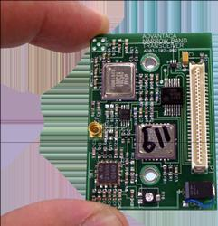
Simulation setup
SENSOR EXAMPLE
SEGA-Node TIMS Radar
Radar Typical Performance
Range 35 M
Frequency 720 MHz
Bandwidth 80 MHz
Tx Power 9 mW
Voltage 3.6 V
Current 5 mA
Temp -40 to +80 C
Target speed 0.1 to 40 m/s
SEGA-Node TIMS Radar
Radio Typical Performance
Range 1 KM
Frequency 315 Mhz
Bandwidth 400 KHz
Tx Power 2 mW
Voltage 3.0 V
Current 1.5 mA
Temp -40 to +80 C
http://www.sperient.com/ (last access on 2018/12/09)

Slide 21
Simulation results

Slide 22
Simulation results
CONFIGURATION
Equivalent linear sensor density
Sensor range: 35 m
Radio range: 250 m
Number of sensor nodes: 40, 80, 120, 160, 200, 240 and 280
Simulation time: 500 sec

Slide 23

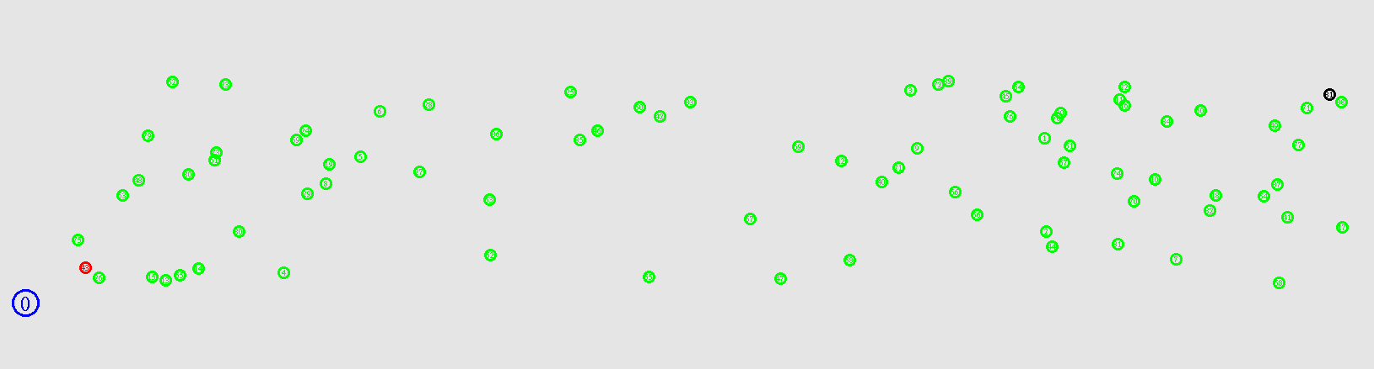
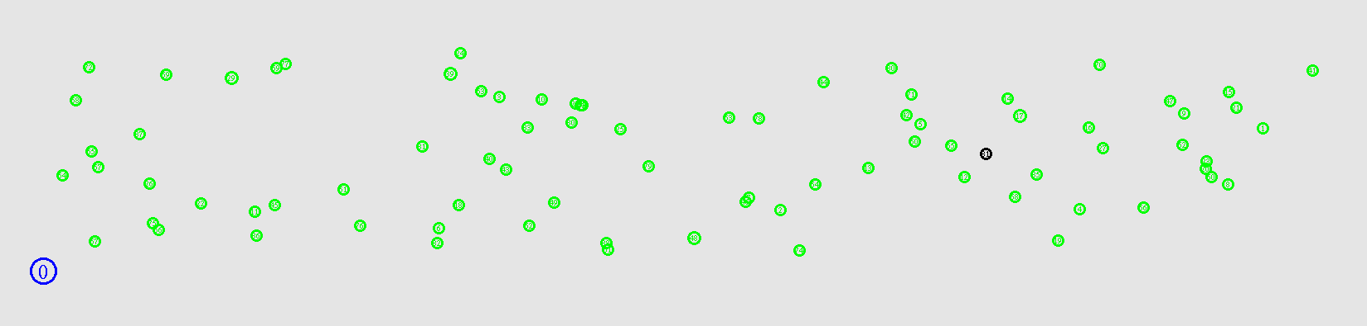
Simulation results
SCENARIOS
Scenario 1
Deterministic sensor nodes depoloyment;
Targuet and sink nodes static;
Scenario 2
Stochastic sensor nodes depoloyment;
Targuet and sink nodes static;
Scenario 3
Stochastic sensor nodes depoloyment;
Targuet node static;
Sink node moving along “x” axis;

Slide 24
Simulation results
SCENARIOS – COMPARATIVE - THROUGHPUT
SCENARIO 1
SCENARIO 2
SCENARIO 3

Slide 25
Simulation results
SCENARIOS – COMPARATIVE – END-TO-END DELAY
SCENARIO 1
SCENARIO 2
SCENARIO 3

Slide 26
Simulation results
SCENARIOS – COMPARATIVE – PDR
SCENARIO 1
SCENARIO 2
SCENARIO 3

Slide 27
Simulation results
SCENARIOS – COMPARATIVE – Emax
SCENARIO 1
SCENARIO 2
SCENARIO 3

Slide 28
Simulation results
SCENARIOS – COMPARATIVE – Eavg
SCENARIO 1
SCENARIO 2
SCENARIO 3

Slide 29
Simulation results
SCENARIO 1
 | Throughtput [bit/sec]
Nº Nodes | AODV | DSDV | DSR
40 | 3804,22 | 3801,31 | 3170,35
80 | 3803,92 | 3774,22 | 3168,73
120 | 3803,08 | 3611,71 | 3173,31
160 | 3787,37 | 3367,91 | 3170,36
200 | 3804,41 | 3062,07
240 | 3803,49 | 2729,55
280 | 3803,6 | 2283,86

Slide 30
Simulation results
SCENARIO 1
 | End to End Delay [sec]
Nº Nodes | AODV | DSDV | DSR
40 | 0,010631 | 0,008497 | 0,007976
80 | 0,021532 | 0,016308 | 0,024601
120 | 0,029694 | 0,023101 | 0,046305
160 | 0,065495 | 0,027406 | 0,041421
200 | 0,051436 | 0,097641
240 | 0,059681 | 0,029999
280 | 0,073309 | 0,027166

Slide 31
Simulation results
SCENARIO 1
 | PDR
Nº Nodes | AODV | DSDV | DSR
40 | 1 | 0,951789 | 1
80 | 1 | 0,809145 | 0,999503
120 | 1 | 0,706262 | 1
160 | 0,995529 | 0,615996 | 0,999503
200 | 0,999503 | 0,500994
240 | 1 | 0,36332
280 | 1 | 0,281312

Slide 32
Simulation results
SCENARIO 1
 | Emax [J]
Nº Nodes | AODV | DSDV | DSR
40 | 3,29796 | 3,7915 | 2,49898
80 | 4,9435 | 9,03365 | 4,81743
120 | 5,76667 | 12,4303 | 6,99889
160 | 4,93765 | 15,1591 | 5,8853
200 | 5,76968 | 17,9943
240 | 5,76686 | 20,2055
280 | 5,766870 | 22,5133

Slide 33
Simulation results
SCENARIO 1
 | Eavg [J]
Nº Nodes | AODV | DSDV | DSR
40 | 0,385167 | 3,61231 | 0,319702
80 | 0,420761 | 6,95888 | 0,397156
120 | 0,412583 | 10,5165 | 0,73549
160 | 0,374092 | 13,2809 | 0,467945
200 | 0,474593 | 15,9676
240 | 0,440988 | 18,3344
280 | 0,502662 | 20,1335

Slide 34
Simulation results
SCENARIO 2
 | Throughtput [bits/sec]
Nº Nodes | AODV | DSDV | DSR
40 | 3803,63 | 3802,46 | 3171,32
80 | 3804,58 | 3766,96 | 3170,29
120 | 3804,77 | 3597,9 | 3170,2
160 | 3804,5 | 3363,77 | 3169,73
200 | 3802,49 | 3037,54
240 | 3804,19 | 2612,4
280 | 3798,09 | 2028,14

Slide 35
Simulation results
SCENARIO 2
 | End to End Delay [sec]
Nº Nodes | AODV | DSDV | DSR
40 | 0,0155364 | 0,00795274 | 0,008084
80 | 0,02154 | 0,016994 | 0,019129
120 | 0,0324034 | 0,0211571 | 0,0273929
160 | 0,0351536 | 0,0262474 | 0,035773
200 | 0,054045 | 0,0290687
240 | 0,056932 | 0,0290415
280 | 0,069885 | 0,0244254

Slide 36
Simulation results
SCENARIO 2
 | PDR
Nº Nodes | AODV | DSDV | DSR
40 | 1 | 0,95231 | 1
80 | 1 | 0,853877 | 1
120 | 1 | 0,747018 | 1
160 | 1 | 0,652584 | 1
200 | 0,999006 | 0,548708
240 | 0,999503 | 0,389662
280 | 0,998509 | 0,260934

Slide 37
Simulation results
SCENARIO 2
 | Emax [J]
Nº Nodes | AODV | DSDV | DSR
40 | 3,30231 | 3,59088 | 2,51204
80 | 5,55543 | 9,49463 | 4,99746
120 | 6,37946 | 14,4954 | 3,84762
160 | 4,73151 | 17,5074 | 5,03324
200 | 5,77038 | 20,4721
240 | 5,76761 | 25,099
280 | 5,76234 | 27,3819

Slide 38
Simulation results
SCENARIO 2
 | Eavg [J]
Nº Nodes | AODV | DSDV | DSR
40 | 0,233982 | 2,59037 | 0,242266
80 | 0,44958 | 7,29463 | 0,385787
120 | 0,373426 | 4,923967 | 0,25653
160 | 0,468213 | 7,89845 | 0,362658
200 | 0,427629 | 8,95975
240 | 0,396824 | 10,06805
280 | 0,407503 | 22,8242

Slide 39
Simulation results
SCENARIO 3
 | Throughtput [bits/sec]
Nº Nodes | AODV | DSDV | DSR
40 | 986,884 | 3522,45 | 3178,26
80 | 1048,74 | 3756,9 | 3176,07
120 | 1078,41 | 3550,74 | 3178,12
160 | 1107,68 | 2683,8 | 3178,77
200 | 1026,52 | 2229,88
240 | 1042,07 | 1977,37
280 | 1100,88 | 2028,14

Slide 40
Simulation results
SCENARIO 3
 | End to End Delay [sec]
Nº Nodes | AODV | DSDV | DSR
40 | 0,002072 | 0,004174 | 0,005098
80 | 0,008792 | 0,016609 | 0,010026
120 | 0,010551 | 0,021755 | 0,020293
160 | 0,009247 | 0,012009 | 0,027455
200 | 0,010374 | 0,021089
240 | 0,018299 | 0,018704
280 | 0,015852 | 0,024425

Slide 41
Simulation results
SCENARIO 3
 | PDR
Nº Nodes | AODV | DSDV | DSR
40 | 0,259443 | 0,886183 | 1
80 | 0,229622 | 0,848982 | 1
120 | 0,235966 | 0,737078 | 1
160 | 0,242921 | 0,459742 | 1
200 | 0,223547 | 0,389662
240 | 0,228018 | 0,319583
280 | 0,241054 | 0,260934

Slide 42
Simulation results
SCENARIO 3
 | Emax [J]
Nº Nodes | AODV | DSDV | DSR
40 | 2,50647 | 2,53146 | 1,52791
80 | 5,7795 | 9,44977 | 2,78052
120 | 4,36316 | 14,1429 | 3,09319
160 | 5,55477 | 18,9066 | 4,85449
200 | 5,99979 | 25,738
240 | 5,765 | 27,7664
280 | 5,76608 | 27,3819

Slide 43
Simulation results
SCENARIO 3
 | Eavg [J]
Nº Nodes | AODV | DSDV | DSR
40 | 0,247702 | 2,47462 | 0,164301
80 | 0,401848 | 7,27264 | 0,217044
120 | 0,302166 | 11,1413 | 0,211215
160 | 0,393544 | 14,3279 | 0,322888
200 | 0,405801 | 19,3771
240 | 0,411209 | 21,9111
280 | 0,397026 | 22,8242

Slide 44
Simulation results
NEXT STEPS
Add more protocols in the evaluation scope;
Different node deployment strategies;
Improve energy model;

Slide 45
references
[1] M. Hammoudeh et al., “A Wireless Sensor Network Border Monitoring System: Deployment Issues and Routing Protocols”, in IEEE Sensors Journal, vol. 17, no. 8, pp. 2572-2582, 15 April15, 2017. doi: 10.1109/JSEN.2017.2672501
[2] Sharei, Hoda & Keshavarz-Haddad, Alireza & Garraux, Gaëtan, “Routing Protocols for Border Surveillance Using ZigBee-Based Wireless Sensor Networks”, Communications in Computer and Information Science. 370, 2013, pp. 114-123. 10.1007/978-3-642-38865-1_13.
[3] Downard, Ian, “Simulating sensor networks in ns-2”, Network and Communication Systems Information Technology Division – U.S. Naval Research Laboratory, may 31 2004, NRL/FR/5522--04-10,073
[4] Anil Saini, Anil Kumar, “Performance Analysis of Routing Protocols in Mobile Ad-hoc Networks Using NS2”, ICETEST Track , International Journal on Future Revolution in Computer Science & Communication Engineering march 2018 volume 4 issue 3 (IJFRSCE), PP: 150 – 154
[5] Khan, Majid I., Wilfried N. Gansterer, and Guenter Haring. “Static vs. Mobile Sink: The Influence of Basic Parameters on Energy Efficiency in Wireless Sensor Networks.” Computer Communications 36.9 (2013): 965–978. PMC. Web. 21 Sept. 2018.
[6] Keerthika, A., Berlin Hency, V., “A survey of routing protocols of wireless sensor network with mobile sinks.” ARPN J. Eng. Appl. Sci. 11(11), 6951–6963, 2016.
[7] Komar, C., 2012, “Detection Quality Measure in Surveillance Wireless Sensor Networks”, PhD Thesis, Boğaziçi University, Istanbul, Turkey.
[8] Senouci, Mustapha & Mellouk, Abdelhamid & Aissani, Amar. “Random deployment of wireless sensor networks: A survey and approach”. Int. J. of Ad Hoc and Ubiquitous Computing. 15. 133 – 146, (2014). 10.1504/IJAHUC.2014.059905.

