Slide 1
A Prescriptive Simulation–Hybrid Optimization Framework for Capacity Planning in Minimally Invasive Gynecology
Raúl H. Araneda, Rodrigo A. Carrasco
Department of Industrial and Systems Engineering — UC Chile
IFORS 2026 — Vienna, Austria · Presented by Raúl H. Araneda
Research partially funded by Fondecyt Regular 1231245

Slide 2
Outline
• Motivation
• Research Problem
• Literature Review
• Objective
• Proposed Framework
• Results
• Discussion
• References

Slide 3
Waiting kills — and Chile is no exception
Motivation
• Prolonged waits deteriorate patient health and increase mortality by 3.4% (Martinez et al., 2019).
• Prolonged waits reduce wages and labor productivity (OECD, 2026).
[FIGURA: listas_espera.png — pegar aquí]

Slide 4
Inside one clinic: where the bottleneck lives
Case Study
• Institutional Relevance
– CRSCO is a medium-complexity public ambulatory center, a key referral hub for Macul and Peñalolén.
• Demand
– More than 30,000 consultations in 2025 — growing pressure on specialized services.
• Gynecology Department Burden
– 30% of the total waiting list; 3,859 pending cases across 11 specialized clinics.

Slide 5
The victim: 318 cases, up to 1,164 days waiting
Case Study
• Waiting Time Metrics
– Average waiting time: 205 days; maximum recorded: 1,164 days.
• Minimally Invasive Gynecology (CMI)
– Fifth largest subspecialty list — 318 active cases, average wait 81 days.

Slide 6
The question: can we make fewer patients wait?
Problem Definition
[FIGURA: proceso_atencion.png — pegar aquí]
• Absence of an analytical framework able to represent and support, in an integrated way, capacity-planning decisions under uncertainty.
• Research question: how do I optimize this process so fewer patients wait?

Slide 7
The scene: modeling the gynecology macro-process
BPMN model of the system — the source of the five challenges
[FIGURA: macro.png — pegar aquí]

Slide 8
The five main pillars
Challenges that emerge from the model — no off-the-shelf method handles all five
• Stochastic demand: patient arrivals, no-shows, cancellations.
• Mixed integer–continuous decision space.
• Structural heteroscedastic noise.
• Expensive evaluations.
• No gradient available.

Slide 9
Fundamental pillars
Literature Review
• DES is a central tool for representing patient flows, queues, operational rules (Monks & Harper, 2025).
• Simulation Optimization (SO): optimize a black-box stochastic objective via simulation (Amaran et al., 2016).
• Derivative-Free Optimization (DFO): minimize when the gradient is unavailable (Conn et al., 2009).
• Metaheuristics (SA, GA, OptQuest): common in healthcare SO but lack formal guarantees under heteroscedastic noise (Wang & Demeulemeester, 2023; Nazri & Yusoh, 2025).

Slide 10
The gap: nobody covers all five at once
The Methodological Gap
 | Stochastic DES | Hetero-scedasticity | Mixed-integer | Adaptive Repl. | Conv. Guarantees
DFO continuous | ✓ | ✗ | ✗ | Partial | ✓
SO integer | ✓ | ✗ | Partial | Partial | ✓
Surrogate-based (RF/GP) | ✓ | Partial | ✓ | Partial | ✗
Surrogate-based (SK) | ✓ | ✓ | ✗ | Partial | ✗
Metaheuristics | ✓ | ✗ | ✓ | ✗ | ✗
Proposed framework | ✓ | ✓ | ✓ | ✓ | ✓
• ✓ satisfies ✗ does not satisfy Partial = partial. The empty space is the gap this work targets.

Slide 11
The suspect: SMAC-SK
Objective
• Design, formulate, and evaluate a prescriptive decision-support framework for capacity planning in Minimally Invasive Gynecology.
• Given the methodological gap, the proposed instrument is SMAC-SK (SMAC with a Stochastic-Kriging surrogate) — my workhorse for the rest of the talk.

Slide 12
How SMAC-SK works: simulate → optimize → prescribe
Proposed Framework
DES Evaluator
SMAC-SK
Prescriptive Output
f(x) ± σ(x)
optimal x*
Black-box stochastic evaluator
Core contribution (recommended method)
Applied to CRS Cordillera
Benchmark: 7 algorithms × 15 seeds, ~150 simulator evaluations, Common Random Numbers (CRN); incumbent re-evaluated n=50.

Slide 13
The levers we can actually pull
Specialist hour scheduling
[FIGURA: diagrama_prog.png — pegar aquí]
[FIGURA: grafico_dist_por.png — pegar aquí]

Slide 14
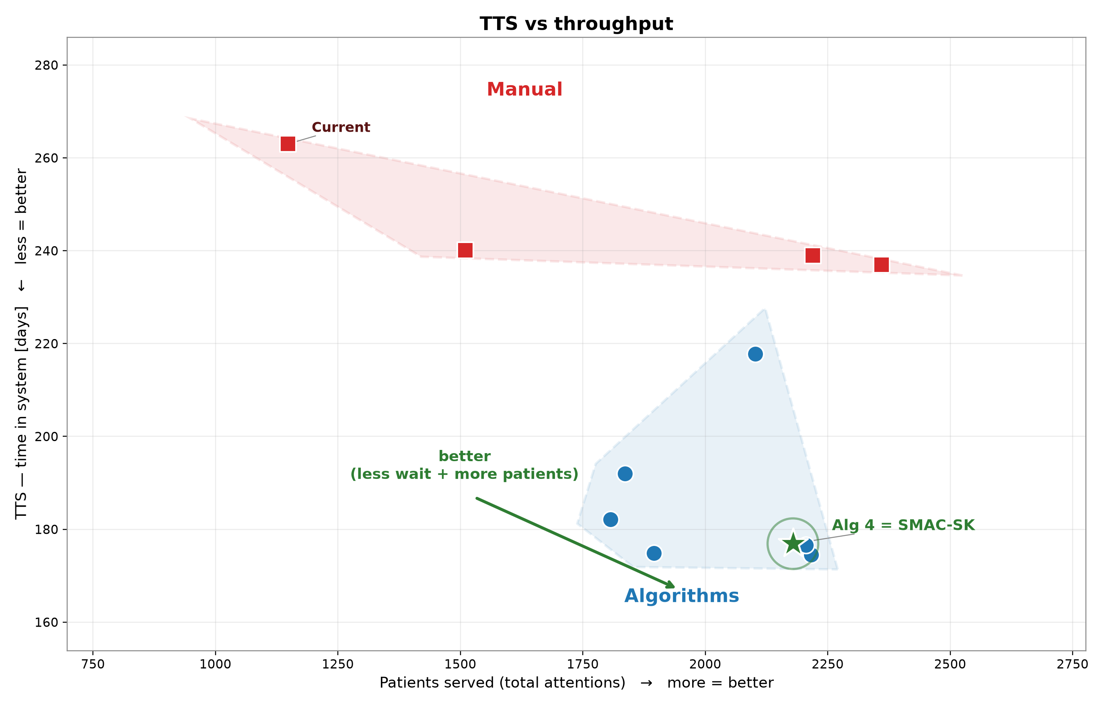
Caught: algorithms beat every manual policy
SMAC-SK (green star) is the recommended method

Slide 15
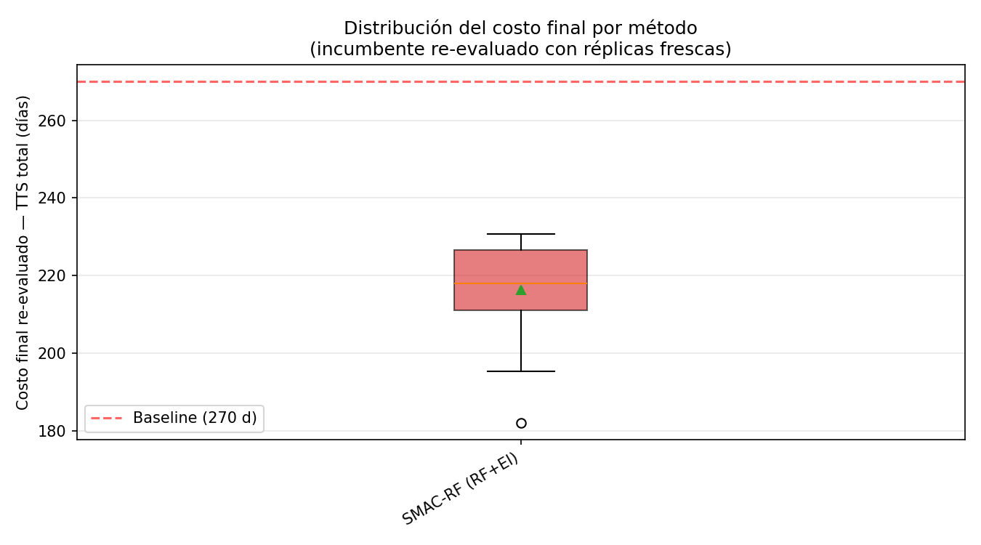
Who really differs? All-vs-all tests
Welch t-test, Holm-corrected — top algorithms are statistically tied

Slide 16
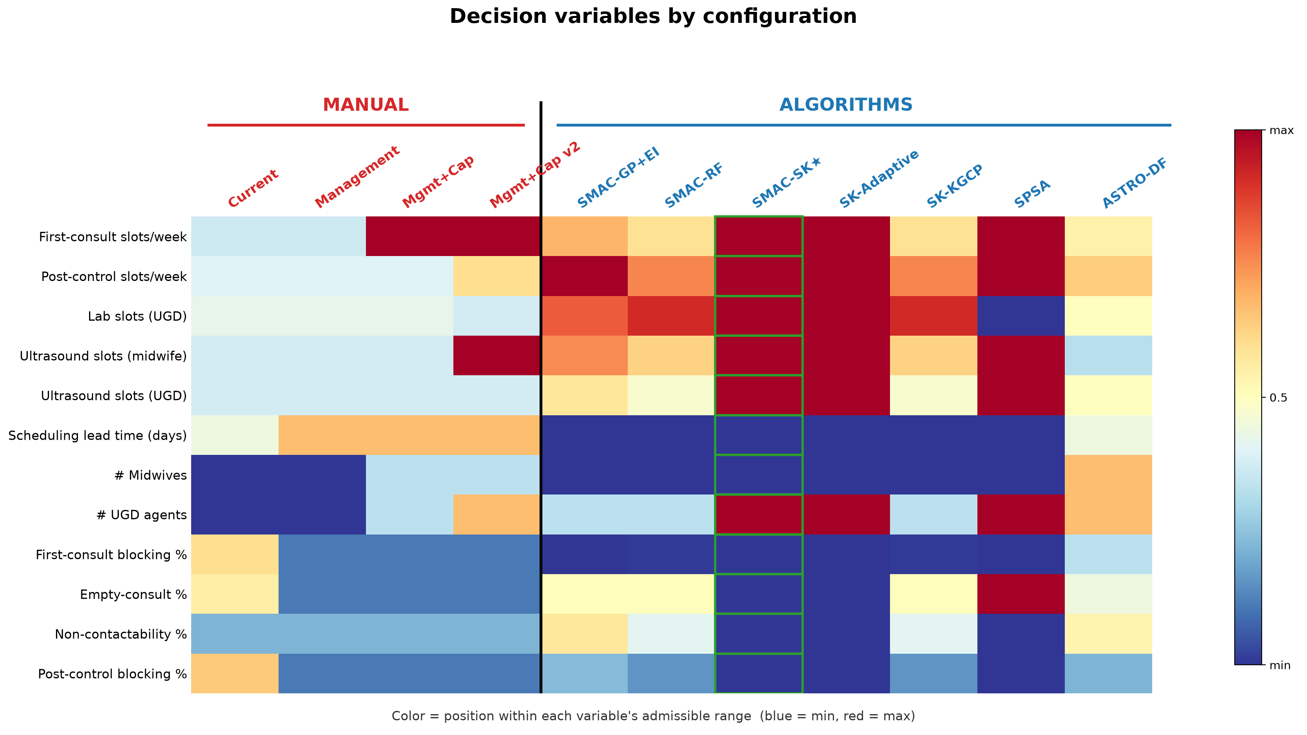
What SMAC-SK does differently
Parameter comparison

Slide 17
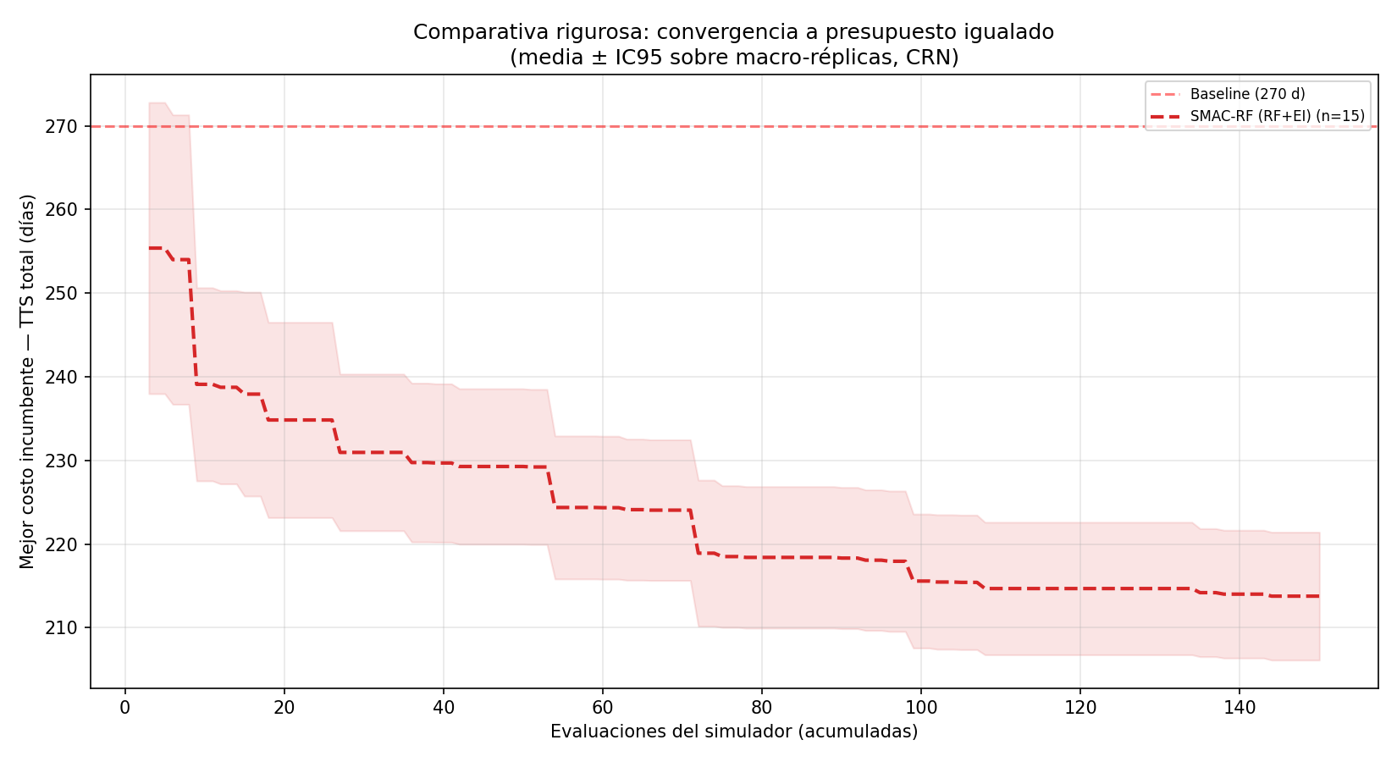
The proof it was not luck: SK earns its place
Green = SMAC-SK; compare against SMAC without SK — the SK term drives the gain

Slide 18
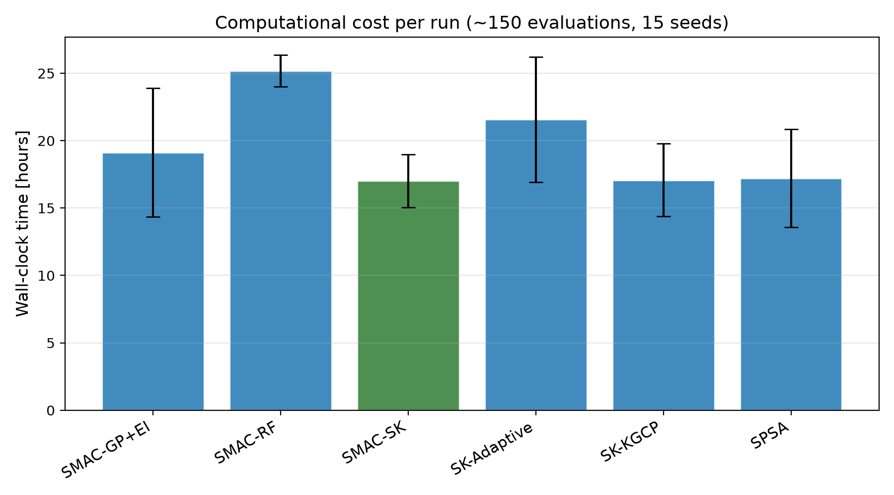
The price: why sample-efficiency matters
Computational cost

Slide 19
Case closed — but the guarantees do not transfer
Discussion
• Main result: SMAC-SK reduced TTS from 263 to 177 days (−33%) while patients served rose from 1,148 to 2,179 (+90%).
• No trade-off: algorithmic optimization Pareto-dominates all manual configurations — wait time and throughput improve simultaneously.
• Existing guarantees do not transfer: all methods converge empirically, yet their asymptotic results assume homoscedastic noise and smoothness — both violated by the DES evaluator.
• Open problem: no existing method natively handles structural heteroscedasticity with mixed-integer variables and formal convergence guarantees — the gap the doctoral work addresses.

Slide 20
The open case: theory the thesis will build
Future Work
• Algorithm design: a DFO method for mixed-integer variables with an adaptive replication-allocation mechanism driven by local variance estimation σ̂²(x).
• Convergence theory: sufficient regularity conditions on the heteroscedastic noise structure under which almost-sure convergence to first-order stationary points is establishable.

Slide 21
Thank you
Raúl H. Araneda — raul.araneda@uc.cl · IFORS 2026, Vienna

Slide 22
Appendix — Benchmark Methods
Method | Surrogate | Variables | Heterosc. | Adapt. Rep. | Convergence
SMAC-GP+EI | Gaussian Process | Mixed | ✗ | ✗ | Asymptotic*
SMAC-RF | Random Forest | Mixed | ✗ | ✗ | None (emp.)
SMAC-SK ★ | Stochastic Kriging | Mixed | Part. | ✗ | Asymptotic*
SK-Adaptive | Stochastic Kriging | Cont.† | Part. | Part. | Asymptotic*
SK-KGCP | Stochastic Kriging | Cont.† | ✗ | ✗ | Asymptotic*
SPSA | — | Cont.† | ✗ | ✗ | Asymptotic*
ASTRO-DF | Quadratic model | Cont.† | ✓ | ✓ | Almost sure
• * assumes homoscedastic noise — not satisfied here. † integers via continuous relaxation + rounding.

