Slide 1
Proactive Defense Against AI-Powered Web Scraping
An Overview of the AI Scraping Defense System
Rich Hamilton
7/15/2025
Notes:
Today, I'll be presenting the AI Scraping Defense System, a project designed to proactively detect and neutralize the growing threat of automated content scraping by sophisticated AI bots.

Slide 2
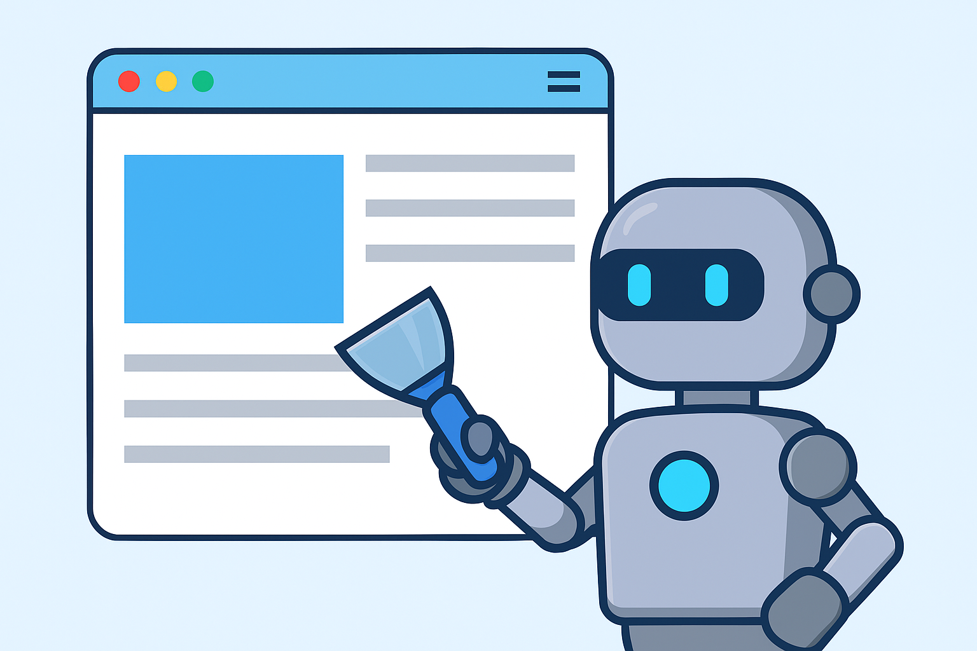
The Problem: The Rise of AI Scrapers
• Data is Valuable: Content, user data, and pricing information are valuable assets.
• Traditional Bots Were Simple: Easily identified and blocked.
• AI Scrapers are a New Threat:
– Mimic human behavior
– Solve CAPTCHAs
– Use residential/rotating IPs
– Parse JavaScript content
• Conclusion: Simple defenses are no longer effective.
Notes:
For years, website owners have dealt with web scrapers. But traditional bots were relatively simple. They had predictable signatures, and measures like IP blocking or respecting the robots.txt file were often sufficient.
However, the game has changed. Modern AI-powered scrapers are far more sophisticated. They can mimic human browsing patterns, bypass simple CAPTCHAs, and use vast networks of IP addresses to appear as legitimate traffic. This unchecked scraping can lead to intellectual property theft, price undercutting, and server overload. This new class of threat requires a new, more intelligent class of defense.

Slide 3

My Solution: A Multi-Layered Defense
Detect, Deceive, and Defend.
• Detect: Use AI to spot sophisticated bots.
• Deceive: Feed bots useless fake data ('Tarpit').
• Defend: Block persistent bots and share intelligence.
Notes:
Our solution is a multi-layered system built on the principle of 'Detect, Deceive, and Defend.'
First, we use an AI-powered service to Detect suspicious traffic that gets past initial checks.
Second, for confirmed bots, we Deceive. Instead of just returning a '403 Forbidden' error, which allows the bot to simply try again from a new IP, we redirect them to a 'tarpit.' The tarpit serves an endless stream of plausible but completely fake data, tying up the bot's resources.
Finally, we Defend. For the most persistent attackers, the system automatically escalates to blocking them entirely, ensuring they can't harm the site.

Slide 4
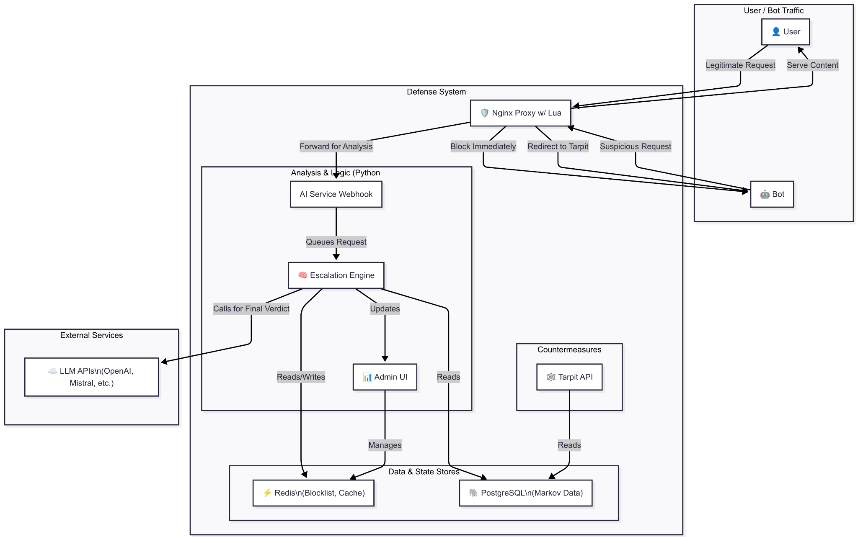
System Architecture
• Nginx with Lua: Entry point, filtering
• Redis: Caching, sessions, blocklists
• AI Service: Python Flask bot/human analysis
• Tarpit API: Generates fake data
• Escalation Engine: Decides permanent blocks
• PostgreSQL DB: Trained models storage
• Admin UI: Monitoring/management
Notes:
This is a high-level look at the system's architecture. Every request first hits our Nginx web server.
Here, Lua scripts perform initial, high-speed checks. They look for obvious bots and check against a blocklist cached in Redis.
If a request is suspicious, Nginx forwards it to the AI Service. This service analyzes the request headers and other metadata to make a more nuanced decision.
If the AI service flags the request as a bot, Nginx redirects it to the Tarpit API. This is where the deception happens. The Tarpit generates fake content using a Markov Chain model trained on real text, served from a PostgreSQL database.
Meanwhile, the Escalation Engine is logging these events. If a single IP is repeatedly identified as a bot, the engine adds it to the permanent blocklist in Redis, cutting off all future access.

Slide 5
System Architecture

Slide 6

Layer 1 - Detection (AI Service)
• Input: Request data from Nginx
• Process: Pre-trained model analyzes request features
• Output: JSON: {'is_bot': true/false}
• Key: Finds subtle patterns to detect bots
Notes:
The brain of our detection layer is the AI Service. When our Lua script in Nginx isn't sure about a request, it sends the request details to this service.
The AI Service uses a machine learning model that has been trained to recognize the fingerprints of automated clients. It looks at combinations of headers, TLS fingerprints, and other metadata that, when combined, create a strong signal of automation.
Based on this analysis, it returns a simple 'yes' or 'no' decision to Nginx, which then determines the request's fate. This is much more powerful than just checking a user-agent string.

Slide 7

Layer 2 - Deception (The Tarpit)
• Bots redirected to Tarpit API
• Markov Chain model generates realistic but nonsensical text
• Can generate fake user profiles, product listings, or zip bombs
• Benefit: Pollutes scraper’s data, wastes resources
Notes:
This is my favorite part of the system: the Tarpit. When we identify a bot, we don't just block it. We trick it.
The Tarpit API is a honeypot that generates an endless supply of fake content. We use a Markov Chain model, trained on a large text corpus like Wikipedia, to create paragraphs that look real at a glance but are ultimately meaningless.
For example, if a bot is scraping user comments, we can feed it thousands of grammatically correct but fake comments. The bot operator won't know their data is polluted until it's too late. We can also generate large, compressed files—a 'zip bomb'—that can overwhelm the scraper's system when it tries to decompress them. This actively fights back, making scraping our site a costly and frustrating experience.

Slide 8
Layer 3 - Defense (Escalation & Blocking)
• Tarpit API logs hits to Redis
• Escalation Engine watches logs
• Rule-based blocking: Too many tarpit hits → IP blocked
• Blocklist enforced at Nginx edge
Notes:
Deception is great, but for highly aggressive bots, we need to eventually shut the door. This is handled by the Escalation Engine.
Every time a bot accesses the Tarpit, it leaves a footprint. The Escalation Engine watches for these footprints. If it sees the same IP address coming back over and over, it concludes the bot is persistent and promotes it from the 'deceive' list to the 'block' list.
This block is enforced by Redis and checked by a Lua script on every single incoming request. Because this check happens in Nginx at the very edge, it's incredibly fast and protects the rest of our application infrastructure from ever having to deal with that attacker again.

Slide 9
Deployment & Management
• Docker Compose: Easy local dev/testing
• Kubernetes: Scalable, resilient production deployment
• Admin UI: Blocked IPs, honeypot logs, system status
Notes:
The entire system is built on modern DevOps principles. For development, a single docker-compose up command brings all the services online in a linked environment.
For production, we use Kubernetes. Each component, from the AI service to the database, is a separate deployment. This allows us to scale individual parts of the system based on load. For example, if we're under heavy attack, we can scale up the Nginx and Tarpit instances without touching the other components.
Finally, we have a simple Admin UI that gives us visibility into the system's operations. We can monitor which IPs are being tarpitted or blocked and ensure everything is running smoothly.

Slide 10

Conclusion & Future Work
Multi-layered, intelligent defense
Scalable, resilient, DevOps ready
Future:
Community Blocklist API
Advanced detection models (transformers)
Dynamic, realistic honeypots
Notes:
In conclusion, the AI Scraping Defense system is a comprehensive solution that moves beyond outdated defense methods. By detecting, deceiving, and then defending, we not only protect our data but also impose real costs on the attackers.
Looking ahead, we plan to expand the system's capabilities by introducing a community-powered blocklist, incorporating more advanced detection models, and making our honeypots even more realistic.
Thank you.

Slide 11

Questions? rich.hamilton7@gmail.com GitHub repo: https://github.com/rhamenator/ai-scraping-defense
Notes:
I'd now be happy to answer any questions you may have.

