Slide 1
Scaling Threat Detection and Response on AWS
Ryan Haney
Solutions Architect, Global Life Sciences
Notes:
Hello, My name is Ross Warren and I am a specialized Solution Architect focused on AWS External Security Services.
I have been at AWS over a year and before joining AWS. I was at a cool Boston startup called Sqrrl. If you read anything about Threat Hunting in 2016 and 2017, you probably were reading something produced by the Sqrrl Team. Previous to Sqrrl, I was working at a Government contract in Northern Virginia running their security operations center as the manager and lead incident responder, where I deployed a distributed Splunk instance that was being feed by a cluster of machines running Security Onion and all the cool tools that come with SecurityOnion.
So why are we here today? We are going to be building an environment in AWS, in which we will deploy detective controls such as GuardDuty and SecurityHub, a few EC2 instances and then run simulated attacks against these hosts. After the attacks have completed, you will play the part of the incident responder sitting in a Security Operations Center and try and figure out what happened and what do to mitigate the risks.
Who else is in the room ?
Bathrooms

Slide 2
Lab Agenda
Use: US West (Oregon)
us-west-2
Module 1: Environment setup (20 min.) ~11:30am
Module 2: Lunch! (60 min.) ~ 12:00pm
Module 3: Detect, investigate & respond (45 min.) ~ 1:00pm
Module 4: Forensic exports from EC2 (45 min) ~ 1:45pm
Module 5: Discussion, Q&A, lab tear-down ~ 2:30pm
PLEASE FOLLOW DIRECTIONS
Notes:
We’ll go fairly quick through this agenda since there is a lot to cover
If not finished with a section before we move on, feel free to keep working and if you have any problems ask one of the facilitators to help – you will be able to work on this workshop outside of this event at any time
Important : Use the Oregon (us-west-2) region, there are some services in this workshop that are only available in Oregon
PLEASE FOLLOW DIRECTIONS – especially in the first part on the parameters screen, people working their way though the workshop are most successful if they follow the directions, please read all the steps, skipping just one step can minimize your enjoyment of this workshop
Module 1:
Run CloudFormation template to Build Detective Controls
Module 2:
Run CloudFormation template
Presentation and live role playing exercise
Module 3:
Investigate the attack
Module 4:
Presentation / group Q&A
Cleanup

Slide 3
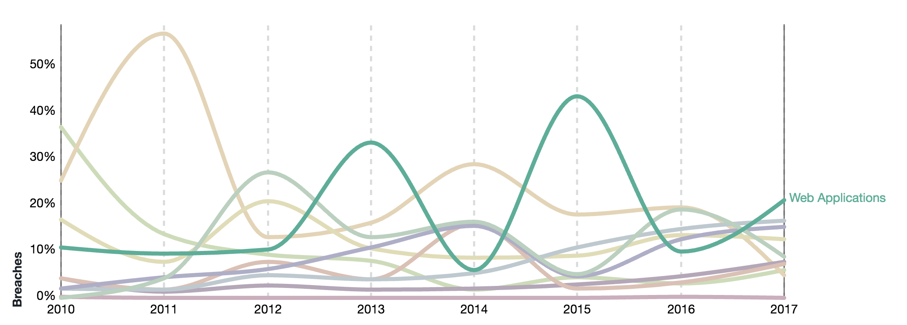
Verizon 2018 Data Breach Investigations Report
Data Breach Patterns
Source: 2018 Data Breach Investigation Report, Verizon, 11th edition 2018
Notes:
We recently went through the 2018 Verizon Data Breach Investigations Report
First. I want to define what a Data Breach is: The incident results in confirmed disclosure of data to an unauthorized party (not just potential exposure) Incident: security event that compromises the confidentiality, integrity or availability of an information asset.
One of the leading data breach patterns is attacks on Web Applications –green line. Brown line is Point of Sale devices. Clearly web apps are an important target. That is one of the reasons we will use a web site in the scenario for this workshop (although the actual threat vector exploited could be done against any server)
Phishing
Drive-by Download
Operating System Exploitation
Misconfigurations
Web Application Attack
Bruteforcing/Password Spraying
Denial of Service

Slide 4







Workshop Scenario
Bare Minimum Architecture for POC
AWS Cloud
VPC
Availability Zone
Public subnet
Users
Internet
Web Server
S3 Bucket
Notes:
So what are we doing in this Workshop?
Think of a hypothetical situation where the engineering team in your org are trying to figure out how to move on-prem applications to the cloud from an existing data center . Your team wants to go ahead with a simple POC
They start with building a bare minimum architecture in AWS with a web server within a VPC that’s hosting a website. Also the webserver uses data that’s stored on an S3 bucket.
In this workshop your job is to put on the hat of a security engineer and use AWS services to figure out the nature of the simulated attack that is occurring and properly remediate the threats
For this Workshop you will setup a single instance in the us-west-2 region. As this was a “lift-and-shift” migration for piloting, you have yet to build redundancy into your application, so you have a single public-facing web server. The web server has access to the Internet Gateway through an Elastic Network Interface.
Customers access your web server through a DNS entry pointing to the Elastic Network Interface. You store static content in an S3 bucket and use the VPC S3 Endpoint Gateway for access from the web server.

Slide 5
Module 1 - Build Detective Controls
Run the AWS CloudFormation template (~5 min.)
Before moving on, make sure the stack status = CREATE_COMPLETE
You will get an email from SNS asking you to confirm the Subscription. Confirm the subscription so you can receive email alerts from AWS services during the Workshop
Manual setup steps (~15 min.)
Notes:
READ SLIDE

Slide 6
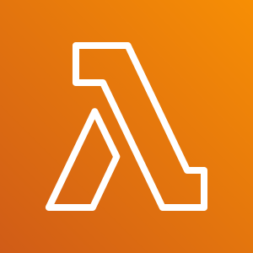




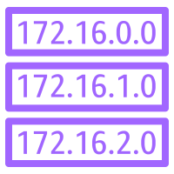






Module 1 - Build Detective Controls
Detect and Investigate
Respond
VPC Flow logs
AWS Lambda
Amazon GuardDuty
Amazon CloudWatch Events
Amazon SNS
DNS Logs
AWS CloudTrail
AWS Security Hub
Security Analyst
Amazon S3
Amazon Macie
Amazon CloudWatch Logs
Amazon Inspector
Notes:
In this what the first cloud formation template in Module 1 is going to create. Ideally these detective controls are already deployed in your production AWS environment.
Explain slide..

Slide 7
Module 1 - Build Detective Controls
Use: US West (Oregon)
us-west-2
https://tinyurl.com/y4l56mh6
Directions:
Browse to URL
Read through the workshop scenario
Follow the instructions to launch the CloudFormation template
Complete the module (~15 min.) and then stop
Note: Do not skip the Manual steps
Notes:
15 mins for this
Use the Oregon region
I will mention once again..
We’ll go fairly quick through this since there is a lot to cover - If not finished with a section before we move on, feel free to keep working and if you have any problems ask one of the facilitators to help
– you will be able to work on this workshop outside of this event at any time
PLEASE FOLLOW DIRECTIONS – esp in the first part on the parameters screen
Timing = 1:30

Slide 8
https://tinyurl.com/y4l56mh6
Use: US West (Oregon)
us-west-2
Do not skip the Manual steps
Module 1: Environment Build ~11:30am
Notes:
~ 1:30
Give some indication that you have completed..
…. Or ask about about 1:25..

Slide 9
Module 2 – Attack Kickoff
Threat detection and response presentation (~30 min.)
Workshop walk-through (~5 min.)
Notes:
Our next module will simulate the actual attack you will be investigating.
Attack and findings need time to run while we go through presentation…

Slide 10

Module 2 – Attack!
Use: US West (Oregon)
us-west-2
https://tinyurl.com/y45rcnkm
Directions:
Browse to URL
Do not move on to Module 3

Slide 11
https://tinyurl.com/y45rcnkm
Use: US West (Oregon)
us-west-2

Slide 12
Threat Detection and Response
Introduction
Notes:
While we wait for the attack to happen and the findings to show up in GuardDuty and Security Hub, we are going to talk about Threat Detection and Response.

Slide 13

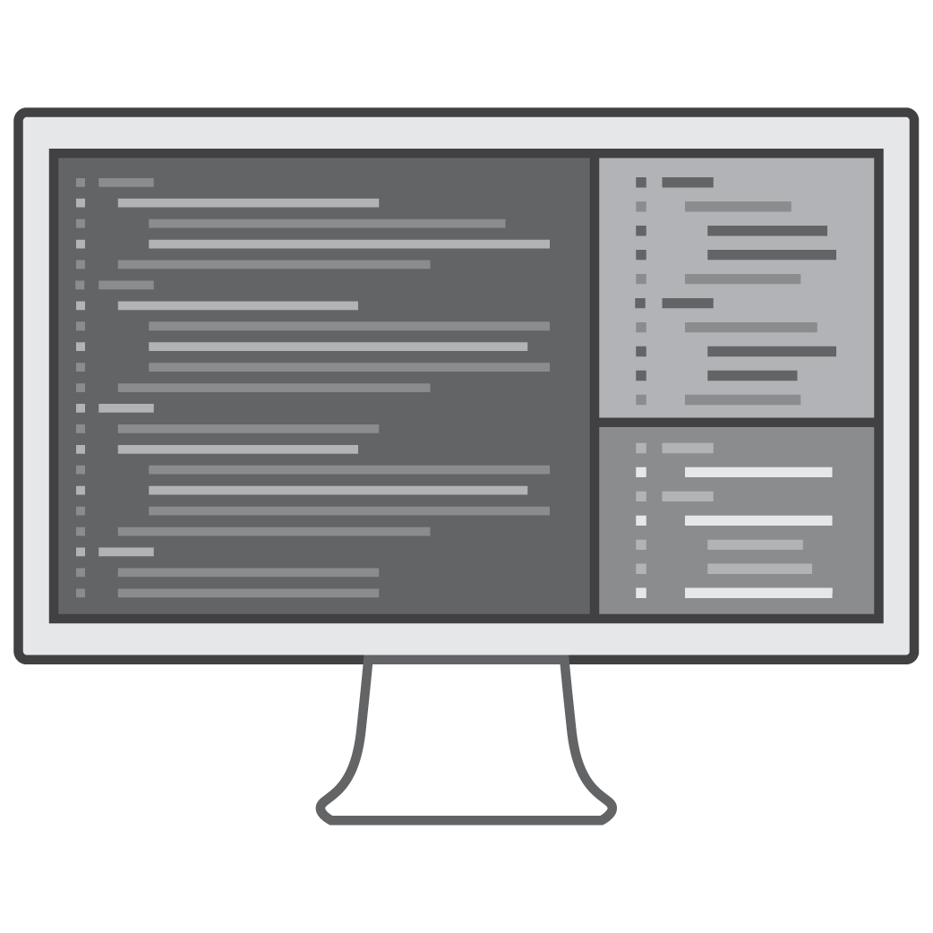

Why is threat detection so hard?
Large datasets
Signal to noise
Skills shortage
Notes:
Threat detection has always been difficult and it is becoming more and more of a challenge.
More connected systems and devices - produce large data sets needing to be analyzed.
Difficult to find the threats in all the data. Alert fatigue from so many notifications and false alarms. What’s really important?
Difficult to find and hire people with the skills needed to interpret all of this data.

Slide 14





Deep Set of Security Tools
Infrastructure Protection
Data Protection
Identity
Detect
Respond
AWS Identity & Access Management (IAM)
AWS Single Sign-On
AWS Directory Service
Amazon Cognito
AWS Organizations
AWS Secrets Manager
AWS Resource Access Manager
AWS Security Hub
Amazon GuardDuty
AWS Config
AWS CloudTrail
Amazon CloudWatch
VPC Flow Logs
AWS Systems Manager
AWS Shield
AWS WAF – Web application firewall
AWS Firewall Manager
Amazon Inspector
Amazon Virtual Private Cloud (VPC)
AWS Key Management Service (KMS)
AWS CloudHSM
AWS Certificate Manager
Amazon Macie
Server-Side Encryption
AWS Config Rules
AWS Lambda
AWS Systems manager
Notes:
Here is good overview of services at AWS that help you secure your environment. Today we are focused on Detection and Response, but I want you to realize there are other service that complement each other to help you.
xxxxx.

Slide 15
AWS Threat Detection Services
Notes:
Use this question to have a discussion in custom threat lists – and threat intelligence in general

Slide 16

Threat Detection: Log Data Inputs
AWS CloudTrail
Flow logs
Amazon CloudWatch
DNS Logs
Track user activity and API usage
IP traffic to/from network interfaces in a VPC
Monitor apps using log data, store & access log files
Log of DNS queries in a VPC when using the VPC DNS resolver
Notes:
AWS logs - data source inputs for a threat detection
Does anyone know of an AWS service that detects threats by analyzing three out of four of the logs? – GuardDuty
CloudTrail provides visibility into user activity by recording actions taken on your account. - Audit
Virtual Private Cloud (VPC) Flow Logs:
Capture information about the IP traffic going to and from network interfaces in your VPC.
Used to monitor the traffic that is reaching your EC2 instances,
With CloudWatch Logs, you can monitor your logs, in near real-time, for specific phrases, values or patterns to create metrics and implement alarms.
DNS Logs are used by GuardDuty as part of the analysis for continuous threat detection and include all DNS queries to the DNS resolver provided within your VPC.

Slide 17
Threat Detection: Machine Learning
Amazon GuardDuty
Amazon Macie
Intelligent threat detection and continuous monitoring to protect your AWS accounts and workloads
Machine learning-powered security service to discover, classify & protect sensitive data
Notes:
AWS security services, GuardDuty and Macie, use the power of machine learning to detect threats.
GuardDuty continuously monitors for malicious or unauthorized behavior to help you protect your AWS accounts and workloads.
It uncovers activity such as unusual API calls or potentially unauthorized deployments that indicate a possible account compromise. It also detects potentially compromised instances and reconnaissance by attackers.
GuardDuty analyzes billions of events across AWS accounts for signs of risk.
Macie:
Helps you better understand where sensitive information is stored
Shows you how your data is being accessed, including user authentications and access patterns
Macie’s user behavior analytics can also identify indications of compromise

Slide 18



Threat Detection: AWS Security Hub – In Preview
Comprehensive view of your security and compliance state within AWS
Aggregates security findings generated by other AWS security services and partners
Analyze security trends and identify the highest-priority security issues
Insights
&
Standards
AWS Security Hub
Findings
Security
findings
providers
Amazon
Inspector
Amazon
GuardDuty
Amazon
Macie
AWS
Config
Partner Solutions
Other
Notes:
Standard: Collection of rules based on the AWS and security industry best practices. For example, Security Hub supports the CIS AWS Foundations Benchmark standard.
Finding: potential security issue detected a provider.
Insight: consolidation of findings - identifies a security area that requires attention or intervention. An
insight provides a prescriptive, actionable view on a particular area of your AWS security state and
enables you to address it. An insight is defined by a combination of specific attributes (filters) that
are applied to all of your existing Security Hub aggregated findings. The result is a particular subset of
your Security Hub aggregated findings that are included in this insight.
Security findings provider: service that generates security findings. Security Hub aggregates security findings generated
by the following supported AWS services:

Slide 19
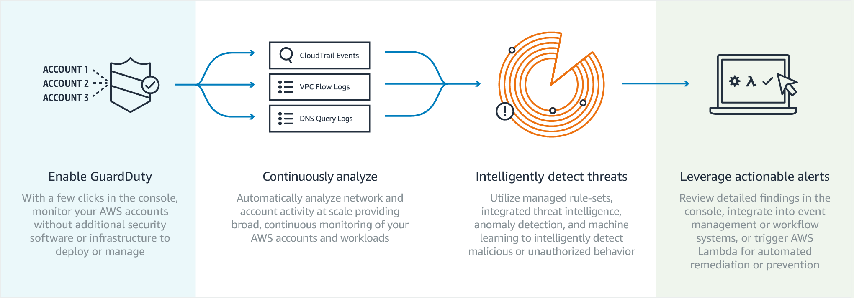
Threat Detection: Amazon GuardDuty
Notes:
You can easily enable GuardDuty in the console and authorize it to monitor your accounts without additional security software or infrastructure to deploy or manage.
It can analyze and correlate billions of events from CloudTrail, VPC Flow Logs, and DNS Logs across all of your associated AWS accounts.
Performs continuous monitoring using managed rule-sets, integrated threat intelligence, anomaly detection, and machine learning to detect malicious or unauthorized behavior.
Review details findings in the console, integrate into event management or workflow systems, or trigger Lambda for automated remediation or prevention.

Slide 20
Threat Detection: Evocations/Triggers
AWS Config
Amazon CloudWatch Events
Continuously tracks your resource configuration changes and if they violate any of the conditions in your rules
Delivers a near real-time stream of system events that describe changes in AWS resources
Notes:
Config Rules and CloudWatch Events can both be used to trigger automated threat response.
Highlights:
Cloudwatch event timing vs Cloudtrail and use cases
Config multi-region, multi-account
A Config Rule represents desired configurations for a resource and is evaluated against configuration changes recorded by AWS Config.
Use Config Rules to assess overall compliance and risk status from a configuration perspective,
View compliance trends over time and pinpoint which configuration change caused a resource to drift out of compliance with a rule.
CloudWatch becomes aware of changes as they occur for near real-time response
Take corrective action by activating functions, making changes, and capturing state information.

Slide 21
What Can Amazon GuardDuty Detect?
Connect to blacklisted site
Anonymizing proxy
Malicious or
suspicious IP
Unusual ISP caller
Unusual traffic volume
RDP brute force
RAT Installed
Exfiltrate data over DNS
Probe API with temp creds
Attempt to compromise account
Bitcoin activity
Recon
DNS exfiltration
Unusual ports
Unusual instance launch
Temp credentials
used off-instance
Notes:
GuardDuty can help identify potentially malicious activity throughout an attack lifecycle
Starting with reconnaissance & infiltration, whether a user was Phished or credentials leaked, once in, attackers commonly work to:
connect to the network, anonymize their access, and deploy their Remote Access Trojan to establish a back door to command & control.
Then, more reconnaissance to figure out what’s there - get user lists, scout targets, and find vulnerabilities.
Lateral movement looking for ways to access instances with credentials that provide more privileged access.
Mission target - access to transfer critical data to an external location.
In the weeds…

Slide 22
Attacker Lifecycle - Stages
Reconnaissance
Escalate Privileges
Maintain Persistence
Establish Foothold
Internal Reconnaissance
Notes:
Live Role Playing DemoGuardDuty can help identify potentially malicious activity throughout an attack lifecycle
Starting with reconnaissance & infiltration, whether a user was Phished or credentials leaked, once in, attackers commonly work to:
connect to the network, anonymize their access, and deploy their Remote Access Trojan to establish a back door to command & control.
Then, more reconnaissance to figure out what’s there - get user lists, scout targets, and find vulnerabilities.
Lateral movement looking for ways to access instances with credentials that provide more privileged access.
Mission target - access to transfer critical data to an external location.
In the weeds…

Slide 23
Attacker Lifecycle - Attacker Actions
RDP brute force
RAT Installed
Exfiltrate data over DNS
Probe API with temp creds
Attempt to compromise account
Notes:
Live Role Playing DemoGuardDuty can help identify potentially malicious activity throughout an attack lifecycle
Starting with reconnaissance & infiltration, whether a user was Phished or credentials leaked, once in, attackers commonly work to:
connect to the network, anonymize their access, and deploy their Remote Access Trojan to establish a back door to command & control.
Then, more reconnaissance to figure out what’s there - get user lists, scout targets, and find vulnerabilities.
Lateral movement looking for ways to access instances with credentials that provide more privileged access.
Mission target - access to transfer critical data to an external location.
In the weeds…

Slide 24
Attacker Lifecycle - Amazon GuardDuty Findings
Connect to blacklisted site
Anonymizing proxy
Malicious or
suspicious IP
Unusual ISP caller
Unusual traffic volume
RDP brute force
RAT Installed
Exfiltrate data over DNS
Probe API with temp creds
Attempt to compromise account
Bitcoin activity
Recon:EC2/PortProbeUnprotectedPort
DNS exfiltration
Unusual ports
Unusual instance launch
Temp credentials
used off-instance
Notes:
GuardDuty can help identify potentially malicious activity throughout an attack lifecycle
Starting with reconnaissance & infiltration, whether a user was Phished or credentials leaked, once in, attackers commonly work to:
connect to the network, anonymize their access, and deploy their Remote Access Trojan to establish a back door to command & control.
Then, more reconnaissance to figure out what’s there - get user lists, scout targets, and find vulnerabilities.
Lateral movement looking for ways to access instances with credentials that provide more privileged access.
Mission target - access to transfer critical data to an external location.
In the weeds…

Slide 25
Respond
Notes:
Use this question to have a discussion in custom threat lists – and threat intelligence in general

Slide 26
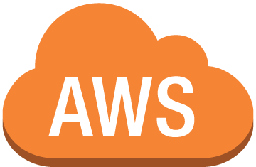
Threat Response: Amazon CloudWatch Events
Partner solutions
Amazon GuardDuty findings
Automated response
Lambda function
Anything
else
Amazon CloudWatch Events
Notes:
CloudWatch Events delivers a near real-time stream of system events that describe changes in your AWS resources.
Using simple rules that are quick to set up, you can match events and route them to one or more target functions or streams.
Respond to changes, take corrective action by sending messages to activate functions, make changes, capture state information and
pass notifications to collaboration and communication tools.
This example shows a GuardDuty finding, but it could just as easily be a Macie event.

Slide 27

Threat Response: Services
Amazon
Inspector
AWS
Lambda
AWS Systems Manager
Run code for virtually any kind of application or backend service – zero administration
Gain operational insights and take action on AWS resources
Automate security assessments of Amazon EC2 instances
Notes:
Automate your threat remediation with these AWS services.
Lambda:
Add prevention mechanisms to security boundary services
WAF, Security Groups, S3 bucket policies
Invoke deeper inspection of the AWS estate
Systems Manager, Inspector
Systems Manager:
Proactively mitigate threats at instance level
Patching system
Amazon Inspector
Automated security assessment service
Helps improve the security and compliance of applications deployed on AWS.

Slide 28

Threat Response: High-Level Playbook
Adversary or intern
Your environment
CloudWatch Events
Lambda function
Notes:
Anyone can have an ‘intern moment’ and the explanation often starts with, “I was in a hurry to meet a deadline…”

Slide 29


Threat Response: Detailed Playbook
AWS CloudTrail
Team collaboration
(Slack, etc.)
AWS Security Hub
Detect
Investigate
Respond
VPC Flow Logs
Amazon CloudWatch
Events
Lambda function
AWS APIs
Amazon
GuardDuty
Amazon Macie
Amazon
Inspector
AWS Config
Notes:
CloudWatch metrics provide details about every incident.
Automate the addition of the bad IPs as indicated by Shield to add to blacklists elsewhere (WAF, VPC or your own Data Center)
advantage of the cloud is having the ability to capture automated events and notifications of changes to your infrastructure.
You can then feed those changes to a Lambda function.
This Lambda function could do any number of things such as Detection, Alerting, Remediation, Countermeasures, or Forensics.
By having the ability to pull together these changes in configuration information and act upon them allows you to ensure you have your security policies are automated from beginning to end and have continuous insight into your environment.

Slide 30
Workshop Walk-thru
Notes:
Use this question to have a discussion in custom threat lists – and threat intelligence in general

Slide 31
Module 2 - Attack Target
AWS Cloud
VPC
Availability Zone
Public subnet
Users
Internet
Web Server
S3 Bucket
Notes:
So what are we doing in this Workshop?
Think of a hypothetical situation where the engineering teams in your org are trying to figure out how to move on-prem applications to the cloud from an existing data center . Your team wants to go ahead with a simple POC
They starts with building a bare minimum architecture with a web server within a VPC that’s hosting a website. Also the webserver uses data that’s stored on an S3 bucket.
In this lab your job is to put on the hat of a security engineer and use AWS services to figure out the nature of the attack that is occurring and properly remediate the threats
For this Workshop you will have a single instance setup in the us-west-2 region. As this was a “lift-and-shift” migration for piloting, you have yet to build redundancy into your application, so you have a single public-facing web server. The web server has access to the Internet Gateway through an Elastic Network Interface. Customers access your web server through a DNS entry pointing to the Elastic Network Interface. You store static content in an S3 bucket and use the VPC S3 Endpoint Gateway for access from the web server.
For this Workshop you will have a simple setup with a single instance setup in the us-west-2 region. As this was a “lift-and-shift” migration for piloting, you have yet to build redundancy into your application, so you have a single public-facing web server that is accessed through an internet gateway and retrieves static content from an S3 bucket.

Slide 32

Module 2 - Setup
Environment
Detect and Investigate
Respond
AWS Cloud
VPC Flow logs
VPC
AWS Lambda
Amazon GuardDuty
Amazon CloudWatch Events
Availability Zone
Public subnet
DNS Logs
Amazon SNS
AWS CloudTrail
AWS Security Hub
Web Server
Security Analyst
Amazon S3
Amazon Macie
Bucket
Amazon CloudWatch Logs
Amazon Inspector
Notes:
An attack is about to occur

Slide 33


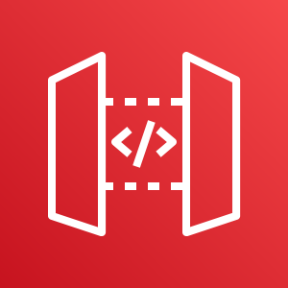
Module 2 - The Attack
AWS Cloud
VPC
Availability Zone
Public subnet
Internet
Malicious Host
AWS Cloud
Amazon EC2
Compromised Instance
Amazon API Endpoints
Bucket
Notes:
We are going to fill this in after we discover what happened during the attack - in the next module

Slide 34
Workshop questions – #1
Which of the following AWS services have direct access to your Amazon EC2 instances?
What performance impact does GuardDuty have on your account if you have more than 100 VPCs?
How do you kick off notifications or actions based on events in GuardDuty?
What is the difference between Macie and GuardDuty?
Notes:
Inspector and Systems Manager
None, since GuardDuty processes the VPC Flow Logs, CloudTrail Logs and DNS Logs outside of your account, enabling GuardDuty. has no impact to your account regardless of the number of VPCs (correct)
GuardDuty automatically sends logs to CloudWatch events. Create a CloudWatch event rule with a target such as SNS or Lambda. (correct)
Macie looks at a subset of the data (S3) and management API calls and GuardDuty looks at management API calls, VPC Flow log and DNS logs. (correct)
Timing 2:15 –latest

Slide 35

Module 3 – Detection and Response
Use: US West (Oregon)
us-west-2
https://tinyurl.com/yxcvvprj
Directions:
Browse to URL
Run through the module (~45 min.)
Notes:
45 mins
Use the Oregon region
Timing = 3:00
We are going to Detect, investigate and respond to the attack!

Slide 36
https://tinyurl.com/yxcvvprj
Use: US West (Oregon)
us-west-2

Slide 37
Review, Questions, and Cleanup
Notes:
Use this question to have a discussion in custom threat lists – and threat intelligence in general

Slide 38
Module 5 - What happened?
Review (5 min.)
Questions (10 min.)
Cleanup

Slide 39

Module 5 - What happened?
Use: US West (Oregon)
us-west-2
https://tinyurl.com/yywsbgcd
Directions:
Browse to URL
We will do a summary of the workshop then questions
Account cleanup instructions are toward the end of the page
Notes:
45 mins
Use the Oregon region

Slide 40
https://tinyurl.com/yywsbgcd
Use: US West (Oregon)
us-west-2
Module 4: Discussion

Slide 41
Scenario Discussion
Notes:
Use this question to have a discussion in custom threat lists – and threat intelligence in general

Slide 42
Module 4 - The Attack
AWS Cloud
VPC
Availability Zone
Public subnet
SSH Brute Force Attack
1
2
Internet
Amazon EC2
Compromised Instance
AWS Cloud
Malicious Host
4
API Calls
Amazon API Endpoints
3
Bucket Changes
Bucket
Notes:
There are two EC2 instances created by the Module 2 CloudFormation template.
The Malicious Host represents the attacker which we pretend is on the Internet.
The Elastic IP on the Malicious Host is in a custom threat list in GuardDuty. The other instance named Compromised Instance represents the web server that was lifted and shifted into AWS.
Although company policy is that only key-based authentication should be enabled for SSH, at some point password authentication for SSH was enabled on the Compromised Instance. This misconfiguration is identified in the Inspector scan that is triggered from the GuardDuty finding.
The Malicious Host performed a brute force SSH password attack against the Compromised Instance. The brute force attack is designed to be successful.
The SSH brute force attack was successful and the attacker was able to log in to the Compromised Instance.
The EC2 Instance that is created in the Module 2 CloudFormation template disabled default encryption on the Data bucket. In addition the CloudFormation template made the Data bucket public. This is used for the Macie part of the investigation in Module 3. We pretend that the attacker made the bucket public and removed the default encryption from the bucket.
The Compromised Instance also has a cron job that continuously pings the Malicious Host to generate a GuardDuty finding based off the custom threat list.
The API Calls that generated the API findings come from the Malicious Host. The calls use the temp creds from the IAM role for EC2 running on the Malicious Host. The GuardDuty findings are generated because the EIP attached to the Malicious Host is in a custom threat list.
A number of CloudWatch Events Rules are evoked by the GuardDuty findings and then these trigger various services.

Slide 43
Module 4 - What really happened?
The Attack
Detect and Investigate
Respond
AWS Cloud
VPC
VPC Flow logs
AWS Lambda
Availability Zone
Amazon CloudWatch Events
Elastic IP in custom Threat List
Amazon GuardDuty
Public subnet
Public subnet
DNS Logs
Amazon SNS
1
2
SSH Brute Force Attack
Malicious Host
Compromised Instance
AWS CloudTrail
AWS Security Hub
Subnet 1
Subnet 2
Security Analyst
3
4
Amazon S3
Amazon Macie
5
Bucket Changes
API Calls
Inspector assessment
Amazon API Endpoints
Amazon CloudWatch Logs
Amazon Inspector
Amazon Inspector
Bucket
Notes:
Attack Recap
1. Module 2 CloudFormation template creates two EC2 instances. They are in the same VPC but different subnets. The Malicious Host represents the attacker which we pretend is on the Internet. The Elastic IP on the Malicious Host is in a custom threat list in GuardDuty (in order to generate . The other instance named Compromised Instance represents the web server that was lifted and shifted into AWS.
2. Although company policy is that only certificate authentication should be enabled for SSH, at some point password authentication for SSH was enabled on the Compromised Instance
3. The Malicious Host performed a brute force SSH password attack against the Compromised Instance. The brute force attack is designed to be successful
4. The SSH brute force attack was successful and the attacker was able to log in to the Compromised Instance
5. We pretend here that the attacker then copied the temp credentials (that came from IAM Role for EC2) from the instance to an S3 bucket - in reality the API calls from the Malicious Host use the temp creds from the IAM Role for EC2 attached to the Malicious Host
6. The CloudFormation template that we ran in Module 2 enables encryption for the Data bucket and then the EC2 instance removes the encryption. In addition the CloudFormation template made the Data bucket public. This is used for the Macie part of the investigation in Module 3. We pretend that the attacker made the bucket public and removed the default encryption from the bucket.
7. The API Calls that generated the API findings come from the Malicious Host. The calls use the temp creds from the IAM role for EC2 running on the Malicious Host. The GuardDuty findings are generated because the EIP on the Malicious Host is in a custom threat list.

Slide 44
Questions
Notes:
Use this question to have a discussion in custom threat lists – and threat intelligence in general

Slide 45
Workshop questions – #2
The lab mentions you can ignore the high-severity SSH brute force attack finding. Why?
Why did the API calls from the “malicious host” generate GuardDuty findings?
What is required for CloudWatch logs to capture evidence to help investigate an SSH Brute force attack?
What key remediation step was missed regarding the SSH brute force attack?
Notes:
This was a side effect of the attack simulation since the “malicious host” is actually running in the same VPC as the compromised instance. (correct)
The Public IP of the “malicious host” was added to a custom threat list in GuardDuty so certain API calls from that EC2 instance will generate findings. (correct)
CloudWatch agent (correct)
Password authentication for SSH access was not disabled

Slide 46
Workshop questions – #3
Originally the bucket involved in the workshop had default encryption using SSE-S3 (server side encryption with S3-managed keys). If the bucket had a bucket policy that allowed global read access, would the encrypted objects have been accessible at the start of the workshop?
How does your answer to the previous question change after default encryption using SSE-KMS (server side encryption with KMS-managed keys) was enabled on the bucket (assuming all the objects were encrypted)?
Notes:
Yes, since the bucket initially had SSE-S3, the objects would have been accessible. (correct)

Slide 47

Notes:
LiveSlide https://ql.tc/xfTj8e

Slide 48
Wrap Up - Lessons Learned From Incident Response
Use a strong tagging strategy!!!
How are my AWS resources classified?
Ownership?
Where does this instance come from?
What is the purpose of this instance?
Which account is this?
What to prioritize?

Slide 49
Wrap Up - Lessons Learned From Incident Response
Questions to ask during the investigation
Who or what is causing this finding?
Internal or external?
How long has this been going on?
Is this the first time I've seen it?
Source of the Intel?
What is the risk to my environment?

Slide 50
Wrap Up - Lessons Learned From Incident Response
Enrich GuardDuty and get the full picture of your environment
- Network intrusion detection
- Firewall alerts
- WAF alerts
- Identity (UBA)
- Endpoint & compute events (AV, EDR,)
- OS level Information
- Application level logs
Centralize GuardDuty findings into a SIEM

Slide 51


Workshop questions – AWS Security Hub
We use AWS Security Hub to investigate the threat. Is AWS Security Hub a detect or response service (or both – or other)?
https://www.nist.gov/cyberframework
Identify
Protect
Detect
Respond
Recover
AWS Systems Manager
AWS Config
AWS Systems Manager
Amazon Inspector
VPC
AWS KMS
AWS CloudHSM
IAM
AWS CloudTrail
AWS Config Rules
Amazon Macie
Amazon GuardDuty
AWS Config Rules
AWS Lambda
AWS Systems Manager
Amazon CloudWatch Events
Pro Services AERO
AWS Disaster Recovery and Backup Solutions

Slide 52
Workshop questions – Amazon Simple Storage Service (Amazon S3) & Macie
Macie had an alert for “S3 Bucket IAM policy grants global read rights.” We investigated that bucket in the workshop. Were the objects in the bucket actually publicly accessible?
What remediation step did we miss for the data Amazon S3 bucket?
Notes:
Answer to 2 is that all the objects were not encrypted by setting default encryption

Slide 53
Workshop question – Amazon S3 & Encryption
What type of server-side encryption was originally used to encrypt the objects in the data bucket?
Would Macie be able to classify the objects in the data bucket if they were encrypted using AWS Key Management Service (AWS KMS) server-side encryption?
If the bucket had a bucket policy that allowed global read access, would the encrypted objects be accessible?
Notes:
3rd is the BIG PRIZE QUESTION

Slide 54
Cleanup
If you haven’t already please do the Cleanup section of Module #5
Notes:
If you haven’t already please do the Cleanup section of Module #4

Slide 55

Scaling Threat Detection and Response in AWS
After Workshop Survey
http://bit.ly/2ObhuZ4

Slide 56
Useful links
https://aws.amazon.com/security/
https://www.verizonenterprise.com/resources/reports/rp_DBIR_2018_Report_en_xg.pdf
https://www.nist.gov/cyberframework
https://d0.awsstatic.com/whitepapers/AWS_CAF_Security_Perspective.pdf
https://aws.amazon.com/security/penetration-testing/

Slide 57
Design Guide Lines
Use Dots for List elements
Alternate Dots and Dashes
Font info
Arial
Color: White
Content: In Arial
Titles: Arial Bold
Content should be Left aligned
No Center aligned text
Avoid Clipart

Slide 58
Everything and Anything Startups Need to Get Started on AWS
aws.amazon.com/activate

