Slide 1


Accessing Spotify Via Python SSIE-500
Team:
Ruhul Amin Haque
Do Hoon Yong
MD Ehsan Khan
Travis Allen

Slide 2
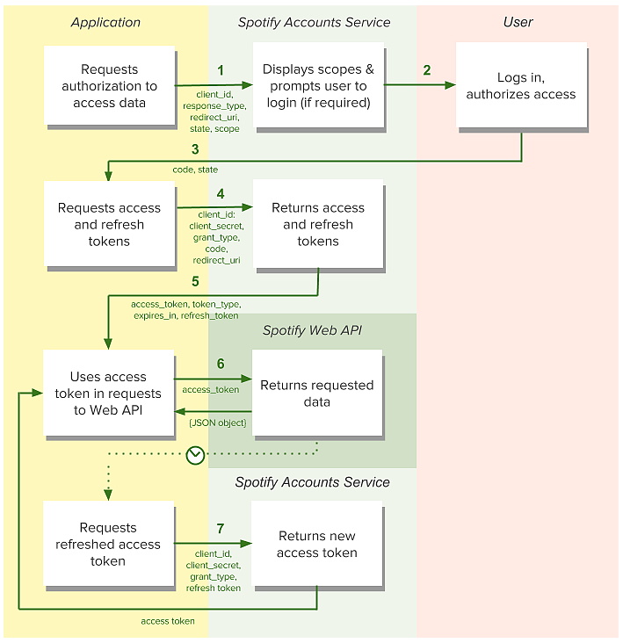
https://developer.spotify.com/web-api/authorization-guide/

