Slide 1
NuBasic
An interpreter OS by Ryan Harding
Based on the Personal OS by Khan Shaikhul Hadi

Slide 2
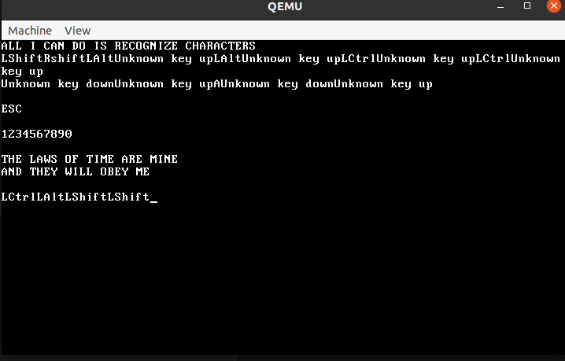
OS v1 Base
Bootloader
Interrupts
Keyboard Logic
Screen Logic
Simple Kernel Printing Characters to Screen

Slide 3
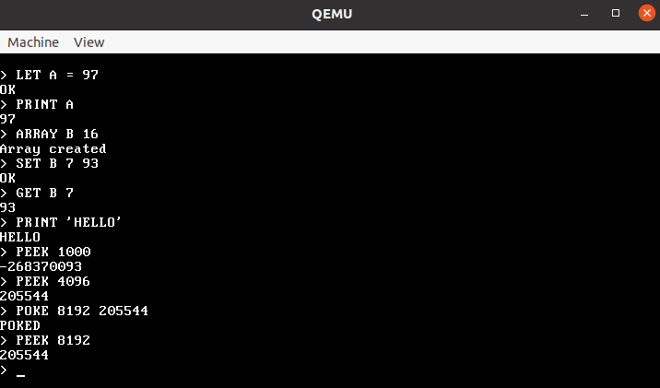
OS v2: NuBasic
Reworked Keyboard Logic
Proper Shell
Simple Bitmapped Memory with Heap
Single Command Execution
Peeks and Pokes
Integer variables and arrays (Single character ID)
Printing
Clearscreen, Reset, and Shutdown

Slide 4
OS Hierarchy
Boot : Bootloader (Unchanged)
CPU: CPU Logic and Interrupts (Unchanged)
Drivers: Keyboard and Screen Drivers (Updated)
Interpreter: Simple Code Parsing and Execution (New)
Kernel: Kernel and Shell (New)
Libc: Library functions (Updated)
Memory: Memory Management (New)

Slide 5
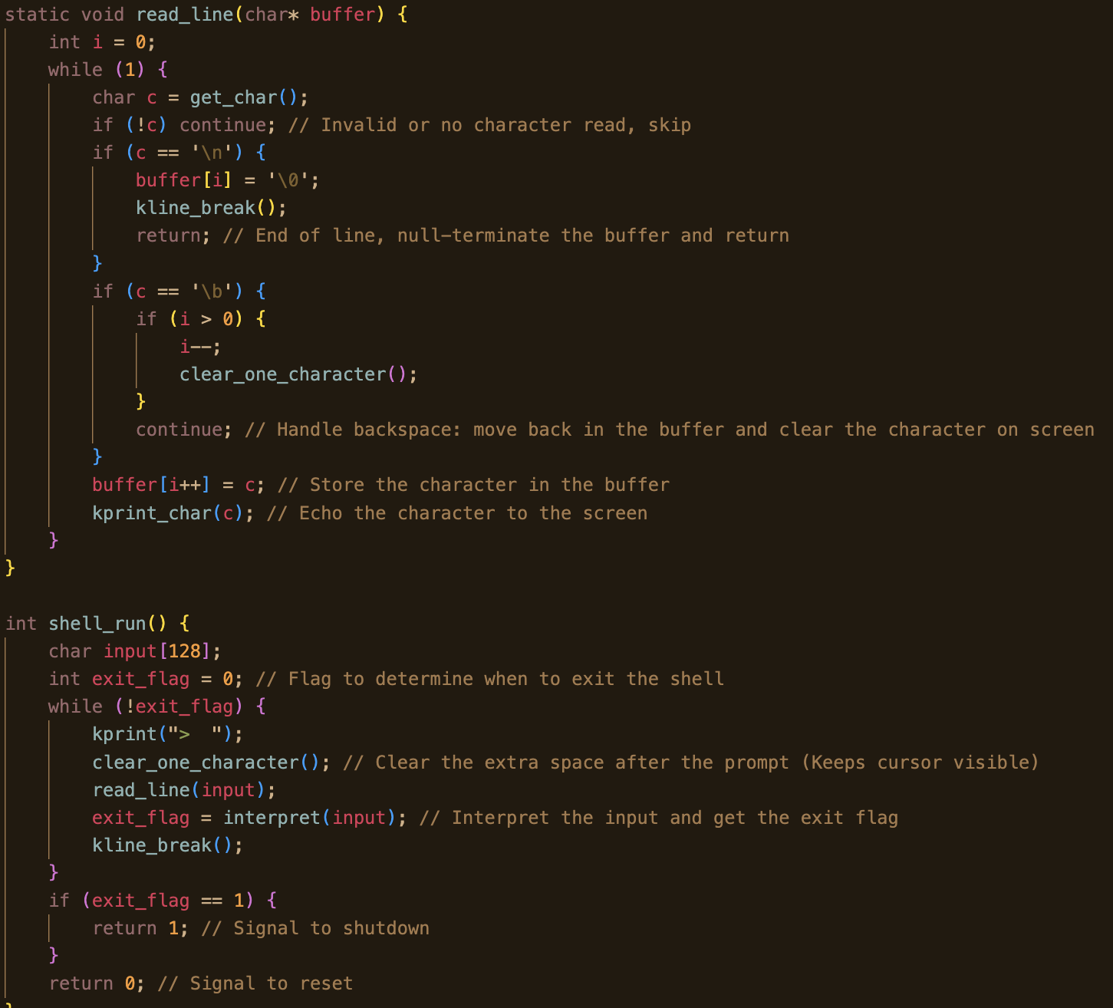
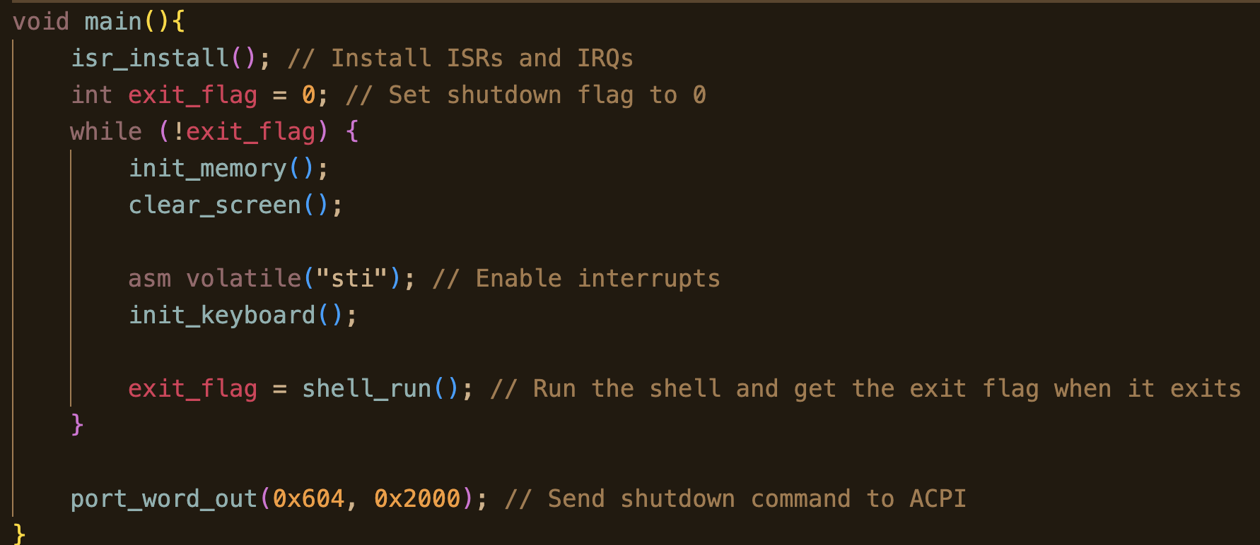
Kernel and Shell

Slide 6
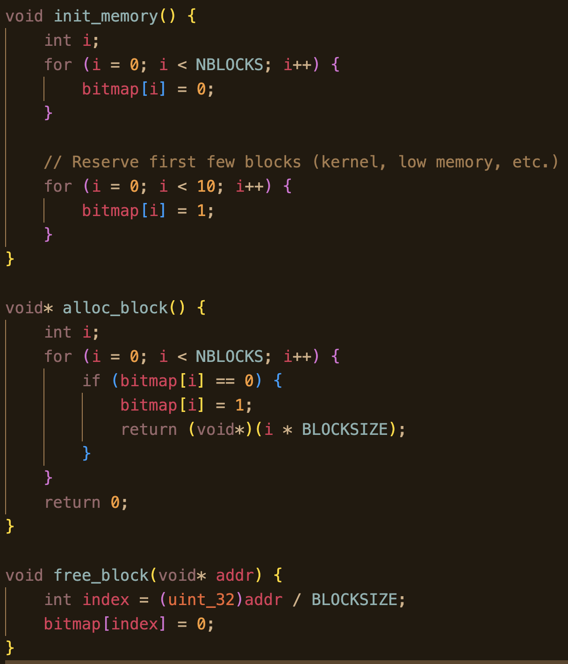
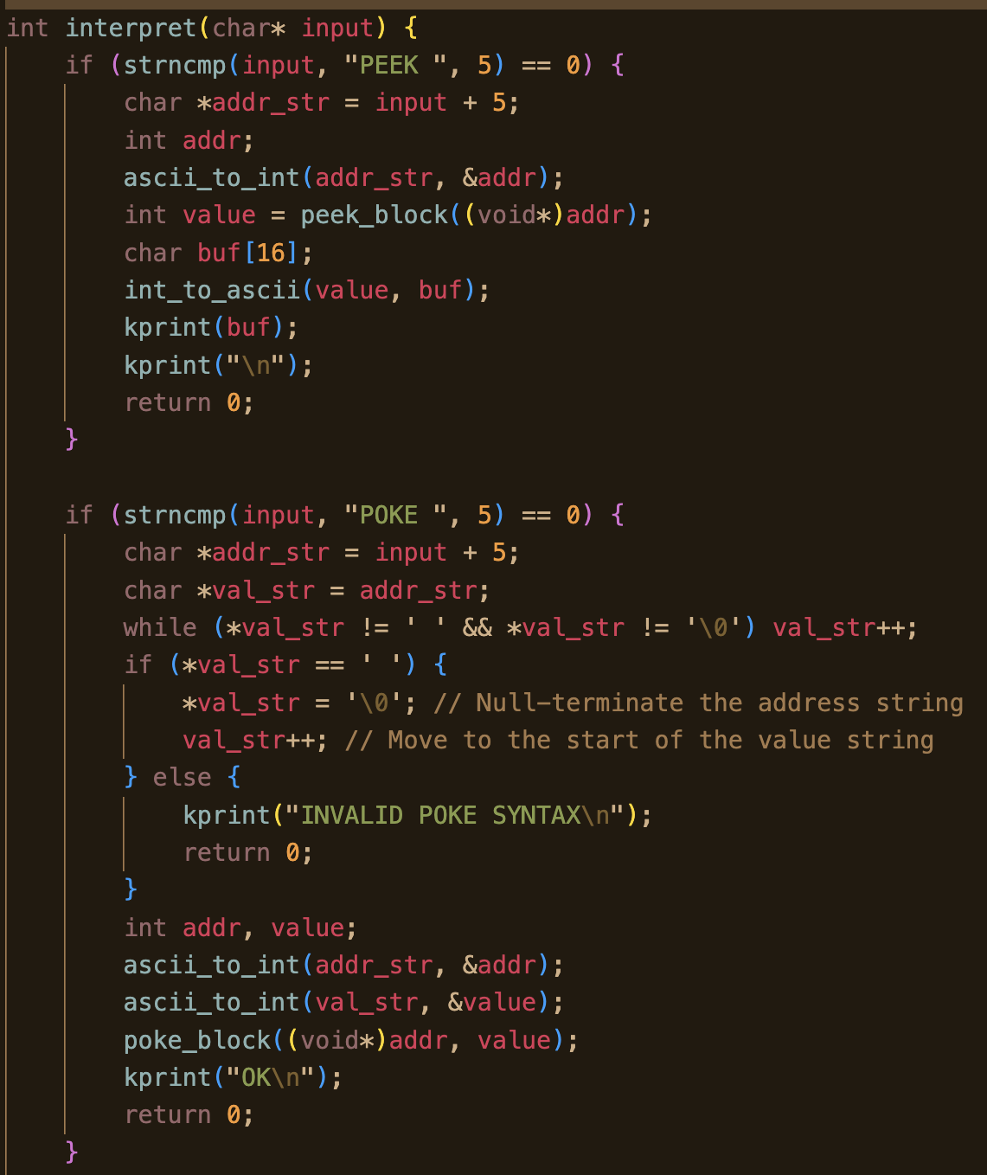
Interpreter and Memory

Slide 7
Demo
Switching to Bulky Other Laptop

Slide 8
Future Work/Stretch Goals Before Due Date
Finish Syntax/Error Enforcement
Memory protection
Make compilation process easier and portable

Slide 9
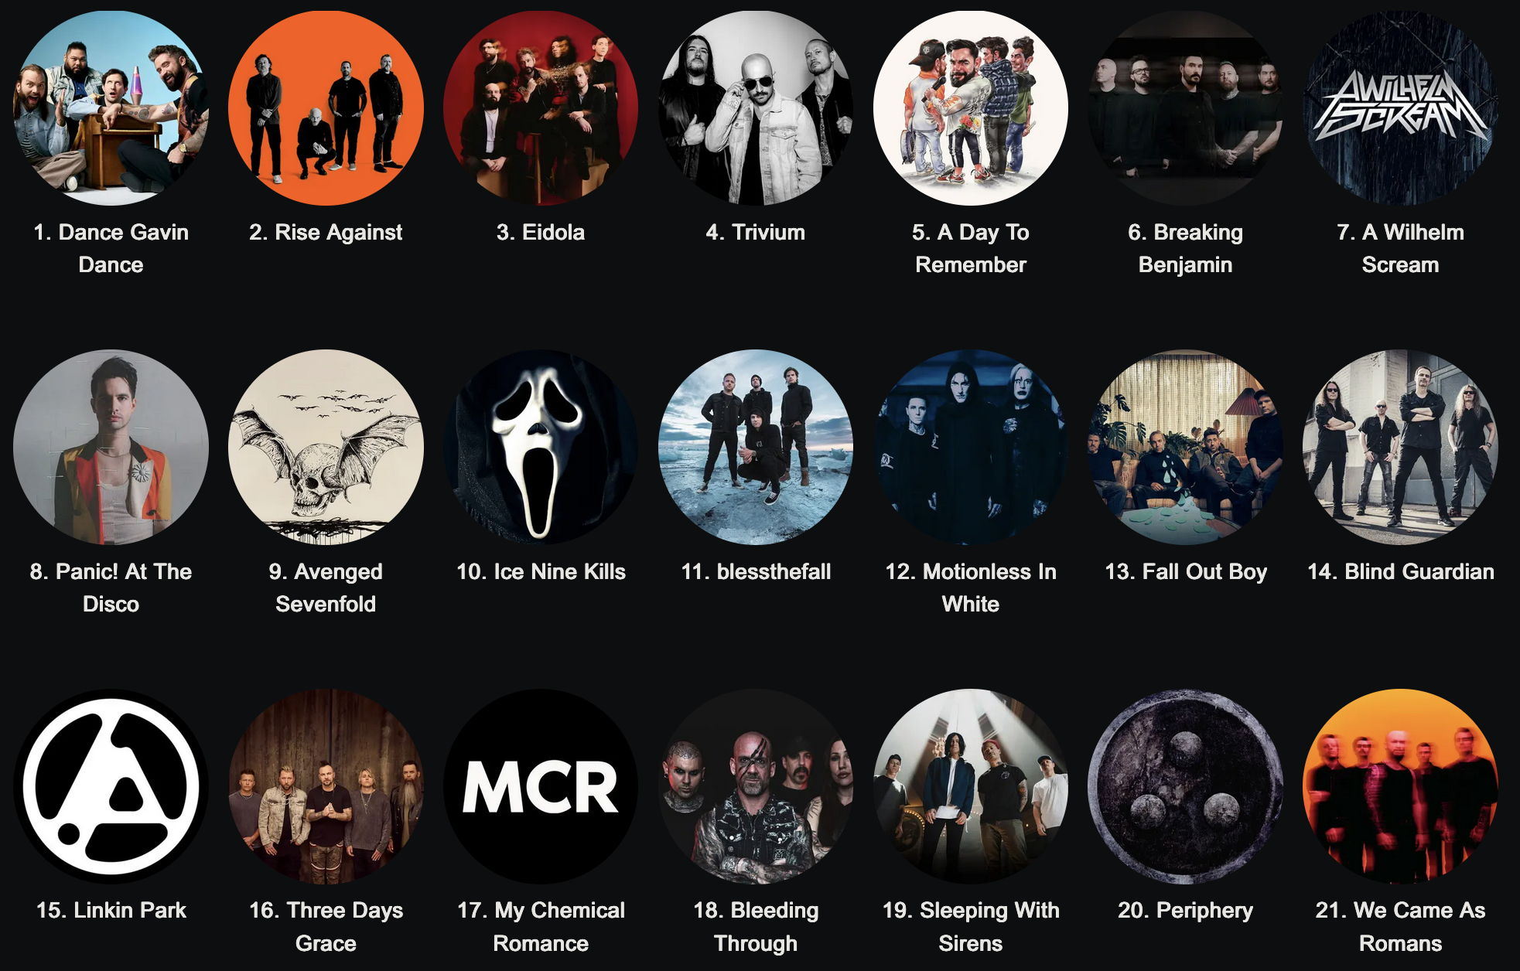
Special Thanks: My Most Listened To Bands This Semester

Slide 10
Git Repo
https://github.com/rharding8/PersonalOSv2

