Slide 1
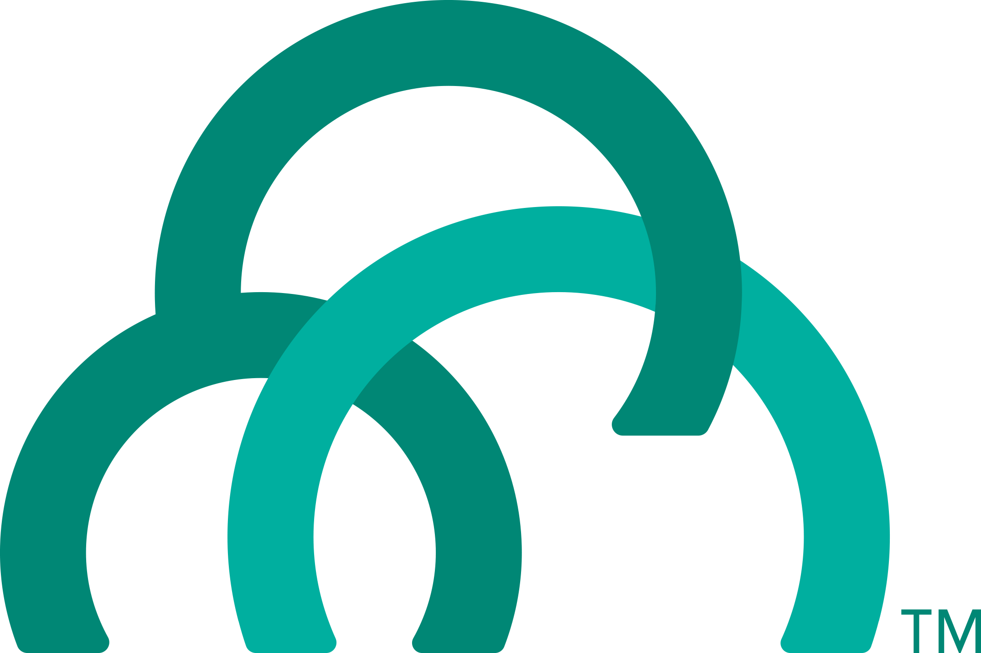
Introduction to
Cloud Foundry Architecture
Ben Bertka / Platform Architect
bbertka@pivotal.io / @P3Geek
Notes:
Platforms
PaaS
Microservices
Cloud Native

Slide 2
The Whole Stack
Notes:
Now you have seen for your selves how easy it is to relive ITOPS from the burdon of managing so many apps! You know know first hand how to better utilize your developer talent to maximize innovation.
So what’s going on under the hood?
The elastic runtime is where apps are pushed, staged, deployed, and managed.
BOSH is used for the orchestration of the entire system.
High availability comes in several flavors too.
Now lets discover together how elegant of a solution PCF really is!
--
You should never give this presentation to folks who have not seen a basic CF demo. You want to use the push of an app, with a service binding (i.e. spring-music) as the backstory for this deck.
The story line for this deck is:
you’ve seen us deploy and scale and app; we want to show you how it’s done.
This deck is intended to instill confidence in our customers, that they can trust their application to our platform. Cloud foundry is implemented with well understood patterns for distributed, web-based computing that result in extreme scalability and resilience. We know cloud and distributed systems.
We have two main layers:
The part that runs your apps (the elastic runtime)
And a whole ‘nother, kickass system, BOSH, that manages the elastic runtime and services
Let’s see how the elastic runtime deploys your app, supports service bindings and scales your app.
Let’s then see how BOSH deploys clusters, such as the elastic runtime, and services.
BUT that’s not all! Now show that the platform does SO much more than just deploy apps or clusters. → The four levels of HA.
Point out similarity of patterns between the ERS and BOSH. These are some of the patterns for distributed systems. This instills confidence.

Slide 3


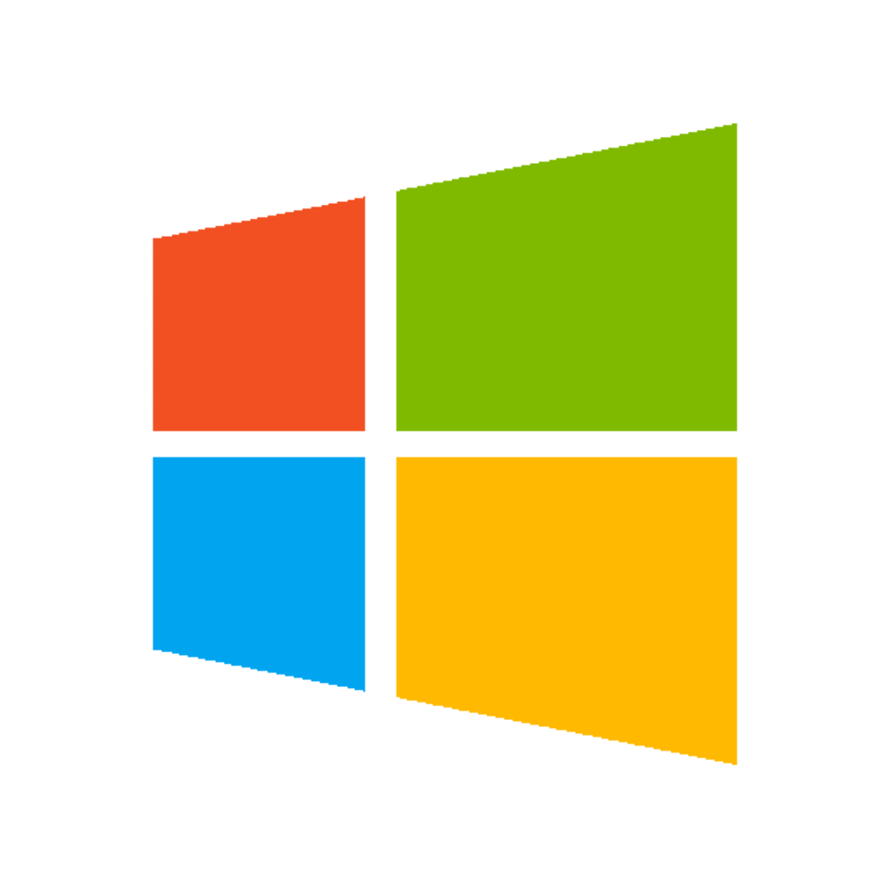
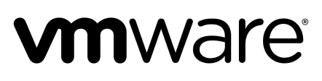

A Multi-Cloud Platform: Cloud Foundry
Jenkins Service
(CI)
Elastic
Container
Runtime
Agile Microservices
Redis
MySQL
Rabbit MQ
DataStax
Cassandra
Elastic managed runtime service integrated into leading data services; all scaled and managed by CF BOSH
Cloud Foundry BOSH
Multi-Cloud Declarative Service Deployment, Operations
Azure
Notes:
Here we have a birds eye view of PCF
-- Deployed over your favorite IaaS solution is our Elastic Runtime – a set of microservices that defines PCF
-- Several application services are integrated into the platform like Jenkins, Messaging, Caching, Hadoop, etc, the list is always growing!
-- The deployment is managed by OSS Cloud Foundry BOSH which we simplify via Ops Manager, a web based management interface
----
When I can, I like to whiteboard this picture – interactive.
Start with the elastic runtime
Managed by BOSH
IaaS agnostic
Other services/clusters managed by BOSH – KV Store, … and even partners, i.e. Jenkins.

Slide 4

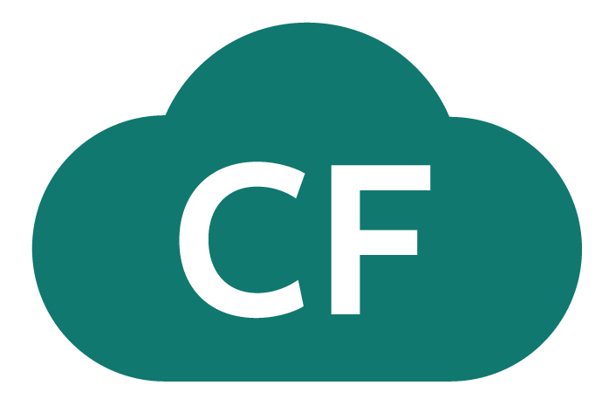
D e m o
Notes:
Show pushing Apps (Scale Demo, and Spring Music)
Autoscaling
Bind Services (SQL, then Mongo) Value of using Spring Boot

Slide 5
Elastic Container Runtime
Technical Drill Down
Notes:
Now dive into the ERS
http://docs.pivotal.io/pivotalcf/concepts/architecture/

Slide 6

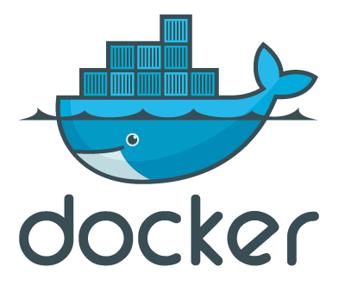
Pivotal Cloud Foundry
Login Server
OAuth 2.0 Server (UAA)
Platform Access
Ops Manager
Ops Manager UI
Elastic Container Runtime
Ops Manager Director
Cloud Controller
Blobstore
Brain
Operations Manager
CELL
CELL
Auctioneer
Service
Rep
Exec.
Rep
Exec.
Converger
Service Broker
Service Nodes
Garden
.NET
Dynamic Router
BBS
Service
Metron Agent
etcd
Service
Metron Agent
Service Broker
Loggregator
Container Access
Service Nodes
Logging / Metrics
Application
Access
Traffic Controller
Service
Doppler
Log Firehose
SSH Proxy
BOSH - Automation Layer
Azure

Slide 7

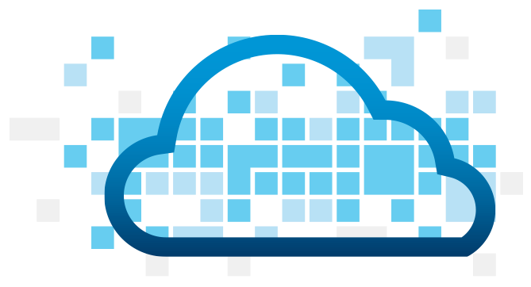
Overview: Pushing an Application
Blobstore
DB
Service
credentials
Upload app bits and metadata
Stage
Cloud Controller
Service Broker Node(s)
Deploy
push app
+ app MD
Cloud Controller Bridge
BBS / etcd
Create and bind services
Stage application
Deploy application
Manage application health
Router
CELL
Brain
DEA
DEA
Auctioneer
+
=
Task
LRP
Runtime
Notes:
Cloud Foundry PaaS
An application runs in a CELL, which is a droplet execution agent. The Cloud Controller orchestrates the routing and lifecycle of all DEAs in the pool. Routers manage application traffic. Health Manager reports mismatched application states to the CC. A service gateway provides an interface for services (native or external). A messaging bus manages all system communication. Apps are accessed directly through the router while web and CLI clients (e.g., vmc, STS) access Cloud Controller via RESTful services.

Slide 8
Creating and Binding a Service
Service
credentials
DB
CLI
create service (HTTP)
Cloud Controller
create service (HTTP)
Service
Broker
reserve resources
Data
Service
Router
bind service (HTTP)
bind service (HTTP)
obtain connection data
Runtime
http://docs.pivotal.io/pivotalcf/services/

Slide 9
Staging an Application
Staging Request
Task
Blobstore
Cloud Controller
Cloud Controller Bridge
BBS / etcd
Service
credentials
CELL Auction
Brain
DB
Auctioneer
Router
CELL
System
Buildpacks
Detect
Compile
Upload
No
Yes
Python
+
=
Java
Runtime

Slide 10
Staging and Buildpacks
Buildpacks are responsible for preparing the machine image for an application.
}
Application
Buildpack
Container
Libraries
Droplet
CELL
Runtime
Operating System

Slide 11
Yes We Can Run your .NET Applications
Diego Brain
App Bits
or Docker Image
.NET binary
Garden Linux
Garden Windows
----
----
----
----
----
----
----
----
----
----
----
----
----
----
----
----
----
----
runC
runC
runC
Windows Container
Windows Container
Windows Container
Linux VM
Windows VM

Slide 12
Yes We Can Run Your Docker Images
Diego Brain
Docker Engine
Garden
containerd
----
----
----
----
----
----
----
----
----
----
----
----
----
----
----
----
----
----
runC
runC
runC
runC
runC
runC
Notes:
Kubernetes doesn’t have buildpacks
----- Meeting Notes (4/20/16 12:11) -----
How do we harden it

Slide 13
Overview: Pushing a Docker Image
Blobstore
DB
Service
credentials
Download metadata for image layers
Stage
Cloud Controller
Service Broker Node(s)
Deploy
push app
Docker app MD
Cloud Controller Bridge
BBS / etcd
Create and bind services
Stage application
Deploy application
Manage application health
Router
CELL
Brain
DEA
DEA
Docker
Pull
=
Auctioneer
Task
LRP
Runtime
Notes:
Cloud Foundry PaaS
An application runs in a CELL, which is a droplet execution agent. The Cloud Controller orchestrates the routing and lifecycle of all DEAs in the pool. Routers manage application traffic. Health Manager reports mismatched application states to the CC. A service gateway provides an interface for services (native or external). A messaging bus manages all system communication. Apps are accessed directly through the router while web and CLI clients (e.g., vmc, STS) access Cloud Controller via RESTful services.

Slide 14
Customize your Container Experience
Cloud Foundry Buildpacks
BYO Docker
Developer brings customized app
Developer brings customized app
Platform provides standard runtime*
Or
Developer brings runtime container image
Platform provides fixed OS container image
Developer brings container OS image
Platform provides host OS Kernel (.NET or Linux)
Platform provides host OS Kernel (Linux)
App container
* Devs may bring custom buildpacks, unless restricted by platform Ops
Notes:
Kubernetes doesn’t have buildpacks
----- Meeting Notes (4/20/16 12:11) -----
How do we harden it

Slide 15
Customize the Container Experience
Buildpacks
Developer brings customized app
Platform buildpacks bring standard runtime*
App
Container
Platform provides fixed OS container image
Platform provides fixed host OS Kernel
* Devs may bring a custom buildpack

Slide 16
Buildpack Flavors
Buildpacks installed into a Cloud Foundry instance or loaded from an external location at app deployment time
Buildpacks provided by public Cloud Foundry
Java Buildpack
Cloud Foundry Community Buildpack
Write you own
Java
Ruby
Node.js
Binary
Go
Python
PHP
Staticfile
.NET
Notes:
Java
Ruby
Node.js
Custom Build packs

Slide 17
D e m o
Notes:
“Anatomy of a Buildpack”
https://github.com/bbertka/python-conda-buildpack/tree/master/bin
Show students a buildpack repo and discuss OSS CF and how each language has a buildpacks that knows how to detect the language as well as compile the droplet.
https://github.com/cloudfoundry/python-buildpack
Compile
Detect: https://github.com/cloudfoundry/python-buildpack/blob/master/bin/detect
Release:
----- Meeting Notes (4/20/16 11:43) -----
cf buildpacks
Liberty buildpack -- WebLogic it requires a license

Slide 18
Application Containers and Scaling
LRP
Deploy Request
LRP
Scale Request
Blobstore
Cloud Controller
Cloud Controller Bridge
BBS / etcd
Access App
Service
credentials
CELL Auction
Brain
DB
Auctioneer
Router
Converger
CELL
CELL
CELL
Desired
Actual
Executor
Rep
Executor
Rep
Executor
Rep
Runtime
Notes:
----- Meeting Notes (4/20/16 12:11) -----
tls 1.2 is supported
app ssl certs happen at the F5 LB
roadmap to container ssl termination

Slide 19
Deploying Cloud Foundry
Overview
Notes:
So how many people in here have heard of BOSH?
BOSH is the cloud foundry platform orchestration engine
This is the same BOSH used in open source cloud foundry, making Pivotal, the closest platform to the original CF!
Then you also know how tedious it can be to manage orchestration via manifest files, hence we created Ops Manager to make an easy way to work with it.
http://bosh.io/docs/about.html
https://bosh.io/docs/bosh-components.html

Slide 20
D e m o
Notes:
Show Ops Manager

Slide 21


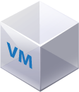
Deploying the CF Runtime with Cloud Foundry BOSH
BOSH
DB
Worker VMs
Deploy new
CF Instance
BOSH Director
Blobstore
etcd
Message Bus
Deployment
Packages
Blobs
Source
Jobs
Manifest
CELL
Health Monitor
Target VM
Cloud Controller
Target VM
Cloud Foundry Operations Manager/BOSH
Target VM
IaaS

Slide 22
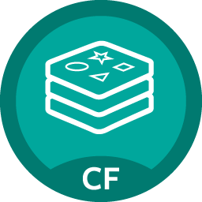
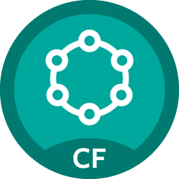
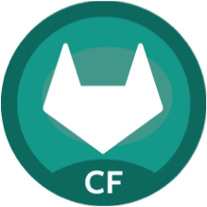

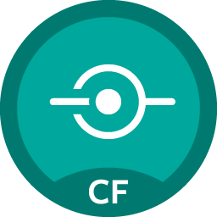


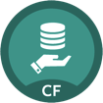
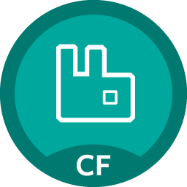
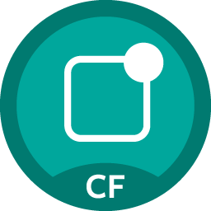

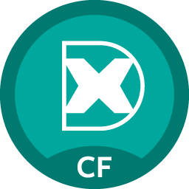



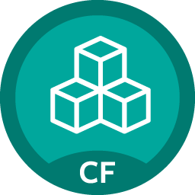

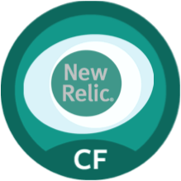
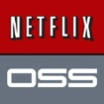
Pivotal Cloud Foundry Services
Mobile
Data
CI/CD
Cloud Native
DataStax Cassandra
Config Server
App Distribution
Redis
Git Lab
Jenkins Enterprise
Service Directory
Push Notifications
MySQL
RabbitMQ
Monitoring
Circuit Breaker
Security
Data Flow
PivotalHD
App Dynamics
Single Sign-on
Session state caching
GemFire
Powered by
New Relic

Slide 23
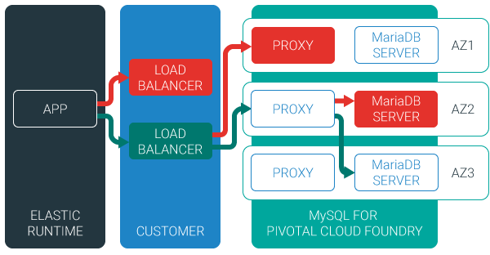
MySQL for Pivotal Cloud Foundry
Relational Database as a Service for Your Applications
Minimized effort to create, configure, and manage a MySQL cluster
Multi-node cluster
Data replication across nodes
Failover functionality ensures app traffic only routed to healthy nodes
Notes:
Deployed with a multi-node cluster; Balanced across Availability zones
Highly Available
Data replication
Failover functionality
Customizable plans
Secure - Different credentials to each application, operators can revoke access selectively!

Slide 24
Four Levels of HA
Built In!
Notes:
So how many people in here have heard of BOSH?
BOSH is the cloud foundry platform orchestration engine
This is the same BOSH used in open source cloud foundry, making Pivotal, the closest platform to the original CF!
Then you also know how tedious it can be to manage orchestration via manifest files, hence we created Ops Manager to make an easy way to work with it.
http://bosh.io/docs/about.html
https://bosh.io/docs/bosh-components.html

Slide 25
D e m o
Notes:
High Availability of Scale Demo

Slide 26
Application Instance HA
Blobstore
Cloud Controller
DB
Service
credentials
creds
Cloud Controller Bridge
Actual State
Desired State
Actual State
Re-deploy App
BBS
Converger & Auctioneer
Router
CELL
CELL
CELL
Exec.
Rep
Exec.
Rep
Exec.
Rep
Runtime

Slide 27
Platform Process HA
BBS
AGENT
Restart!
Health Monitor
Responses:
Cell
pager
AGENT
pager
Message Bus
email
email
monitoring
monitoring
…
…
Cloud Controller
AGENT
Pivotal CF Operations Manager
IaaS
Notes:
Two processed on the VMs are MONIT and BOSH agent
Monit monitors the actual state of processes, while BOSH agent is used to communicate the status to the health monitor
In a process goes down, Monit tries to restart it
If successful, or not, BOSH agent is notified, who then tell Health monitor, which will notify the operator
The processes running on the virtual machines (i.e. the health manager) are started with monit, an opensource linux utility that keeps an eye on processes and will respond when one dies. If a process dies then, monit will do two things: first, it will try to restart the process and second, whether the restart is successful or not, it will tell the BOSH agent about the failure. Recall that the Bosh agent is there to communicate with Operations Manager and in this case it will relay this failure information to the Operations Manager Health Monitor (not to be confused with the Health Manager of the elastic runtime that was discussed above) – we’ll abbreviate it OMHM. The OMHM will take this alert and pass it through a list of responders that can be configured to do things like send emails, page administrators and display alerts in operations dashboards. There’s a good chance that monit will already have recovered the process, but we also want there to be an opportunity for a human to respond.
----- Meeting Notes (4/20/16 13:46) -----
What is the message that gets sent for a failed process?
error condition
resource consumption
memory, etc

Slide 28

Platform Virtual Machine HA
Cloud Controller
DB
Agent
Process
BOSH Director
Health Manager
Blobstore
Re-create VM
Agent
Process
Ressurector
BBS
VM is
missing…
Agent
Process
Message Bus
Health
Monitor
Cloud Controller
Agent
Process
Pivotal CF Operations Manager
IaaS

Slide 29
Availability Zone HA
Zone 1
Zone 2
Availability Zones are vCenter Resource Pools
Cell
Cell
System components and Application instances are evenly distributed over two availability zones.
Cell
Cell
Router
Cell
Cell
Loosing an AZ keeps instances running and available.
Notes:
Zone could = rack, for example

Slide 30

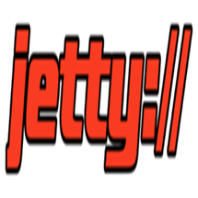


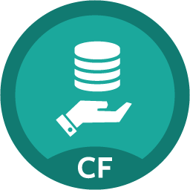
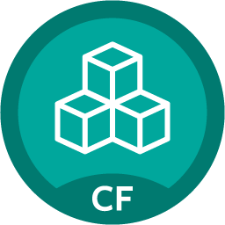

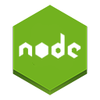
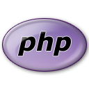

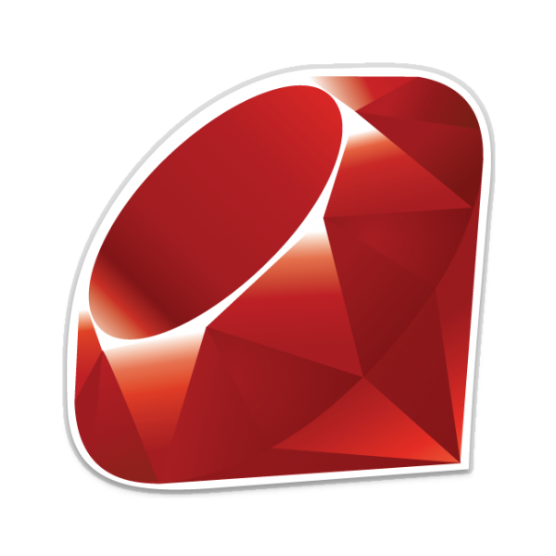

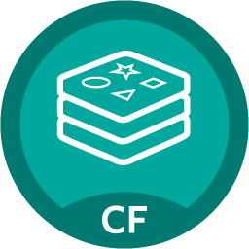



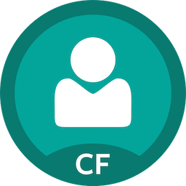

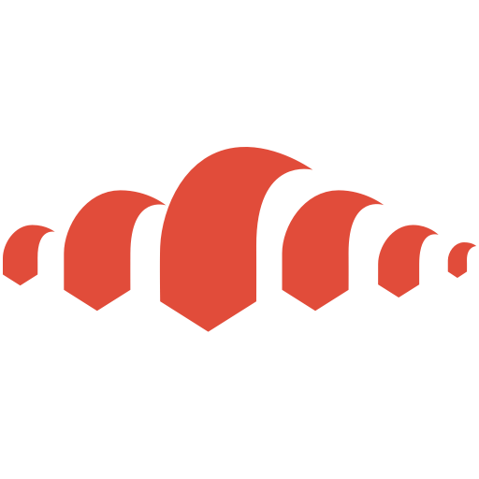
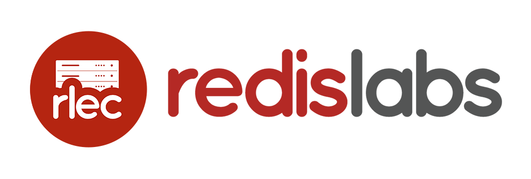
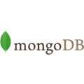
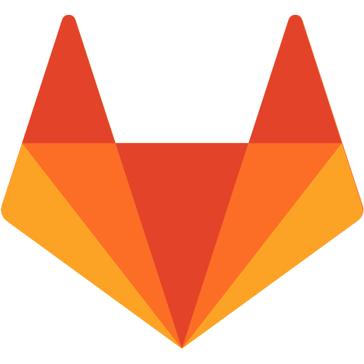
Applications / APIs / Microservices
BOSH Managed Services
Brokered Services
MySQL
Greenplum
PIVOTAL
BYO container, deployed and managed by platform
Redis
HDB
Compiled, staged, containerized, deployed and managed by platform
RabbitMQ
…
PIVOTAL
Elastic Container Runtime
Netflix OSS
Container Scheduling
Elastic (Auto) Scaling
Dev + Ops Role-Based Self Service Access
SSO
…
PARTNERED
Jenkins
Integrated Logging/Metrics
Self-Healing & High Availability
Zero Downtime Upgrades & Patches
GitLab
PARTNER
…
Oracle DB
MS SQL Server
Infrastructure Automation
(BOSH)
Multi-Cloud Orchestration
Infrastructure Agnostic
MySQL
USER PROVIDED
Health and Lifecycle Management
Version Controlled Configuration
Active MQ
30
IBM DB/2
Azure

