Slide 1


SRI KRISHNA COLLEGE OF ENGINEERING AND TECHNOLOGY (AN AUTONOMOUS INSTITUTION | AFFILIATED TO ANNA UNIVERSITY | ACCREDITED BY NAAC WITH “A” GRADE) ACCREDITED BY NBA(CSE, IT, ECE, EEE, MECH, MCT & CIVIL) KUNIAMUTHUR, COIMBATORE, TAMILNADU, INDIA
SKCET STUDY MATERIAL
Subject Name : PHYSICS - 22PH201
Module : l –QUANTUM MECHANICS AND QUANTUM COMPUTING
TOPIC : INTRODUCTION TO QUANTUM COMPUTING
BRANCH : I B.E CSE (CYS)
Dr. J. Jayaprakash
Assistant Professor in Physics
Department of Science and Humanities

Slide 2
Computing Generations
First Generation (1940-1956)
🞑 Vacuum Tubes
Second Generation (1956-1963)
🞑 Transistors
Third Generation (1964-1971)
🞑 Integrated Circuits
Fourth Generation (1971-Present)
🞑 Microprocessors
Fifth Generation (Present and Beyond)
🞑 Artificial Intelligence

Slide 3
Why Quantum Computing
"The number of transistors incorporated in a chip will approximately double every 24 months.“
Gordon Moore, Intel Co- Founder

Slide 4
By 2020 to 2025, transistors will be so small and it will generate so much heat that standard silicon technology may eventually collapse.
Already Intel has implemented 32nm silicon technology
If scale becomes too small, Electrons tunnel through micro-thin barriers between wires corrupting signals.

Slide 5
What is a quantum computer?
A quantum computer is a machine that performs calculations based on the laws of quantum mechanics, which is the behavior of particles at the sub-atomic level.
A theoretical model is the Quantum Turing machine – Universal Quantum Computer.

Slide 6
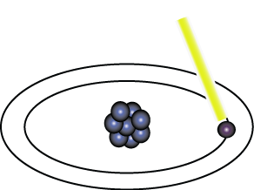
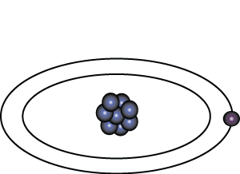
Representation of Data - Qubits
A bit of data is represented by a single atom that is in one of two states denoted by |0> and |1>. A single bit of this form is known as a qubit
A physical implementation of a qubit could use the two energy levels of an atom. An excited state representing |1> and a ground state representing |0>.
Light pulse of frequency λ for time interval t
Excited State
Ground State
Nucleus
Electron
State |0>
State |1>

Slide 7
Quantum Logics and Representation
Quantum Computers use quantum mechanical phenomena-
🞑Entanglement
🞑Superposition
Quantum computational operations were executed on a very small number of Qubits (quantum bits)

Slide 8
Representation of Data - Superposition
A single qubit can be forced into a superposition of the two states denoted by the addition of the state vectors:
|ψ> = α₁ |0> + α₂ |1>
Where α¹ and α² are complex numbers and
|α¹ |² + | α² |² = 1
1
2
A qubit in superposition is in both of the states |1> and |0 at the same time

Slide 9
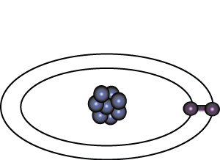
Representation of Data - Superposition
Light pulse of frequency λ for time interval t/2
State |0>
State |0> + |1>
Consider a 3 bit qubit register. An equally weighted superposition of all possible states would be denoted by:
|ψ> = |000> + |001> + . . . + |111>
1
1
1
√8
√8
√8

Slide 10
Data Retrieval
In general, an n qubit register can represent the numbers 0 through 2^n-1 simultaneously.
Sound too good to be true?…It is!
If we attempt to retrieve the values represented within a superposition, the superposition randomly collapses to represent just one of the original values.
In our equation: |ψ> = α1 |0> + α |1> , α1 represents the probability of the superposition collapsing to |0>. The α’s are called probability amplitudes. In a balanced superposition,
α = 1/√2 where n is the number of qubits.
2
n

Slide 11
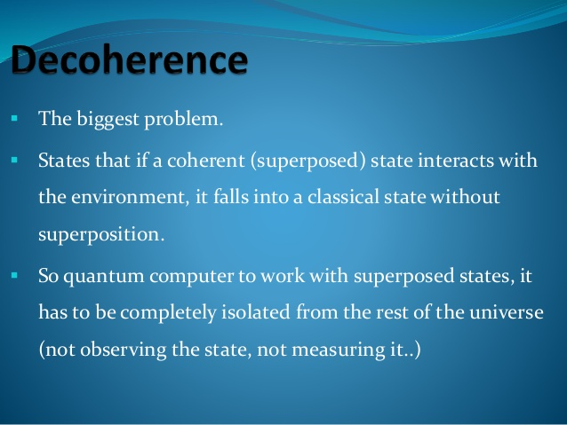

Slide 12
The term decoherence is used in many fields of (quantum) physics to describe the disappearance or absence of certain superpositions of quantum states.
Decoherence is a consequence of the unavoidable interaction of virtually all physical systems with their environment.

Slide 13
Relationships among data – Entanglement
Entanglement is the ability of quantum systems to exhibit correlations between states within a superposition.
Imagine two qubits, each in the state |0> + |1> (a superposition of the 0 and 1.) We can entangle the two qubits such that the measurement of one qubit is always correlated to the measurement of the other qubit.

Slide 14
QUANTUM SUPREMACY
In quantum computing, quantum supremacy or quantum advantage is the goal of demonstrating that a programmable quantum device can solve a problem that no classical computer can solve in any feasible amount of time (irrespective of the usefulness of the problem)

Slide 15
What is quantum supremacy?
It is a term proposed in 2012 by John Preskill, professor of theoretical physics at the California Institute of Technology.
It describes the point where quantum computers can do things that classical computers cannot.
In Google’s case, researchers at the University of California, Santa Barbara have claimed to have developed a processor that took 200 seconds to do a calculation that would have taken a classical computer 10,000 years.

Slide 16
Differences in quantum and classical computation.
Classical Computing
Quantum Computing
Conventional computing is based on the classical phenomenon of electrical circuits being in a single state at a given time, either on or off.
Quantum computing is based on the phenomenon of Quantum Mechanics, such as superposition and entanglement, the phenomenon where it is possible to be in more than one state at a time.

Slide 17
Information storage and manipulation is based on “bit”, which is based on voltage or charge; low is 0 and high is 1.
The circuit behavior is governed by classical physics.
Information storage and manipulation is based on Quantum Bit or “qubit”, which is based on the spin of electron or polarization of a single photon.
The circuit behavior is governed by quantum physics or quantum mechanics.

Slide 18
Conventional computing use binary codes i.e. bits 0 or 1 to represent information.
CMOS transistors are the basic building blocks of conventional computers.
Quantum computing use Qubits i.e. 0, 1 and superposition state of both 0 and 1 to represent information.
Superconducting Quantum Interference Device or SQUID or Quantum Transistors are the basic building blocks of quantum computers.

Slide 19
In conventional computers, data processing is done in Central Processing Unit or CPU, which consists of Arithmetic and Logic Unit (ALU), processor registers and a control unit.
In quantum computers, data processing is done in Quantum Processing Unit or QPU, which consists of a number of interconnected qubits.

Slide 20
https://youtu.be/T2DXrs0OpHU
https://youtu.be/-ZNEzzDcllU
https://youtu.be/QF7QfE6qgTM

