Slide 1
Childhood Cancer Genetic Risk
Surveillance System
A backend system that automatically reminds doctors and parents when a
child with a known cancer-risk gene needs their next check-up.
Prepared by Harini
Second-Year B.Sc. Computer Science • Mini Project

Slide 2
What Is the Idea?
Some children inherit a gene mutation from a parent.
This is called a genetic predisposition — it doesn't guarantee cancer, but it raises the chance of a specific type appearing in childhood.
Doctors already publish exactly which tests such a child needs, starting at what age, and how often.
The Problem
Applying these guidelines to one real child — tracking exact calendar dates over many years — is currently done manually.
A missed or delayed test means a warning sign of cancer could go undetected.
Childhood Cancer Genetic Risk Surveillance System
2

Slide 3
The Solution — This Project
A backend software system that removes the manual work.
1
2
3
4
Enter a child's date of birth
and diagnosed condition
→
System looks up the correct
published screening guideline
→
System auto-generates every
test date, birth to age 18
→
Each test is marked
Done or Pending
Childhood Cancer Genetic Risk Surveillance System
3

Slide 4
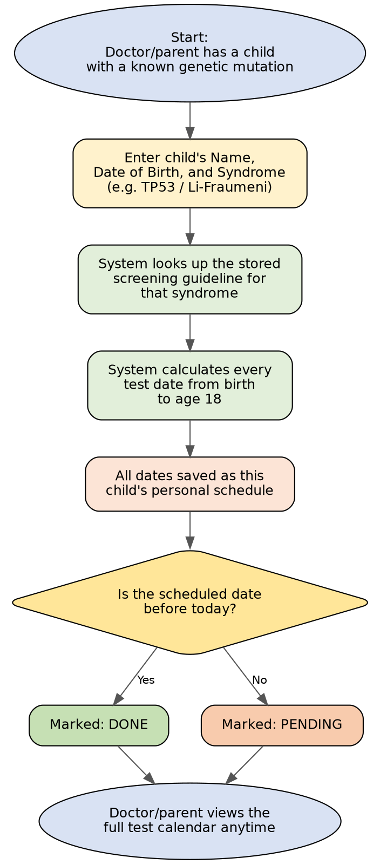
How It Works — Process Flow
From entering a child's
details to viewing their
finished, dated schedule.
Childhood Cancer Genetic Risk Surveillance System
4

Slide 5
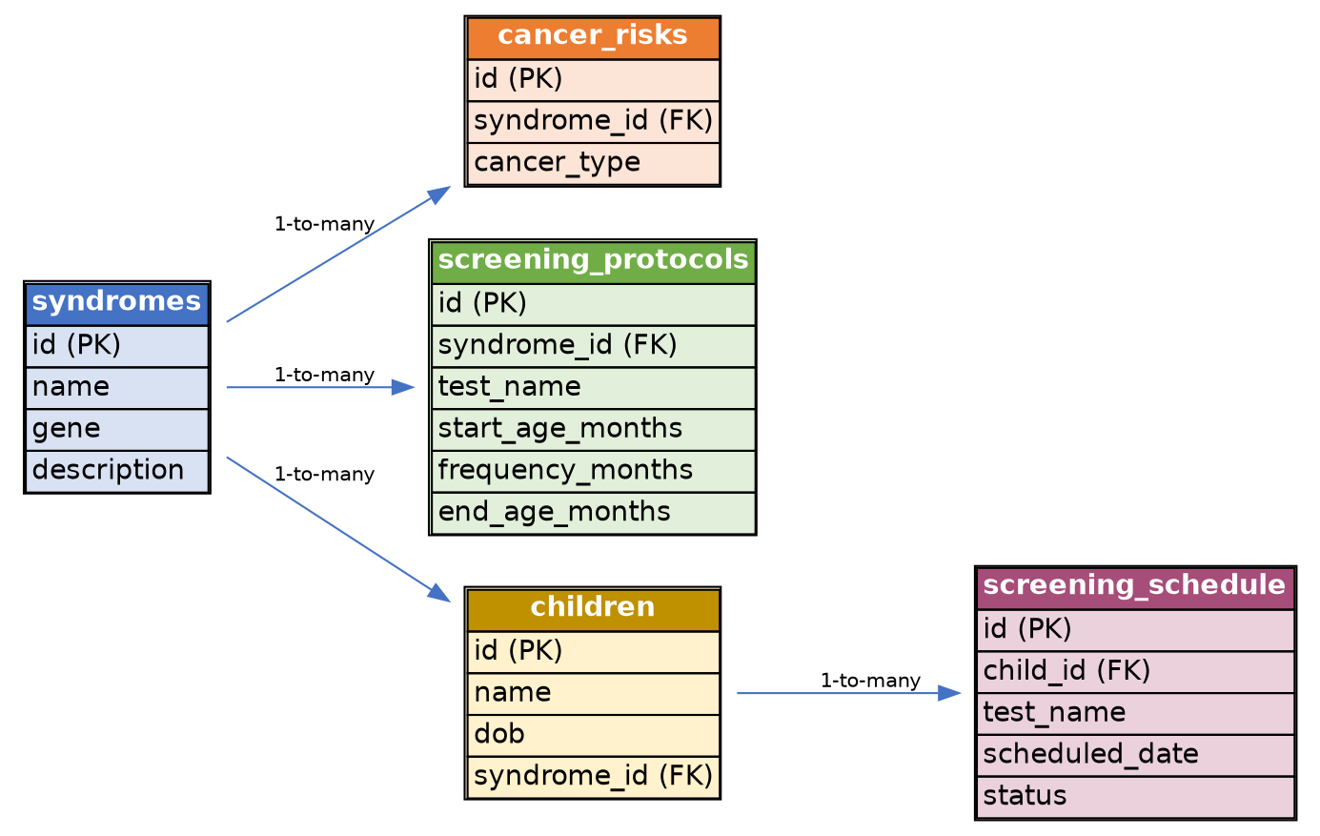
Database Design — 5 Connected Tables
syndromes is the central table — each condition has its own risks, its own screening protocol, and its own list of registered children.
Childhood Cancer Genetic Risk Surveillance System
5

Slide 6
The 5 Genetic Conditions in the System
Condition | Gene | Risk (Simple)
Li-Fraumeni Syndrome | TP53 | Sarcoma, brain tumors, and other cancers
Retinoblastoma Predisposition | RB1 | Eye cancer in early childhood
DICER1 Syndrome | DICER1 | Rare lung tumor, thyroid & ovarian growths
MEN2 | RET | Thyroid cancer; sometimes early surgery
Beckwith-Wiedemann Syndrome | 11p15 region | Kidney tumor (Wilms) and liver tumor
These 5 conditions, and their official screening guidelines, are already published by doctors — this project did not create new medical knowledge.
Childhood Cancer Genetic Risk Surveillance System
6

Slide 7
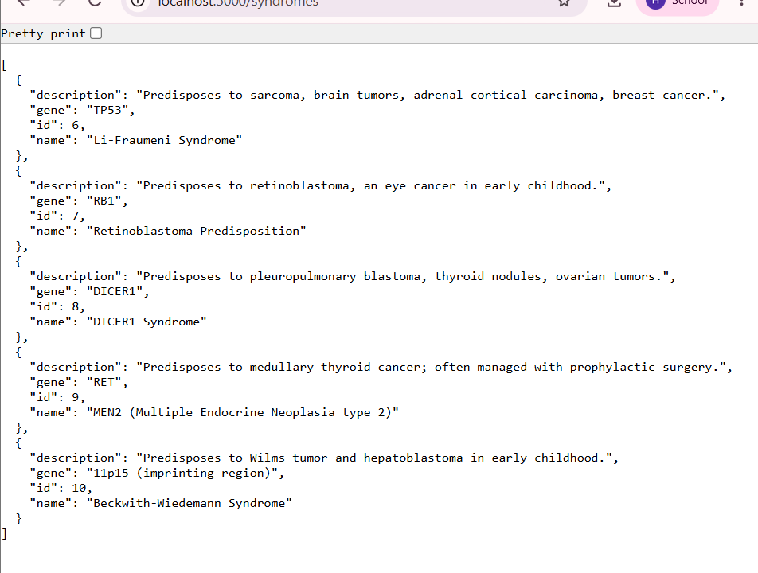
Proof — The System Actually Runs
Live output from the running backend, listing all 5 stored conditions:
What this shows:
• The database is live and reachable
• All 5 syndromes load correctly
• Each includes its gene and description
Childhood Cancer Genetic Risk Surveillance System
7

Slide 8
Demonstration — Auto-Generated Schedule
Sample child “Priya”, born 10 June 2020, diagnosed with Li-Fraumeni Syndrome:
Date | Test | Status
10 Jun 2020 | Whole-body MRI | Done
10 Jun 2020 | Abdominal Ultrasound | Done
10 Sep 2020 | Abdominal Ultrasound | Done
... | (continues every few months) | ...
10 Oct 2026 | Blood Test (CBC) | Pending
10 Jun 2027 | Whole-body MRI | Pending
... | (continues until age 18) | ...
150+
dated test entries generated automatically — 3 tests, each with its own frequency, zero manual calculation.
Childhood Cancer Genetic Risk Surveillance System
8

Slide 9
Tech Stack & Scope
Built With
What This Does NOT Do
Python + Flask — backend REST API
SQLite — 5-table relational database
Core logic — steps through a syndrome's protocol and converts each interval into a real calendar date from the child's date of birth
5 API endpoints — list syndromes, view one syndrome, register a child, view full/upcoming schedule
• Does not discover any new gene or new cancer risk
• Does not diagnose a child or replace a doctor
• Only works for children with a known genetic condition — most childhood cancers have no known inherited cause
Childhood Cancer Genetic Risk Surveillance System
9

Slide 10
What Could Be Added Next
1
Mark Test Done
2
Reminders
A button for doctors to mark a completed screening
Automatic email/SMS alerts before a test is due
3
Calendar View
4
Doctor Validation
A simple visual calendar for parents
Guideline data reviewed by a real geneticist
Childhood Cancer Genetic Risk Surveillance System
10

Slide 11
Conclusion
A small, focused software system can take existing medical knowledge and turn it into something genuinely useful — without needing to be a doctor or medical researcher to build it.
A realistic, complete example of applying backend development skills to a real-world healthcare problem — and a strong, working project for interviews and portfolios.
Thank you

