Slide 1
R Meetup Group – April 1, 2017
Using Git and GitHub
Ray Harris

Slide 2
Git
Distributed Version Control System (DVCS)
VCS Examples:
  Microsoft Visual Source Safe (VSS) (centr)
  Concurrent Versioning System (CVS) (centr)
  Subversion (SVN) (centr)
  Perforce
  Git (de-centr)
Created by Linus Torvalds in 2005
Git: def'n: “unpleasant person” (British)

Slide 3
Git
VCSes enable:
  Track who changed what, when…
  Multiple parallel branches of code: PROD, Feature Branches, Maintenance Branches, Experimental Branches
  Collaboration between team members per branch
Separate from building, configuring, deploying, tracking defects (via separate tools)

Slide 4
Centralized Version Control Systems
VSS / CVS / SVN:
  Each user only has one copy of one set of files
  “Source” copy of the files are “locked” on the server
  “Unlock” / “Checkout” files to work on them
  Checked Out files cannot be worked on by anyone else until checked in
  Server tracked “deltas” between files

Slide 5
Decentralized Version Control System: Git
Git:
  Each user has a clone of “the” repository
  Each user has an entire copy of the entire repository containing the entire history of all changes
  In other words, each user has * EVERYTHING*
  Do not * need * a centralized (Gold Standard) server
  But, have a Gold Standard server for “safety's sake” and for convenience

Slide 6
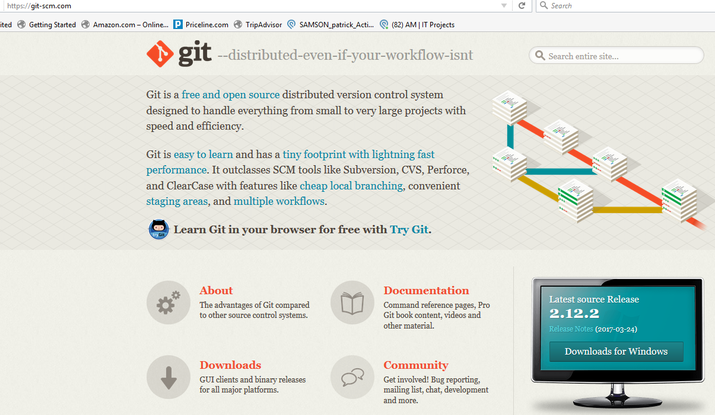
Getting / Installing Git (git-scm.com)

Slide 7
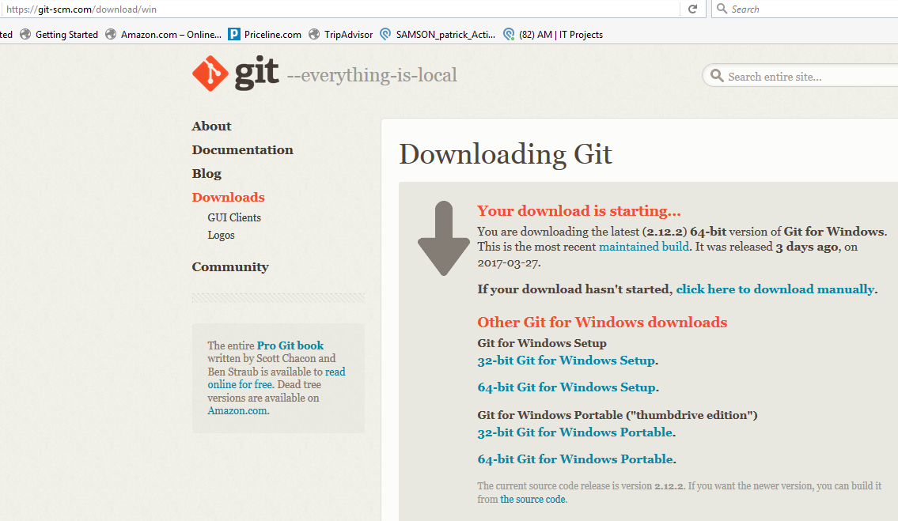
Getting / Installing Git

Slide 8
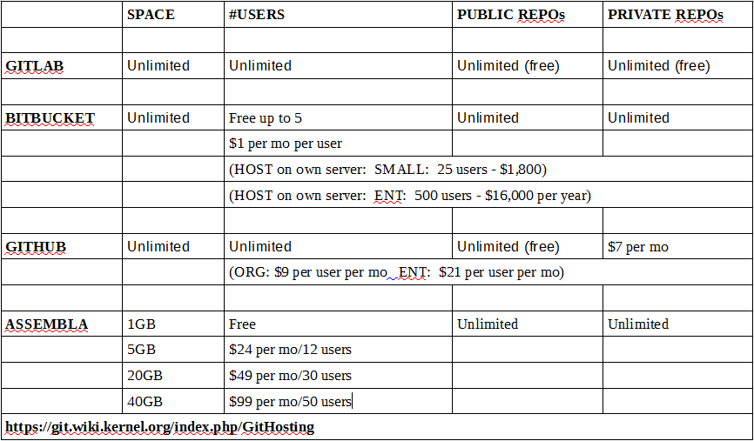
Git Hosting Alternatives/Pricing

Slide 9
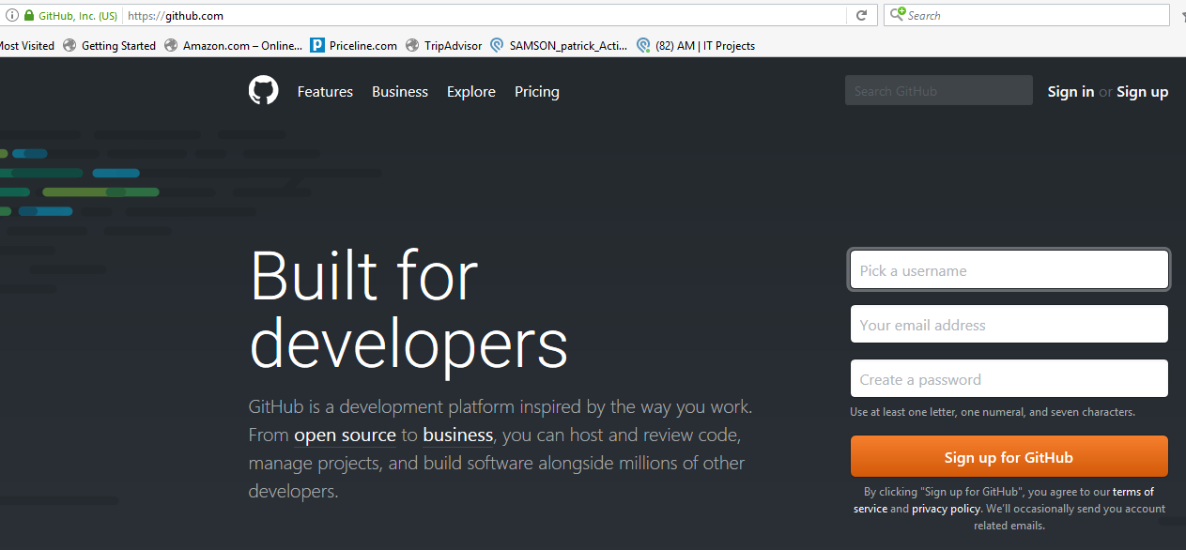
GitHub Account

Slide 10
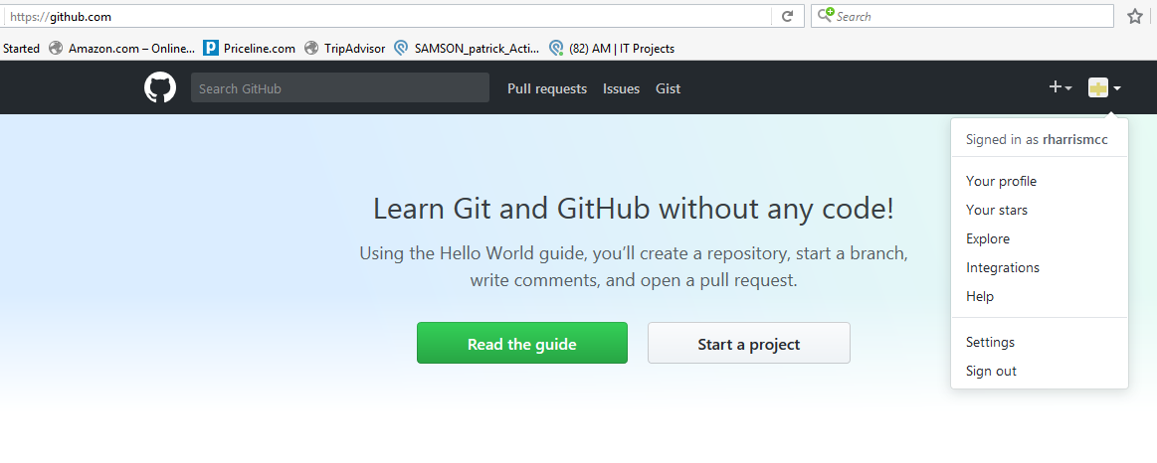
GitHub Account

Slide 11
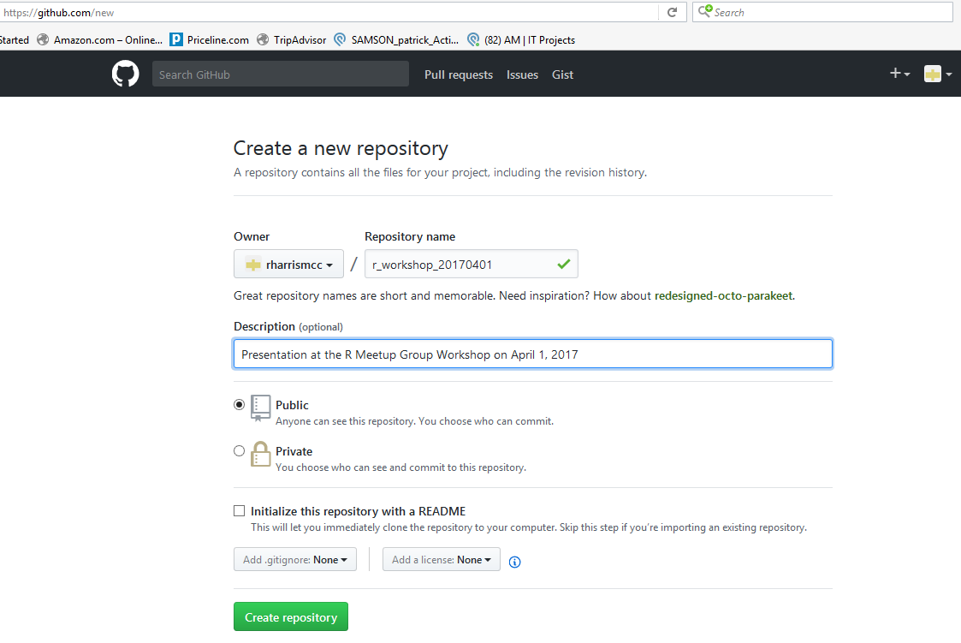
GitHub Account

Slide 12
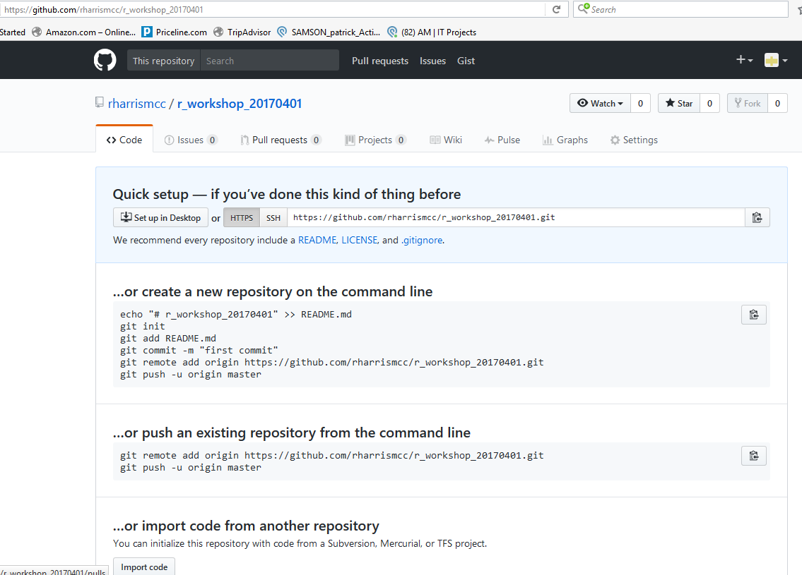
GitHub Account

Slide 13
.gitignore Resources
List of .gitignore files by language:
  https://github.com/github/gitignore
  https://github.com/github/gitignore/blob/master/R.gitignore
  https://github.com/github/gitignore/blob/master/VisualStudio.gitignore
  https://github.com/github/gitignore/blob/master/Java.gitignore
  https://github.com/github/gitignore/blob/master/C.gitignore
  https://github.com/github/gitignore/blob/master/Perl.gitignore
  GENERATOR: https://www.gitignore.io/

Slide 14
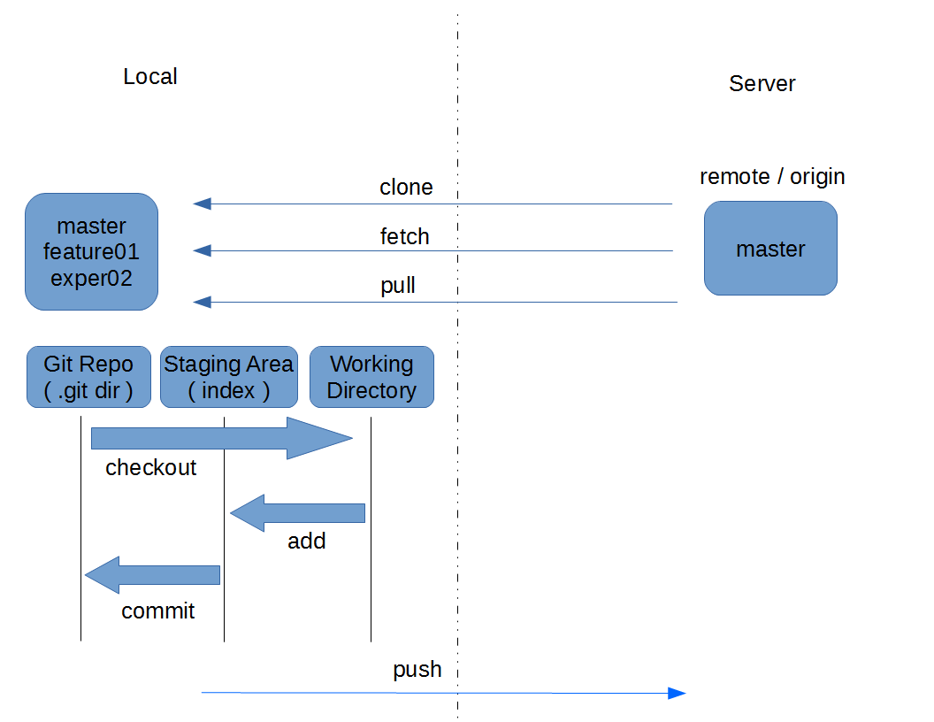
Git

Slide 15
Git Basic / Common Commands
Basic Commands:
  git init
  git add .
  git commit -m “Added all files”
  git remote add origin https://github.com/ACCOUNT/PROJECTNAME.git
  git push -u origin master

Slide 16
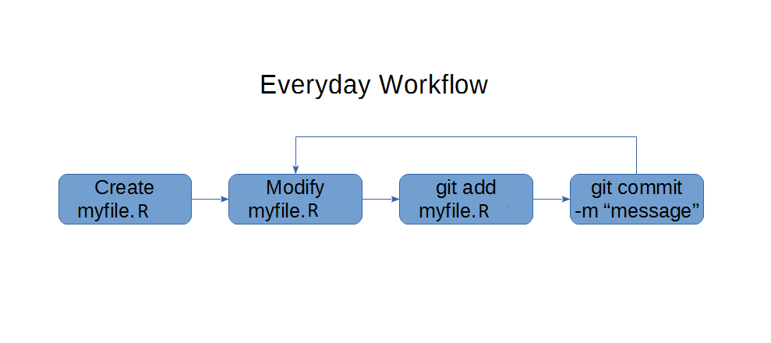
Git Individual Workflow Example

Slide 17
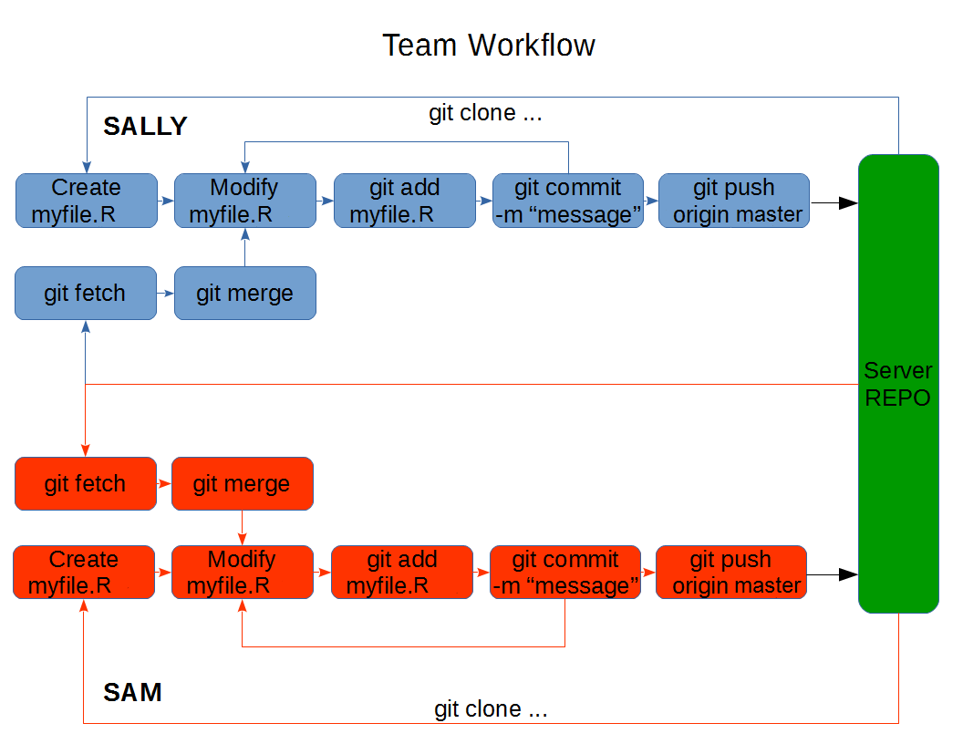
Git Team Workflow example

Slide 18
Git Cheat Sheet URLs
https://www.git-tower.com/blog/git-cheat-sheet/
http://ndpsoftware.com/git-cheatsheet.html
https://www.atlassian.com/dms/wac/images/landing/git/atlassian_git_cheatsheet.pdf
http://www.cheat-sheets.org/saved-copy/git-cheat-sheet.pdf
http://zeroturnaround.com/rebellabs/git-commands-and-best-practices-cheat-sheet/
https://services.github.com/kit/downloads/github-git-cheat-sheet.pdf
https://scotch.io/bar-talk/git-cheat-sheet
http://www.patrickzahnd.ch/wp-content/uploads/2014/02/git-transport-v1.pdf
https://github.com/mattharrison/Git-Supervisual-Cheatsheet/blob/master/gitcheat.png
https://jan-krueger.net/wordpress/wp-content/uploads/2007/09/git-cheat-sheet.pdf

Slide 19
Git GUI Clients (Linux)
LIST: https://git-scm.com/download/gui/
Git Gnome
https://wiki.gnome.org/Apps/Gitg
Giggle
https://wiki.gnome.org/Apps/giggle/
Git GUI
https://www.kernel.org/pub/software/scm/git/docs/git-gui.html
QGit
http://digilander.libero.it/mcostalba/#Download

Slide 20
Git GUI Clients (Windows)
LIST: https://git-scm.com/download/gui/
Tortoise Git
https://tortoisegit.org/
GITHUB FOR Windows
https://github-windows.s3.amazonaws.com/GitHubSetup.exe
SourceTree
https://downloads.atlassian.com/software/sourcetree/windows/
Aurees
https://aurees.com/download

Slide 21
Git GUI Clients (MAC)
LIST: https://git-scm.com/download/gui/
GitBox
http://d1oa71y4zxyi0a.cloudfront.net/gitbox-1.6.2-ml.zip
GitXDev
https://rowanj.github.io/gitx/
GitUP
http://gitup.co/
https://s3-us-west-2.amazonaws.com/gitup-builds/stable/GitUp.zip
Fork
https://git-fork.com/update/files/Fork.dmg

Slide 22
Git GUI Clients (Cross Platform)
SmartGit
http://www.syntevo.com/smartgit/download
GitKraken
https://www.gitkraken.com/download
Tower
https://www.git-tower.com/windows/
Git Cola
https://git-cola.github.io/downloads.html
GitEye
https://www.collab.net/downloads/giteye
Git Ahead
https://scitools.com/gitahead/

Slide 23
Appendix A – REPO With Presentation
Git Book:
https://git-scm.com/book/en/v2
Repository to download presentation/resources:
git clone https://github.com/rharrismcc/r_workshop_20170401.git

Slide 24
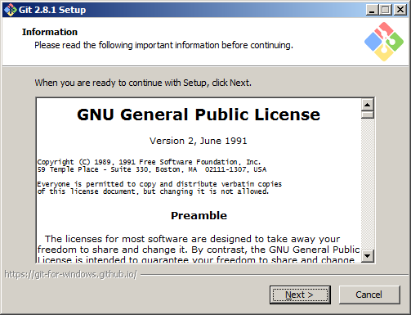
Appendix B – Installing Git

Slide 25
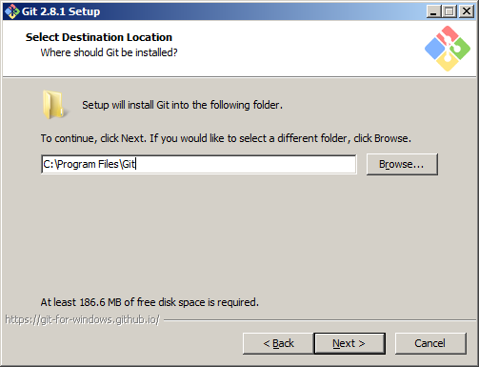
Appendix B – Installing Git

Slide 26
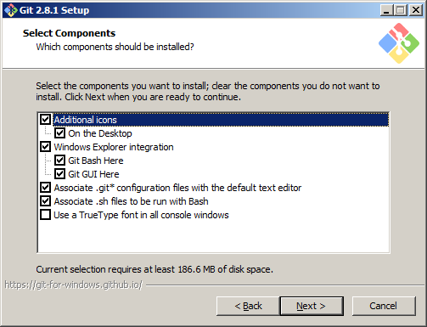
Appendix B – Installing Git

Slide 27
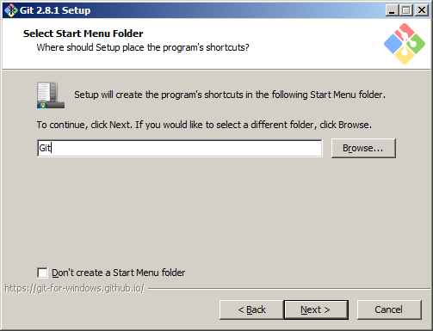
Appendix B – Installing Git

Slide 28
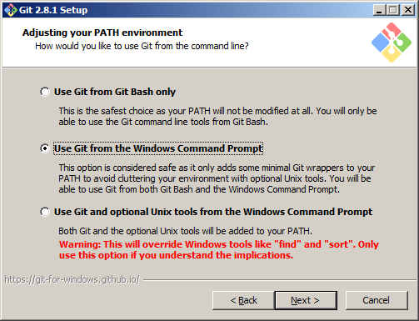
Appendix B – Installing Git

Slide 29
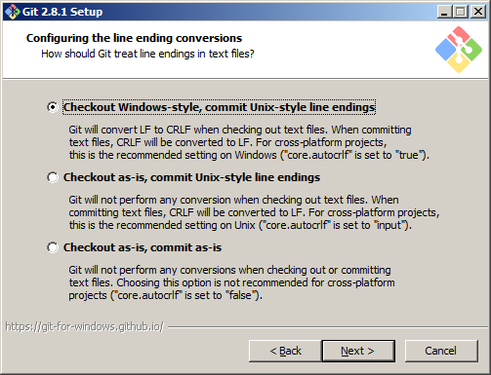
Appendix B – Installing Git

Slide 30
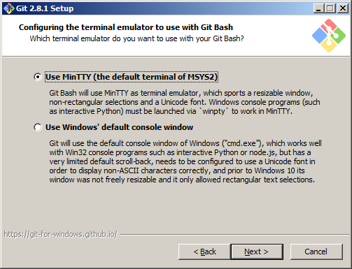
Appendix B – Installing Git

Slide 31
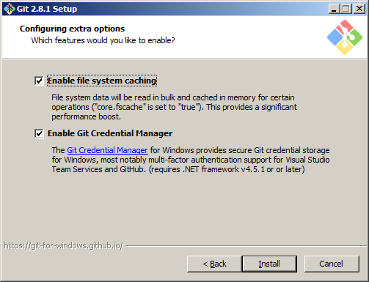
Appendix B – Installing Git

Slide 32
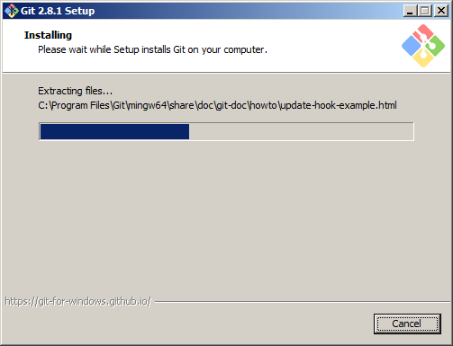
Appendix B – Installing Git

Slide 33
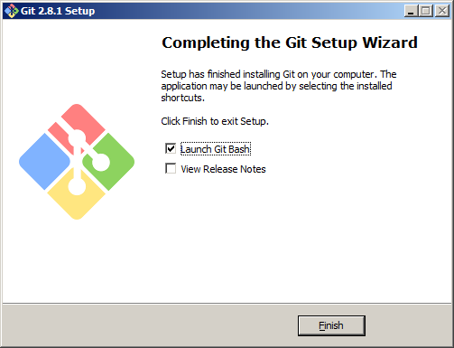
Appendix B – Installing Git

Slide 34
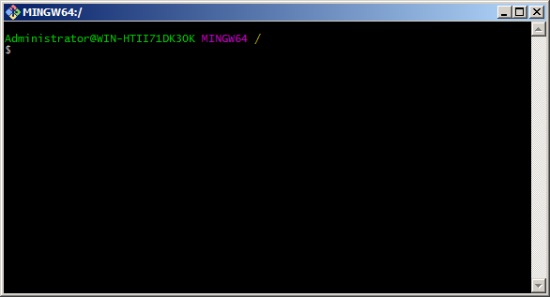
Appendix B – Installing Git

Slide 35
Git

Slide 36
Git

