Slide 1
DRIVER DROWSINESS DETECTION SYSTEM

Slide 2
TEAM MEMBERS:
Harsh Kumar Pandey
(E23MCAG0024)
Sagar Sharma
(E23MCAG0023)
Samarth Swaroop Saxena
(E23MCAG0029)
Shubhangi Kundu
(E23MCAG0078)

Slide 3
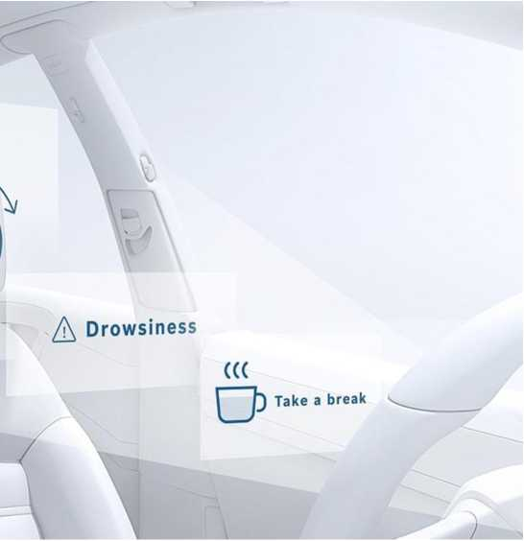

Slide 4
ABSTRACT
The face, a crucial bodily feature, communicates a lot of information. Facial expressions, such as blinking and yawning more frequently than usual, differ from those in a normal state when a driver is fatigued.
• In this project, we suggest a system that, without fitting the driver’s bodies with gadgets, which uses videos to extract images to detect signs of fatigue in drivers, such as blinking, and the length of time their eyes are closed.
• We suggest a computer vision-based technique for identifying tiredness in a driver from video captured by a cam. Every frame is subjected to the method's effort to identify the face and then find the eye.
• In addition, we developed a brand-new face region identification technique based on ‘n’ critical features, then utilize these facial regions to evaluate the driver’s state.
• By combining the features of the eyes, we can alert the driver using a fatigue warning with the alarm sound

Slide 5
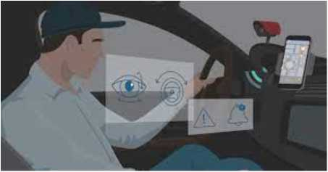
INTRODUCTION
A non-intrusive method based on computer vision. The little camera is put to use by a mechanism that directs its focus directly onto the driver's face and eyes. Finding the driver's eyes and determining whether they are open or closed in the process and recognising driver’s eye aspect ratio. The suggested method implies that the driver is dozing off if their eyelids are close for five consecutive frames, and a signal of warning has been given.The sleepiness measures based on cameras make a valuable contribution to the detection.

Slide 6
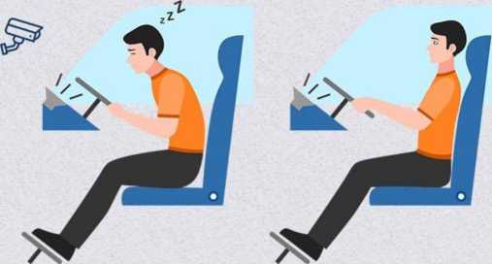
OBJECTIVE
• Driver drowsiness detection is a car safety feature that guards against collisions when the driver is beginning to nod off, potentially saving their lives.
• The major goal is to develop a system that continuously scans the eye to detect driver fatigue.
• The device functions even when the driver is wearing eyeglasses and in different lighting situations.
• Sound an alarm or buzzer to notify the driver when drowsiness is detected. And the vehicle's speed can be decreased which lead to fewer accidents, thus also traffic management can be maintained.

Slide 7
PROPOSED SYSTEM
• Visual object tracking
• Recognition of facial landmarks
• Recognition of eyes
• Detecting eye aspect ratio
• Detecting sleepiness in drivers
• Alert for Self Mode
• Alarm goes off

Slide 8
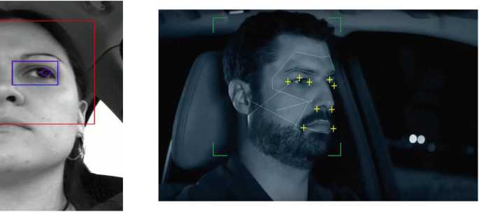

Slide 9
METHODOLOGY USED
scipy.spatial:
Geometry and Spatial Algorithms: 'scipy.spatial' provides a wide range of spatial algorithms and data structures for tasks such as distance computation, spatial indexing, and convex hulls. It is particularly useful for working with geometric data and solving spatial problems in scientific and engineering applications.
k-D Trees and Delaunay Triangulation: The library includes efficient implementations of k-dimensional trees (k-D trees) for spatial indexing and Delaunay triangulation, which is valuable for tasks like nearest neighbor search and mesh generation.

Slide 10
METHODOLOGY USED
imutils:
Convenience Functions for OpenCV: 'imutils' is a collection of convenience functions that simplify common tasks when working with OpenCV (cv2). It provides easy-to-use functions for resizing, rotating, and displaying images, making it easier to prototype and develop computer vision applications.
Cross-Compatibility: One of the notable features of 'imutils' is its effort to maintain compatibility between OpenCV 2, 3, and 4. This makes it easier to write code that works across different versions of the OpenCV library.
simpleaudio:
Cross-Platform Audio Playback: 'simpleaudio' is a Python library that simplifies the playback of audio files on various platforms. It provides a straightforward interface for playing WAV files, making it easy to incorporate sound into Python applications.
Multiple Channel Support: The library supports playing audio on multiple channels simultaneously, allowing for the creation of complex audio experiences. This can be useful in applications ranging from simple sound playback to more advanced audio processing tasks.

Slide 11
METHODOLOGY USED
dlib:
Machine Learning and Computer Vision: 'dlib' is a versatile C++ library with Python bindings that includes a wide range of functionality, from machine learning tools to image processing and computer vision algorithms. It is known for its face detection and recognition capabilities.
Facial Landmark Detection:One of the standout features of 'dlib' is its ability to perform facial landmark detection, enabling applications like facial expression analysis and head pose estimation. It also provides pre-trained models for facial recognition.
cv2 (OpenCV):
Computer Vision Toolkit: OpenCV (cv2 in Python) is a powerful open-source computer vision library that provides a plethora of tools for image and video analysis. It is widely used for tasks such as object detection, image processing, and feature extraction.
Real-Time Computer Vision: OpenCV is optimized for real-time computer vision applications, making it suitable for tasks like video surveillance, augmented reality, and robotics. Its extensive documentation and active community contribute to its popularity in the computer vision field.

Slide 12
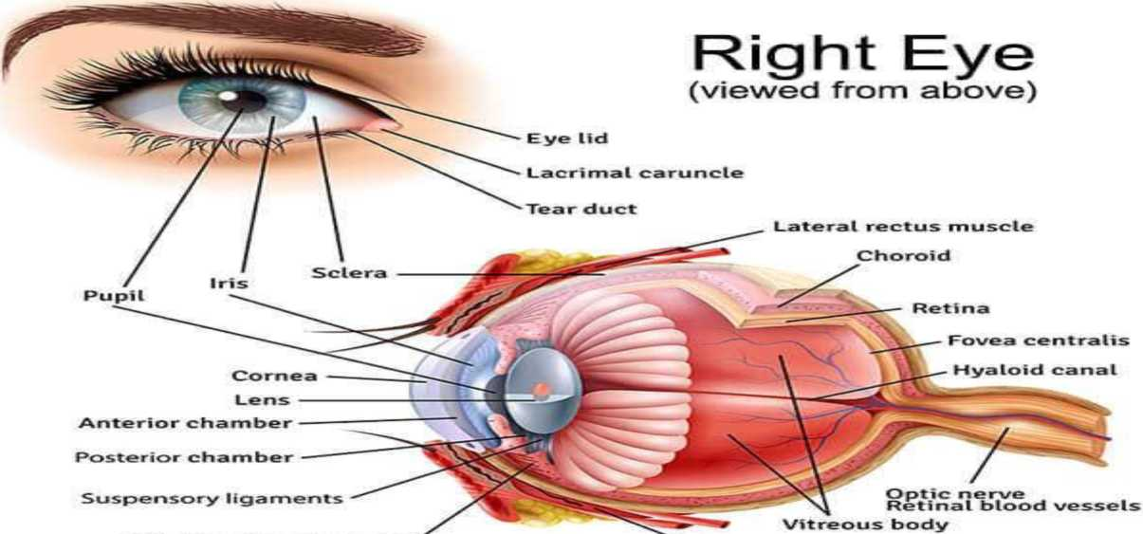
BASIC EYE STRUCTURE
Ciliary body and muscle
Medial rectus muscle

Slide 13
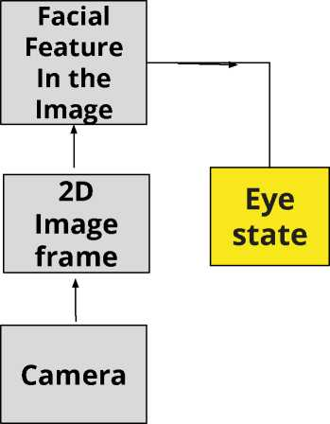
BLOCK DIAGRAM
Face
location
Eyes
location
Eyes opened /closed

Slide 14
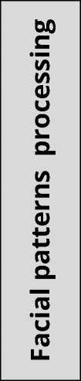
Eye aspect ratio
Frequency of eyelid blinks
Duration of eyelid blinks
Eyelid distance
Drowsiness
judgement
PERCLOS

Slide 15
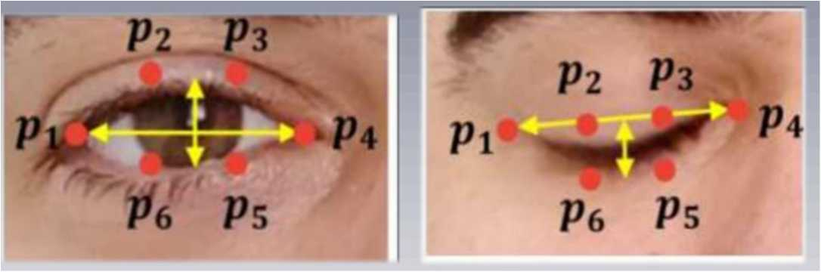
working
The primary approach for image feature detection relies on extracting facial landmarks. The dlib library includes a facial-landmark detector that identifies 68 coordinates. For open eyes, the coordinates contribute to calculating the Eye Aspect Ratio (EAR), approximately 0.24. In contrast, closed eyes exhibit an EAR of around 0.15.

Slide 16
FLOW CHART

Slide 17
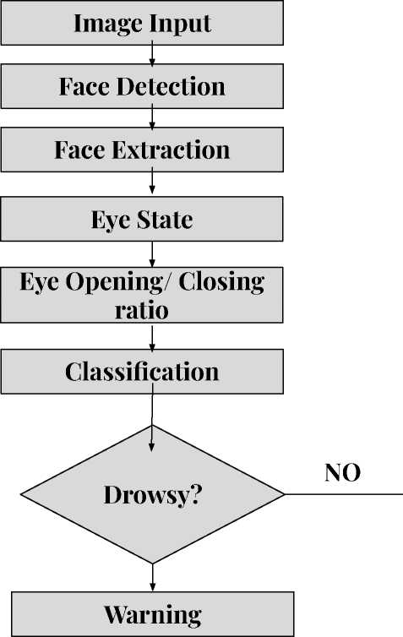
I
YES

Slide 18
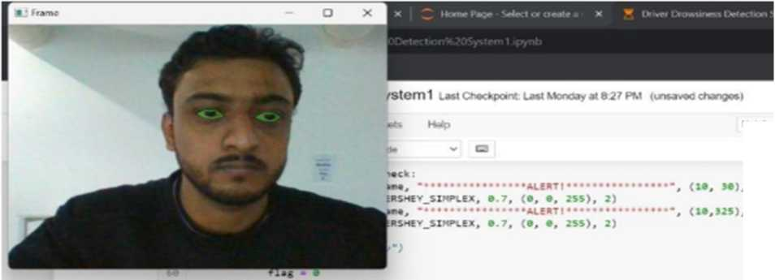
Outcomes:
Normal State: - There is no alert or alarm when the user's eyes are open.
cv2.1n«hou<^{a,}'ra««ª_{i} *>***♦ )
k«y • Cv2.*«itK«y< 1 > t
If k#y — ortf(V):
brMh
Cv2 . d*ttroyAllWlndOurt( )
1
2
3

Slide 19
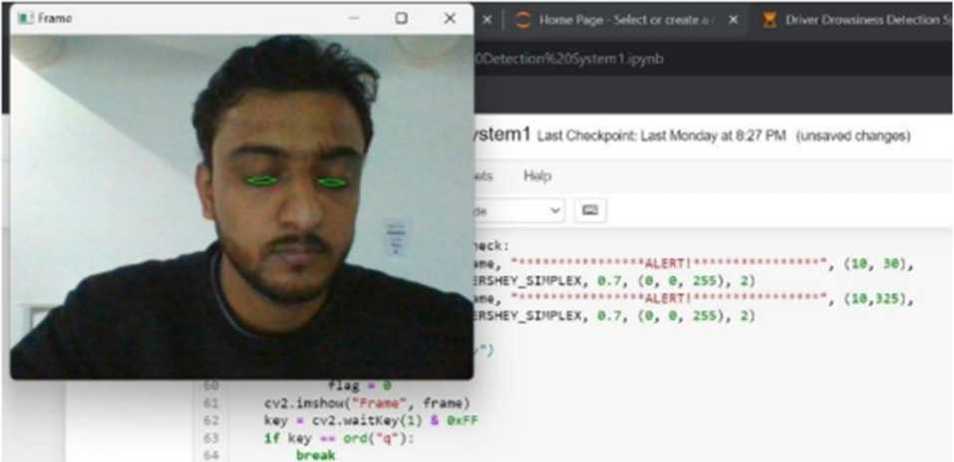
Outcomes:
Alarm Activation: - The alarm sounds after the user shuts their eyes for four to five seconds.
Cv2. d*itrovAHUln4o«*<)

Slide 20
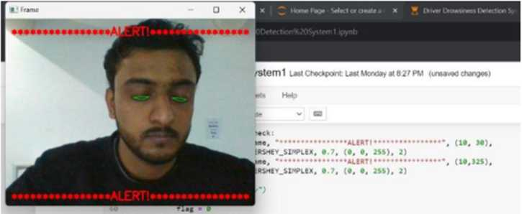
Outcomes
Alert Mechanism: - A beeping sound is produced when the alarm is triggered.
cv2.inshOM<*Fraae°, franc)
key ■ cv2.waitK«y(l) ft if key »• ord("q"): break
Cv2.destroyAllWl-OO-l() cap.releesc(}
These actions demonstrate how the project works and give outputs, it keeps the user in a normal state when the eyes are closed, but it sounds an alarm using a unique alert mechanism when the eyes are closed.

Slide 21
Result Analysis
A comprehensive test was conducted ten times, varying parameters such as surrounding light, different drivers, and alarm sensitivity. The accuracy test evaluated using the formula CR = (C/A) X 100%, where CR represents the correct rate, C is the number of successful tests, and A is the total number of tests, resulted in an 80% accuracy rate. Among the ten tests, eight ran successfully, while two failed due to poor lighting conditions at night. The project's accuracy is notably influenced by light conditions during the experiment, with brightness being a critical factor. Therefore, the average accuracy of our project is 80%, showcasing its effectiveness despite variations in lighting conditions.

Slide 22
Conclusion
The importance of eye blink detection in real-time drowsy driver identification has been emphasized in this paper' thorough review of drowsiness detection techniques. The suggested system analyses blinking patterns and detects drowsiness by using the effective and economical Euclidean distance ratio technique. The system is able to process images, generate alarms, detect drowsiness in real-time, and capture facial features with accuracy thanks to the integration of libraries such as SciPy, Imutils, Simple Audio, dlib, and cv2. This system's installation could greatly lower the number of accidents caused by fatigue, improving traffic safety and averting fatalities.

Slide 23
FUTURE SCOPE
• We can make the driver drowsiness detection model more accurate by using other data, such as how often the driver blinks, yawns, and how the car is behaving (e.g., is it swerving or braking suddenly).
• Netflix and other streaming services can use the same technology to detect when a user is asleep and stop the video, so that the user doesn't miss anything when they wake up.
• We can add a sensor to track the heart rate of drivers to prevent accidents caused by sudden heart attacks.

