Slide 1
Rich Tastes
Silver Anniversary Brew Fest
Presented By: Richard Hart, Ross Fu, and Jeremy Simpson
February 26, 2019

Slide 2
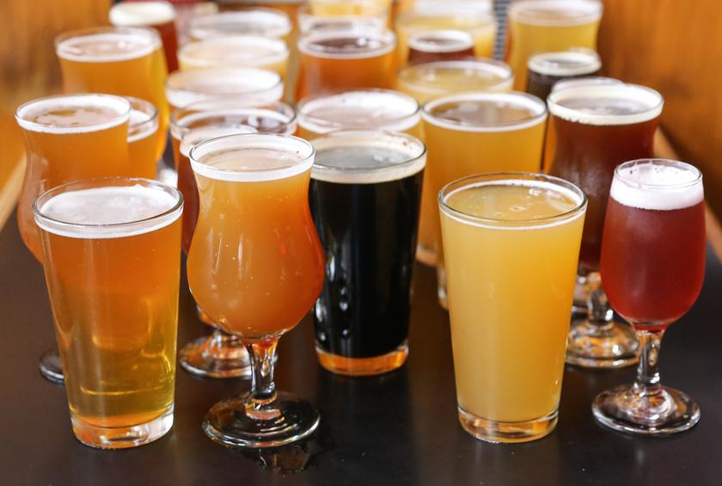
Introduction
2019 marks the 25 year anniversary that Rich Tastes has been winning hearts by providing the highest quality and best tasting beer from the top breweries in the country to the state of Texas. The past five years we have enjoyed our most successful run in company history. We are now the top distributor for the entire state of Texas, and in 2014 and 2017 we expanded our territories to include the states of Louisiana and Oklahoma. Additionally we added several new breweries and many new beers to our distinctive distribution collection.
Our marketing team is planning the 'Rich Tastes Silver Jubilee Beer Fest’, to celebrate this monumental event in our company’s history. It is at this time that we will announce the our expansion to cover the territories of Alabama, Arkansas, and Mississippi. We are also featuring new beers from breweries in Oregon and Colorado which will be featured at the beer fest.
The Data Analytics team of Ross, Richard and I were given a data set of beers and breweries spanning the entire country. Today we will present to you how we used statistical analysis tools to break down the data to help make critical business decisions.

Slide 3
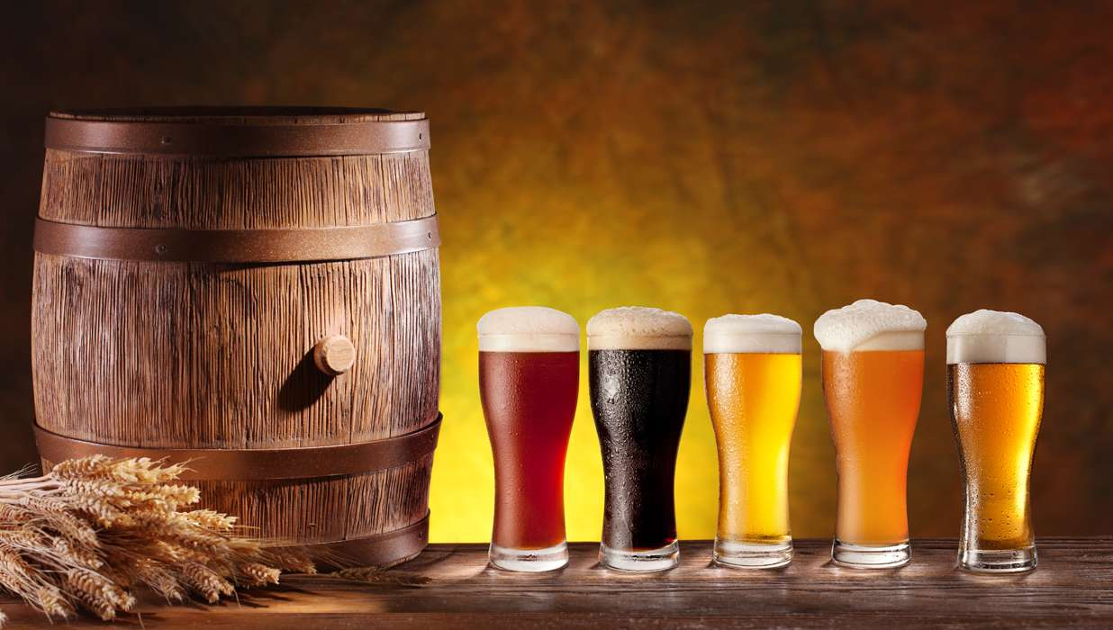
Rich Tastes
25 Years of Winning Hearts with Rich Tastes

Slide 4
Breweries by State
Top 10 Breweries by State
Bottom 10 Breweries by State
State | Breweries
CO | 47
CA | 39
MI | 32
OR | 29
TX | 28
PA | 25
MA | 23
WA | 23
IN | 22
WI | 20
State | Breweries
DC | 1
ND | 1
SD | 1
WV | 1
AR | 2
DE | 2
MS | 2
NV | 2
AL | 3
KS | 3
Notes:
TOLA beers because they’re in close proximity to houston

Slide 5
Beers and Breweries
Top 6 Beers and Breweries
Brewery ID | Beer | Beer ID | ABV | IBU | Style | Ounces | Brewery | City | State
1 | Get Together | 2692 | 0.045 | 50 | American IPA | 16 | NorthGate Brewing | Minneapolis | MN
1 | Maggie's Leap | 2691 | 0.049 | 26 | Milk / Sweet Stout | 16 | NorthGate Brewing | Minneapolis | MN
1 | Wall's End | 2690 | 0.048 | 19 | English Brown Ale | 16 | NorthGate Brewing | Minneapolis | MN
1 | Pumpion | 2689 | 0.06 | 38 | Pumpkin Ale | 16 | NorthGate Brewing | Minneapolis | MN
1 | Stronghold | 2688 | 0.06 | 25 | American Porter | 16 | NorthGate Brewing | Minneapolis | MN
1 | Parapet ESB | 2687 | 0.056 | 47 | Extra Special / Strong Bitter (ESB) | 16 | NorthGate Brewing | Minneapolis | MN
Notes:
TOLA beers because they’re in close proximity to houston

Slide 6
Beers and Breweries
Bottom 6 Beers and Breweries
Brewery ID | Beer | Beer ID | ABV | IBU | Style | Ounces | Brewery | City | State
556 | Pilsner Ukiah | 98 | 0.055 | NA | German Pilsener | 12 | Ukiah Brewing Company | Ukiah | CA
557 | Heinnieweisse Weissebier | 52 | 0.049 | NA | Hefeweizen | 12 | Butternuts Beer and Ale | Garrattsville | NY
557 | Snapperhead IPA | 51 | 0.068 | NA | American IPA | 12 | Butternuts Beer and Ale | Garrattsville | NY
557 | Moo Thunder Stout | 50 | 0.049 | NA | Milk / Sweet Stout | 12 | Butternuts Beer and Ale | Garrattsville | NY
557 | Porkslap Pale Ale | 49 | 0.043 | NA | American Pale Ale (APA) | 12 | Butternuts Beer and Ale | Garrattsville | NY
558 | Urban Wilderness Pale Ale | 30 | 0.049 | NA | English Pale Ale | 12 | Sleeping Lady Brewing Company | Anchorage | AK
Notes:
TOLA beers because they’re in close proximity to houston

Slide 7
NAs
Number of NA’s per Column in the Data Set
Number of cells with no values
Brewery ID | Beer | Beer ID | ABV | IBU | Style | Ounces | Brewery | City | State
0 | 0 | 0 | 62 | 1005 | 0 | 0 | 0 | 0 | 0
Notes:
TOLA beers because they’re in close proximity to houston

Slide 8
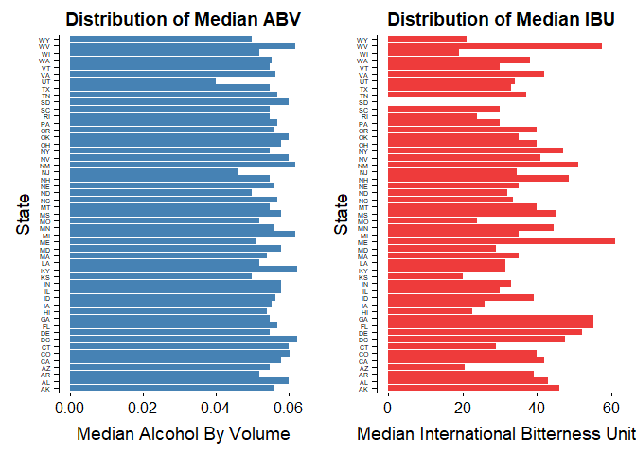
ABV and IBU
Part of out detailed analysis of the select beers we’re choosing to be part of Rich Tastes, we needed to outline the Median Alcohol by Volume and Median International Bitterness Units for each State.

Slide 9
ABV and IBU
State with Highest ABV
Colorado – 12.8%
State with Highest IBU
Oregon – 138 IBU
Part of out detailed analysis of the select beers we’re choosing to be part of Rich Tastes, we needed to outline the Median Alcohol by Volume and Median International Bitterness Units for each State. On the left is the state with the highest median ABV and the state with highest median IBU.

Slide 10
Alcohol By Volume (ABV)
Summary of Statistics of the Beer Alcohol by Volume
Minimum
1st Quantile
Median
Mean
3rd Quantile
Maximum
0.00100
0.05000
0.05600
0.05977
0.06700
0.12800

Slide 11
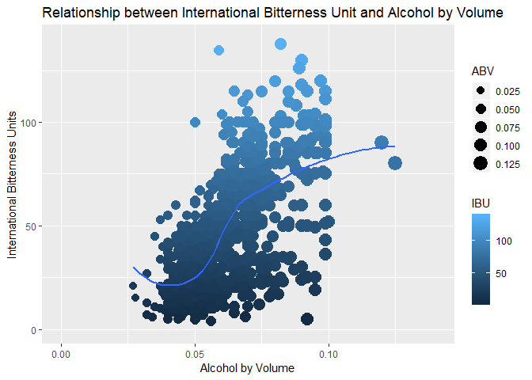
ABV and IBU
Relationship between Alcohol by Volume and International Bitterness Units

Slide 12
Conclusion
Data Analytics is a very powerful tool. Using such tools and techniques adds value to our company. Our business strategy is to provide the best tasting best quality beer to our customer base.
Choosing a quality beer may seem like a very simple task. This becomes complicated when you have so many beers at breweries spread out across several different geographical regions, with vastly different qualities.
The data was presented in a way that allowed our decision makers to make quick and informed decisions.
Analytics allows us to narrow our search and still factor in the qualities that are most important to us.
Analysis allowed us to discover the regions with the most potential for growth. We found the regions that suffer from a scarcity of quality breweries. No one should be deprived of quality beer.
Through the analysis of the data we discovered the states densely populated with breweries that feature a great selection of quality craft beers prompting us to forge ties with them.
Our long standing company motto is "Winning Hearts with Rich Tastes". Employing innovative strategies like Data Analytics will aid the company long into the future in providing our customers with the highest quality best tasting beers.

Slide 13
We look forward to a successful Beer Fest.
Cheers to the next 25 years of success here at Rich Tastes.
Thanks to Innovative Strategies in Data Analytics!

