Slide 1
MAN10081
Teams, People and Productivity
Lecture:
Trust

Slide 2
Programme
1. The meaning of “trust”
2. Trust and trusting beliefs
3. The benefit of trust in organisations
4. Dimensions and types of trust
5. Principles of trust
6. Seven basic rules of trust
7. Questions and answers

Slide 3
The meaning of “trust”
Pause for thought…
‘The importance of trust becomes clear when we try to imagine a world without it’ Shaw (1997) cited in Caproni (2012).
Discussion Question:
What would a world without trust be like?
Source:
Caproni. P. J. (2012). Management Skills for Everyone. (3rd Ed). Prentice Hall. London.
Shaw, R. (1997). Trust in the Balance. San Francisco. CA. Jossey- Bass.

Slide 4
How much do you trust the following?
On a score from 0 to 10 (with 10 being the highest score), to what extent do you trust the following:
The Prime Minister of the UK (Sir Keir Stamer)
The BBC
The NHS
Facebook
Instagram
YouTube
X

Slide 5
The meaning of “trust”
‘Trust is a willingness to ascribe good intentions to and have confidence in the words and actions of other people’ Cook and Wall (1980) in Caproni (2012).
Source:1
Caproni. P. J. (2012) Management Skills for Everyone. (3rd Ed). Prentice Hall. London.
Cook. J. and Wall. T. (1980). New worker attitude measures of trust, organizational commitment and personal need non-fulfillment. Journal of Occupational Psychology. 53. pp.39-52. cited in Buchanan. B. (1974). Building organizational commitment: the socialization of managers in work organizations. Administrative Science Quarterly. 19. pp.533-546.

Slide 6
The meaning of “trust”
Trust: confident, safe; secure; faithful; trusty; reliable
To have faith or confidence that something desired is or will be the cause.
To give credence to (a statement), to rely upon…
Source:
Little. W., Fowler. H. W. Coulson., J. prepared by: Onions. C.T. (1933 Ed. 1965). The Shorter Oxford Dictionary on Historical Principles. Oxford Press. Oxford.

Slide 7
The meaning of “trust”
People generally respond according to the way they are treated. If you give a little, you will invariably get a lot back. Make people feel important and give them a sense of personal worth. The majority of staff will respond constructively if treated with consideration and respect, and as responsible individuals who wish to serve the organisation well. However, how can members of staff show that they can be trusted unless trust is first placed in them? The initiative must come from Management.
Mullins, L. & Rees, G. (2023) Management and Organisational Behaviour. 13th edition. Harlow: Pearson Education, Limited.

Slide 8
The meaning of “trust”
Trust has become more complicated with the advent of the internet. We can now connect with more ideas and individuals. Yet, is the person who communicates back with us real? Is it someone with a fake account or maybe not even a person at all, but a robot? Even though trust is complicated and we can sometimes be taken advantage of, we still need to find ways to trust others in our lives.
Levine, M. P. (ed.) (2023) Psychology of trust. London: IntechOpen.

Slide 9
The meaning of “trust”
Some considerations....
Trust creates more trust
  Mistrust drives out trust
  Trust can be regained
  Mistrusting groups self-destruct
  Mistrust generally reduces productivity
  I will now discuss these in more detail
Source: Robbins. S. P. and Judge. T. A. (2009).13th ed. Organizational Behavior. Prentice Hall. New Jersey. USA.

Slide 10
Behaviours outlining the movement of trust in others
Trust creates more trust:
In the same way that mistrust drives out trust, exhibiting trust in others tends to encourage reciprocity.
Effective leaders increase trust in small increments and allow others to respond in kind. By offering trust in only small increments, leaders limit penalty or loss that might occur if their trust is exploited
(Robbins 2010, p.353)
Source: Robbins. S. P. and Judge. T. A. (2010).14th ed. Organizational Behavior. Prentice Hall. New Jersey. USA.

Slide 11
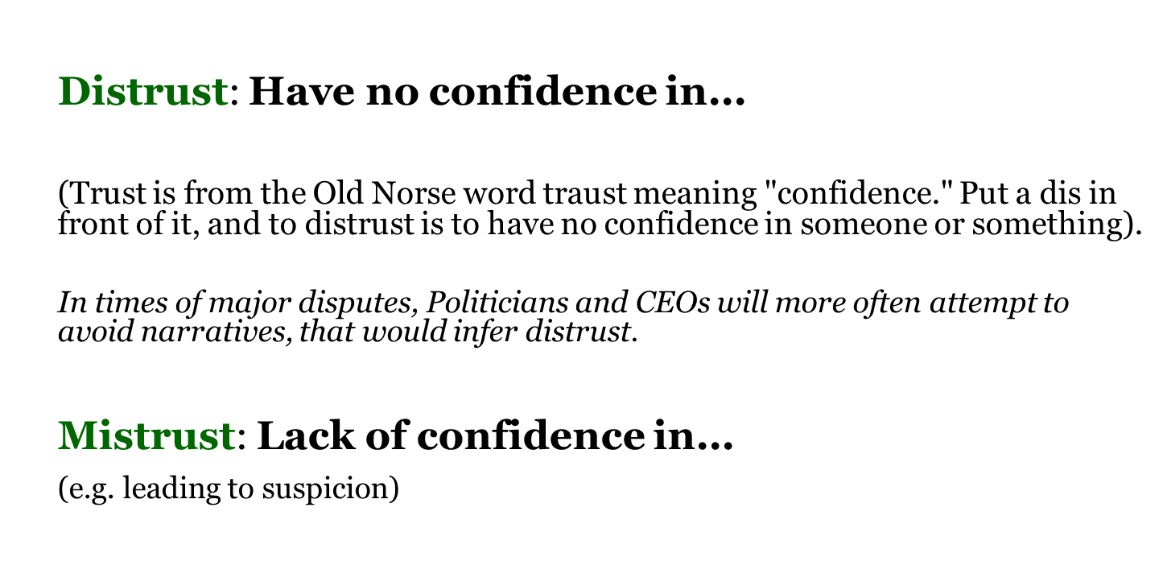
Mistrust and Distrust
Source:
The concise Oxford Dictionary, 1976 ( 6th Ed). Oxford University Press. Oxford. UK.
http://www.vocabulary.com/dictionary/distrust.
Ross. A. G. 2002 English Old-Norse Dictionary. Linguistics Series. Cambridge.

Slide 12
Behaviours outlining the movement of trust to mistrust
Mistrust drives out trust
‘People who are trusting demonstrate their trust by increasing their openness to others, disclosing relevant information, and expressing true intentions’.
‘In contrast… ‘People who mistrust do not reciprocate. They conceal information and act opportunity to take advantage of others’.
‘To defend against repeated exploitation, trusting people are driven to mistrust’.
‘A few mistrusting people can poison the entire organisation’.
Robbins 2010, p. 353
Source: Robbins. S. P. and Judge. T. A. (2010).14th ed. Organizational Behavior. Prentice Hall. New Jersey. USA.
.

Slide 13
Behaviours outlining the movement of trust to mistrust
Trust can be regained
‘Once it is violated, trust can be regained, but only in certain situations. When an individual’s trust in another is broken because the other party failed to do what is expected of him/her, it can be restored when the individual observes a consistent pattern of trustworthy behaviors by the transgressor. However, when the same trustworthy behaviors occurs with deprecation, trust never fully recovers, even when the deceived is given apologies or a consistent pattern of trustworthy actions’ Schwietzer (2006) cited in Robbins 2010, p.353).
Source:
Schweitzer. M. E. Hershey. J. C. and Bradlow. E.T. (2006). Promises and lies: restoring violated trust. Organizational Behavior and Human Decision Processes. 101. pp.1-19. in: Robbins. S. P. and Judge. T. A. (2010).14th ed. Organizational Behavior. Prentice Hall. New Jersey. USA.

Slide 14
Behaviours outlining the movement of trust to mistrust
Mistrusting groups self-destruct
The corollary to the previous principle is that when group members mistrust each other, they repel and separate. They peruse their own interests rather than the group’s. Members of distrusting groups tend to be suspicious of each other, are constantly on guard against exploitation and restrict communication with others in the group. These actions tend to undermine and eventually destroy the group (Robbins 2010, p.353).
Source: Robbins. S. P. and Judge. T. A. (2010).14th ed. Organizational Behavior. Prentice Hall. New Jersey. USA.

Slide 15
Mistrust generally reduces productivity
Although we cannot say trust necessarily increases productivity, though it usually does, mistrust almost always reduces productivity. Mistrust focuses attention on the differences in member interests, making it difficult for people to visualize common goals. People respond by concealing information and secretly pursing their own interests. When employees encounter problems, they avoid calling on others, fearing that those others will take advantage of them. A climate of mistrust to stimulate dysfunctional forms of conflict and retard cooperation
Source: Robbins. S. P. and Judge. T. A. (2010).14th ed. Organizational Behavior. Prentice Hall. New Jersey. USA.

Slide 16
Overall benefits of trust in organizations
Increases recruitment and retention
Promotes sense of belonging and identification with organization
Builds support for leaders’ and organization’s goals
Enhances productivity because it enables employees to focus on value-added work
Inspires people to go beyond the call of duty
Enhances communication
Increases speed and efficiency of decision-making
Source:
Caproni. P. J. (2012). Management Skills for Everyone. (3rd Ed). Prentice Hall. London.

Slide 17
Overall benefits of trust in organizations
Enhances cooperation and reduces conflict and costs of negotiation
Improves team decision-making
Enhances cross-department collaboration
Promotes organizational change
Helps organizations survive crisis
Helps employees accept unfavorable information and decisions
Enables virtual teams to handle the uncertainty and complexity of the virtual environment
Source:
Caproni. P. J. (2012) Management Skills for Everyone. (3rd Ed). Prentice Hall. London.

Slide 18
Team Activity
In your team, each member is asked to complete the following two sentences:
The quickest way to gain my trust is to…
My trust in another person is instantly eroded when…
These insights help us understand how perceptions of trust are formed and this can be an important step in moving the team to higher levels of trust
.
McLean (2025). How to build trust in your team.

Slide 19
Dimensions of trust
Integrity
  Honesty and truthfulness
Competence
  An individual’s technical and interpersonal knowledge and skills
Consistency
  An individual’s reliability, predictability, and good judgment in handling situations
Loyalty
  The willingness to protect and save face for another person
Openness
  Reliance on the person to give you the full truth
Source: Robbins. S. P. and Judge. T. A. (2009).13th ed. Organizational Behavior. Prentice Hall. New Jersey. USA.

Slide 20
Types of trust
Deterrence-based Trust
Trust based on fear of reprisal if the trust is violated
Identification-based Trust
Trust based on a mutual understanding of one another’s intentions and appreciation of the other’s wants and desires
Knowledge-based Trust
Trust based on behavioural predictability that comes from a history of interaction
Source: Robbins. S. P. and Judge. T. A. (2009).13th ed. Organizational Behavior. Prentice Hall. New Jersey. USA.

Slide 21
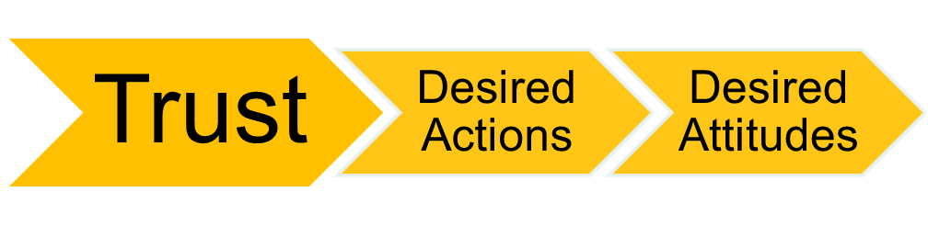
Trust: attribute associated with leadership
Trust – a psychological state that exists when you agree to make yourself vulnerable to another because you have a positive expectation for how things are going to turn out.
  Key attribute associated with leadership
  Followers who trust their leader will align their actions and attitudes with the leader’s behaviors/requests
Source: Robbins. S. P. and Judge. T. A. (2010).14th ed. Organizational Behavior. Prentice Hall. New Jersey. USA.

Slide 22
Propensity…
Propensity: a natural inclination or tendency.
‘The proposed model can explain trust (based on propensity) before any relationship between two parties has developed. As a relationship begins to develop, the trustor may be able to obtain data on the trustee's integrity through third-party sources and observation, with little direct interaction. Because there is little information about the trustee's benevolence toward the trustor, we suggest that integrity will be important to the formation of trust early in the relationship. As the relationship develops, interactions with the trustee allow the trustor to gain insights about the trustee's benevolence, and the relative impact of benevolence on trust will grow. Thus, the development of the relationship is likely to alter the relative importance of the factors of trustworthiness’(Mayer, Davis, and Schoorman 1995, p.722).
‘
Source:
Mayer. R. C., Davis, J. H. and Schoorman, F. D. (1995). An integrative model of organizational trust. Academy of Management Review. 20. 3. pp. 709-734.

Slide 23
‘To trust wisely, we need to readjust our mind-set and behavioral
habits, following seven basic rules’ (Kramer 2009). /Rule 1
Rule 1 Know yourself. If you tend to trust the wrong people, you must work on interpreting the cues you receive. If you’re good at recognizing cues but have difficulty forging trusting relationships, then you’ll have to expand your repertoire of trust-building behaviors.
Source: Kramer, R. M. (2009). Rethinking Trust. Harvard Business Review. June. pp. 69-77.USA.

Slide 24
‘To trust wisely, we need to readjust our mind-set and behavioral
habits, following seven basic rules’ (Kramer 2009). /Rule 2
Rule 2 Start small. Measured trust begins with small acts that foster reciprocity. A good example of the dynamic was displayed by Hewlett-Packard in the early 1980s. Management allowed engineers to take equipment home whenever they needed to, without having to go through a lot of red tape. That sent a strong signal that the company trusted employees, yet it involved relatively little risk, because the policy was tied to employees’ not abusing the trust.
Source: Kramer, R. M. (2009). Rethinking Trust. Harvard Business Review. June. pp. 69-77.USA.

Slide 25
‘To trust wisely, we need to readjust our mind-set and behavioral
habits, following seven basic rules’ (Kramer 2009). /Rule 3
Rule 3 Write an escape clause. With a clearly articulated plan for disengagement, people can trust more fully and with more commitment. In Hollywood, scriptwriters register their pitches with the Writers Guild – a simple act that hedges against the risk that others will claim a story as their own.
Source: Kramer, R. M. (2009). Rethinking Trust. Harvard Business Review. June. pp. 69-77.USA.

Slide 26
‘To trust wisely, we need to readjust our mind-set and behavioral
habits, following seven basic rules’ (Kramer 2009). /Rule 4
Rule 4 Send strong signals. Most of us believe our trustworthiness is obvious. We actually need to signal it more clearly. By the same token, we have to retaliate strongly when our trust is abused. Sending weak signals about our willingness to engage in trust or punish abuse of it makes us more vulnerable to exploitation.
Source: Kramer, R. M. (2009). Rethinking Trust. Harvard Business Review. June. pp. 69-77.USA.

Slide 27
‘To trust wisely, we need to readjust our mind-set and behavioral
habits, following seven basic rules’ (Kramer 2009). /Rule 5
Rule 5 Recognize the other person’s dilemma. Because we worry so much about protecting ourselves, we often forget that the people we’re dealing with confront their own trust dilemmas and need reassurance about whether (or how much) they should trust us. Good relationship builders are proactive at decreasing the anxiety and allaying the concerns of others.
Source: Kramer, R. M. (2009). Rethinking Trust. Harvard Business Review. June. pp. 69-77.USA.

Slide 28
‘To trust wisely, we need to readjust our mind-set and behavioral
habits, following seven basic rules’ (Kramer 2009). /Rule 6
Rule 6 Look at roles as well as people. A person’s role or position can provide a guarantee of his expertise and motivation. But be careful; people on Main Street USA trusted people on Wall Street for a long time because the financial system seemed to be producing reliable results that were the envy of the world.
Source: Kramer, R. M. (2009). Rethinking Trust. Harvard Business Review. June. pp. 69-77.USA.

Slide 29
‘To trust wisely, we need to readjust our mind-set and behavioral
habits, following seven basic rules’ (Kramer 2009). /Rule 7
Rule 7 Remain vigilant and always question. Many people whose trust is abused do conduct their due diligence initially. The trouble is that they don’t keep the due diligence up-to-date, because they find that being vigilant and ambivalent about the people they trust is psychologically uncomfortable.
Source: Kramer, R. M. (2009). Rethinking Trust. Harvard Business Review. June. pp. 69-77.USA.

Slide 30
Team Activity
As a team, come up with 3 activities that you could implement in an organisation to enhance levels of trust. These activities might relate specifically to work or social activities. From the 3 activities, select one that you feel is the best option for improving levels of trust.

Slide 31
References
Buchanan, D. A. & Huczynski, A. (2023) Organizational behaviour. Eleventh edition. Harlow: Pearson Education Limited.
Robbins. S. P. and Judge. T. A. (2010).14th ed. Organizational Behavior. Prentice Hall. New Jersey. USA.
Kramer, R. M. (2009). Rethinking Trust. Harvard Business Review. June. pp. 69-77.USA.
Caproni. P. J. (2012). Management Skills for Everyone. (3rd Ed). Prentice Hall. London.
Mullins, L. & Rees, G. (2023) Management and Organisational Behaviour. 13th edition. Harlow: Pearson Education, Limited.
Shaw, R. (1997). Trust in the Balance. San Francisco. CA. Jossey- Bass.
McLean, R. (2025). How to build trust in your team. Available at https://mcleanonline.medium.com/how-to-build-trust-in-your-team-385a386e37f6
Levine, M. P. (ed.) (2023) Psychology of trust. London: IntechOpen.

